Slide 1
Artificial Intelligence Engineer Introduction to Python for AI/ML A Beginners Guide – Part 2
Dr. Nuwan Kodagoda
Head/Department of Computer Science and Software Engineering
Faculty of Computing
SLIIT

Slide 2
Learning Outcomes
Fundamentals of programming using Python
Data types and variables in programming
Sequence, Selection, Repetition and using Functions.
Built-in functions in Python programming language

Slide 3
Data Types
Data Type | Keyword | Value
Integer | int | Holds signed integers of non-limited length.
Float | float | Holds floating precision numbers and it’s accurate upto 15 decimal places.
Boolean | bool | Holds True or False.
String | String | Holds sequence of characters. Generally, strings are represented by either single or double quotes.

Slide 4
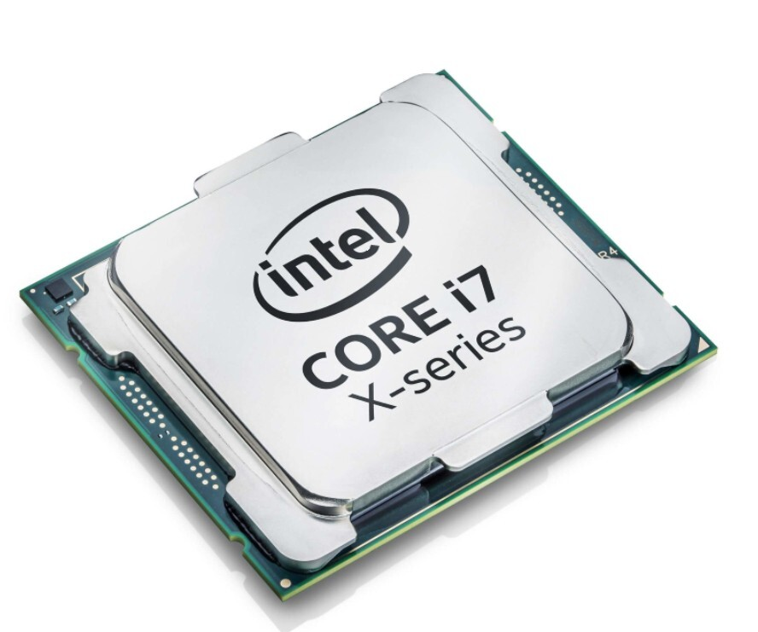
Variables
Machine Code
C8
B7
23A7
D7
AA
89
DD
89D23
A9
F4
A9
...
CPU

Slide 5
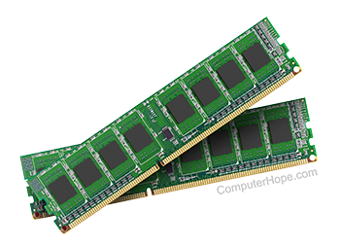
Variables
Machine Code
34
C8
B7
23A7
D7
AA
89
DD
89D23
A9
F4
A9
...
102
78
RAM
12
100
94
CPU

Slide 6
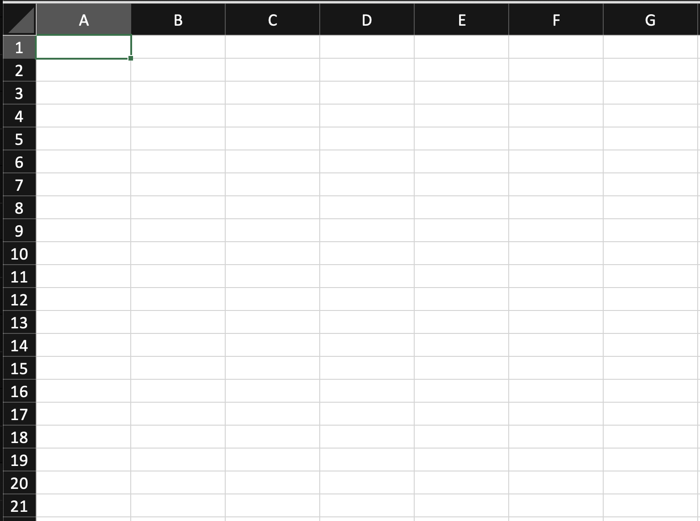
Variables
RAM
CPU

Slide 7
Variables
A variable in any programming language is a named piece of computer memory, containing some information inside.
Variables are used to store information to be referenced and manipulated in a computer program.
Sole purpose of a variable is to label and store data in memory. This data can then be used throughout a program.
Variables usually are of a certain type (data type) which define their logical representation and size.

Slide 8
Variables (Contd)
Data types of a programming language defines the type of a variable.
Data type of a variable;
Structure of data in a variable.
Indicates the size reserved in memory for storing the variable.
Communicate to the compiler or interpreter how the programmer intends to use the data.

Slide 9
Variables – Steps to use a variable
Creating variables
Creating variables is also called declaring variables. Different programming languages have different ways of creating variables inside a program.
Python is a high level language. Unlike in many other programming languages, in python, it is not necessary to define the data type in variable declaration.
In python, data type of a variable is added automatically by considering the value assigned for the variable.

Slide 10

Variables – Steps to use a variable
Python programming has the following simple way of creating variables in python shell.
The above code creates two variables to reserve two memory locations with names a and b.
These variable will be stored as integer type variables.
Same method can be used to create variables to store float, String or any other data type.

Slide 11
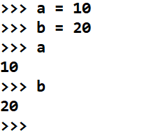
Variables – Steps to use a variable
2. Access stored values in variables
Variables are created to store values in a program.
These values can be accessed in a program using the variable name.
Variable name is a reference to the value stored in memory.
The previous program had two variables a and b with values stored as 10 and 20, respectively. These values can now be accessed with the variable names a and b.

Slide 12
Variables in Memory
Data type of variable x is integer
10
>>> x = 10
>>> x
>>> 10
X
4 bytes
Random Access Memory
(RAM)

Slide 13
Rules for Variable Names
A variable name must start with a letter or the underscore character
A variable name cannot start with a number
A variable name can only contain alpha-numeric characters and underscores (A-z, 0-9, and _)
Variable names are case-sensitive (age, Age and AGE are three different variables)
Variable names cannot be python keywords

Slide 14
Commands in Programming
A command is an instruction given in a program by a user to do a specific task.
Commands are special words in a programming environment which invokes a predefined function to be done in a program.
These special words are called as keywords in a programming language.

Slide 15
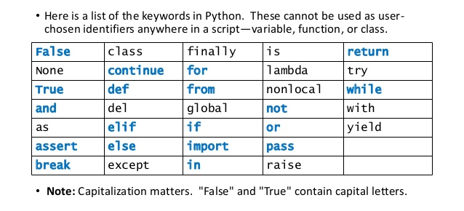
Python Keywords

Slide 16
Built-in functions in Programming
The Python interpreter contains set of instructions to execute for a general behavior in a programs.
Ex: Printing a message on screen
Collection of these instructions defined by the interpreter are called as built-in functions.
Programmers use these built-in functions to execute a general behavior in a program.

Slide 17
Basic Python Functions
Output Function
Output function of a programming language is used to display something on the screen.
The print() function in python is the output function that prints a message given within the pair of brackets to the screen.
The message can be a string, or any other type and this message will be converted into a string before written to the screen.
Source Code
Output

Slide 18
Basic Python Functions (Contd.)
The print() function in python can also print multiple values. These values have to be separated by a comma (,).
Example:
=============
X is 10
>>>
x = 10
print (“X is”, x)
Source Code
Output

Slide 19

Basic Python Functions (Contd.)
Input Function
Input function of a programming language is used to get user inputs for a program.
The input() function in python reads a line entered on a console by an input device such as a keyboard.
A message can be passed within the brackets of the input function. This message will prompt on screen when the program is requesting for an input from the user.
The value that is received by the input() function has to be stored to a variable in the program. Therefore, input() function is called as a value assigned to a variable.
Source Code
Output

Slide 20
Basic Python Functions (Contd.)
The input() function in python converts any user input in to a String value and pass to the program.
If the program needs to store the inputted value in any other type, then it is necessary to convert the input value into the relevant type explicitly.
x = int (input("Enter value for X "))
y = x + 1
print(y)
=============
Enter value for X 5
6
>>>
Source Code
Output

Slide 21
Basic Python Functions (Contd.)
Max function
Returns the maximum value of given set numbers within the pair of brackets.
Min function
Returns the minimum value of given set numbers within the pair of brackets.
=============
5
>>>
print(max(1,2,3,4,5))
Source Code
Output
=============
1
>>>
print(min(1,2,3,4,5))
Source Code
Output

Slide 22
Activity 1
Write the python code to get three number as user inputs and print the maximum and minimum numbers on screen.
==================
Enter value 1 12
Enter value 2 7
Enter value 3 9
Minimum value is 7
Maximum value is 12
>>>
Sample Output

Slide 23
Activity 1 answer
x = int(input("Enter value 1 "))
y = int(input("Enter value 2 "))
z = int(input("Enter value 3 "))
minimum = min(x,y,z)
maximum = max(x,y,z)
print ("Minimum value is ", minimum)
print ("Maximum value is ", maximum)

Slide 24
Basic Control Structures
In a program, a control structure determines the order in which statements are executed.
Following are the basic control structures in programming languages;
Sequential
Selection
Repetition

Slide 25
Computer Program
A computer program is a set of instructions given for the computer to behave as a solution for a problem.
Flow of these instructions in a solution sometimes depend on a decision.
A program might needs to select the next instruction to execute based on a decision.
Programming languages define basic control structures to handle the flow of instructions in a program based on the requirement of a solution.

Slide 26
Sequential
In Sequential execution each statement in the source code will be executed one by one in a sequential order. This is the default mode of execution.
START
Statement 1
Statement 2
STOP

Slide 27
Sequential - Example
A program input two numbers and find the sum.
Start
Input Number1
Input Number2
Sum = Number1 + Number2
Display Sum
Stop

Slide 28
Sequential - Example
Start
Number1 = int(input("Enter Number1 "))
Number2 = int(input("Enter Number2 "))
sum = Number1 + Number2
print (“Sum is ", sum)
Input Number1
Input Number2
Sum = Number1 + Number2
Display Sum
Stop
Python Program

Slide 29
Activity 2
Write a python program to input the length and a width of a rectangle and find the area and the perimeter of the rectangle.
x
y
Area = x * y
Perimeter = (2*x) + (2*y)

Slide 30
Activity 2 - Answer
length = int(input("Enter Length "))
width = int(input("Enter Width "))
area = length * width
perimeter = (2*length) + (2*width)
print (“Area is ", area)
print (“Perimeter is ", perimeter)

Slide 31
Selection
The selection control structure is used for making decisions and branching statements.
IF
True
Condition?
False
Statement sequence 1
Statement sequence 2
ENDIF

Slide 32
Selection
Following are the basic selection statements in the programming language.
if:
If statement checks for the condition and if the condition is satisfied it executes the statements in the “if” block, otherwise it exits the “if” block.
if-else:
If-else statement is used to execute any of the two blocks of statements, if the condition satisfies it executes the statements in the “if block”, otherwise it executes the “else block”.

Slide 33
Selection – Example (if)
Start
Wake Up
Get Out of Bed
Am I Clean ?
yes
Have A Shower
if condition
No
if block
Dry Yourself
Get Dressed
Stop

Slide 34
Selection – Example (if-else)
Start
No
Is it a weekday?
yes
If condition
else block
Read a Book
Pack Bag/Lunch
if block
Leave
Stop

Slide 35
Selection – Python Programming
if
if-else
if <condition>:
<if block>
if <condition>:
<if block>
else:
<else block>

Slide 36
Boolean (Relational) Operators
Greater than > 10 > 5 - True, 10 > 10 - False
Less than < 10 < 5 - False, 10 < 10 - False
Greater than or equal to >= 10 >= 5 – True, 10 >= 10 - True
Less than or equal to <= 10 <= 5 – False, 10 <= 10 - True
Equal == 10 == 5 – False, 10 == 10 - True
Not Equal != 10 != 5 – True, 10 != 10 - False

Slide 37
Selection - Example
A program to input the length and the width of a rectangle and display whether it is a square.

Slide 38
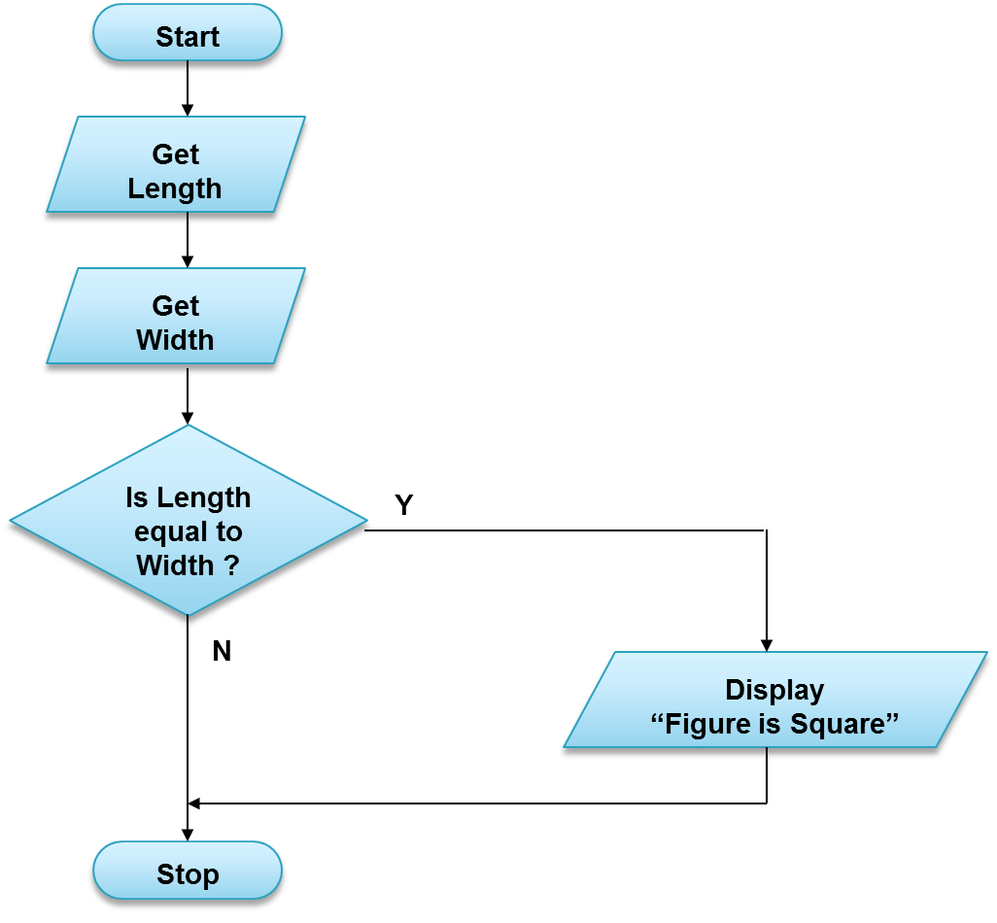
Selection - Example
A program to input the length and the width of a rectangle and display whether it is a square.

Slide 39
Selection - Example
length = int(input("Enter Length "))
width = int(input("Enter Width "))
if length == width:
print ("Figure is a square")
Python Program

Slide 40
Selection - Example
A program to input the length and the width of a Rectangle and display whether it is a square or a rectangle.

Slide 41
Selection - Example
Start
A program to input the length and the width of a Rectangle and display whether it is a square or a rectangle.
Get Length
Get Width
Is Length equal
Width ?
Y
N
Display “Figure is Square”
Display “Figure is Rectangle”
Stop

Slide 42
Selection - Example
Start
length = int(input("Enter Length "))
width = int(input("Enter Width "))
if length == width:
print ("Figure is a square")
else:
print ("Figure is a rectangle")
Get Length
Get Width
Is Length equal
Width ?
Y
N
Display “Figure is Square”
Python Program
Display “Figure is Rectangle”
Stop

Slide 43
Activity 3
Write a python program to input the year of birth of a person and display whether he is an adult or child.
==================
Enter year of birth : 1980
You are an adult..
>>>
Sample Output

Slide 44
Activity 3 - Answer
DOB = int(input("Enter year of birth "))
age = 2022 - DOB
if age >= 18:
print ("You are an adult..")
else:
print ("You are a child..")
Python Program

Slide 45
Repetition (Iteration)
The Repetition control structures are used for repetitively executing a block of code multiple times.
A commonly used iterative control structure is the “while loop”.
A while loop contains a condition and it executes statement inside the “while block” repeatedly as long as the condition satisfies.
In a while loop we continue to repeat something while a condition is true – we terminate the loop when it is false.

Slide 46
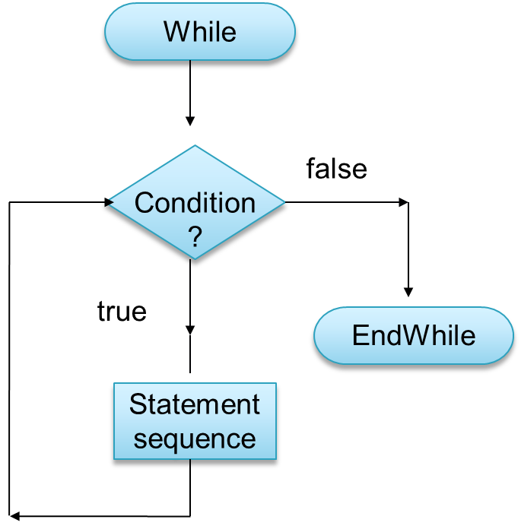

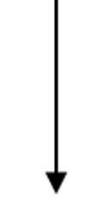
Repetition/Iteration/Loops
while block

Slide 47
Repetition – Python Programming
while <condition>:
<while block>

Slide 48
Repetition - Example
A program to display the numbers 1, 2, 3, 4, 5, ….., 100.
Start
no = 1
no <= 100
false
true
Display no
Stop
no = no + 1

Slide 49
Repetition - Example
A python program to display the numbers 1, 2, 3, 4, 5, ….., 100.
Start
no = 1
while no <= 100:
print (no)
no = no + 1
no = 1
no <= 100
false
true
Display no
Stop
Note: Without the while control structure above program will have more than 100 lines of code.
no = no + 1

Slide 50
Activity 4
A python program using a while loop to find the sum of 10 numbers entered through the keyboard.
==================
Enter number 12
Enter number 8
Enter number 5
Enter number 2
Enter number 3
Enter number 8
Enter number 7
Enter number 5
Enter number 9
Enter number 1
Sum is 60
>>>
Sample Output

Slide 51
Activity 4 - Answer
iteration = 1
total = 0
while iteration <= 10:
number = int(input("Enter number " ))
total = total + number
iteration = iteration + 1
print ("Sum is ", total)
Python Program

Slide 52
Functions
A block of reusable code that we can define once and call many times.
This allows easier maintance of code.
Allows you to break a large problem to a set of smaller sub problems.
def functionName(par1, par2, ...):
<statement 1>
<statement n>
[return result]

Slide 53
Python Functions – Example
def Sum(no1, no2, no3):
ans = no1 + no2 + no3
return ans
print (Sum(40, 50, 20))
print (Sum(100, 30, 50))

Slide 54
Activity 5
Implement a function in python to calculate the average of 3 numbers.

Slide 55
Activity 5 - Answer
def Avg(no1, no2, no3):
ans = (no1 + no2 + no3)/3
return ans
print (Avg(40, 50, 30))
print (Avg(100, 80, 90))

Slide 56
Activity 6
Implement a function to calculate the factorial of a given number.
e.g.
Factorial(5) = 5 x 4 x 3 x 2 x 1
Factorial(3) = 3 x 2 x 1
The following code can be used to calculate the factorial of 5
fac = 5
result = 1
while fac >= 1:
result = result * fac
fac = fac - 1
print(result)

Slide 57
Activity 6 - Answer
def Factorial(no):
result = 1
while no >= 1:
result = result * no
no = no - 1
return result
print(Factorial(5))

Slide 58
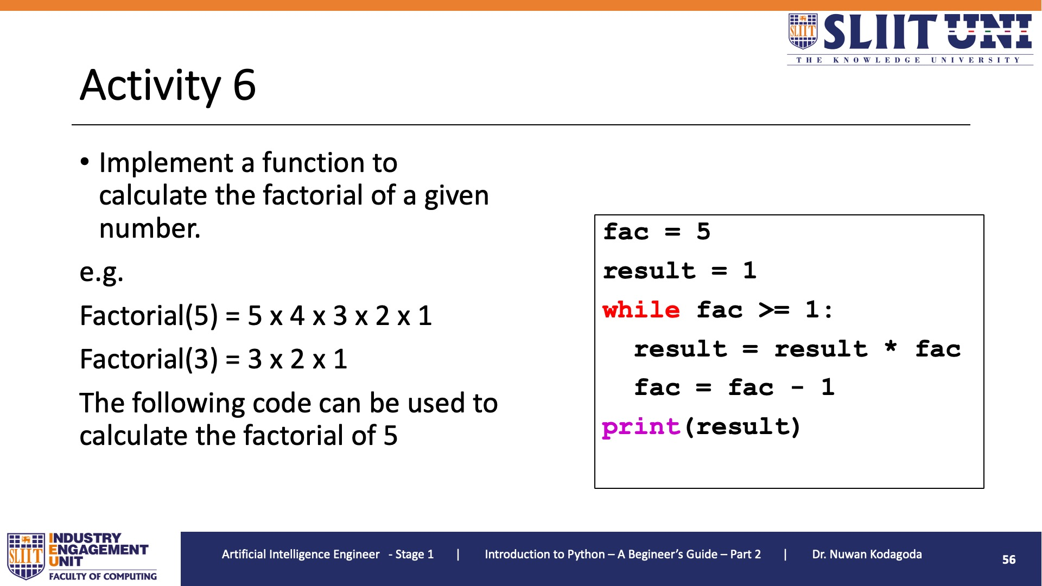
Activity 6 - Answer
def Factorial(no):
result = 1
while no >= 1:
result = result * no
no = no - 1
return result
print(Factorial(5))

