Slide 1
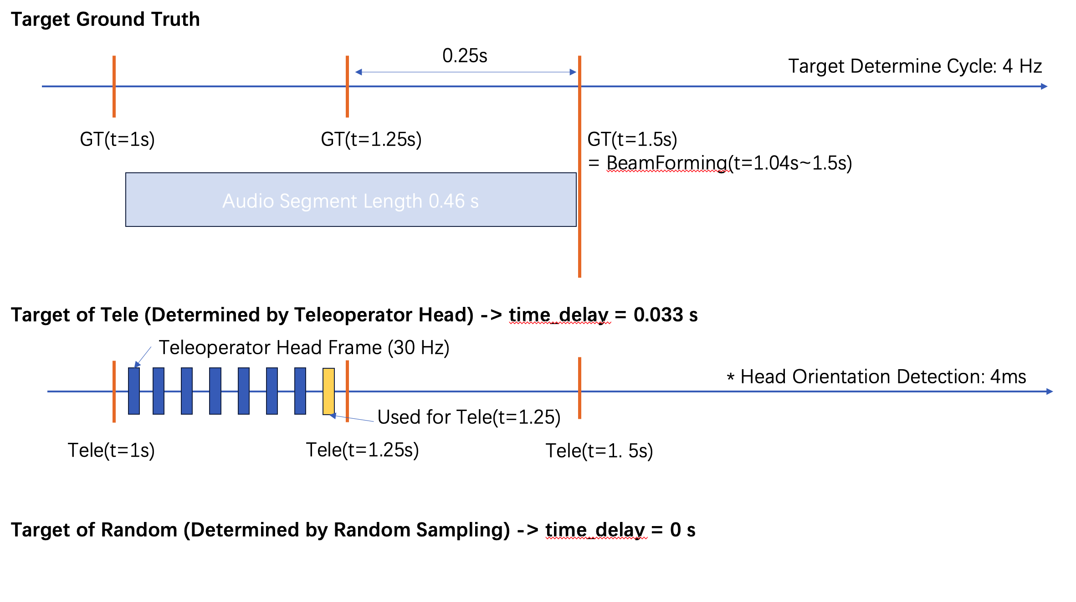

Slide 2
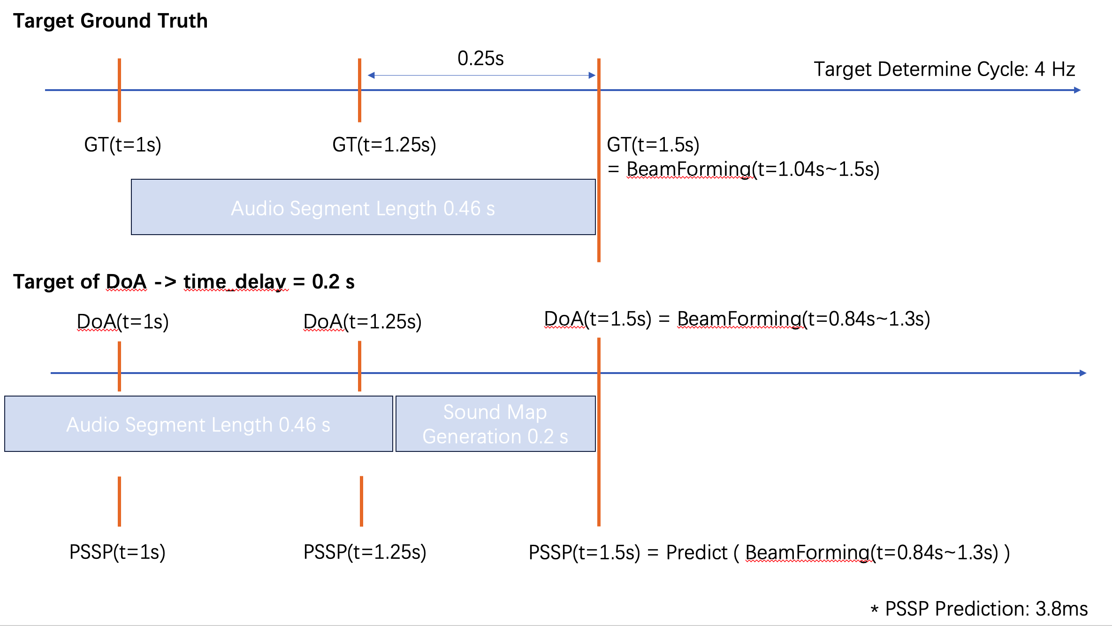

Slide 4
Target Ground Truth
0.25s
Target Determine Cycle: 4 Hz
GT(t=1s)
GT(t=1.25s)
GT(t=1.5s)
= BeamForming(t=1.04s~1.5s)
Audio Segment Length 0.46 s
Target of Tele (Determined by Teleoperator Head) -> time_delay = 0.033 s
Teleoperator Head Frame (30 Hz)
* Head Orientation Detection: 4ms
Used for Tele(t=1.25)
Tele(t=1s)
Tele(t=1.25s)
Tele(t=1. 5s)
Target of Random (Determined by Random Sampling) -> time_delay = 0 s

Slide 5
Target Ground Truth
0.25s
Target Determine Cycle: 4 Hz
GT(t=1s)
GT(t=1.25s)
GT(t=1.5s)
= BeamForming(t=1.04s~1.5s)
Audio Segment Length 0.46 s
Target of DoA -> time_delay = 0.2 s
DoA(t=1s)
DoA(t=1.25s)
DoA(t=1.5s) = BeamForming(t=0.84s~1.3s)
Audio Segment Length 0.46 s
Sound Map
Generation 0.2 s
PSSP(t=1s)
PSSP(t=1.25s)
PSSP(t=1.5s) = Predict ( BeamForming(t=0.84s~1.3s) )
* PSSP Prediction: 3.8ms

Slide 6
VAD: 20 ms

