Slide 1
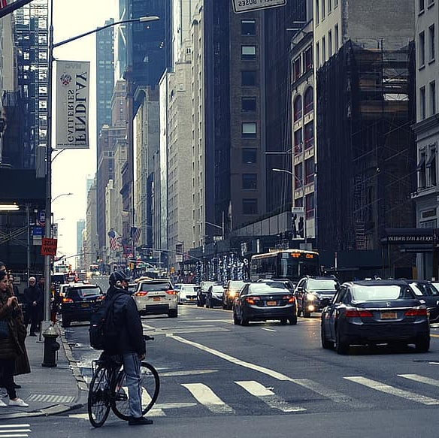

HawkEye
Graduation Project
Supervised By: Prof. Ihab Talkhan
Team Members:
Fathy Nabil Fathy
Mohab Hassan Ahmed
Osama Ashraf Sayed
Omar Mohamed Gomaa

Slide 2
agenda
Introduction and Overview
Architecture
Work-Flow
Implementation
Challenges
Future Work

Slide 3
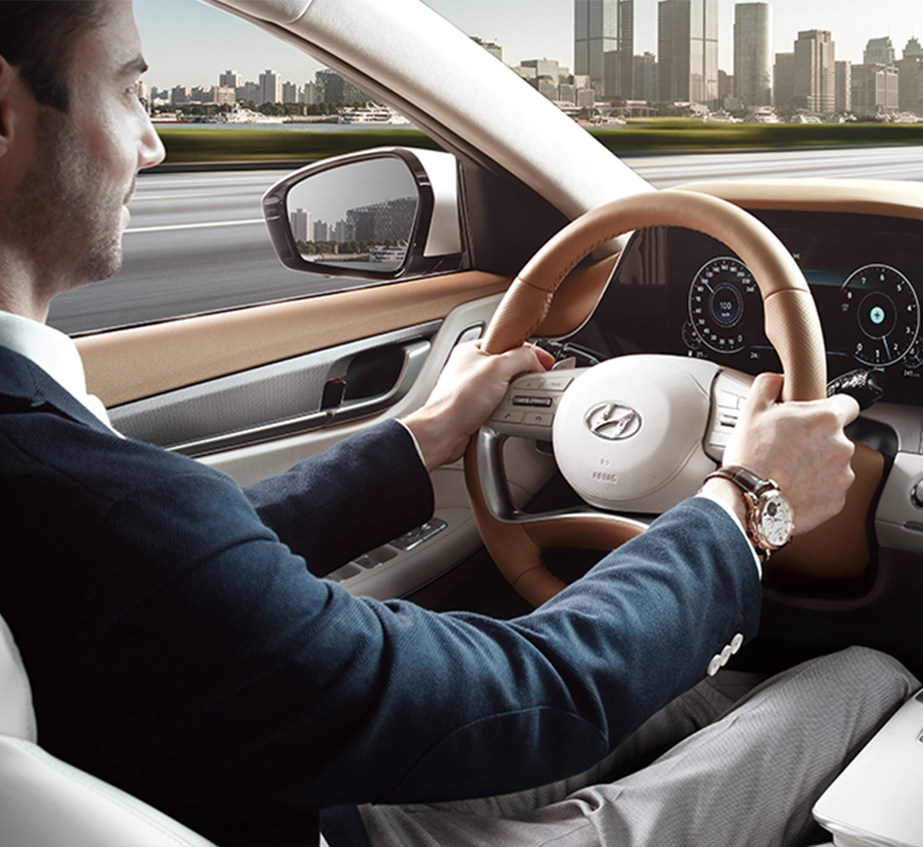
Introduction and overview
Motivation and Problem
Proposed Solution
System Overview

Slide 4

Architecture

Slide 5
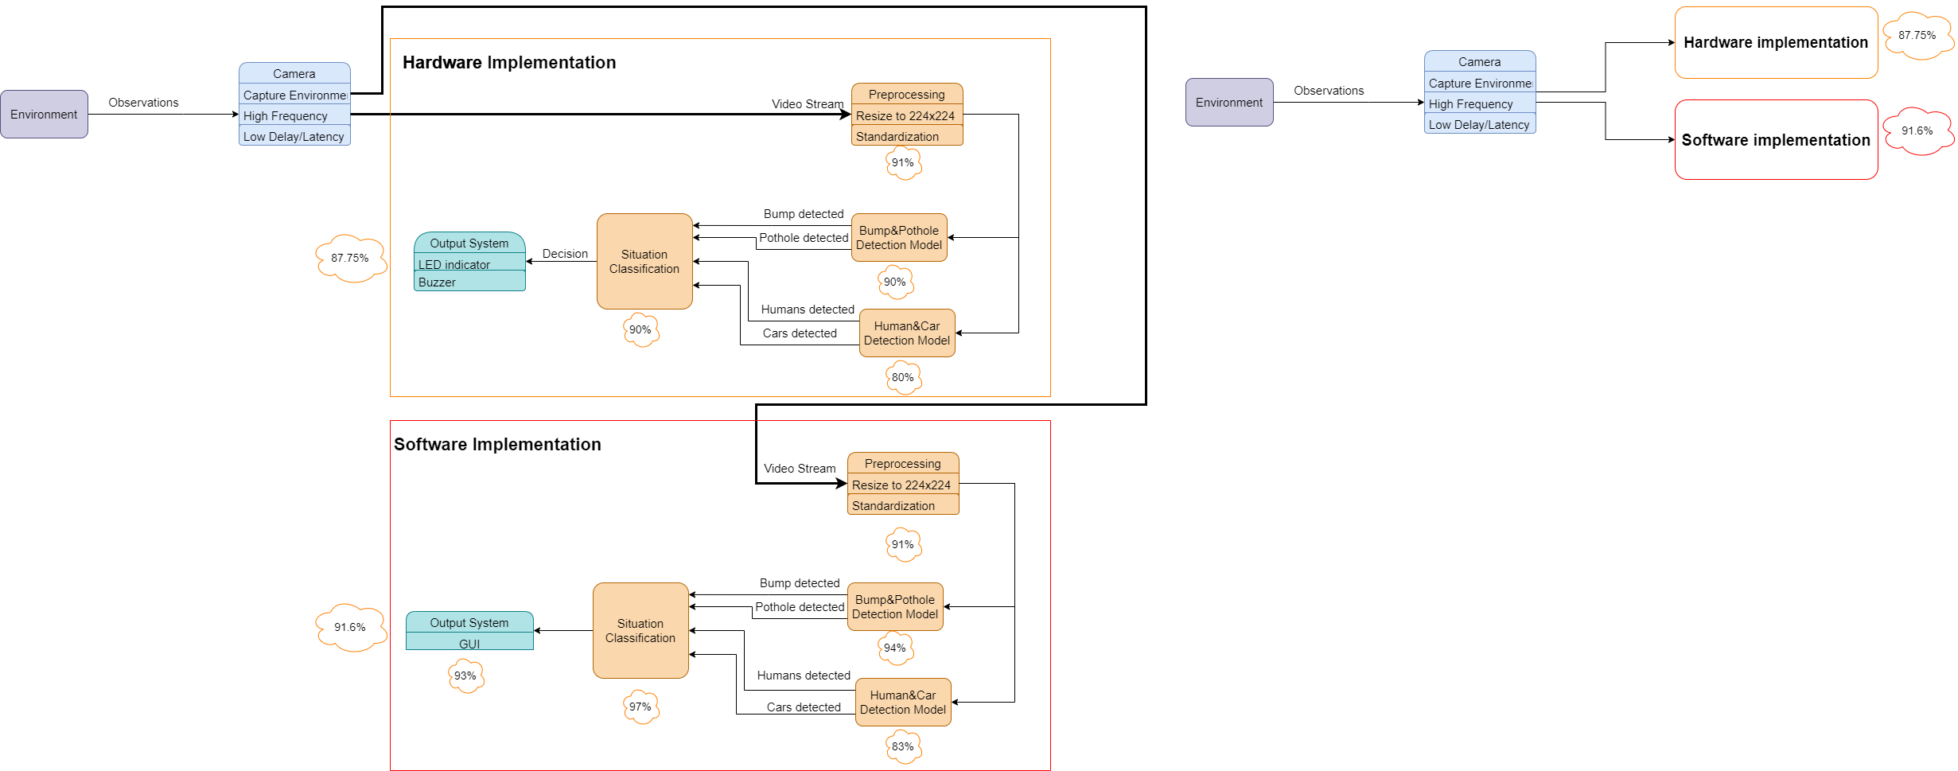
Architecture

Slide 6
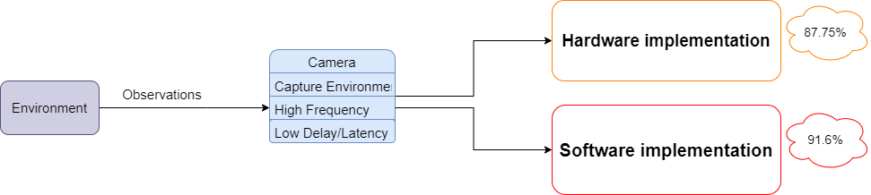
Architecture

Slide 7
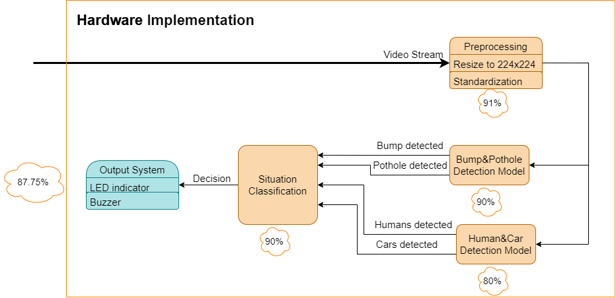
Architecture

Slide 8
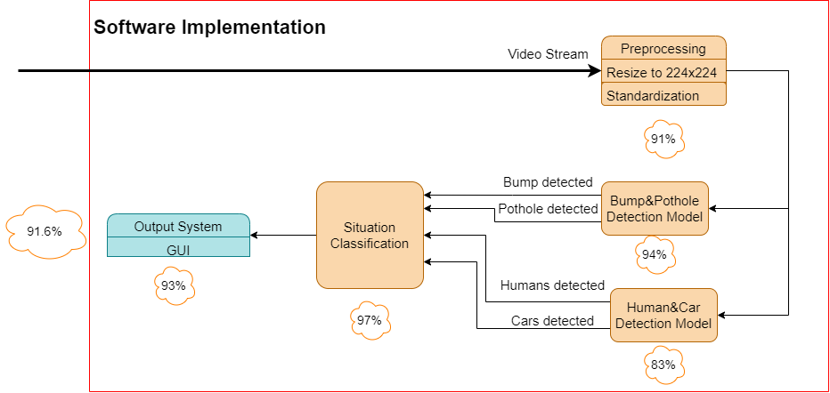
Architecture

Slide 9
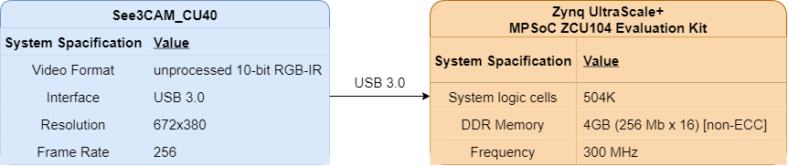
Architecture

Slide 10
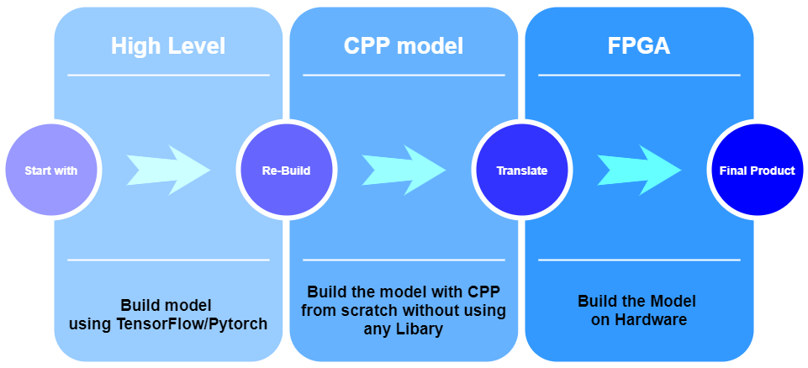
Work-Flow

Slide 11

Implementation

Slide 12
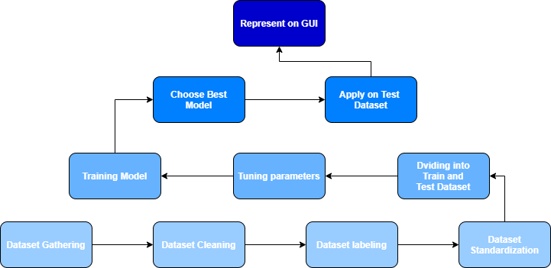
Implementation

Slide 13
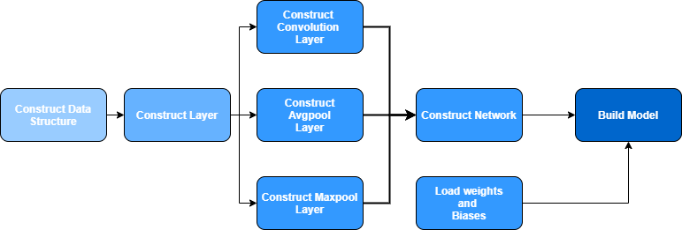
Implementation

Slide 14

Challenges

Slide 15





Challenges
Testing
and
Debugging
Code Complexity
Dataset Imbalance
Hyperparameters Tuning
Dataset Cleaning

Slide 16

Future Work

Slide 17


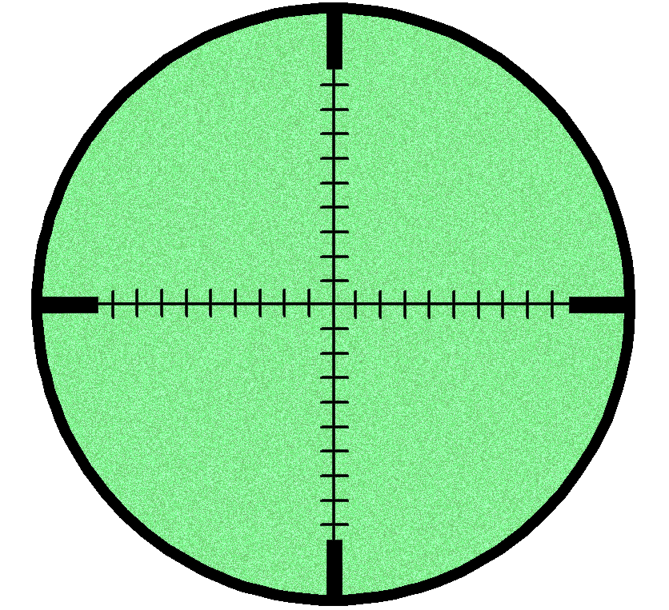


Future Work
Lane Detection
Driver Distraction
Night Vision
Model
All In One
Mobile Model

Slide 18
Conclusion

Slide 19
Conclusion
Lane Detection
Driver Distraction
Night Vision
Model
All In One
Mobile Model

Slide 20
Thank You

