Slide 1
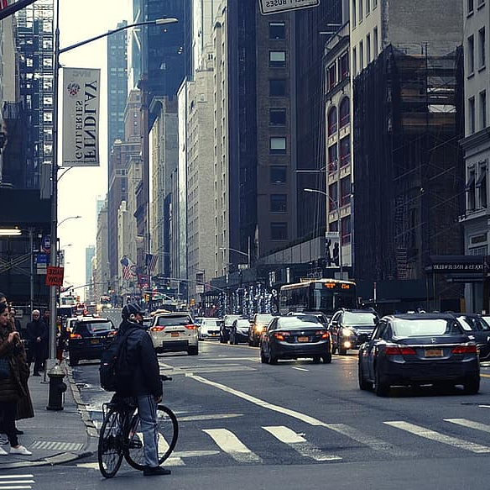

HawkEye
Graduation Project
Supervised By: Prof. Ihab Talkhan
Team Members:
Fathy Nabil Fathy
Mohab Hassan Ahmed
Osama Ashraf Sayed
Omar Mohamed Gomaa

Slide 2
agenda
Introduction and Overview
Work-Flow
Architecture
Challenges
Future Work
Conclusion

Slide 3
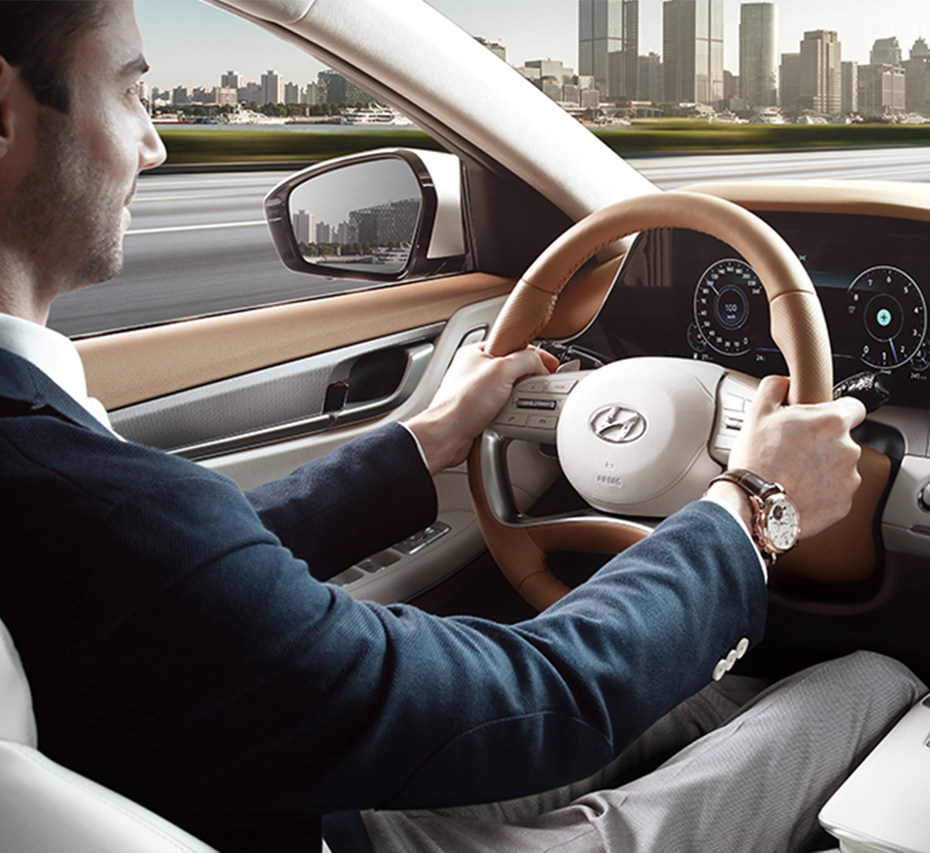
Introduction and overview
Motivation and Problem
Proposed Solution
System Overview

Slide 4

Workflow

Slide 5
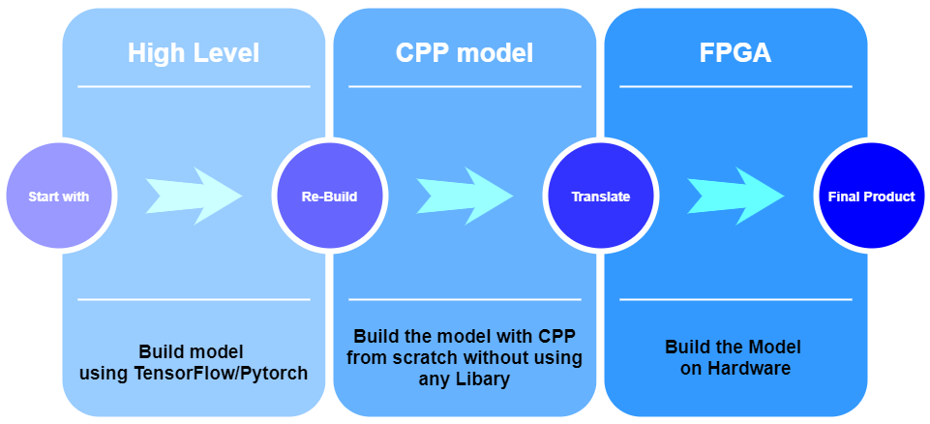
Work-Flow

Slide 6

Architecture

Slide 7
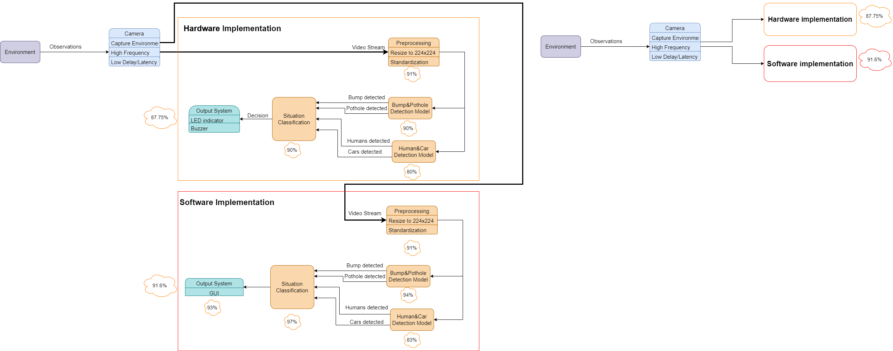
Architecture

Slide 8
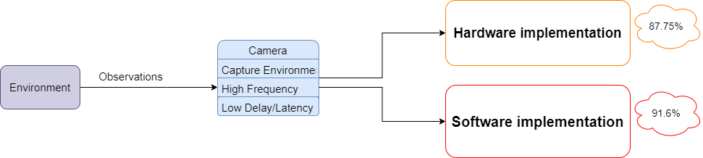
Architecture

Slide 9
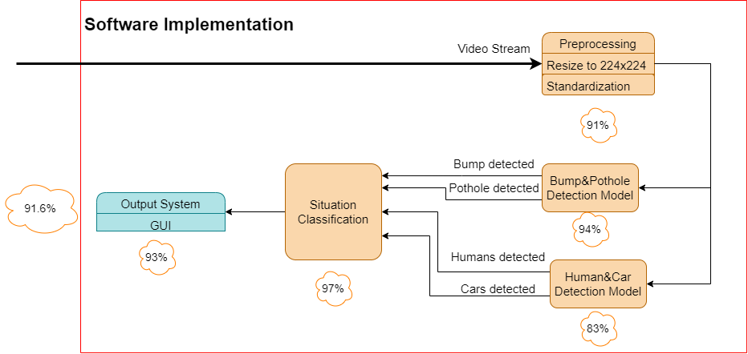
Architecture

Slide 10
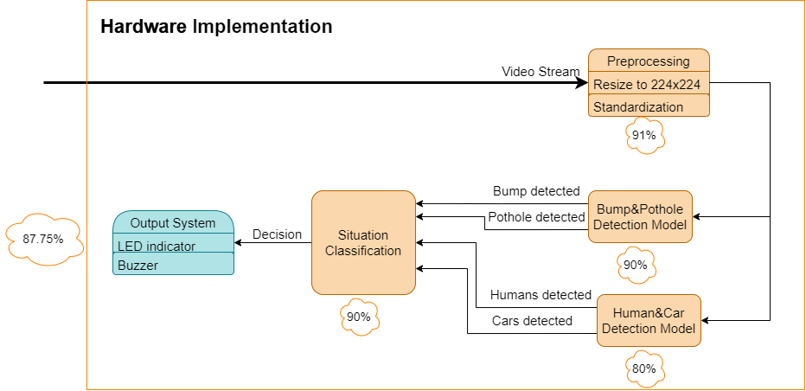
Architecture

Slide 11
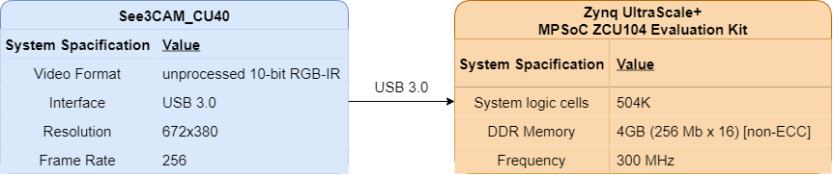
Architecture

Slide 12

Challenges

Slide 13





Challenges
Dataset Imbalance
Hyperparameters Tuning
Dataset Cleaning
Testing
and
Debugging
Code Complexity

Slide 14

Future Work

Slide 15


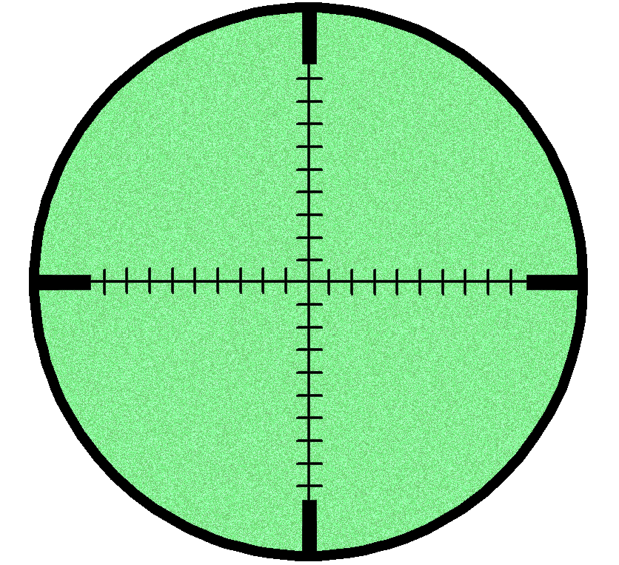


Future Work
Lane Detection
and
Distance estimation
Driver Distraction
Night Vision
Model
All In One
Mobile Model

Slide 16
Conclusion

Slide 17
Conclusion
Applied University Courses
Real-Time Performance
Reasonable Accuracy
Product Deployment

Slide 18
Thank You

