Slide 1

Implementation

Slide 2
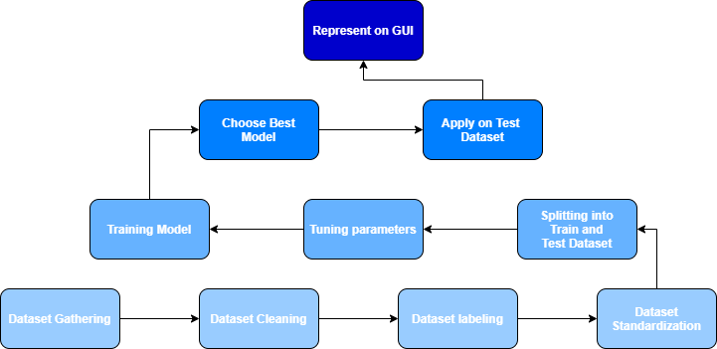
Implementation
High-Level

Slide 4
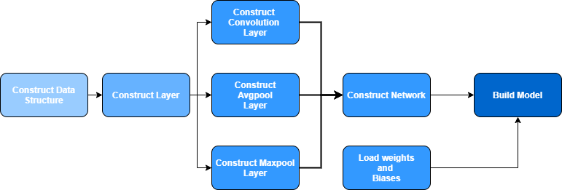
Implementation
CPP Model

Slide 5
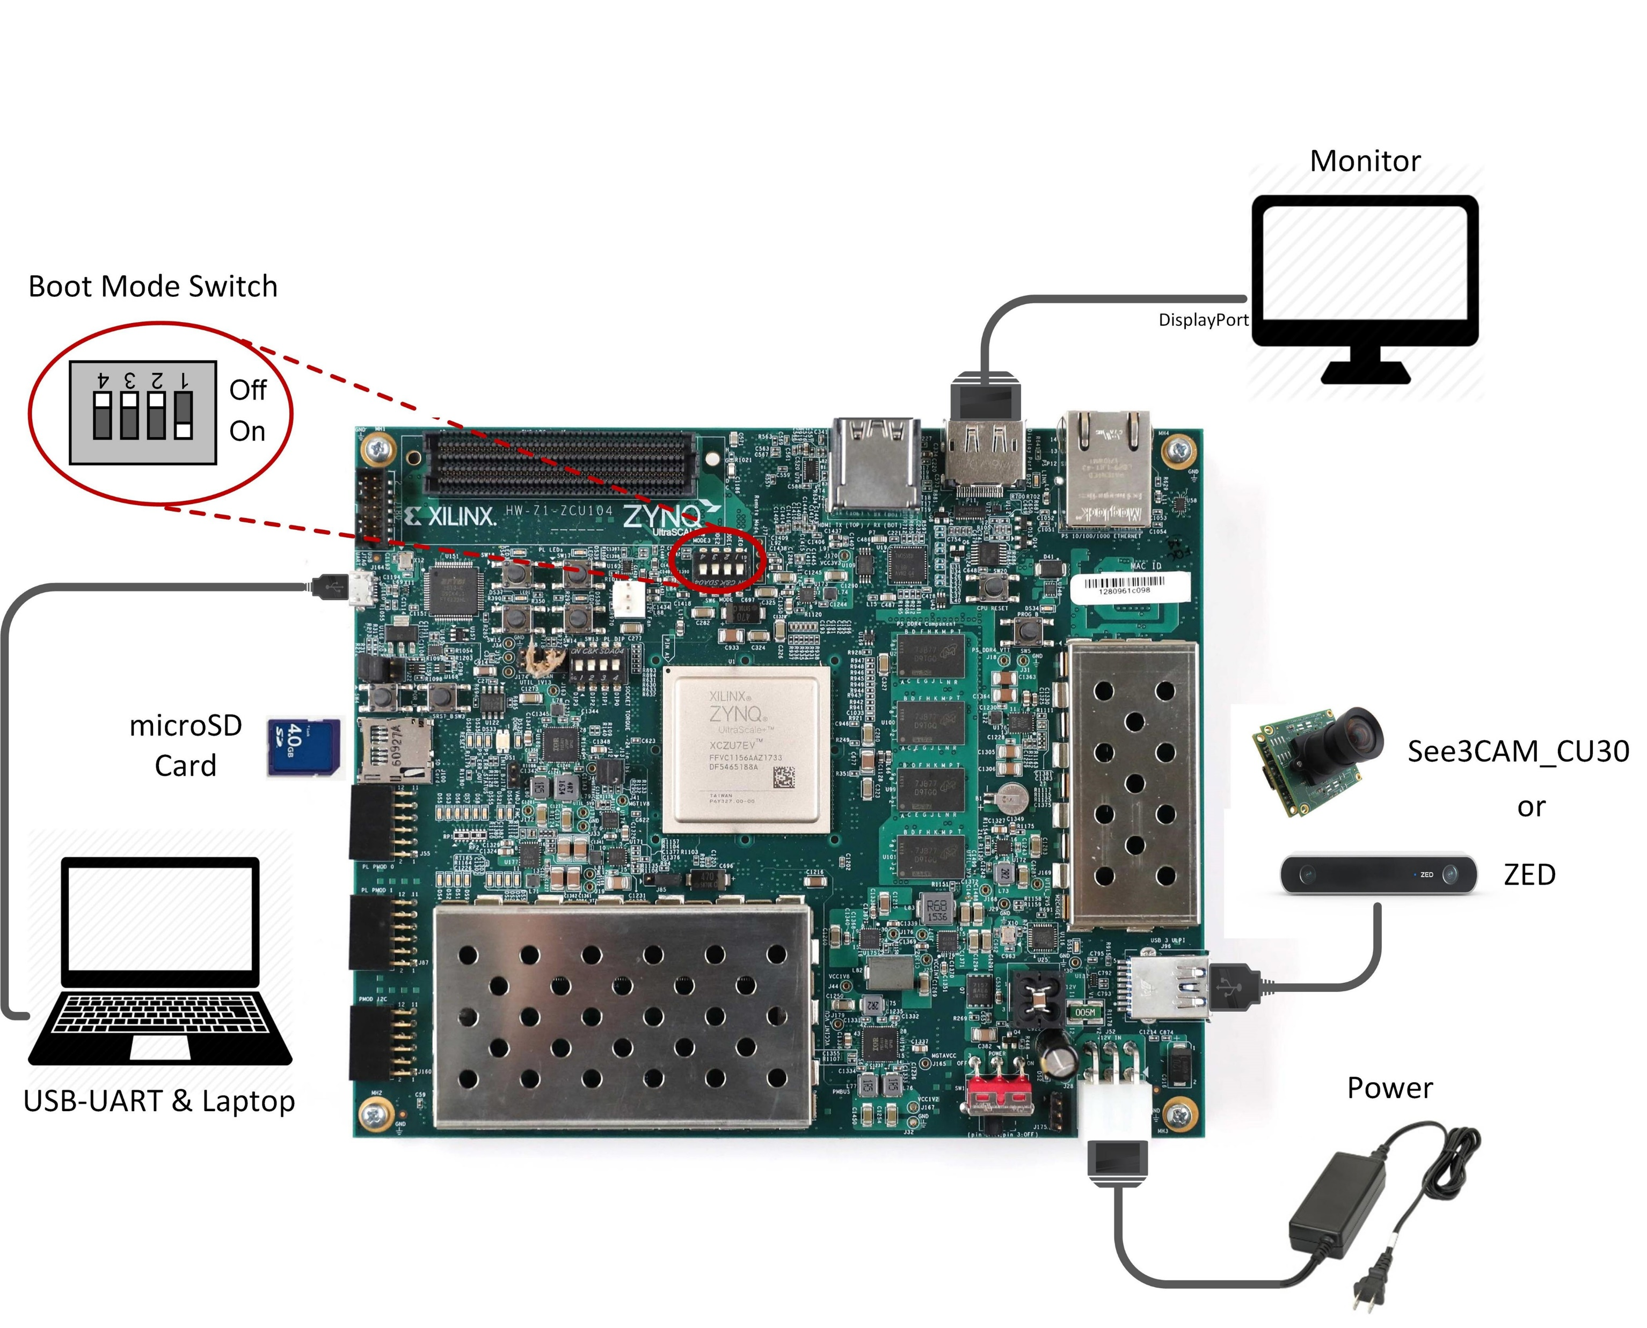
Implementation
FPGA Board

Slide 6
Implementation
Hardware Model

Slide 7
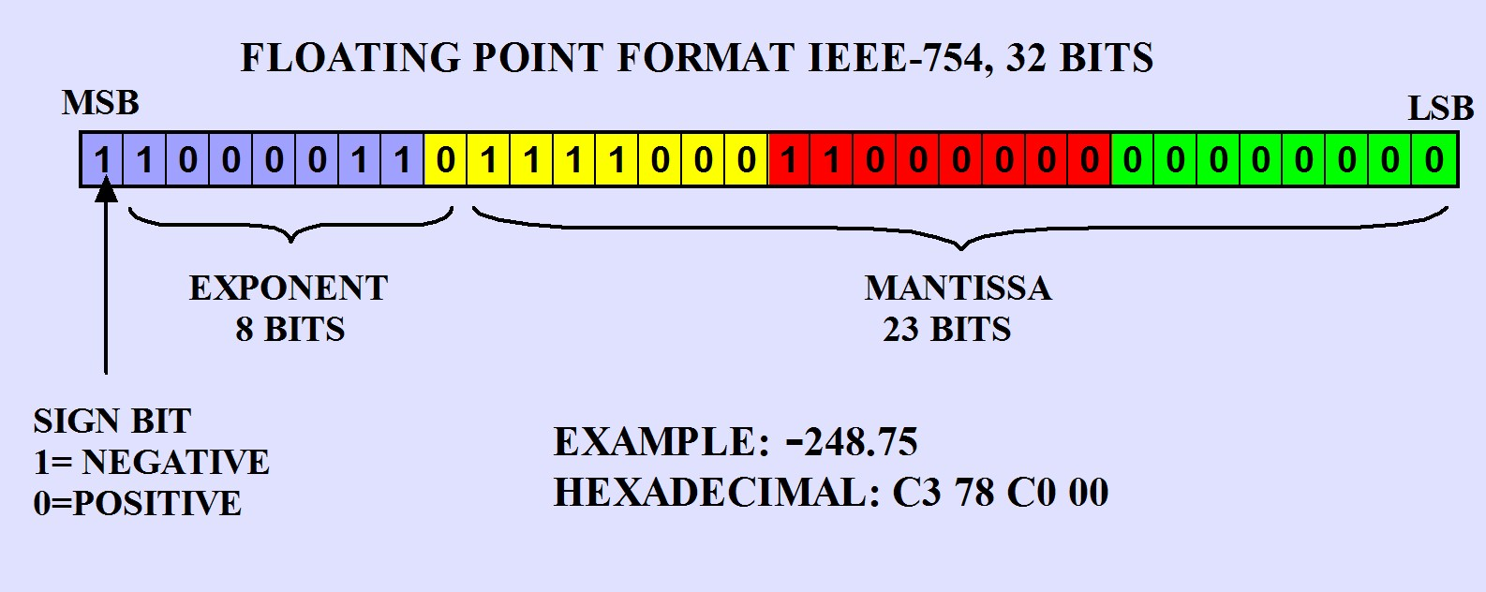
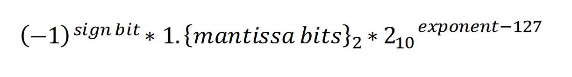
Implementation
Verilog Model

Slide 8
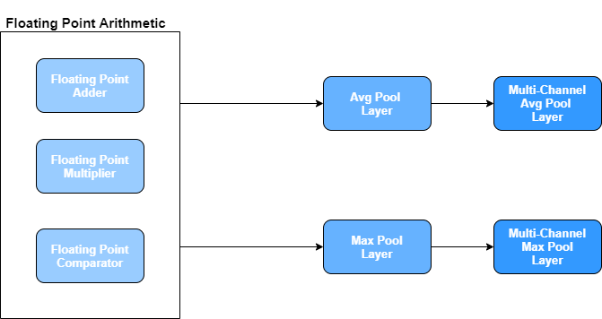
Implementation
Verilog Model

