Slide 1

Implementation

Slide 2
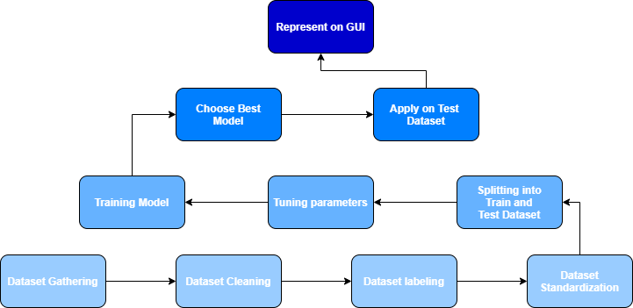
Implementation
High-Level

Slide 4
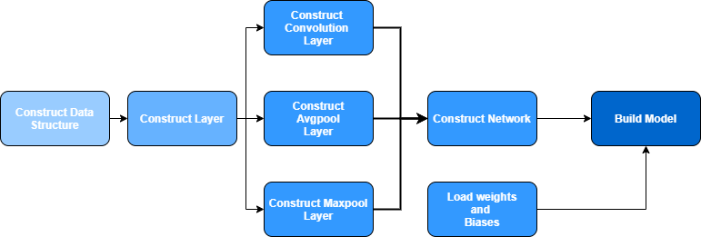
Implementation
CPP Model

Slide 6
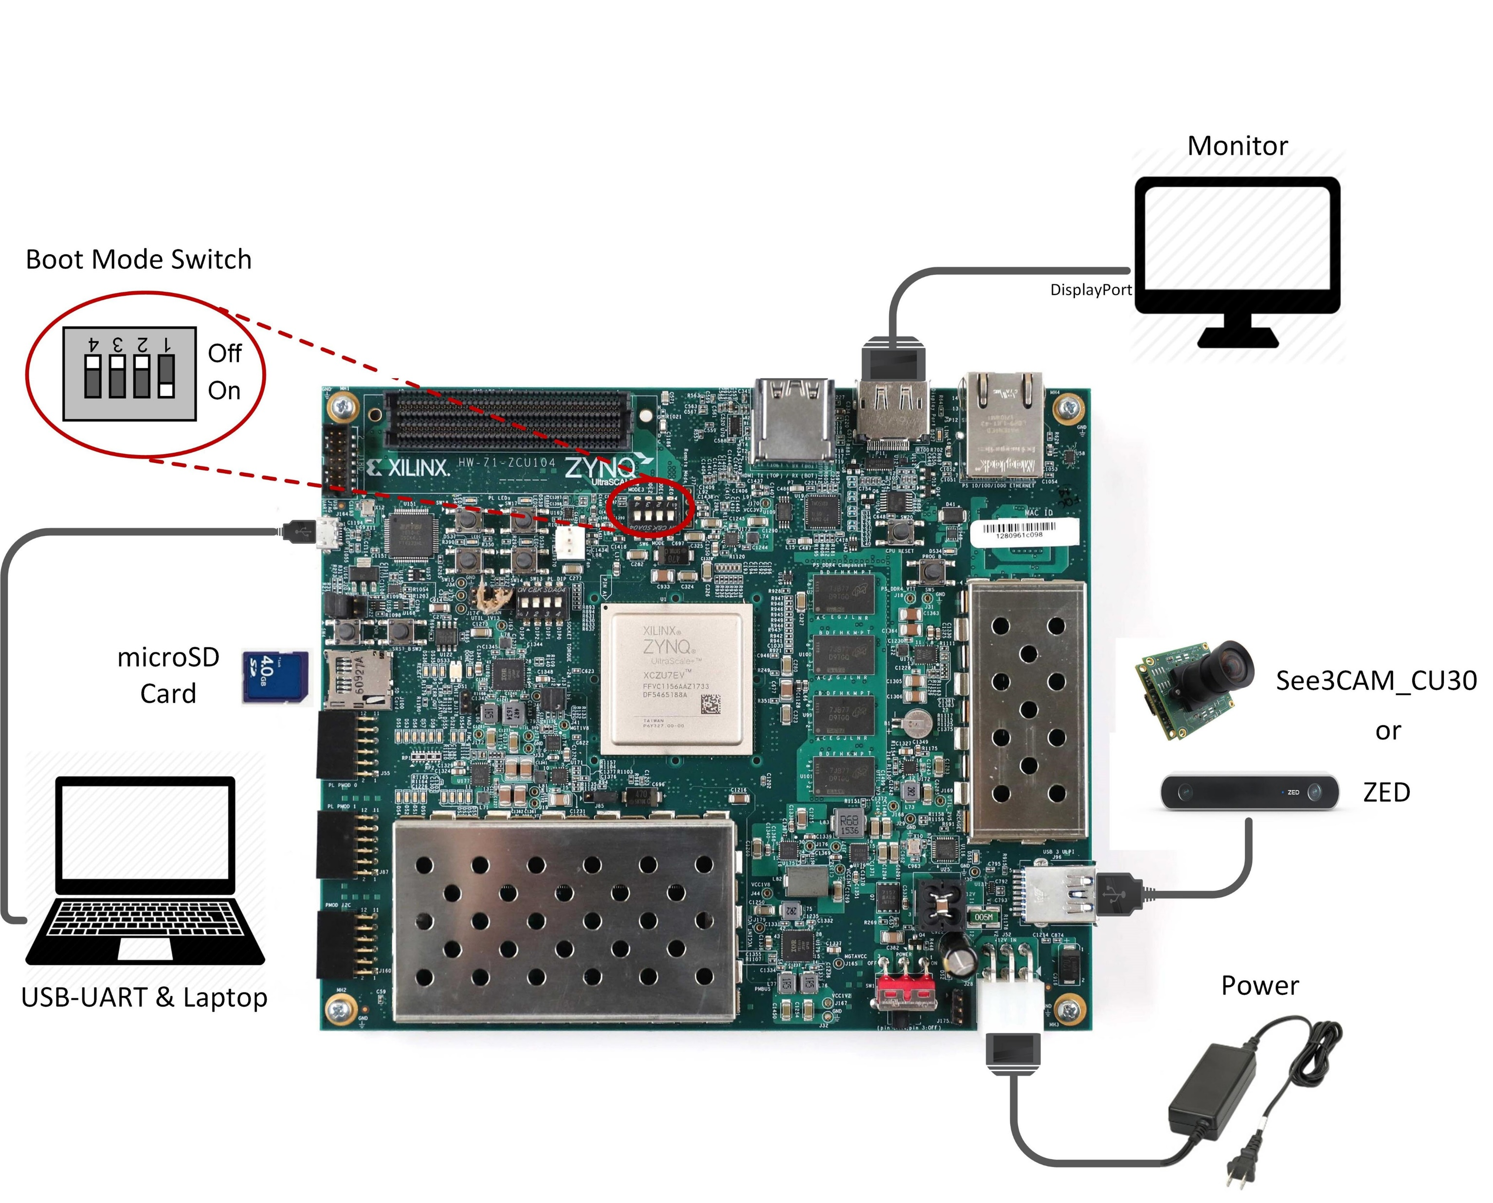
Implementation
FPGA Board

Slide 7
Implementation
Hardware Model

Slide 8
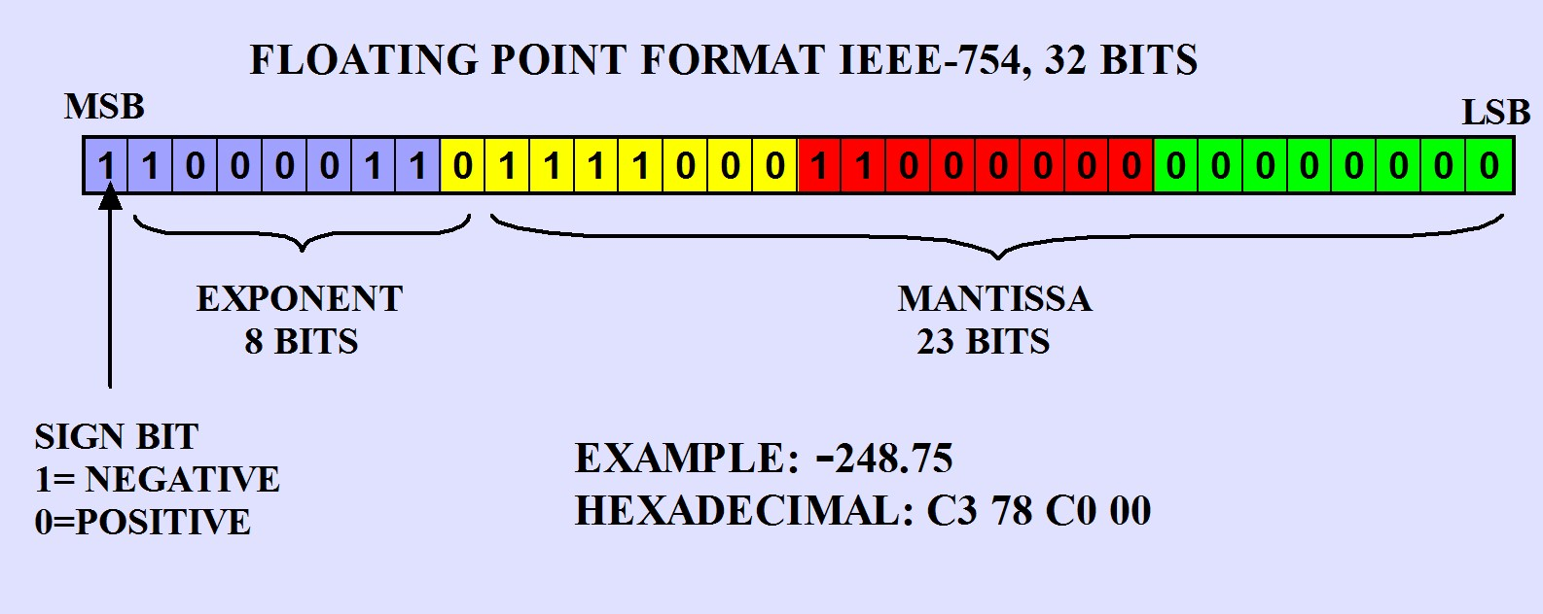
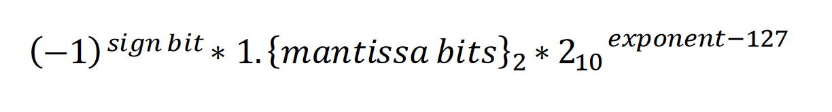
Implementation
Verilog Model

Slide 9
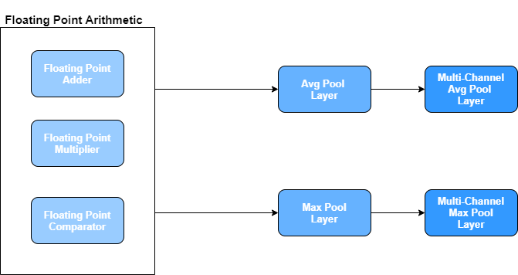
Implementation
Verilog Model

Slide 11
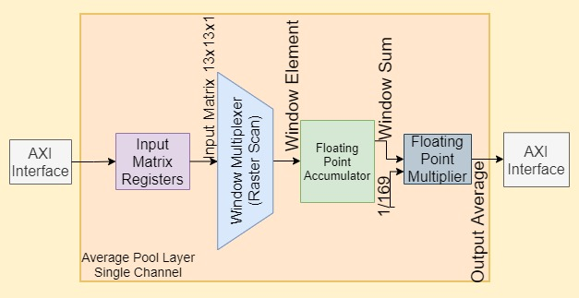
Avg Pool Layer

Slide 12
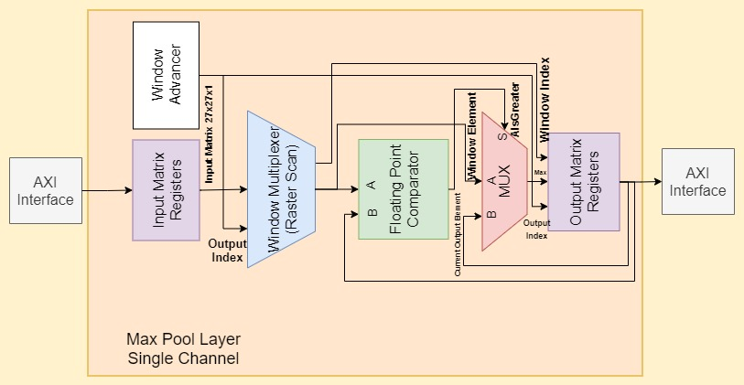
Max Pool Layer

Slide 13
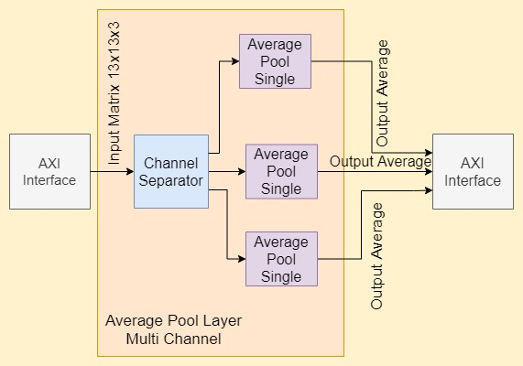
Avg Pool Layer - Multichannel

Slide 14
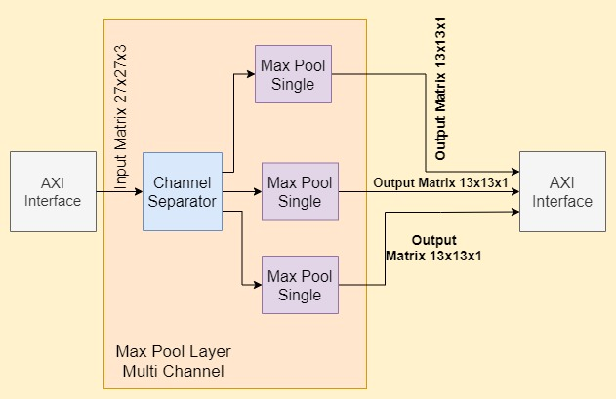
Max Pool Layer - Multichannel

