Slide 1
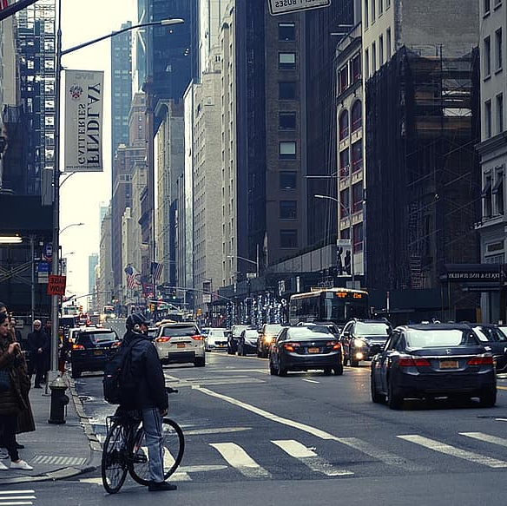

HawkEye
Graduation Project
Supervised By: Prof. Ihab Talkhan
Team Members:
Fathy Nabil Fathy
Mohab Hassan Ahmed
Osama Ashraf Sayed
Omar Mohamed Gomaa

Slide 2
agenda
Introduction and Overview
Architecture
Work-Flow
Implementation
Challenges
Future Work

Slide 3
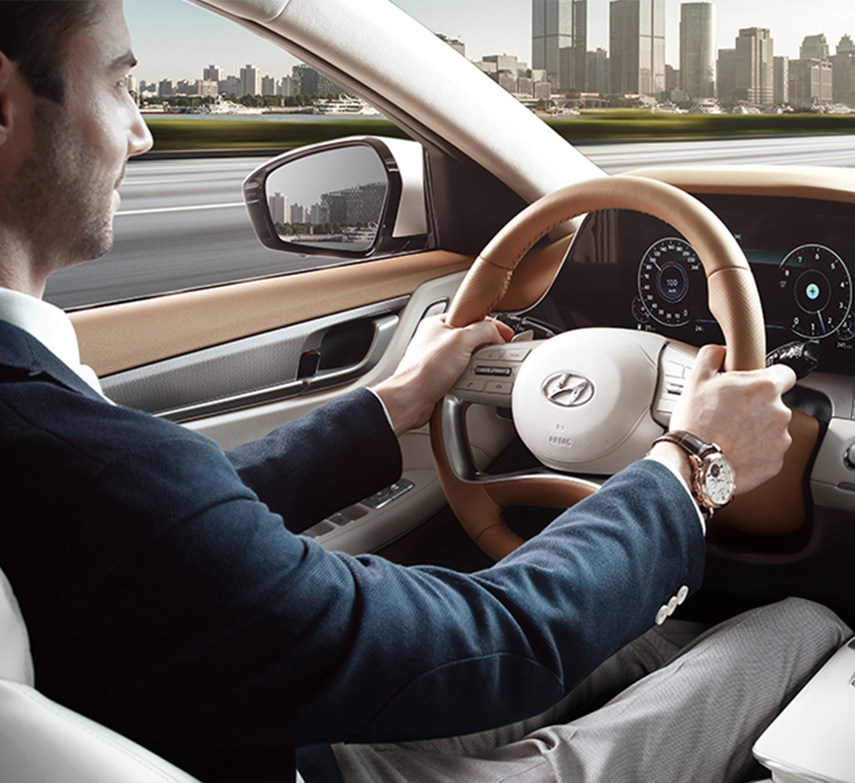
Introduction and overview
Motivation and Problem
Proposed Solution
System Overview

Slide 4

Architecture

Slide 5
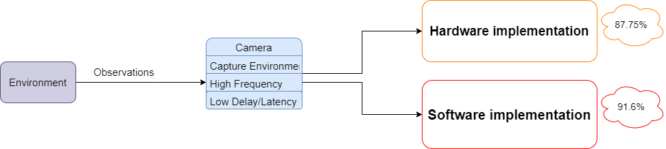
Architecture

Slide 6
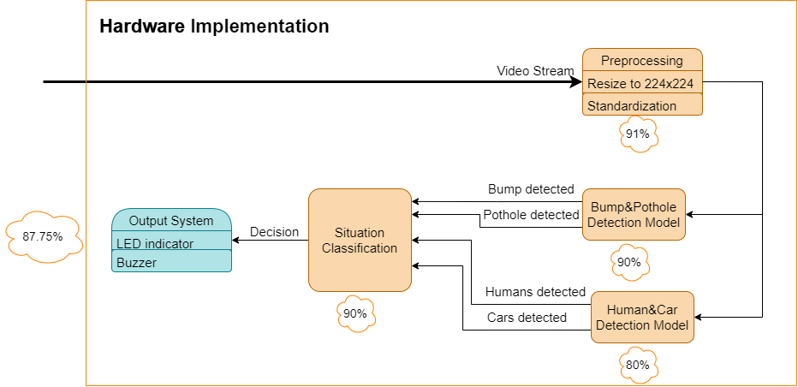
Architecture

Slide 7
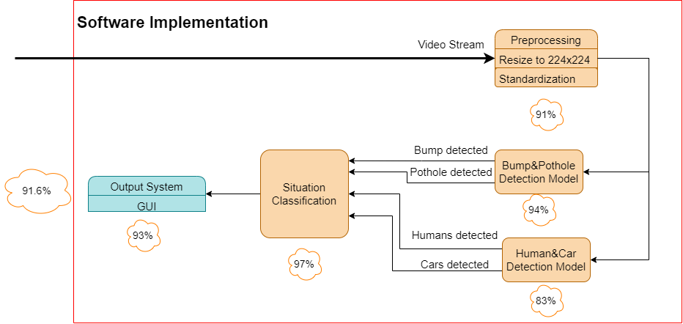
Architecture

Slide 8
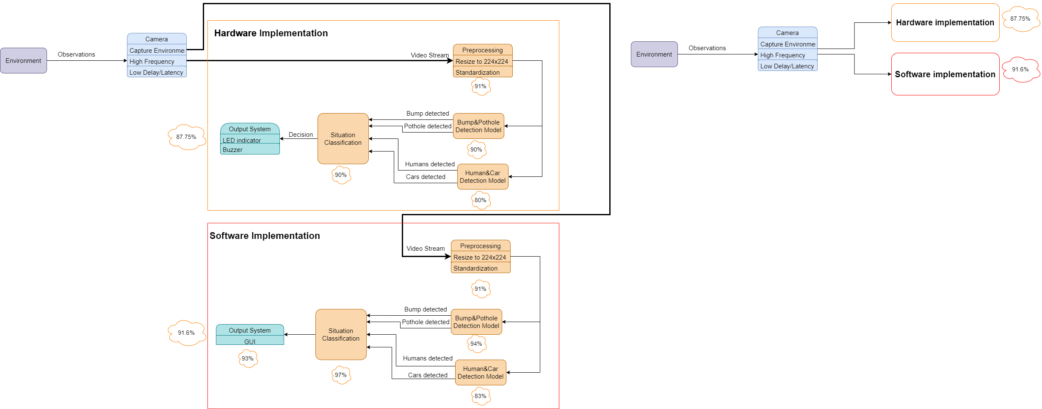
Architecture

Slide 9
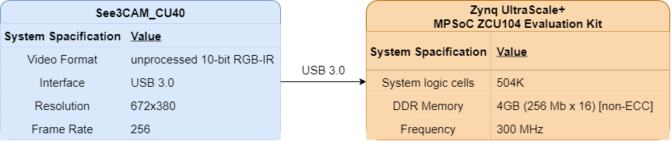
Architecture

Slide 10
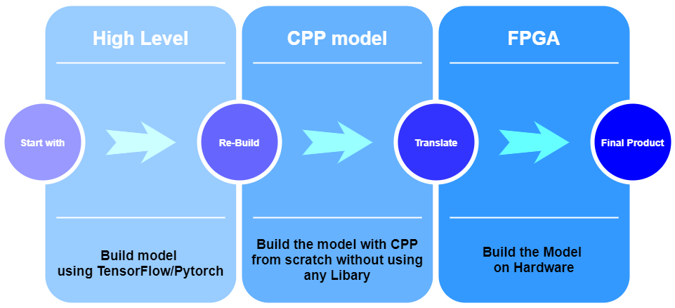
Work-Flow

Slide 11

Challenges

Slide 12





Challenges
Testing
and
Debugging
Code Complexity
Dataset Imbalance
Hyperparameters Tuning
Dataset Cleaning

Slide 13

Future Work

Slide 14


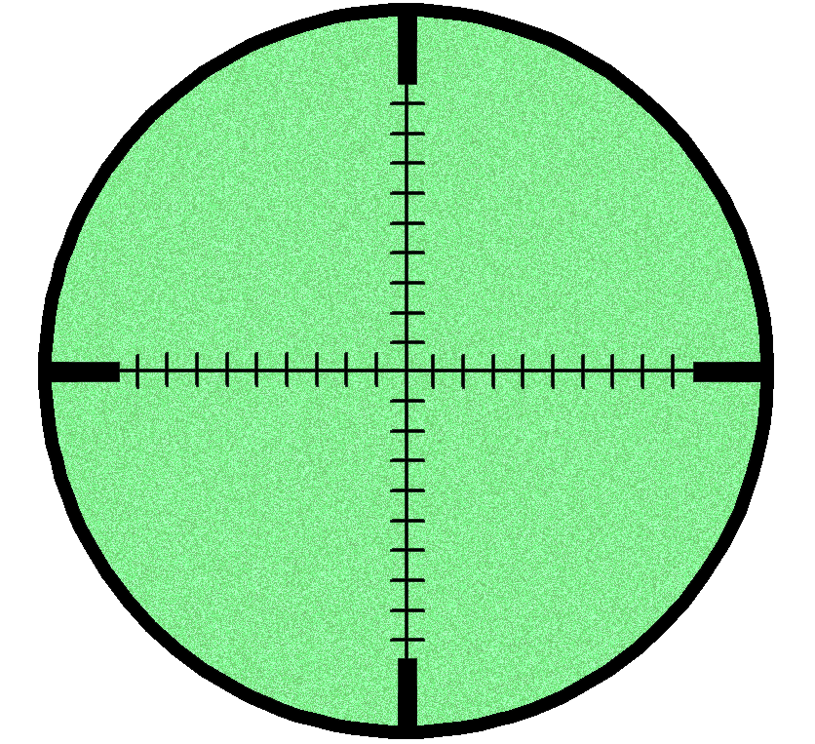


Future Work
Lane Detection
Driver Distraction
Night Vision
Model
All In One
Mobile Model

Slide 15
Conclusion

Slide 16
Conclusion
Lane Detection
Driver Distraction
Night Vision
Model
All In One
Mobile Model

Slide 17
Thank You

