Slide 1
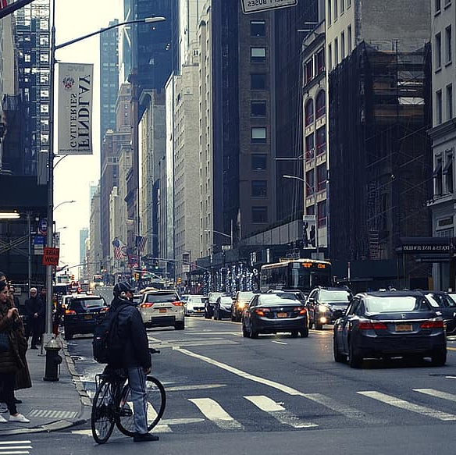

HawkEye
Graduation Project
Supervised By: Prof. Ihab Talkhan
Team Members:
Fathy Nabil Fathy
Mohab Hassan Ahmed
Osama Ashraf Sayed
Omar Mohamed Gomaa

Slide 2
agenda
Introduction and Overview
Architecture
Work-Flow
Implementation
Challenges
Future Work

Slide 3
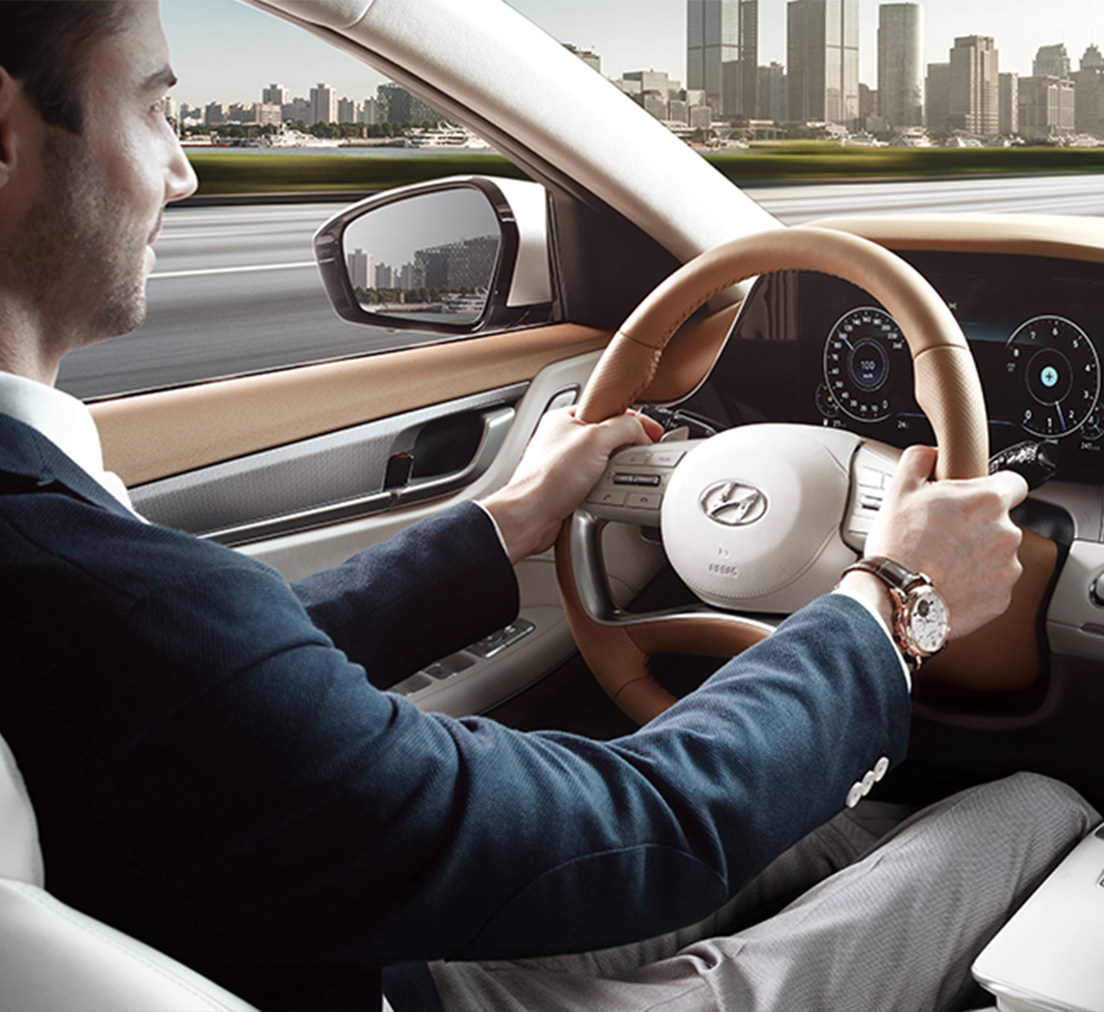
Introduction and overview
Motivation and Problem
Proposed Solution
System Overview

Slide 4

Architecture

Slide 5
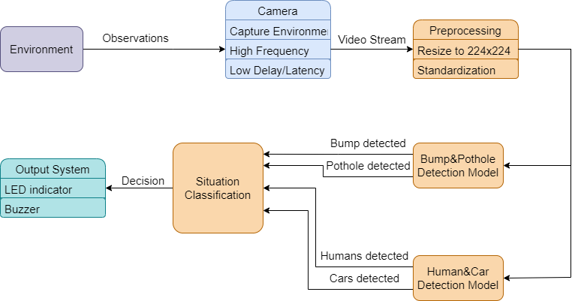
Architecture

Slide 6
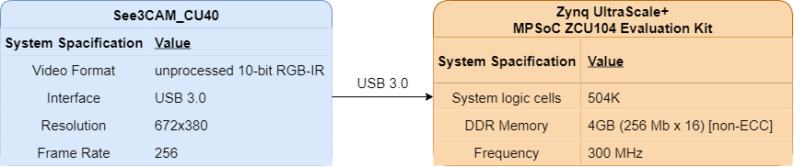
Architecture

Slide 7
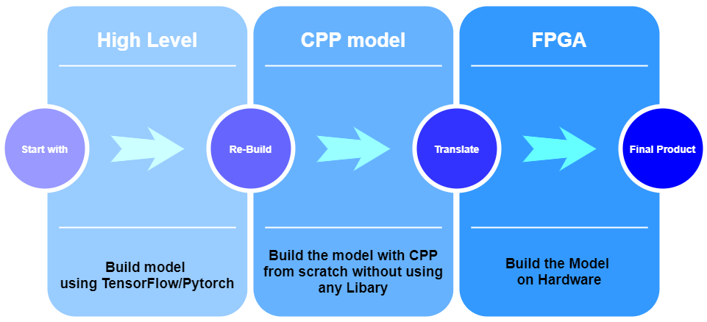
Work-Flow

Slide 8

Challenges

Slide 9





Challenges
Testing
and
Debugging
Code Complexity
Dataset Imbalance
Hyperparameters Tuning
Dataset Cleaning

Slide 10

Future Work

Slide 11


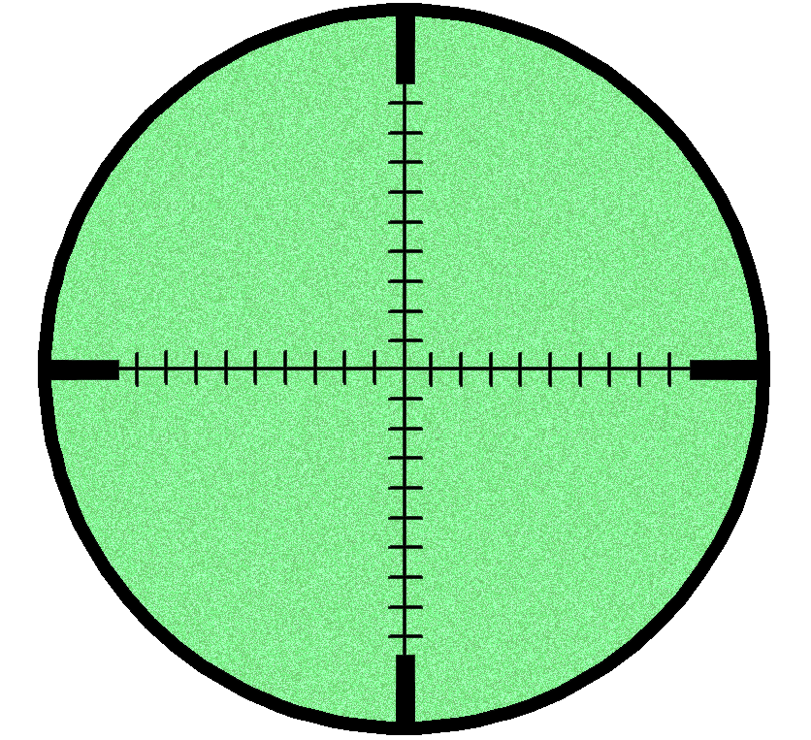


Future Work
Lane Detection
Driver Distraction
Night Vision
Model
All In One
Mobile Model

Slide 12
Conclusion

Slide 13
Thank You

