Slide 1
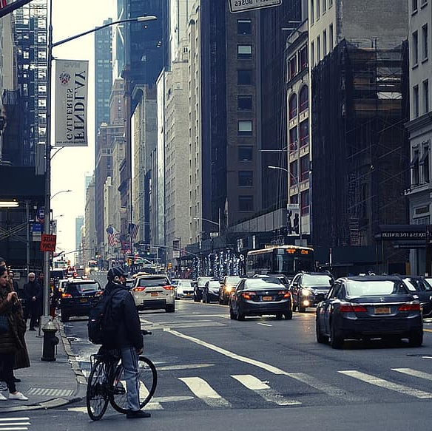

HawkEye
Graduation Project
Supervised By: Prof. Ihab Talkhan
Team Members:
Fathy Nabil Fathy
Mohab Hassan Ahmed
Osama Ashraf Sayed
Omar Mohamed Gomaa

Slide 2
agenda
Introduction and Overview
Architecture
Work-Flow
Challenges
Future Work

Slide 3
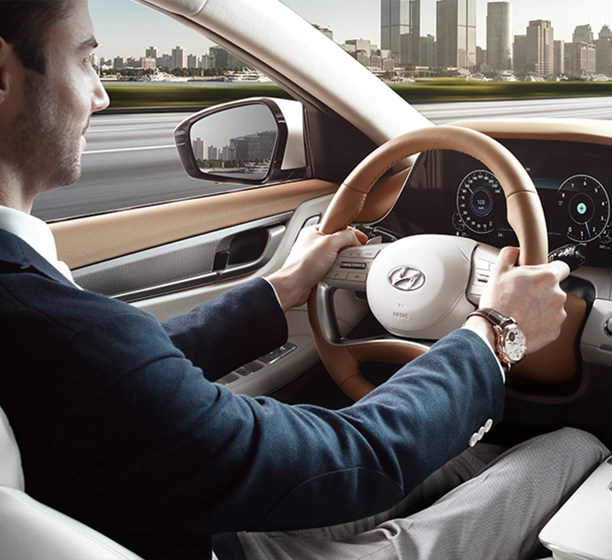
Introduction and overview
Motivation and Problem
Proposed Solution
System Overview

Slide 4

Architecture

Slide 5
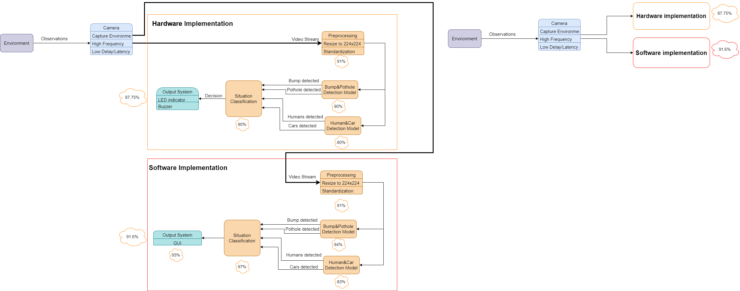
Architecture

Slide 6
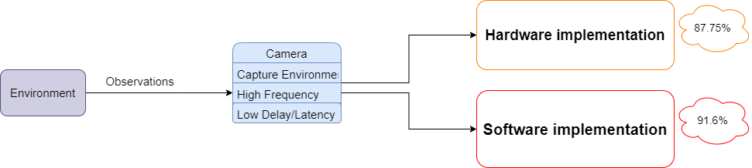
Architecture

Slide 7
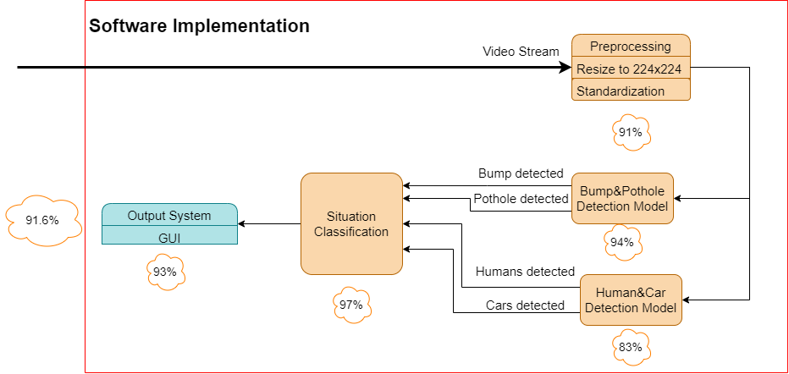
Architecture

Slide 8
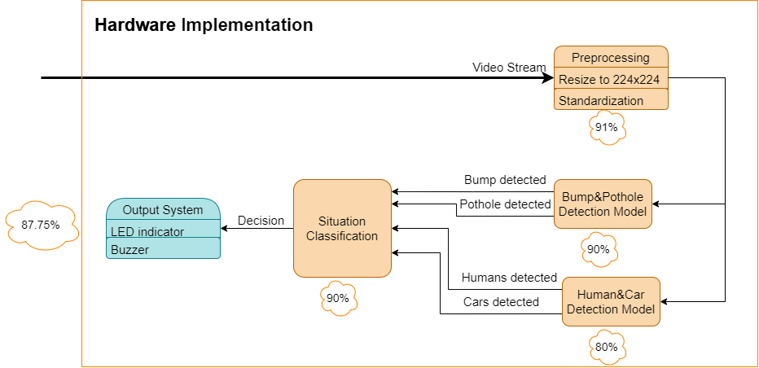
Architecture

Slide 9
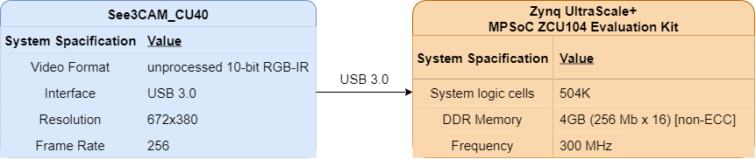
Architecture

Slide 10

Workflow

Slide 11
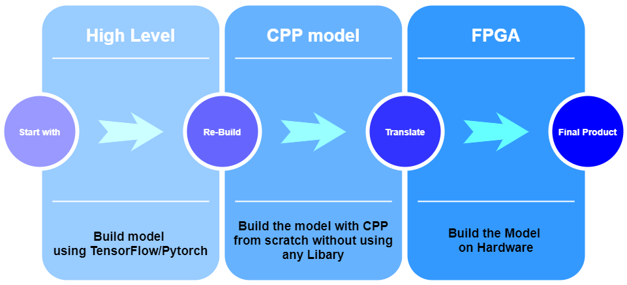
Work-Flow

Slide 12

Implementation

Slide 13
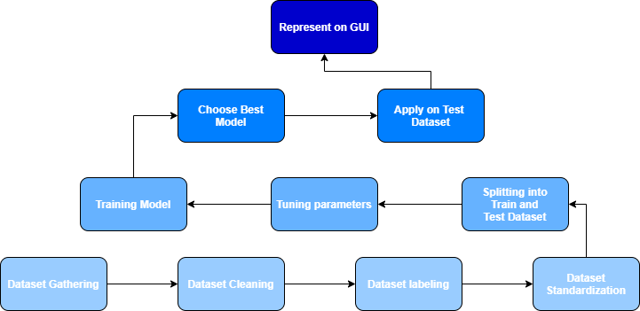
Implementation

Slide 14
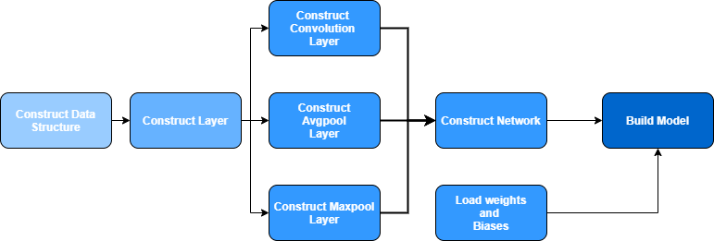
Implementation

Slide 15

Challenges

Slide 16





Challenges
Testing
and
Debugging
Code Complexity
Dataset Imbalance
Hyperparameters Tuning
Dataset Cleaning

Slide 17

Future Work

Slide 18


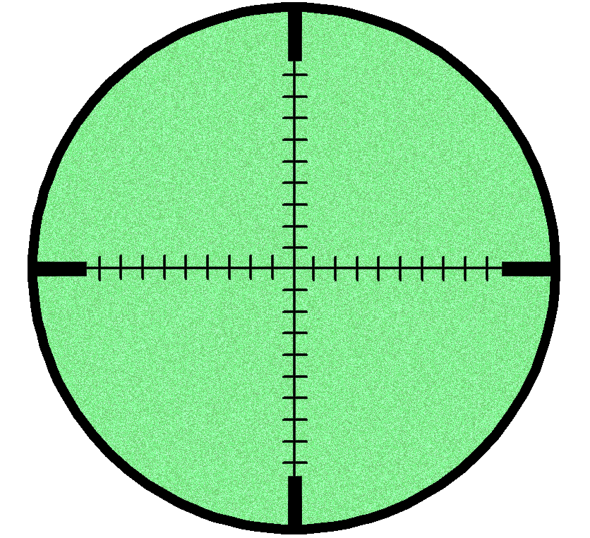


Future Work
Lane Detection
Driver Distraction
Night Vision
Model
All In One
Mobile Model

Slide 19
Conclusion

Slide 20
Conclusion
Lane Detection
Driver Distraction
Night Vision
Model
All In One
Mobile Model

Slide 21
Thank You

