Slide 1
✚
DH 308 / FINAL PROJECT
Designing a hospital
billing system with HIS
A prototype for Indian hospitals that connects clinical care, lab tests, pharmacy and the final bill.
Doctor encounter
Lab result
Pharmacy dispense
Itemised bill

Slide 2
INTRODUCTION & BACKGROUND
Project scope and billing workflow
The billing system receives completed work from the HIS and links every charge to one encounter.
01
02
03
04
Doctor
Lab
Pharmacy
Billing
Records the encounter, diagnosis and orders.
Records the result and completed test.
Dispenses against a prescription and stock batch.
Prices completed work and issues one invoice.
Shared key: one patient encounter
DH 308 / HIS billing
02

Slide 3
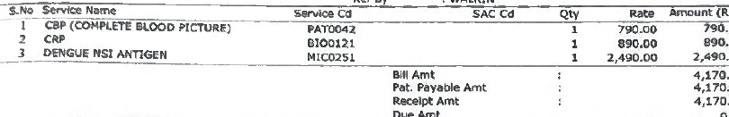
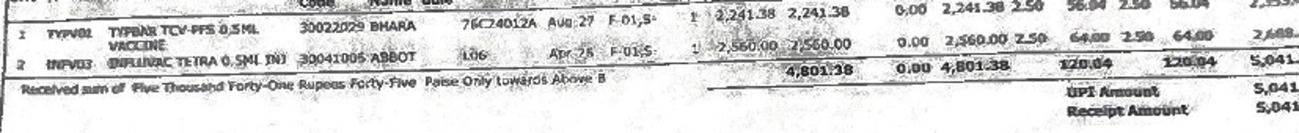
INTRODUCTION & BACKGROUND
Source bills: OPD tests and pharmacy
KIMS bills show a service code and amount for each test, plus separate tax fields on a pharmacy invoice.
OPD diagnostics
CBC ₹790
CRP ₹890
Dengue NS1 ₹2,490
Pharmacy GST
Taxable value ₹4,801.38. CGST and SGST are 2.5% each. Receipt ₹5,041.45.
De-identified crops from the supplied KIMS bill pages. Values above are transcribed from the scanned documents.
DH 308 / HIS billing
03

Slide 4
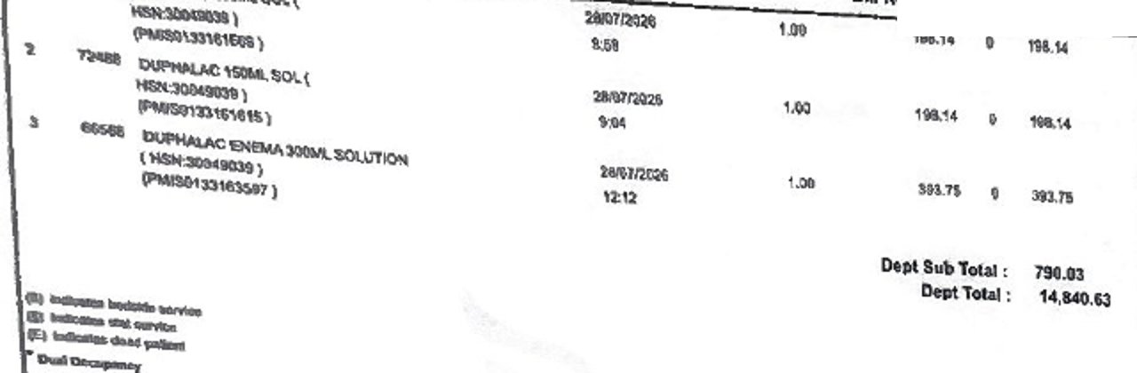
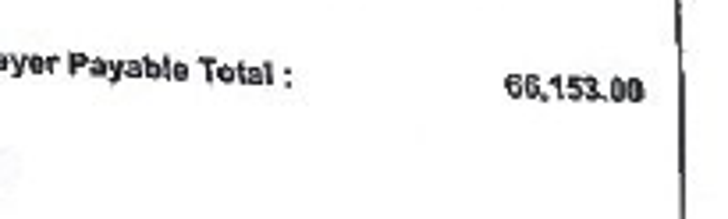

INTRODUCTION & BACKGROUND
Source bills: Apollo inpatient account
The IPD account combines department charges, pharmacy lines, bed history and a separate payment receipt.
01 Consultation charges
₹9,500 on the account page
02 Emergency services
₹5,280, plus a ₹430 procedure
03 Pharmacy and bed history
Three medicine lines total ₹790.03.
Final payable
Separate receipt
Bed dates and categories appear separately.
The payable and receipt remain distinct records.
De-identified crops from supplied Apollo IPD bill and receipt pages. Values are transcribed from the scanned documents.
DH 308 / HIS billing
04

Slide 5
INTRODUCTION & BACKGROUND
Billing patterns in the 19 source pages
The scans cover different visit and payment situations. Related pages are grouped below.
SOURCE GROUP
READABLE OBSERVATION
SYSTEM REQUIREMENT
KIMS consultations (4)
₹650 and ₹750 consultation receipts
Doctor and visit tariff
KIMS diagnostics (6)
Pelvic scan ₹1,880; CBC, CRP and NS1 total ₹4,170
Service code and department
KIMS pharmacy (2)
₹40 and ₹5,041.45 receipts; HSN, batch and split GST
Stock and product tax rule
KIMS registration (1)
₹150 receipt
Payment record
Apollo OPD (2)
₹1,000 consultation bills
OPD invoice and payment
Apollo IPD (4)
₹66,153 payable; separate ₹5,779 receipt
Running bill and settlement
13 KIMS and 6 Apollo scanned pages supplied for the project. Amounts shown only where the scan is legible; no patient identifiers appear.
DH 308 / HIS billing
05

Slide 6
INTRODUCTION & BACKGROUND
Problem statement and objectives
Problem
A service can be missed, repeated, charged at the wrong tariff, or confused with a payer approval.
01
02
03
04
Capture once
Use the right rate
Explain the bill
Track money
Reject a repeated HIS event ID.
Snapshot the payer tariff on the charge.
Show item, quantity, GST and total.
Keep claims and actual receipts separate.
DH 308 / HIS billing
06

Slide 7
INTRODUCTION & BACKGROUND
Existing gaps and why they occur
Gap
Reason
Design response
01
Missing service
Manual handoff between care and billing
Doctor event posts a charge
02
Wrong amount
Different payer rate cards
Rate chosen at capture time
03
Payment confusion
Approval treated as collection
Claim and receipt stored separately
04
Discharge delay
Charges assembled at the end
Running bill stays current
DH 308 / HIS billing
07

Slide 8
LITERATURE REVIEW / STANDARDS
Evidence behind the billing design
01
Itemised billing
The Patients’ Rights Charter supports a clear charge list and receipt for the patient.
02
Charge versus invoice
HL7 FHIR separates a performed ChargeItem from the priced lines of an Invoice.
03
Payer workflow
IRDAI describes preauthorisation for cashless care; NHA uses package rules for PM-JAY.
04
HIS data model
Course lectures on ER, ICD-10 and HL7 informed the encounter and code fields.
Sources: MoHFW, HL7 FHIR R4, IRDAI, NHA and DH 308 course material. Full references are on the final slide.
DH 308 / HIS billing
08

Slide 9
LITERATURE REVIEW / STANDARDS
Clinical and billing codes
Different codes answer different questions. The system stores each code with its source.
CODE
MEANING
USE IN THIS DESIGN
ICD-10
Why was care needed?
Doctor diagnosis and claim context
Service code
What was done?
KIMS bill examples: PAT0042, BIO0121, MIC0251
CPT
External procedure mapping
Optional licensed mapping, not the default Indian tariff
LOINC
Which lab observation?
HbA1c result uses 4548-4 in the demo
HSN / SAC
What is the GST class?
Pharmacy goods and billable service classification
PM-JAY HBP
Which scheme package?
Rate and claim route for an empanelled case
WHO ICD; MoHFW EHR standards (CPT is optional and licensed); DH 308 ICD/LOINC lecture; NHA HBP manual. Service codes are from the supplied KIMS bill.
DH 308 / HIS billing
09

Slide 10
LITERATURE REVIEW / STANDARDS
GST rules the prototype applies
The tariff stores tax treatment by item and supply context.
Clinical care
Qualifying consultation and treatment
Exempt
Separate OPD medicine sale
KIMS pharmacy sample: ₹4,801.38 taxable
5% GST
Notified nil-rated medicine
Rate follows the product classification
Nil
Specified non-ICU room
Example: ₹6,000 per day, above ₹5,000
5%, ₹300 tax
Inpatient medicines supplied as part of qualifying hospital care need a composite-supply review; the OPD pharmacy rate is not applied automatically.
GST Council 2025 medicine FAQ; CBIC service rate entry 31A (5% without ITC); notification 12/2017 and inpatient AAR orders.
DH 308 / HIS billing
10

Slide 11
SYSTEM DESIGN & ARCHITECTURE
System modules and integration
Three desks work on the same encounter. FastAPI checks each write before PostgreSQL stores it.
DOCTOR
PHARMACY
BILLING
Note, ICD-10, service, prescription
Prescription, batch, dispense
Room, payer, invoice, receipt
FastAPI: access checks, charge capture, tax rules, claim state and invoice lock
PostgreSQL: linked records and audit events
DH 308 / HIS billing
11

Slide 12
SYSTEM DESIGN & ARCHITECTURE
Database schema: the useful links
CARE
BILLING
PAYER
patients
services
coverages
patient_id (PK)
service_code (PK), tariff, tax rule
encounter_id (FK), payer route
encounters
charges
preauths
encounter_id (PK), patient_id (FK)
charge_id (PK), encounter_id (FK), event ID
encounter_id (FK), approved amount
clinical_notes
invoices
claims
encounter_id (FK), ICD-10, procedure code
invoice_id (PK), encounter_id (FK)
invoice_id (FK), diagnosis and status
prescriptions
invoice_lines
receipts
encounter_id (FK), pharmacy item
invoice_id (FK), charge and tax snapshot
invoice_id (FK), payer and amount
One encounter has many charges and at most one final invoice.
DH 308 / HIS billing
12

Slide 13
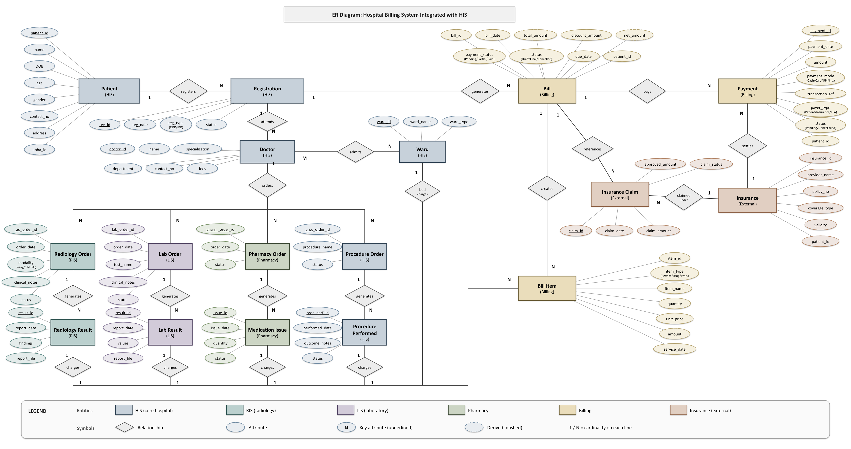
SYSTEM DESIGN & ARCHITECTURE
Chen notation ER diagram
This conceptual diagram was supplied for the project. It links HIS, pharmacy, billing and external payer entities.
DH 308 / HIS billing
13

Slide 14
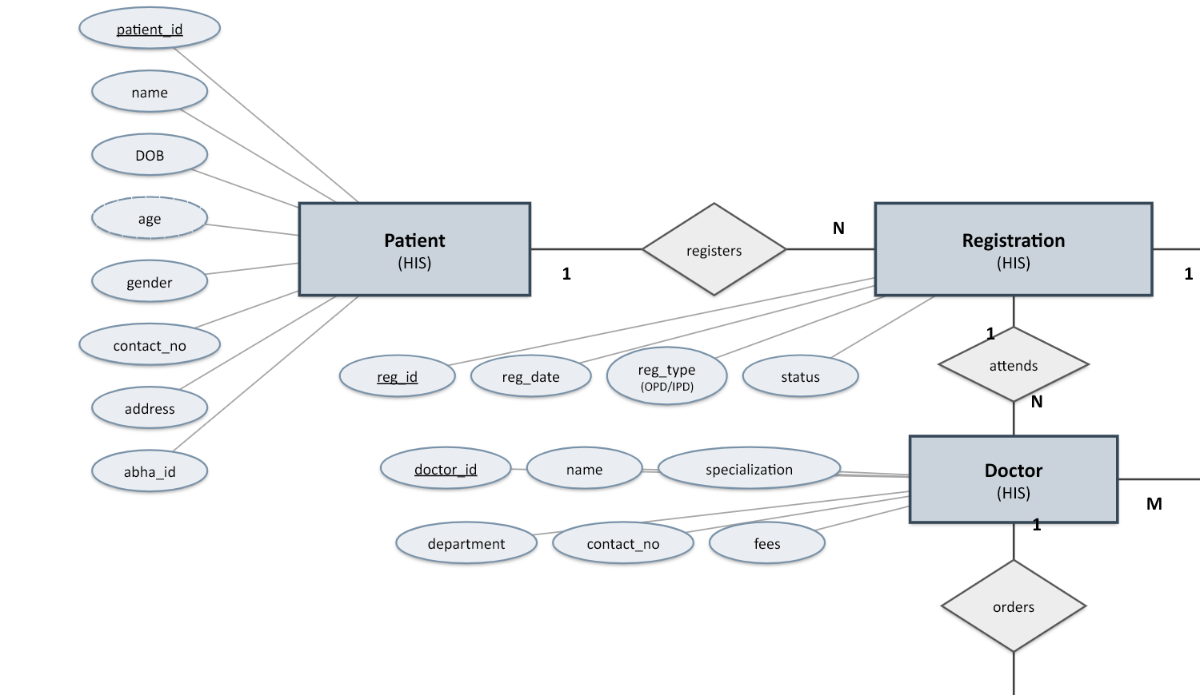
SYSTEM DESIGN & ARCHITECTURE
ER detail: patient and registration
One patient can have many registrations. Each registration connects to the doctor and later bill.
DH 308 / HIS billing
14

Slide 15
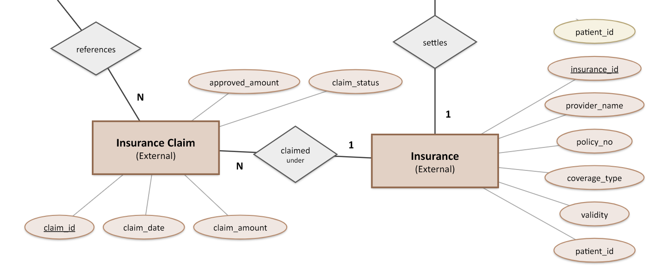
SYSTEM DESIGN & ARCHITECTURE
ER detail: claim and insurance
A claim records its approved amount and status; it belongs to an insurer. The full diagram links it back to a bill.
DH 308 / HIS billing
15

Slide 16
PROTOTYPE ASSUMPTIONS
What our demo assumes
01
Hospital size
The working scope represents a 20 to 50 bed hospital.
02
Patient records
All patients, prices, identifiers and clinical notes are invented.
03
External systems
Lab events are local API calls. TPA and PM-JAY replies are simulated.
04
GST master
Training rates illustrate rules. A real hospital must verify product HSN and current tariff.
05
Diagram scope
The Chen diagram is broader than the demo. RIS and wider LIS links remain conceptual.
DH 308 / HIS billing
16

Slide 17
TECHNICAL IMPLEMENTATION
Prototype implementation
01
02
03
Next.js
FastAPI
PostgreSQL
Role screens for doctor, lab, pharmacy and billing.
Validates orders, results, dispensing and billing.
Links encounters, orders, charges and receipts.
Core API calls
POST /api/clinical/demo-encounters
doctor confirms mapped case
POST /api/lab/orders/{id}/complete
result plus one lab charge
POST /api/pharmacy/dispense
stock plus charge
POST /api/invoices
one final bill
POST /api/claims
payer submission
POST /api/receipts
money received
DH 308 / HIS billing
17

Slide 18
TECHNICAL IMPLEMENTATION
Backend rules that prevent common errors
01
Doctor
Confirms the pathway; diagnosis code comes from the selected case, not free text.
02
Lab
A completed order posts one charge. A repeated result does not add another.
03
Pharmacy
A dispense needs a prescription and available unexpired batch stock.
04
Invoice
The system copies charge details into invoice lines and locks the encounter.
05
Receipt
A claim approval does not settle the bill. A receipt reduces the balance.
DH 308 / HIS billing
18

Slide 19
DATA FLOW & INTEGRATION
OPD example: Asha Kulkarni
One invented follow-up visit shows how completed work becomes a bill.
01
Doctor
Confirms ICD-10 E11.9; consultation ₹500
02
Lab
HbA1c result, LOINC 4548-4; test ₹650
03
Pharmacy
10 training tablets × ₹6; GST ₹3
04
Invoice
₹500 + ₹650 + ₹60 + ₹3 = ₹1,213
CPT 83036 is an optional reference. HBA1C is the hospital code that sets the lab price.
DH 308 / HIS billing
19

Slide 20
DATA FLOW & INTEGRATION
IPD insurance and PM-JAY flows
Private TPA
PM-JAY
01
Coverage and payer rate linked to encounter
01
Beneficiary check is simulated
02
Preauthorisation and approved limit recorded
02
Training HBP package linked to encounter
03
Daily room, procedure and medicine charges accumulate
03
Preauthorisation is recorded
04
ICD-10, procedure code and documents join the claim
04
Package invoice and claim are prepared
05
Insurer receipt reduces the outstanding balance
05
Patient collection is blocked in the demo
NHA HBP manual and IRDAI health insurance guidance informed the state sequence. Portal responses remain simulated.
DH 308 / HIS billing
20

Slide 21
DATA FLOW & INTEGRATION
Finance outputs after invoicing
The invoice records the amount due. Claims and receipts determine who still owes it.
01
GSTR-1 review
Separates taxable B2B, taxable B2C and exempt or nil supplies. Includes HSN summary.
02
Insurance receivable
Tracks submitted claims, partial settlement and remaining insurer balance.
03
Patient balance
Records advances and receipts separately from the total invoice.
04
Daily report
Shows collections and payer mix from posted records.
The GSTR-1 screen is a review packet for this prototype. It does not file or upload a return to the GST portal.
DH 308 / HIS billing
21

Slide 22
RESULTS & PROTOTYPE DEMO
Prototype coverage
The live demo follows Asha’s encounter across four staff roles.
01
Doctor
Encounter, diagnosis, consultation charge and orders
02
Lab
HbA1c result with LOINC 4548-4 and completed-test charge
03
Pharmacy
Prescription, batch and expiry check, tax on separate sale
04
Billing
Running account and itemised OPD invoice
05
IPD
Room stay, running account and discharge bill
06
Insurance
Preauthorisation, claim and settlement ledger
07
PM-JAY
Simulated eligibility, package and zero patient collection
08
Finance
GSTR-1 review and aged receivables
Local API and browser flows were exercised with synthetic cases. External HIS and government or insurer portals remain simulated.
DH 308 / HIS billing
22

Slide 23
RESULTS & PROTOTYPE DEMO
What is still a prototype
01
No real portal exchange
Insurer, PM-JAY, CGHS and GST outputs use local simulation.
02
Training master data
The items, HSN, tariff and package examples need hospital review before use.
03
Classroom sign-in
Production needs staff identity, audit policy, security and backups.
04
Limited departments
The website has one local lab test. RIS and wider LIS integration remain future work.
DH 308 / HIS billing
23

Slide 24
CONCLUSION & FUTURE SCOPE
Conclusion and next build
The prototype shows how clinical work can produce a clear, itemised bill without retyping every charge.
Next for a mid-sized hospital
01
02
03
More departments
More payer detail
Production controls
Extend the lab catalog and connect radiology and theatre results.
Add named TPA formats, CGHS and corporate review screens.
Use approved portal links, stronger login, backups and tested tax masters.
DH 308 / HIS billing
24

Slide 25
REFERENCES
References
Supplied bills
GST Council
19 KIMS and Apollo scanned pages; only de-identified crops appear in this deck.
2025 medicine rates FAQ, gstcouncil.gov.in/sites/default/files/2025-09/faq_0.pdf
DH 308 lectures
CBIC
ER modelling, ICD-10 and LOINC, HL7 and healthcare database standards.
GST service rate entry 31A and healthcare exemption, cbic-gst.gov.in
MoHFW
GST Council
Patients’ Rights Charter, clinicalestablishments.mohfw.gov.in
Hospital inpatient composite supply AAR, gstcouncil.gov.in
MoHFW
GST portal
EHR standards for India: ICD, LOINC and optional licensed CPT mapping.
GSTR-1 tables and HSN summary, tutorial.gst.gov.in
WHO
IRDAI
ICD-10 E11.9 example, icd.who.int/browse10/Content/statichtml/ICD10Volume2_en_2019.pdf
FAQs on health insurance regulations, irdai.gov.in
LOINC
NHA
HbA1c blood observation 4548-4, loinc.org/4548-4
PM-JAY Health Benefit Package 2.2 manual, nha.gov.in
HL7 FHIR R4
ChargeItem and Invoice resources, hl7.org/fhir/R4
DH 308 / HIS billing
25

