Slide 1
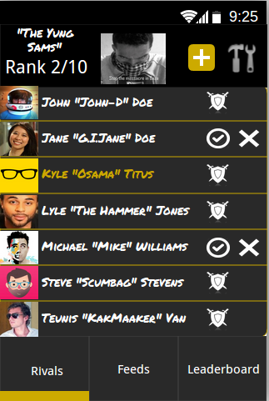
LeaderBoard
Life's a game, so who's winning?

Slide 2
What is LeaderBoard

