Slide 1
DoctorAid
BPMN Diagram
Presented by-
Syed Jarullah Hisham(1805004)
Group 2(A1)

Slide 2
Group Members
1805002 - A. H. M. Osama Haque
1805004 - Syed Jarullah Hisham
1805006 - Tanjeem Azwad Zaman
1805008 - Abdur Rafi
1805019 - Md. Rownak Zahan Ratul
1805030- Md Toki Tahmid

Slide 3
BPMN Diagram

Slide 4
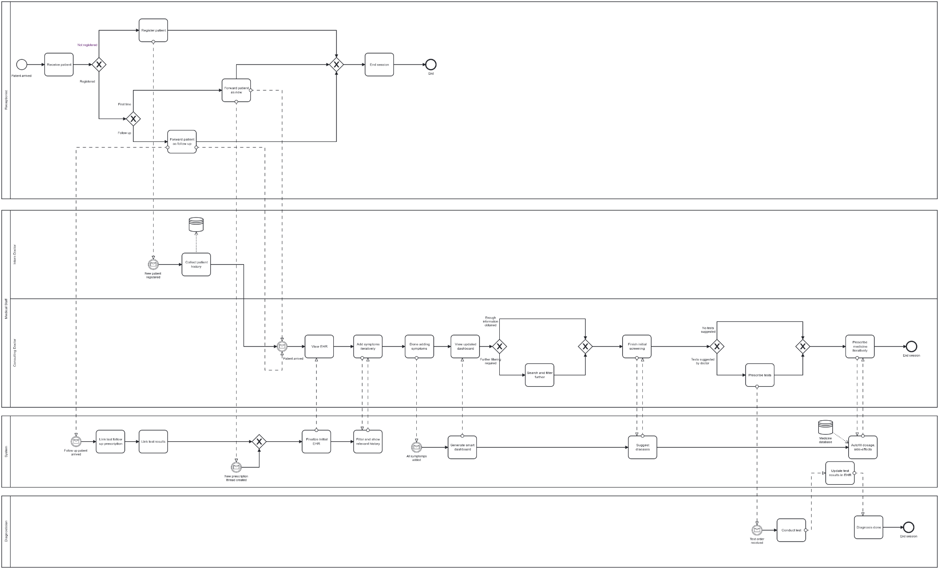

Slide 5
Pools & Lanes
Receptionist
Medical Staff
Intern doctor
Consulting doctor
System
Diagnostician

Slide 6
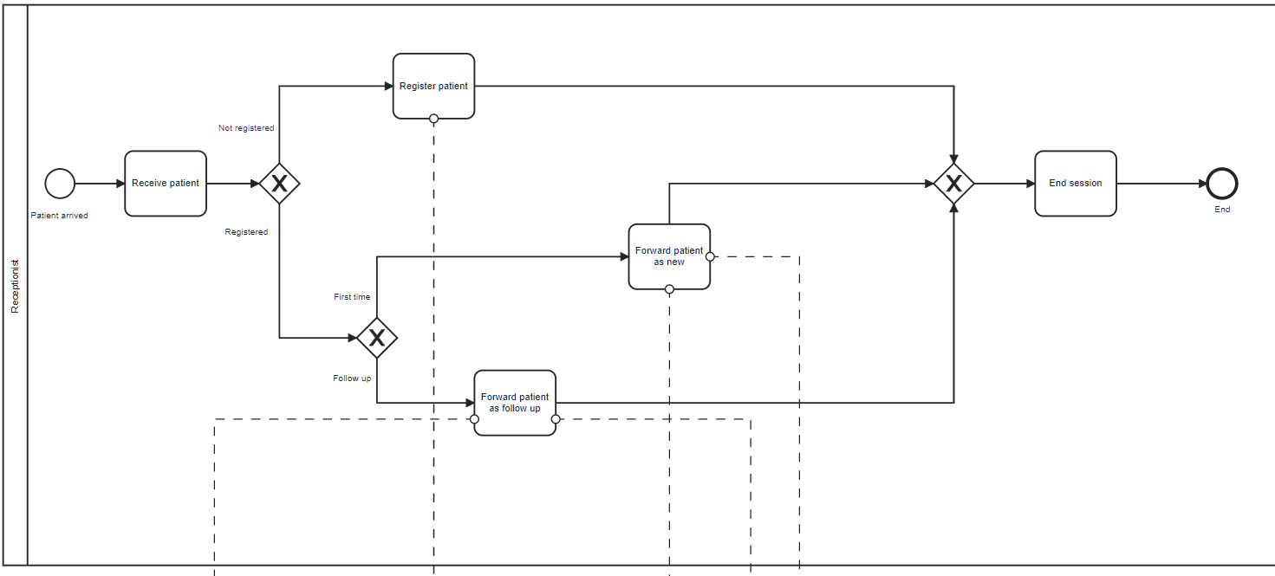
Receptionist Pool

Slide 7
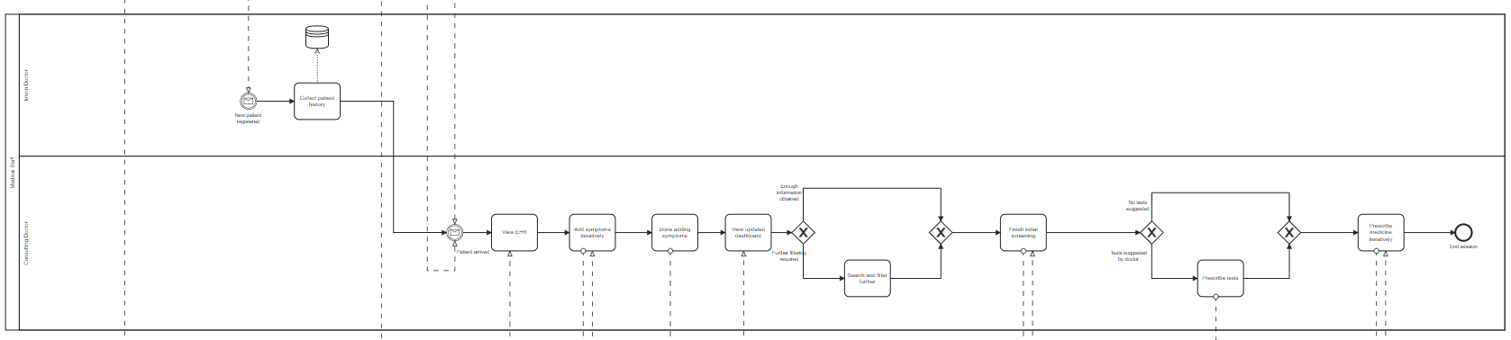
Medical Staff Pool

Slide 8
System Pool

Slide 9
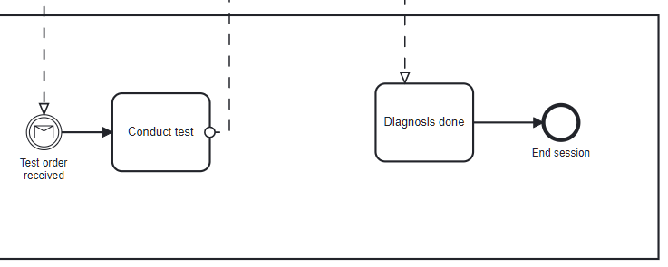
Diagnostician Pool

Slide 10
Thank You!

