Slide 1

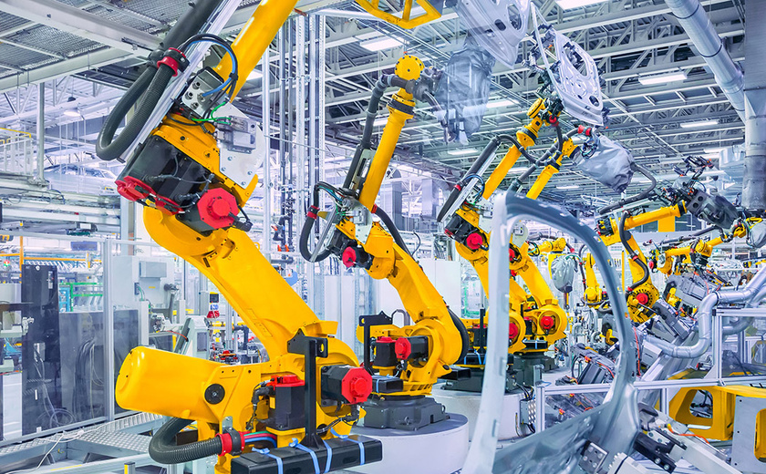
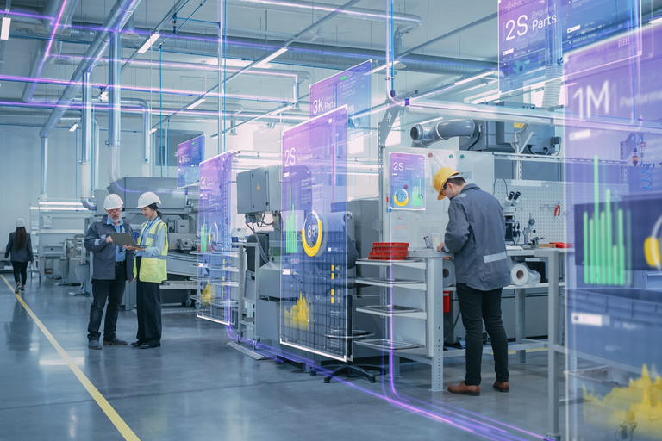
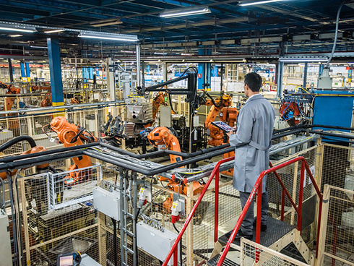



AI Solutions for Smarter Manufacturing Operations
An AI/ML-Based Approach
Prepared by: Usama Abid

Slide 2

Introduction
What Were the Key Challenges?
Manual QC evaluation was slow and inconsistent, delaying batch decisions
Operators lacked real-time visibility into equipment and batch progress
No centralized system to monitor equipment utilization or idle time
Difficulty in identifying bottlenecks, stuck equipment, or underutilized resources
What Business Problems Did I Solve and How?
What was my solution?
Built an ML model to automate QC pass/fail classification with high accuracy
Deployed the model via API for real-time usage
Created a live dashboard to visualize:
Equipment status (active, idle, stuck)
Batch progress (start time, stage, end time)
Utilization metrics (daily, weekly, monthly)
Focused on increasing throughput, reducing delays, and enabling real-time operational visibility.

Slide 3

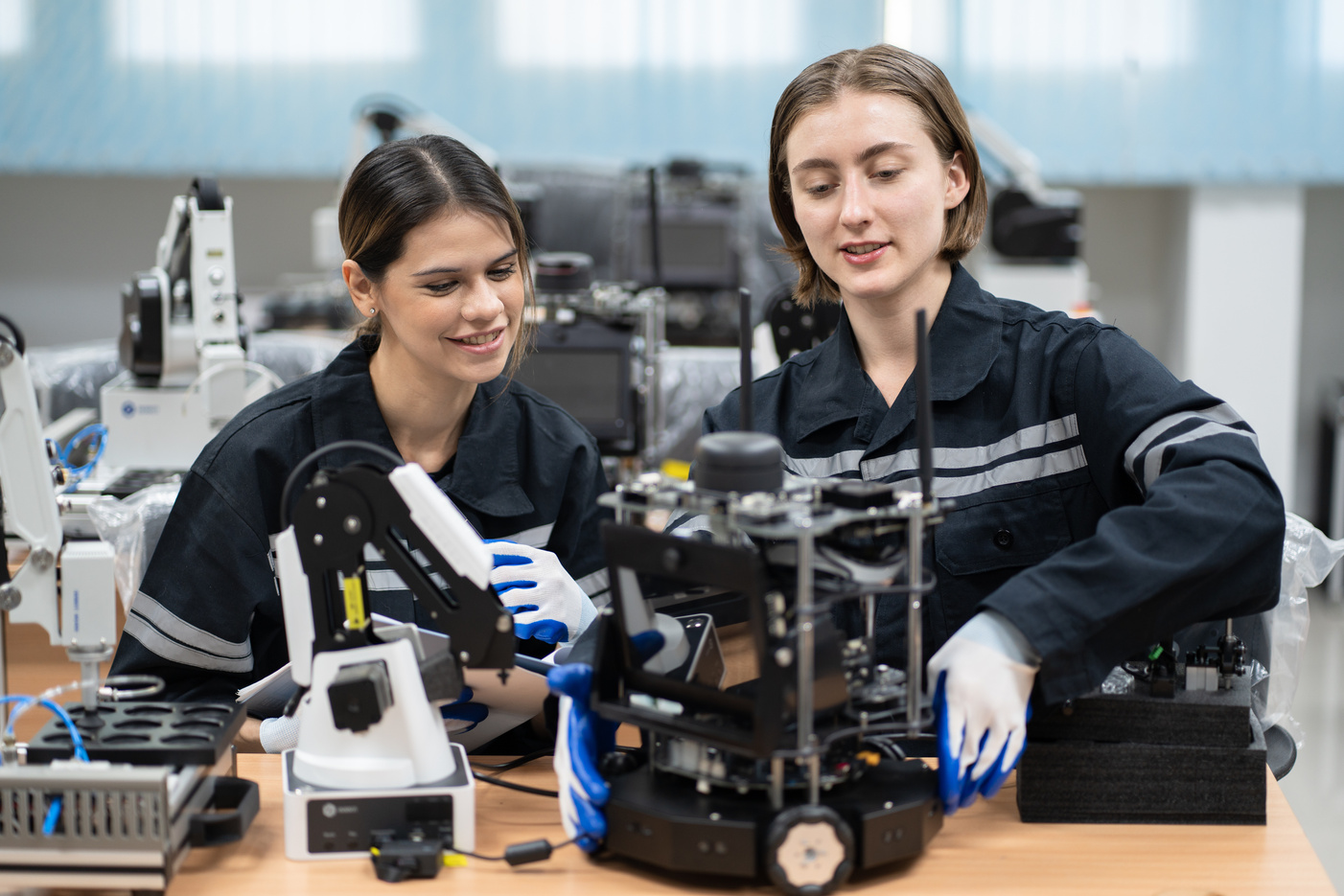
AI-Powered QC Evaluation
API Integration
Handling False Positive
Speed with Safety
Built and deployed a machine learning model to classify QC test results as pass/fail
Created an API to integrate model into live production
Implemented threshold tuning and fallback review for false positive handling
Enabled faster decisions while preserving manual oversight for critical checks
Impact
31% reduction in turnaround time
→ Increased daily output from 6–7 to 9–10 batches
85%+ model accuracy
Manual QC still involved for cross-verification, but operators can now:
Send batches forward based on model output
Stop batches immediately if manual review later identifies issues
AI-Powered QC Evaluation

Slide 4
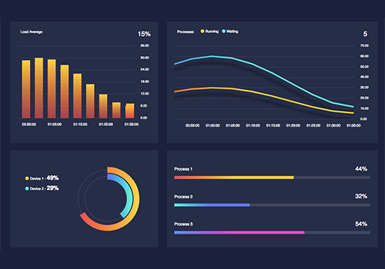
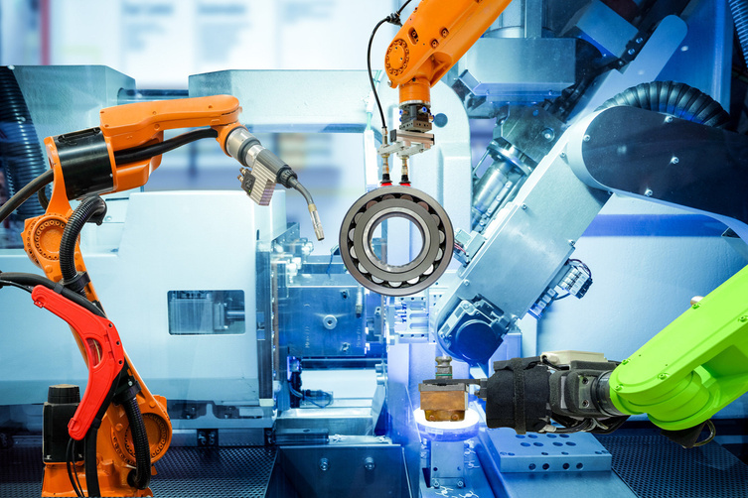
Dashboard Features
User-Centric Design
Time-Frame Analysis
From Data to Action
Built a real-time dashboard with bar and bubble charts to visualize:
Equipment status (in use, idle, or stuck)
Batch timeline: start time, process stage, end time
Designed for Operations Managers at the site level
Included utilization percentages across:
Daily, Weekly, and Monthly views
Turned operational data into actionable insights directly on the production floor
Impact
Improved response time for stuck or idle equipment
Enabled live batch tracking for better scheduling and traceability
Provided data-driven decision support at a glance
Equipment Utilization Dashboard for Operations

Slide 5
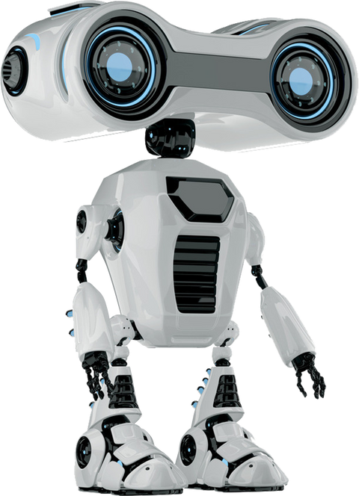

Thank You
Predicting the future isn’t magic — it’s machine learning.
Don’t just explore models — build them, question them, improve them.
Start small, stay curious, and grow with every dataset.
Whether you’re optimizing business decisions or advancing research, your journey in ML can shape how the world understands data.

