Slide 1

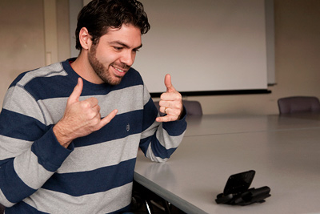
Unheard Voices App
Contact your world easily
Dr. Nora Nizy
Eng. Ahmed Fouad

Slide 2
Team Members:
Members | Role
Khalid Mohamed Nigm (Team Leader) | machine learning engineer & flutter developer
Amr Sabry Mohamed Albary | flutter developer
Osama Gamal Hamed Ramadan | flutter developer

Slide 3

Introduction
In a world that heavily relies on verbal communication, individuals who are deaf or mute often face significant barriers in expressing themselves and connecting with others. However, with the revolutionary Unheard Voices app, we aim to break down these barriers and enable seamless communication for the deaf and mute community.

Slide 4
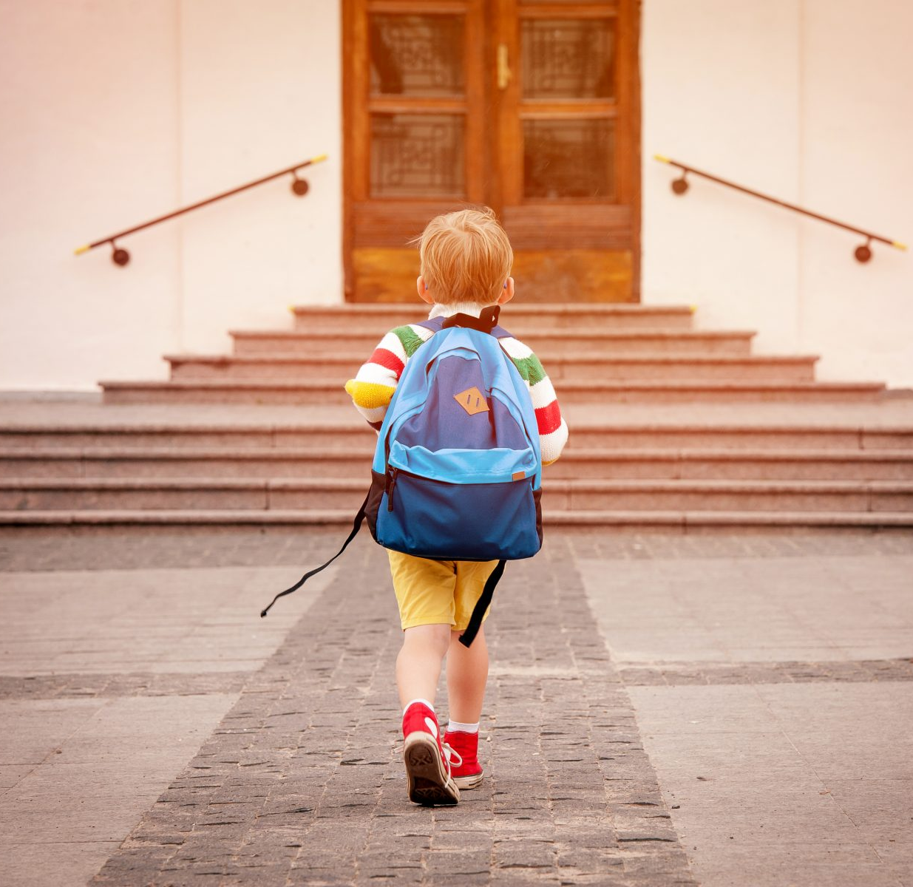
Problem Definition:
The issue at hand is the limited educational opportunities and challenges faced by students who are deaf and dumb or have hearing and speech disabilities. These students struggle to access quality education due to various barriers that impede their learning and development.
So Deaf People must attend special schools to give them the particular education and support they need to succeed.

Slide 5
How Many People Are Deaf?
About two to four of every 1,000 people in the U.S. are “functionally deaf,” with the majority of them aged 65 years or older. More than 70 million people worldwide are deaf, with more than 80% of them residing in developing countries.
According to the World Health Organization (WHO), more than 1.5 billion people, or nearly 20% of the global population, live with hearing loss, and 430 million of them have disabling hearing loss.
It is estimated that by 2050, over 700 million people, or 1 in every 10 people, will have disabling hearing loss

Slide 6
Source
WHO
© Statista2023

Slide 7
Solution Approach:
Develop a mobile app that uses machine learning to translate speech to sign language and vice versa. The app should be easy to use for both deaf and hearing people,
Collect a large dataset of sign language videos and corresponding text transcripts.
2.Use the dataset to train a machine learning model to recognize and translate sign language.
3.Develop a mobile app with a user interface that is easy to use for both deaf and hearing people.
4.Integrate the machine learning model into the app so that it can translate speech to sign language and vice versa in real time.
5.Test the app with deaf users to ensure that it is accurate and user-friendly.

Slide 8
Objective:
This objective is comprehensive and addresses the key challenges faced by deaf people in education, and it has the potential to make a real difference in the lives of deaf people,
Provide deaf students with a platform to connect with each other and with hearing students, so that they can build a supportive community and learn from each other,
Provide real-time translation of spoken language into sign language and vice versa, so that deaf students can fully participate in class discussions and activities.

Slide 9
Plan:

