Slide 1

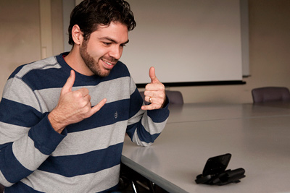
Unheard Voices
Communicate with the world without barriers​​
Dr. Nora Niazy
Eng. Ahmed Fouad

Slide 2
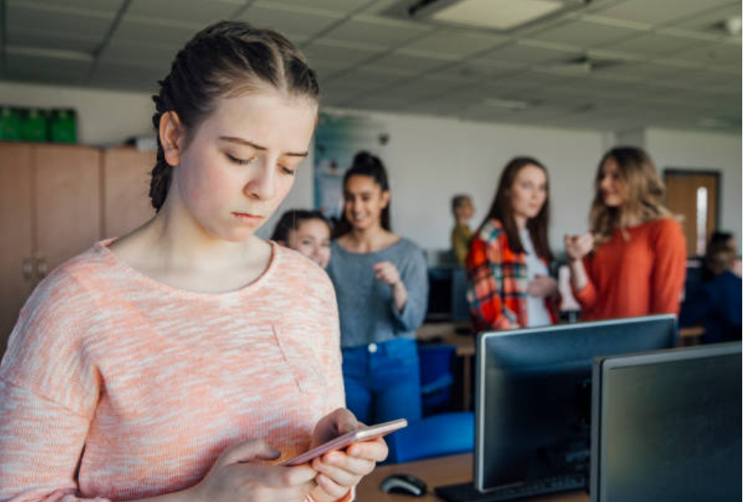
Overview of project
Deaf and dumb people face different problems in dealing with ordinary people and their lives in general.
These problems include the following:
Difficulty in communication: Communication between humans depends mainly on speech and sound, and since deaf and dumb people cannot hear, they depend on other means of communication, such as sign language or writing.
Discrimination: Deaf and dumb people may be subject to discrimination by ordinary people, and may have difficulty obtaining employment, education, entertainment, and health care opportunities.
Lack of understanding: Lay people may not understand the needs of deaf and dumb people, and may behave in an insensitive or hurtful way.

Slide 3

Below are some specific examples of problems that deaf and mute people may face in public colleges and universities in Egypt:
Deaf and dumb students may have difficulty following speech-based lectures.
Deaf and dumb students may not be able to communicate with professors and other students.
Deaf and dumb students may have difficulty participating in extracurricular activities.
الكليات المتاحة للطلاب الصم والبكم فى مصر هى كلية التربية النوعية وكلية الاقتصاد المنزلى فقط، وذلك وفقاً للمادة الثانية عشر بالقرار الوزاری رقم ٢٥٥٥ لسنة ۲٠٢٠

Slide 4
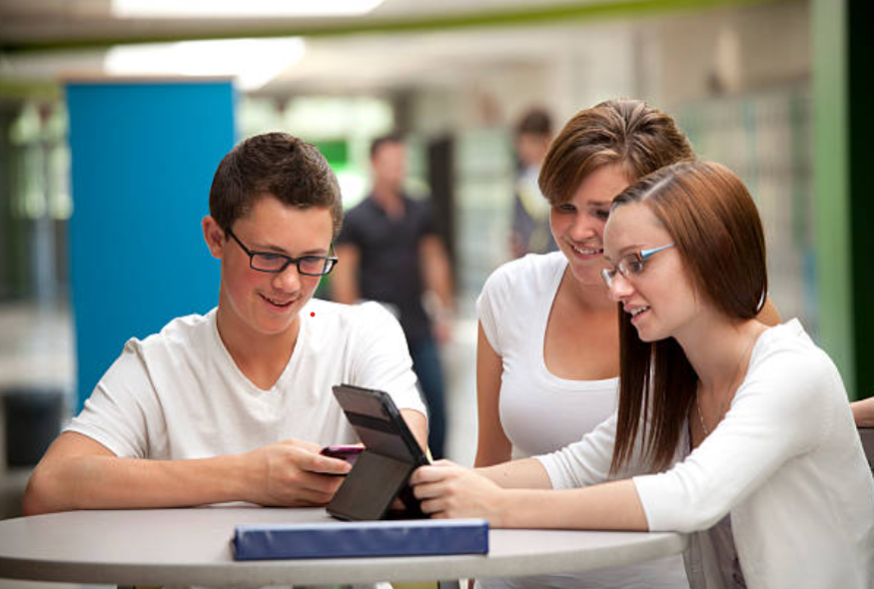
What problem does the graduation project solve?
Create an app that helps and facilitates communication between deaf and dumb people and normal people throughout the day.
The application also aims to help deaf and dumb people in education.
The application works by converting speech to sign language and vice versa, and will have a special section for learning sign language for those who are not proficient in sign language.
The goal of this application is to help deaf and dumb people realize their dreams and gain equality with natural persons.

Slide 5



What are the tools used to implement the project?
Mobile Application
Web Application
Machine Learning

Slide 7
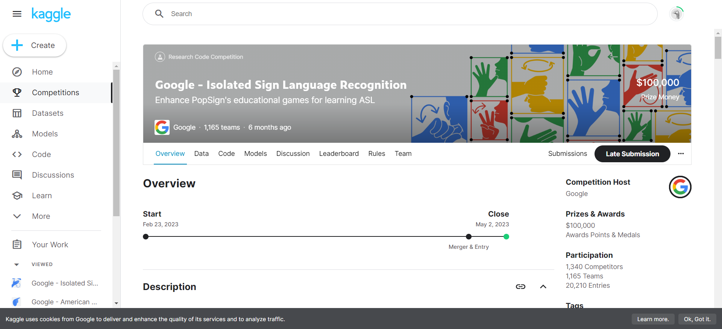

Slide 8
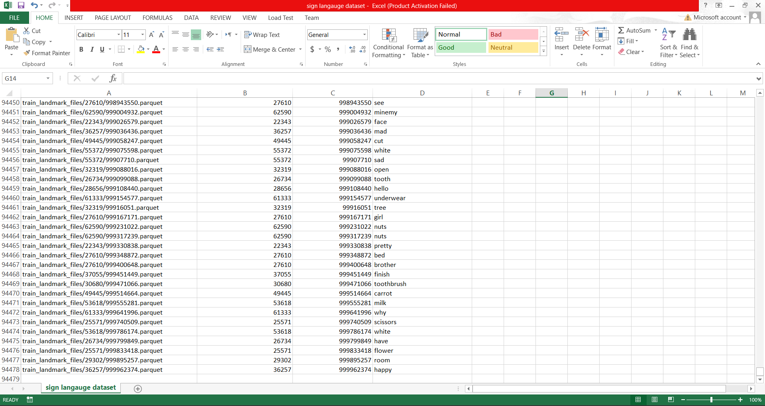

Slide 10
ASL Model detection
Recurrent Neural Networks (RNNs) are a class of neural networks designed to work with sequential data.
Here are some examples of sequential data:
Video Data:
Frames in a video sequence.
Motion capture data.

Slide 11
LSTM stands for Long Short-Term Memory, and it is a type of recurrent neural network (RNN) architecture.
LSTM networks contain special units called memory cells, which can store information for long durations of time. Making them well-suited for learning from sequences of data.
Applications of LSTM networks include:
Time series prediction and forecasting tasks like stock price prediction and weather forecasting.
Speech recognition and synthesis.
Handwriting recognition.
Gesture recognition in sign language.

Slide 12
Less Data Required
Faster To Train
Faster Detections
Real-Time Processing
Robustness to Noise and Variability
Adaptability and Flexibility
Overall, using LSTM networks for sign language recognition offers the potential to develop robust, accurate, and real-time systems for facilitating communication and interaction between hearing-impaired individuals and the rest of society.

Slide 13
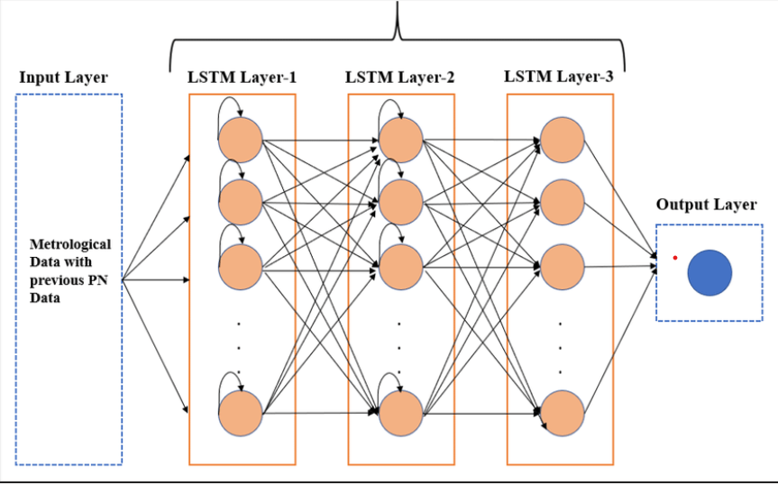
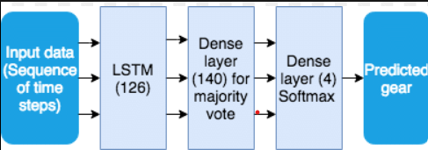

Slide 14
A Dense layer, also known as a fully connected layer, It is called "dense" because every neuron in a Dense layer is connected to every neuron in the preceding layer.
Feature Extraction and Aggregation:
The LSTM layers extract temporal features from the sequential input data, capturing patterns and dependencies between signs in sign language.
However, the output of the LSTM layers may be high-dimensional and complex.
The Dense layer(s) following the LSTM layers help to further process and aggregate these features, summarizing the information learned by the LSTM layers into a more compact representation.

Slide 15
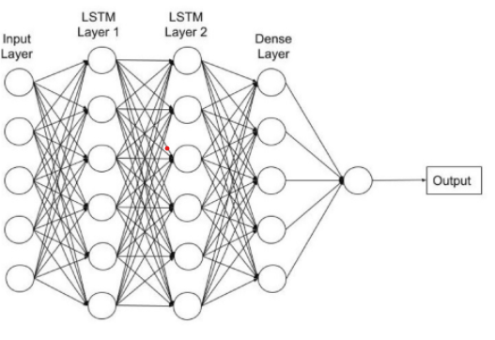
Regularization:
Dense layers can act as a form of regularization by preventing overfitting and improving the generalization ability of the model.
Final Classification:
The Dense layer(s) culminate in the output layer, which performs the final classification of sign language gestures.

