Slide 1

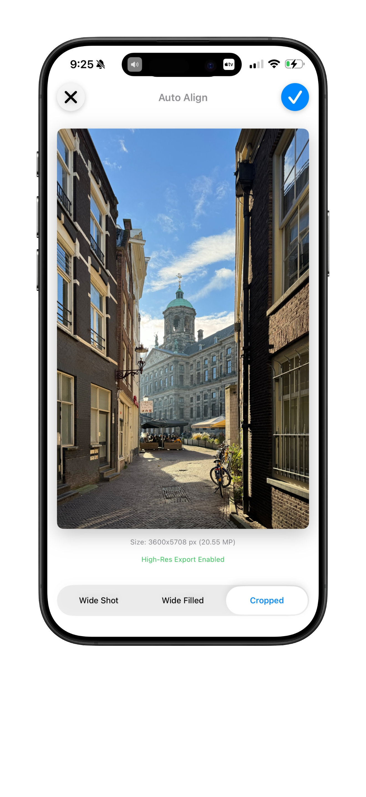
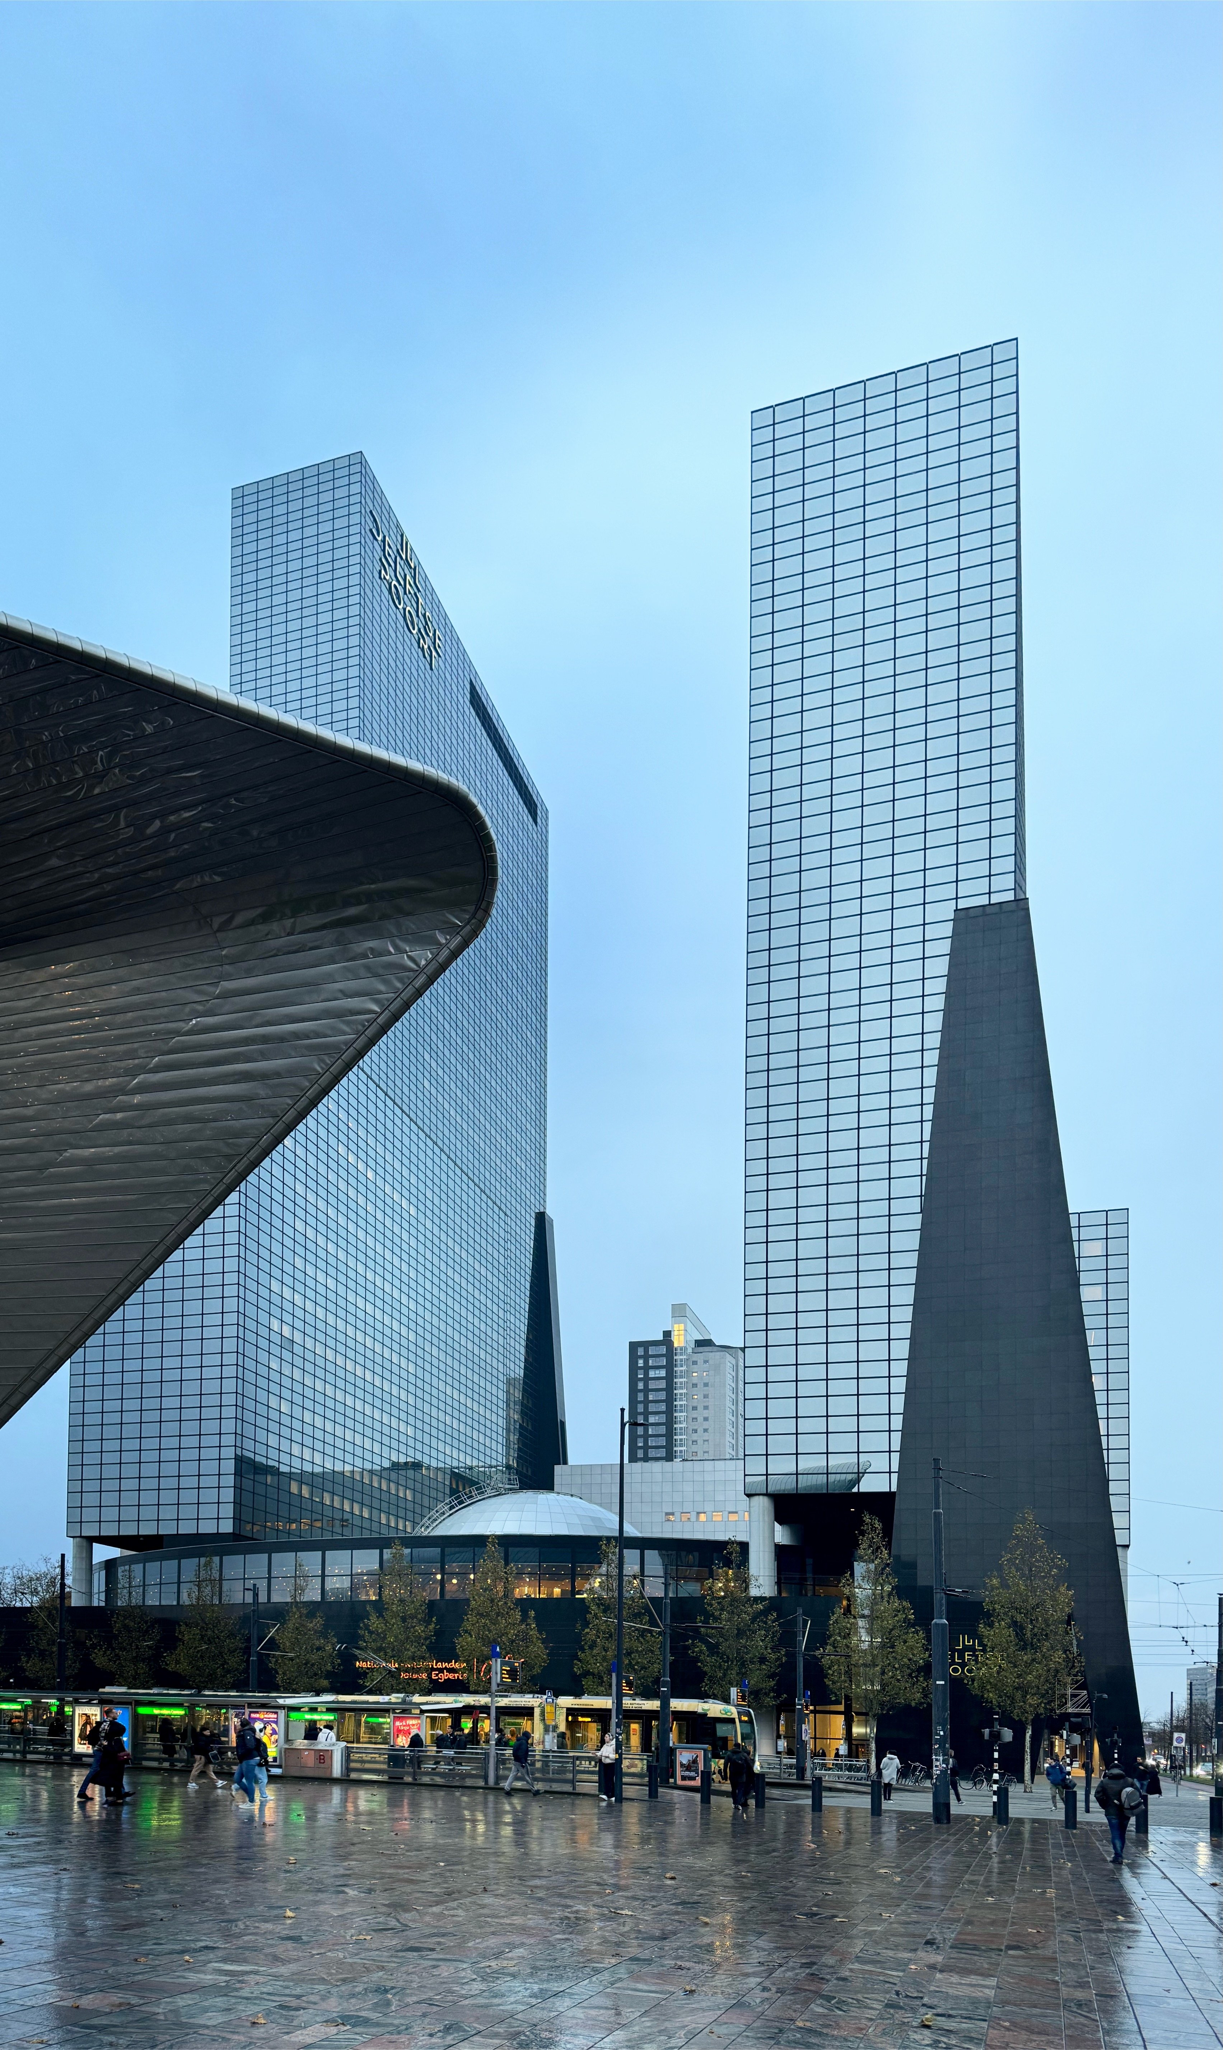
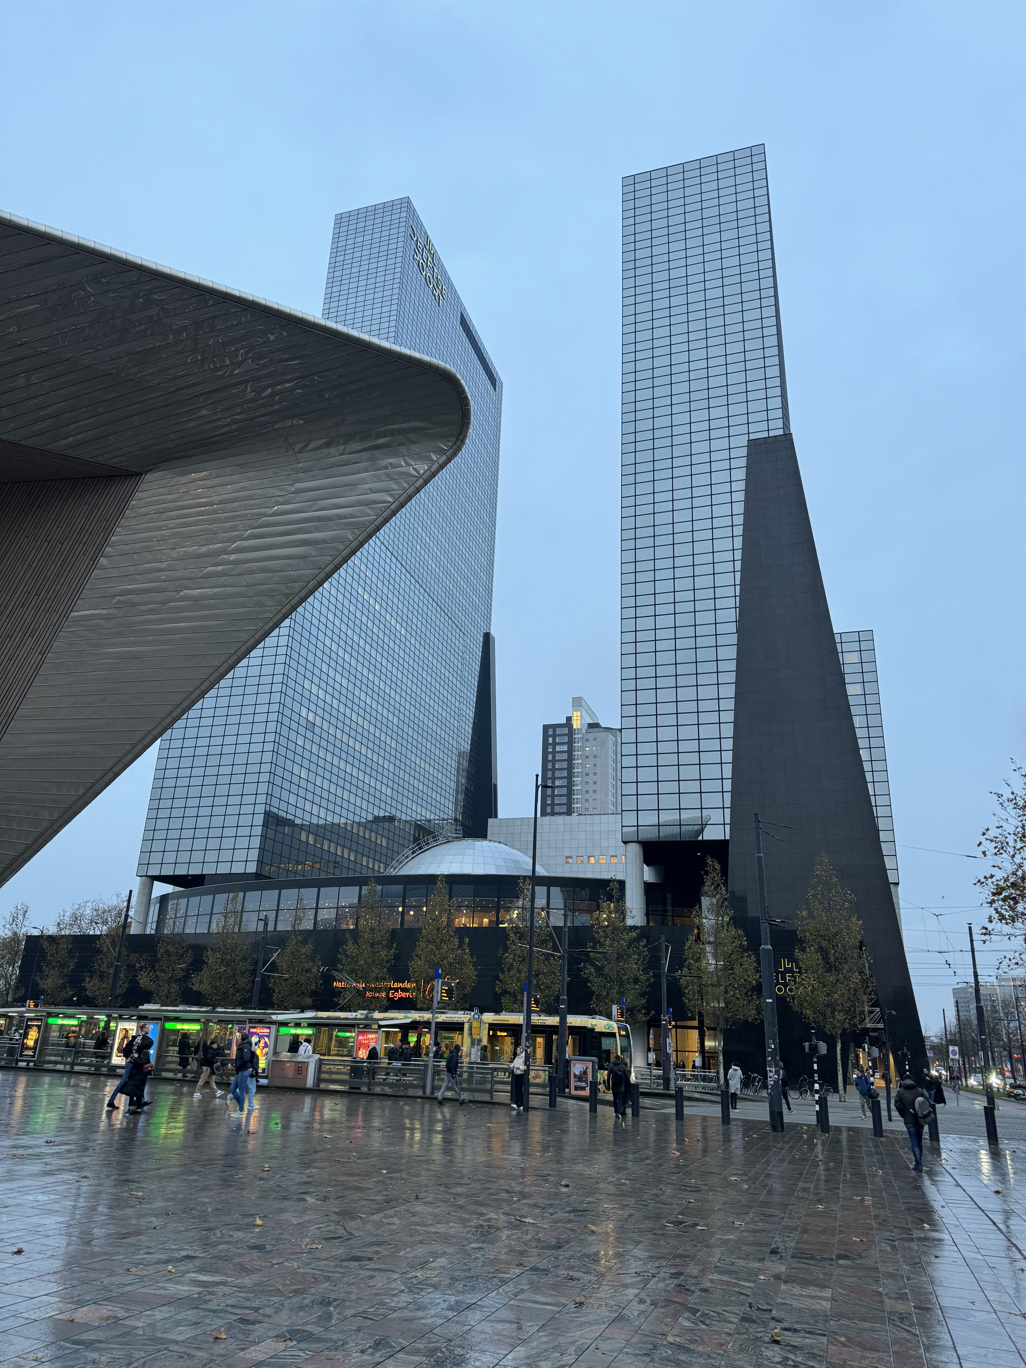




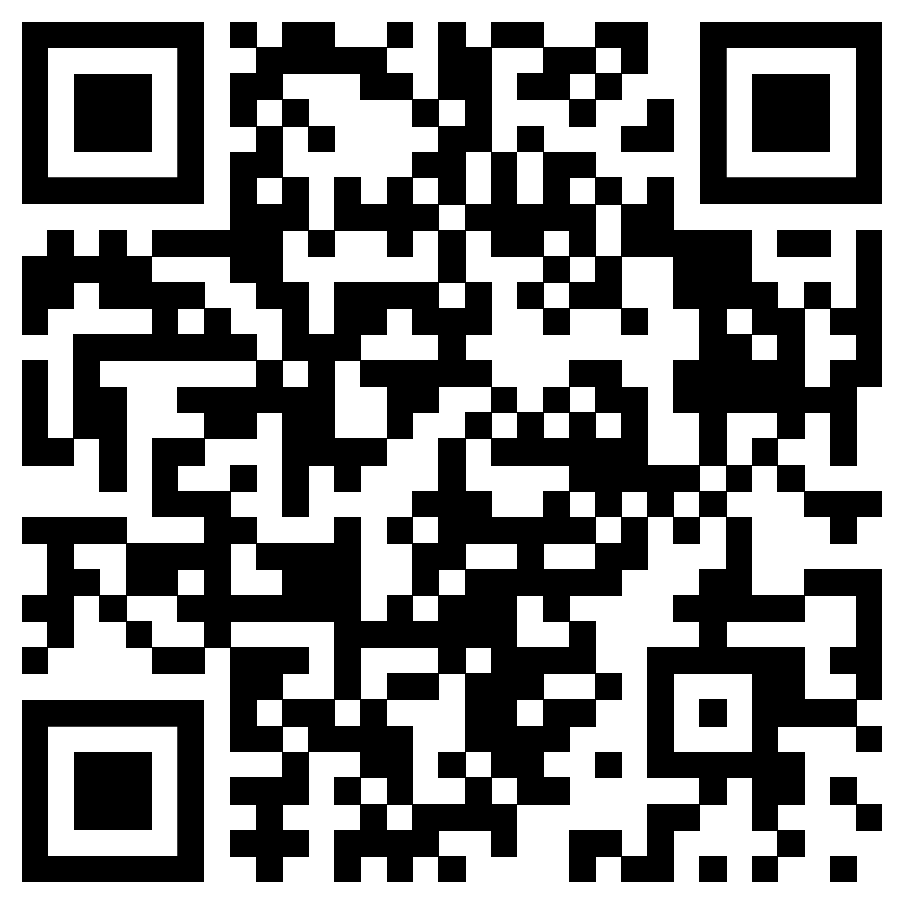
Download_on_the_App_Store_Badge_US-UK_wht_092917.eps
Modern Sleek UI
Automatically Straighten Tilted Urban Photos
Instantly corrects perspective distortion for images of buildings and urban scenes
Auto Align
Detect Urban Structures
Automatically detect urban structure for alignment
Intuitive Modern UI for both iPhone and iPad
Seamless Integration
Works directly within Photos App for quick edits
www.orbitaar.com

