Slide 1
CAM – content-addressable memory
ENCS3330 Project
Osama Rihami – 1190560, Abdallah Alabed - 1190781

Slide 2
Introduction
content-addressable memory (CAM) is a special type of computer memory used in certain very-high-speed searching applications.
its beneficial in a variety of applications that require high-speed lookup table. It is used mostly in low power CPU design, network routers, and cache controllers.

Slide 3
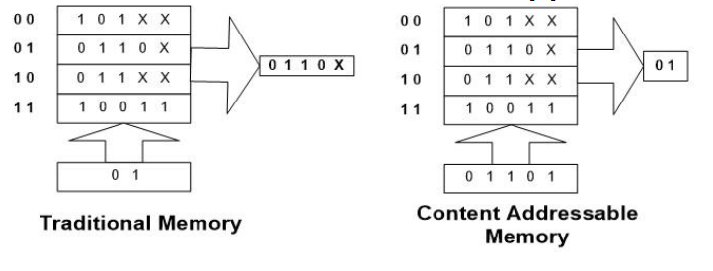
Theory
In Random Access Memory (RAM) system, a memory address is sent to the RAM module to retrieve or read the contents stored at the target memory address.
However in a CAM ,a data is sent to the module to retrieve target memory address where the input searched data match the stored data.

Slide 4
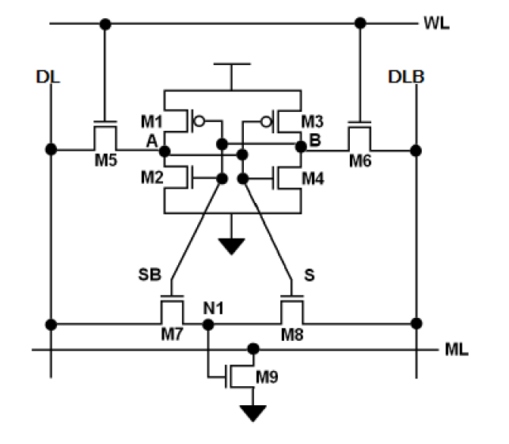
Theory
CAM is constructed from 9-Transistor SRAM cells which is used basically to store the data.
And each cell contains a compare circuit which compares the data stored in the 9T-SRAM with the searched data.
When there is a match we get a high value (1),and low value (0) otherwise

Slide 5
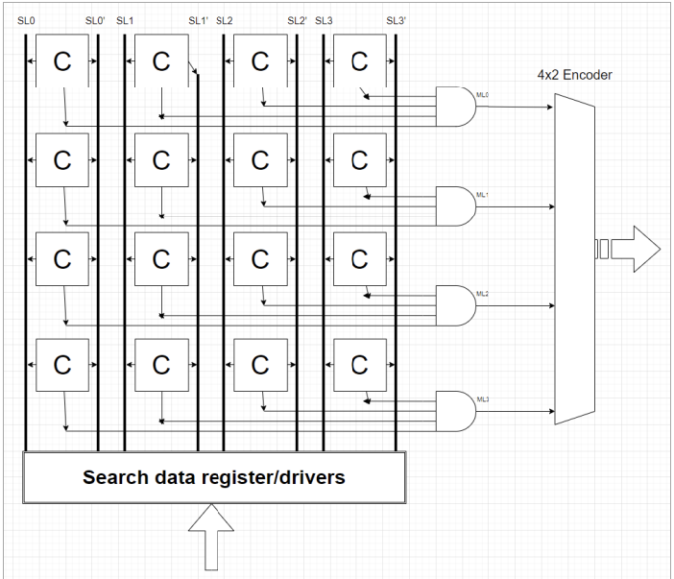
Theory
A 4*4 CAM is constructed from 16 cells.
Each row contains 4 cells , and the output from each cell is connected to 4-input AND gate at the end of each line.
If one row matched the searched data line ,the output of the AND gate will be high (1),and low (0) otherwise.

Slide 6
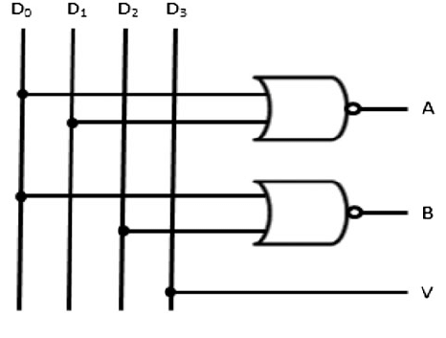
Theory
All the AND gates are connected to 4*2 encoder.
The output of the encoder is the memory address where the searched data is stored .
Note that any two rows cant have the same values , each row should have a unique value.

Slide 7
Procedure
First we draw all the schematics using Spice tool.
Then we draw the layouts using Microwind tool using 22nm technology.

Slide 8
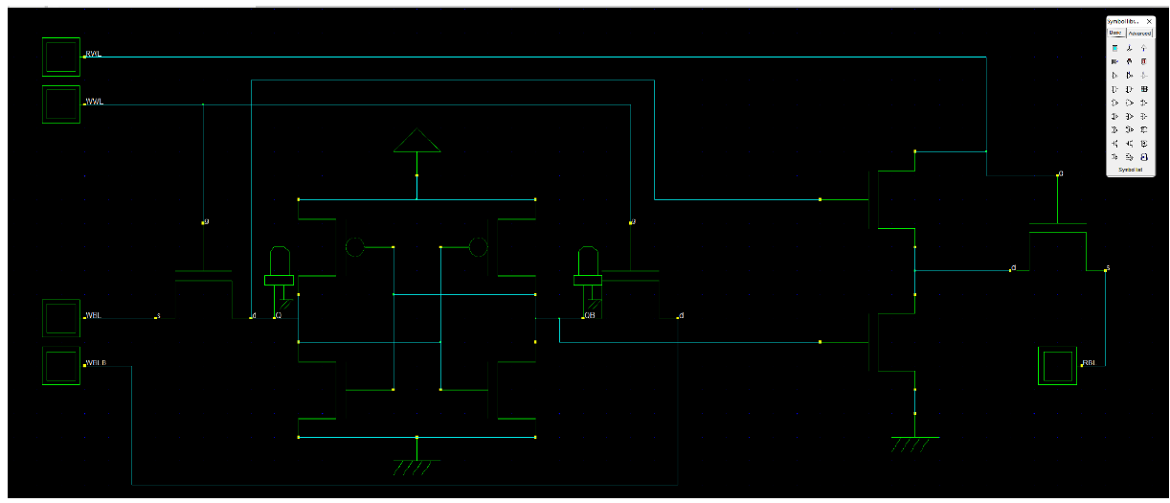
Procedure
9T-SRAM spice design

Slide 9
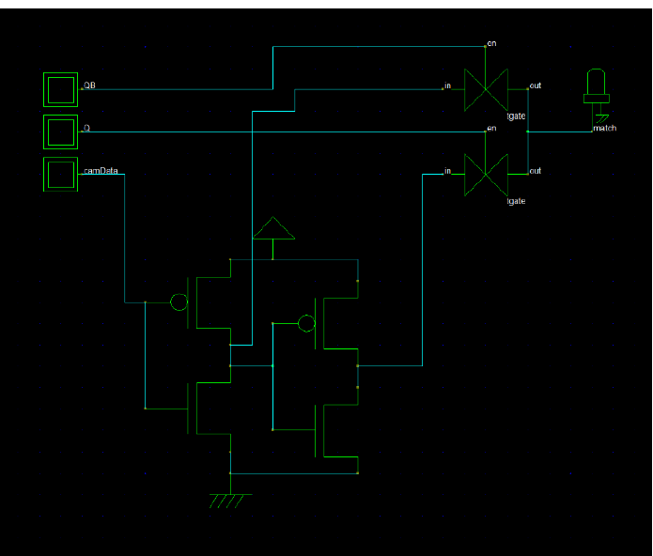
Procedure
compare circuit spice design

Slide 10
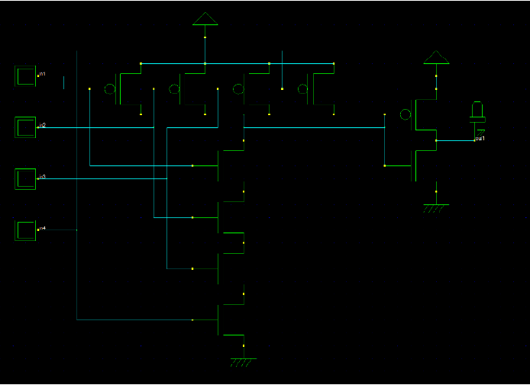
Procedure
4-input AND gate spice design

Slide 11
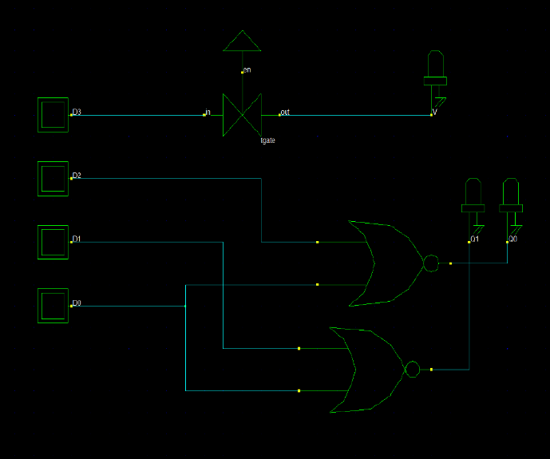
Procedure
4*2 encoder spice design

Slide 12
Procedure
4*2 encoder spice design

Slide 13
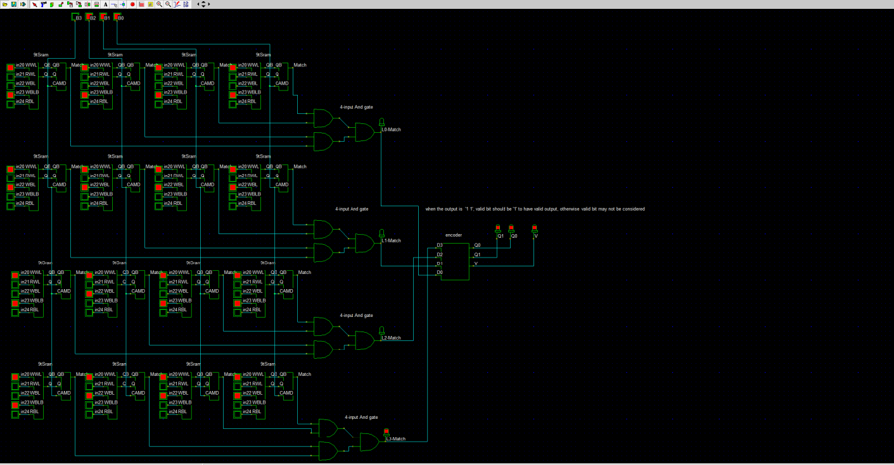
Procedure
CAM spice design

Slide 14
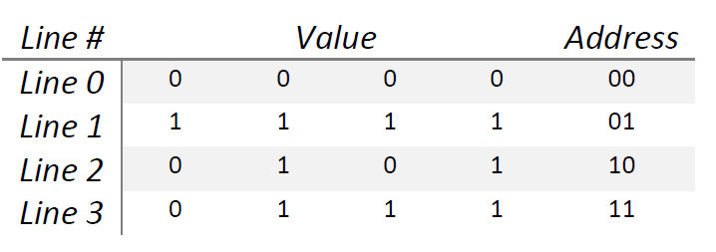
Simulation
we will search for 0101
The data stored in the CAM:
So the output should be 10 .

Slide 15
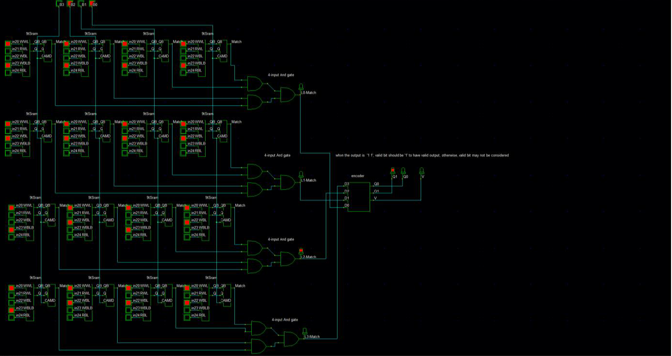
Simulation
Spice simulation:

Slide 16
LAYOUT and simulation

Slide 17
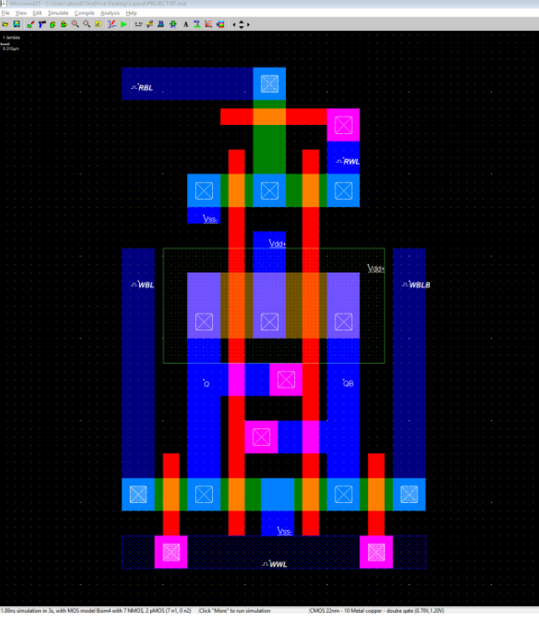
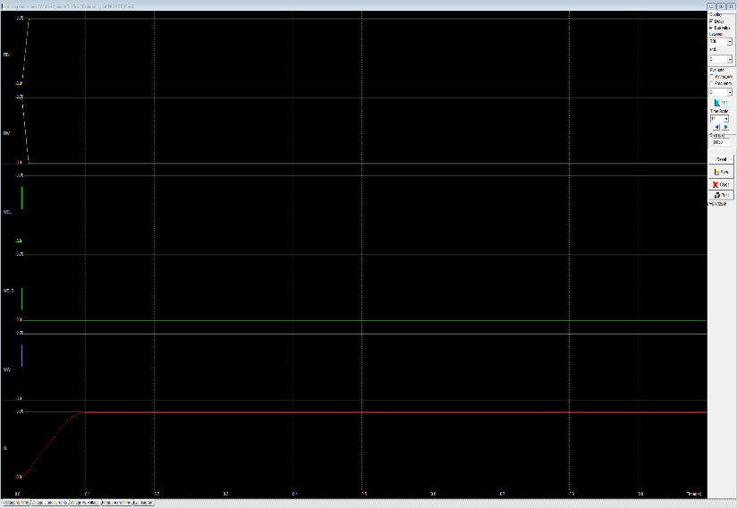
LAYOUT and simulation
9T-SRAM layout and simulation

Slide 18
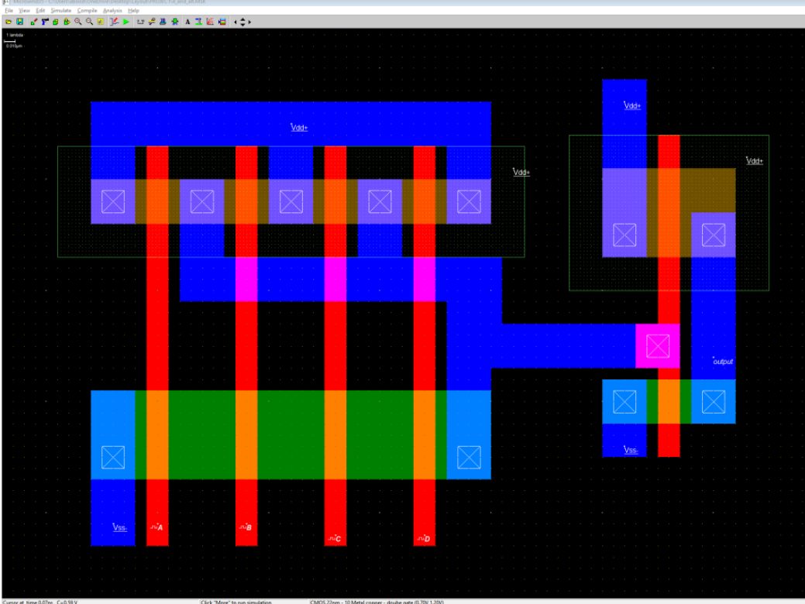
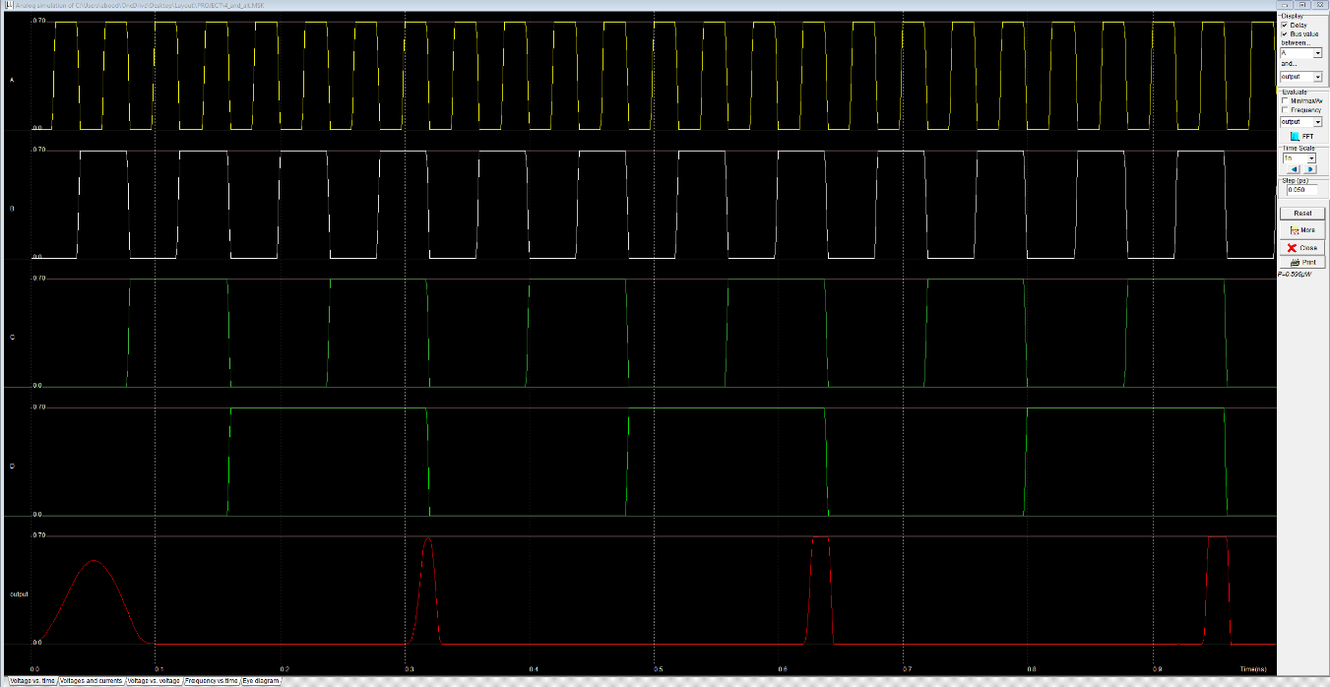
LAYOUT and simulation
4-input AND gate layout and simulation

Slide 19
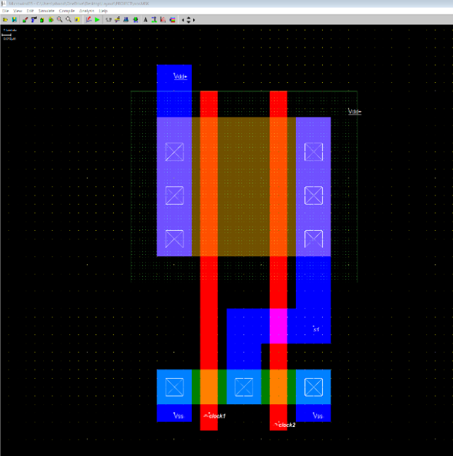
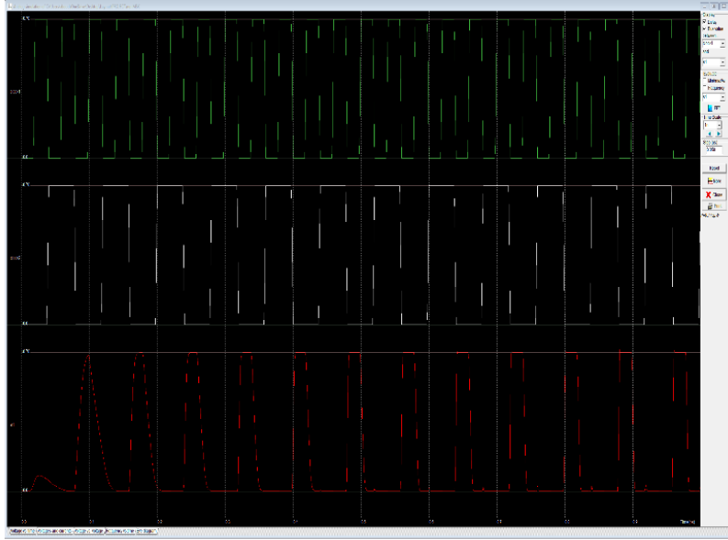
LAYOUT and simulation
2-input NOR gate layout and simulation

Slide 20
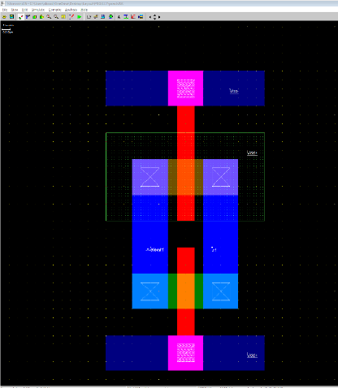
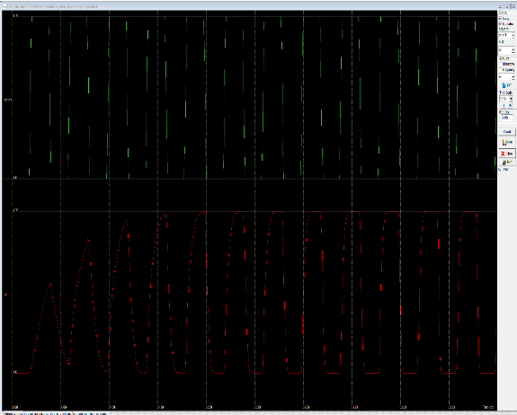
LAYOUT and simulation
Pass gate layout and simulation

Slide 21
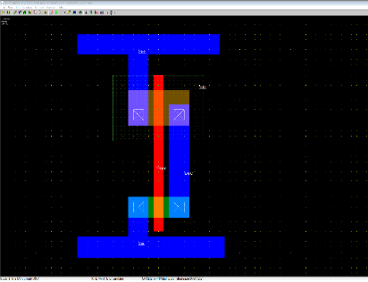
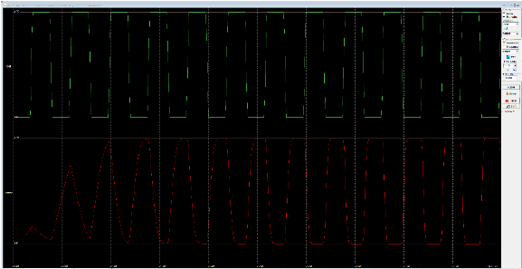
LAYOUT and simulation
inverter (NOT gate) layout and simulation

Slide 22
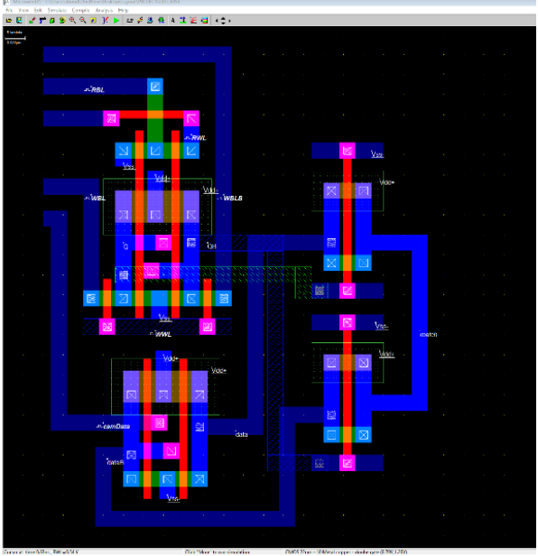
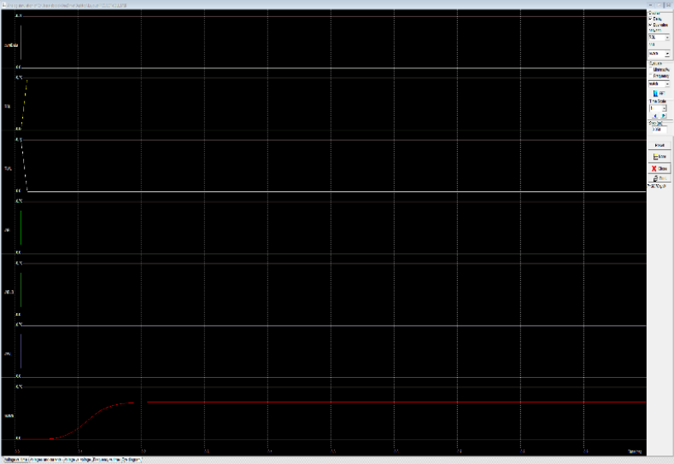
LAYOUT and simulation
CAM cell layout and simulation

Slide 23
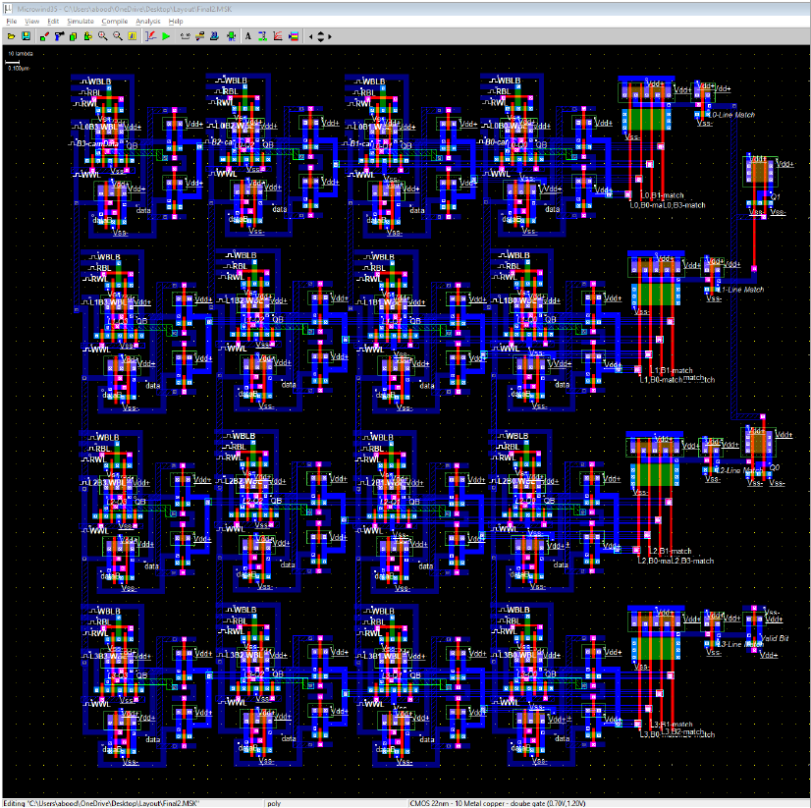
LAYOUT and simulation
CAM layout

Slide 24
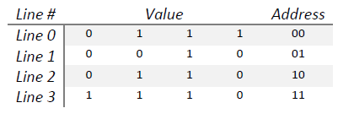
LAYOUT and simulation
CAM Simulation:
The CAM stored values are:
And the cam data is ‘1110’ so the output should be ‘11’ and valid bit should be ‘1’.

Slide 25
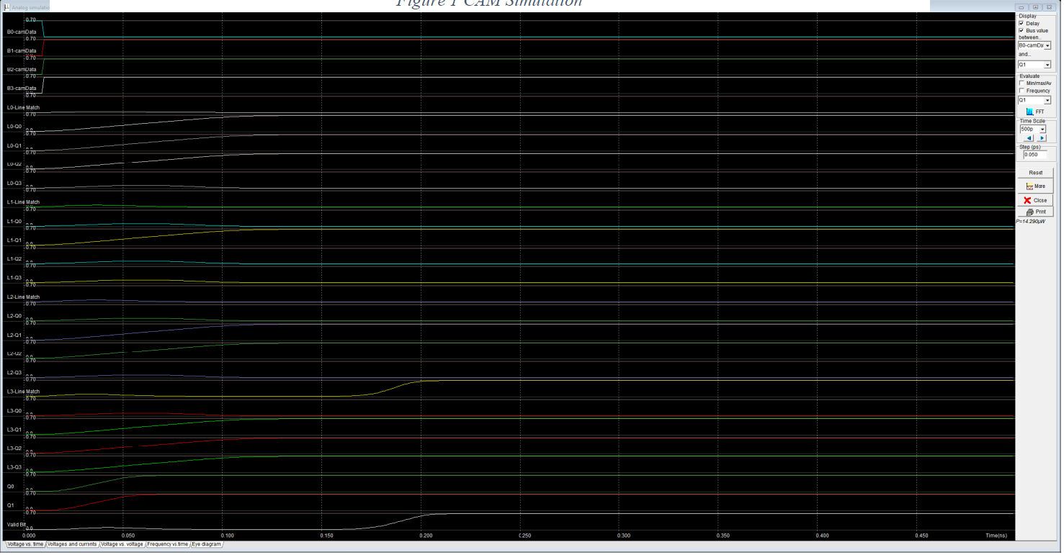
LAYOUT and simulation
CAM simulation

Slide 26
Delay
The delay for the simulation from the start till we got the output was 215ps.

Slide 27
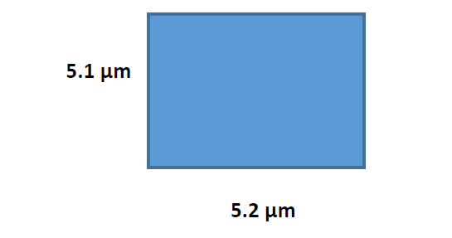
Area
The Over All Area for all parts of the CAM is:
Area = 5.1µ*5.2µ = 2.652 * 10^ (-11)

Slide 28
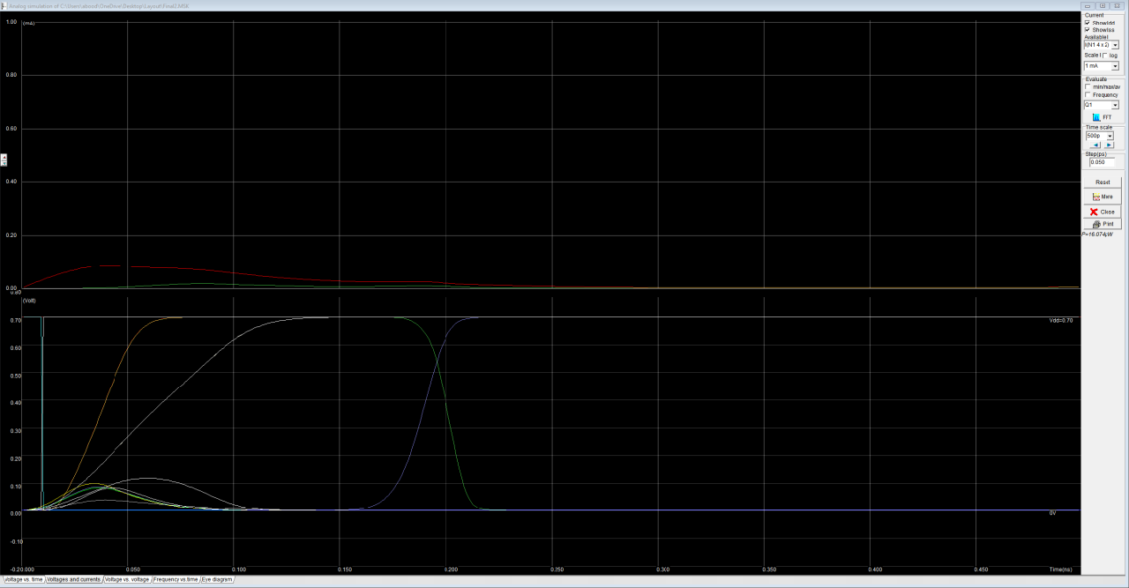
POWER
We have used 22nm tech with voltage = 1.2V and 0.7 considered as logic 1, and 0V as logic 0.
The power consumption has been taken in consideration while designing all parts of the CAM, the max power (From Voltage vs Current figure above) Pmax = V*I = 0.7 V* 0.022mA = 15.4 µW
CAM Voltage
vs Current diagram:

Slide 29
Thanks for listening

