Slide 1


Tawzie Tech

Slide 2
About US
Tawzie Tech IT specializes in solving distribution problems.
We are
Expert in software development
Expert in GIS
Expert in Data analysis
Expert in Distribution system

Slide 3
Mission
Behind every success, there are great Sales.
SMART
LOGISTIC…
SMART ..

Slide 4


O u r S e rv i c e s
Software Development

Slide 5

O u r S e rv i c e s
BI & data analytics

Slide 6
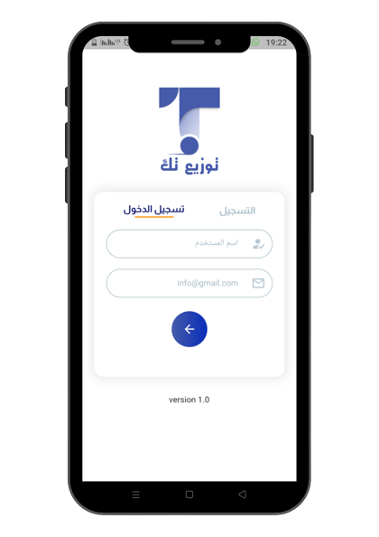
LIVE DEMO

Slide 7
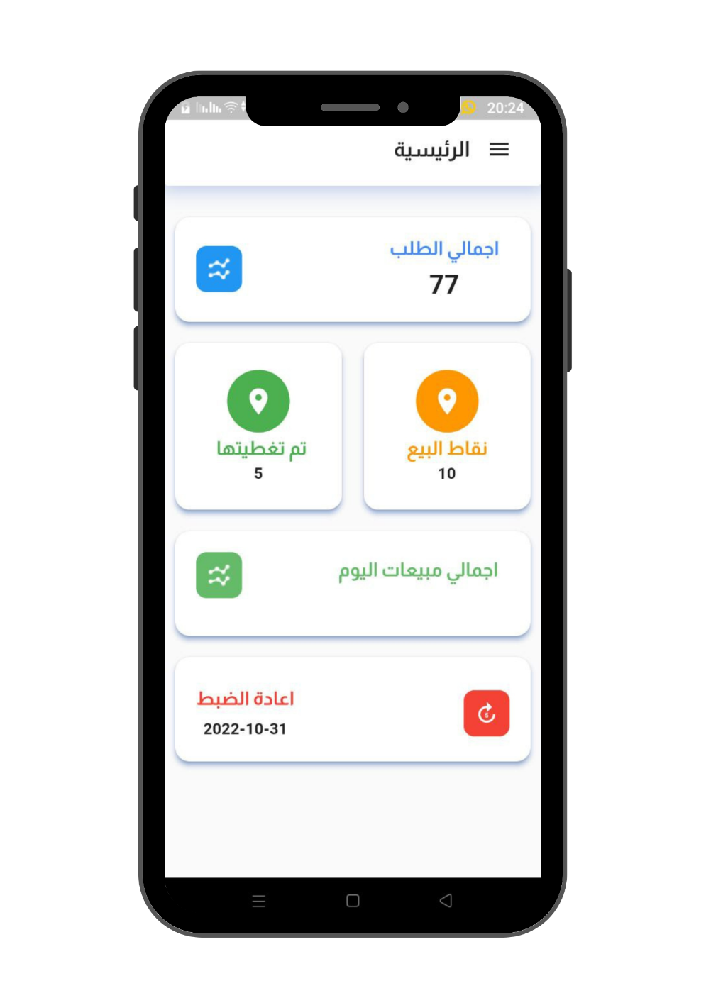
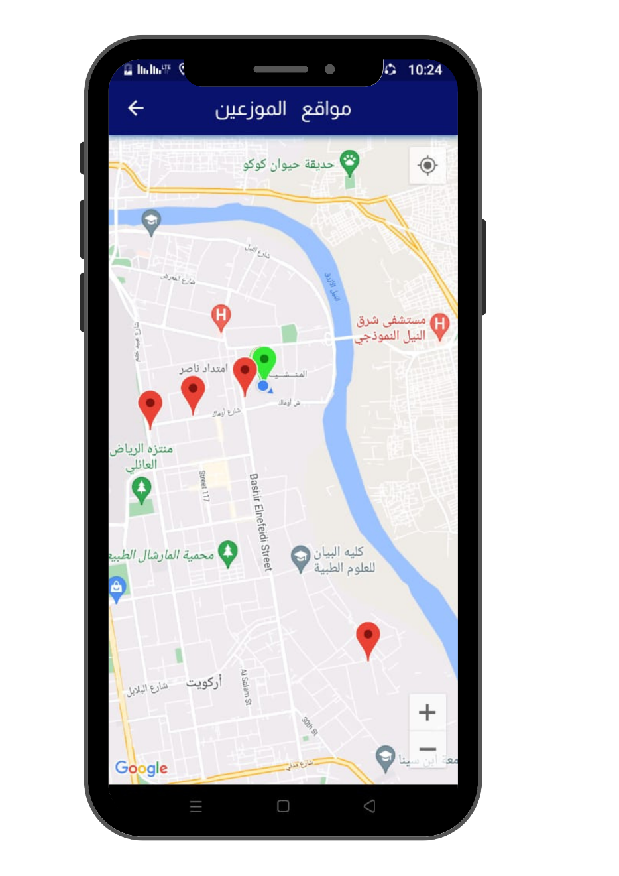
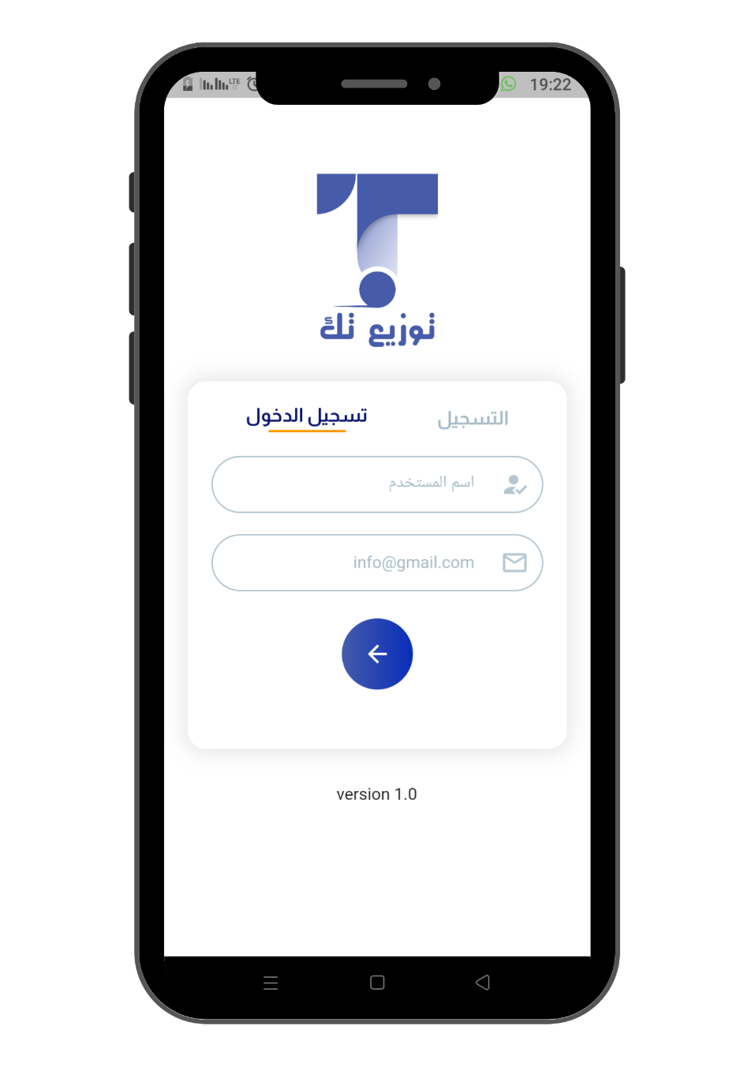
Mobile Application

Slide 8
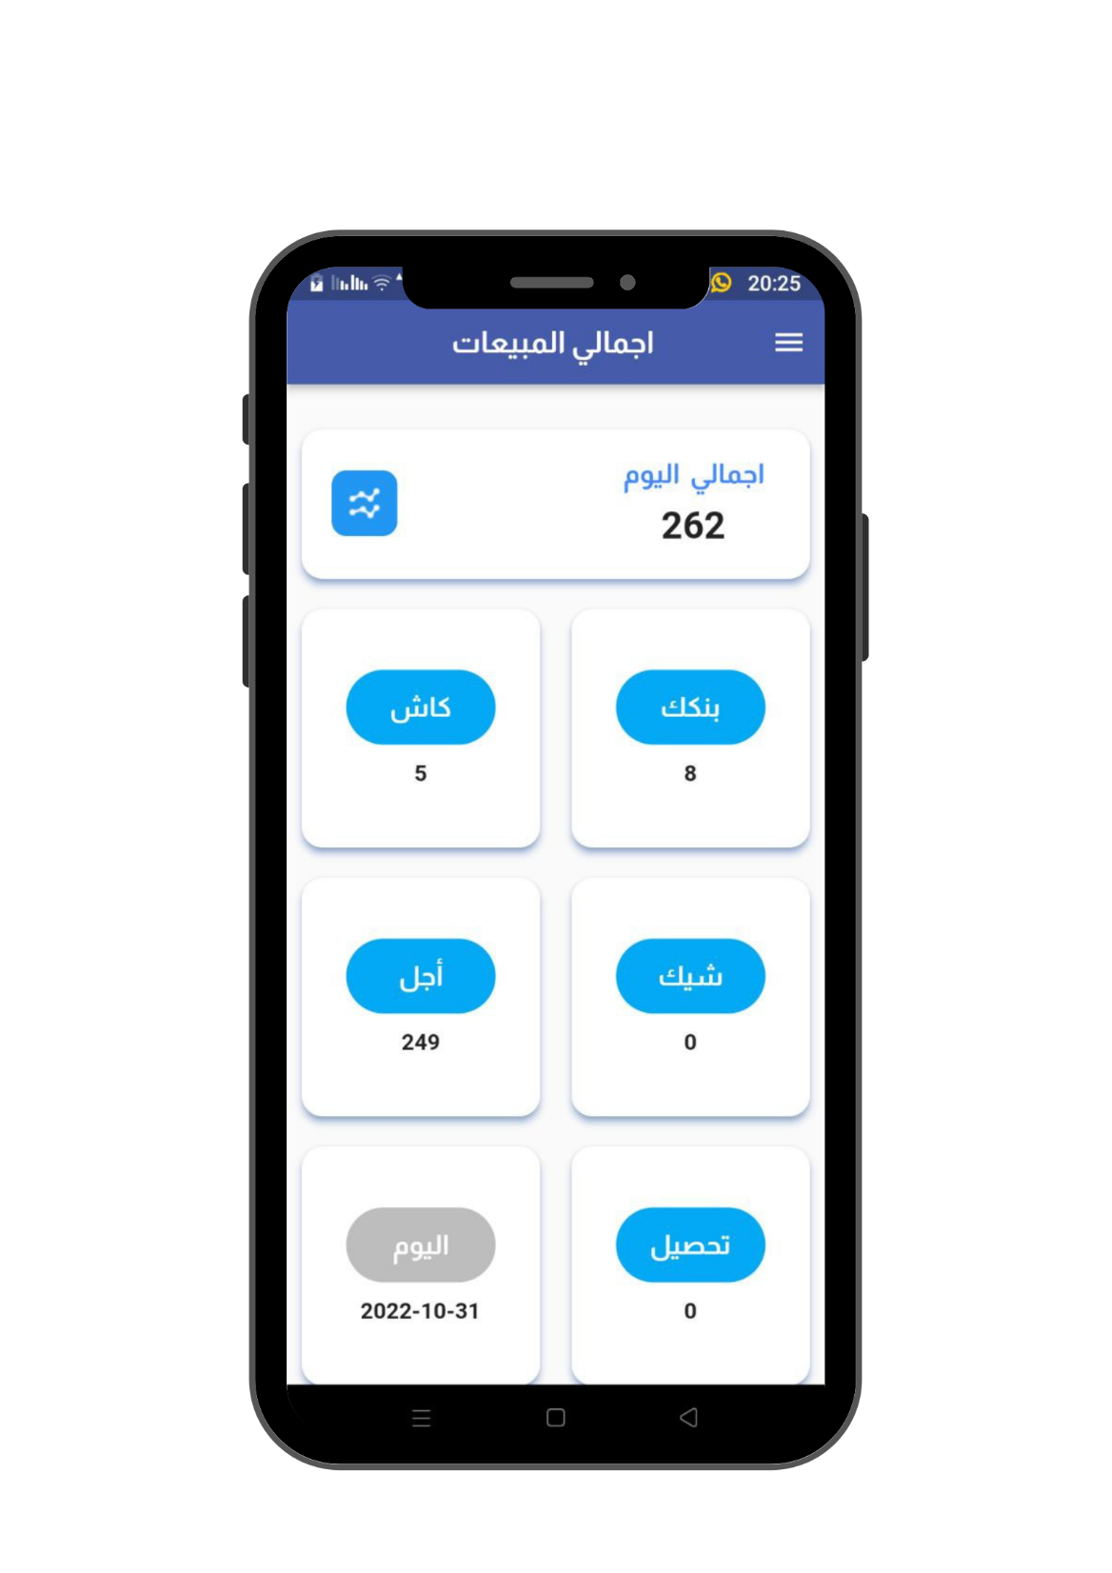
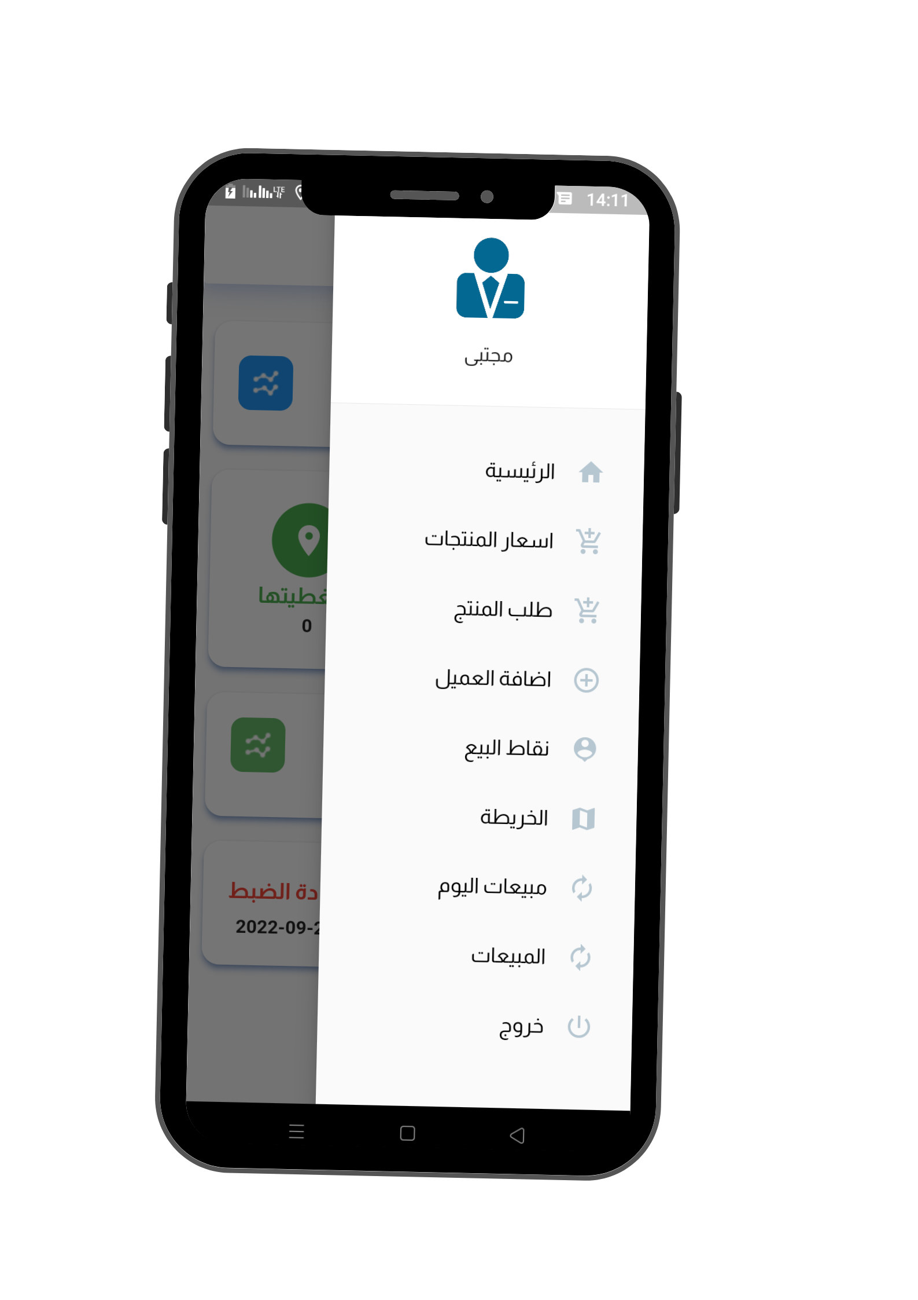
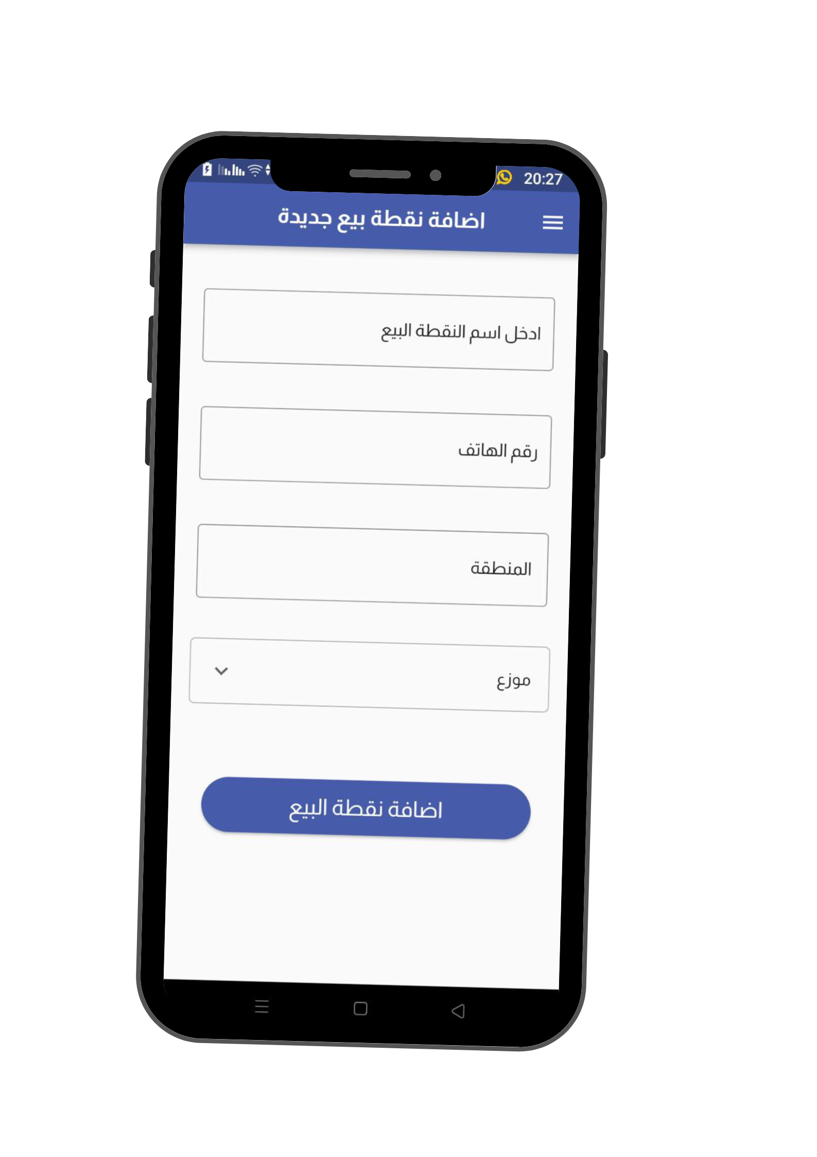

Slide 9
1
Data and collection
2
Suffer from linking their data to the geographical location
We Provide solutions
3
Appointment of a new distributor
4
Lack of monitoring in the distribution process.
5
Wasted time and high costs
6
Resource consumption

Slide 10
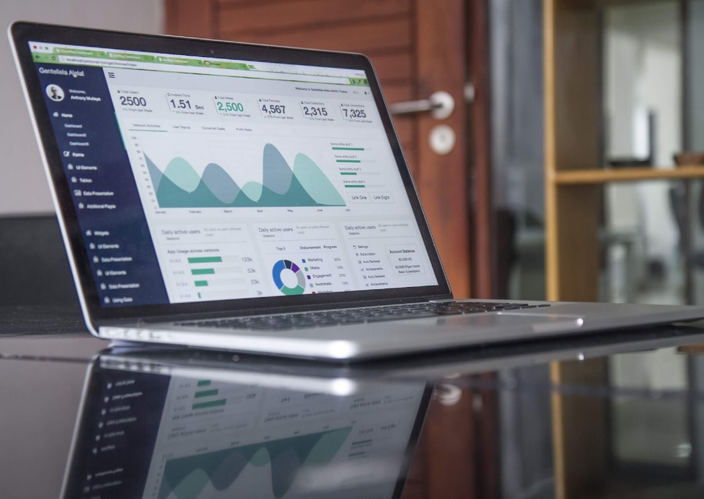
By Developed to
Development of a smart logistic services system helps to overcome the problems by:
01
Using digital maps helps cover large geographical areas
02
reduce costs, time and wasted resources
03
increasing the rate of demand for products
04
Support administrative marketing decisions
05
providing full control in the process of distributing products or providing services

Slide 11
Added value
Enhancing the product distribution process
Reducing the cost and time required in the distribution
increasing the rate of demand for products
Support administrative marketing decisions
Helps cover large geographical areas for the distribution.
Distribute the right product in the right place
Optimal use of technology
05

Slide 12
Deliverables
Mobile Application
Web Application

Slide 13
THANK YOU

