Slide 1

Sales Strategy Presentation

Slide 2
Overview
Revenue Of Different Sales Method.
Increase Revenue And Lower Losses.
Balance Efforts That Team Members Make.

Slide 3

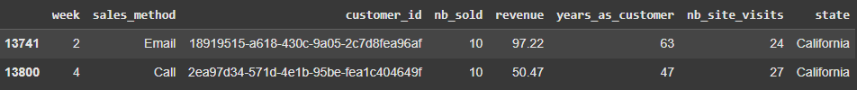
Summary Of Project
Data Validation:
Sales Method Years As Customers Same Classes But Years As Customers More Than
Different Representations. 40 Years (Our Company’s Age = 40).

Slide 4
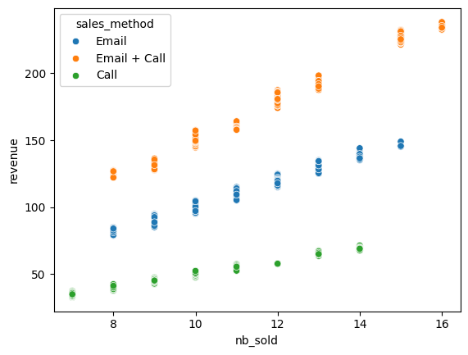
Summary Of Project
Revenue
Different Patterns For Each Approach.
Filling Missing Values Based On Conditions.
Example:
Record has missing value in Revenue column
That has “call” sales method, 8 number of
products sold, etc…
Fill the mean according to that segment.

Slide 5
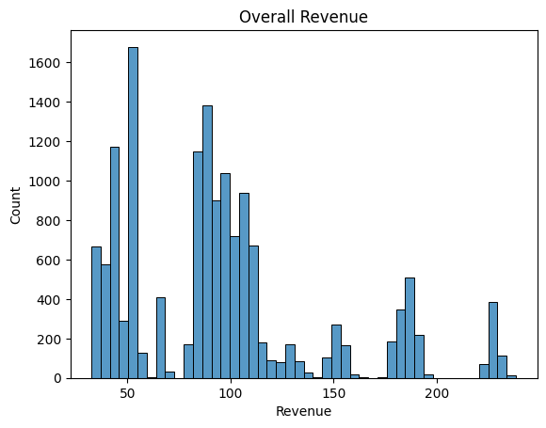
Key Findings
Show Different Mean Points In The
Distribution Of Revenue.

Slide 6
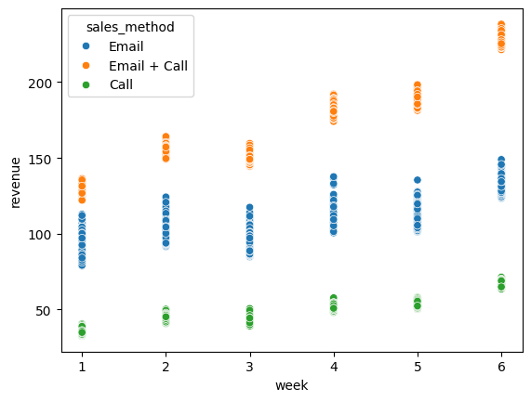
Key Findings
Show Different Mean Points In The
Distribution Of Revenue.

Slide 7
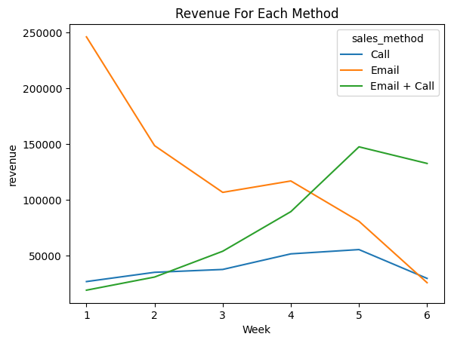
Key Findings
Email: Made a huge revenue for the first month of launching. Then gradually decrease with the time goes on, it seems that the launched product will be known enough after a month where emails will be neglected.
Email + Call: Made a great revenue after one month when the product launched. It is a good approach to use after a month of product launched. However, it seems that it is only beneficial for two weeks after a month of launching.
Call: Made less revenue, and it seems it will not grow more even as time goes on. However, using this approach for high loyalty customers is preferable to show a sign of appreciation.

Slide 8
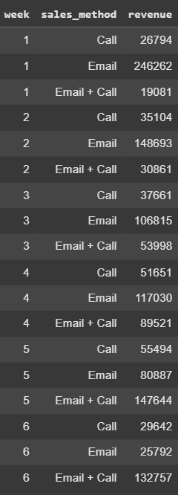
Business Metric
We can detect the total revenue of each method for each week which can help us identify trends and ensure that we are on the right track.
As shown, the initial values of the metric will be the first week where;
Call revenue: 26794$
Email revenue: 246262$
Email + Call revenue: 19081$
We can see that in the second week, the call revenue and email + call revenues increased.
However, email revenue significantly decreased.
To compare, the total revenue of the first week was 292137$, while the second week revenue was 214658$. The difference equals to -77479$.
Even though two approaches revenue increased in the second week.

Slide 9
Business Recommendation
We should use more of Email Approach for a month when launching a new product.
Then, after a month, we should add the Call Approach for two weeks while keep sending emails. Which means using Email + Call Approach.
In addition, adding only calls approach to high customer loyalty to show appreciation.
In this way, we are balancing methods and how to use them properly. In addition, balancing in terms of efforts that team members make.
Since there is no data that can help us decide what to do next after 6 weeks of launching a new product, we better get more data by experimenting with the same methods or add another sales method for marketing.
For example, launching a YouTube video and advertising it for targeting wider and different segments of customers. By that, we can detect what customers we should focus on to gain more revenue while consuming less effort.

Slide 10
30 Days

