Slide 1
The AI Revolution
Starts Here
ORIENTATION
A beginner-friendly guide with real-world analogies. No tech background needed — just curiosity.
Based on the Agent Factory Thesis agentfactory.panaversity.org

Slide 2
What We'll Cover Today
What is AI, Really?
What is Agentic AI?
The Agent Is the Operating Layer
The 10-80-10 Rhythm
The Agent Factory Idea
Your Personal AI Delegate
The 7 Principles of General Agent Problem Solving
The 7 Golden Rules of
an AI-Native Company (Invariants)
10 A Real Example: Ecomm Mart
08
09
From 'Smart Tool' to 'Smart Worker'
05

Slide 3

What is AI, Really?
PART 01

Slide 4
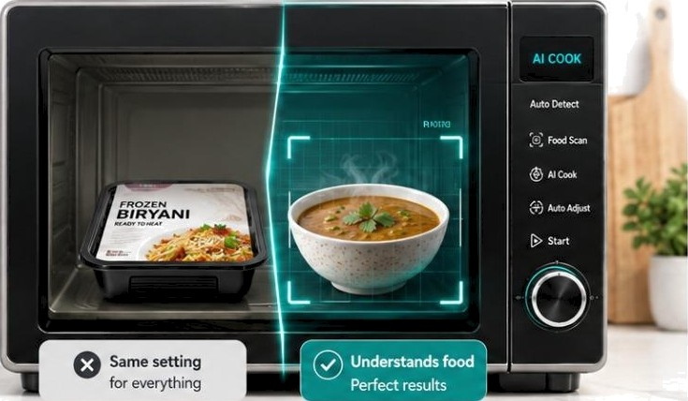














A N A LO G Y
The Smart
ORDINARY kIICROWAVS
Uses fixad time & power
suART nicRowAvz
Lo oŁ s recog ta‹Yes,dec ide s
Kitchen Appliance
A normal microwave follows fixed rules.
A smart one can |ook, recognize, and decide what to do.
o a
Input food
You place food inside
Reads what it sees
Figures out what the food is
Chooses the best settings
Picks time & temperature automatically
Working with AI is the same
PaNern recognition
It figures out what it is
Information in
AI looks at the input
Decision
|t chooses what to do

Slide 5


Breaking Down "Artificial Intelligence"
Artificial
Made by humans, not by nature. A plastic flower is artificial.
AI is intelligence built from software.
Intelligence
The ability to learn, understand,
and make decisions.
Humans have natural intelligence. AI has a version built from data.
Everyday Examples You Already Use
Voice Assistant
Alexa, Siri
YouTube Recs
Spots patterns in what you like
Auto-correct
Predicts the word you meant
ChatGPT / Claude
Writes answers from questions

Slide 6


KEY TAKEAWAY
AI is software that can learn from data and make decisions on its own — without a human giving it step-by-step instructions every time.
It's not magic. It's math, data, and clever programming.
And it's already everywhere in your daily life.

Slide 7

What is Agentic AI?
PART 02

Slide 8

Normal AI vs Agentic AI
Both ore smart — but only one does the job for you.
Normal AI
You ask: "How do I make a sandwich?"
It tells you the steps to follow... but YOU do all the work!
You get the bread, add the filling, and build the whole
sandwich yourself.
Agentic Al
You say: "Please make me a sandwich."
It makes a plan and does each step... the whole job, all by itself!
It goes to the kitchen, gets the bread, makes the sandwich, and brings it to you.

Slide 9



Game: "Get Ready for the Playground!"
It's a holida — the class is free to go p/oy outside!
The Goal You Give
"Get everyone ready to go play in the playground."
That’s it — just the goal, nothing more. Don't tell them the steps; the kids figure it out on their own!
What the Kids Might Do (their own plan!)
Wear shoes
Grab the ball
@ Line up
Make a line and wal k out together safely.
Put on sports shoes and caps for the sun
Pick a ball, skipping rope, or favorite game.
¿ "You just acted like an AGENT! Nobody told you each step — you had a goal and made your own plan. That is exactly what agentic AI does!"

Slide 10
What is "Agentic AI”?
Normal AI
You ask: "How do I make a sandwich?"
Agentic AI
You say: "Please make me a sandwich."
It tells you the steps to follow... but YOU do all the work yourself.
It makes a plan and does each step... the whole job, all by itself!
An Agent Does 3 'things
1. THINK
Makes a plan to reach the goal.
3. CHECIf
Sees if it worked.
Actua|ly does the steps.
"First I need bread, then filling."
Goes and builds the sandwich.
Tries again if something is wrong.

Slide 11
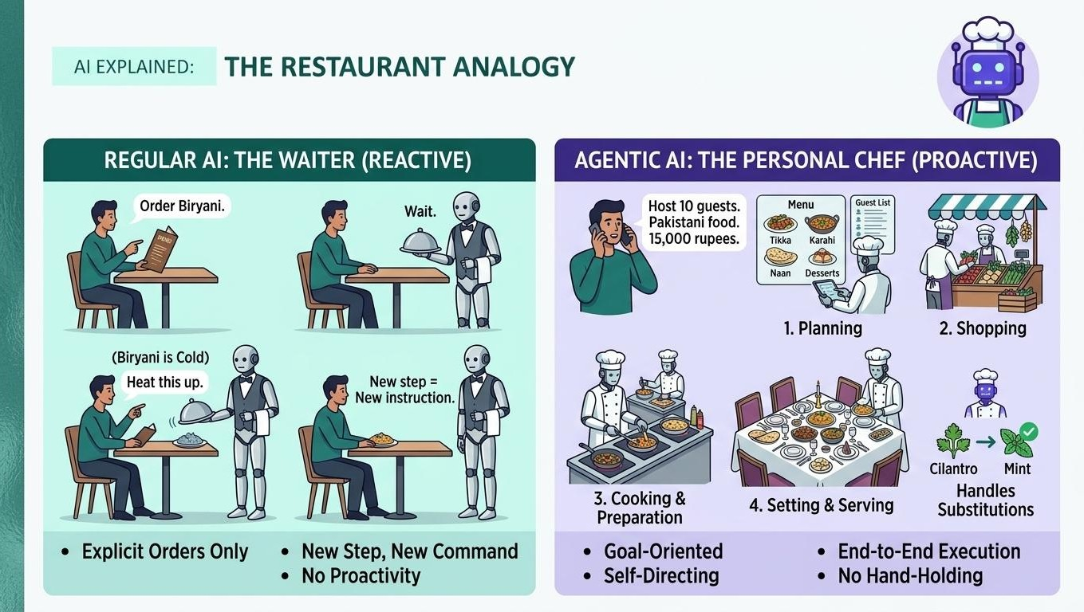

Slide 12










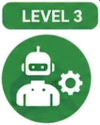

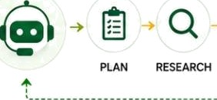




Three Levels of AI
Level 1 — Predictive AI
(The Smart Filter)
-4
Spam
-*,-----*
Not Spam
You give it data. It gives one prediction.
Spam or not spam? What product
to recommend? No conversation, no memory.
PREDICTION
ENGINE
Recommended Product
Level 2 — Generative AI
(The Chat Partner)
You have a conversation. It remembers context. Creates text, images, and code.
Still waits for your next instruction.
Can you write a tagline for my ecp-friendly brand?
* T
Text
-- ----D
image
"Clean choices. Better tomorrow.”
' ’+ </} Code
Level 3 — Agentic Al
(The Worker)
You give it a goal. It does the work.
It plans, uses tools, fixes mistakes, and finishes the job — without you guiding every step.
Build a landing page for our new product and launch it.
BUILD
TEST
o
LAUNCH COMPLETE
Level 1
predicts.
Level 2
creates and chats.
Level 3
plans and delivers.

Slide 13





What Makes AI "Agentic"?
Four abilities that turn a chatbot into a worker:
Planning
Breaks a big goal into smaller steps and decides the order
Tool Use
Browses the web, writes code, reads files, sends messages
Self-Correction
Notices mistakes and tries a different approach on its own
Goal Completion
Works until the job is done, not just one answer

Slide 14



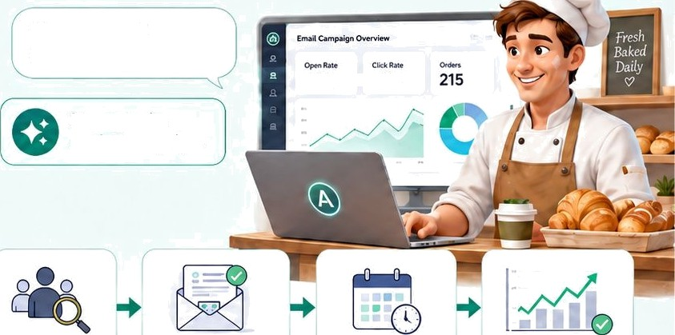








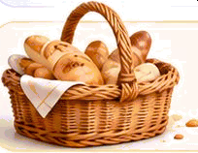


Bakery Email Marketing: Two Paths
&zzl
Regutar AI: The Single-Task Tool Agentic AI: Your Intelligent Partner
“Write a marketing email for my bakery.”
“Run my email marketing this month.”
X
42% 12%
A
Writes ONE generic email.
Then it is done.
Manages the
entire campaign.
Your manual tasks:
Send the email
” manually
Track opens and clicks
Follow up with interested customers
1. Segments customers
2. Writes targeted persona(ized emaib
3. Schedules automatic sending
4. Tracks performance and improves
the next batch
Regular AI helps with one task. Agentic AI handles the full goal.
Tool = one step I Agent = end-to-end work

Slide 15










From Browser Chat to General Agents
Hovr most eade s first meet Al — and mat comes next
1. Browser Chat
O
2. General Agents
index py x
X
Project Board +
To On 3
Add usar authentication
,. Files
G my-project
PL README.md
{ ) package.json
' ‹let add(a, b):
New Chat
Canyouexp|ainvvhat APlmeums?
I list Of y
O
An API (Application Programmin₉ Interface) is a set of rules and protocols that allows different software applications to communicate with each other.
‹.c I mat n ( ) :
result = add(2, 3)
print (' ' ' { resu £t i ” )
/«/?, Codebases
w# indexpy r# utilspy
tests
e ,t,«.
B r_{e}quir_{e}ments.‹.
In Progress
2
fiefactor utils module
Tools
Set:ings
Move
Beyond Chat
Can you give me an example?
Terminal
S python index . py
hash
oone
E- Commands
Sure! For example, a weather app might use a weather API to get real-time data from a weather service.
Workflows
:â Outline
Most readers first meet AI through a browser-based LLM. They log into ChatGPT, Claude, Gemini, or another model and start typing in a chat window.
Cl at CPT Claude Gemini Other LLMs
General agents move beyond ordinary chat. They can work inside an environment. files, codebases, tools, commands, workflows, and projects.
Claude Code OpenCode Claude Cowork
Projects
OpenWork
Chat: conversation in a browser
Ask questions. Get answers. Stay in the chat.
General agents: work inside an environment
Take actions. Use tools. Complete real work.

Slide 16
PART 03
The New AI Era
The Agent Is the
Operating Layer
The new era of computing: from app-centric PCs to agent-native PCs. Why the agentic era ends the app, SaaS, and the PC as we know it.

Slide 17
Two Deaths, Not One
PART 03-A

Slide 18

“For forty years, you launched apps. Click. Type.
With RTX Spark and Microsoft Windows, you ask — and the PC does the work.”
JUNE 1, 2026
— Jensen Huang, NVIDIA · GTC Taipei
NVIDIA and Microsoft unveiled a petaflop-class chip to run agents locally on Windows.

Slide 19

Two Deaths, Not One
The agentic era takes two casualties — one smaller, one larger.
1. SaaS dies
The agent replaces the app. The login, the navigation, the seat-based UI — unbundled into capabilities an agent calls and never names to you.
The smaller event: the app dissolves into a function call.
2. The PC dies — as we know it
The agent replaces you at the controls. The app-on-OS model, driven by hand through a graphical shell, becomes obsolete.
The larger event: you stop operating the machine.
Not the silicon — the operating model. It begins with digital, bounded, recoverable work.

Slide 20

The SaaSpocalypse, Unbundled
A SaaS app is three things welded together. The agent pulls them apart.
Workflow UI
Dies first. It existed only so a human could operate the capabilities. An agent operating them directly bypasses the screens entirely.
Capabilities
Survive — demoted from product to function call. A tool the agent reaches for via API or MCP, then sets down.
System of record
The prize. The authoritative data an agent must read to act becomes the most strategic layer in the stack.
SaaS gets unbundled — and the bundle was the business.

Slide 21
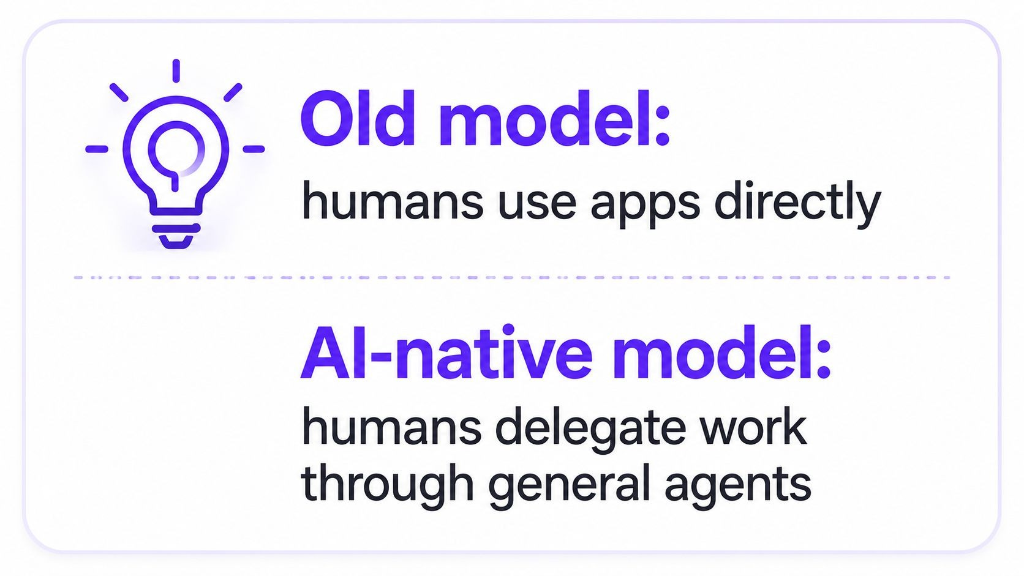

Slide 22

The AI Operating Layer
PART 03-B

Slide 23
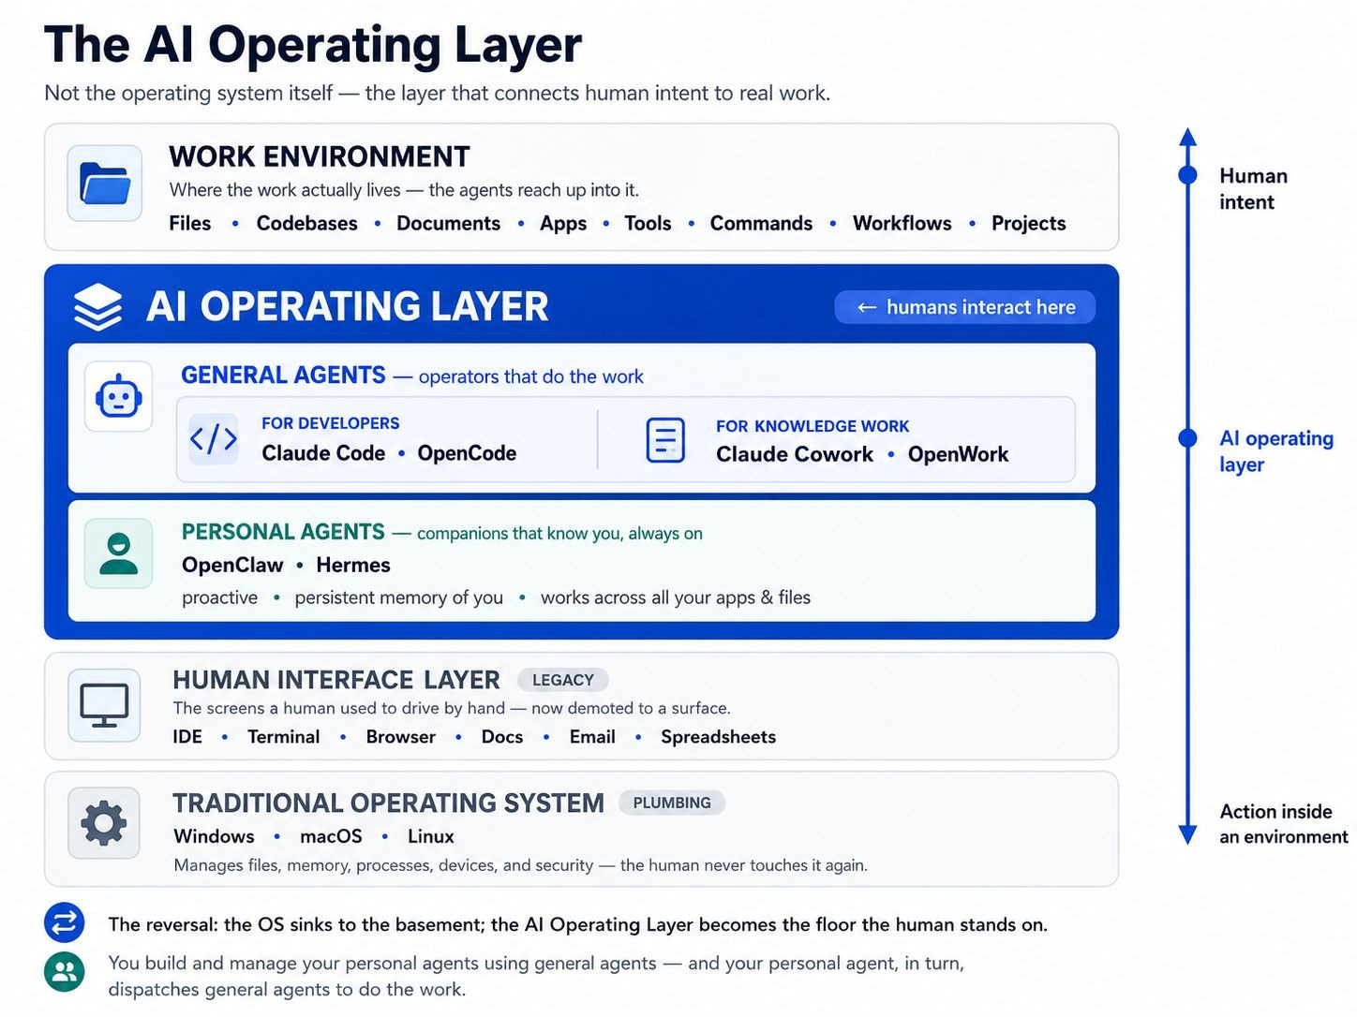

Slide 24


The Reversal
The forty-year stack flips: the OS sinks, the agent layer rises.
The OS becomes plumbing
Windows, macOS, and Linux survive as invisible infrastructure — like TCP/IP or the BIOS. The human never touches them again.
The shell dies as the interface
The desktop, the dock, the app grid, the window-shuffling — demoted to legacy surfaces behind the agent layer.
The agent layer becomes the floor
You state the goal. The agent reaches down through the old interface and operates the machine on your behalf.

Slide 25
General vs Personal Agents
PART 03-C

Slide 26
Two Kinds of Agents
Both live in the operating layer. One is oriented toward the work, the other toward you.
 | General agents | Personal agents
Oriented toward | the task / the work | the person — you
Examples | Claude Code, OpenCode; Claude Cowork, OpenWork | OpenClaw, Hermes
Lifespan | summoned per job; sessional | always-on; persistent
Memory | task-scoped context | long-term — it knows you
Initiative | directed — you invoke it | proactive — it anticipates
Role in the stack | your workforce / operators | your delegate / interface

Slide 27
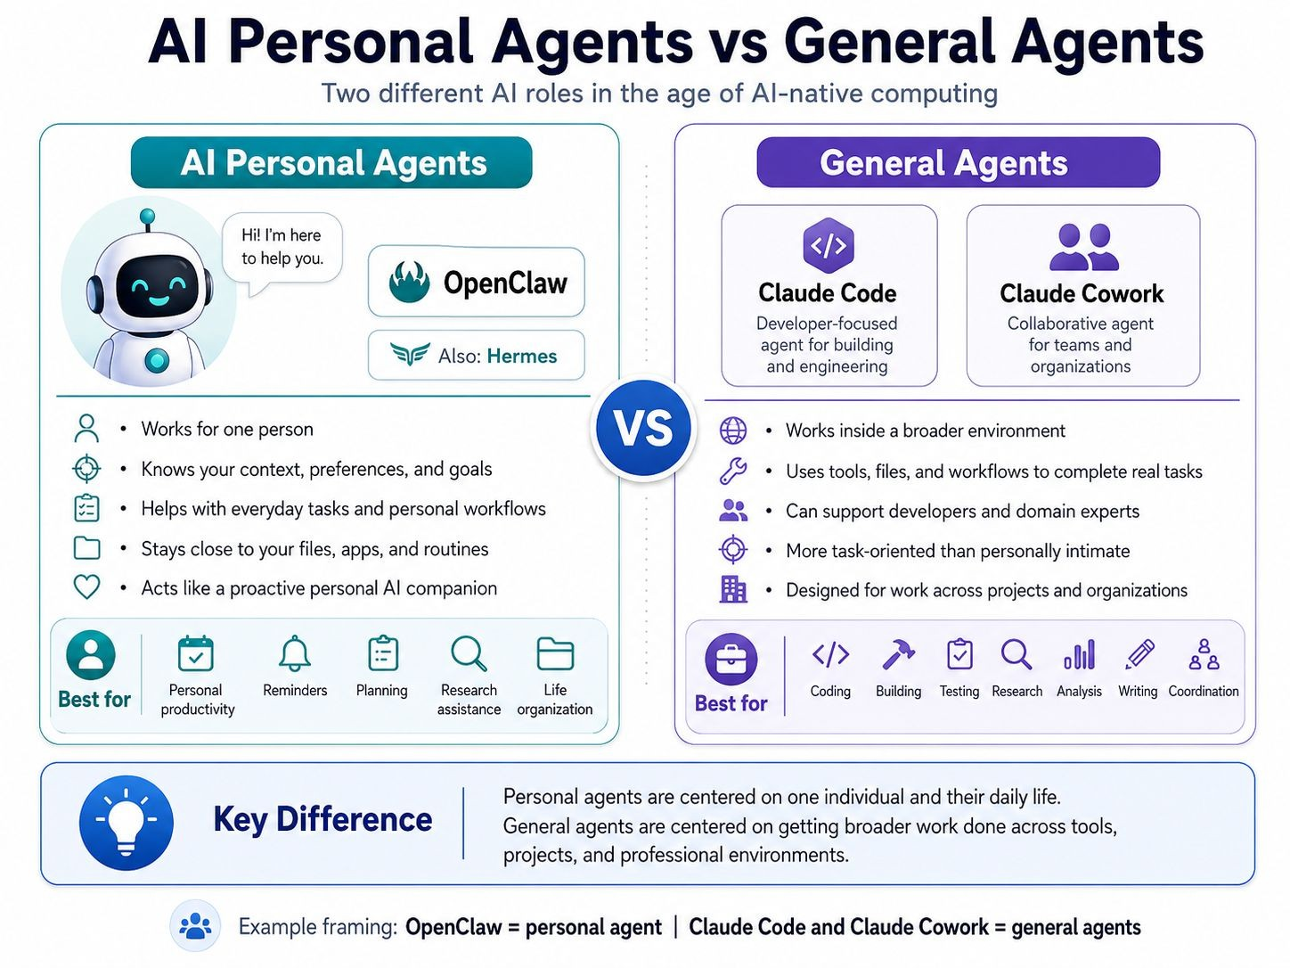

Slide 28

Build the Delegate; the Delegate Runs the Rest
The layer is recursive — you manage personal agents using general agents.
You → General agents
You build and configure your personal agent — its memory, permissions, and skills — with developer-grade general agents like Claude Code and OpenCode.
Personal agent → General agents
At runtime, your delegate knows your intent and dispatches general agents and AI Workers to carry out the work, then reports back to you.
The personal agent is your chief of staff. The general agents are the staff.

Slide 29

The Computer That Controls Itself
PART 03-D

Slide 30

RTX Spark: The Personal Agent PC
A petaflop-class chip puts frontier-model agents on the device — no cloud round-trip.
≈1 PF
AI performance, on-device
128 GB
unified memory
20
Arm CPU cores
Local
private — your data stays
NVIDIA’s OpenShell governs what an agent may touch and what may leave the machine. The interesting engineering is not the petaflop — it is governed capability.

Slide 31
FROM TOOL TO TEAMMATE
The machine stops being an instrument you play and becomes an actor you direct.
A computer that controls itself — given your intent.
You ask; the PC does the work.

Slide 32
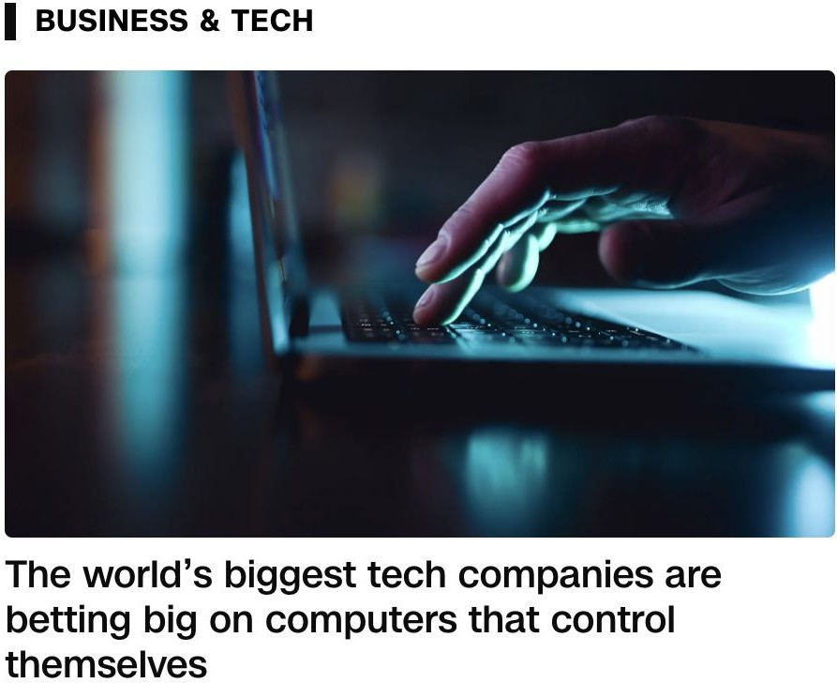
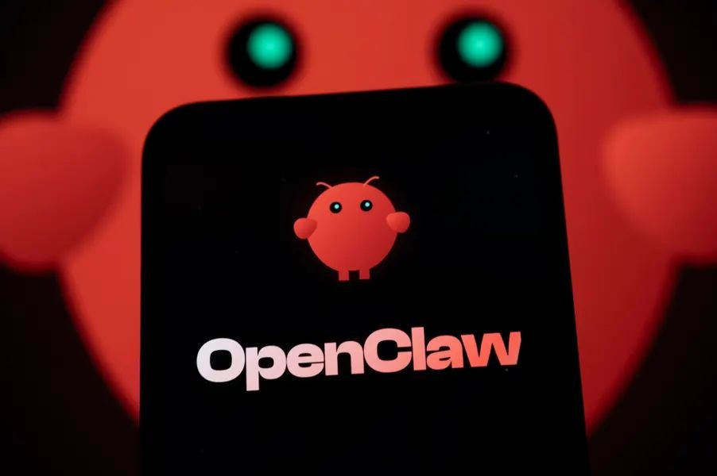

Slide 33


Slide 34
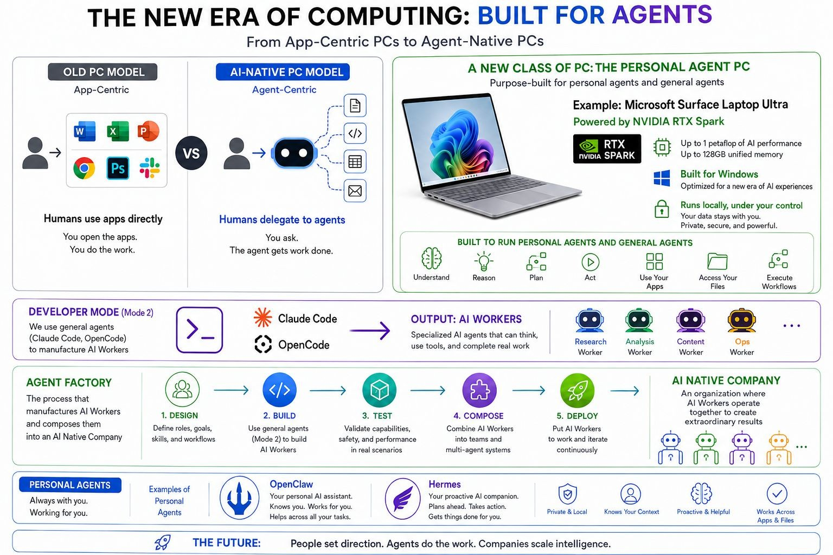

Slide 35
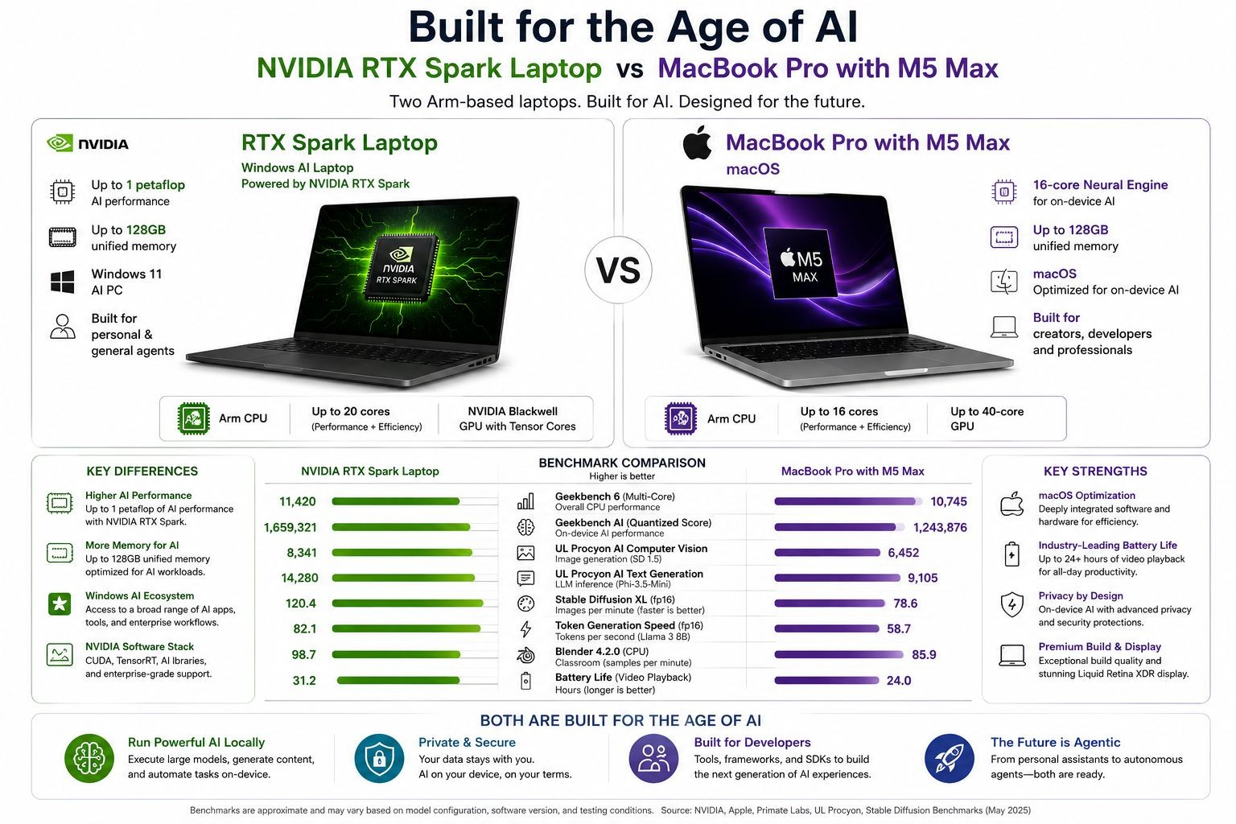

Slide 36

Why This Time Is Different
PART 03-E

Slide 37

Three Things Changed — Together
Models crossed a threshold
On OSWorld — real desktops, no partial credit — agent success jumped from ~12% to ~66% in a year, crossing the human baseline.
66%
Compute came to the device
A local petaflop with 128GB makes always-available, private, unmetered agent compute native to the machine — not a cloud subscription.
The OS vendors rebuilt
Microsoft wired agents into Windows behind every surface; eight makers ship RTX Spark PCs this fall. The change is the platform, not an app.
When all three land together, doing it yourself stops being the default — the gap the Siri decade never closed.

Slide 38



The Honest Objections
These set the pace and the scope — not the direction.
Cost
Petaflop laptops are a premium category; the installed base of human-operated machines persists for years.
Trust & governance
An agent with broad access can be misled. The platform that wins solves governed capability, not the most FLOPs.
The hybrid
For now, high-stakes work stays human + UI + agent — the thesis in its transitional phase, not an alternative to it.
Reliability
~66% average means roughly one task in three still fails. Bounded, recoverable tasks go first.

Slide 39

What Dies, What Survives
PART 03-F

Slide 40

What Dies, What Survives
WHAT DIES
The app as the unit of human work
The graphical shell as the place you live
SaaS as a destination
The human as operator
WHAT SURVIVES
The OS as invisible plumbing
Software capabilities, as tools agents call
The human as the source of intent
Judgment: what to want, and whether it’s good
The PC as hardware does not die — it becomes more essential. What dies is the human’s job of driving it.

Slide 41


What It Means for Builders
The strategic ground shifts — the agent has no eyes for your interface.
The moat moves
Be the layer the agent lives in, the capability it must call, or the governance it must obey. A beautiful, sticky UI is no longer the defense.
The firm that orchestrates agents out-produces the firm that buys more seats of the old software.
700 FTEs
≈ $40M profit lift
Klarna’s customer-service agent did the work of ~700 full-time staff — “scale intelligence, not headcount.” (Humans were re-added for complex cases: bounded tasks first.)

Slide 42
THE BOTTOM LINE
People set direction. Agents do the work.
The interface is the agent.
The era is no longer “humans use apps.” It is “humans delegate work.”

Slide 43

Two Ways to Use AI (General Agents)
PART 03-G

Slide 44
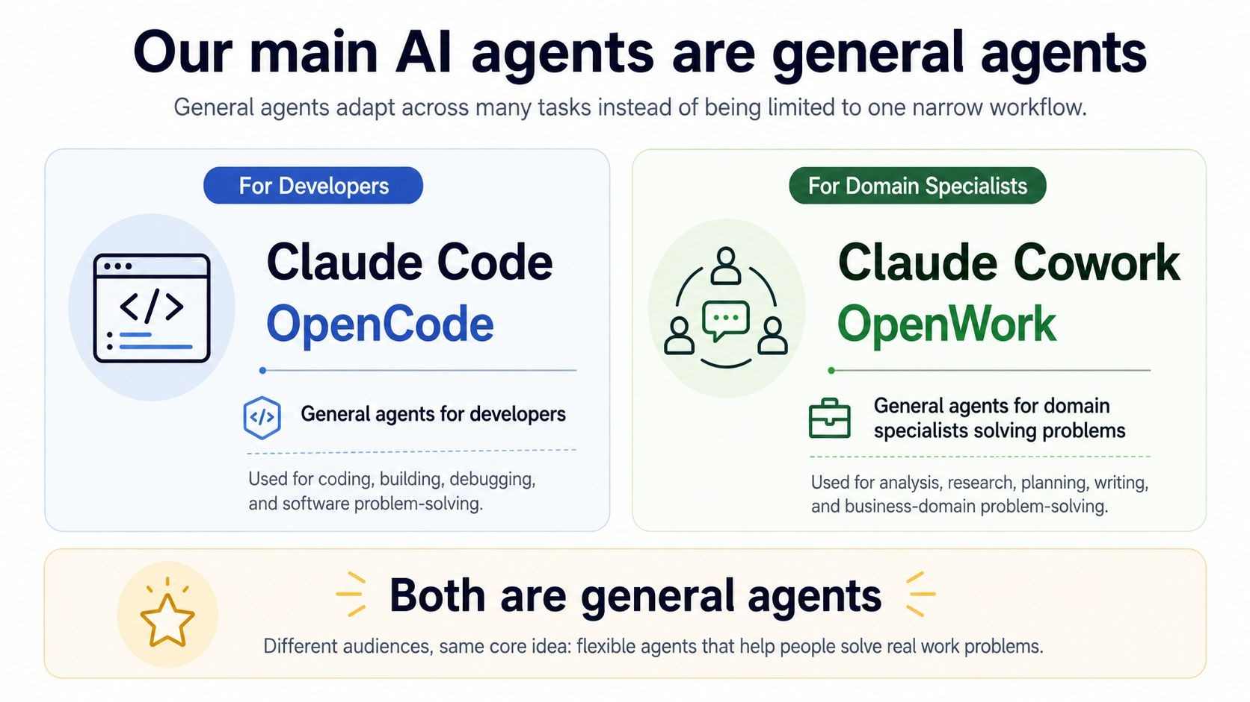

Slide 45
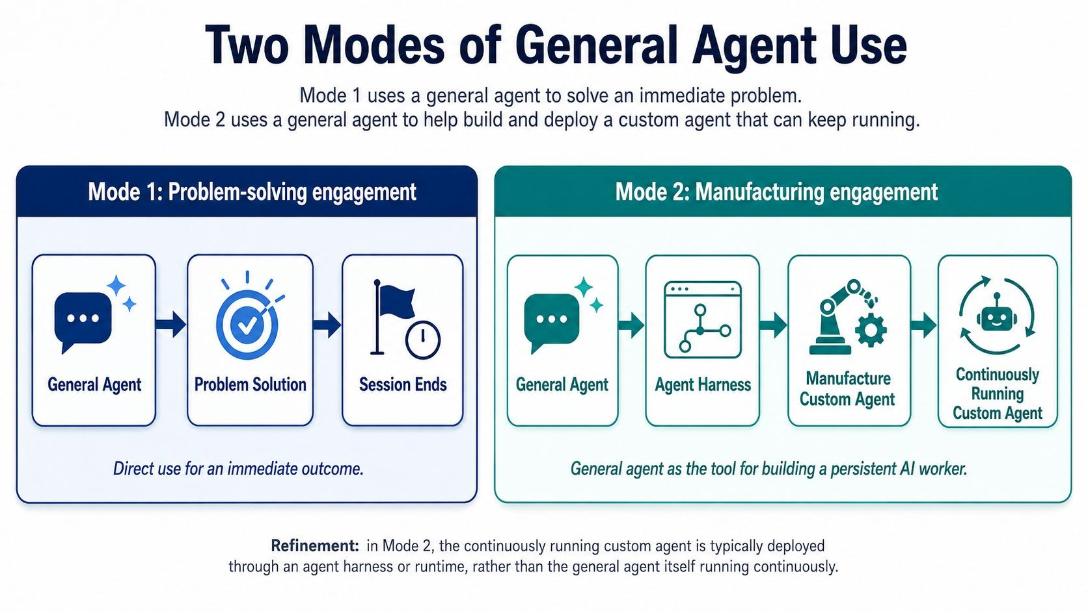

Slide 46












Fish vs. Fishing Net
Two Modes. Two Outcomes.
ANALOGY
+
PROBLEM-SOLVING
Catch a fish. Solve today's problem.
MANUFACTURING
Build a net. Catch fish every day.
BOTH ARE
VALUABLE
fi • O
EAT IT PROBLEM
SOLVED
CATCH ONES
BUILD
A NET
CATCH FISH EVERY DAY
SCALE & GROW
SUSTAINABLE RESULTS
Solves today.
Builds tomorrow.
O
Start with Mode 1
Solve today's problem.
Move to Mode 2
Build tomorrow's solution.
Learn both. Use both. Grow beyond both.

Slide 47

Two Modes Side by Side
Mode 1 — Problem-Solving
"Help me do this thing right now."
You have a problem. You use AI to solve it. The session ends. Nothing permanent is built.
Example: "Help me analyze this spreadsheet" or "Write me an email to my client."
Mode 2 — Manufacturing
"Help me build a worker that does this job forever."
You use AI to build a new AI worker that will keep running long after you close your laptop.
Example: "Build me a customer support bot that runs 24/7 and answers common questions."

Slide 48
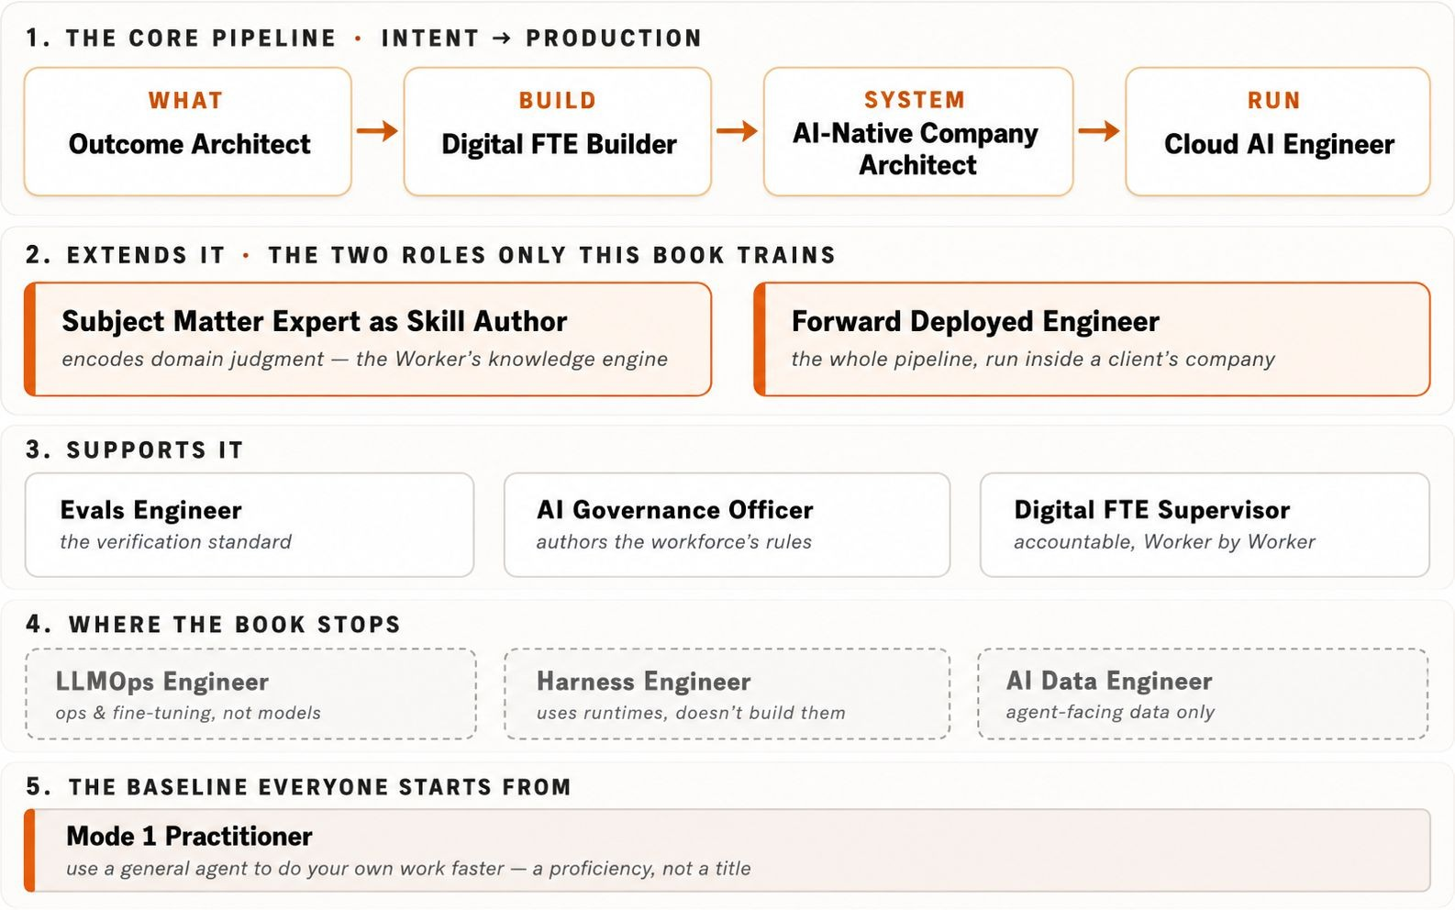
The Roles This Book Trains

Slide 49
The 10-80-10 Rhythm
PART 04

Slide 50

The Film Director
A director doesn't do every task.
They gui o the work.
Set the vision
What should it look like?
Let the team work
They do the work
Review the final cut
Check and approve
Working with AI is the same
First 10%
You set direction
Last 10%
You review & approve
................................................. .................................... ...................
START IN PROGRESS
FINISIJ

Slide 51


The 10-80-10 Split
10%
Human sets direction
80%
AI does the work
10%
Human checks & approves
Three Things That Always Stay With Humans
Intent
Knowing what you want
Verification
Checking if the work is good
Ownership
Being responsible for the result

Slide 52

You're Promoted, Not Replaced
The Human Role
You are promoted, not replaced. From typist to editor. From coder to
architect. From worker to director. AI takes over the middle 80%. You keep the parts that matter most — direction and judgment.
REAL EXAMPLE
Old Way
You spend 4 hours writing a business report yourself.
New Way
20 min writing clear instructions. AI writes the report in 5 min. 20 min reviewing and fixing. Same quality. One-tenth the time.

Slide 53

From "Smart Tool" to "Smart Worker"
PART 05

Slide 54

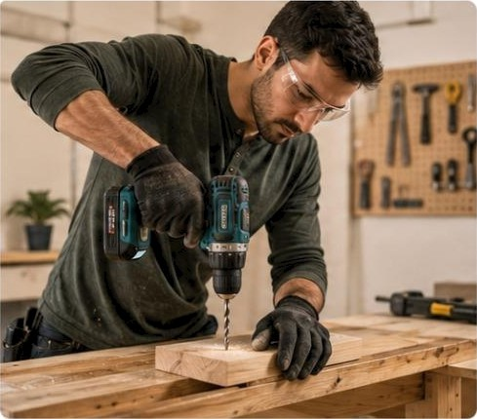

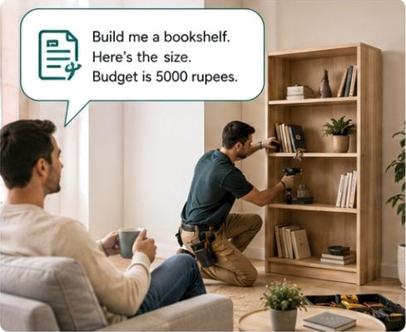







The Carpenter's Drill vs.
Hiring a Contractor
ANALOGY
You hold it. You decide.
You do the work.
You give the job. It does the work.
You check the result.
AI as a TOOL
You control every step
AI as a WORKER
€i
You define the outcome
Worker handles the task
You reyiew the result
Tool makes one part faster
You still do the job
Working with Al is the same
Give the job Define what you
Al
e
Check the result Review and approve
!**O
It hddees he t

Slide 55

KEY TAKEAWAY
The biggest shift in AI right now isn't about making smarter tools. It's about turning AI from a tool you use into a worker you hire.
You stop paying for access to software. You start paying for finished results.

Slide 56
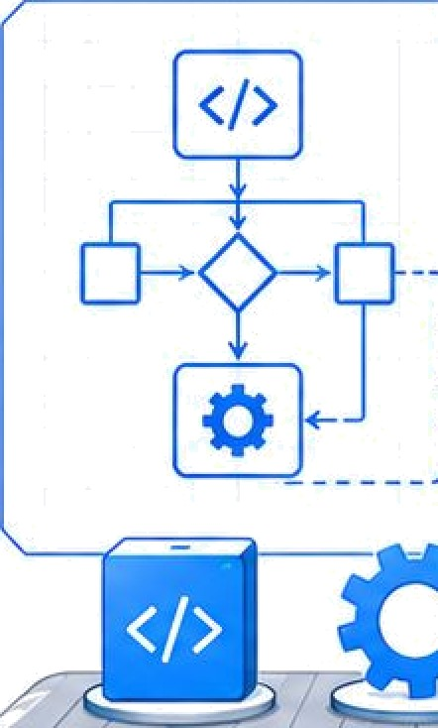
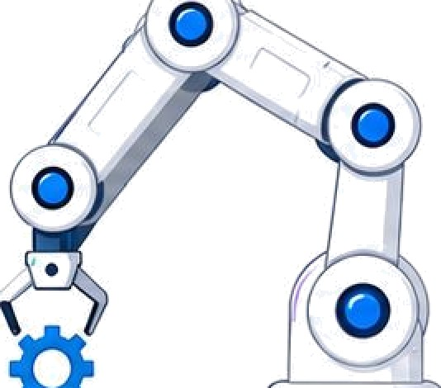
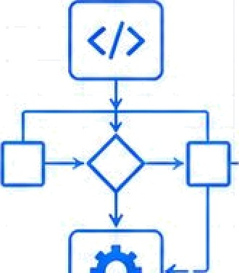


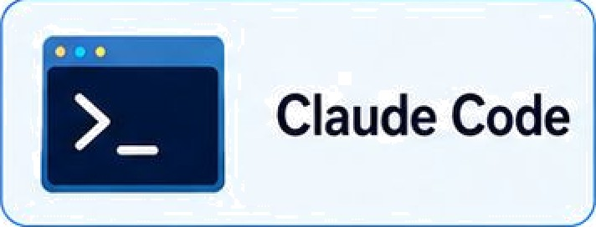
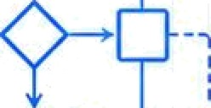

















Mode 2: Using General Agents to Manufacture Al Workers
General agents such as Claude Code and OpenCode are used to build, configure, and deploy AI Workers.
General Agents
Al Workers
Digital FTEs
Claude Code
Research Worker
Coding Worker
›
OpenCode
Build M eA T
Deploy
Support Worker Analyst Worker
Specialized workers created for real tasks.
Work inside files, tools, commands, workflows, and projects.
f: :.ttg‹!n
é:km:.
Browser chat answers questions. ! Mode 2 general agents
O O 0
create the workers that do the work.

Slide 57

The Agent Factory Idea
PART 06

Slide 58

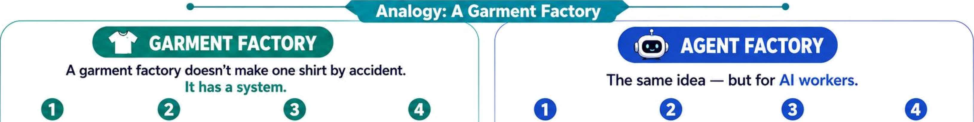
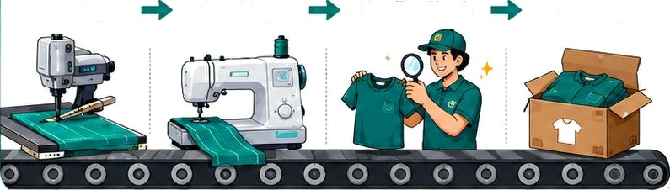
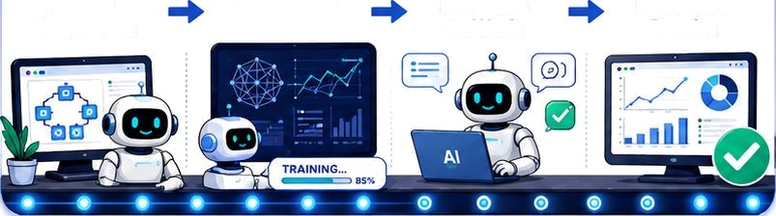


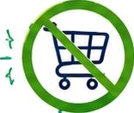


TheAgect Factory
’ . e e ’ . - . e
A garment factory doesn't make one shirt by accident.
The same idea — but for AI workers.
It has a system.
OOOOOOOO
Cutting Stitching gual'ity Check Packing ) n Train Them
PutThem to ¥\fork
Check the Results
A
REPEATABLE PROCESS
Design -+ Train -+ Deploy —+ Verify
NOT a product ’"
Not something you buy.
A practice you learn
A repeatable way to build and manage Al workers.
Al-Native Company -
A company where most workers are AI.

Slide 59













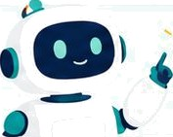

The Company With Invisible Employees
Old World
New World
10
Humans
10 human supervisors handle tricky cases and oversee AI
200
Humans
VS
190
AI Workers
190 AI workers handle routine questions 24/7
Phones + emails
Routine questions
.
AI handles
! instantly
Complex , - cases
Humans review
^
Fast service Instant answers most of the time
Lower cost Fewer humans to do the work
24/7
Always on.
day and night
Most workers are AI. Humans handle the tricky cases.
Al-Native Company
A company where most of the workers are AI, not human.
Customers barely notice the difference — they just get fast, good service.

Slide 60







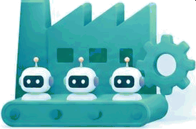



The Agent Factory Flow
Human sets the goal
Factory builds workers
Workers do the jobs
Results
delivered
Human gives direction -+ system builds Al workers -+ workers do the work
results return for human review

Slide 61
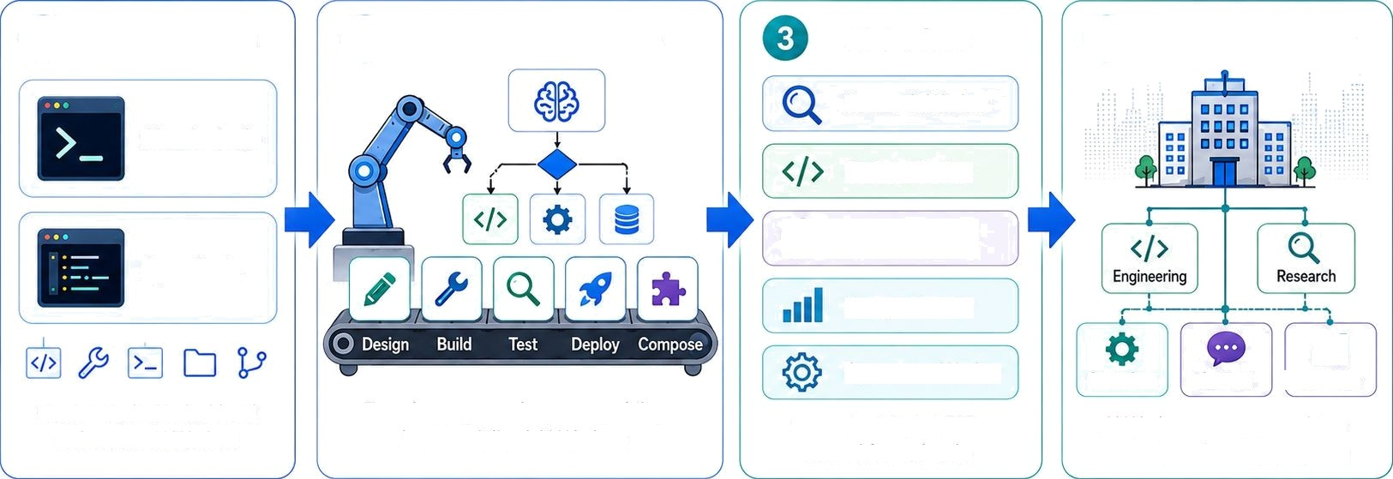
Agent Factory -
The process that manufactures Al Workers and composes them into an Al-Native Company
General Agents Agent Factory Process Al Workers
O
Al-Native Company
Research Worker
Claude Code
Coding Worker
Support Worker
OpenCode
Analyst Worker
4ll
I Analytics
Operations Worker
Operations Support
Used in Mode 2 to build and orchestrate AI Workers
Transforms general-agent capability into specialized AI Workers
Specialized Digital FTEs created for real tasks
AI Workers are composed into a coordinated company system
General agents create AI Workers.
Agent Factory organizes them into an Al-Native Company.

Slide 62

Your Personal AI Delegate
PART 07

Slide 63







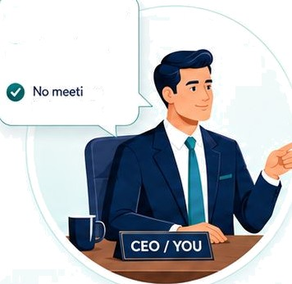
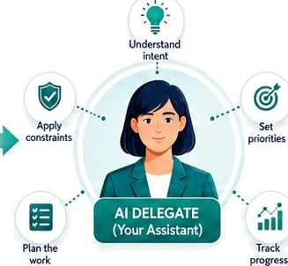

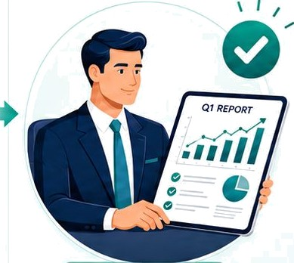









The Executive Assistant
C W
Delegate AI workforce
You set direction. Your AI delegate manages the work. You review the result.
Delegate coordinates
Intent
You set direction
You provide goals + guardrails
Your Al delegate
Understands your intent
You review & approve
You review the final cut
specialist AI workers
Behind the scenes
O |$/e_{d}Q,¹° "
_{O} Budget under
Re earch
!
S lakh
Schedule
o,a
ngs before 10am
coordinates
Analyze
Update
Secure ' Private • Always on
You approve the result
A A A A A A A
You do not manage 20 AI workers directly.
Your one detegate manages them for you.

Slide 64




The Two-Layer Model
EDGE LAYER
→
Your personal AI that knows your preferences,
carries your authority, and manages workers.
You
Your Delegate
AI WORKFORCE LAYER
Support Worker
Finance Worker
Sales Worker
Legal Worker

Slide 65
The 7 Principles of General Agent Problem Solving
PART 08

Slide 66
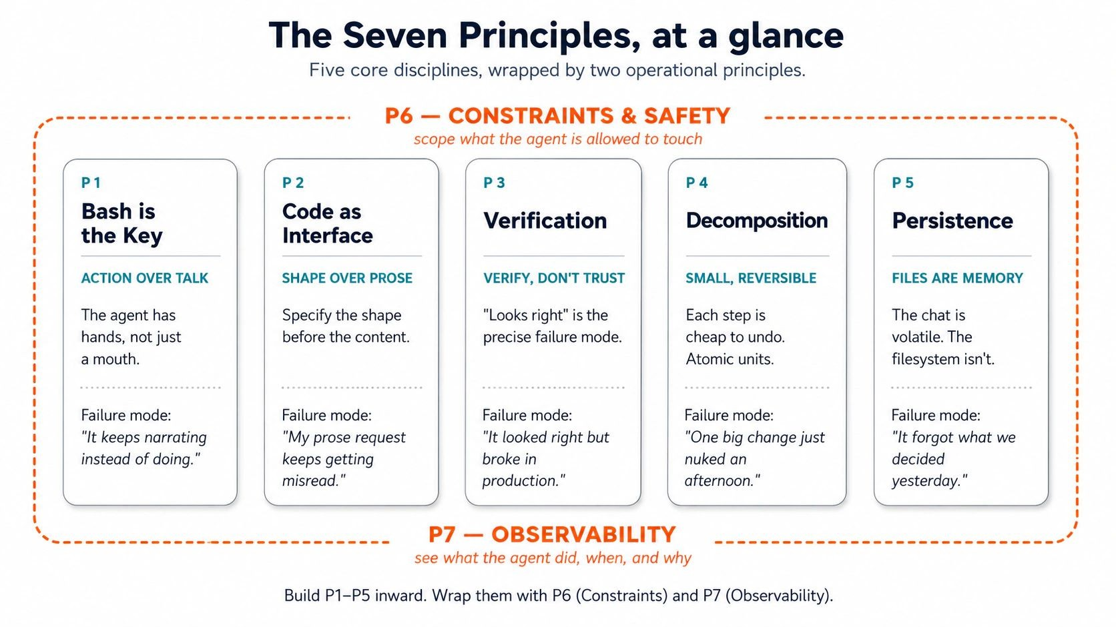

Slide 67
The 7 Golden Rules of an AI-Native Company (Invariants)
PART 09

Slide 68

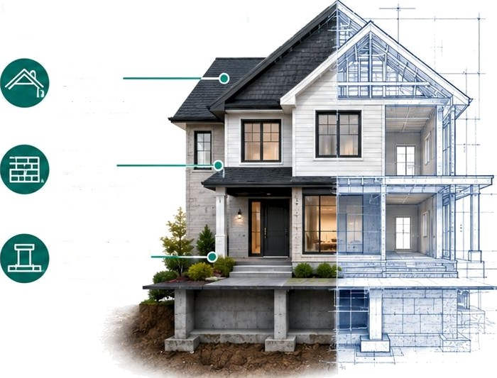










Building Rules That Never Change
Tools change. Structural rules don't.
ANALOGY
Non-negotiable rules
+ Choices can vary
For AI companies:
Roof Protects what's inside
Bricks or concrete
7 rules =
your building code
Walls
Give structure and shape
Toois change every year
Flat or sloped roof
Structural principles stay the same
Foundation
Supports everything
Tools change
Rules stay

Slide 69
The 7 Golden Rules (1–4)
1
Human is always in charge
Every action traces back to a human. AI never sets its own goals.
2
Every human gets a delegate (identic AI)
You can't manage 20 workers by hand. Your delegate coordinates.
3
Workforce needs a management layer
Someone hires, assigns tasks, controls budgets, fires underperformers.
4
Each worker uses the right engine
Important work = reliable engine. Simple work = cheap engine.

Slide 70
The 7 Golden Rules (5–7)
5
Every worker uses a system of record
AI workers read/write the company's official memory. Without it, AI makes things up.
6
Workforce can grow under rules
When a gap appears, the system hires a new worker automatically — within human-set limits.
7
Company runs on a nervous system
Just like your body sends signals automatically,"hand touched something hot, pull back!" the AI company sends work between workers automatically. No human needed to pass tasks along. And if something breaks, the system recovers on its own.
Tools change. Rules stay.

Slide 71

A Real Example: Ecomm Mart
PART 10

Slide 72
Building the Support Worker (Steps 1–3)
Step 1
Write Clear Instructions
Define the goal: read tickets, classify them, write replies, escalate hard cases. Set budget:
$200/month max.
Step 2
Connect to Company Records
Link to Shopify orders, customer database, and ticket system so the AI can look up real data.
Step 3
Give It Skills
Teach it: how to write professional replies, how to classify tickets, when to escalate. Like a training manual.

Slide 73
Building the Support Worker (Steps 4–5)
Step 4
Set the Guardrails
Budget cap, approval for big refunds, audit trail of every action. The AI can never go outside these limits, all will be define in specs
Step 5
Test, Then Deploy
Run on 100 old tickets first. Check results. Fix problems. Only then let it handle real customers.
Result: You just built a Digital FTE — a Full-Time Employee made of software. It works 24/7, stays within rules, and handles 80% of support tickets automatically.

Slide 74
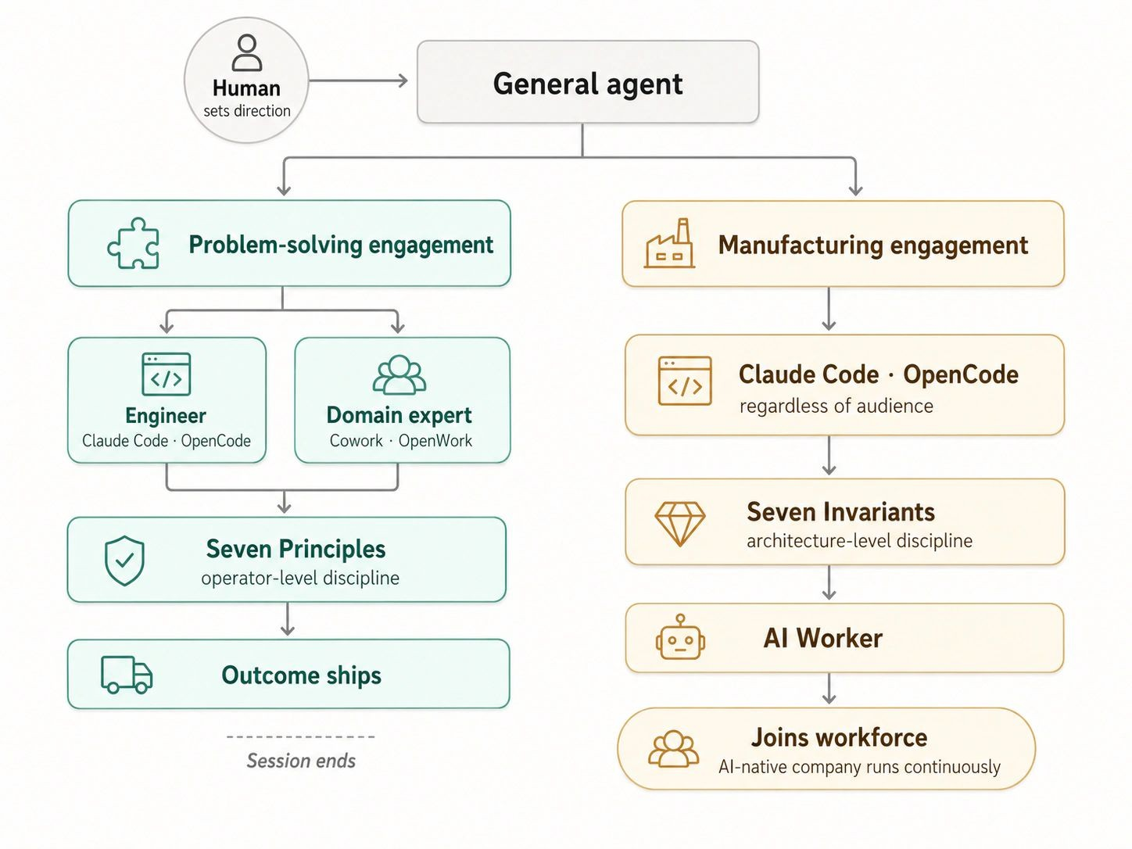

Slide 75

Key Vocabulary & What's Next
PART 11

Slide 76
Essential Vocabulary (1/2)
AI |  | Software that learns from data and makes decisions
Agentic AI |  | AI that plans, uses tools, fixes mistakes, completes jobs
AI Worker / Digital | FTE | AI built to do one specific job, like a human employee
Agent Factory |  | The method for building AI workers (a practice, not a product)
AI-Native Company |  | Company where most workers are AI, selling results not tools

Slide 77
Essential Vocabulary (2/2)
Delegate Your personal AI that manages the workforce for you
System of Record
Company's official memory — the single source of truth
Spec Clear written instruction: goal, limits, budget, success criteria
10-80-10 Rule
Human direction (10%) + AI work (80%) + Human check (10%)

Slide 78

AI is software that learns and makes decisions. Agentic AI takes this further — it plans, uses tools, and completes entire jobs.
TODAY'S BIG IDEAS — IN ONE BREATH
The Agent Factory is the method for building AI workers and organizing them into AI-Native Companies where AI does the work and humans set direction and check quality.
You're not being replaced — you're being promoted from worker to director.
The future belongs to people who can clearly tell AI what to do, connect it to real data, and verify the results are correct.
That's what this program will teach you. Welcome aboard.

Slide 79
Thank You
Your journey into Agentic AI starts now.
Based on the Agent Factory Thesis agentfactory.panaversity.org

