Slide 1

Computer Graphics
Dr. Akram Alsubari

Slide 2

realistic drawing of a cube
how do we describe the cube?
Vertices
Edges
How do we then visualize in 2D?

Slide 3
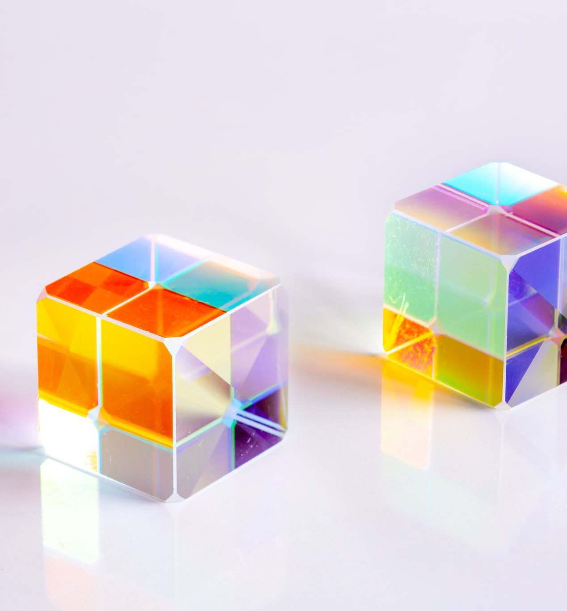
Example for the cube modeling
Suppose our cube:
centered at the origin (0,0,0)
dimensions 2 x 2 x 2
What are the coordinates of the cube vertices and edges?
Vertices {A: ( 1, 1, 1 ) B: (-1, 1, 1 ) C: ( 1,-1, 1 ) D: (-1,-1, 1 ) E: ( 1, 1,-1 )F: (-1, 1,-1 )G: ( 1,-1,-1 )H: (-1,-1,-1)}
Edges {AB, CD, EF, GH,AC, BD, EG, FH,AE, CG, BF, DH}

Slide 4
drawing the cube
How do we draw this 3D cube as a 2D (Flatten) image?

Slide 5

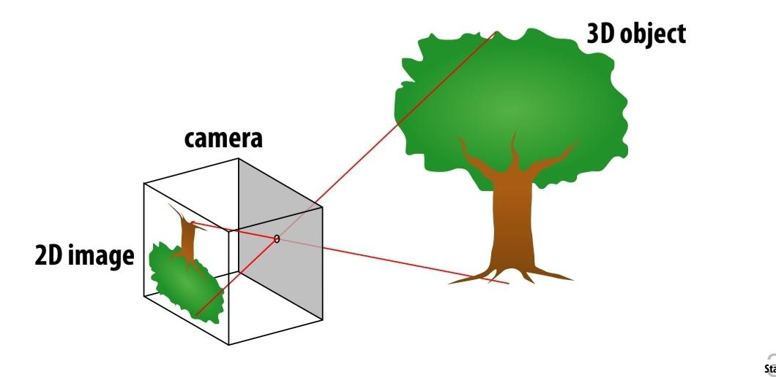
Perspective projection
Objects look smaller as they get further away (“perspective”)

Slide 6
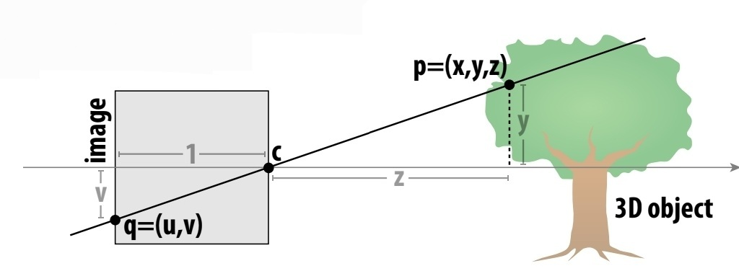
side view
Where exactly does a point p = (x,y,z) on the tree end up on the image?
Let’s call the image point q=(u,v)
Assume camera has unit size, coordinates relative to pinhole c
Then v/1 = y/z… v = y/z
Likewise, horizontal u= x/z

Slide 7

camera position
Step 1: Define Cube Geometry and Camera
Realistic Coordinates 8 points (X,Y,Z)
Camera Position (Cx,Cy,Cz)
Step 2: Compute Screen Coordinates
Subtract the camera position: (x,y,z) = (X-Cx, Y-Cy, Z-Cz)
Divide x,y by z to get the 2D Coordinates
Closer to the camera (smaller z), so larger in the projection.
Farther from the camera (larger z), so smaller

Slide 8
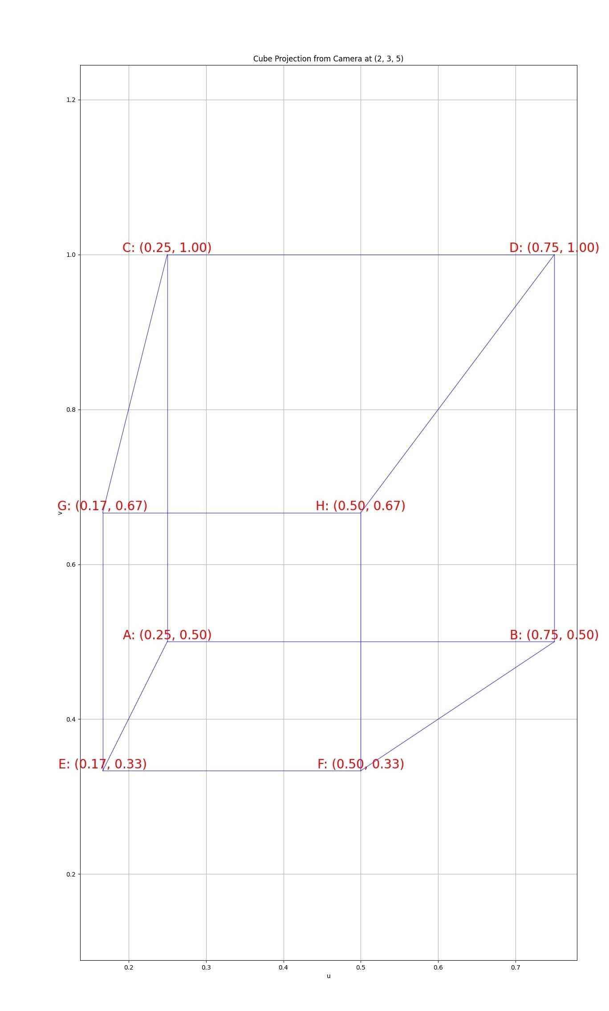
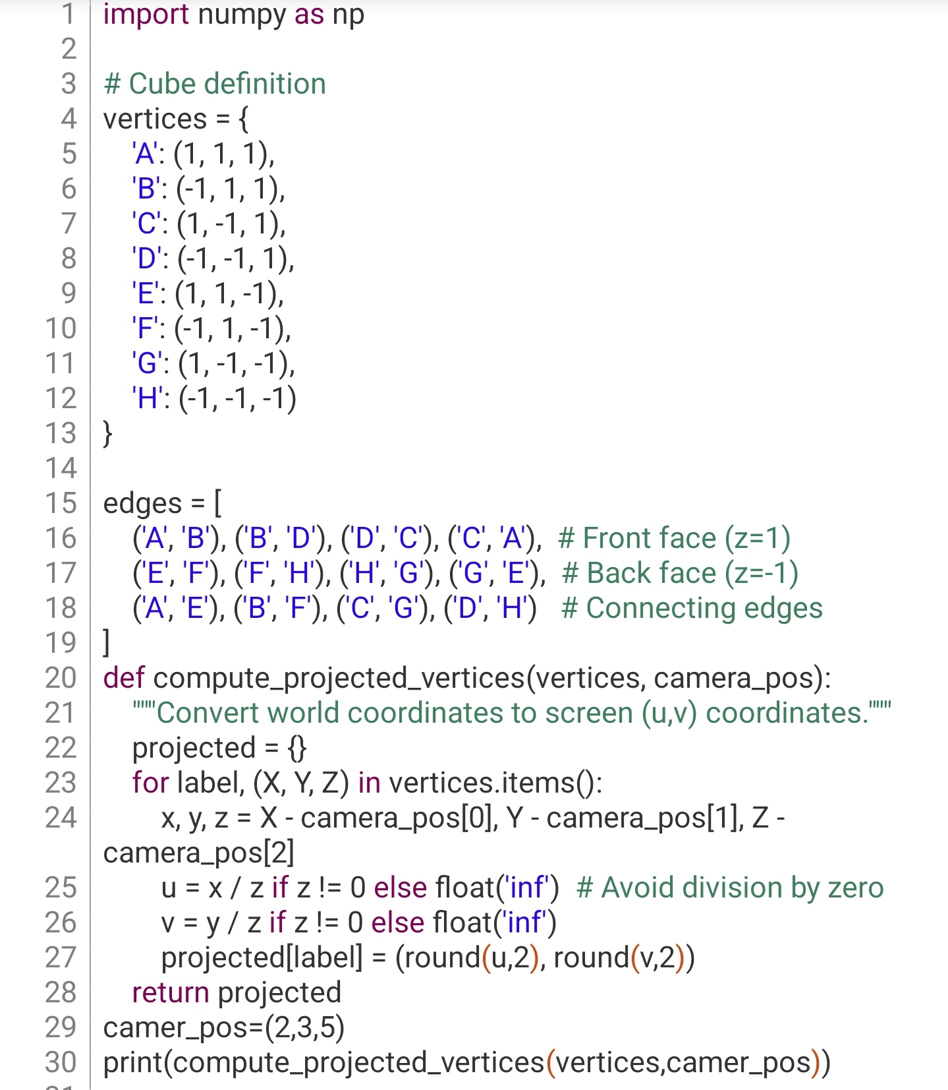
Python Code example
{'A': (0.25, 0.5), 'B': (0.75, 0.5), 'C': (0.25, 1.0), 'D': (0.75, 1.0), 'E': (0.17, 0.33), 'F': (0.5, 0.33), 'G': (0.17, 0.67), 'H': (0.5, 0.67)}[Program finished]

Slide 9
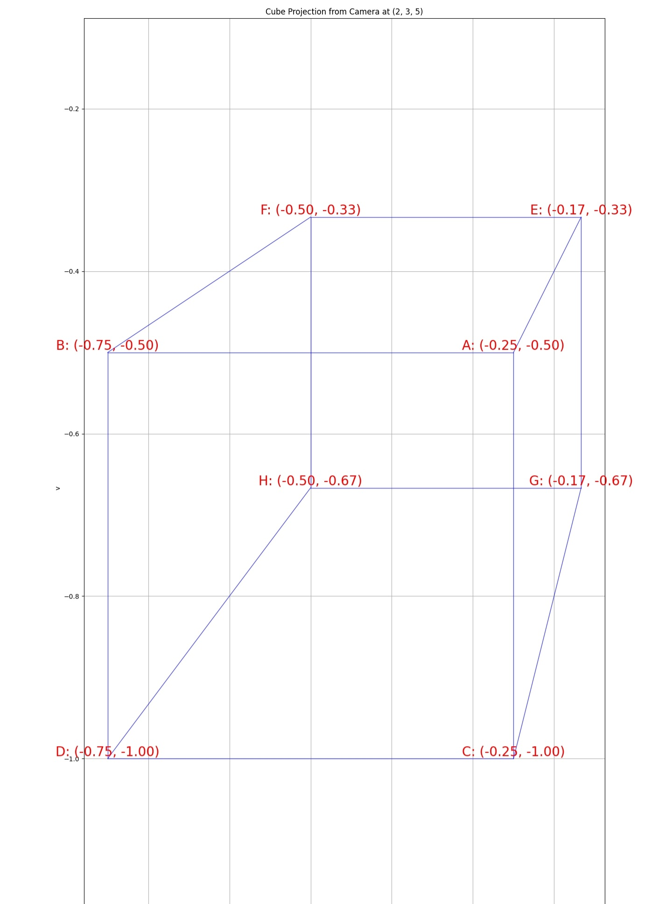
Mirror image
The projection image is mirror, so to resolve the visual multiple Coordinates by -1

Slide 10
Tasks
- Draw the lines between vertical using different lines algorithm

Slide 11
Object segmentation
Reign Boundaries
Valleys detection

