Slide 1

almosnif1095@gmail.com
Lab 1
Data Mining
IT3
Eng:Malek Almosanif

Slide 2
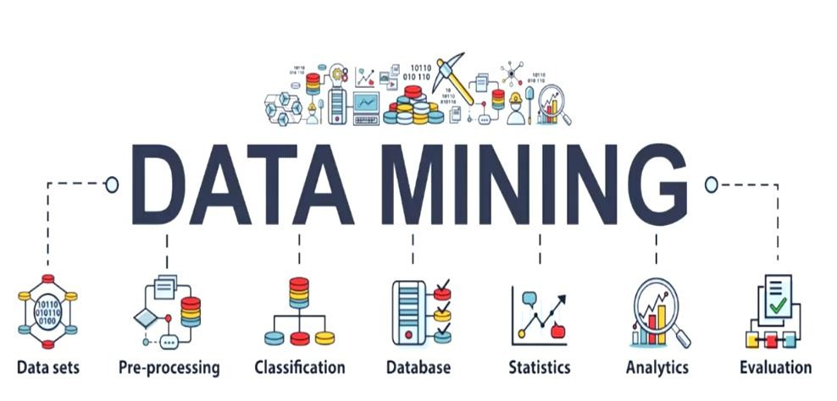

Slide 3
Outline
What is Data Mining ?
Why Data Mining ?
Knowledge Discovery (KDD) Process
Data Mining Tasks
Summary

Slide 4




02
03
01
04

Slide 5
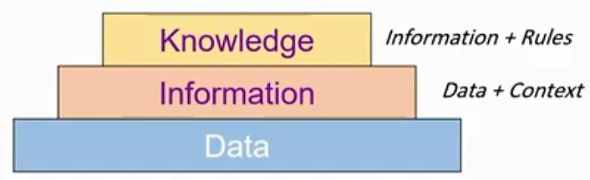
Data Pyramid
Wisdom
Knowledge + Experience

Slide 6

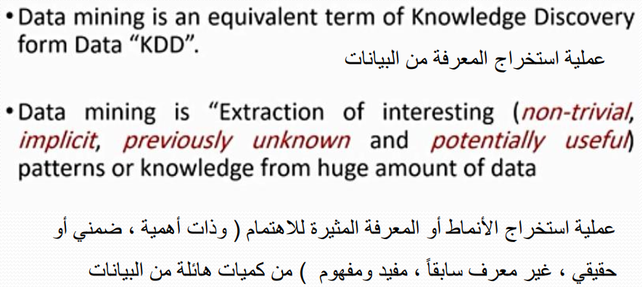

Slide 7
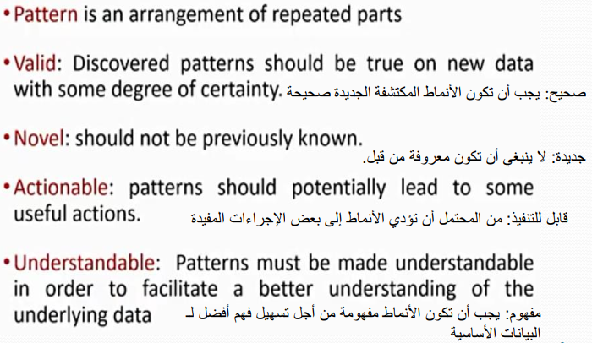
What is Data Mining ?

Slide 8
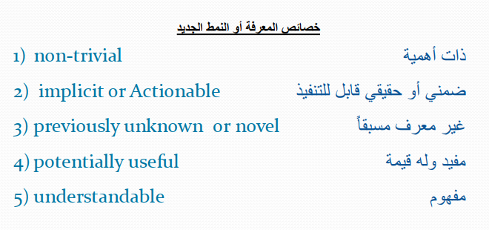
Characteristics of knowledge or new pattern

Slide 9
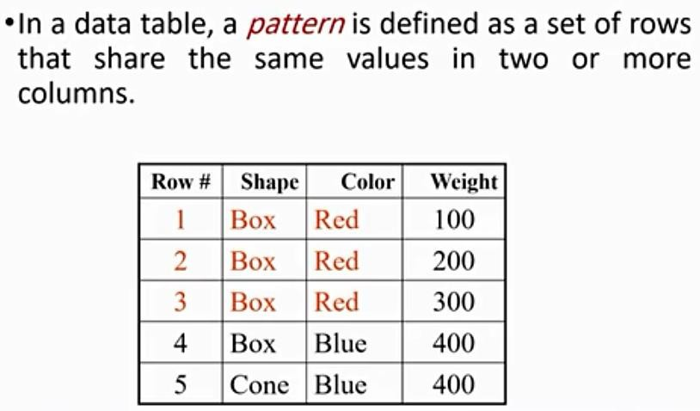
What is Data Mining ?

Slide 10
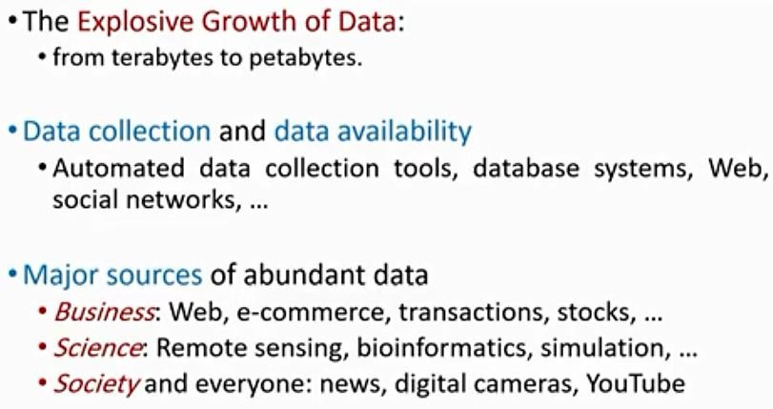
Why Data Mining ?

Slide 11
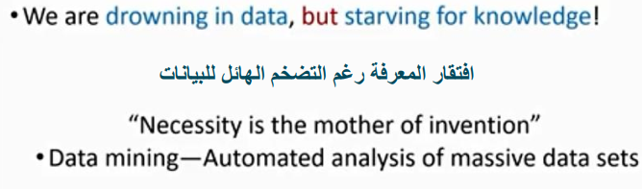
Why Data Mining

Slide 12
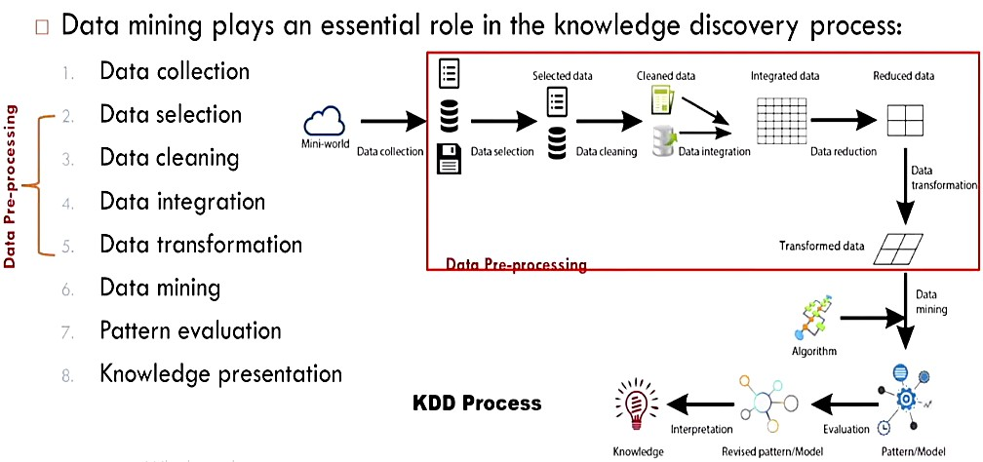
Knowledge Discovery (KDD) Process

Slide 13
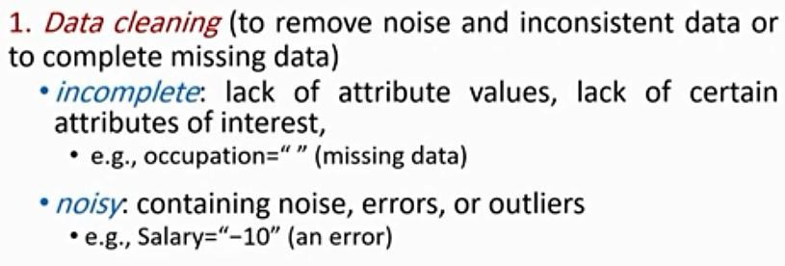

Knowledge Discovery (KDD) Process

Slide 14
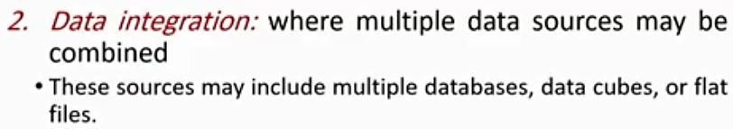
Knowledge Discovery (KDD) Process

Slide 15

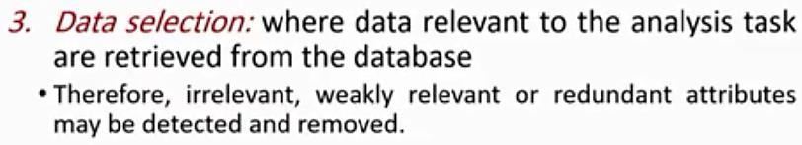

Slide 16
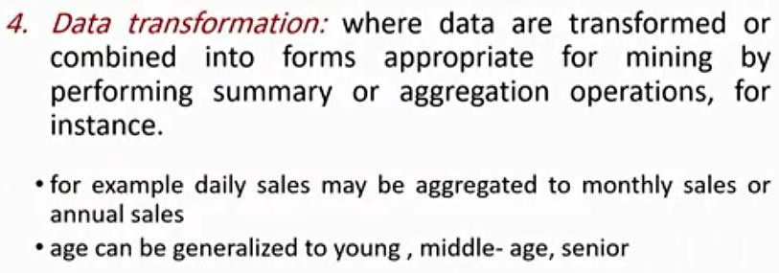

Slide 17
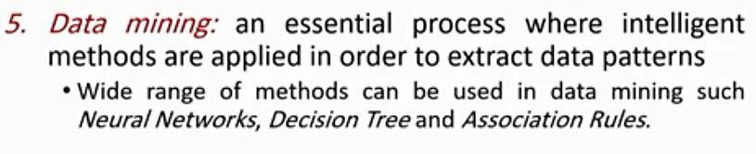
Knowledge Discovery (KDD) Process

Slide 18
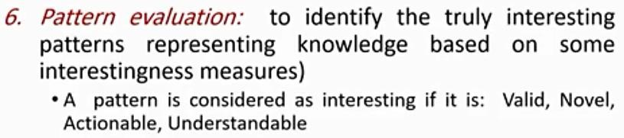
Knowledge Discovery (KDD) Process

Slide 19
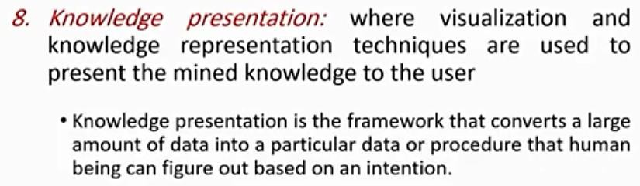

Knowledge Discovery (KDD) Process

Slide 20
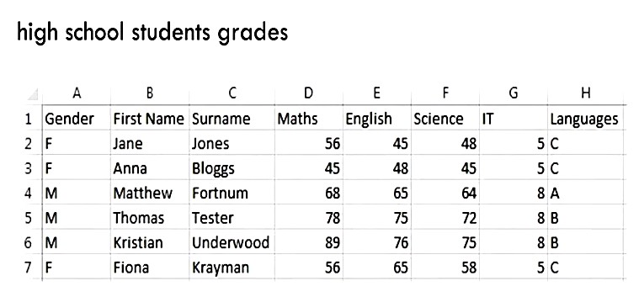
Data set

Slide 21
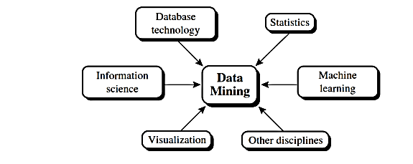
Data Mining - interdisciplinary

Slide 22
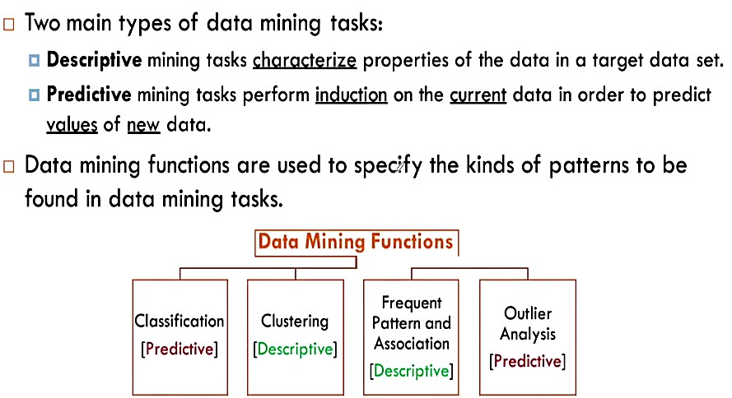
Data Mining Tasks

Slide 23
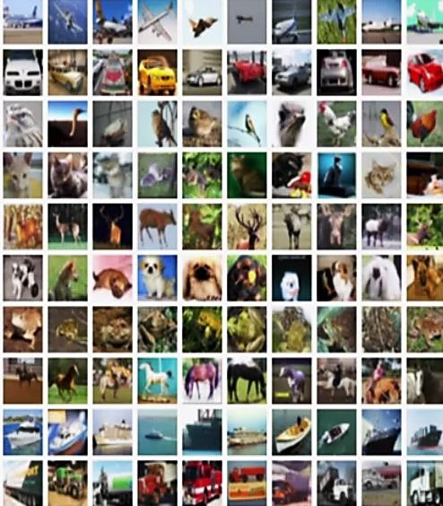

Data Mining Tasks : Example

Slide 24
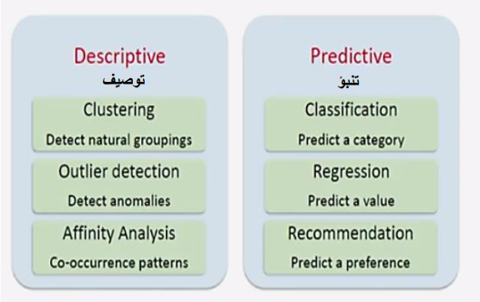
Descriptive vs Predictive

Slide 25
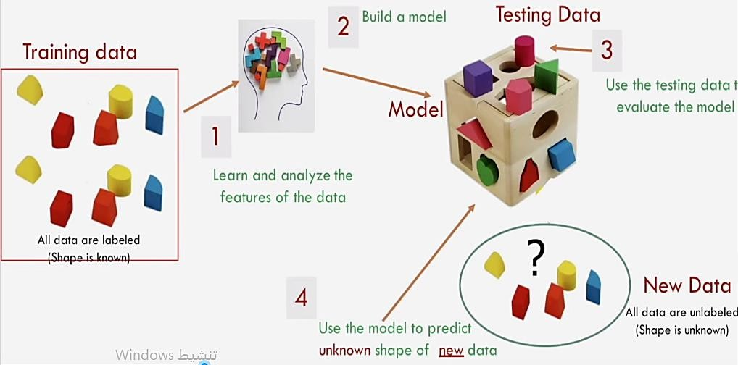

A simple metaphor for the concept of classification

Slide 26





Training Data vs Test Data
Data
Training | Test

Slide 27
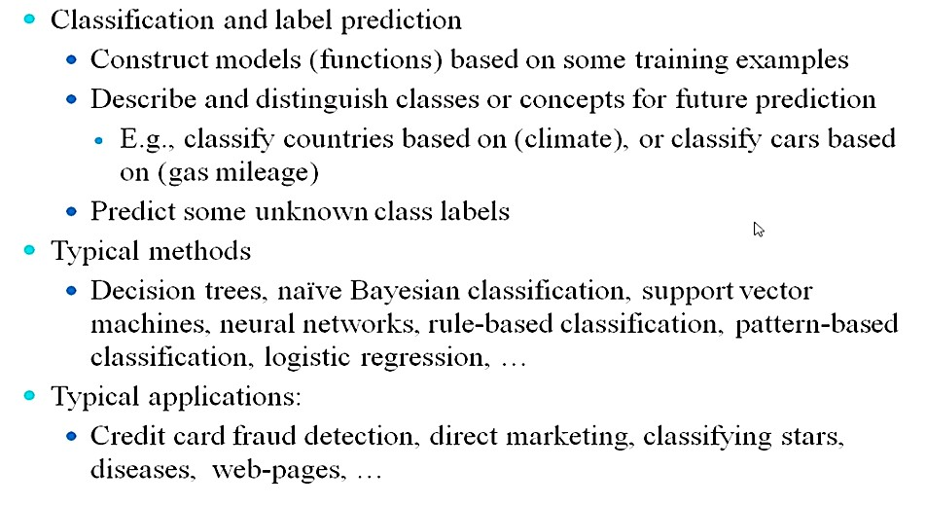
Data Mining Function : (1)Classification

Slide 28
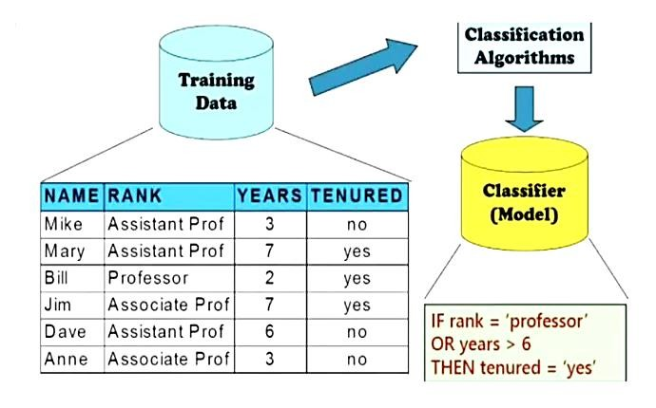
Classification : Example

Slide 29
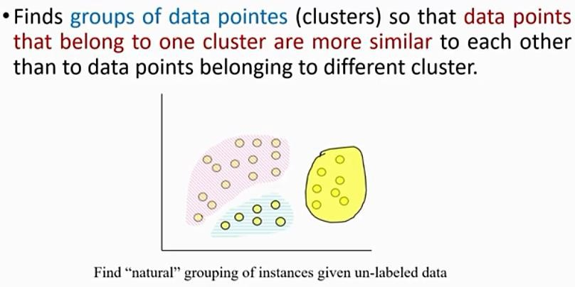

Data Mining Tasks : (2) Clustering

Slide 30

Clustering : Example

Slide 31
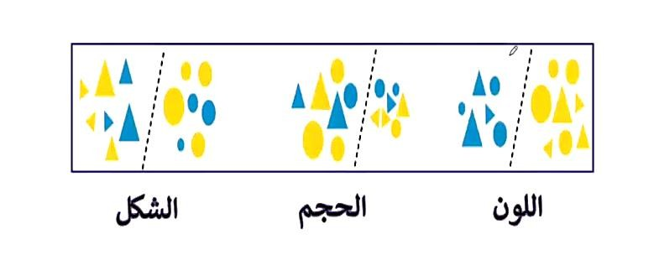
Clustering : Example

Slide 32
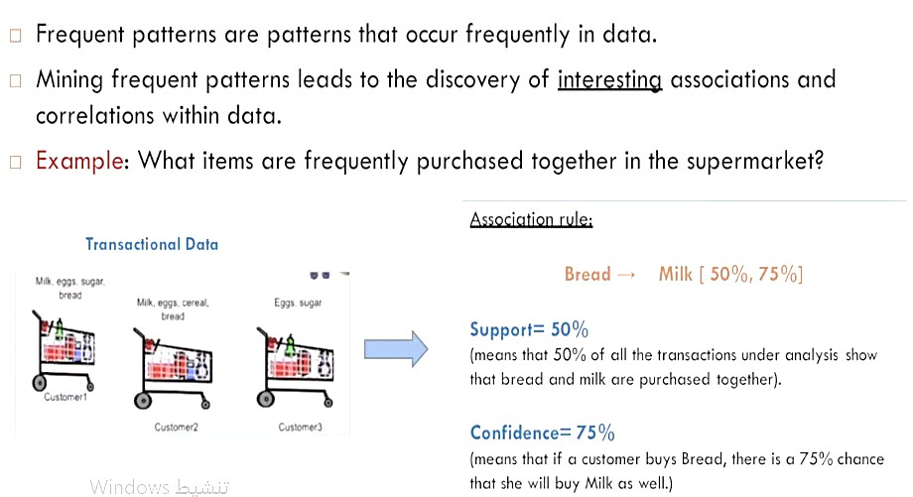

Data Mining Function (3)
Frequent patterns , Association and Correlation Analysis

Slide 33
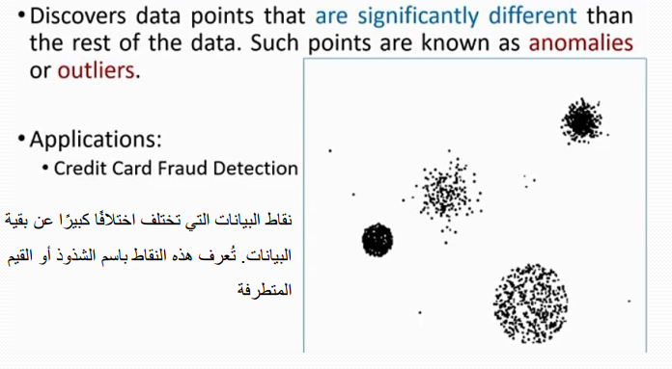
Data Mining Task (4) : Outlier Analysis

Slide 34
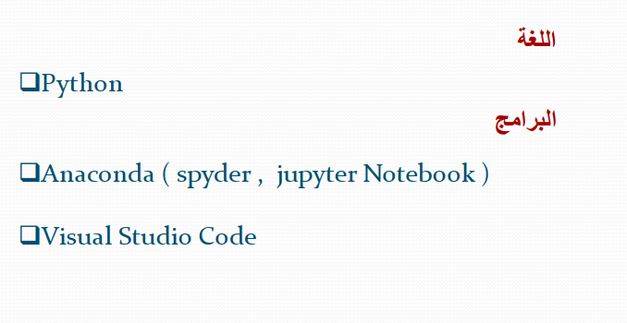

Slide 35
Data Sets

Slide 36
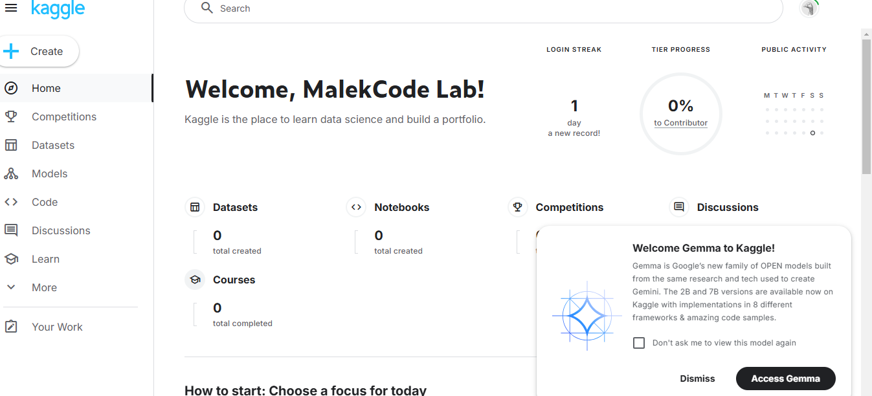
Dataset Sources

Slide 37
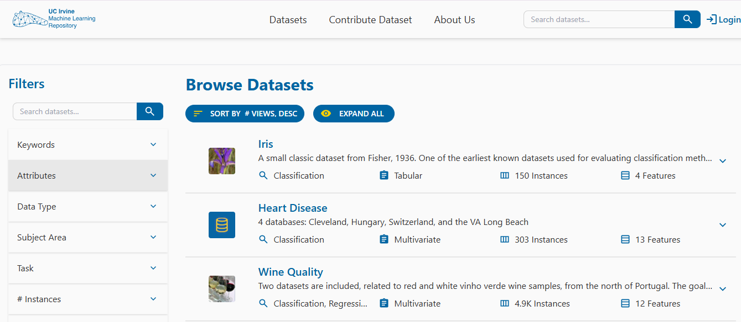
Dataset Sources

Slide 38
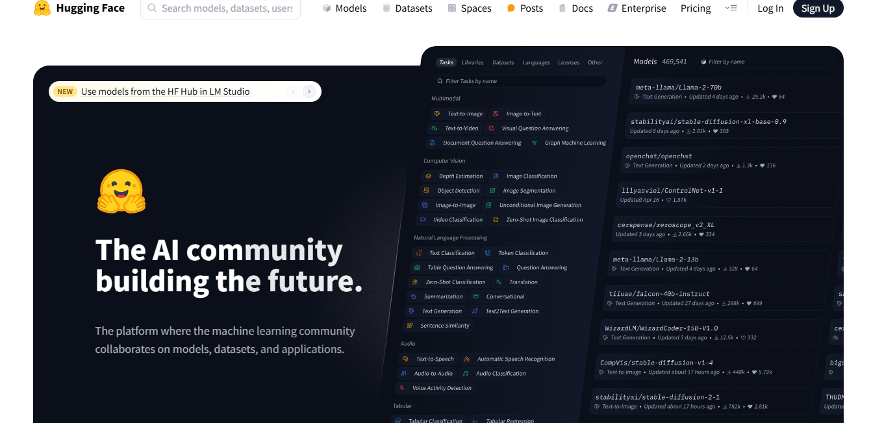
Dataset Sources

Slide 39
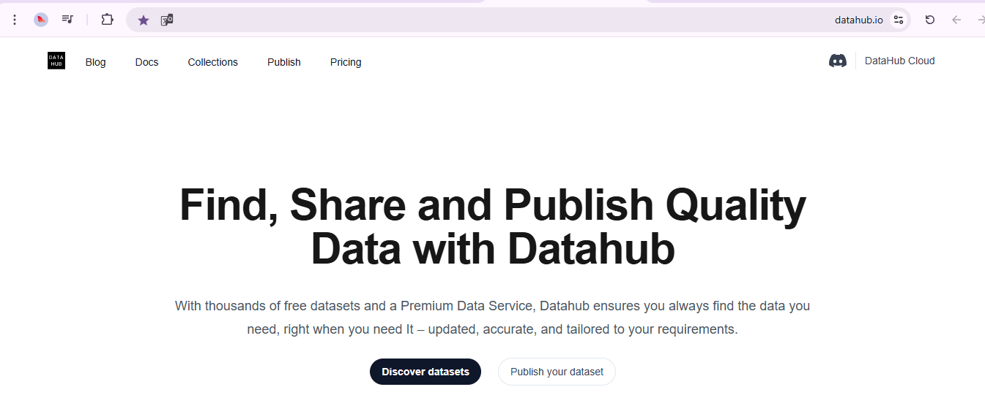
Dataset Sources

Slide 40
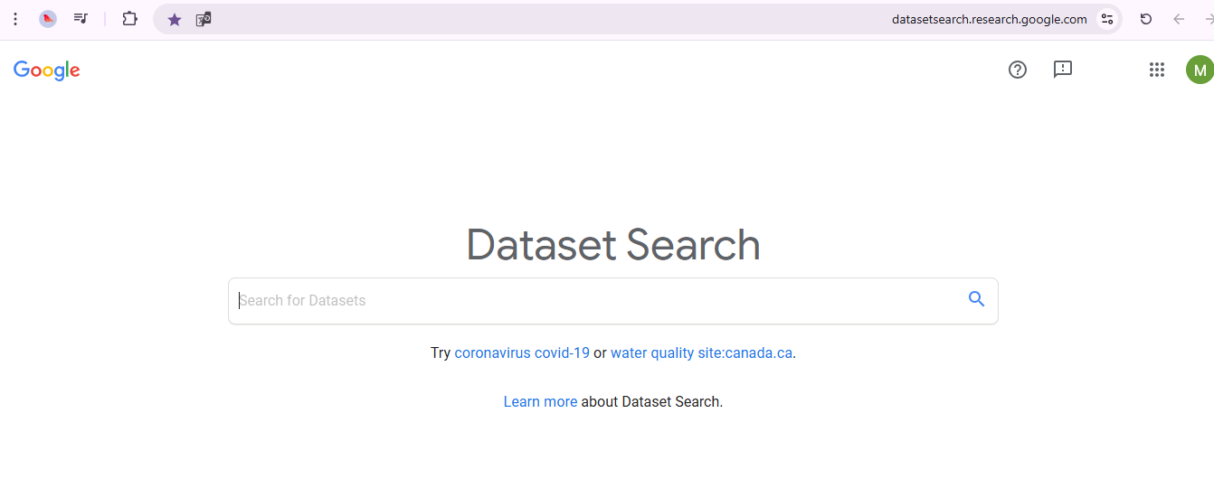
Dataset Sources

Slide 41
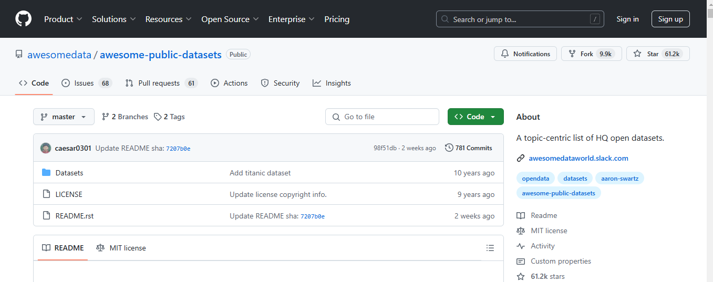
Dataset Sources

Slide 42
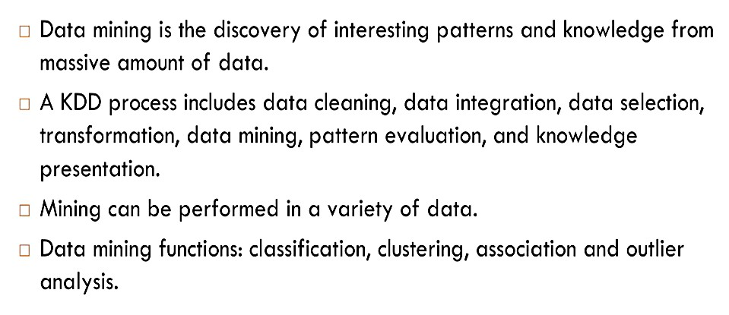
Summary

Slide 43
Thank You.

