Slide 1

almosnif1095@gmail.com
Lab 4
Data Mining
IT3
Eng:Malek Almosanif

Slide 2
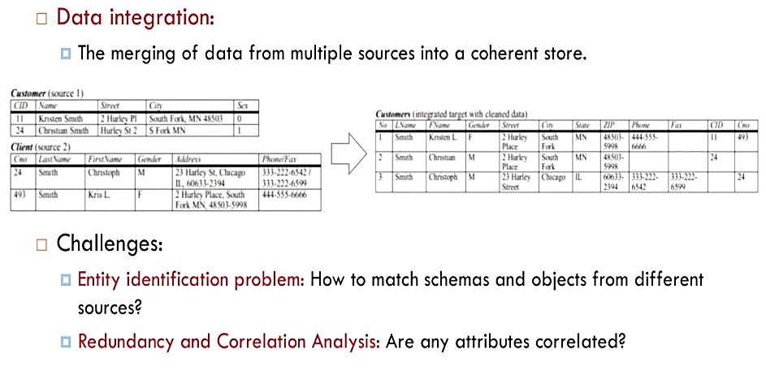
Data Integration

Slide 3
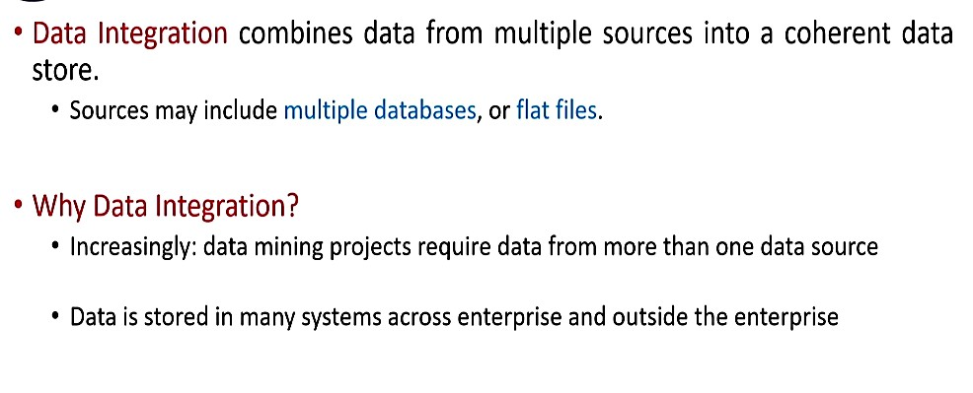
Data Integration

Slide 4
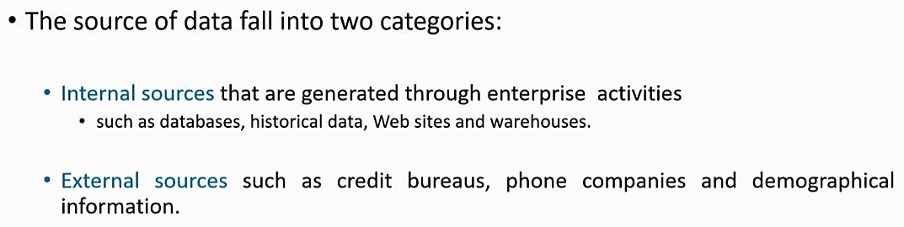
Data Integration

Slide 5
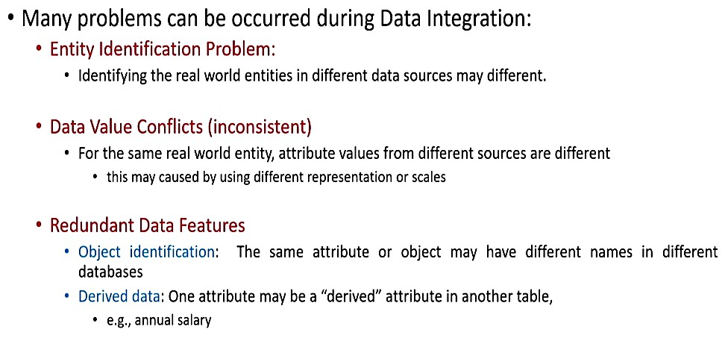
Data Integration

Slide 6
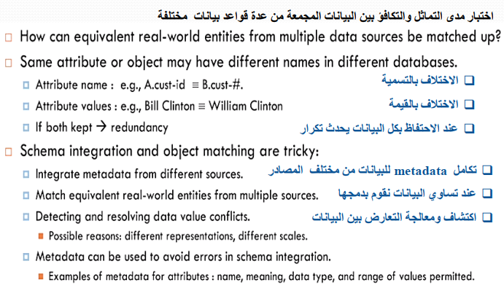
Entity Identification problem

Slide 7
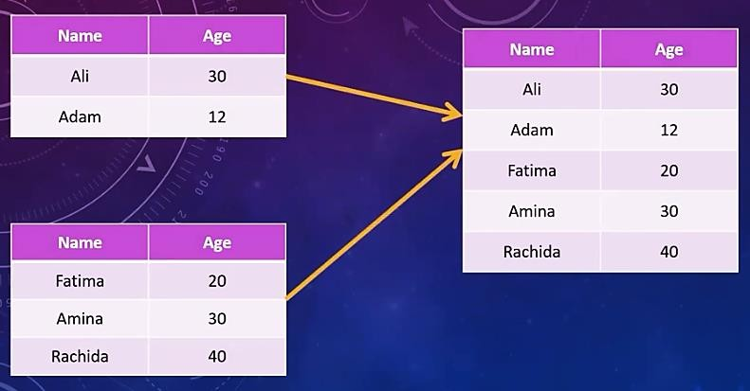
Data Integration

Slide 8
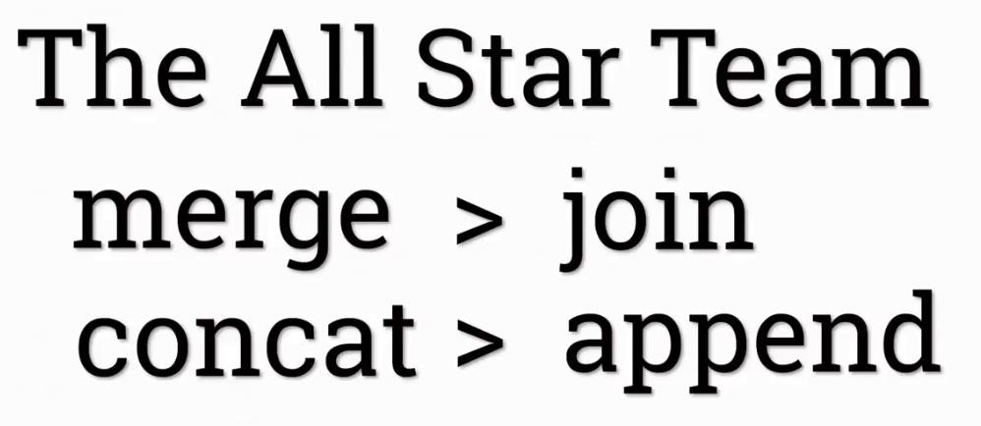
Type the Data Integration

Slide 9
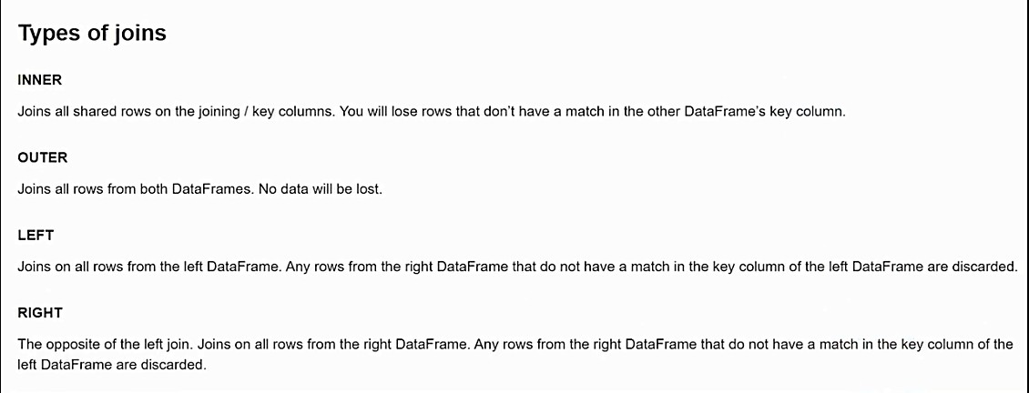
Data Integration

Slide 10
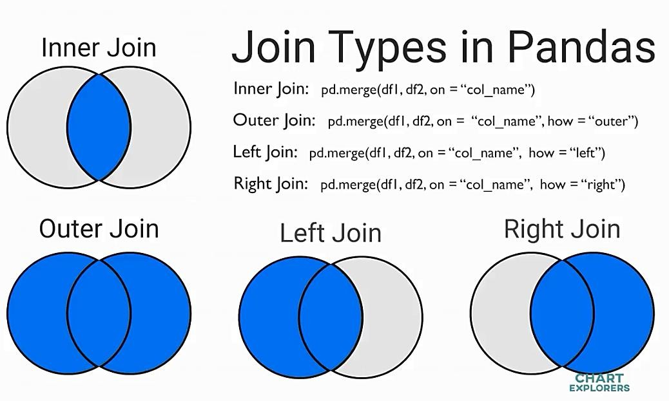
Data Integration

Slide 11
Thank You.

