Slide 1

almosnif1095@gmail.com
Lab 8
Data Mining
IT3
Eng:Malek Almosanif

Slide 2
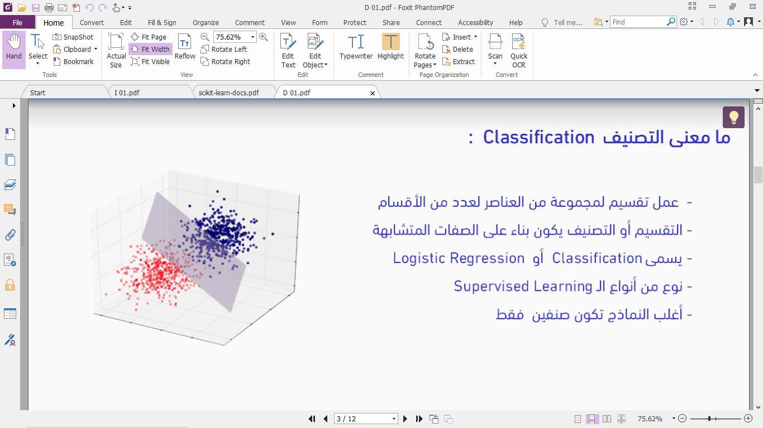
Classification

Slide 3
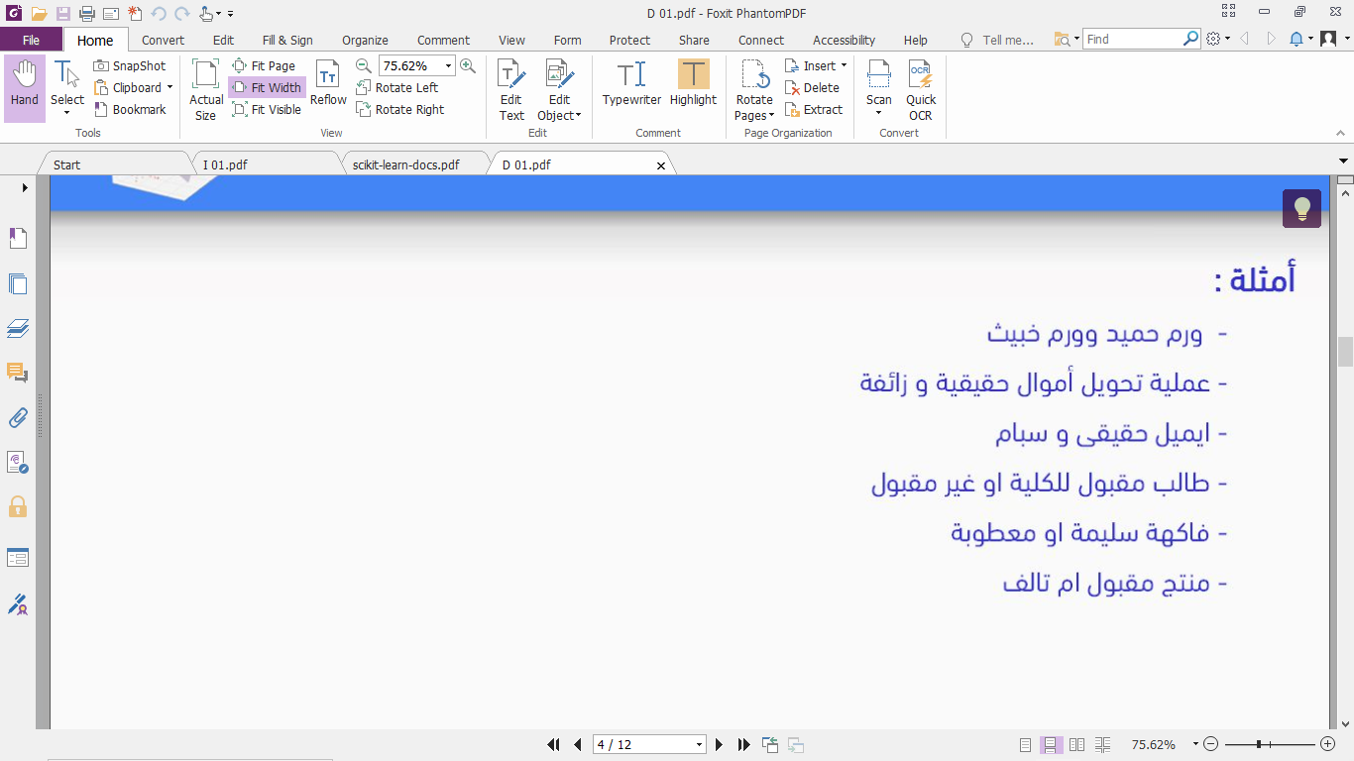
Classification

Slide 4
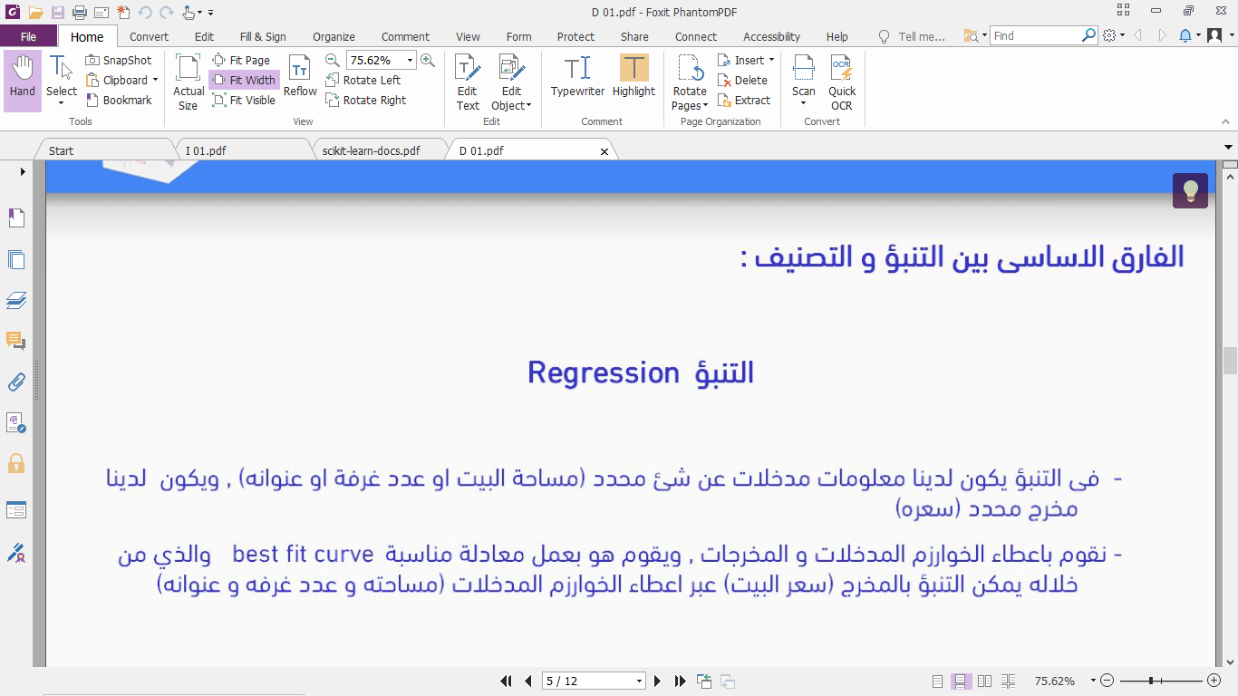
Classification

Slide 5

Classification

Slide 6
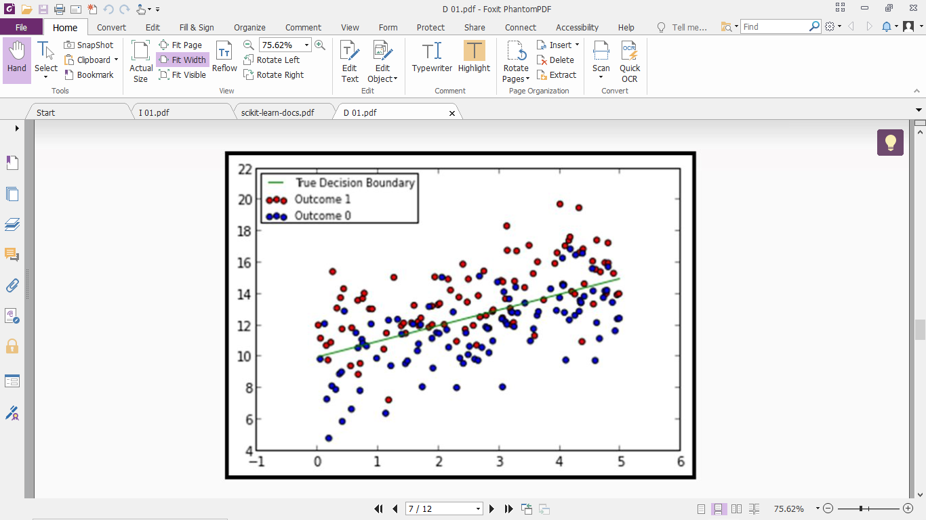
Classification

Slide 7
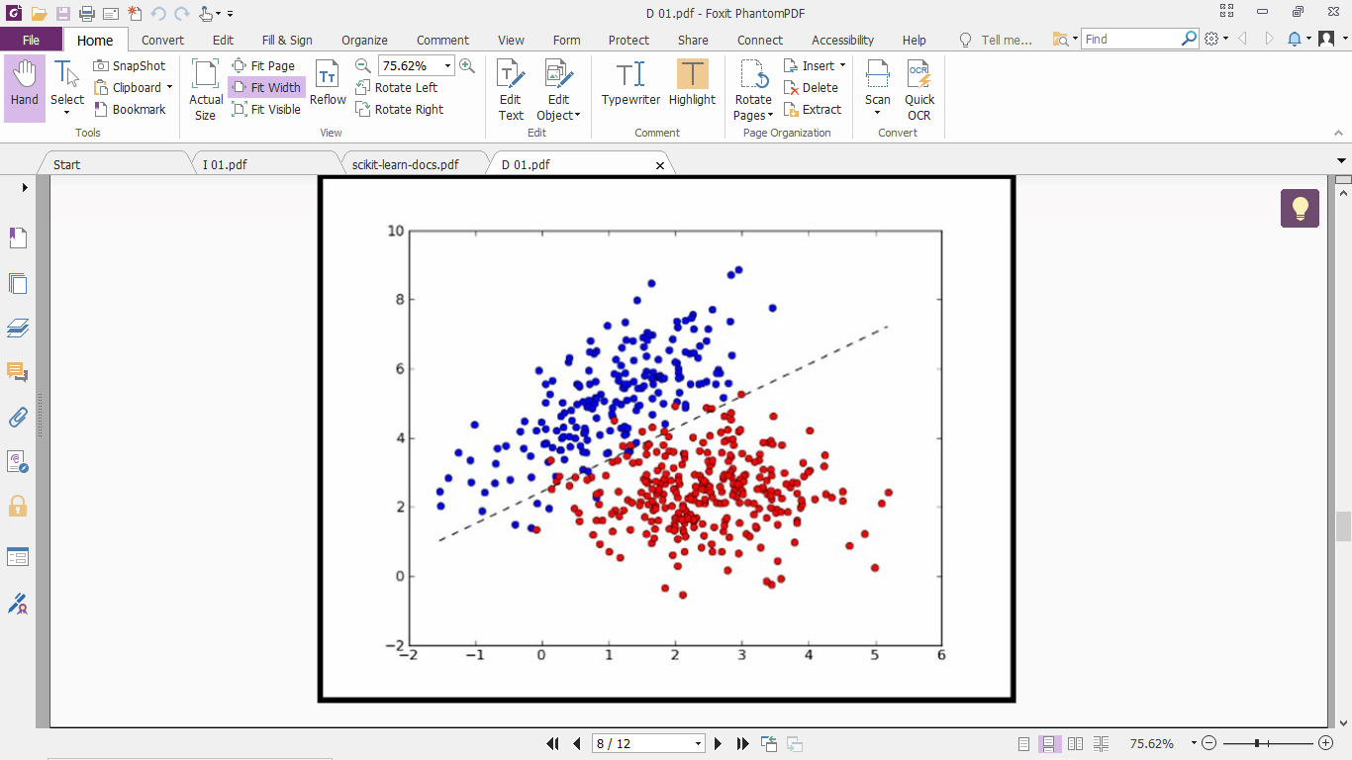
Classification

Slide 8
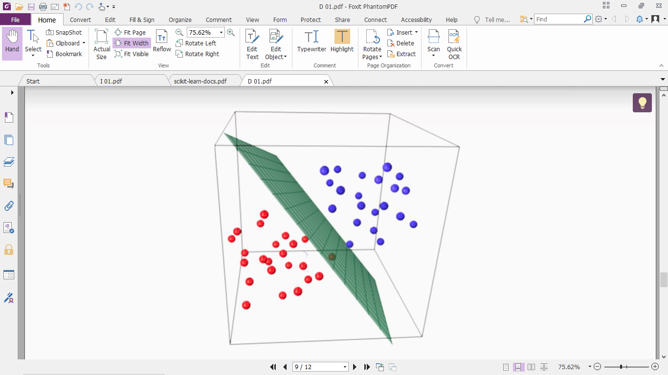
Classification

Slide 9
Famous Classification Algorithms
Decision Tree
Random Forest
SVM
Logistic Reg
Naïve Base
KNN
ANN

Slide 10
Decision Tree

Slide 11
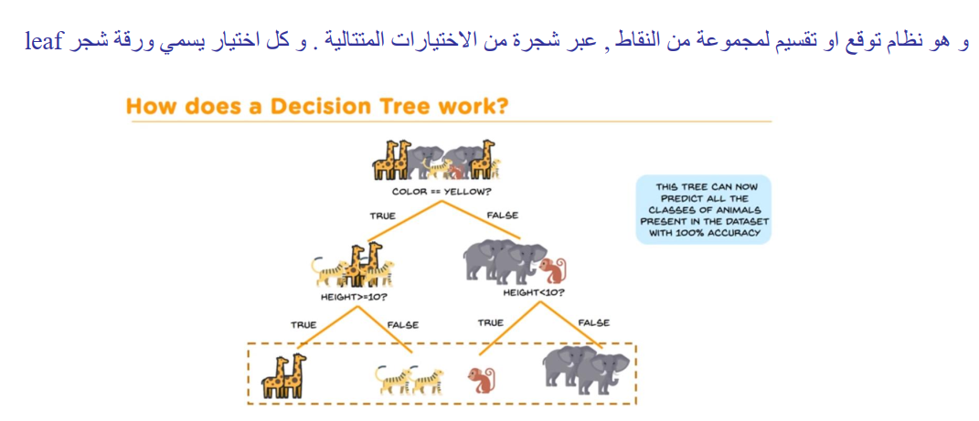
Decision Tree

Slide 12
Classification
Classification
Algorithms
Training
Data
Classifier
(Model)
IF rank = ‘professor’
OR years > 6
THEN tenured = ‘yes’

Slide 13
Classification
Classifier
Testing
Data
Unseen Data
(Jeff, Professor, 4)
Tenured?

Slide 14
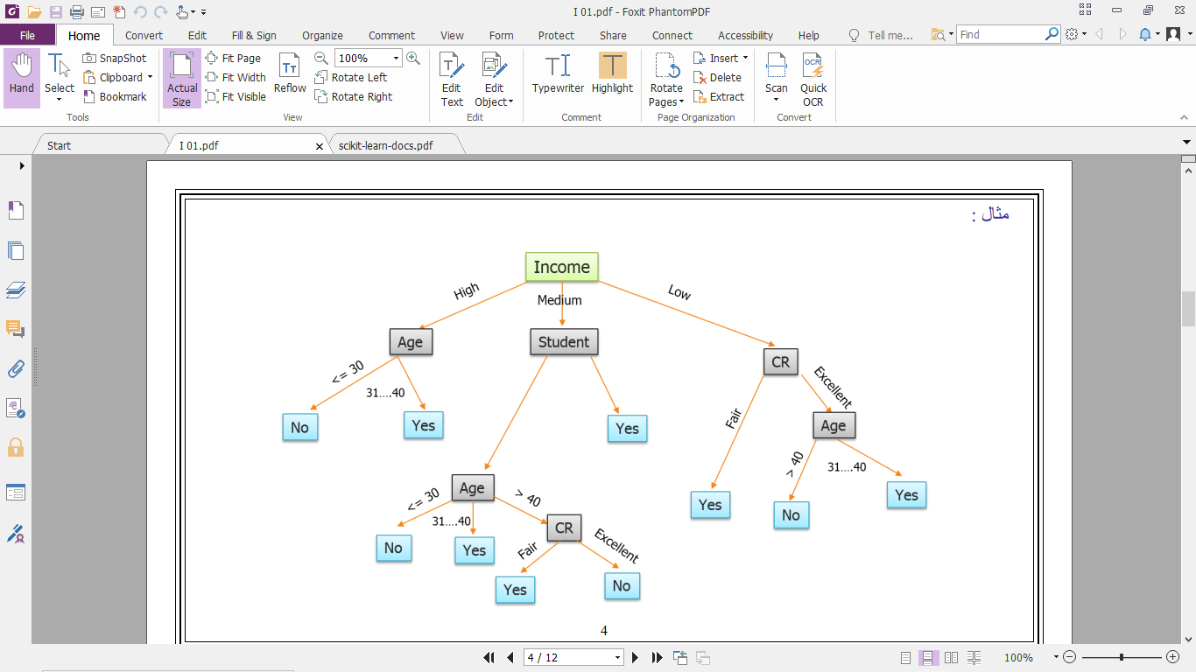
Decision Tree
Training data set: Buys_computer

Slide 15
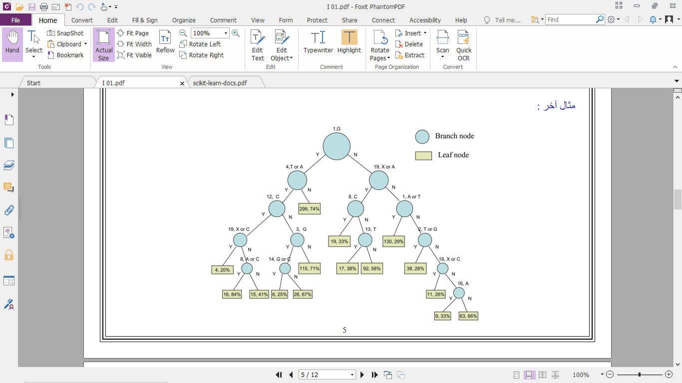
Decision Tree

Slide 16
How to choose the best attribute at each node
information gain
”Entropy”
Gini Impurity

Slide 17
Classification Metrices

Slide 18
Confusion Matrix
- | Pred Positive | Pred Negative
Actual Positive | TP | FP
Actual Negative | FN | TN
Ex:
y_pred = ['a','a','b','b','a','b','a','a','a','a']
y_true = ['a','b','b','a','b','a','a','b','a','b']

Slide 19
Confusion Matrix
y_true = ['a','b','b','a','b','a','a','b','a','b’]
y_pred = ['a','a','b','b','a','b','a','a','a','a']
- | Pred a | Pred b
Actual a | 3 | 2
Actual b | 4 | 1

Slide 20
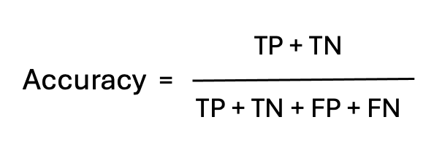
Accuracy

Slide 21
Accuracy

Slide 22
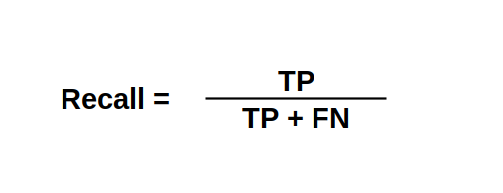
Recall

Slide 23
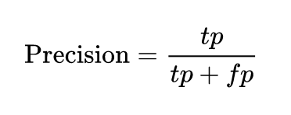
Precision

Slide 24
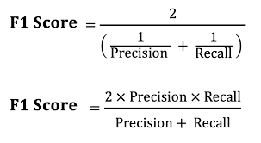
F1 Score

Slide 25
Thank You.

