Slide 1



Salford & Co.
HOME
SERVICE
ABOUT US
CONTACT US
JUST IN TIME
COMPANY
Logistics and Supply Chain Management

Slide 2
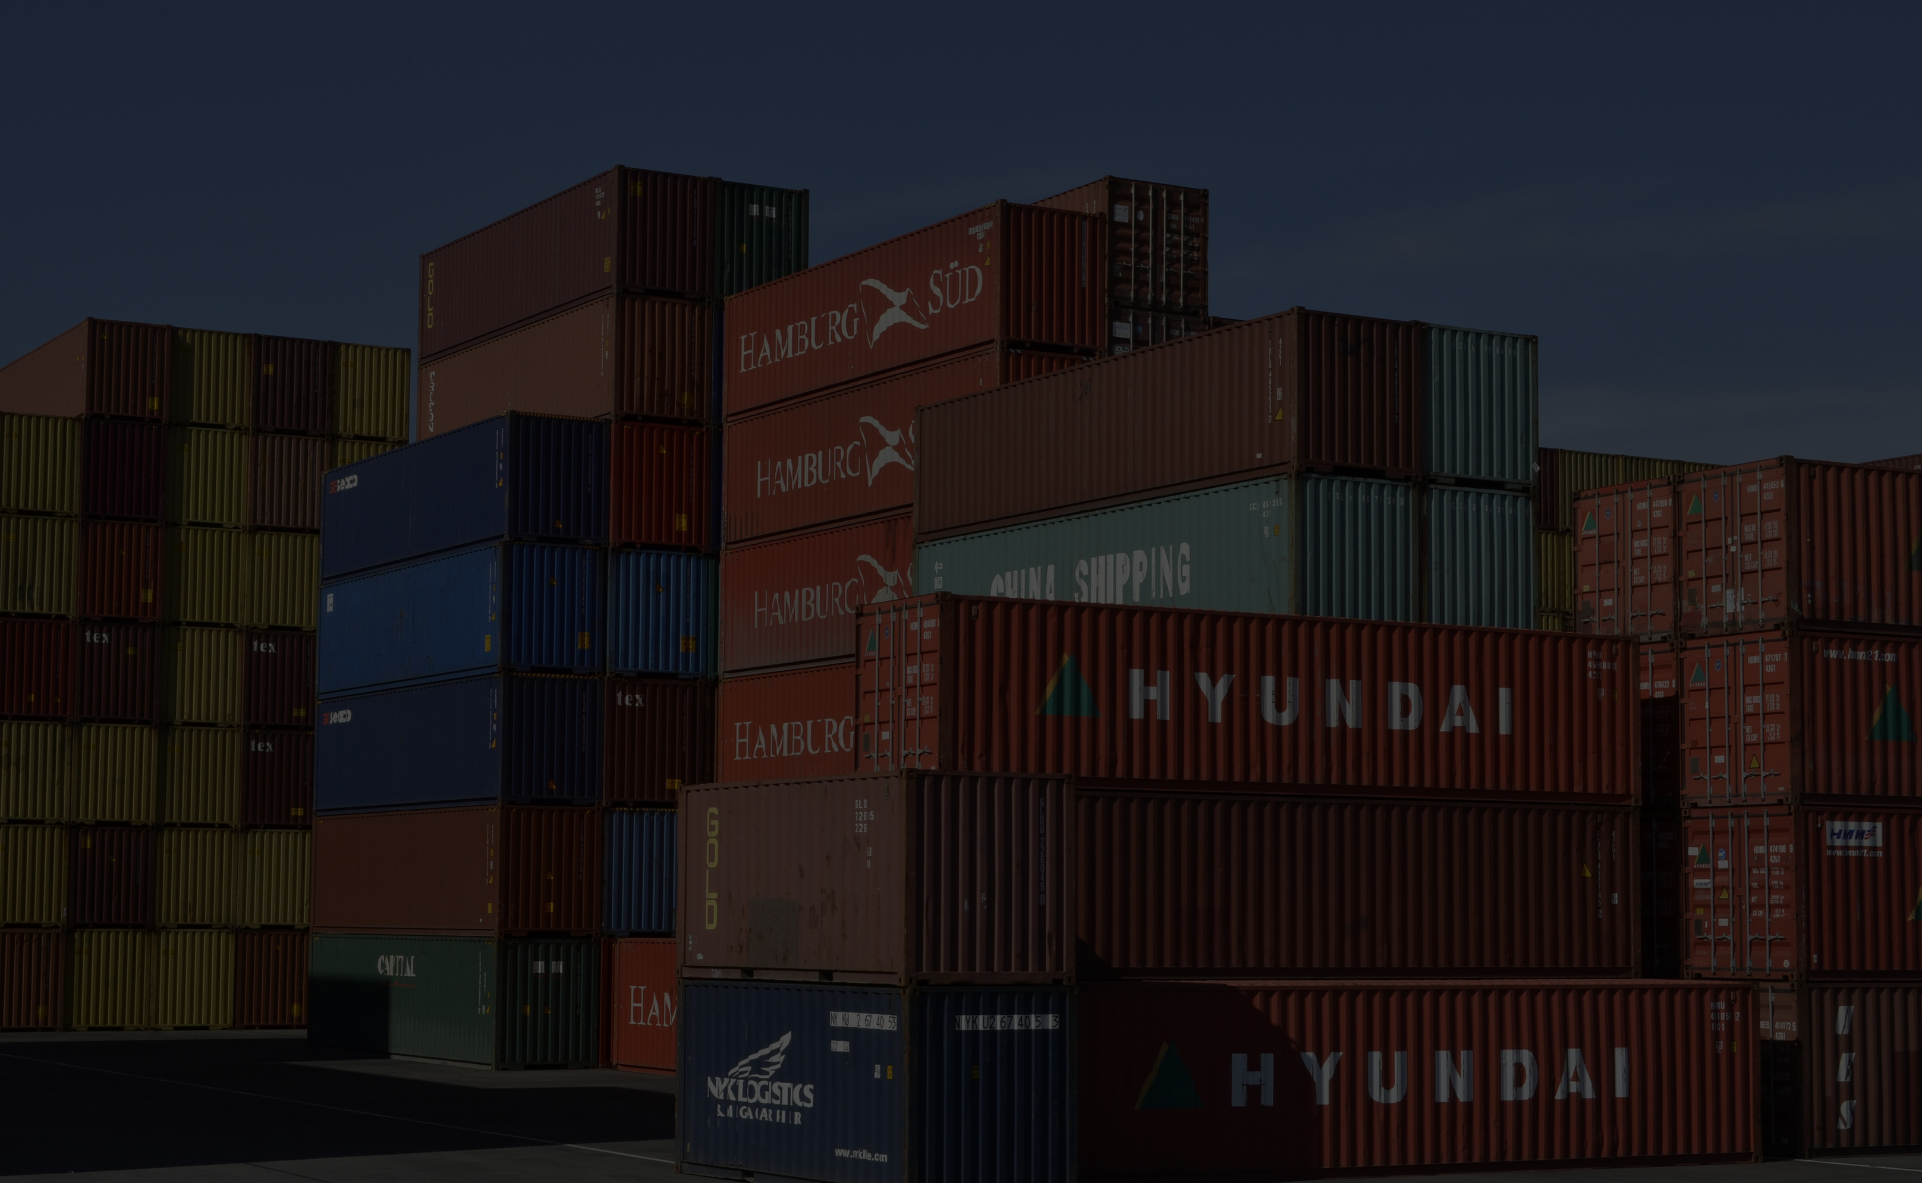
ONL3_DATA2_G1
Lecture’s Name: Eng/ Ahmed Abdel Latif
Team Leader : Osama Hamza Team Member:
Haytham Abubakr
Mostafa Walid
Mohamed Samir Bakheet
Esraa Ahmed
Marwa Essa
Nermin Fahmy
Osama Hamza
R3- Power BI Specialist

Slide 3
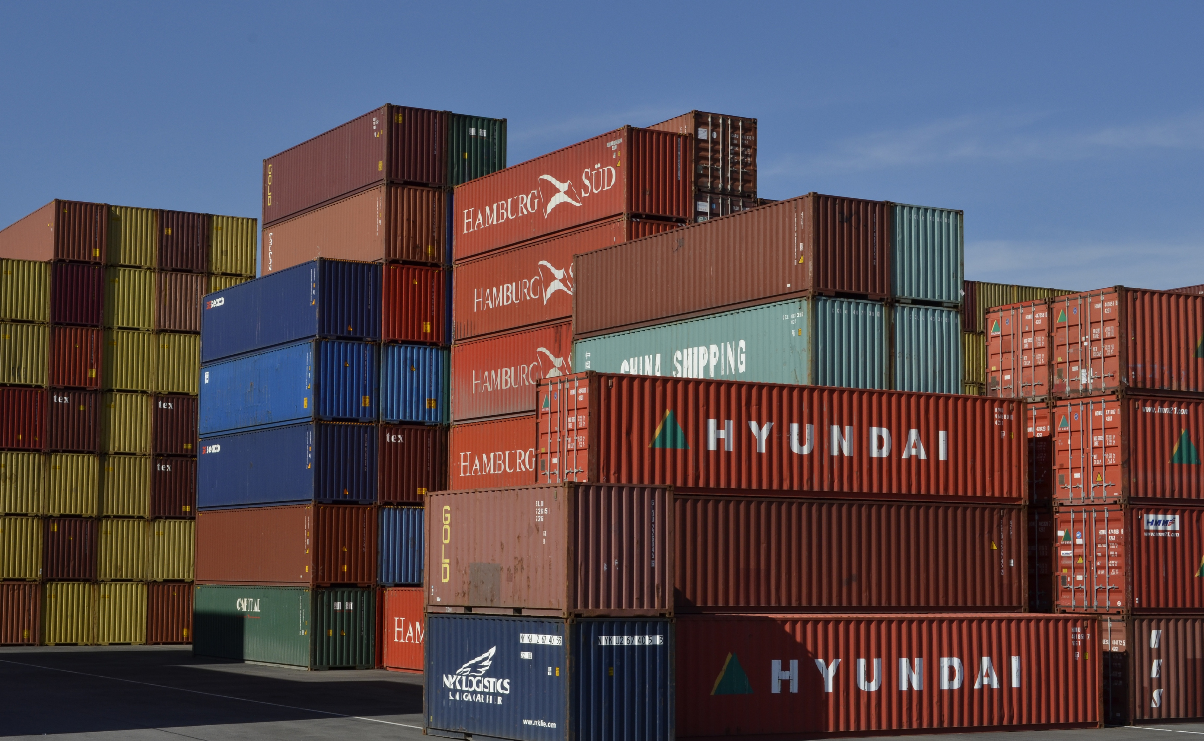
Salford & Co.
About Our
Company
Just In Time Inventory System is a company specialized in supply chain and inventory management, aiming to optimize inventory flow, reduce storage costs, and ensure timely delivery to customers through multiple warehouses.

Slide 4
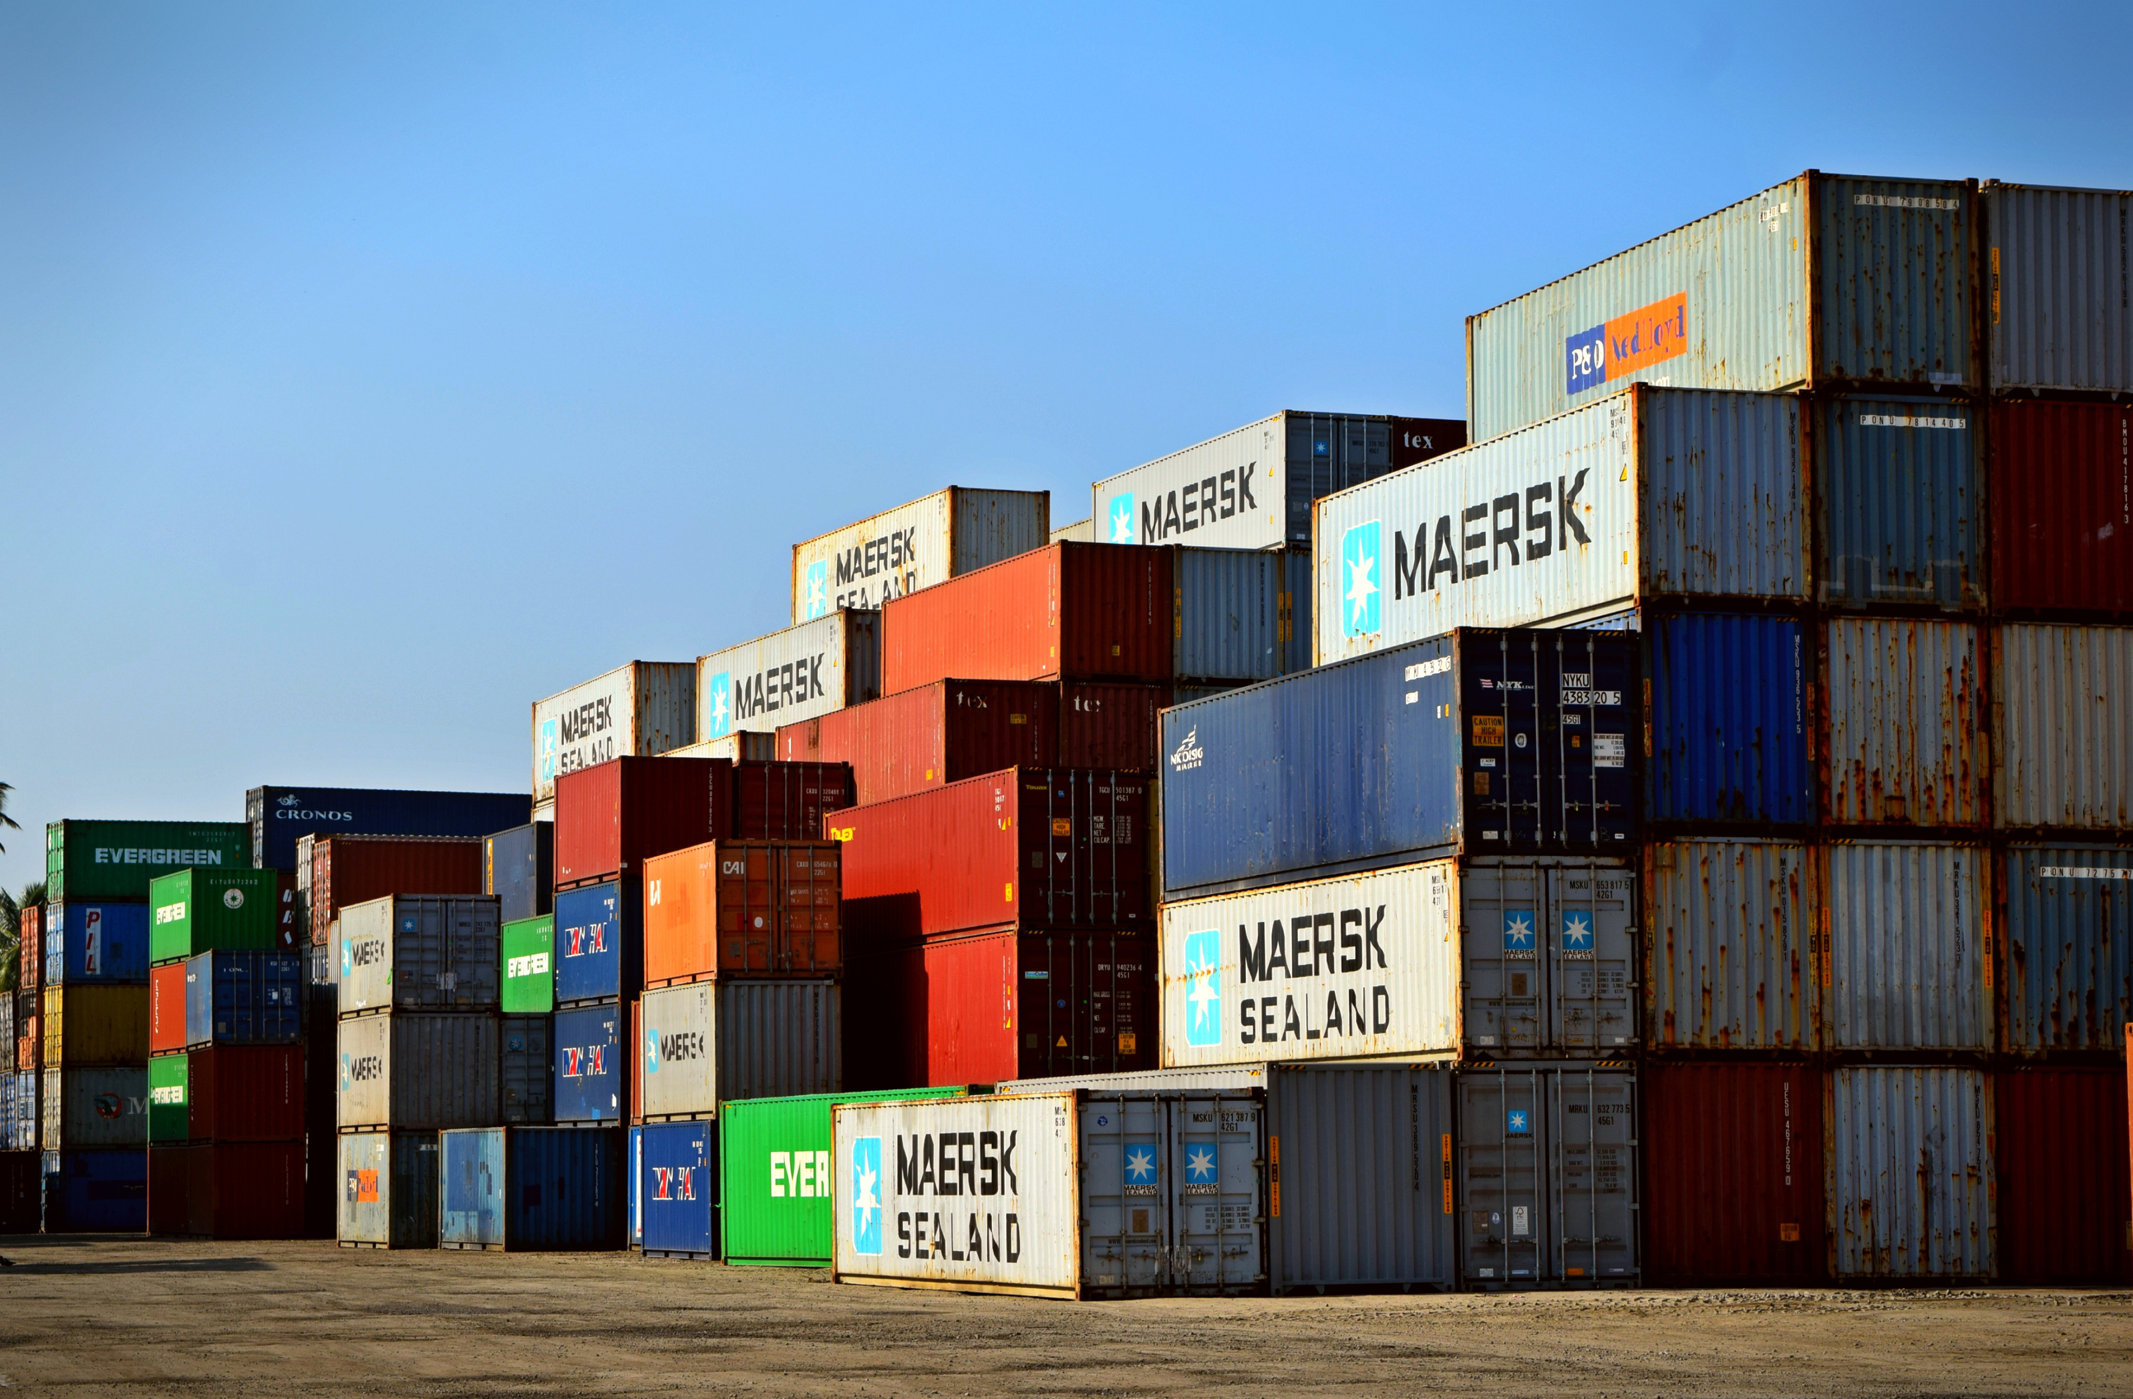
Salford & Co.
Yearly Performance Summary
2015
2016
2017
Sales were stable, with strong order volumes and low late shipment rates.
Top-selling product categories led the company’s performance.
Sales showed a slight decline, and inventory management issues began to appear.
Late shipment rates increased, and demand for key product categories started to drop.
Sales and profits dropped significantly, with orders at their lowest level.
Late shipments and inventory inefficiencies became more evident.

Slide 5
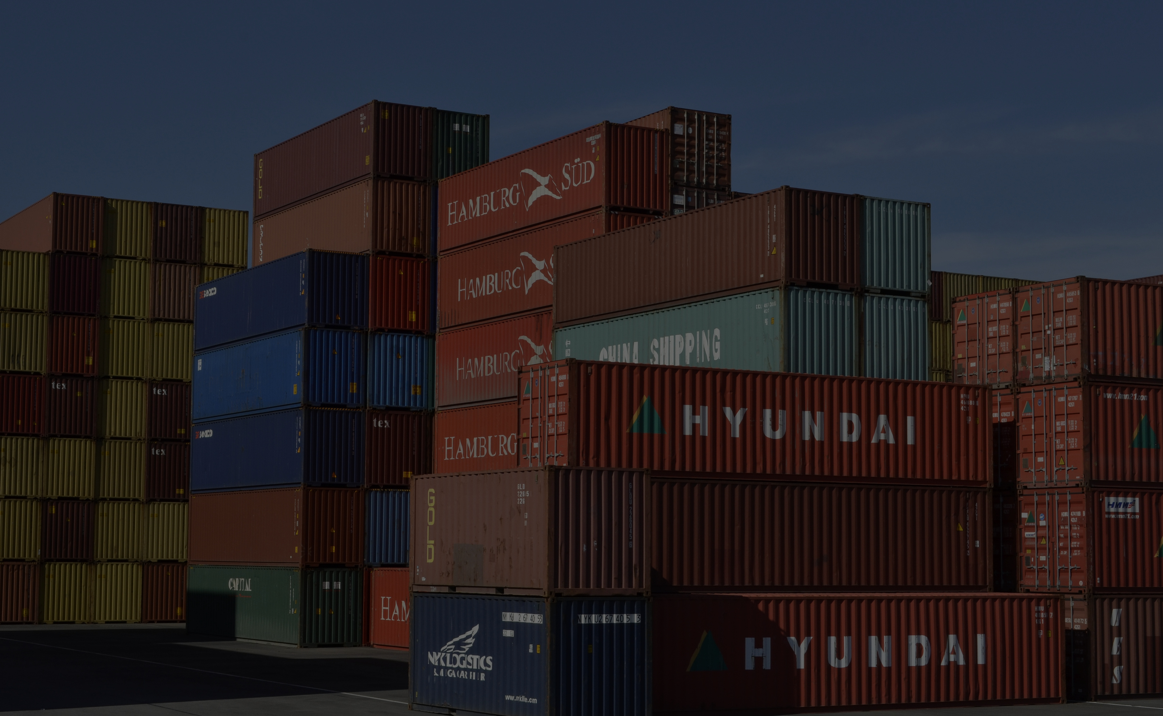

Salford & Co.
HOME
SERVICE
ABOUT US
CONTACT US
Data Structure:
Dataset consist:.
28 columns
25861 rows
Presented in 4 dimension tables and 1 fact table

Slide 6

Salford & Co.
Data Cleaning
• Removed unnecessary columns: Order Item ID and Order Time.
• Fixed column data types.
• Removed special characters from the Customer Country column.
• Checked for missing and duplicate values.
• Found 5 products in the inventory but not in the orders; kept them because they represent a significant storage cost.
• Cleaned shipping time values: removed negative values and those greater than 28 days as they are unrealistic.

Slide 7
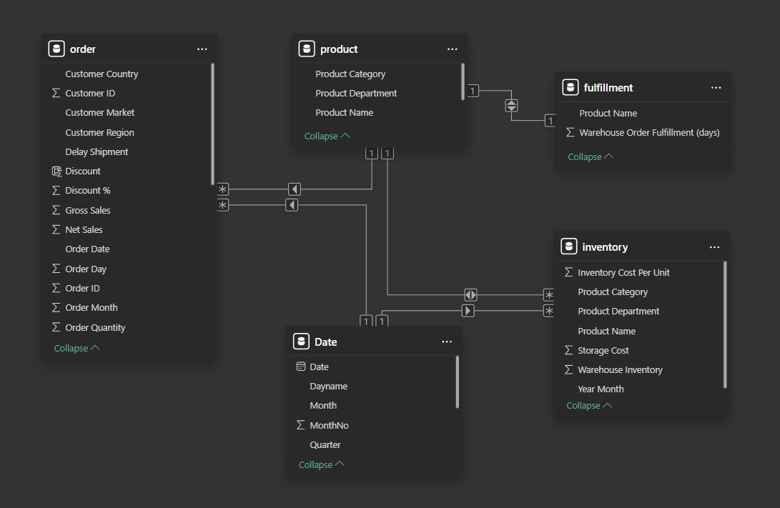

Data Modeling
With one PK in each dimension table & 5 FK in fact table
Connect tables on Star Scheme
5 connections many to one

Slide 8
KPIS
(Sales & Profit)
(Orders & Customers)
(Shipment)
(Inventory & Warehouse)
(Top Products & Categories)
Total Net Sales: 5M$
Net Sales (from analysis): 4.604k$
Total Profit: 4M$
Profit Margin: 71%
Average Order Value: 449$
Number of Orders: 10,265
Order Quantity: 54K
Number of Customers: 7,414
Discounts Given: 520K$
Late Shipment Rate: 56%
Shipment Mode: First Class
Shipment Schedule (days): 79K
Status: Late
Warehouse Inventory: 71,014
Storage Cost: 86K$
Average Warehouse: 5
Inventory Cost per Unit: 5K$
Top Category: Fishing
Top Product: Field & Sports Man 16 Gun Fire Safe
Warehouse Country: Puerto Rico
Late Shipment Rate (56%) → Indicates a significant delivery delay issue.
Top Product / Top Category → Highlights the main contributors to revenue.
Profit Margin (71%) → Shows efficient profitability per sale.

Slide 9
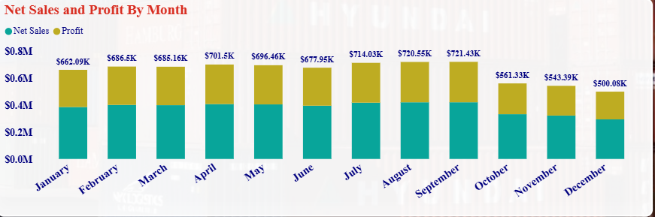
Insights
Shows net sales and profit for each shipment by month.
September had the highest sales and profit, highlighting the peak performance period for shipments and helping plan for upcoming months.

Slide 10
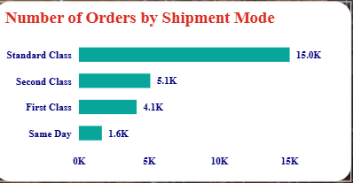
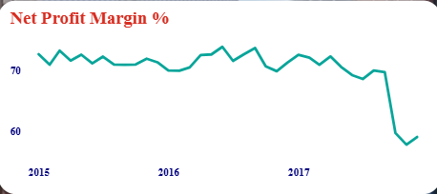
Shows how orders are shipped by method.
Most orders use Standard Class. This helps improve shipping strategies and offer faster options
Shows the change in net profit margin over the years
The profit margin has been decreasing since 2015, indicating higher costs or lower prices. The company should review strategies to improve efficiency and reduce costs.

Slide 11
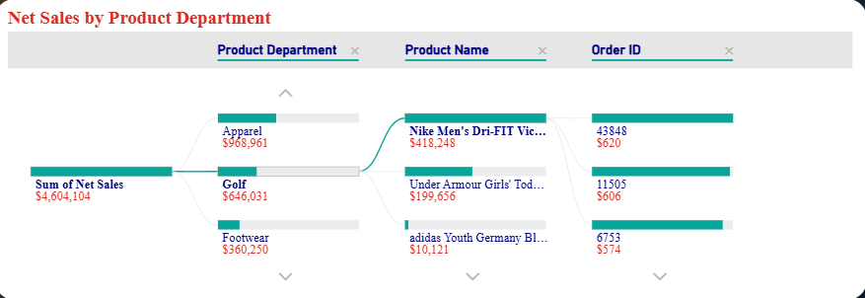
Shows the hierarchy of net sales from product departments down to sub-departments and individual orders.
Fan Shop is the top contributor to net sales, led by Field & Stream Sports and order 27536, highlighting the key revenue drivers.

Slide 12
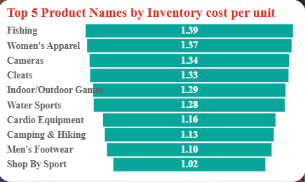
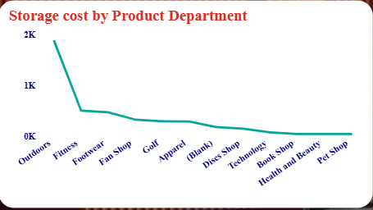
Apparel has the highest storage cost (~$23,400).
Health & Beauty has the lowest cost (~$3.4).
Fan Shop has the highest inventory cost per unit (183.54), while Footwear is the lowest (41.689). This helps identify departments with higher unit costs for better inventory management.
Conclusion
The chart shows that storage cost is much higher in Apparel and very low in Health & Beauty.

Slide 13
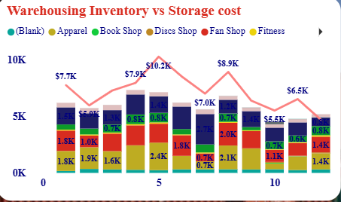
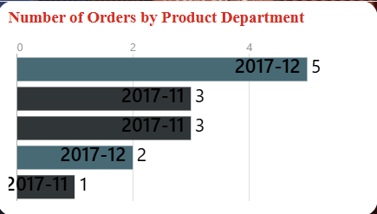
Warehouse inventory levels directly impact storage costs. Highlighting key product departments helps manage stock efficiently and reduce unnecessary expenses.
Shows the number of orders for each product department over time.
Some product departments receive more orders than others, highlighting the busiest categories.

Slide 14
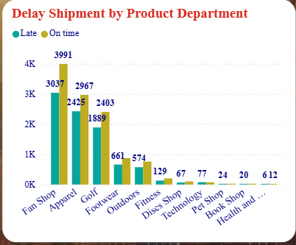
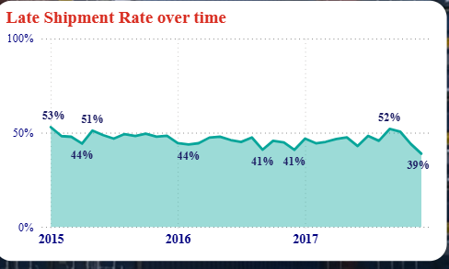
Fan Shop: 3,037 orders were late, 3,991 orders were on time → most orders delivered on time, but significant delays exist.
Health & Beauty: 6 orders were late, 12 orders were on time → very few orders overall, delays minimal.
Most departments deliver the majority of orders on time, but high-volume departments like Fan Shop still have a notable number of late shipments, highlighting areas for improvement in logistics.
Late shipment rate decreased from 53% in January 2015 (Q1) to 39% in December 2017 (Q4)
indicating improvement in delivery performance over time.

Slide 15
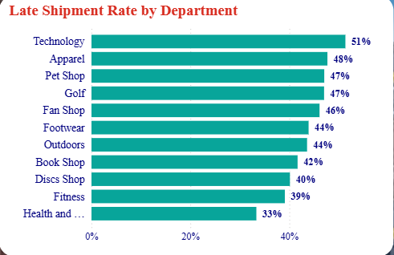
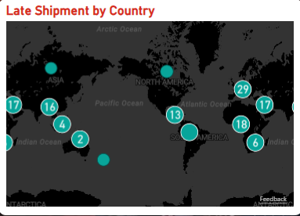
One country has the highest number of late shipments (29) indicating it faces the most delivery delays and may need focus to improve logistics.
Technology has the highest late shipment rate (51%), while Health & Beauty has the lowest (33%)
showing which departments face more delivery delays.

Slide 16
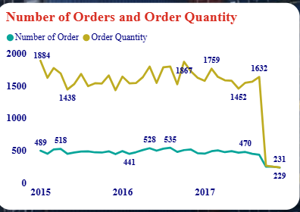
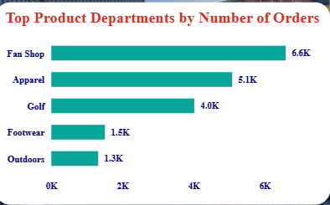
Number of orders and order quantity fluctuated over time, with the highest activity in January 2015 and lower activity in December 2017, indicating seasonal or temporal trends in orders.
Fan Shop has the highest order volume and revenue, while Outdoor shows fewer orders but a higher profit margin.

Slide 17
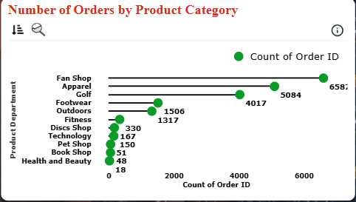
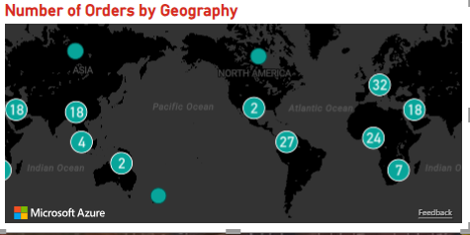
Fan Shop has the highest number of orders and strong profitability, while Health & Beauty has very few orders with a lower profit margin, highlighting the contrast in performance across product categories.
One country has the highest number of orders (32), highlighting the region with the most customer activity and potential focus for logistics or marketing efforts.

Slide 18
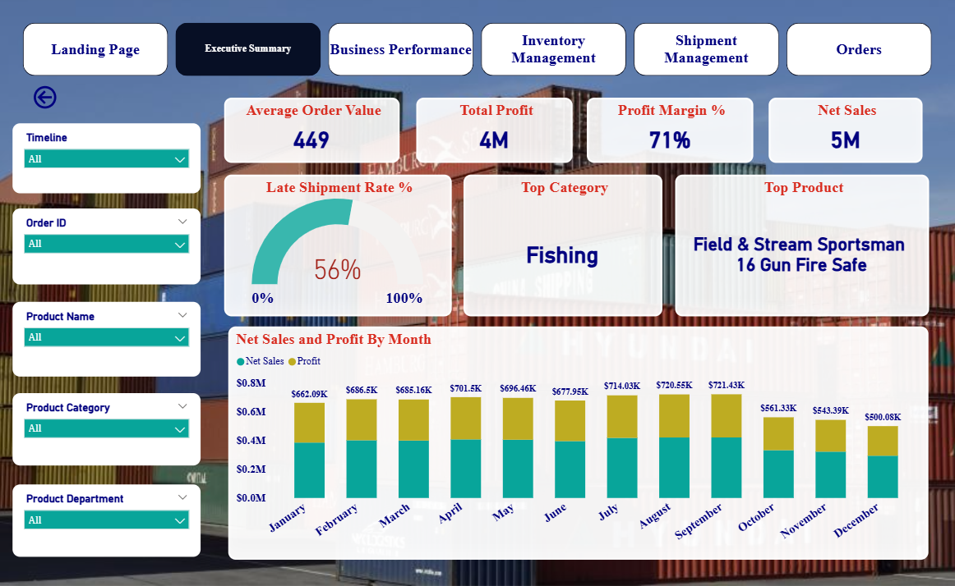

Slide 19
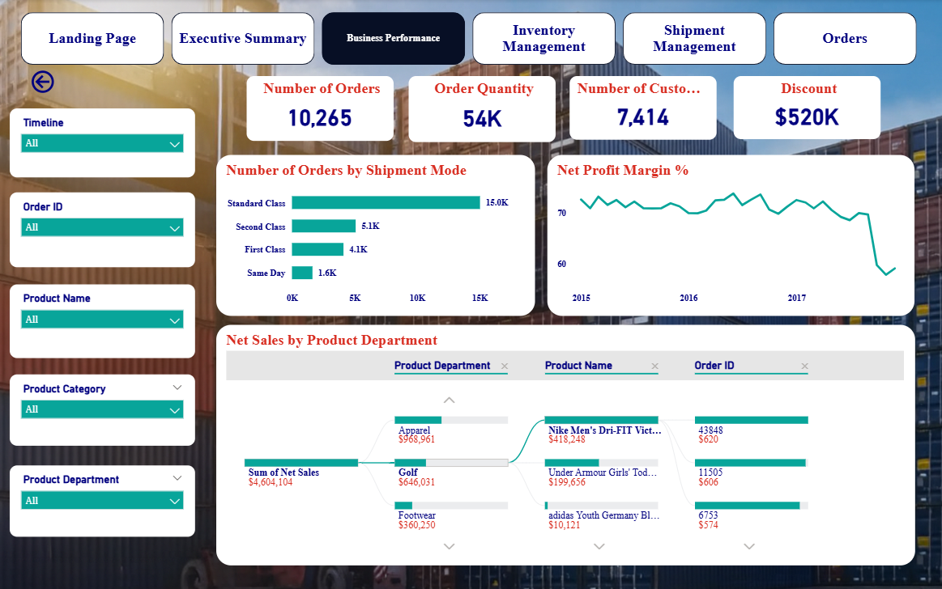

Slide 20
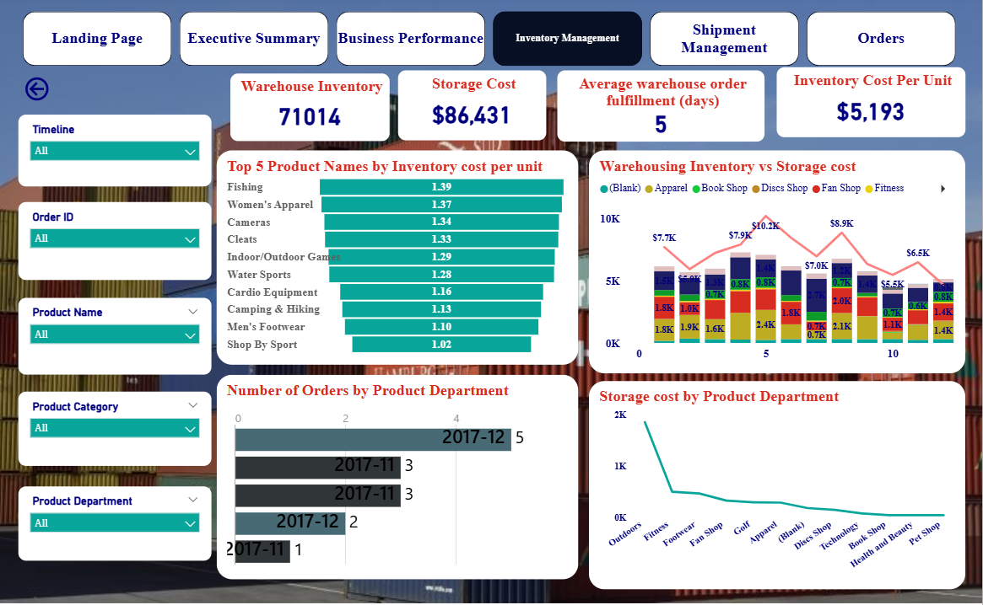

Slide 21
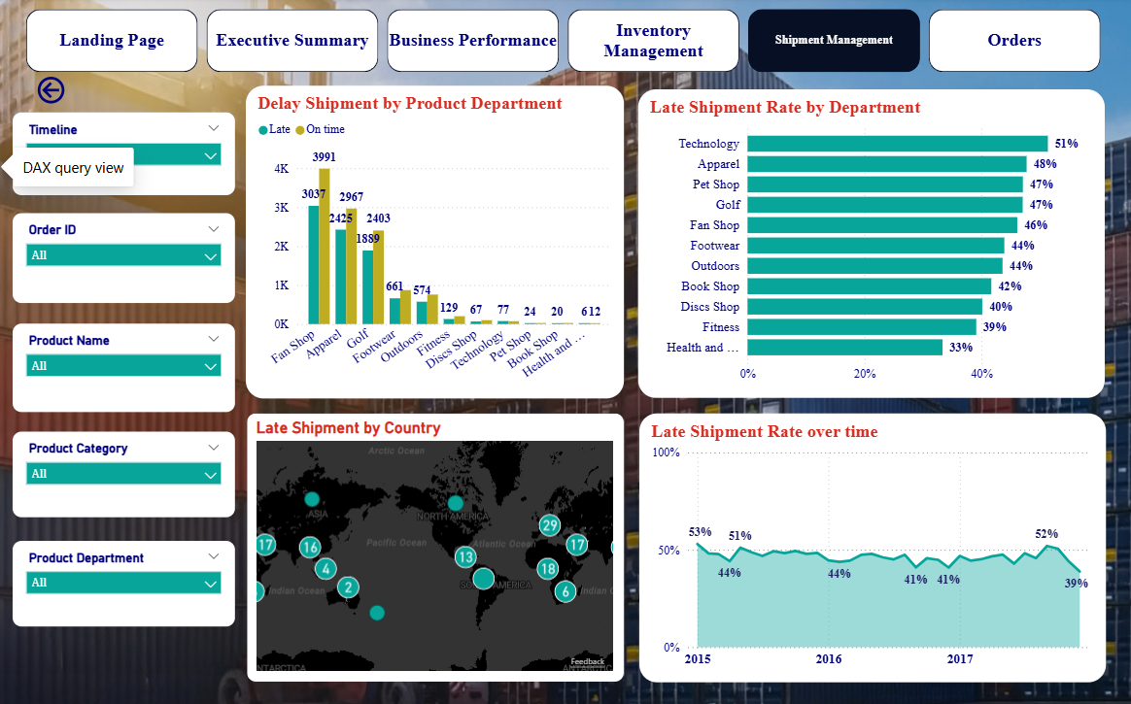

Slide 22
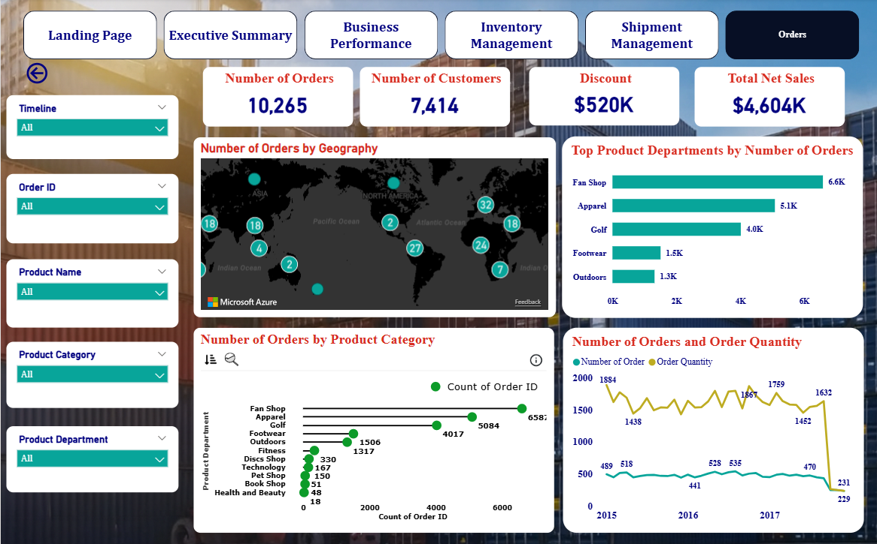

Slide 23
Conclusion
Strong past performance with high profit margin (71%), but recent sales and profit dropped sharply due to fewer orders.
Decline is revenue-driven, not cost-related.
Loss of best-selling products (Apparel, Fan shop, Footwear, Golf) is the main driver of the downturn.
Customer demand stayed stable, so the issue likely comes from supply disruptions or a product strategy shift.
Best-selling items also had the longest replenishment times, worsening stock availability.
Shipping delays are widespread, even for fast-ship orders.
High late-shipment rate (~56%) across products and regions signals major supply chain inefficiencies.

Slide 24
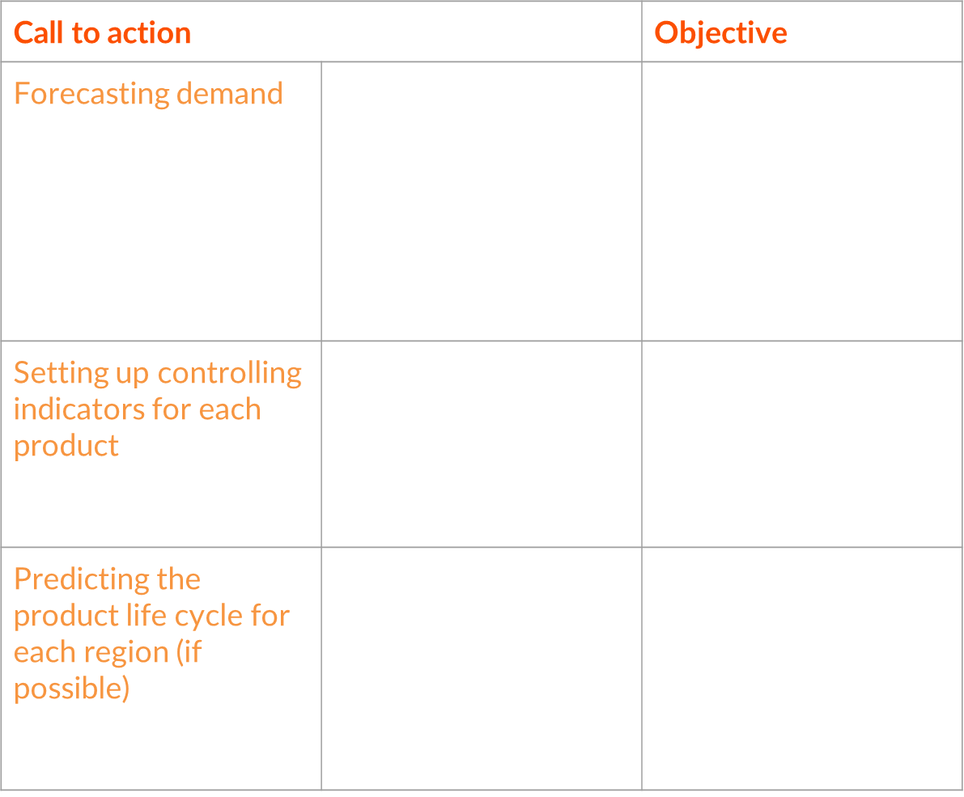
Recommendation
Inventory management

Slide 25
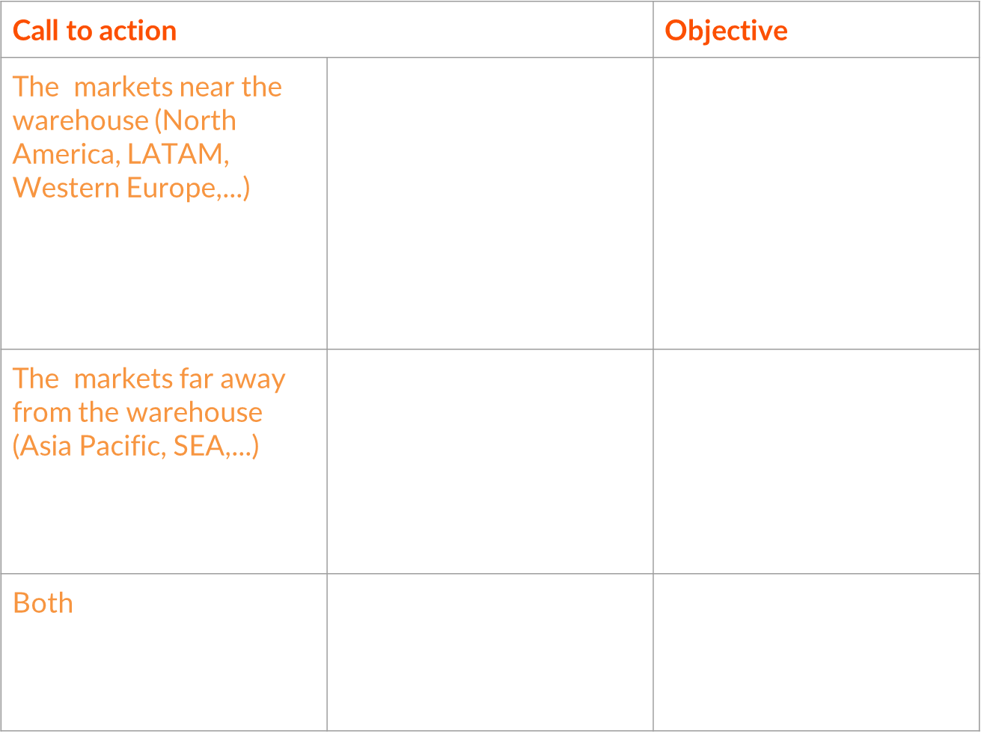
2. Delay shipment

Slide 26
Salford & Co.
SERVICE
ABOUT US
CONTACT US
Thank You
Grateful for your kind attention

