Slide 1
Predicting Term Deposit Subscription
A Decision Tree and Random Forest Comparison on Bank Telemarketing Data
Osamuyi Osunde
MSc in Data Analytics • Dublin Business School
Programming for Data Analysis (B9DA108) — CA Two

Slide 2
Overview
01
The Dataset
UCI Bank Marketing data — 4,119 clients, 21 variables, imbalanced target
02
Preparation
Cleaning, feature engineering, and encoding
03
Exploration
What drives subscription — including contact timing
04
Modelling
Decision Tree vs. Random Forest
05
Findings
Results, key drivers, and what they mean for the bank
2

Slide 3
The Dataset
UCI “Bank Marketing” dataset (Moro, Cortez and Rita, 2014) — not sourced from Kaggle
4,119
21
10.9%
0
Client records
Original variables
Subscribed (“yes”)
Duplicate rows
Four variable groups:
Client attributes — age, job, marital status, education, default/housing/loan status
Current campaign — contact type, month, day of week, number of contacts
Previous campaign — days since last contact, prior outcome
Macroeconomic context — Euribor rate, employment level, price & confidence indices
Target is heavily imbalanced: 89.1% did not subscribe vs. only 10.9% who did — this shaped every modelling choice that followed.
3

Slide 4
Preparing the Data
Cleaning, feature engineering, and encoding
Cleaning
Feature Engineering
No duplicate rows found
“unknown” kept as a genuine category (not imputed) — up to 19.5% of values in ‘default’
pdays sentinel (999 = never contacted) affects 3,959 of 4,119 rows
was_contacted_before — binary flag extracted from the pdays sentinel
age_group — six ordinal bands (18-25 … 66+) from raw age
Encoding & Leakage
11 nominal variables → one-hot encoded (job, month, poutcome, etc.)
age_group → ordinal integer encoding (preserves order)
duration dropped — only known after the call ends, so it leaks the outcome
23 columns → 55 columns after encoding
4

Slide 5
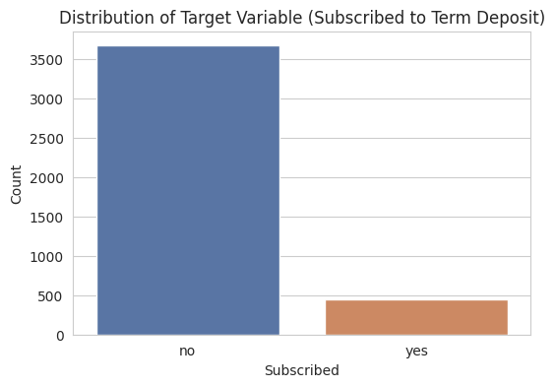
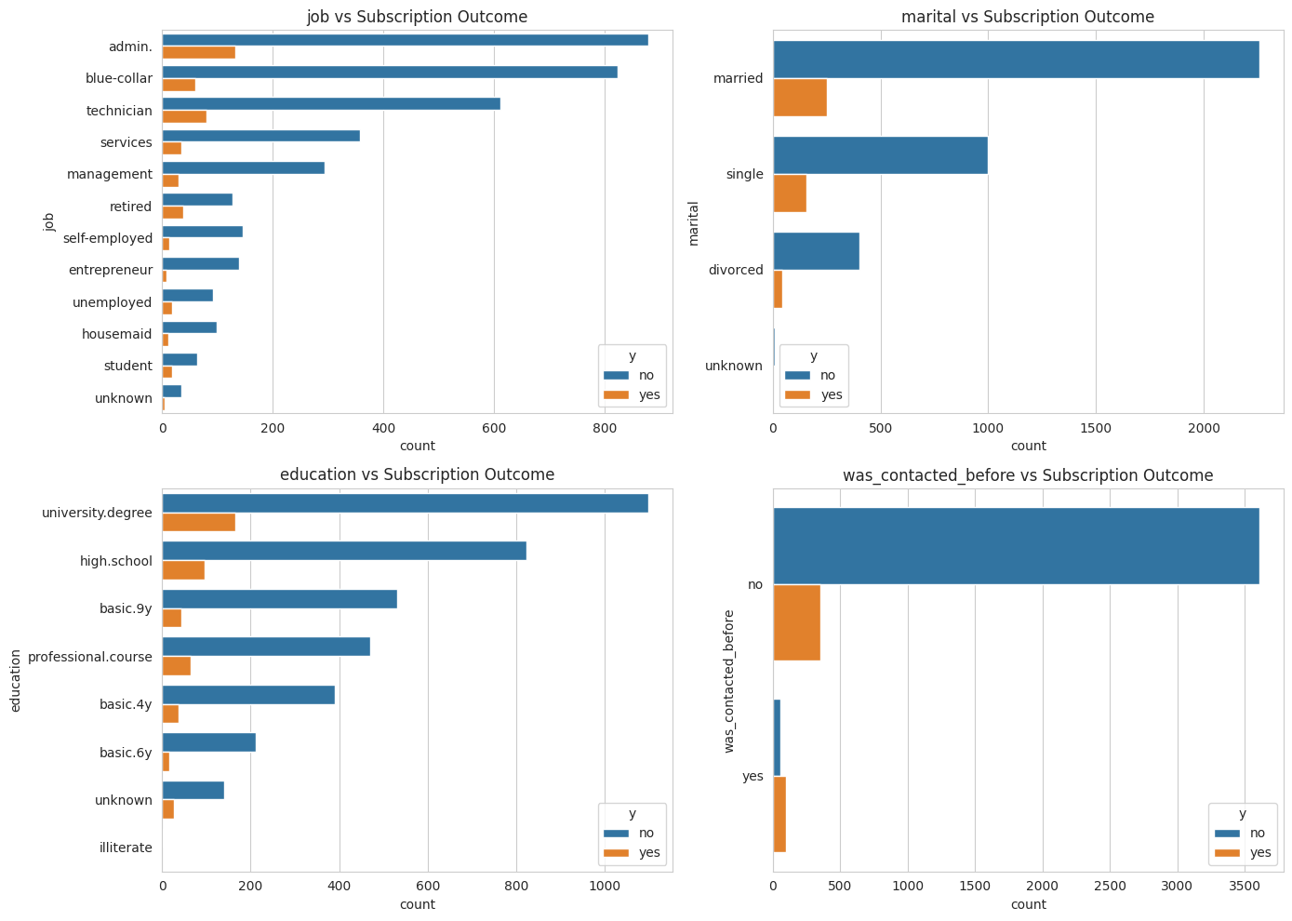
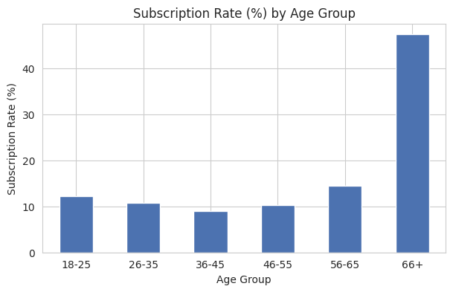
Who Subscribes?
Target distribution and key categorical patterns
5

Slide 6
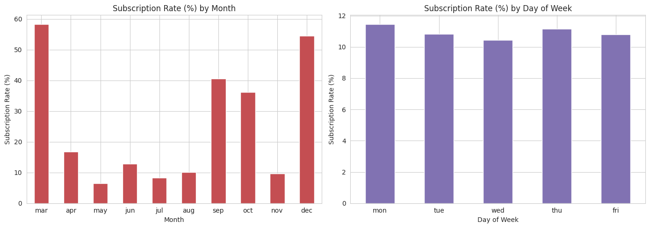
When Does It Work Best?
Subscription rate by month vs. day of week
March, September, October and December convert far better (36-58%) than the busy summer months (6-13%) — despite receiving fewer calls. Day of week barely moves the needle.
6

Slide 7
Modelling Approach
Two tree-based classifiers, compared head-to-head
Decision Tree
Random Forest
Single interpretable tree
Ensemble of 300 trees
Max depth = 6
Max depth = 10
class_weight = “balanced”
class_weight = “balanced”
Baseline model
Averages many decorrelated trees
Both trained on a 75/25 stratified train/test split (3,089 / 1,030 rows), preserving the 89/11 class balance in both sets.
Evaluated on accuracy, precision, recall, F1-score and ROC-AUC — not accuracy alone, given the class imbalance.
7

Slide 8
Model Performance
Random Forest outperforms the single Decision Tree on 4 of 5 metrics
Random Forest
88.8% accuracy
0.776 ROC-AUC
Fewer false positives
Decision Tree
84.4% accuracy
Higher recall (0.469)
More false positives
8

Slide 9
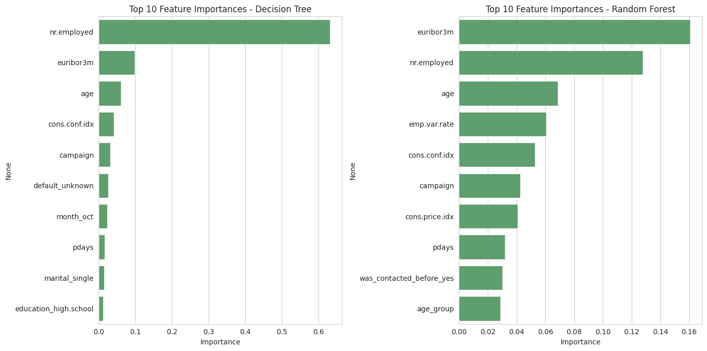
What Drives Subscription?
Top predictors from the Random Forest
euribor3m and nr.employed — both macroeconomic indicators — are the two strongest predictors, ahead of any individual customer attribute (~29% of total importance combined).
9

Slide 10
Key Insights
1
Timing beats targeting
Economic conditions at time of contact matter more than who is called — euribor3m and nr.employed dominate feature importance.
2
Ensembles generalise better
Random Forest's averaging across 300 trees reduces variance vs. a single Decision Tree, lifting accuracy from 84.4% to 88.8%.
3
Imbalance is the core challenge
Even with class-weighting, recall on subscribers stays at 0.38-0.47 — a real trade-off for deployment.
4
Leakage matters
Dropping duration keeps the model realistic for pre-call prediction, at some cost to raw accuracy.
10

Slide 11
Conclusion
Random Forest is the stronger model overall (88.8% accuracy, 0.776 ROC-AUC) but the precision/recall trade-off vs. the Decision Tree should guide the final choice based on business priorities.
Campaign timing and macroeconomic context are at least as valuable a lever for the bank as customer targeting.
Next steps: threshold tuning or resampling (e.g. SMOTE) to improve recall on the minority “yes” class.
Thank you — Questions?
Osamuyi Osunde • MSc Data Analytics, Dublin Business School

