Slide 1
FORGET CHATGPT, TRY THESE 7
FREE AI TOOLS

Slide 2
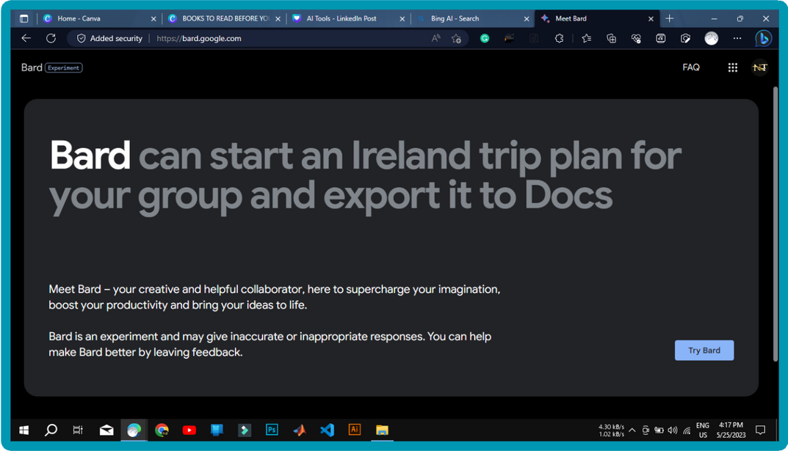
Google Bard
An AI chatbot that can answer questions, summarize articles, and generate images using natural language and internet access.

Slide 3
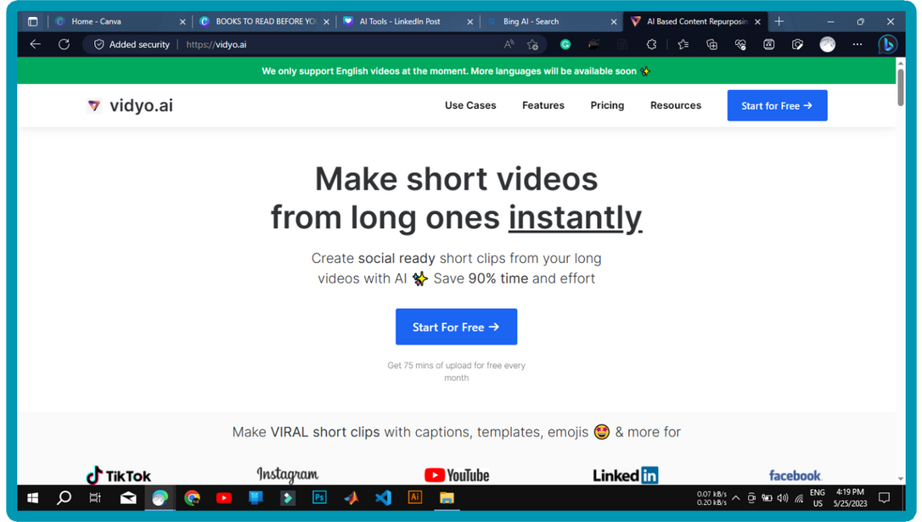
Vidyo.ai
An AI that can convert YouTube videos into short clips with captions and editing options.

Slide 4
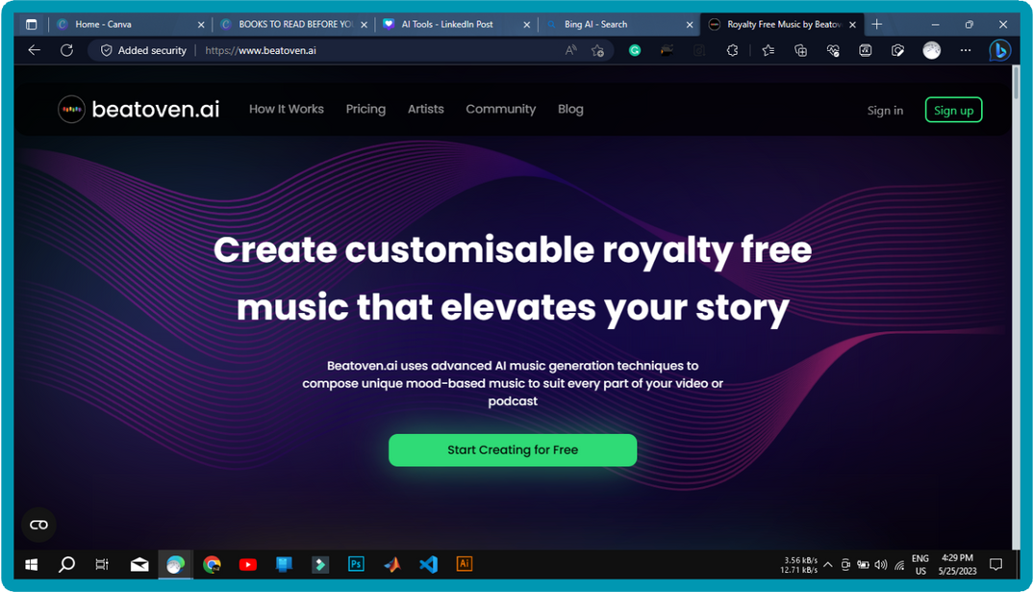
Beat Oven
An AI that can generate royalty- free music based on the user’s preferences and edits.

Slide 5
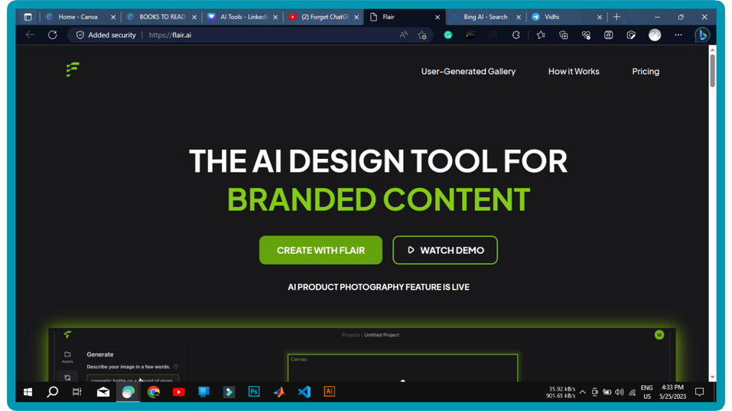
Flair.ai
An AI that can create graphics by removing the background and adding effects to images or generating images from prompts.

Slide 6
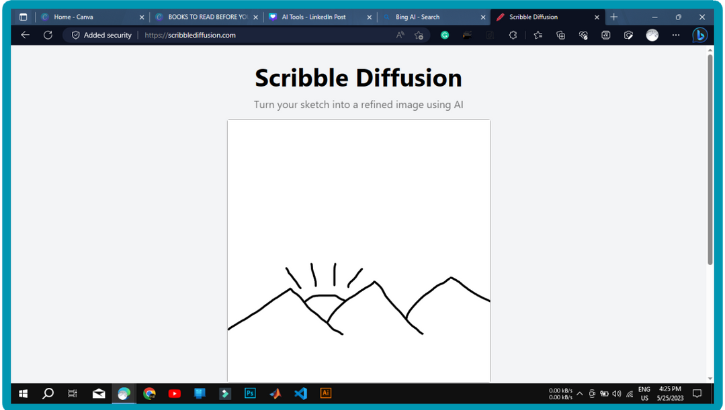
Scribble Diffusion
An AI that can turn scribbles into realistic drawings and generate captions for them.

Slide 7
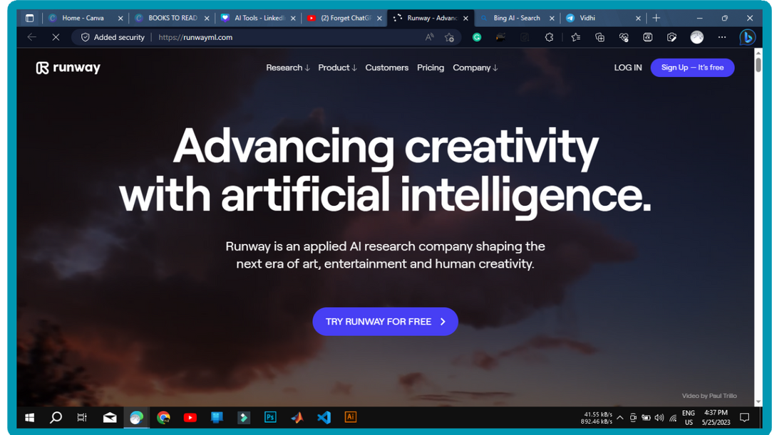
Runway.ml
An AI that can edit videos and remove unwanted objects using inpainting and other magic tools.

Slide 8
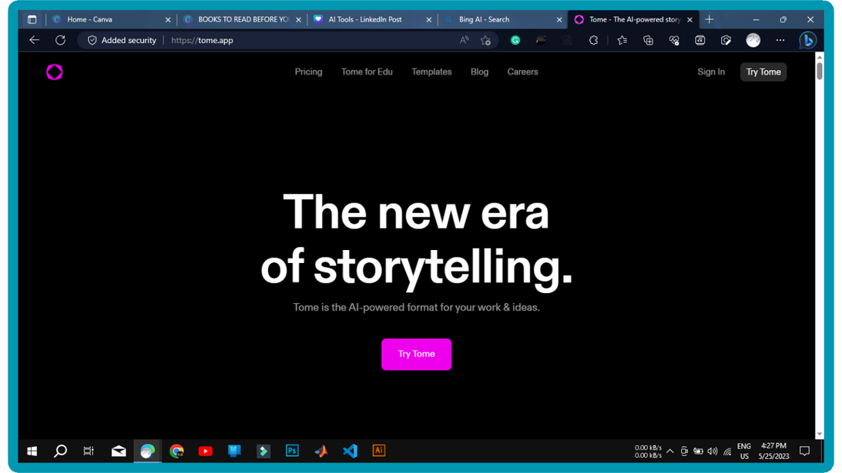
Tome
An AI that can create presentations from a single prompt using ChatGPT and DALL-E.

