Slide 1
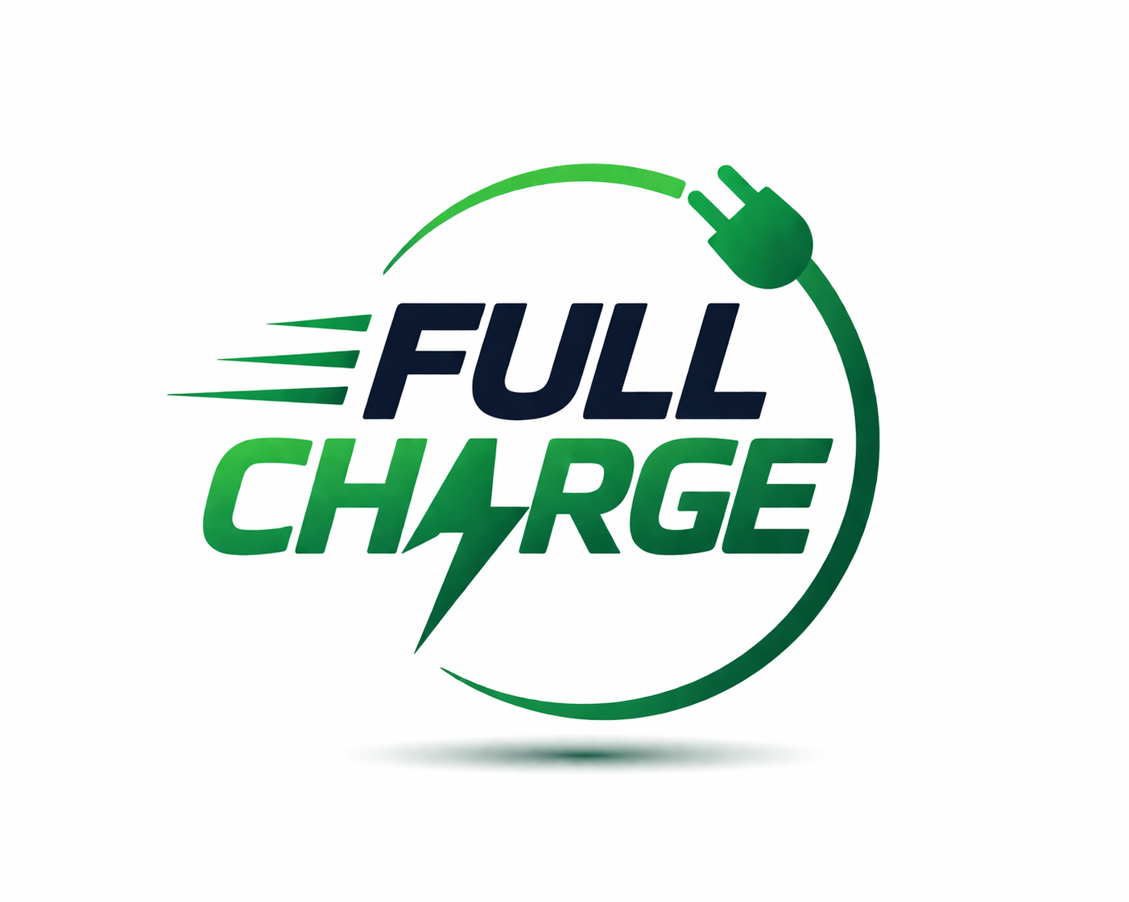
HIMSHIKHAR 2026 · CAPSTONE PITCH
FullCharge
One app. Every charger. One payment.
IIT Mandi • Team: Team 2 (FULLCHARGE)
Sourabh Saha · Guru Charan R · Sagar Verma · Amrit Murjani · Atharva Sonwane

Slide 2




The Problem
Charging an EV in India means juggling apps, not just miles
Fragmented data
Multiple wallets
Reliability of the Charger
Station info is scattered across many separate network apps (E-DRIVE, Tata Power, Statiq, and more).
Each network needs its own account and its own payment method.
Even if the charger show available when you check it might go offline by the time you arrive
Result: range anxiety, wasted trips to occupied or broken chargers, and slower EV adoption.

Slide 3


Our Solution
FullCharge — the single app for every charging network
Unified locator
One payment
Charger Behavior
Live charger status pulled across all EV charger providers in one map.
A single wallet works across every partner network.
Detailed analysis of the charger history, downtime, uptime, maintenance, peak time, charging experience
Powered by a direct API relationship with all EV charger providers for public data access along with detailed analysis of each charger based on historic data

Slide 4


How It Works
Three steps from empty battery to charged and moving
1. Find
2. Arrive
3. Charge & Pay
Open FullCharge Specify the current range/SOC and see every charger within the range, live, across all EV charger providers.
Reserve a slot at the charger that fits your route and timing.
Plug in and pay once — FullCharge settles with the network behind the scenes.

Slide 5
Lean Canvas
Our entire business, on one page
Problem
Solution
UVP
EV drivers in India struggle to find nearby chargers because each provider operates its own siloed app, forcing users to download and switch between multiple applications.
Also, this requires the user to maintain multiple wallets
A single unified nationwide EV charging platform followed by app that aggregates real-time availability and smart route planning across all major charger networks based on available range.
We will also provide a unified payment gateway to pay using single wallet
One platform/app listing all the EV charger under one roof With single wallet payment facility
Unfair Advantage
Customer Segments
Key Metrics
First-mover unified aggregator with deep partnerships (Tata, BPCL, Statiq, ChargeZone, etc.)
Real-time data aggregation + proprietary route optimization engine
Unified wallet & payment system (major differentiator)
Urban & highway EV owners; fleets; first-time EV buyers,
EV charger operators
Sessions booked/month; Active user/month; New user/month; New operators/months; Advertisement received/month
Channels
Cost Structure
Revenue Streams
EV owner communities & forums; EV dealership tie-ups; Digital Marketing ; Outdoor flex; referrals
API & data integration costs (CPOs) Development, hosting & maintenance Customer acquisition (marketing) Payment gateway fees Operations & support team
Commissions/unit, Advertisement; Platform fees/subscriptions;

Slide 6
Market Size
TAM / SAM / SOM — bottom-up, working estimates
TAM
~1,800-2,000 Cr
***India has a total of ~5 Lakh EV Cars On road till March-26 | Expected YOY Growth: 40%-55% each year until 2030
~Only 7.7% of PV market is EV
SAM
~550-600 Cr
SOM
~55-60 Cr
Source: working estimates based on national EV registration trends; to be refined with state transport authority data.

Slide 7



Go-To-Market
How we get our first 100 customers — and beyond
Community Marketing
Digital Marketing
Dealership tie-ups
Beta access to all the EV owners via EV communities. Early birds will get 1st charge or 1,000 Rs in the wallet
Using various medium like social media, bulk marketing, Advertising, SEO optimization
Bundle FullCharge with new EV purchases through local dealerships.

Slide 8
Unit Economics
Illustrative model — see accompanying spreadsheet for live formulas
₹115
~₹500
~₹5300
₹1000
Net revenue / session
Revenue / active user / mo
12-month LTV
CAC per user
Key assumptions
Avg. session spend: ₹750, commission 15%
4 sessions booked / active user / month
12-month expected active lifetime
CAC from ₹50 Lacs monthly marketing ÷ 5000 new users

Slide 9

Customer Evidence
Customer interview
“ Why am I not able to see this charger in Google Maps or Plugshare"
— Sourabh Saha, Ballarpur
“ There was a E-Drive charger online but when we reached there it was not working for some technical reason"
— Guru Charan R, Tirupati
Insight that changed our idea
We wanted to just know where the charger are exactly if there is one around us, irrespective of the service provider, per unit cost.

Slide 10

The Ask
What we need to launch: 1 Cr (At 10 Cr valuation pre-funding), focused on E-DRIVE / partner API integration, app development, marketing, payment gateway integration
Our Team
Sourabh Saha
MBA, BE, Entrepreneur, Group Manager
Guru Charan R
Realtor, Digital Marketer, Student, Founder of growing student community.
Atharva Sonwane
BE, Developer, Prompt Engineer, Tech Nerd
Team Lead / CEO — vision & pitch narrative
Market / Finance (CMO) — GTM & unit economics
Product / Ops (CTO) — prototype & business model
Sagar Verma
Entrepreneur
Amrit Murjani
Entrepreneur
Team member- Marketing
Team member- Finance
FullCharge • One app. Every charger. One payment. • HimShikhar 2026

