Slide 1
Customer Churn And Retention Analysis
SkinBloom
Data-driven insights on customer behavior and revenue retention (2020–2022)
Osaretin Idiagbonmwen
October, 2025

Slide 2
Table Of Contents
Executive Summary
Context & Business Problem
Data & Methodology
Customer & Subscription Insights
Revenue & Retention Analysis
Risk & Prediction Insights
Recommendations & Actions
Conclusion & Next Steps
Appendix / Technical Backup

Slide 3
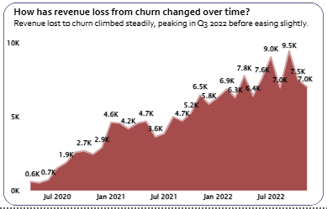
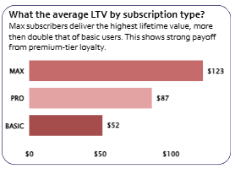
Executive Summary
The 2022 Story: Revenue Growth Masks a Critical Churn Leakage
We closed 2022 on a high note:
Total Revenue hit $619.58K, representing $37.3% growth year-over-year, and our total customer base expanded to $6.37K . Our overall retention rate also remained strong at 85.90%.
However, this success is overshadowed by a critical, and growing, leakage problem.
While our new acquisition was robust, the absolute number of customers we lost in 2022 increased by 10%, resulting in an accelerating loss of revenue over the period. Revenue lost to churn climbed steadily from 2020 through 2022, peaking dramatically in Q3.
Key Insights: Who is leaving and when?
The deep dive into our subscription tiers and customer lifecycle reveals two major areas of concern.
The Basic Tier is the Core Vulnerability.
The greatest churn risk is concentrated in the Basic subscription tier. Although the Basic tier has the highest count of subscribers, its churn rate stands at 13.78% - the highest of all three tiers
This suggests a major weakness in the Basic onboarding or initial value delivery.
MAX Subscribers deliver the greatest long-term value, justifying premium focus. The MAX tier, while having a high nominal churn rate of 13.19%, generates the highest total revenue ($537.74k) and delivers an Average Lifetime Value (LTV) that is more than double that of the Basic tier $123 vs. $52 Our premium customers are highly valuable once retained.

Slide 4
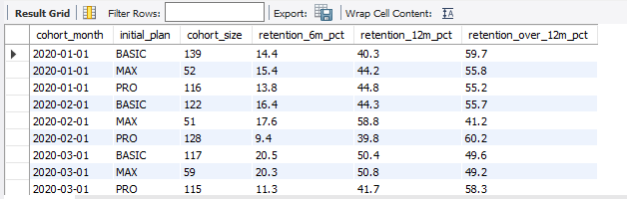
2. Early Churn is the Primary Threat to LTV.
The window for churn intervention is narrow - the risk is highest early on. Our cohort data confirms that customers are most likely to churn in the first 2–3 months of their subscription . Once a customer passes the six-month mark and enters the Loyal Segment, their value dramatically increases.
Loyal customers become exponentially more valuable the longer they stay. Revenue retention improves from 100% in the first month to an astonishing 278% by month 35 . This finding proves that loyalty directly translates to increased spend and upgrades, making early retention efforts a priority.
Implication for Management: Focus on the Funnel's Start
The analysis clearly points toward a required shift in focus: We must stabilize the Basic tier and secure the first 90 days of the customer lifecycle.
Prioritize Basic Onboarding: The high churn suggests customers are not finding initial value in the Basic tier. We must immediately investigate user experience and feature discovery for this segment.
Targeted Early Intervention: Given the high risk in the first three months, Marketing and Customer Success need to implement proactive retention campaigns during this period to lock in early loyalty.
Invest in Premium Loyalty: The high LTV of MAX subscribers justifies increased investment in premium support and exclusive features to maintain their high retention rates.
These findings allow us to shift from broad retention campaigns to surgical, value-driven initiatives.

Slide 5
Context & Business Problem
The Challenge: A Hidden Leakage In Our Revenue Stream
For the past two years, our business has done an excellent job of growing. Our total customer base expanded to $6.37K, and total revenue reached $619.58K in 2022. This growth shows the strength of our product and acquisition efforts.
However, success is masking a critical, persistent problem: customer churn has remained stubbornly high, eroding the long-term value of every new subscriber. We closed 2022 with an overall churn rate of $14.10%. This "leakage" means we are constantly replacing customers we just lost, instead of compounding our revenue.
The Stakes: Why We Must Act Now
Losing customers is not just a problem for our subscription count - it is a massive financial threat. Industry data confirms that simply improving our retention rate by 5% could increase our profits by 25-95%. Conversely, every customer we lose today is lost future revenue and profitability forever.
This is the situation we faced:
KPI: Overall Churn Rate for 2022 was 14.10%
Cost: Revenue lost to churn has been steadily climbing since 2020. This financial loss hit its most damaging peak in Q3 2022 .

Slide 6
The Core Business Problem
We have reached a tipping point where retention risk outweighs the strength of our acquisition.
The goal of this analysis is not just to report the churn rate, but to provide a blueprint for securing our future recurring revenue.
We need to understand who is leaving, when they leave, and why they cancel their subscription so that we can implement targeted, high-impact strategies.
This presentation will uncover the weak spots in our subscriber lifecycle and show you exactly where to invest to turn this churn leakage into stable, compounding revenue.

Slide 7
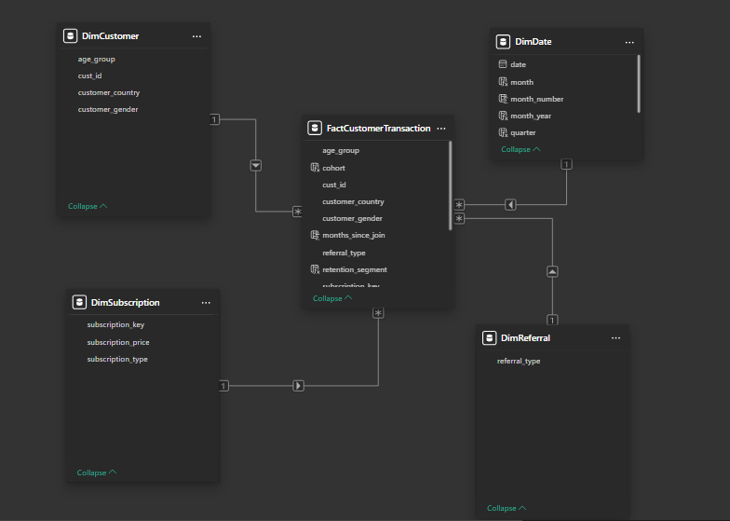
Data & Methodology
The Engine Behind Our Insights
We didn't just analyze the data; we engineered it. Our conclusions are built upon a foundation of clean, structured data covering three years (2020 - 2022), ensuring our recommendations are both reliable and actionable. The goal of this phase was to transform raw transactions into clear measures of customer value and risk.
1. The Data Foundation: Structuring the Facts
All our analysis stems from a single, detailed SQL table:
customer_subscription_and_transaction_details. Our first crucial step was breaking this monolithic source into a modern, query-friendly structure using the Star Schema model.
The Core: We created the FactCustomerTransaction table to centralize every event—subscription status, payments, and dates. This is the heart of the analysis.
The Context: Four crucial Dimension tables (DimSubscription, DimDate, DimCountry, DimReferral) were created to add context to every transaction.
Modeling for Reliability: We imported and linked these tables in Power BI to form a clean Star Schema . This clean architecture ensures that every DAX measure aggregates correctly, preventing errors and building trust in our final numbers.

Slide 8
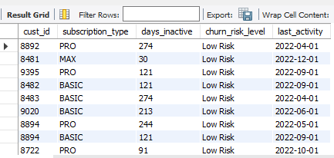
2. Feature Engineering: Turning Events into Churn Signals
Raw transaction history is messy. Using MySQL, we executed several critical transformations to clean the data and create the specialized features needed to measure retention and risk.
Creating Predictive Features
The most powerful insights came from manipulating the transactional data to track customer behavior over time:
Cohort Analysis: We identified each customer’s first transaction month to create a specific Cohort group. This allows us to track how well specific groups of customers retain over time, not just the overall average.
Measuring Tenure: We computed Month Since Join using DATEDIFF(transaction_date, cohort_start). This metric is vital for understanding when customers are most likely to churn.
The Churn Flag: We identified customers that are likely to churn and categorized them as follow: “Low Risk”, “Medium Risk”, “High Risk”, “Critical Risk”. These was done based on days inactive by the customers.

Slide 9
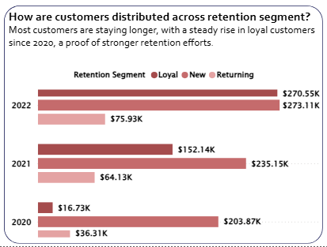
3. Quantification: The Key DAX Measures (Power BI)
The final step was translating these structured features into the core business measures in Power BI's DAX environment:
Churn Rate: The percentage of customers who ended their subscription in a given period.
Revenue Retained % & Revenue Lost to Churn: Crucial measures that show the financial magnitude of the problem we are solving.
Customer Lifetime Value (CLV): The ultimate measure of a customer’s worth, guiding our investment decisions.
Retention Segmentation: We categorized customers based on their tenure and then rank based on revenue generated from each segment across 2020 – 2022 to target our analysis: “New” (less than a month), “Returning” (< 6 months), and “Loyal” (> 6 months).

Slide 10
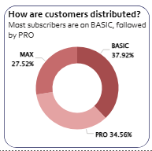
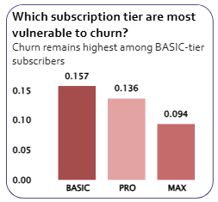
Customer & Subscription Insights
Customer loyalty strengthens with higher-tier plans, but the base tier remains our biggest churn risk.
Our subscriber base is healthy, with 37.92% of customers on the Basic tier . This volume is great for market share, but a closer look at behavior shows where our long-term value truly lies.
The problem starts with retention: The segment that drives the most volume (Basic) is also the churn-prone segment. Churn is significantly higher for the Basic tier compared to the highly retained MAX tier . This contrast suggests that the perceived value of our entry-level offering may not meet the expectation, causing quick abandonment.
Segment Loyalty and Financial Impact
The difference between tiers is not just in monthly cost - it is in Lifetime Value and fundamental loyalty.
MAX tier customers are our most valuable asset, delivering a Lifetime Value of $123, which is more than double the LTV of the Basic tier $52. This high LTV for premium users proves that once customers find deep product fit, they stay and contribute disproportionately to profitability. Furthermore, the MAX and PRO tiers generate the highest total revenue , demonstrating that premium experiences drive premium results.
When we look at retention over time, the curves for MAX and PRO consistently track higher and show more resilience against market volatility than the Basic tier . The gradual flattening of the retention curve for these premium plans indicates long-term satisfaction and sustained value delivery, a clear sign of loyalty.

Slide 11
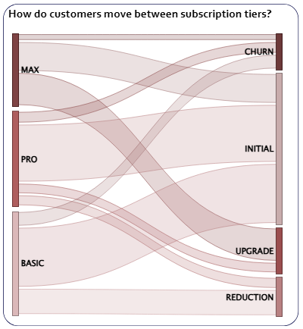
The Behavioral Path
Analyzing customer movement between plans reveals an important behavioral insight. We see a clear, healthy migration flow: customers frequently upgrade from Basic to PRO, and from PRO to MAX .
This upgrade pathway is critical. Customers who move up the ladder are essentially self-selecting for higher value and lower future churn risk. They are telling us that initial retention issues in the Basic tier can be overcome by successfully selling the improved feature set of the PRO or MAX plan.
Conclusion: The Path to Profitability
Higher-tier users don't just pay more; they stay longer, becoming the stable core of our recurring revenue. High churn among Basic users may signal onboarding or feature engagement issues rather than pricing alone.
Our strategy must focus on optimizing the Basic-to-PRO upgrade funnel - using the success of that migration path to reduce early churn risk and quickly shift customers into our most valuable and loyal segments.

Slide 12
Revenue & Retention Analysis
The Compounding Value of Loyalty
The Financial Question
We know that customer churn affects growth, but to what extent does it cost us, and where is the greatest financial gain to be found? This analysis reveals that our revenue story is one of volatility driven by early losses, but ultimately saved by the compounding loyalty of our long-term customers.
The Early Drop vs. The Value Gap
While our overall revenue has surged, our retention performance shows a tension between quick initial losses and massive long-term potential.
First, the impact of churn is not consistent; it hits hard and unexpectedly. We can clearly see the volatility in our revenue base: Revenue Lost to Churn climbed steadily from 2020 through 2022, peaking sharply in Q3 2022 . This peak, at $9.5K, shows the specific quarter when churn was most financially damaging, signaling the need for more agile, mid-year intervention strategies.
We overcome this volatility because the value of retained customers grows exponentially. When looking at the Average Lifetime Value (LTV) by subscription type, the value gap is stark . A MAX user delivers an LTV of $123, nearly two and a half times the $52 LTV of a Basic user. This illustrates a clear financial mandate: loyalty compounds exponentially with tier commitment.

Slide 13
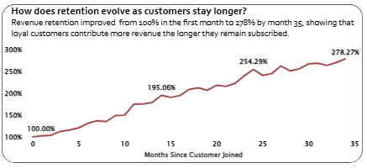
Resolution: Loyalty Is Our Biggest Financial Lever
The data proves that sustained retention is the single biggest lever for stabilizing and growing recurring revenue.
Loyalty doesn’t just improve retention - it drives additional spend.
Our Revenue Retained % by Month Since Join illustrates this perfectly. While customers may show early drop-off, those who stay past the initial months begin to spend more, leading to a remarkable increase in value. Revenue retained improved from the baseline 100% in the first month to an astonishing 278.27% by Month 35. This metric confirms that long-term customers are actively upgrading and expanding their relationship with us.
The Loyal Segment now drives our financial stability.
The composition of our revenue has fundamentally shifted between 2020 and 2022. In 2020, the Loyal Segment contributed only $16.73K. By 2022, after two years of successful retention, the Loyal Segment contributed a massive $270.55K. Loyal customers now account for the majority of our most stable, recurring revenue, indicating a crucial level of business maturity.
Strategic Conclusion
Sustaining retention beyond the first six months is the single most important financial action we can take. The data is clear: Growth doesn't come solely from acquiring more customers - it comes from keeping them longer, and subsequently selling them more. Our immediate financial action must be to invest disproportionately in the MAX and PRO retention experience, using their stability to offset the volatility introduced by the Basic tier.

Slide 14
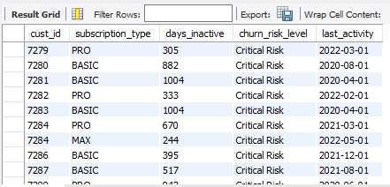
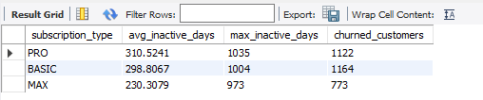
Risk & Prediction Insights
Catching Churn Before It Happens
The best way to improve retention is to intervene before a customer decides to leave. We have moved beyond simply counting losses; we can now use behavioral data to predict who is at risk and why.
Defining Risk Levels
We analyzed customer activity to sort every subscriber into a defined risk category. This allows us to move from blanket marketing to targeted, resource-efficient engagement.
This segmentation shows us the pool of customers who need immediate attention versus those who are stable. By prioritizing the High-Risk group, we focus our retention budget where it will have the greatest financial impact. This system provides Customer Success and Marketing teams with a clear, dynamic list of who to contact today.
2. The Critical Role of Inactivity
The most reliable sign that a customer is about to churn is a drop in product use. Inactivity is the true pre-churn signal.
We measured the average number of days a customer was inactive just before they ultimately canceled. The results give us clear thresholds for action.
MAX customers, our highest-value segment, have the lowest average inactivity period before they churn, at around 230 days. This suggests that when a premium user stops using the service, their dissatisfaction is often quicker and more decisive.

Slide 15

PRO and BASIC users average around 300 days of inactivity before leaving. This gives us a slightly wider window to re-engage them.
This information is powerful: once a customer hits 300 days of inactivity, the clock is running out. We can set up automated alerts to trigger a high-touch intervention, such as an email or a personalized call, as soon as they cross that 300-day threshold.
3. Pre-Churn Behavioral Signals
In addition to inactivity, we analyzed specific behaviors that signal a customer is preparing to leave. Sometimes, the movement itself is the warning.
We found that nearly 11% of churned customers attempted a plan REDUCTION before canceling. This downgrade is often a final attempt to justify the cost of the service.
The insight is simple: Any attempt to reduce the subscription tier should immediately trigger an intervention. This is a clear sign for help or value, not just a casual adjustment. We must treat a downgrade attempt as a high-risk churn signal and try to save the customer's total value instead.
Conclusion
We now have the tools to shift from reactive damage control to proactive risk management.
By monitoring the 300-day inactivity mark and tracking downgrade attempts, we can stop losses before they happen. The immediate next step for the business is to integrate these risk thresholds directly into our CRM and marketing automation systems to ensure timely intervention.

Slide 16
Recommendations & Actions
Building a Proactive Retention Culture
Insight without action changes nothing. Based on the financial and behavioral patterns we’ve identified, especially the high risk in the Basic tier and the critical 300-day inactivity threshold, we have three clear, focused strategies to stabilize revenue and secure our customer base.
Strategy 1: Fortify the First 90 Days
The Issue: Churn risk is highest in the initial 2-3 months, particularly among Basic subscribers.
The Goal: Increase the chance a customer passes the critical six-month loyalty marker.
Action: Implement a Mandatory First-Month Success Program.
For all new Basic and PRO subscribers, mandate a structured, automated communication flow focusing purely on time-to-value. This means highlighting two key features they must use in the first 30 days.
Expected Outcome: A 5% reduction in churn rate for the Basic tier.
Metric to Track: Retention Rate at 6 Months (by initial plan).
Strategy 2: Mobilize Predictive Intervention
The Issue: We can predict high-risk churn signals (inactivity and downgrades) but lack an automatic process to follow up.
The Goal: Use our predictive model to intervene with the right message at the right time.
Action: Launch a "Value Intervention" Trigger.
Customer Success and Marketing must immediately set up two automated triggers:
Inactivity Alert: When any customer (especially MAX) crosses the 300-day inactivity mark, trigger a personalized email or call offering specific, targeted content to reactivate them.
Downgrade Rescue: Treat any attempt by a customer to REDUCE their plan as a high-risk churn signal. Customer Success should immediately reach out with a personalized discount or feature add-on to keep them at their current tier.

Slide 17
Expected Outcome: A 10% increase in saved customers from the High-Risk segment.
Metric to Track: Revenue Lost to Churn (with a focus on reversing the Q3 spike).
Strategy 3: Reward and Elevate High-Value Users
The Issue: MAX subscribers are our highest LTV customers, yet their churn rate is still significant.
The Goal: Reinforce the long-term satisfaction of our loyal base to drive revenue retention past the $278 mark.
Action: Establish a Tiered Loyalty Upgrade System.
Target PRO subscribers and long-term loyal customers with exclusive, value-based incentives. Offer small, periodic perks and a clear, smooth pathway to upgrade to MAX. This reinforces the value of staying in the premium ecosystem.
Expected Outcome: An increase in Average Lifetime Value (LTV) for PRO subscribers and greater stability in the MAX segment.
Metric to Track: Upgrade-to-Downgrade Ratio.
Final Takeaway
We must shift our culture from reacting to losses to proactively managing customer relationships. By applying these three targeted strategies, we can leverage the data to stabilize our revenue base and unlock the full potential of our customer lifetime value.

Slide 18
Conclusion & Next Steps
This analysis has shown us that our growth is strong, but our foundation is vulnerable. We moved past simply seeing a high churn rate; we now understand how and when that revenue leakage occurs, and which customers are most financially valuable.
The true insight here is simple: Customer retention is not just a metric - it’s a relationship. The exponential revenue growth from our loyal segment proves that securing a customer for the long term delivers far more financial stability than constant new acquisition.
The Path Forward
Our focus shifts entirely to proactive relationship management. We must embed our new risk insights directly into the daily workflow of the Marketing and Customer Success teams.
This means we will move immediately into predictive action:
Implement A/B Testing: We will validate the proposed new campaigns for the Basic tier and the 300-day inactivity trigger to measure their direct impact on retention rates.
Build Predictive Modeling: We will advance our risk scoring to forecast churn and revenue loss for the next two quarters, allowing us to allocate retention budget before the customer even shows signs of leaving.
Establish Health Metrics: We will now track Loyalty Segment Growth and Revenue Retained % as our primary measures of success, replacing simple churn rate as the guiding KPI.
By using data to anticipate needs and intervene early, we stop playing defense against churn and start building customer value intentionally.

Slide 19
Appendix / Technical Backup
This section provides the technical documentation and data validation materials that support the conclusions presented in the main report. Our goal is to ensure full transparency and reproducibility of the analysis.
All insights regarding churn patterns, revenue impact, and customer lifetime value were derived using a clean, structured data model and rigorously tested measures. This appendix is designed for analysts, data engineers, and any stakeholder seeking to understand the specific methodologies used in the project.
Here you will find documentation for:
Data Modeling: The Power BI Star Schema used to link customer facts to dimensions.
SQL Feature Engineering: The core queries used to define cohorts, detect churn, and establish risk indicators.
DAX Measure Definitions: The foundational calculations that quantified revenue, retention, and LTV.
Supporting Visuals: Additional charts and tables for detailed technical verification.

Slide 20
Data Model Structure

Slide 21
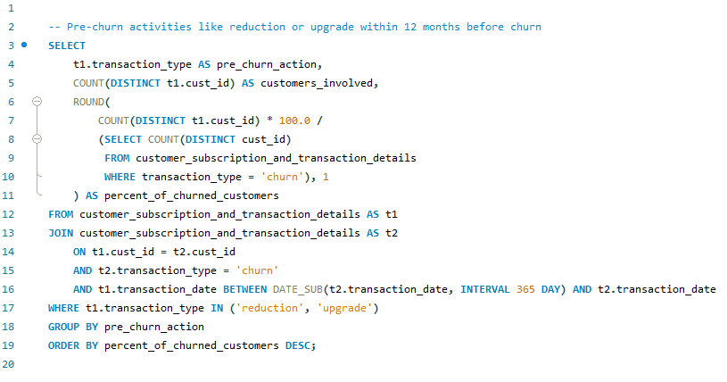
2. Core SQL Feature Engineering

Slide 22
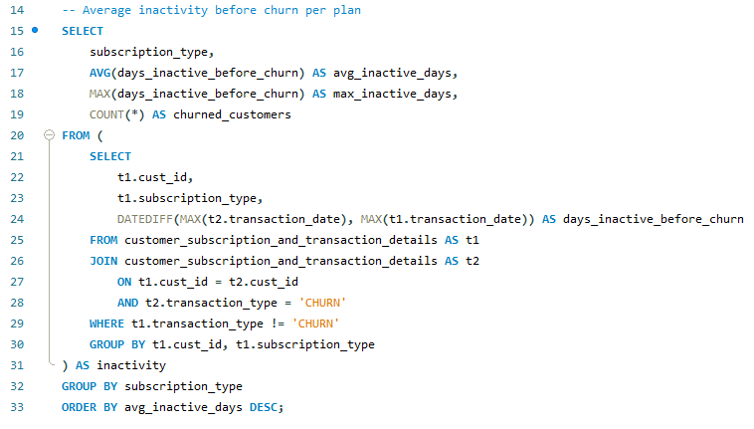
Average Inactivity Before Churn

Slide 23
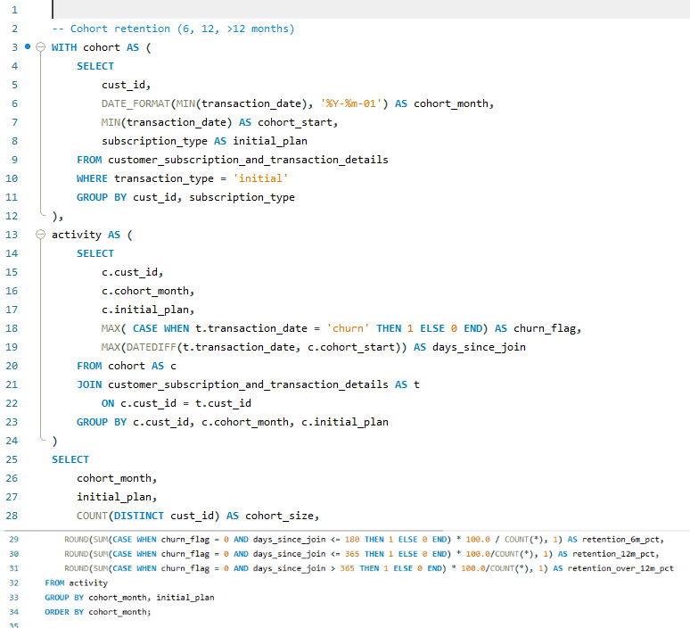

Slide 24
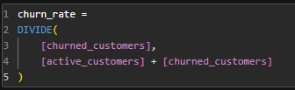
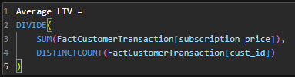
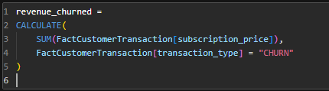
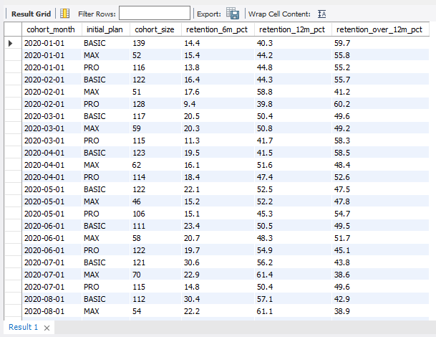
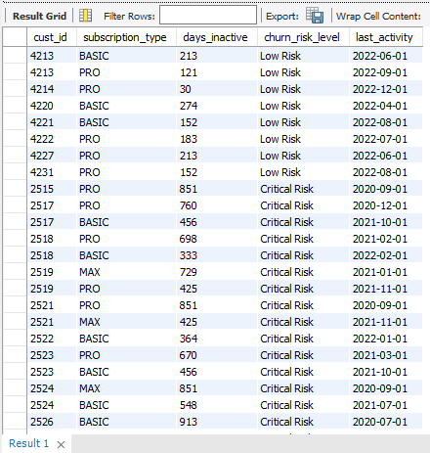
3. Power BI DAX Measure
4. Technical Visuals
Cohort Retention
Real-time churn risk

