Slide 1
Cart Abandonment Analysis
Predicting and Reducing Customer Drop-offs
OSARETIN IDIAGBONMWEN
OCTOBER 2025

Slide 2
Table Of Content
Project Overview
Executive Summary
Data Overview
Workflow Overview
Model Performance
Business Implications & Strategic Recommendations
Path Forward
Thank You

Slide 3
Project Overview
Online stores lose a significant portion of potential revenue because many shoppers add items to their carts but don’t complete the purchase. This can occur for various reasons, such as hesitation, distractions, or issues during checkout. Each abandoned cart not only means a lost sale but also a missed chance to understand customer behavior. By predicting who might abandon their cart, businesses can act before it happens. They can send personalized reminders, improve the checkout process, or offer time-sensitive discounts to encourage completion.
Project Goal
The main goal of this project is to create a predictive model that identifies which customers are most likely to abandon their carts. By using machine learning to analyze customer and behavioral data, the model helps businesses shift from a reactive approach, where they send the same reminder emails to everyone, to a proactive strategy that targets the right customers at the right time.
Core Objectives
The project has four key objectives. First, it aims to predict cart abandonment using a supervised classification model that differentiates between completed and abandoned sessions. Second, it seeks to identify the main causes of abandonment, such as how customer demographics, product type, or device usage affect the choice to drop off. The third objective is to convert these insights into business actions by integrating model outputs into Power BI. This will enable teams to create smarter campaigns and interventions. The fourth objective is to assess performance using accuracy, precision, recall, and F1-score, with a particular focus on recall. The goal is to capture as many potential abandoners as possible.
Business Impact
This project has a measurable impact on the e-commerce workflow. It helps reduce cart abandonment through data-driven actions, allowing marketing teams to concentrate on high-risk, high-value customers. It also boosts conversion rates and improves resource allocation by making retention campaigns more effective. Lastly, it provides leadership with clear, visual insights into shopping behavior and abandonment trends. This information guides both marketing and product decisions with confidence.

Slide 4
Executive Summary
This section summarizes key findings through a combination of machine learning predictions and behavioral analytics that help understand from which sources value is lost and what specific interventions can recover it. The analysis was developed to move beyond raw metrics, turning model outputs and user behavior patterns into clear, actionable strategies that marketing teams can apply with confidence.
This analysis draws on a test sample of 750 transactions, taken from the larger customer dataset used to train the model. Using a supervised classification approach, it predicts the likelihood that a user will complete a purchase or abandon their cart. Combined with Power BI visuals, the results highlight both the patterns behind cart abandonment and the main drivers influencing customer behavior. The insights move the business from reactive follow-ups to proactive, data-driven engagement that helps prevent drop-offs before they happen.
Overview of KPI
KPI | Value | Interpretation
Total Transactions | 750 | This represents the total number of customer sessions analyzed across different cities, devices, and user groups. It provides a solid foundation for identifying consistent behavioral patterns, rather than isolated or one-off actions.
Average Abandonment Risk | 0.50 | On average, there is a 50 percent chance that a visitor will abandon their cart before completing checkout. This figure signals that while engagement is healthy, friction or hesitation still affects a large share of potential buyers.
Predicted Abandonment Rate | 0.72 | The model predicts that approximately 72 percent of future sessions may be abandoned. Although higher than the historical rate, this over prediction is intentional favouring recall to ensure fewer abandoners are missed.
Actual Abandonment Rate | 0.51 | The historical record reveals that half of all customer sessions ended in abandonment, indicating the magnitude of the challenge and the model's relevance to real-world conditions.
Model Accuracy | 0.51 | The model identifies a little more than half of all outcomes correctly, which is good given the complexity of customer behavior. The strong recall of 0.72 is especially valuable, whereby the majority of true abandoners are captured for early intervention.
High-Value Customer Share | 0.25 | One in four customers is a high-value customer, where even minor improvements in retention or engagement drive outsized revenue impact. This insight suggests that predictive targeting could produce substantial ROI if focused on these users.

Slide 5
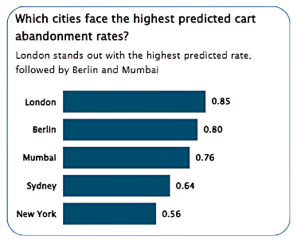
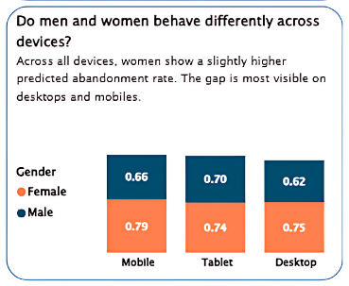
The KPIs show a clear opportunity to reduce abandonment risk through targeted action. With a recall-oriented model and predictive accuracy in line with business goals, the organization can identify high-risk sessions early and intervene especially among high-value customers where every recovery counts.
Key Insights from the Dashboard Visuals
1. City-Level Trends
The analysis highlights that some cities have much higher predicted abandonment rates. London stands out as the most at-risk, followed by Berlin and Mumbai. These locations show consistently high abandonment probabilities, suggesting the presence of regional factors such as delivery concerns, pricing competitiveness, or local trust barriers during checkout.
These cities represent the most immediate opportunity for targeted intervention. By providing personalized offers, running localized campaigns, or improving shipping transparency, this can directly lower abandonment in these areas, driving measurable improvements in both conversion rate and revenue performance.
2. Device and Gender Patterns
Mobile devices have the highest abandonment rates overall, and within that, women are more likely to have drop-off compared to men. On mobile, abandonment for females is at an average of 0.79 versus 0.66 for males, while on desktop, the difference remains notable: 0.75 versus 0.62.
These differences likely reflect variations in user experience, screen design, or checkout friction on smaller devices. Improving mobile navigation, simplifying payment flows, and testing trust-building messages aimed at female users could yield rapid gains. Since mobile commerce drives the majority of traffic, optimization here will have a direct link to improved revenue.

Slide 6
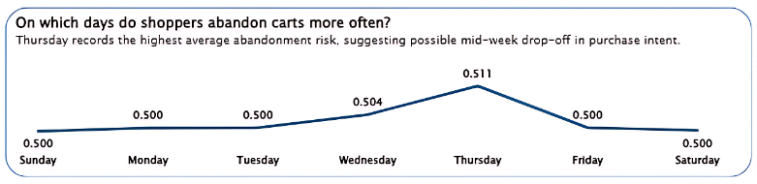
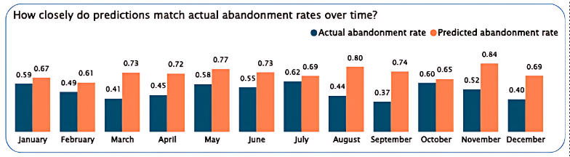
3. Behavioral Timing
Weekly patterns are indicative of increased abandonment risk in midweek, peaking on Thursdays. This may be due to decreased purchase intent or simply other distractions on workdays.
This is where timing-based interventions might help, for example, running Thursday evening retargeting campaigns or making midweek offers to capture users who dropped off in the earlier part of the day. By linking marketing actions with behavioral rhythm, engagement gets more natural and conversion more likely.
4. Predictive Validation Over Time
The predicted and actual abandonment trends follow each other closely when plotted for several months. This means that the model captures an underlying behavioral pattern rather than random fluctuations.
The closeness of the forecast to the actual outcome will help to reinforce stability and reliability of the
model which makes it suitable for operational integration because the marketing automation system can confidently act upon predictions and continuously monitor the performance in real time.

Slide 7
Overall Conclusion
The results showed a systematic pattern of cart abandonment across key demographic and behavioral dimensions. With the design for strong recall, the predictive model brings early detection for at-risk sessions and gives a critical advantage to the business in retaining customers before they leave. These insights, from a business perspective, enable a strategic shift where teams can stop relying on mere reactive discounts or reminders and instead use data to anticipate hesitation in customers, thus intervening precisely when it matters most.
In essence, this analysis gives the business a roadmap for smarter engagement which include; optimize mobile experiences, personalize communication for high-risk groups, and focus on the cities with the highest abandonment rates. By taking action on these insights, the organization will reduce lost sales, boost conversion rates, and create a more frictionless shopping journey that builds both trust and loyalty.

Slide 8
Data Overview
Data Source and Structure
The dataset comes from a simulated e-commerce environment designed to capture customer shopping behavior.
It’s organized into multiple relational tables that mirror a typical online retail database:
Table | Description
Customer Table | Includes demographic information such as age, gender, and city.
Product Table | Contains product details like category and price.
Device Table | Tracks how the session occurred across device types like desktop, tablet, or mobile along with operating system.
Date Table | Provides date information used to extract time-based features such as month and day of the week.
Fact Table | Records transaction-level data, linking all dimensions together. It’s where the “abandoned” label originates.
Data Integration
All five tables were merged using their respective foreign keys to form a fact-dimension schema, which was later prepared for modeling.
After integration, the data was cleaned, and a subset of 750 records was used for evaluation.
Key transformations included:
Handling missing values using median (numeric) and most frequent (categorical) imputations
Log-transforming prices to reduce skewness
Creating a binary is_high_value feature based on transaction amount
Extracting month and day_of_week from the date_id
Removing personal identifiers and potential leakage columns such as customer_name, product_name, and abandonment_time.

Slide 9
Feature Composition
The modeling dataset consisted of two main feature types:
Numeric Features
Age
Quantity
Log-transformed price (log_price)
High-value indicator (is_high_value)
Categorical Features
Gender
City
Category
Device type
Operating system
Day of week
Month
These features capture both who the customer is and how they shop, allowing the model to learn meaningful behavioral patterns.
Preprocessing Pipeline
A custom preprocessing pipeline was built using scikit-learn’s ColumnTransformer to ensure consistency across training, validation, and test sets.
Numeric pipeline: imputation + scaling
Categorical pipeline: imputation + one-hot encoding
This automation guarantees the same transformations are applied during model training, evaluation, and future predictions whereby improving reliability and reproducibility.
Raw Data
Cleaning
Encoding
Model-ready dataset
Scaling

Slide 10
Workflow Overview
The workflow for this project was built as a complete end-to-end system, starting from raw data and ending with live insights in Power BI. Each stage plays a specific role in making the predictions accurate and the results actionable.
Data Preparation
Data was sourced from five tables - Customer, Product, Device, Date, and Fact - and merged into one clean dataset. Missing values were filled, numerical features were standardized, and categorical variables were encoded. This ensured that all model inputs were consistent and reliable.
Feature Engineering
Important behavioral and transactional features were created, including log-transformed prices, product quantities, and a binary “is_high_value” flag based on total spend. Additional features like day of the week and month were extracted from dates to capture seasonal shopping behavior.
Model Training
Several algorithms were trained and fine-tuned, including Logistic Regression, Random Forest, Gradient Boosting, SVM, and Neural Network. Cross-validation was used to ensure fairness in comparison. The SVM model stood out by achieving the best recall while keeping precision reasonable, making it ideal for identifying customers most likely to abandon their carts.
SQL Integration
Once the model was finalized, predictions were automatically saved into a SQLite database. This created a structured and easily accessible source for performance tracking, reporting, and further analysis.
Power BI Visualization
The SQL database was connected to Power BI, where dashboards were built to visualize abandonment risk, model performance, and key customer insights. This made the analytics accessible to both technical and non-technical users, allowing data-driven decisions in real time.

Slide 11
Model Performance
The final model was evaluated using standard classification metrics:
Accuracy: 0.51
Recall: 0.72
F1 Score: 0.60
The recall score of 0.72 shows that the model successfully identifies most customers who are at risk of abandoning their carts. While accuracy is moderate, this trade-off is acceptable given that the goal is to capture as many potential abandoners as possible rather than focus on perfect precision.
In a business context, this means the model can be used to trigger proactive retention actions, like reminders or discount offers, before a customer leaves the purchase process.

Slide 12
Business Implications and Strategic Recommendations
The insights from this project go beyond prediction, they highlight where the business can act decisively to reduce lost sales and improve the shopping experience. The model has revealed meaningful behavioral differences between customer segments, devices, and locations, which can now inform more targeted operational and marketing strategies.
1. Prioritize High-Risk Markets for Retention Efforts
Cities like London, Berlin, and Mumbai show a consistently higher likelihood of cart abandonment. These regions likely face a mix of issues from competitive pricing to cultural differences in online buying confidence. Concentrating retention campaigns and localized offers in these areas could yield measurable improvement in conversion rates. For instance, region-specific discounts, optimized shipping policies, or localized customer support might reduce hesitation at checkout.
2. Optimize the Mobile Checkout Experience
With mobile users, especially female shoppers, show the highest abandonment rates, so the mobile checkout experience needs closer attention and improvement. Friction points like form complexity, slow page load, or lack of preferred payment options can discourage completion. Simplifying mobile checkout steps, adding digital wallet integrations, and improving progress visibility can create smoother experiences and lower abandonment.
3. Leverage Predictive Scores for Targeted Re-Engagement
The predictive model can serve as an early-warning system. When a session crosses a high abandonment risk threshold (e.g., 0.6 or higher), the system can trigger personalized email or in-app reminders, offering limited-time discounts or highlighting saved items. This kind of real-time, data-driven outreach can recover a significant share of potentially lost sales.
4. Protect and Grow the High-Value Customer Segment
High-value customers represent 25% of all shoppers but contribute disproportionately to revenue. Targeted retention for this group should focus on loyalty programs, early access offers, or premium customer support. Even a small drop in abandonment among this segment could translate into major profit gains.
5. Bridge Marketing and Product Teams with Data Insights
The analysis has shown how behavioral data can inform both marketing strategy and product design. Marketing teams can use these patterns to refine audience targeting, while product teams can translate them into design and UX improvements. This kind of cross-functional collaboration turns data insights into tangible business outcomes.

Slide 13
Path Forward
This project lays the foundation for a data-driven approach to understanding and preventing cart abandonment. The next phase should focus on improving model performance, deepening automation, and embedding insights into real-time operations.
1. Refine the Prediction Model
The current model’s recall of 0.72 is strong for identifying at-risk customers, but future work should aim to improve precision without sacrificing recall. Experimenting with ensemble stacking or fine-tuning the decision threshold could create a better balance between identifying abandoners and reducing false positives.
2. Integrate Predictions into Live Marketing Systems
Deploying the model within the company’s marketing automation or CRM platform would allow predictions to trigger real-time actions, such as sending a reminder email or push notification minutes after a cart is left idle. This step would turn the analysis from retrospective insight into live business impact.
3. Implement Continuous Monitoring and Model Drift Checks
Consumer behavior changes rapidly. Regularly retraining the model with new data and tracking performance over time ensures it remains accurate and aligned with evolving patterns. This can be automated through scheduled retraining pipelines or dashboard alerts when accuracy or recall drops below target levels.
4. Expand the Scope of Analysis
Future iterations could include additional behavioral data such as session duration, referral source, or device location data. These features might reveal new predictors of abandonment and help design more nuanced interventions.
In summary, the model has proven its value as both an analytical and operational tool. Moving forward, the focus should shift from insight generation to execution, which include, integrating the predictions into real-time systems, aligning business teams around data-driven interventions, and continuously improving model performance to stay ahead of customer behavior trends.

Slide 14
Thank You
Thank you for your time and attention.
This project represents how data science can bridge business challenges and customer behavior whereby turning insights into actions that
drive measurable impact.
I’d be happy to take any questions or discuss possible extensions of the project, such as real-time deployment, deeper behavioral
segmentation, or model optimization.
Contact Details
📧 Email: oidiagbonmwen@gmail.com
🔗 LinkedIn: Osaretin Idiagbonmwen
💻 GitHub: github.com/OsasAnalyst
📂 Project Repository: Cart Abandonment Prediction
Thank you!

