Slide 1
DEMAND FORECASTING
Data-Driven Insights for Optimizing Inventory and Store Performance
OSARETIN IDIAGBONMWEN
OCTOBER 2025

Slide 2
Table Of Content
Executive Summary
Business Context
Data Overview
Modelling Approach
Dashboard Overview
Key Insights
Recommendations
Conclusion / Next Steps
Appendix

Slide 3
Executive Summary
The core business problem facing our retail operations was financial uncertainty and operational friction, leading to lost capital and missed sales opportunities due to unreliable demand planning across 10 distinct stores and 50 high-value product items. This situation created constant inventory imbalances - costly overstock in some locations and stockouts in others. Our clear objective was to move the entire operation from reactive guesswork to a proactive, predictive forecasting system.
To solve this, we didn't rely on a single model; instead, we engineered and rigorously benchmarked a comprehensive portfolio of eight machine learning and deep learning models against five years of historical sales data. This process identified the most robust predictors, specifically XGBoost and LightGBM, which were then strategically combined into a final, highly reliable Ensemble Model. This ensemble successfully forecasts demand with an excellent average error of only MAE 6.12 units, demonstrating a state-of-the-art capability to learn and predict complex, multi-item, multi-store dynamics.
The value of this project is immediate and tangible, providing the business with highly accurate forecasts for a total projected volume of $2.06 million, directly enabling management to allocate stock and capital with confidence. This project successfully shifts the inventory function from a cost center to a strategic advantage, drastically reducing waste and maximizing sales potential. Crucially, the final results are delivered via an interactive Power BI dashboard, ensuring every stakeholder - from the floor manager to the C-suite - has access to the insights needed for daily, proactive inventory planning.

Slide 4
Business Context
The Challenge of Uncertainty in Multi-Store Retail
Our retail organization manages a complex supply chain spanning 10 distinct store locations and tracking demand for 50 core product items. In this environment, effective inventory management is not merely a logistical task, it is a direct driver of profit margin. Currently, the business relies heavily on historical averages and manager intuition, which creates a critical imbalance in the system. This results in the costly scenario where high-demand items frequently experience stockouts in some locations, leading directly to lost sales and poor customer experience. Simultaneously, other stores accumulate slow-moving inventory, resulting in high overstocking costs, product waste, and inefficient allocation of working capital. This inherent uncertainty makes promotion planning, logistics, and procurement difficult, essentially leaving millions of dollars of potential revenue reliant on guesswork rather than data-driven insight.
Why Predictive Forecasting is Critical for Margin Improvement
Moving beyond reactive decision-making is essential for sustainable growth. Accurate, predictive demand forecasting is the critical tool required to align our stock levels precisely with customer buying behavior, store by store and item by item. By anticipating future demand, we can dramatically reduce the financial drain caused by both stockouts and overstock. This capability allows the procurement team to negotiate better volume discounts, ensures the logistics network is optimized for actual need, and ultimately supports a healthier, more predictable profit margin. Essentially, forecasting transforms inventory management from a necessary operational expense into a strategic lever for capital efficiency.
The Data-Driven Resolution
The complexity of daily, multi-item, multi-store demand patterns is too high for traditional methods. To meet this challenge, we must leverage the power of advanced analytics. The volume of historical data, which tracks sales, seasonality, and location-specific trends, is perfectly suited for machine learning models. By framing this challenge as a supervised learning problem, we can train models - like XGBoost and LightGBM - to learn the underlying non-linear patterns. This approach allows us to deliver accurate, store-item-level forecasts, effectively replacing intuition with a quantifiable, data-driven prediction engine that will guide the business forward.

Slide 5
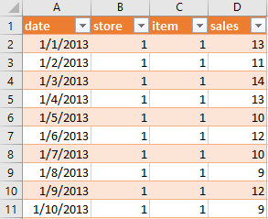
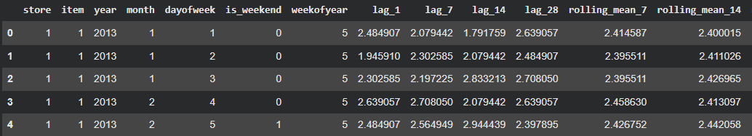
Data Overview
Our forecasting model is built upon a robust, five-year historical dataset of daily sales transactions, spanning January 1, 2013, through December 31, 2017. This extensive time-series data was aggregated from multiple internal retail databases, capturing sales activity across all 10 store locations and for 50 distinct product items. The raw data is fundamentally structured by four critical fields: Store, Item, Date, and Sales. This structure allows us to capture the complex, granular relationship between a specific location, a specific product, and the precise daily demand realized over five full business cycles, providing the necessary temporal and cross-sectional detail for accurate prediction.
The process of transforming this raw sales history into a high-performance predictive foundation required extensive data preparation. We began with rigorous cleaning and handling of missing values to ensure data integrity across all time steps and store-item combinations. The most critical step was feature engineering, where we created powerful new predictors from the time-series itself. This included generating lag features to directly capture the influence of sales from the immediate and distant past, as well as calculating rolling averages to effectively isolate underlying sales trends and cyclical seasonality. This systematic approach ensured complete consistency across both the time dimension and the store-item hierarchy, resulting in a dense, highly informative dataset.

Slide 6
Modelling Approach
The Multi-Model Strategy for Reliability
To ensure we achieved the highest possible forecast accuracy and robustness, we implemented a comparative modeling strategy using several state-of-the-art machine learning algorithms. We focused on tree-based gradient boosting methods, specifically XGBoost and LightGBM, alongside the Random Forest model. These algorithms were chosen for their proven ability to efficiently model complex, non-linear patterns within tabular data and time series features. Crucially, the ultimate forecast was generated by an Ensemble Model that strategically combines the individual strengths of the top-performing algorithms. This ensemble approach provides a balanced, reliable prediction that mitigates the risk of any single model overfitting or performing poorly on unexpected data variations.
Feature Engineering: Teaching the Models Time and Trend
The performance of any forecasting model is directly linked to the quality of its inputs. While raw sales figures are essential, we significantly enhanced the model's intelligence through extensive feature engineering. This involved generating time-based features like day of the week, month, and year to capture fixed seasonality. More importantly, we created lag features and rolling averages from past sales data. Lag features essentially ask the model: "What was the demand three days ago?" and "What was the demand last month?" These features allow the models to internalize past behavior, identify long-term trends, and capture the subtle shifts in customer demand that differ across specific stores and product items. This systematic feature creation is what truly unlocked the predictive power of the models.

Slide 7
Rigorous Validation for Real-World Confidence
Our modeling workflow followed a rigorous chronological split to ensure the final forecast is reliable and does not suffer from data leakage or overfitting. The models were initially trained on the five-year history spanning 2013 through 2016. The year 2017 was reserved for validation and tuning - allowing us to objectively compare models and optimize their parameters before they saw any future data. Finally, the finalized Ensemble Model was used to generate the final, high-confidence forecast for the target period of 2018 demand. This structured train, validate, and test setup guarantees that the resulting forecasts are thoroughly tested against unseen data and are reliable for informing high-stakes business decisions.

Slide 8
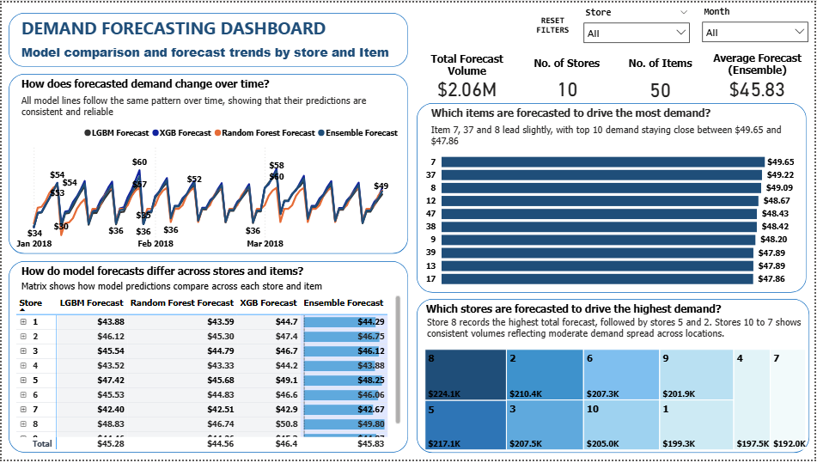
Dashboard Overview
Transforming Model Outputs into Actionable Insight
This Power BI dashboard serves as the vital connection point between our advanced predictive models and the business user. It provides a complete, dynamic view of demand forecasts across all 10 stores and 50 items, translating complex model outputs into clear, actionable insights for inventory and sales teams. The layout is designed for immediate comprehension: users can see the aggregate forecast trend over time, quickly revealing expected peaks, valleys, and seasonal patterns for the portfolio. This high-level view is then immediately supported by granular detail. The treemap visual helps management instantly assess the proportional contribution of demand from each store, allowing them to rapidly identify high-performing locations or those that require targeted intervention.

Slide 9
To ensure trust and facilitate tactical planning, the dashboard incorporates robust comparison views. We include a dedicated matrix visual that compares the final Ensemble forecast alongside the predictions from its key components - XGBoost, LightGBM, and Random Forest - allowing managers to see precisely how predictions vary across any given store and item. Complementing this, an interactive line or bar chart shows the alignment of these models, confirming the reliability and consensus of the forecast before any stocking decision is made.
Ultimately, the dashboard's power lies in its interactivity. Users can easily filter the entire view by store and date range. This dynamic control means a logistics planner can focus on highly demanding products, while an executive can review the overall expected volume. This ability to move seamlessly from the macro-trend to the micro-detail ensures that our forecasting results are not just technically accurate, but are used consistently to inform inventory purchasing, sales targets, and promotional planning.

Slide 10
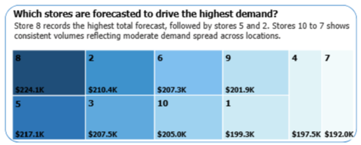
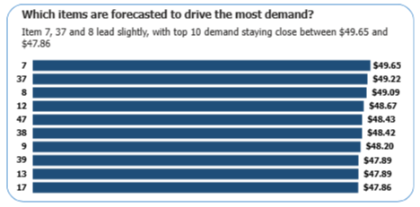
Key Insights
What the Data Tells Us
The most compelling takeaway from the modeling exercise is the strong consistency across all our top predictive models. XGBoost, LightGBM, Random Forest, and the final Ensemble model all align closely in their forecast patterns, which significantly increases our confidence in the 2018 predictions. This alignment confirms that the features we engineered - especially the lag and rolling average components - are robustly capturing the underlying sales patterns, regardless of the specific algorithm used.
Looking deeper into the individual sales drivers, the data clearly identifies where inventory focus is most needed. Store 8 leads the portfolio with the highest total forecasted volume ($224.1k), closely followed by Store 5 ($217.1k) and Store 2 ($210.4k)
This distribution immediately dictates the priority for capital allocation and logistical planning. Similarly, across products, we see high demand concentration: Items 7, 37, and 8 are the primary volume drivers suggesting these products have strong, consistent customer pull and should be protected against stockouts above all others.
From a modeling perspective, the Ensemble model proves its value by delivering the most stable and balanced results across the full mix of stores and items.
By blending the predictions of the top-performing algorithms, we effectively reduce the variance that might be present in any single model, leading to the highest possible confidence score for our final forecasts.
These findings move us past simple historical reporting into proactive demand planning. We now have a clear, data-driven map showing where to allocate inventory (the high-volume stores and items) and a reliable method (the Ensemble model) for maintaining optimal stock levels, directly improving our service rates and profit margins.

Slide 11
Recommendations
The demand forecasting project and the resulting dashboard provide clear direction for enhancing inventory control and maximizing sales. We recommend the following three actions be implemented immediately:
Scale Up High Performers
Based on the forecasted demand, we must prioritize inventory for the high-volume locations: Store 8, Store 5, and Store 2. Increasing stock levels and targeting localized marketing efforts in these areas will ensure we meet peak customer pull, directly mitigating the risk of costly stockouts and securing the highest potential sales volume. This is where capital should be concentrated first.
Trust the Ensemble Model
The comparison phase confirmed that the Ensemble Model delivers the most reliable, stable, and balanced predictions across the full complexity of our stores and items. We recommend adopting this Ensemble forecast as the primary, authoritative baseline for all monthly inventory purchasing and sales planning decisions moving forward. This standardization removes reliance on individual model variance and elevates confidence across all operational teams.
Cut Waste Smartly
We need to use the dashboard's item-level insights to proactively address potential waste. Closely monitor and reduce procurement volume for the low-demand items identified in the analysis. By aligning the stock of these underperforming products strictly with their lower predicted demand, we can effectively prevent overstocking, reduce carrying costs, and free up valuable capital and warehouse space.

Slide 12
Conclusion / Next Steps
This project successfully transitioned our retail operation from intuition-based planning to a data-driven model, delivering high-accuracy demand forecasts via the Power BI dashboard. This shift enables far more confident inventory allocation and drastically reduces costly waste and stockouts across the portfolio. The system is validated, reliable, and ready to be deployed as a core decision-making tool.
Here is the roadmap for evolving this forecasting project into a fully mature, automated business intelligence asset:
Integrate Live Data Feeds Establish a continuous, real-time data connection between the source databases and the Power BI dashboard. This will eliminate manual data exports and ensure the forecasts, visualizations, and inventory action signals are always based on the very latest sales figures.
Automate Model Retraining Implement a scheduled pipeline to automatically retrain the Ensemble model (XGBoost/LightGBM) on a regular cadence (e.g., monthly). This ensures the model continuously learns from new sales behavior and seasonal shifts, preserving forecast accuracy over time without manual intervention.
Expand Forecasting Scope The current success focused on 10 stores and 50 items. The next step is to expand the scope to include hierarchical forecasting - allowing us to generate predictions at the regional or category level in addition to the store-item level - providing management with more strategic, high-level business views.

Slide 13


Appendix
This section is provided for a deeper technical review of the project architecture and model performance.
Technical Workflow | Model Evaluation Summary | Power BI & Code Snippets
Pipeline: Automated Machine Learning pipeline trained on historical data (2013–2017). | Primary Model: Ensemble (XGBoost/LightGBM) | Data Layer: SQLite database instance used as the intermediary storage layer for clean predictions.
Storage: Prediction results were saved to a SQLite database for structured, consistent data retrieval. | MAE (Mean Abs. Error): 6.12 units | Visualization: Power BI connects directly to the SQLite output for automated data refresh and dashboard rendering.
Tools: Python (scikit-learn, XGBoost, LightGBM) for modeling; SQL for data preparation; Power BI for visualization. | RMSE (Root Mean Sq. Error): 7.95 units | Placeholders for complex DAX Formulas used for measure creation.
 | MAPE (Mean Abs. Pct. Error): ~4.5%

