Slide 1
PROJECT ON FAKE NEWS DETECTION SYSTEM USING DEEP LEARNING
By
Mohammed Abdul Haseeb 1604-19-733-095
Mohammad Rayyan Sami 1604-19-733-084
Mir Osayd Ali 1604-19-733-096

Slide 2
Objective
The Objective of the project ‘Fake news detection system’ is to classify the news article or other documents as real or fake. We explore identification of fake news using various models and classifiers and predict the accuracy of different models and classifiers. Through this project, we examine the model giving accuracy and classify the news into real or fake. In this project, we generate computational resources and models for the detection of fake news. We propose two datasets for of real and fake news and implement that datasets using various technologies like, natural language processing and deep learning. Using these datasets, we handled diverse exploratory analyses to identify linguistic properties that are broadly present in deceptive content.
To put our outcomes in perspective, we likewise associate the precision of our fake news detection models with already anticipated exactness. We use deep learning techniques such as LSTM to implement our model. The goal of the project is to get a model or application that has a good f1-score and whose accuracy score ranges from 90 to 99 and overall, the application should be able to classify textual information or news as fake or real.

Slide 3
Fake News:
What is Fake news-
Fake news is false or misleading information presented as news.
Why is it made-
Damaging the reputation of a person or entity.
Making money through advertising revenue.

Slide 4
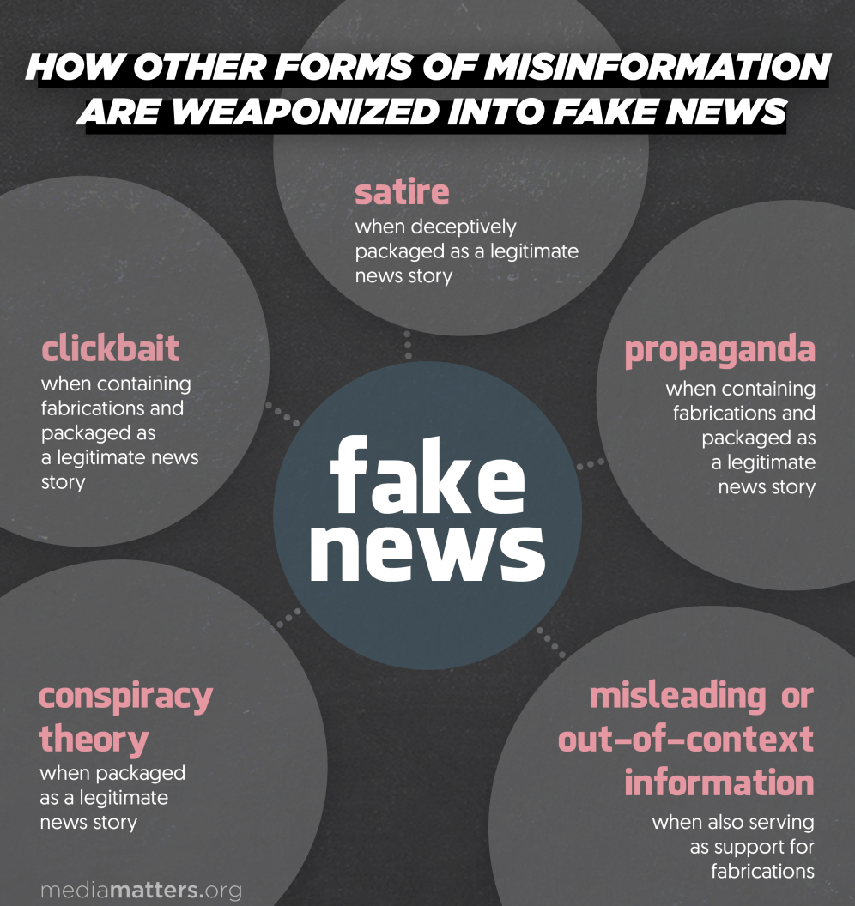
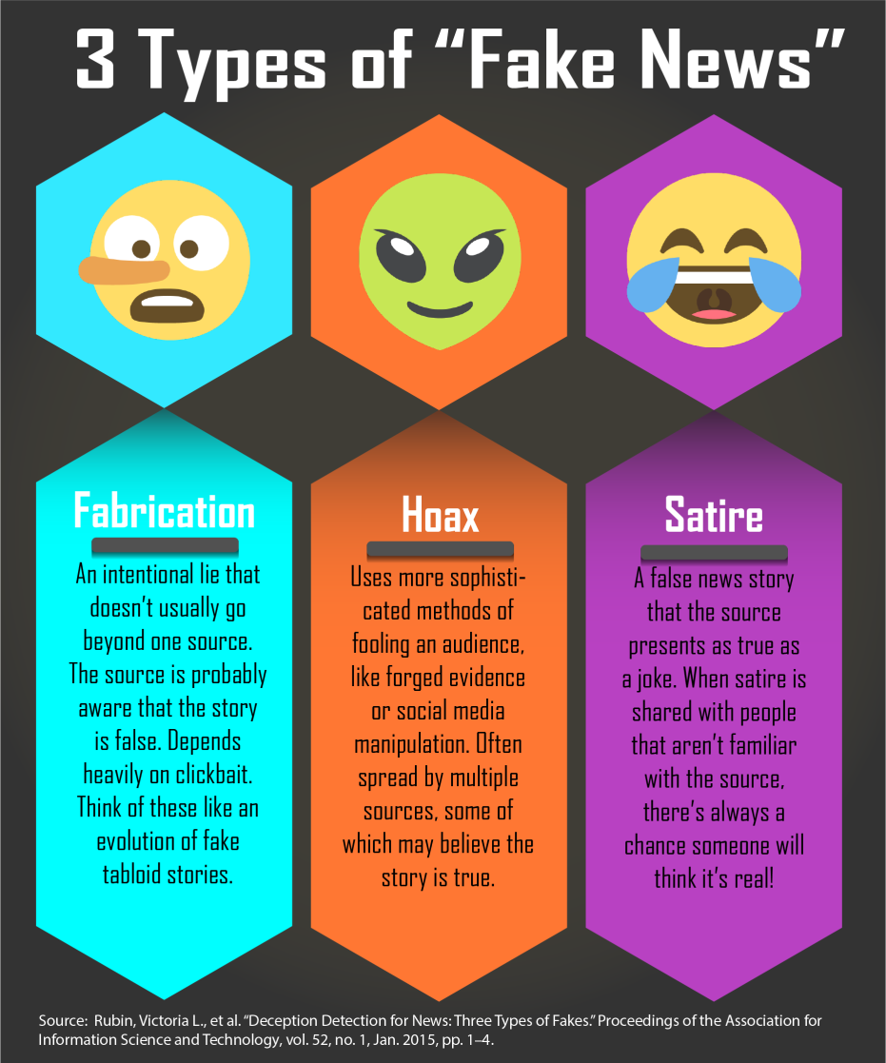
Types of Fake News

Slide 5
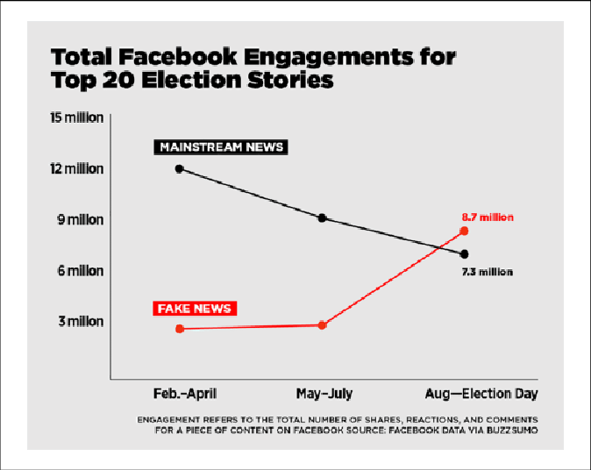
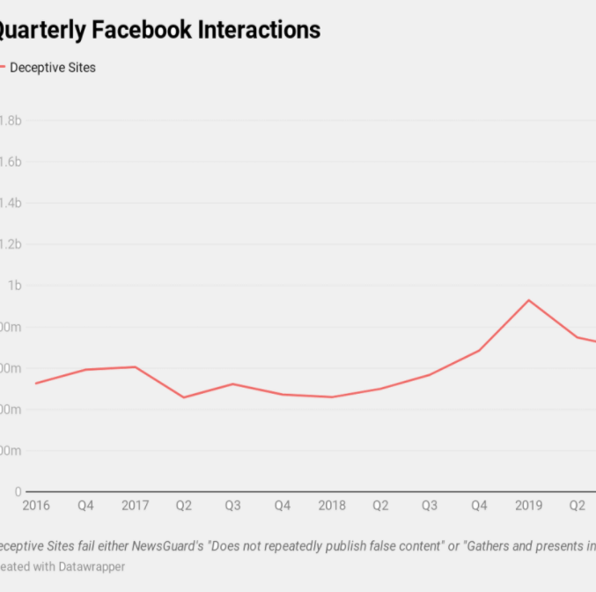
Few Important Facts-
A fake news website can spread fake news faster than real news
Social media proficiency does not correlate with digital literacy
Businesses are developing countermeasures against misinformation

Slide 6
Effects of Fake News
Distrust in the media.
Undermining the democratic process.
Platforms for harmful conspiracy theories and hate speech.
Spread of false or discredited science.
Many Believe Fake News Articles.
Fake News Can Affect Your Grades.
Fake News Can Be Harmful to Your Health.
Fake News Makes It Harder For People To See the Truth.

Slide 7
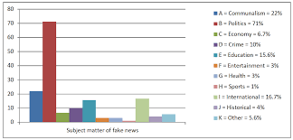

Slide 8
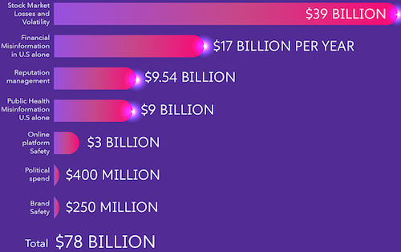
Loss due to Fake News

Slide 9
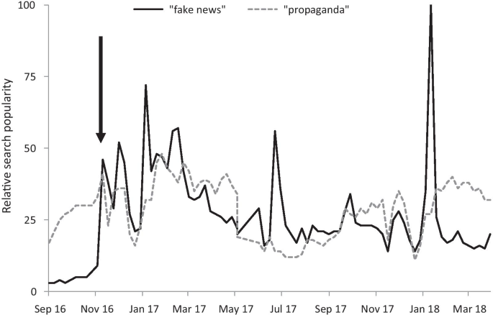
Fake News and Politics

Slide 10
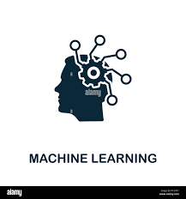
Machine Learning
Machine learning (ML) is a type of artificial intelligence (AI) that allows software applications to become more accurate at predicting outcomes without being explicitly programmed to do so.
Machine learning algorithms use historical data as input to predict new output values.

Slide 11
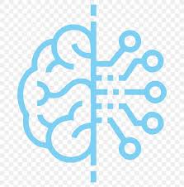
Deep Learning
Deep learning is a type of machine learning and artificial intelligence (AI) that imitates the way humans gain certain types of knowledge.
Deep learning is an important element of data science, which includes statistics and predictive modeling

Slide 12







Libraries Used

Slide 13
Pandas
Pandas is a Python library used for working with data sets.
It has functions for analyzing, cleaning, exploring, and
manipulating data.
Pandas allows us to analyze big data and make conclusions
based on statistical theories.
Pandas can clean messy data sets, and make them readable
and relevant.
Pandas gives you answers about the data. Like:
Is there a correlation between two or more columns?
What is average value?
Max value?
Min value?

Slide 14
NumPy
NumPy is a Python library used for working with arrays.
It also has functions for working in domain of linear algebra, fourier transform, and matrices.
NumPy stands for Numerical Python.
NumPy aims to provide an array object that is up to 50x
faster than traditional Python lists.
The array object in NumPy is called ndarray, it provides a lot of
supporting functions that makes working with ndarray very easy.
NumPy arrays are stored at one continuous place in memory unlike
lists, so processes can access and manipulate them very efficiently.
This is the main reason why NumPy is faster than lists. Also it is optimized to
work with latest CPU architectures.

Slide 15
Seaborn, Matplotlib
Matplotlib is a low level graph plotting library in
python that serves as a visualization utility.
Matplotlib was created by John D. Hunter.
Matplotlib is open source and we can use it freely.
Matplotlib is mostly written in python, a few segments
are written in C, Objective-C and Javascript for Platform
Compatibility.
Seaborn is a library for making statistical graphics in Python. It builds on top of matplotlib and integrates closely with pandas data structures.
Seaborn helps you explore and understand your data. Its plotting functions operate on
dataframes and arrays containing whole datasets and internally perform the necessary
semantic mapping and statistical aggregation to produce informative plots. Its dataset
oriented, declarative API lets you focus on what the different elements of your plots mean,
rather than on the details of how to draw them.

Slide 16
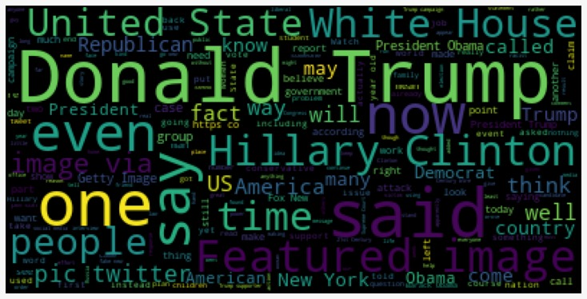
Wordcloud
Word Cloud is a data visualization technique used for representing text data in which the size of each word indicates its frequency or importance.

Slide 17
TensorFlow
TensorFlow is an open source artificial intelligence
library, using data flow graphs to build models. It allows
developers to create large-scale neural networks with
many layers.
TensorFlow is mainly used for: Classification,
Perception, Understanding, Discovering, Prediction and
Creation.

Slide 18
SciPy
SciPy is a scientific computation library that
uses NumPy underneath.
SciPy stands for Scientific Python.
It provides more utility functions for optimization, stats
and signal processing.
SciPy has optimized and added functions that are
frequently used in NumPy and Data Science.
SciPy is predominantly written in Python, but a few segments are written in C.

Slide 19
Word2Vector (gensim)
Word2Vec is a group of models which helps derive relations between a word and its contextual words.
word2vec is one of the most popular techniques to learn
word embeddings using shallow neural network .It was
developed by Tomas Mikolov in 2013 at Google. Word
embedding is the most popular representation of a
document vocabulary. It is capable of capturing context
of a word in a document. Semantic and syntactic
similarity, relation with other words etc..

Slide 20
LSTM
Long short-term memory (LSTM)
is an artificial recurrent neural network (RNN)
architecture used in the field of deep learning. Unlike
standard feedforward neural networks, LSTM has
feedback connections. It can process not only single data
points (such as images), but also entire sequences of
data (such as speech or video). For example, LSTM is
applicable to tasks such as unsegmented,
connected handwriting recognition, speech recognition and
anomaly detection in network traffic or IDSs (intrusion detection systems).

Slide 21
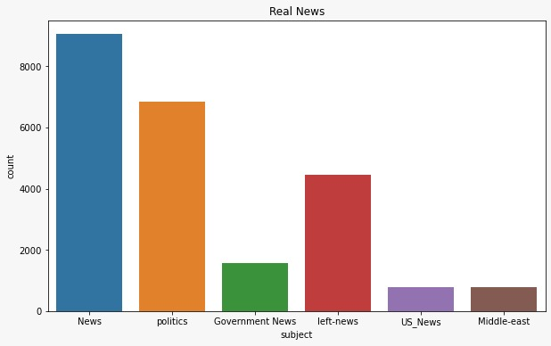

Dataset

Slide 22
Approach and Procedure
Exploring Dataset:
Few observations were taken from the dataset of real and fake news and accordingly plotted as shown in graphs.
Differences in text were observed
Real news had source of publication which is not present
in fake news
looking at the data:
most of text contains reuter info such as
"WASHINGTON (Reuter)".
Some text are tweets from twitter.
Few text do not contain any publication info.

Slide 23
Contd..
Cleaning Data:
Removing reuters or Twitter tweet info from the text.
Text can be split only once at "-" which is always present after mentioning source of publication, this gives us publisher part and text part.
If we do not get text part, this means publication details were not given for that record.
The twitter tweets always have same source ,a long text of max 259 characters.

Slide 24

Vectorization and Tokenization
The Fake and Real news text content were appended in a list having columns (text, class) where class corresponds to the type of news (class{Real}=1 class{fake}=0).
The list was split into words and made into a list containing those words.
Using Word2Vec vectorization of those words was done and each word had its corresponding word index.
Tokenization of those vectors was done to have a sequence and padding to '0' was done to all the vectors.

Slide 25
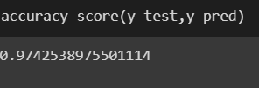
Model
The model was set as a sequential model using TensorFlow library.
Vectors were passed to the model to train.
Using LSTM (Deep Learning) model parameters were set as default (Accuracy,Optimizer,Activation)
Using sklearn library of python the model was tested, and validated
Accuracy score and Classification Report was generated as :

Slide 26
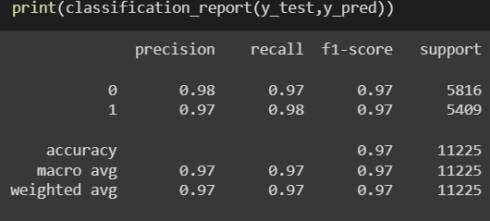
Classification Report

Slide 27

Summary
The accuracy of the model was found to be 97% which indicates that it is a stable model neither underfit nor overfit with "f1-score" as 0.97.
This model can accurately differentiate fake and real news when some article is given as an input.
The input article must not be too short it should be atleast a paragraph.
The accuracy of the model underlies in the dataset as time passes the dataset must be modified such that there is no decrease in the accuracy.

Slide 28
Summary
This project therefore provides solution for detecting
fake news on different social media platforms and
networking sites.
It is great way to fact check any news article using this
model.
This model can be implemented on different social
media platforms by including this algorithm in their
community guidelines such that there is no such fake
news propagated on these platforms.

Slide 29
THANK YOU

