Slide 1
Chapter 7
Distribution Strategies

Slide 2
7.1 Introduction
Focus on the distribution function.
Various possible distribution strategies, and the opportunities and challenges associated with these strategies.
Two fundamental distribution strategies:
  Items can be directly shipped from the supplier or manufacturer to the retail stores or end customer
  Use intermediate inventory storage points (typically warehouses and/or distribution centers).
Issues with warehouses
  Manufacturing strategy (make-to-stock vs. make-to-order)
  Number of warehouses
  Inventory policy
  Inventory turn over ratio
  Internal warehouses vs. outside distributor
  Owned by a single firm or by a variety of firms

Slide 3
7.2 Direct Shipment Distribution Strategies
Advantages:
  The retailer avoids the expenses of operating a distribution center
  Lead times are reduced.
Disadvantages:
  Risk-pooling effects are negated
  Manufacturer and distributor transportation costs increase
Commonly used scenarios:
  Often mandated by powerful retailers
  Manufacturer may be reluctant but may have no choice
  Retail store requires fully loaded trucks
  Lead time is critical.
  Prevalent in the grocery industry
    lead times are critical because of perishable goods.

Slide 4
7.3. Intermediate Inventory Storage Point Strategies
Variety of characteristics distinguish different strategies.
  Length of time inventory is stored at warehouses and distribution centers.
Strategies:
  Traditional warehousing strategy
    distribution centers and warehouses hold stock inventory
    provide their downstream customers with inventory as needed.
  Cross-docking strategy
    warehouses and distribution centers serve as transfer points for inventory
    no inventory is held at these transfer points.
  Centralized pooling and transshipment strategies
    may be useful when there is a large variety of different products

Slide 5
Traditional Warehousing
Inventory management and risk pooling key factors
Other factors also play a significant role
  Centralized vs Decentralized Management
  Central vs Local Facilities

Slide 6
Centralized vs Decentralized Management
Decentralized system
  Each facility identifies its most effective strategy without considering the impact on the other facilities in the supply chain.
  Leads to local optimization.
Centralized system
  decisions are made at a central location for the entire supply network.
  Typical objective: minimize the total cost of the system subject to satisfying some service-level requirements.
  Centralized control leads to global optimization.
  At least as effective as the decentralized system.
  Allow use of coordinated strategies
If system cannot be centralized
  often helpful to form partnerships to approach the advantages of a centralized system.

Slide 7
Central vs. Local Facilities
Centralized facilities
  Employ both fewer warehouses and distribution centers
  Facilities are located further from customers.
Other factors:
  Safety stock.
    Lower safety stock levels with centralized facilities
  Overhead.
    Lower total overhead cost with centralized facilities
  Economies of scale.
    Greater economies of scale with centralized facilities
  Lead time.
    Lead time to market reduced with local facilities
  Service.
    Utilization of risk pooling better with centralized
    Shipping times better with local
  Transportation costs.
    Costs between production facilities and warehouses higher with local
    Costs from warehouses to retailers lesser with local

Slide 8
A Hybrid Decision
Some products use centralized strategy while others use local strategy
Not an either or decision
Varying degrees of centralization and localization due to the varying levels of advantages and disadvantages

Slide 9
Cross-Docking
Popularized by Wal-Mart
Warehouses function as inventory coordination points rather than as inventory storage points.
Goods arriving at warehouses from the manufacturer:
  are transferred to vehicles serving the retailers
  are delivered to the retailers as rapidly as possible.
Goods spend very little time in storage at the warehouse
  Often less than 12 hours
  Limits inventory costs and decreases lead times

Slide 10
Issues with Cross-Docking
Require a significant start-up investment and are very difficult to manage
Supply chain partners must be linked with advanced information systems for coordination
A fast and responsive transportation system is necessary
Forecasts are critical, necessitating the sharing of information.
Effective only for large distribution systems
  Sufficient volume every day to allow shipments of fully loaded trucks from the suppliers to the warehouses.
  Sufficient demand at retail outlets to receive full truckload quantities

Slide 11
Inventory Pooling – GM Example
1,500 Cadillacs parked at a regional distribution center in Orlando
Await delivery to dealers statewide within 24 hours
10% to 11% sales loss because a car is not available…
Test program expected to:
  improve customer service
  boost sales of Cadillacs by 10%

Slide 12
Centralized Pooled Systems Perform Better
For the same inventory level, a centralized system provides:
  higher service level
  higher sales
Push-pull supply chain
  Moving from a push supply chain
    Dealers have to order before demand is realized
  To a push-pull supply chain
    Dealers pull from regional distribution centers.
Implications:
  End consumers will see better customer service
  More cars are available to them.

Slide 13
Other Factors
Will GM sell more cars to GM dealers?
  Total number of cars ordered by dealers will not necessarily increase, even as customer service increases.
What about the dealers?
  Dealers have access to more inventory
    Potentially can sell more.
  Levels out the playing field between dealers.
    Small dealers would favor such a system Competitive advantage of large dealers wiped out

Slide 14
Customer Search
If the customer arrives at a dealer and does not find the item
  Switches to another dealer
  Helps the manufacturer sell more products
Which system is better under customer search?
  No impact on the centralized system

Slide 15
Impact on Decentralized System
If a dealer knows that its competitors do not keep enough inventory
  this dealer should raise the inventory level to satisfy:
    its own demand
    demand of customers who initially approach other dealers with limited inventory.
If a dealer knows that its competitors has significant inventory
  this dealer will reduce the inventory level
    It is not likely to see customers who switch
Dealer’s strategy depends on its competitor’s strategy.
Dealers may/may not know their competitor strategy
  not clear how they decide on their inventory level.
  not clear about the impact of search on the manufacturer

Slide 16
Nash Equilibrium (Game Theory)
If two competitors are making decisions, they have reached Nash equilibrium if they have both made a decision
  Both have decided on an amount to order
  neither can improve their expected profit by changing the order amount if the other dealer doesn’t change his order amount.

Slide 17
Nash Equilibrium
 |  | Prisoner A
 |  | confess | not confess
Prisoner B | confess | Both sentenced 5 years in prison | A sentenced 10 years; B sentenced 1 year
 | not confess | A sentenced 1 year; B sentenced 10 years | Not guilty
Notes:
Both A and B should not confess. But if the investigator told A that B has confessed because of some evidences have been found, then A might confess.

Slide 18
 | Dealer 2 stocks '0' | Dealer 2 stocks '100' | Dealer 2 stocks '200' | Dealer 2 stocks '300'
Dealer 1 stocks '0'
Dealer 1 stocks '100'
Dealer 1 stocks '200'
Dealer 1 stocks '300'
Profit is $5 per product sold, loss is $1 per product unsold.
Demand for each market is 100. Customer search rate=1.

Slide 19
 | Dealer 2 stocks '0' | Dealer 2 stocks '100' | Dealer 2 stocks '200' | Dealer 2 stocks '300'
Dealer 1 stocks '0' | $0, $0 | $0, $500 | $0, $1000 | $0, $900
Dealer 1 stocks '100' | $500, $0 | $500, $500 | $500, $400 | $500, $300
Dealer 1 stocks '200' | $1000, $0 | $400, $500 | $400, $400 | $400, $300
Dealer 1 stocks '300' | $900, $0 | $300, $500 | $300, $400 | $300, $300
Profit is $5 per product sold, loss is $1 per product unsold.
Total demand is 200.

Slide 20
Example
α = percentage of customers that search the system
Each retailer can determine what their effective demand will be if the other retailer orders a specific amount.
Based on this information, they can calculate how much they should order given any order by their competitors.
  Best response

Slide 21
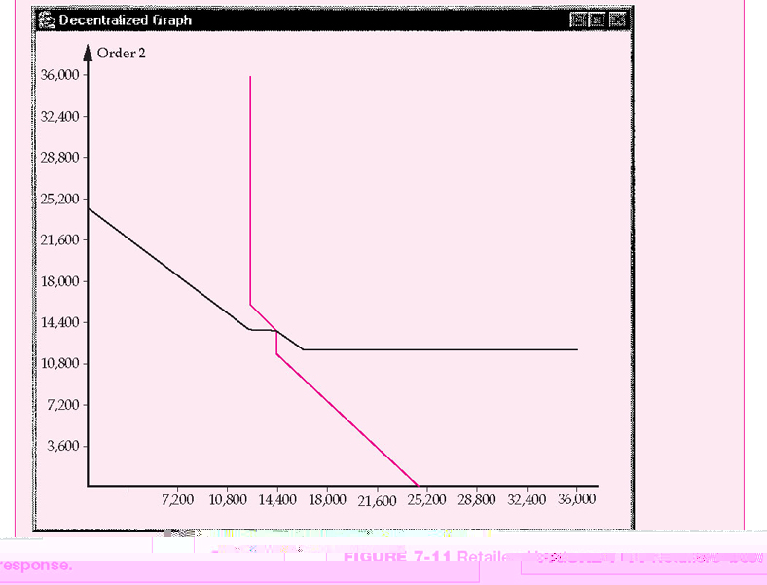
Best Response with α=90%
Response by retailer 2
Order by
Retailer 1
FIGURE 7-11: Retailers’ best response

Slide 22
Nash Equilibrium of the System
Retailer one orders about 20,000 units, retailer two will respond by ordering about 12,000 units
If this is the case, then retailer one should modify its strategy and reduce the order quantity
No retailer has an incentive to modify its strategy
They order amounts associated with the intersection of the two curves.
Optimal order quantity for each retailer = 13,900 units
Total expected profit for each retailer = $489,460
    (125-80)*12604 – (80-20)*(13900-12604) = 489,700
Total expected profit = $978,920
Total expected sales = 25,208
Total amount ordered from the manufacturer = 27,800
Manufacturer’s profit = $1,251,000.

Slide 23
Decentralized and Centralized Systems for Search Level of 90%
Strategy | Retailers | Manufacturer | Total
Decentralized | 978,920 | 1,251,000 | 2,229,920
Centralized | 1,009,392 | 1,170,000 | 2,179,392
Centralized system does not dominate the decentralized system.
Retailers prefer the centralized system
Manufacturer’s profit is higher in the decentralized system

Slide 24
As α Increases
Each retailer’s order quantity and profit increases
Retailers’ total expected profit will be higher in the centralized pooling system than in the decentralized system.

Slide 25
As α Increases
With larger α
  retailers will order more in a decentralized system
  manufacturer will prefer a decentralized system
  retailers will prefer a centralized system
With smaller α
  manufacturer will order less in a decentralized system
  both the retailers and the manufacturer will prefer a centralized pooling system.

Slide 26
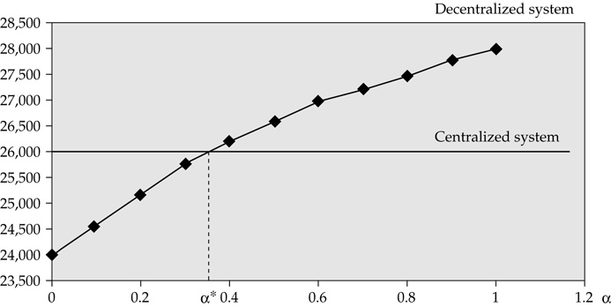
Effect of α on Amounts Ordered
FIGURE 7-12: Amount ordered by dealers as a function of the search level

Slide 27
Critical Search Level
Presence of a critical search level
  manufacturer prefers the centralized system below the level
  otherwise, manufacturer prefers the decentralized system.
Manufacturer always prefers a higher search level

Slide 28
How Can the Search Level Be Increased?
Increase brand loyalty
  customers will more likely search for a particular brand at another retailer if their first choice does not have the product in inventory.
Information technology initiatives to increase communication between retailers
  increases the ease with which customers can search in the system
  higher likelihood that customers will search in the system

Slide 29
Quality Measurement of Products or Services
Product / Service Quality Itself
Customer Satisfaction
Customer
Value

Slide 30
Customer Value
The perceived value to the customer of the entire relationship with a company.
The way the customer perceives the entire company’s offerings, including products, services, and other intangibles.

Slide 31
Customer value Management
Customer value management is managing each customer relationship with the goal of achieving maximum lifetime profit from the entire customer base.
Customer value management enables companies to take full advantage of the economics of loyalty by increasing retention, reducing risk, and amortizing acquisition costs over a longer and more profitable period of engagement.

Slide 32
Dimensions of Customer Value
Conformance to requirements.
Product selection. (Variety, Configurability)
Price and brand.
Value-added services.
Relationships and experiences.

Slide 33
Relationships and experiences
  Relationship makes it more difficult for customers to switch to another provider
  Designing, promoting, and selling unique experiences to customers
  An experience occurs when a company intentionally uses services as the stage, and goods as props, to engage individual customers in a way that creates memorable events
    Examples: Airline frequent flyer programs, theme parks, Saturn owner gatherings, Lexus weekend brunch and car wash events.

Slide 34
Transshipment
Shipment of items between different facilities at the same level in the supply chain to meet some immediate need
Occurs mostly at the retail level
Can be achieved when:
  with advanced information systems
  Shipping costs are reasonable
  Retailers have same owner

Slide 35
Retailers with Different Owners
May not want to do transshipments
Distributor Integration strategies may be adopted
Not clear regarding inventory levels
  A retailer’s strategy depends on competitors’ strategies

Slide 36
Which Strategy to Adopt?
Different approaches for different products
Factors:
  Customer demand and location
  Service level
  Costs => transportation & inventory costs
  Demand Variability

Slide 37
Traditional Warehouse
Warehouses close to customers
Products are transferred from factory to regional warehouses
One SO corresponding to one SD
Invt at warehouses, transfer-out (IO) and transfer-in (II) according to invt level.
Warehouses are owned by manufacturers.
SO
PO
II
W
C
IO
S
W
C
IO
II
W
C
SD
IR

Slide 38
Centralized Warehouse
PO
C
SO
II
S
W
C
IO
SD
C
IR

Slide 39
Centralized Warehouse with Milk-Run
PO
C
SO
II
S
W
C
IO
SD
C
IR

Slide 40
Distribution Center
SO
II
Products are from many suppliers and to many customers.
One SO corresponding to one SD, one PO corresponding to one IR.
Invt at DC, PO/IR according to invt level.
DC is owned by retailers.
S
C
PO
IO
S
W
C
IR
IO
S
C
SD
II
ROP

Slide 41
Distribution Center with Milk-Run
SO
II
S
C
PO
IO
S
W
C
IR
IO
S
C
SD
II

Slide 42
Cross Docking
Products are from many suppliers and to many customers.
Many PO are transformed to many SO, paperlessly.
Many SD are transformed to many IR, CD sheet instruct reassembly, no in or out.
No invt at warehouse, products are in motion.
Retailer owners warehouses
SO
PO
S
C
S
W
C
S
C
SD
IR
Sorting only
No storing
HQ of retailer processes the orders

Slide 43
Orders in ERP system
seller
buyer
SO
PO (initiate)
SD
IR
(initiate) IO
II
shipper
receiver

Slide 44
Summary of the Distribution Strategies
Strategy → Attribute ↓ | Direct shipment | Cross-docking | Inventory at warehouses
Risk pooling |  |  | Take advantage
Transportation costs |  | Reduced inbound costs | Reduced inbound costs
Holding costs | No warehouse cost | No holding costs
Allocation |  | Delayed | Delayed

Slide 45
Summary
Critical to implement effective distribution strategies regardless of the total level of supply chain integration.
Strategies:
  direct shipping
  warehouses or distribution centers
Related decisions
  Should there be many or only a few warehouses or DC’s?
  Should inventory be held at these locations, or transshipped?
  As a retailer, does it make sense to participate in a centralized inventory pooling system?
  What about a transshipment system?

Slide 46
Ch. 9 Questions
Q 3, 4, 8, 9

