Slide 1
Ebola Epidemics Project
Group Members:
Jialin Zhang (400400788)
XiaoJun Ge (400370084)
Ziyao Zhang (400368829)
Hengyu He (400381436)
Binghe (Ruby) Li (400412789)

Slide 2
Background & Motivation
Ebola discovered in 1976; 2014–2016 epidemic was most severe
28,000 cases, and >11,000 deaths (Guinea, Liberia, Sierra Leone)
Traditional funerals = major transmission pathway (60%+ in some areas)

Slide 3
Research Question & Modeling Approach
Research question: How do funeral practices affect Ebola transmission?
Approach: Discrete-time compartmental SIFR model
Extension: Include public health interventions (safe burial rate)

Slide 4
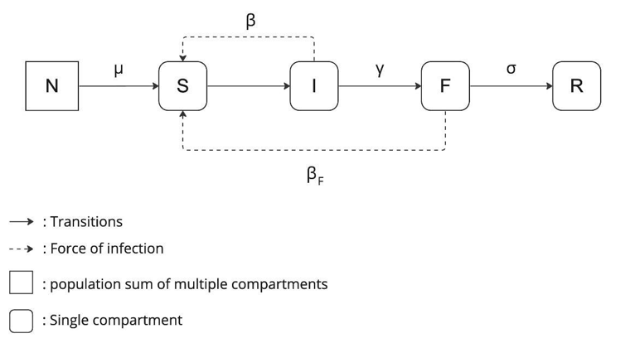
Base Model Overview
S → I → F → R compartments
No recovery: all infected eventually die and proceed to funerals
Key assumptions: constant population, homogeneous mixing

Slide 5
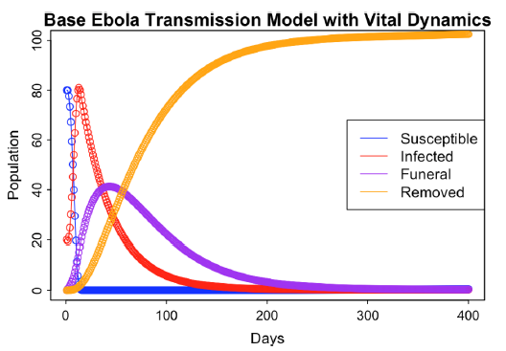
Base Model Simulation & Analysis
Result: Infected and funeral populations spike and then vanish
Eventually, everyone moves to the removed category
Eigenvalue analysis shows disease-free equilibrium is stable

Slide 6
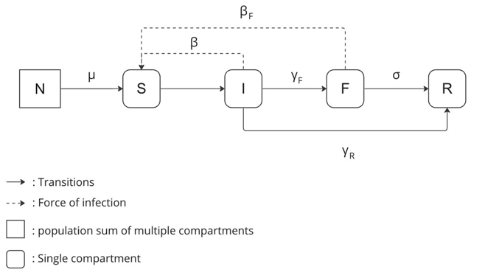
Extended Model with Safe Burial Pathway
New feature: Infected can be removed without a funeral
Reflects safe burial policies, public health campaigns
Goal: lower funeral-based infections

Slide 7
Extended Model Simulation & Results
Outbreak dies out in ~50 days with high safe burial coverage
~80% of population remains uninfected
Intervention significantly flattens the curve

Slide 8
Limitations & Future Directions
Simplified assumptions: no recovery, constant population, equal mixing
Next steps: add vaccination, recovery, targeted interventions
Importance of culturally sensitive approaches

Slide 9
Thanks for listening! Open to questions
References: WHO, Hopkins, Canada Ebola Study, etc.

