Slide 1
Broadcasting Webservice For Smart TV
Design
PSE Team 2

Slide 2
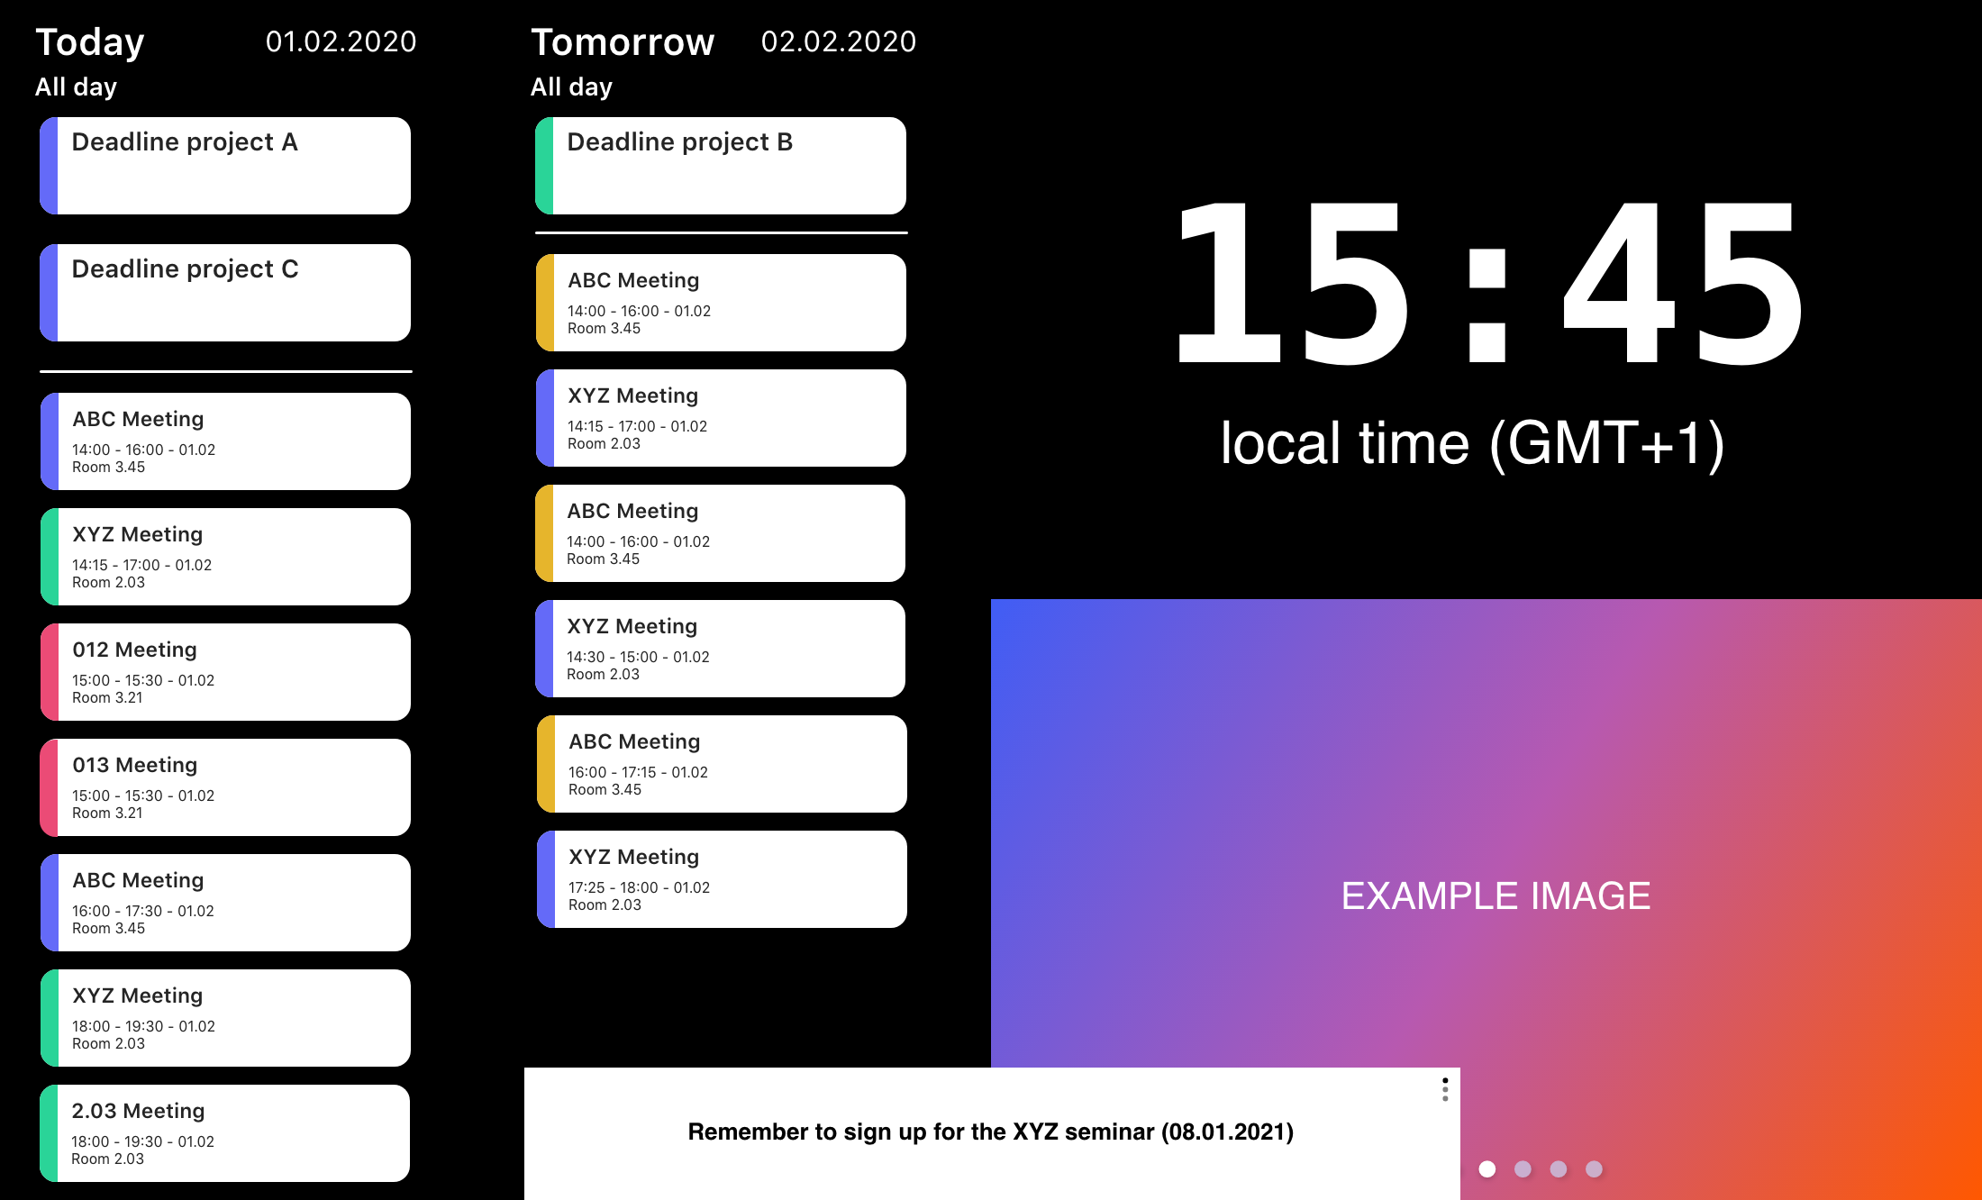
Goal
A Webservice
- Extensible
- Easy to configure
- Flexible layout system

Slide 3
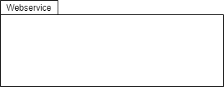
Structure

Slide 4
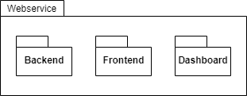
Structure

Slide 5
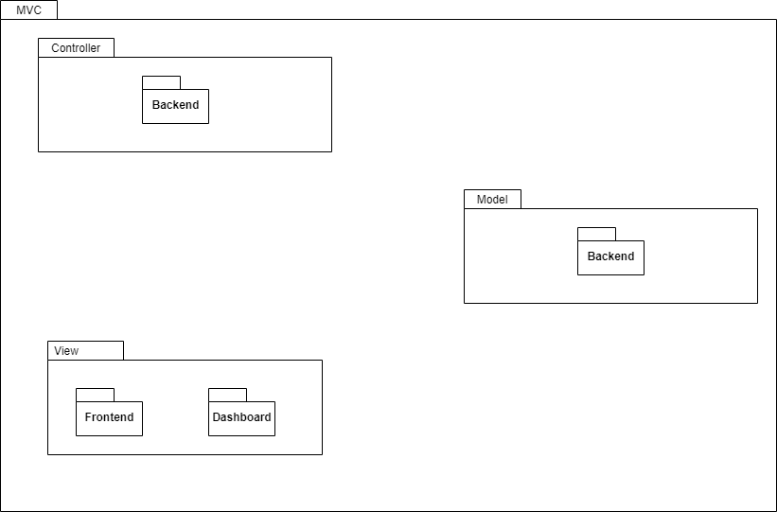
Structure
MVC
- Backend:
- manages the data of the application
- houses the main logic of the application
and relays information between Model and
View.
- Dashboard & Frontend:
- presents the data of the application.
* Also the internal structures of Backend, Dashboard and Frontend use MVC.

Slide 6
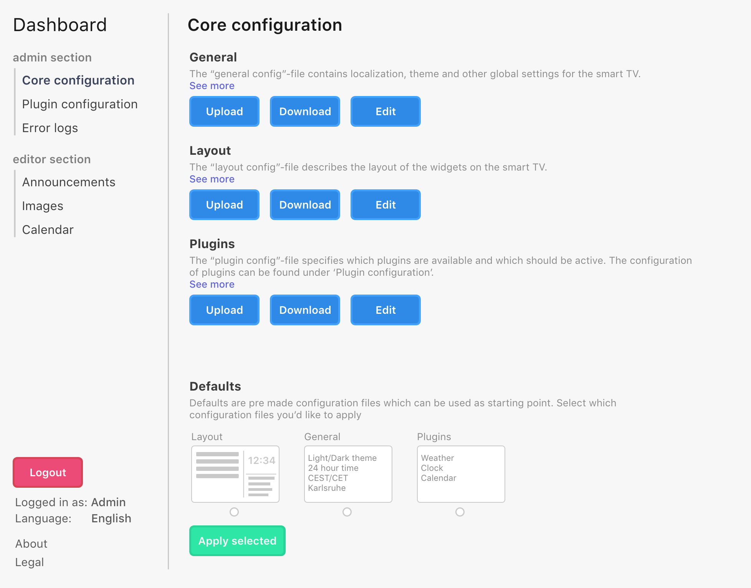
Example: Dashboard

Slide 7
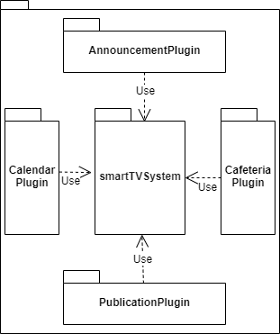
Backend

Slide 8
Backend
JAVA (Spring)

Slide 9
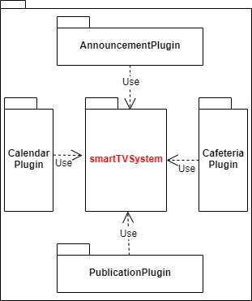
Backend

Slide 10
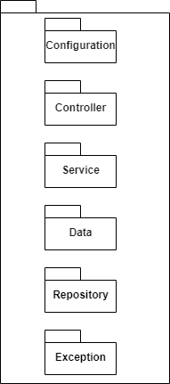
Backend

Slide 11
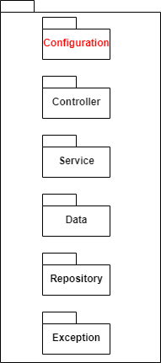
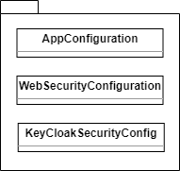
Backend

Slide 12
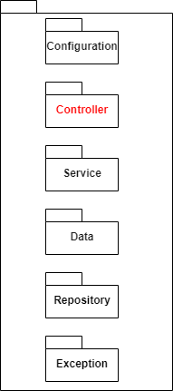
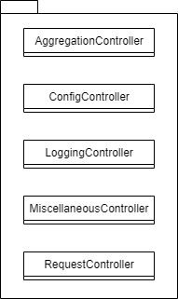
Backend

Slide 13
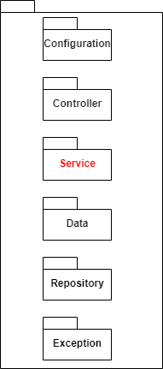
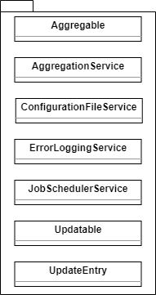
Backend

Slide 14
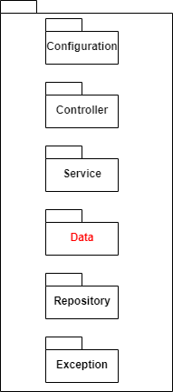
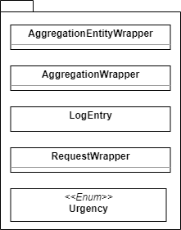
Backend

Slide 15

Backend

Slide 16
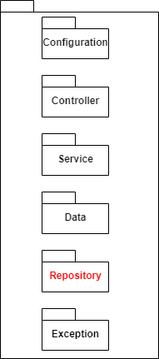

Backend

Slide 17
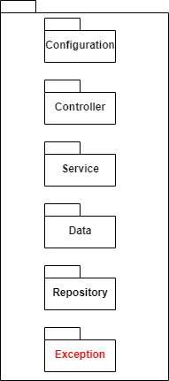

Backend

Slide 18
Backend
View
Controller
MVC
Model

Slide 19
Backend

Slide 20
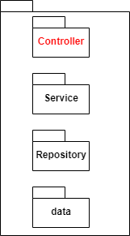

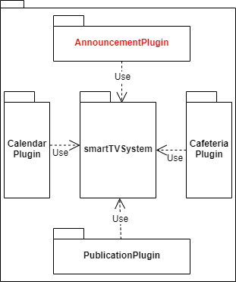
Backend

Slide 21
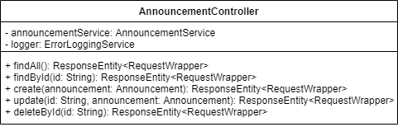
Backend

Slide 22


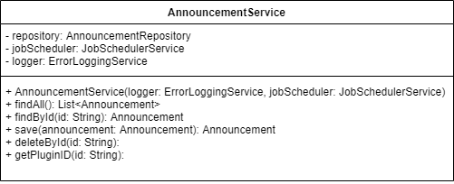
Backend

Slide 23


Backend

Slide 24

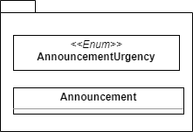
Backend

Slide 25

Backend

Slide 26

Backend

Slide 27

Backend

Slide 28

Backend

Slide 29

Backend

Slide 30

Backend

Slide 31

Backend

Slide 32
Backend
JSON response

Slide 33
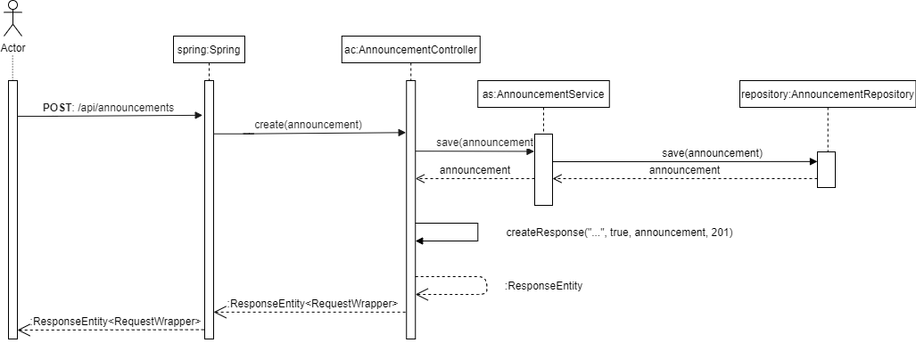
Backend
Example: createAnnouncement

Slide 34
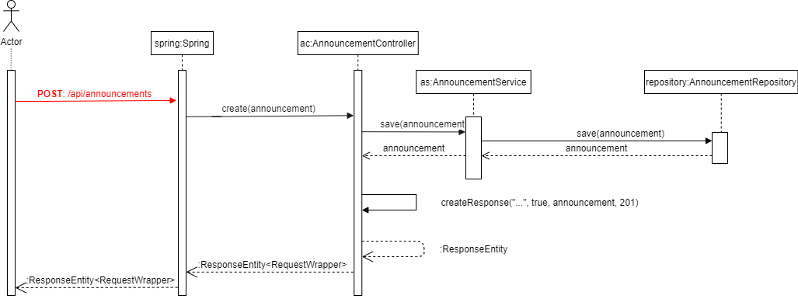
Backend
Example: createAnnouncement

Slide 35
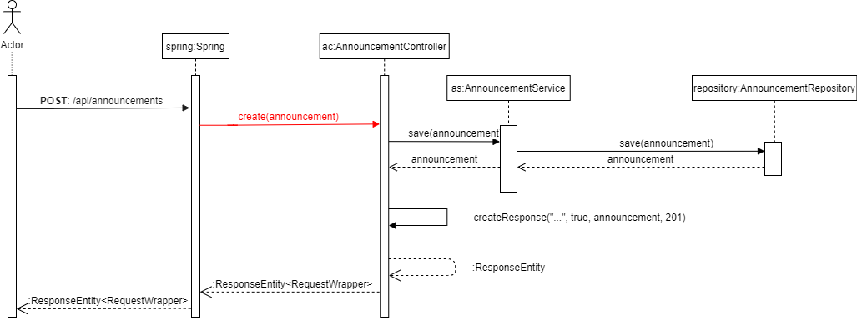
Backend
Example: createAnnouncement

Slide 36
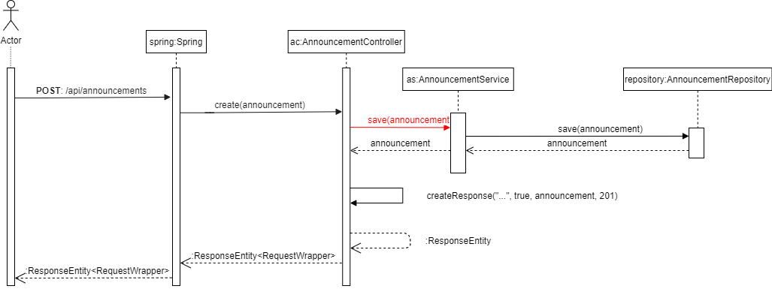
Backend
Example: createAnnouncement

Slide 37
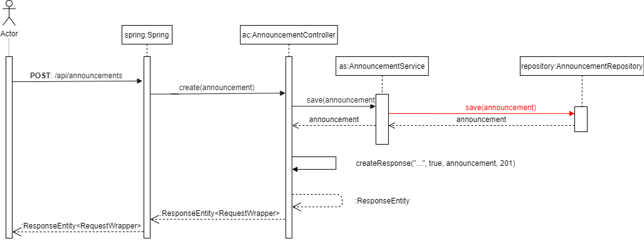
Backend
Example: createAnnouncement

Slide 38
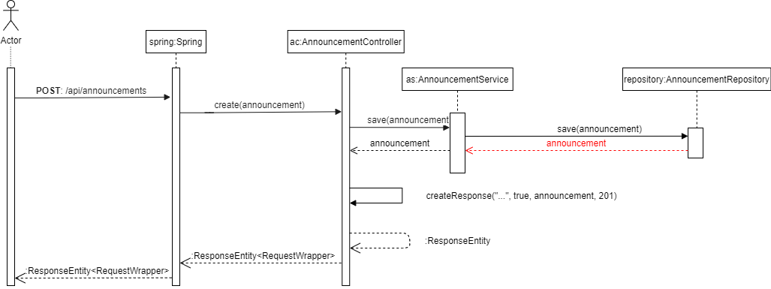
Backend
Example: createAnnouncement

Slide 39
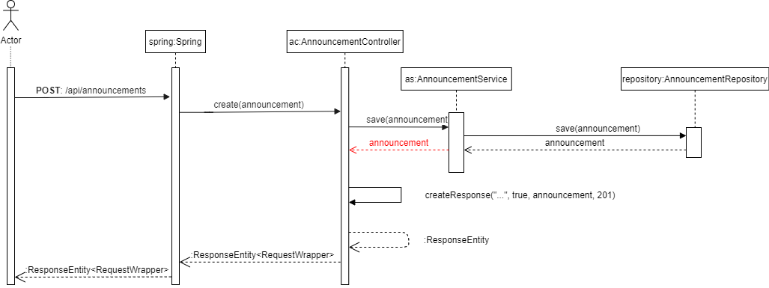
Backend
Example: createAnnouncement

Slide 40
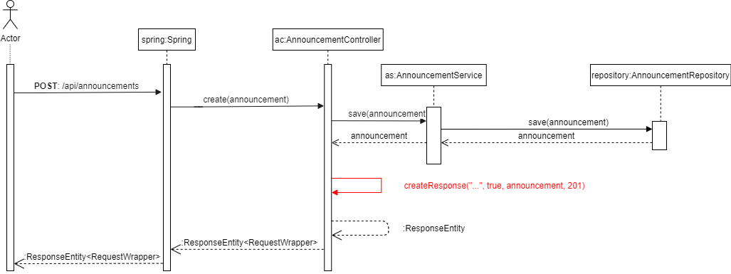
Backend
Example: createAnnouncement

Slide 41
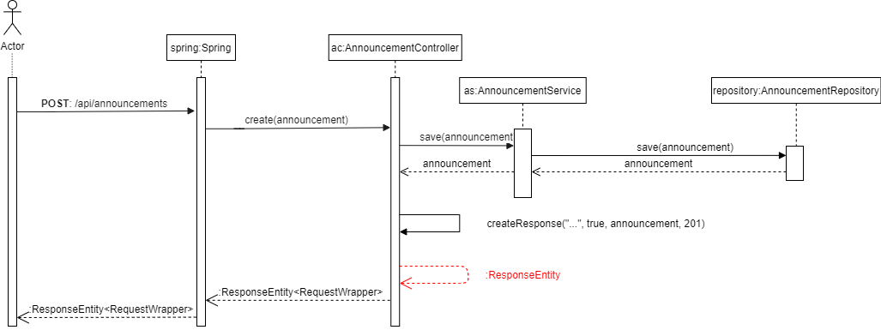
Backend
Example: createAnnouncement

Slide 42
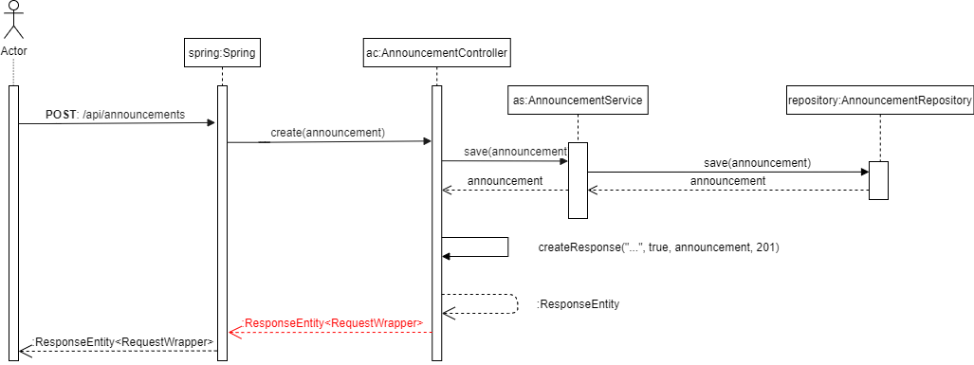
Backend
Example: createAnnouncement

Slide 43
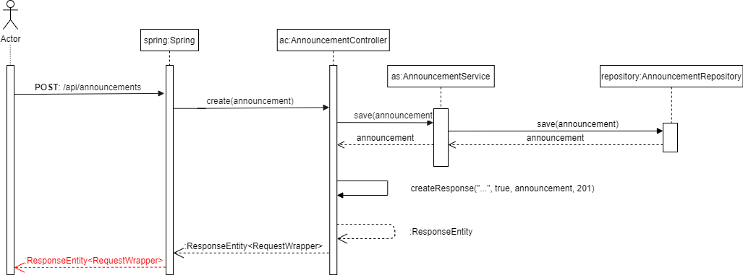
Backend
Example: createAnnouncement

Slide 44
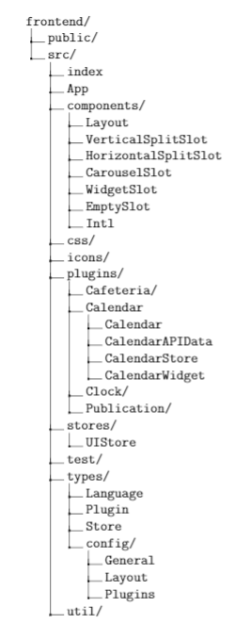
Frontend
Typescript(react)

Slide 45
Frontend

Slide 46
Frontend
Different slots
translation

Slide 47
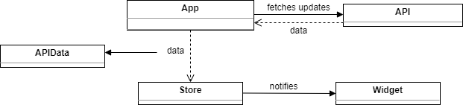
Frontend

Slide 48
Frontend

Slide 49
Frontend

Slide 50
Frontend

Slide 51
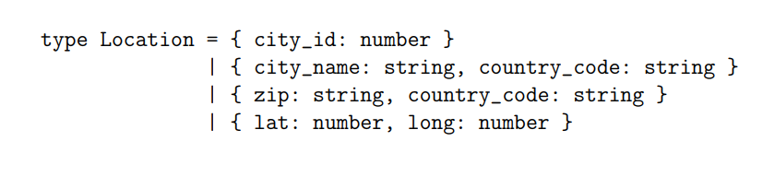
Frontend

Slide 52
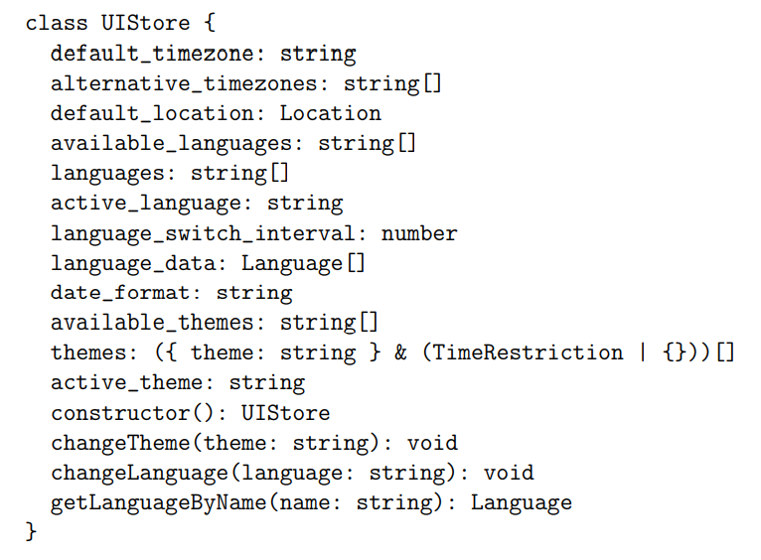
Frontend

Slide 53
Frontend

Slide 54
Frontend
Controller
View
Widget: View
Store : Controller
MVC
Controller
Model

Slide 55
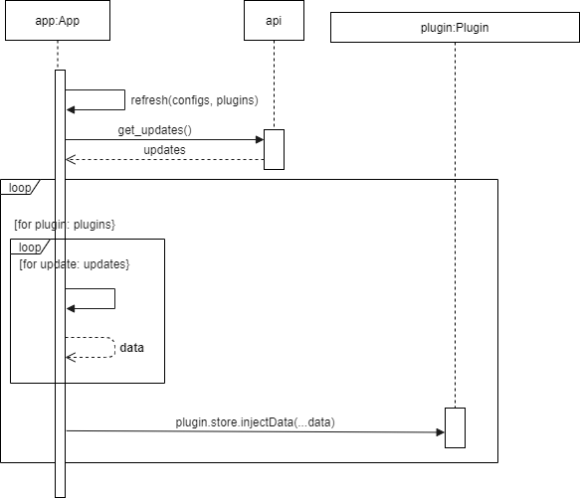
Frontend
Example: refresh data

Slide 56
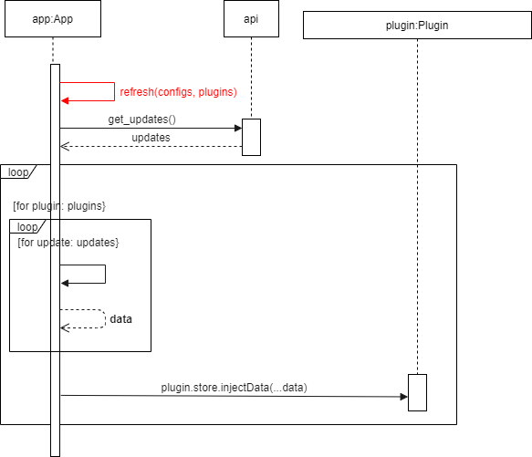
Frontend
Example: refresh data

Slide 57
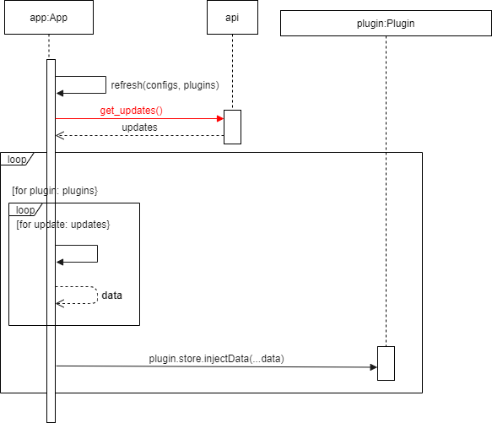
Frontend
Example: refresh data

Slide 58
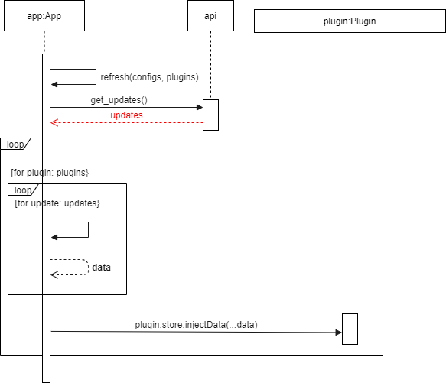
Frontend
Example: refresh data

Slide 59
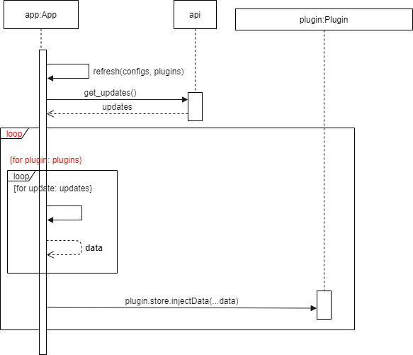
Frontend
Example: refresh data

Slide 60

Frontend
Example: refresh data

Slide 61
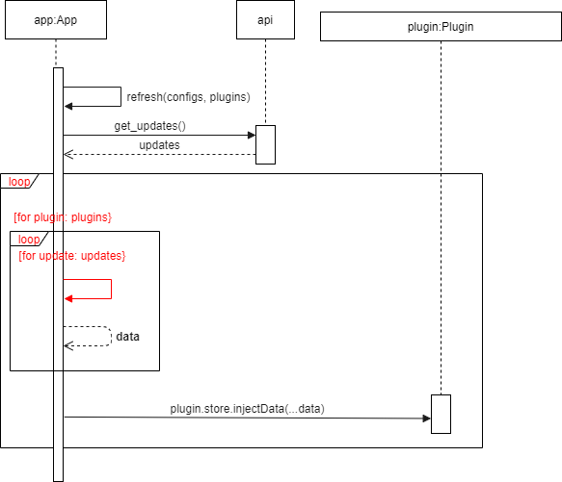
Frontend
Example: refresh data

Slide 62
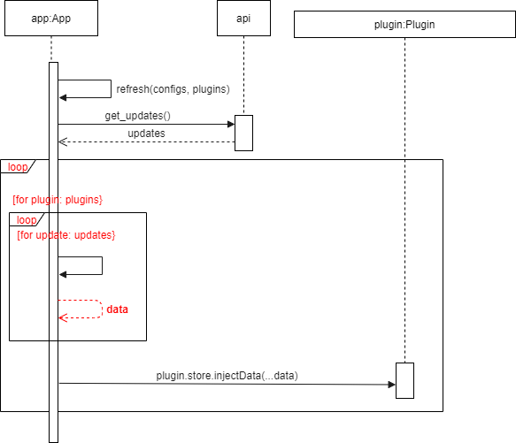
Frontend
Example: refresh data

Slide 63
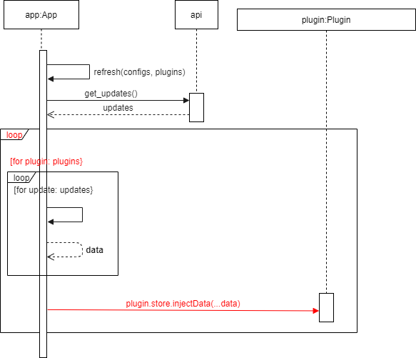
Frontend
Example: refresh data

Slide 64
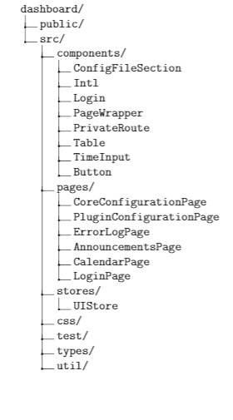
Dashboard
Typescript(react)

Slide 65
Dashboard

Slide 66
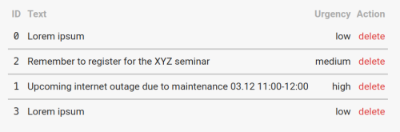
Dashboard

Slide 67


Dashboard

Slide 68
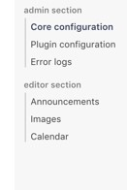
Dashboard

Slide 69
Dashboard

Slide 70
Dashboard

Slide 71
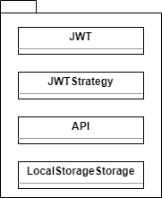
Dashboard

Slide 72
Dashboard
View
Controller
View
MVC
View + Controller
Controller + Model

Slide 73

Dashboard
Example: create Announcement

Slide 74

Dashboard
Example: create Announcement

Slide 75

Dashboard
Example: create Announcement

Slide 76

Dashboard
Example: create Announcement

Slide 77

Dashboard
Example: create Announcement

Slide 78

Dashboard
Example: create Announcement

Slide 79

Dashboard
Example: create Announcement

Slide 80

Dashboard
Example: create Announcement

Slide 81

Dashboard
Example: create Announcement

Slide 82

Dashboard
Example: create Announcement

Slide 83

Dashboard
Example: create Announcement

Slide 84

Dashboard
Example: create Announcement

Slide 85

Project schedule : overview

Slide 86
Thank you for listening Any questions?

