Slide 1

SMART TV SYSTEM
By Lennard Kittner, Jiangang Huang, Sicheng Dong, Jannik Wibker and Henry Boos

Slide 2
Overview
Goal
Problem
Requirements
Process
Waterfall
Teamwork
Tools
Difficulties
Result
Statistics
Features
Live Demo
Summary
Personal Takeaways
Software

Slide 3
Goal
Problem
Requirements

Slide 4
Problem
Web Service
Useful information
Smart TV
Configurable
?!
Extensibility
CES
“Can’t this TV display something useful?”
Notes:
Building
Ces
Smart tv
Aked
Could with webservice
Connects
Useful information
Configurable
Extensibil
Aim our smartTV system
Get some use

Slide 5

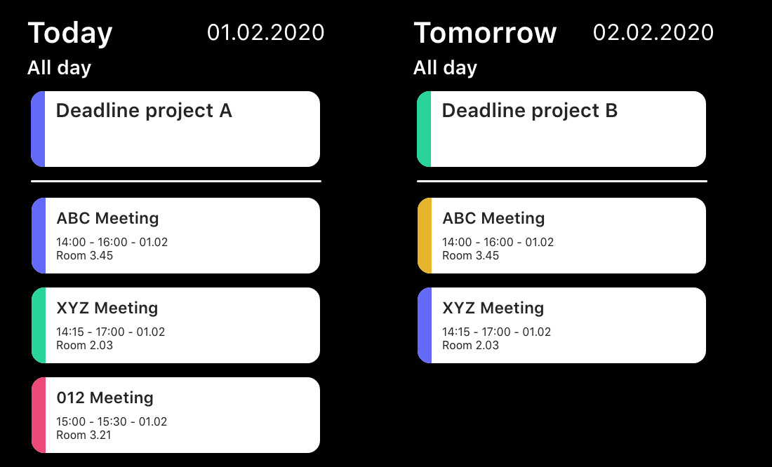
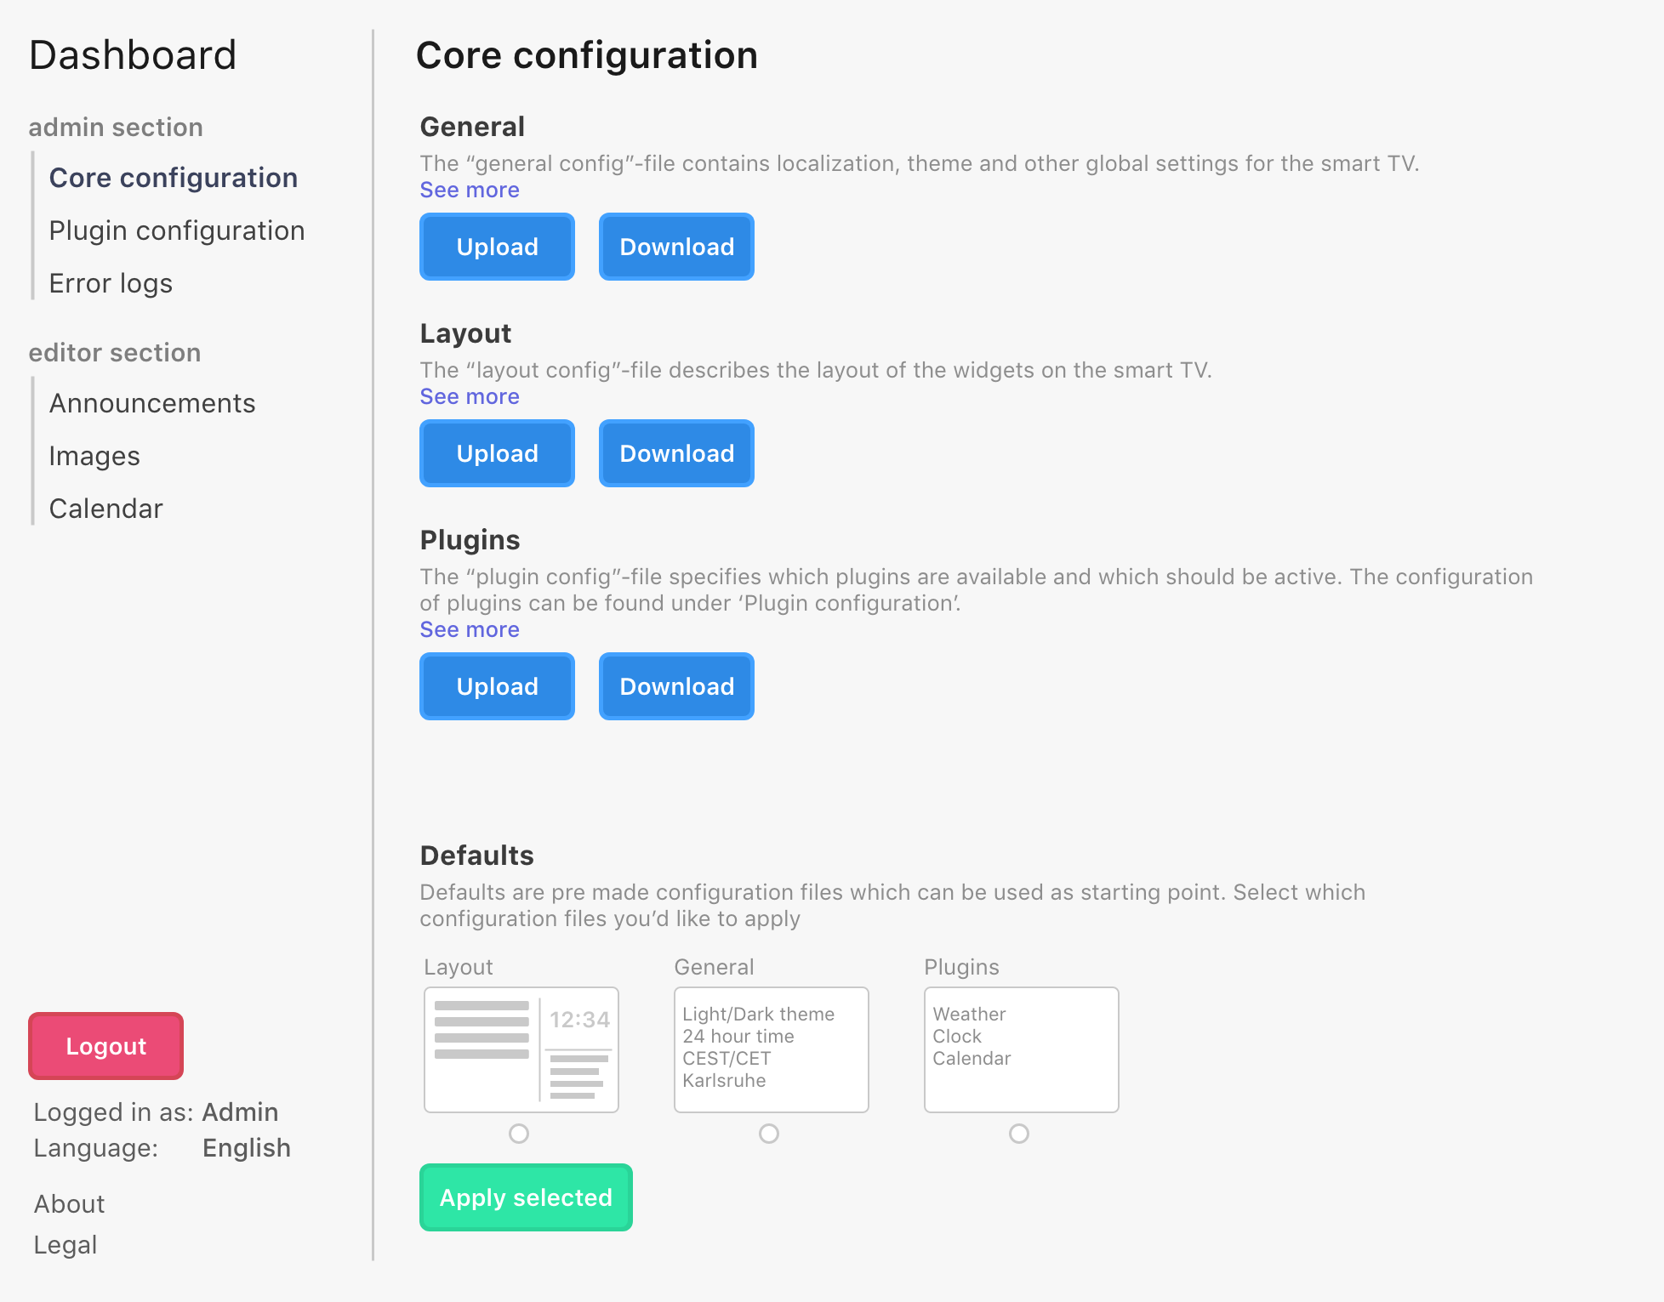
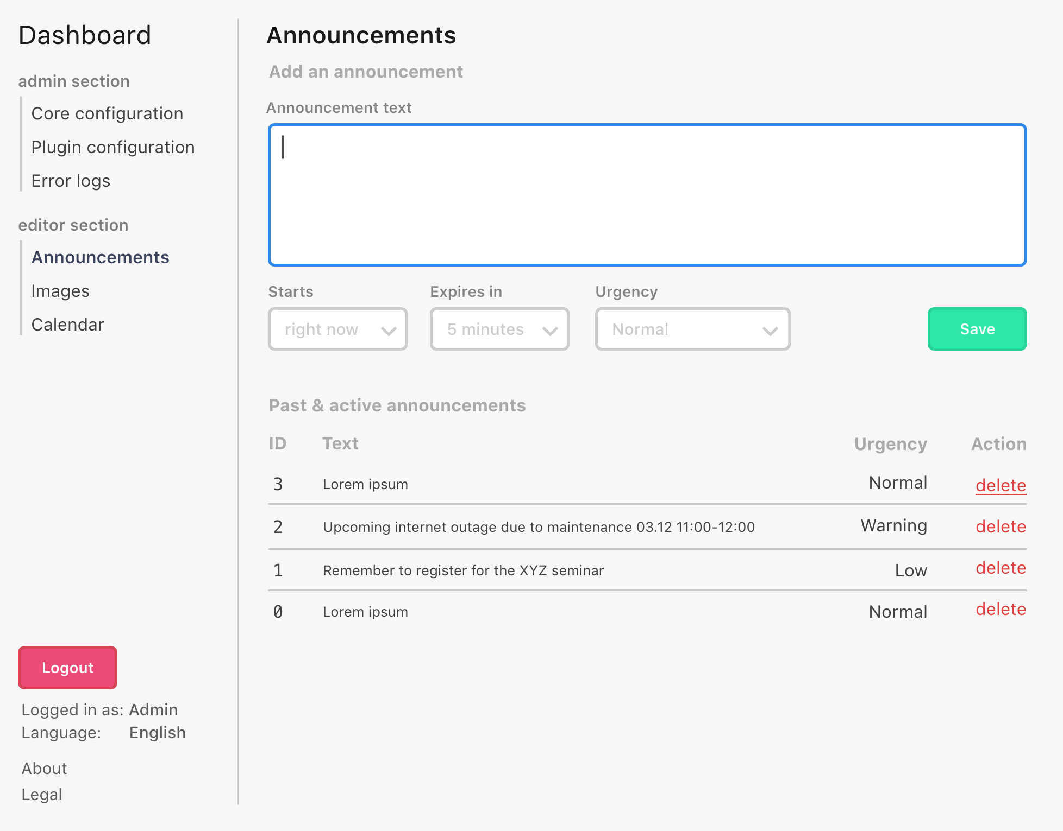
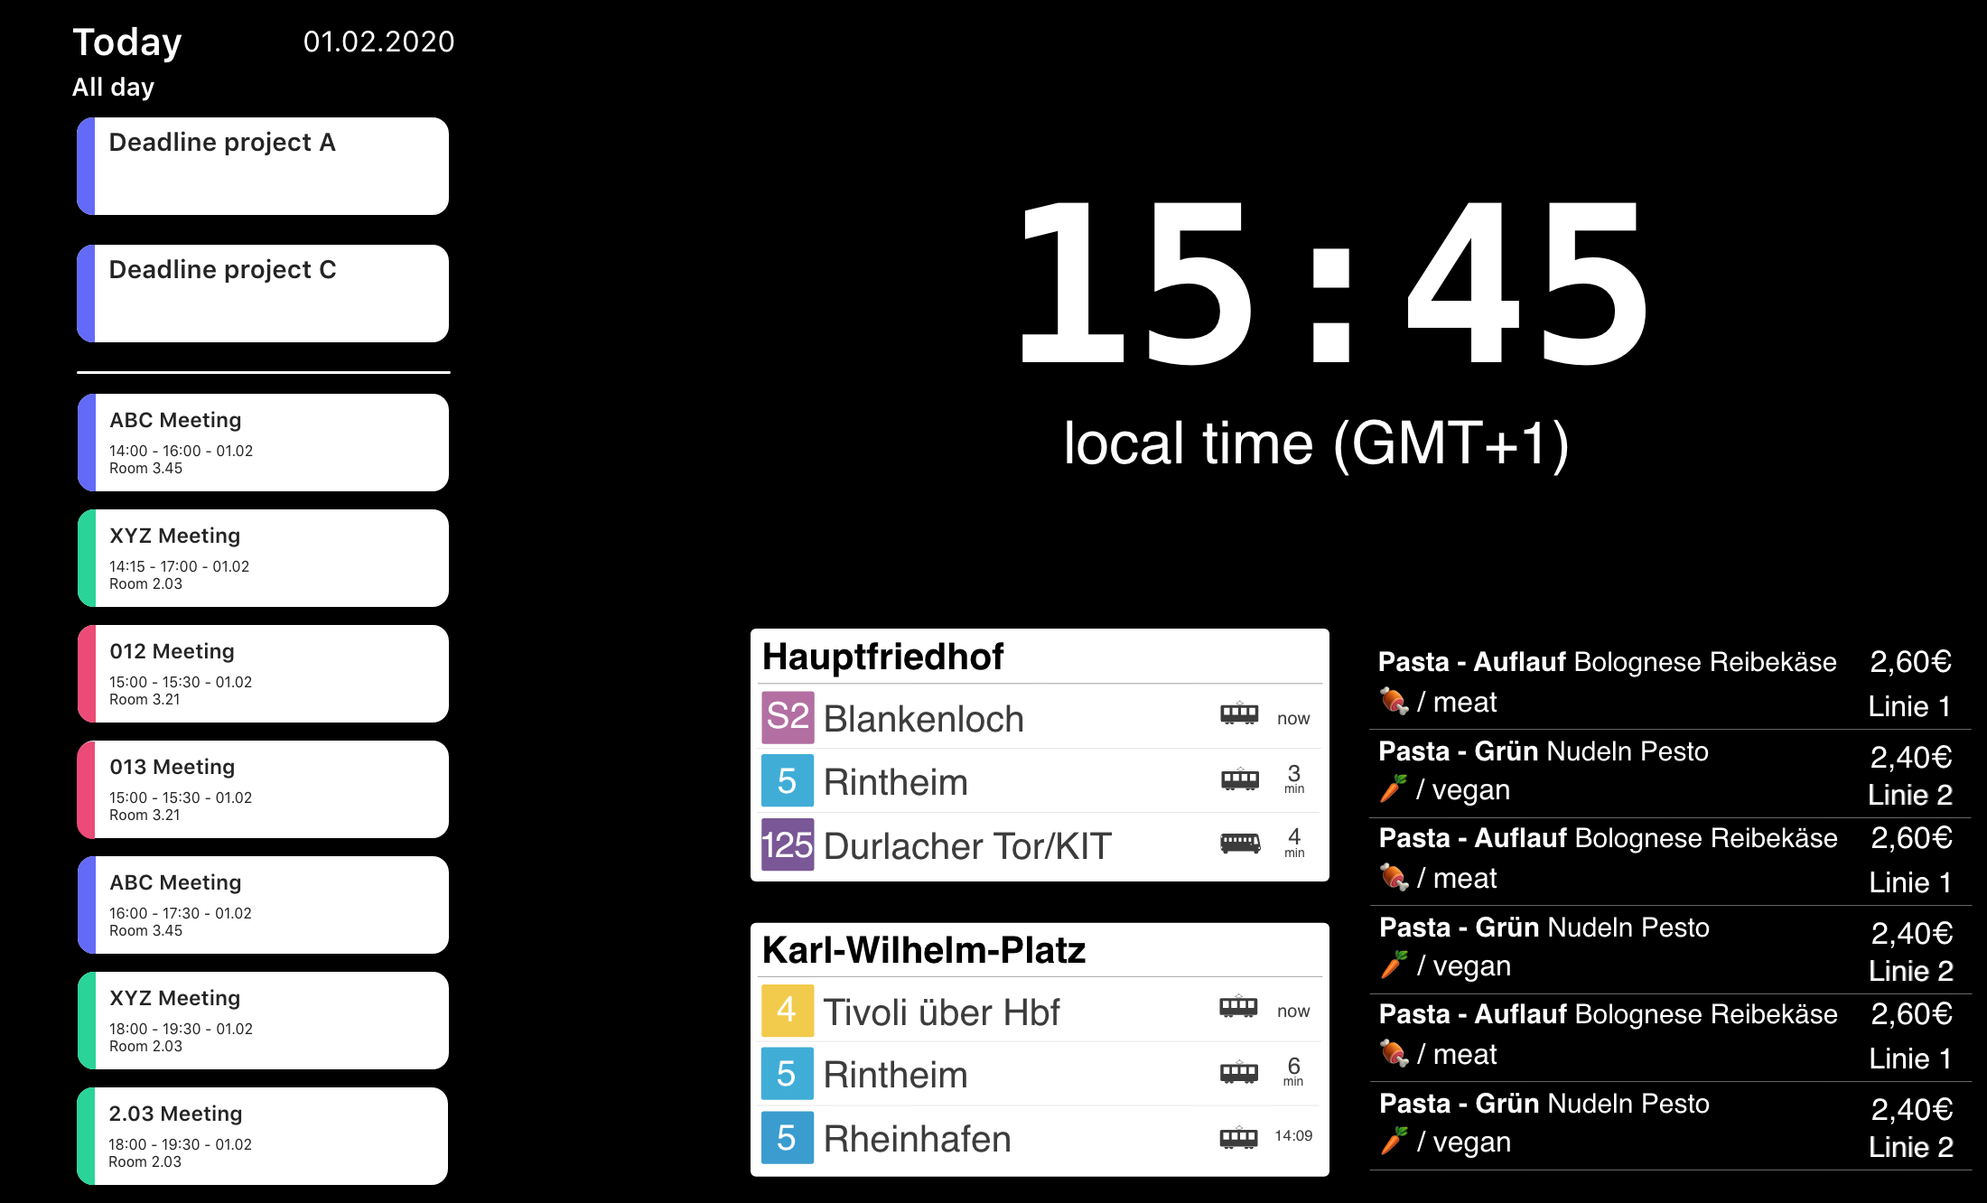
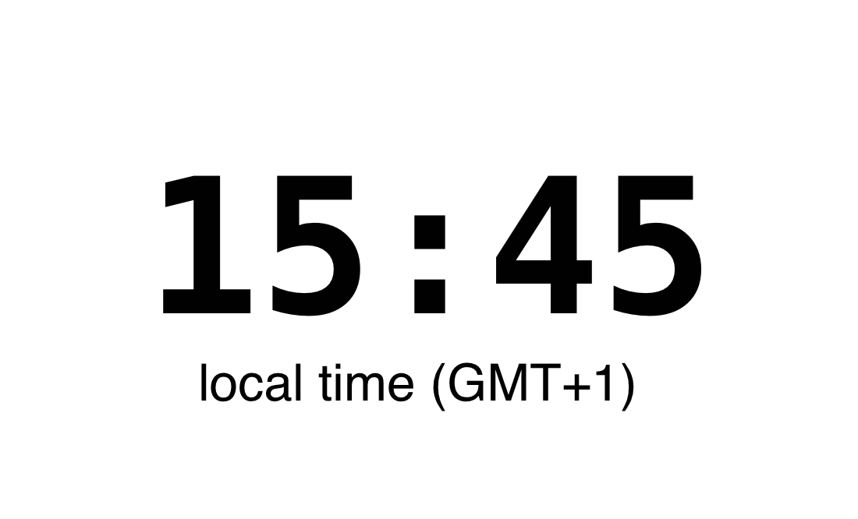
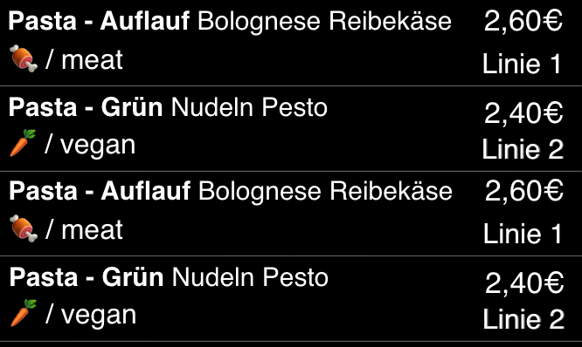

Requirements
Split into frontend, backend and dashboard
Deeply configurable Layout System
Plugin System
Widgets/Plugins
Calendar
Publications
Announcements
Clock
Cafeteria
… (optional)
Frontend
Backend
Dashboard
Nonfunctional requirements
Notes:
Mündlich: Error logging, theming, Permission system, internationalisation System, optionale Plugins z.B. Image display & Weather, Nonfunctional Requirements z.B. Extensibility & Easy to setup and use, 12 functional requirements & 10 optional, and 5 non functional

Slide 6
Process
Waterfall
Teamwork
Tools
Difficulties

Slide 7
Waterfall with feedback
_________________________________________________________
_________________________________________________________
_________________________________________________________
_________________________________________________________
Requirements
Design
Implementation
Testing

Slide 8
Teamwork
Meetings
Two times a week
What tasks have been done?
What is left to do?
Who does what?
Distributed the work equally
Helped each other
E.g. Typescript was new for most of us
Small language barrier in the beginning
“All in all we grew into a strong, good working and well organized team”

Slide 9
Tools
Languages
Java
Typescript
Python
Frameworks
Spring Boot
React
Deployment
Docker
Keycloak
Postgres
Java
nginx
Parsing
antlr4
Jsoup
io-ts
Version Control
git
Testing
JUnit
Jest
Mockito
Notes:
The backend is written in java. The frontend and dashboard are written in typescritp.
We used python to automate the building and configuring of the system.
To parse the calendar data we used antler and jsoup. In the dashboard and frontend io-ts was used for runtime type checking of config files.
In the dashboard and frontend jest was used for testing while
Mockito and Junit were used in the backend.
The frameworks used in the project are spring-Boot and react.
The whole system is container based, we have
one docker container for keycloak handling authorization
a postgres database housing all the data
and nginx which is used as a webserver and proxy.
For better collaboration all parts of the project and all documents have their own git repositories.

Slide 10
Difficulties
Keycloak setup
Spring
Dependencies
Our Plugin System
Antlr4
Deployment via docker
A lot of work
Notes:
Docker: slow because of rebuild and differences between plattforms

Slide 11
Result
Statistics
Features
Live Demo

Slide 12
Statistics
_________________________________________________________
_________________________________________________________
_________________________________________________________
_________________________________________________________
4 documents with
over 340 pages
Over 1.100 commits
12/12
Mandatory requirements
Over 50 Meetings
ca. 11.300 lines of code
</>
+3
Optional
requirements
____⊠
____⊠
⊠
Test coverage of 80%
Notes:
And all that led us to

Slide 13
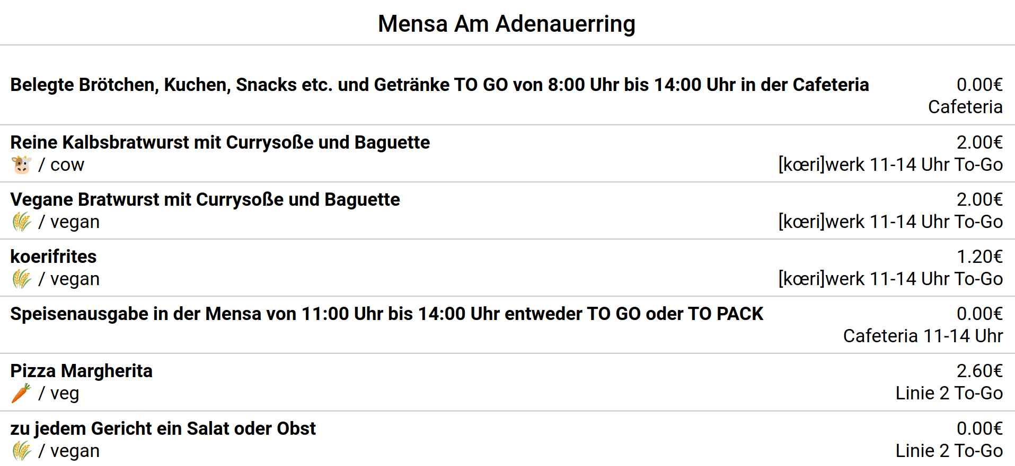
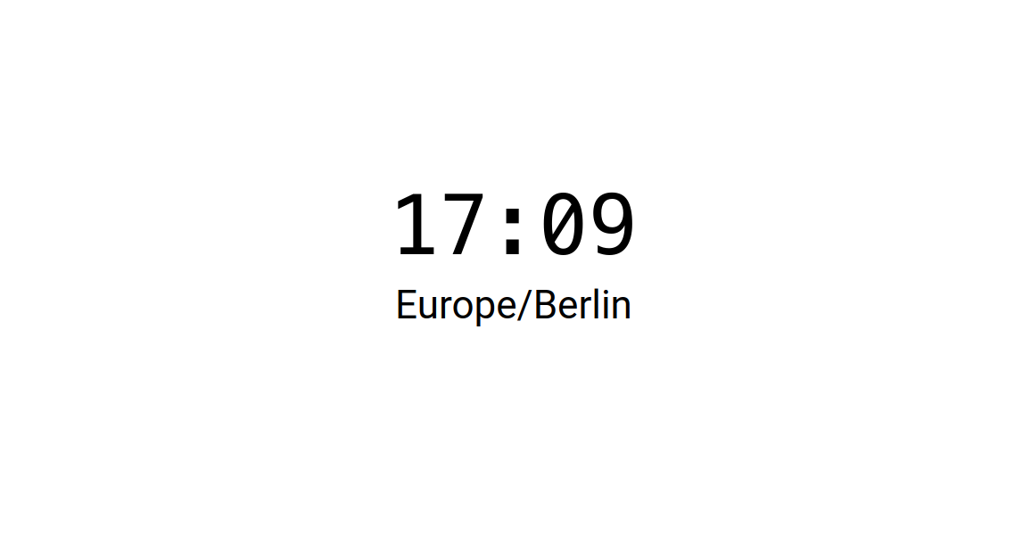


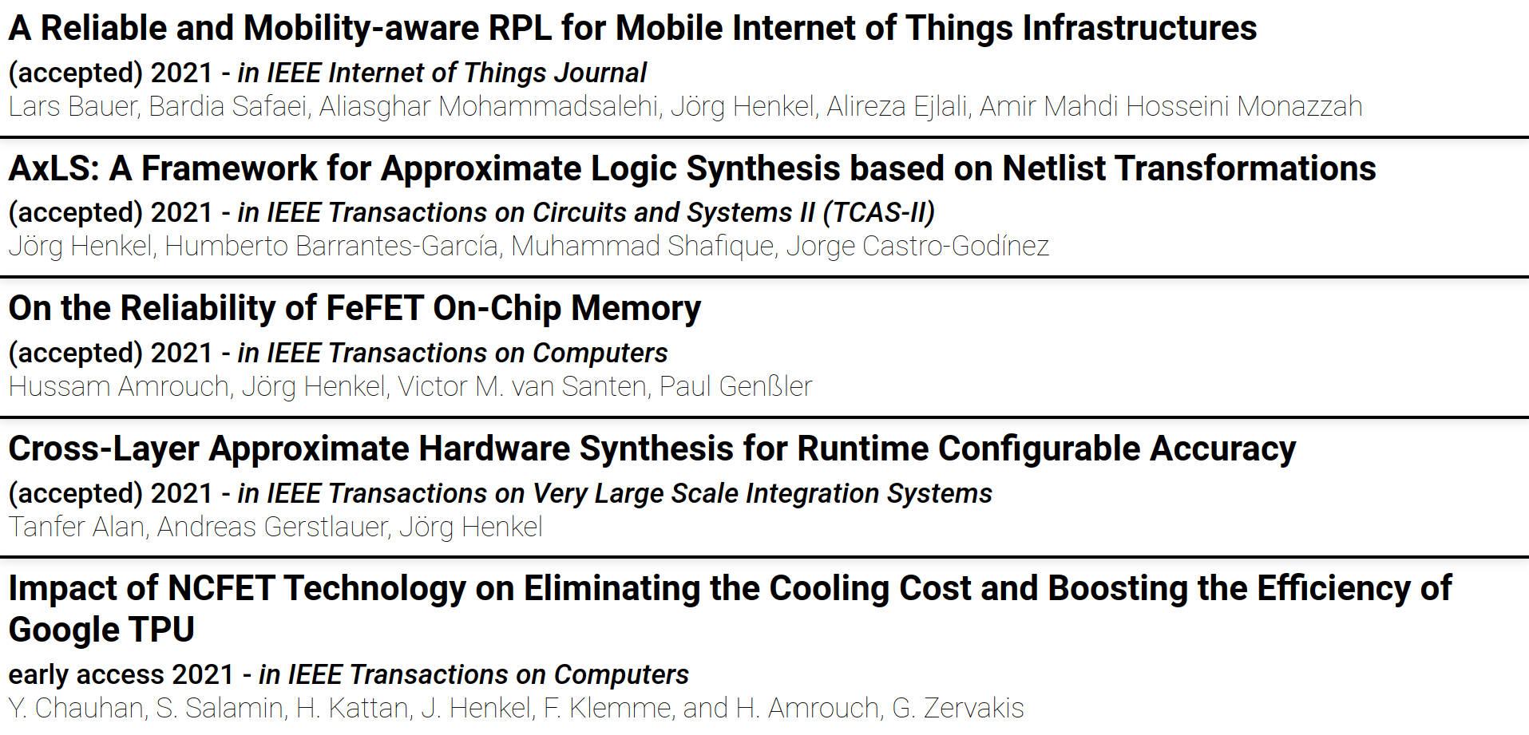
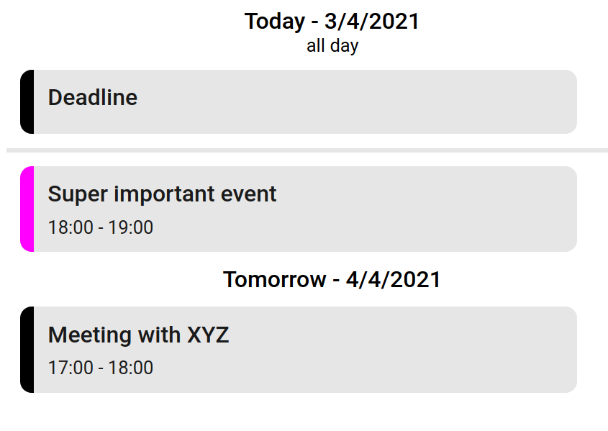
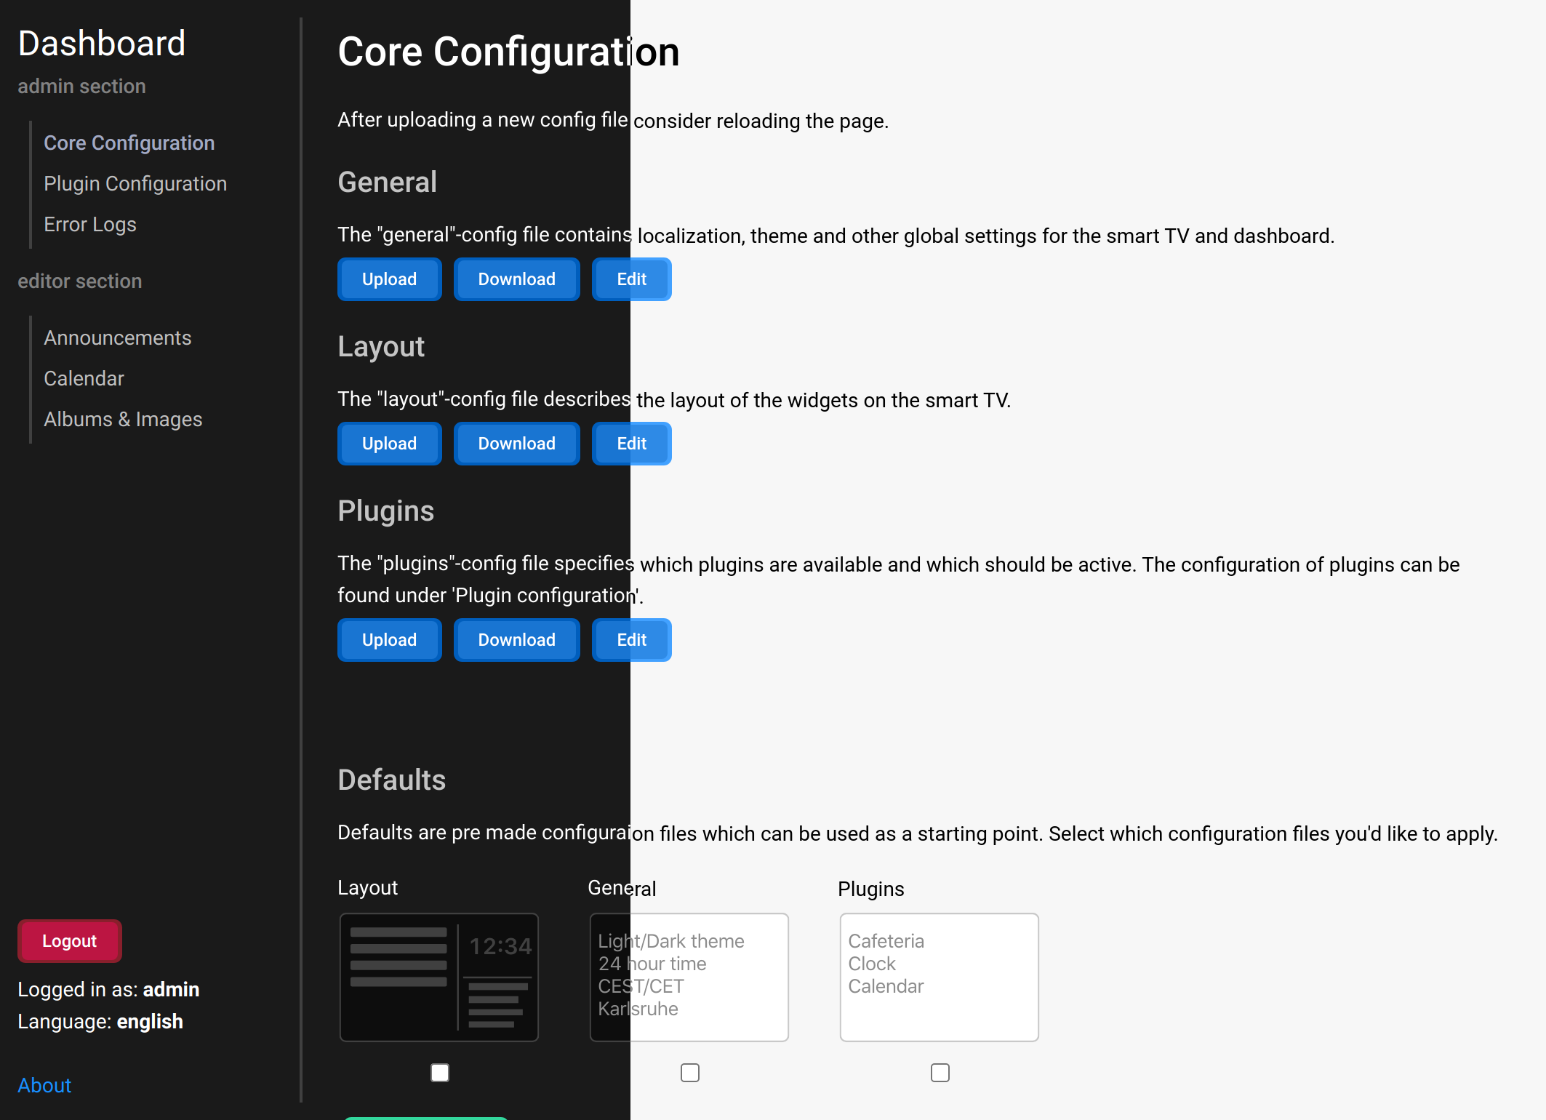
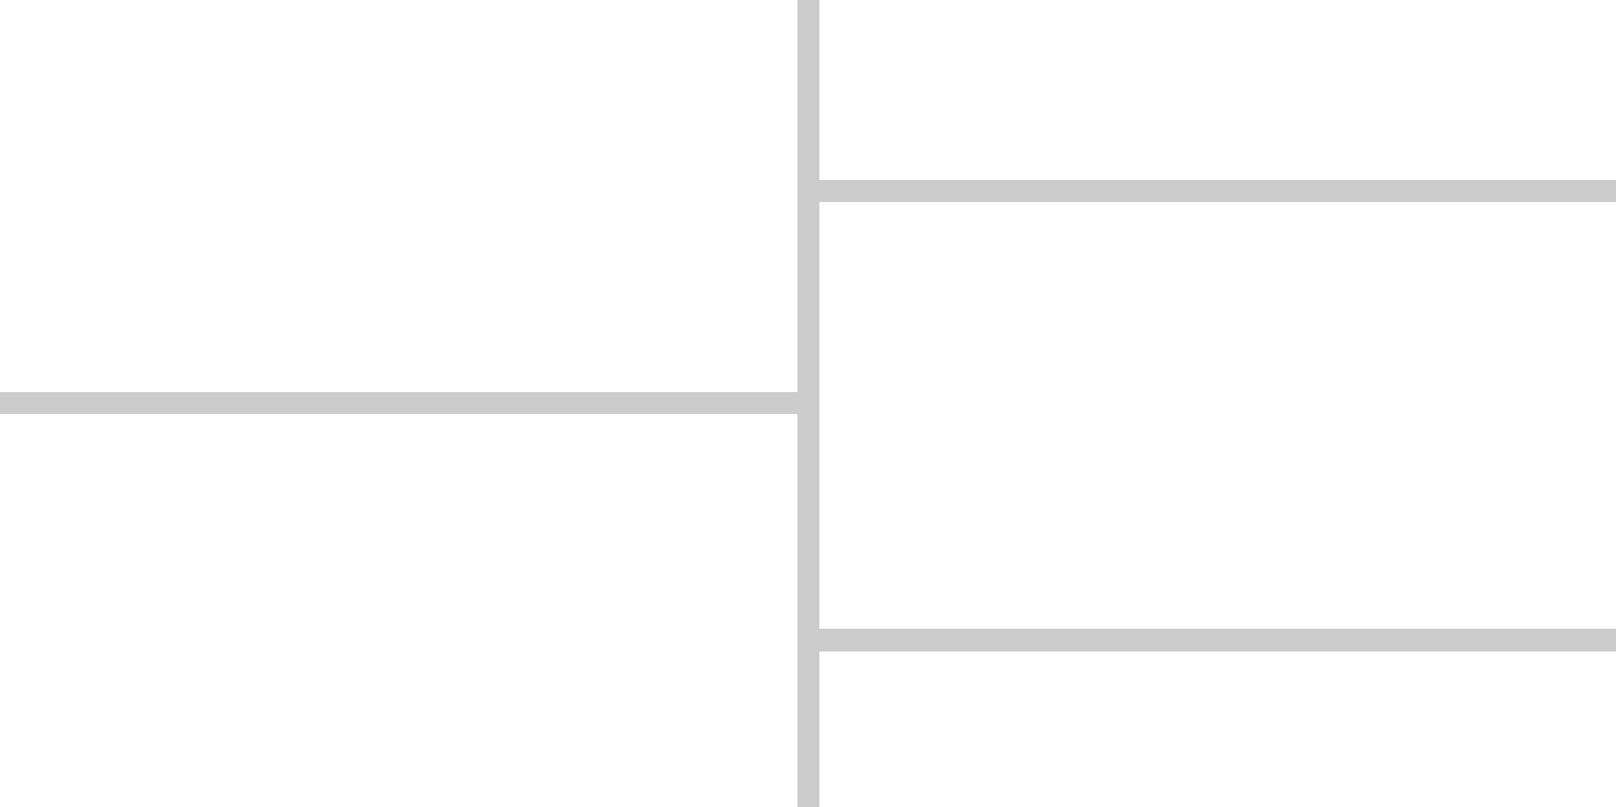
Features
Announcements
Clock widget
Cafeteria widget
Publications widget
Image display widget
Calendar widget
Dashboard
Edit config files
Plugin System
Error logging
Themability
Permission system
Layout System
[…]
Frontend
Backend
Dashboard
Notes:
Plugin System, modular, you can load plugins like,

Slide 14
Live Demo

Slide 15
Summary
Personal Takeaways
Software

Slide 16
Personal Takeaways Henry Boos
Development process of software
Docker
API design
Collaboration & Leadership
Unit testing
Typescript
git
Project structure
Workload & Stress
LaTeX

Slide 17
Personal Takeaways Jannik Wibker
Development process of software
Docker
API design
Collaboration & Leadership
Unit testing
Typescript
git
Project structure
Workload & Stress
LaTeX
Notes:
I've furthered my understanding of typescript as well as unit testing as I haven't done unit testing on such a large scale before.
Additionally I also learned a lot about how docker works and how to work with docker.
The workload and stress was quite high at some points but I’ve also stepped up my collaboration and leadership skills

Slide 18
Personal Takeaways Jiangang Huang
Development process of software
Docker
API design
Collaboration & Leadership
Unit testing
Typescript
git
Project structure
Workload & Stress
LaTeX

Slide 19
Personal Takeaways Sicheng Dong
Development process of software
Docker
API design
Collaboration & Leadership
Unit testing
Typescript
git
Project structure
Workload & Stress
LaTeX

Slide 20
Personal Takeaways Lennard Kittner
Development process of software
Docker
API design
Collaboration & Leadership
Unit testing
Typescript
git
Project structure
Workload & Stress
LaTeX
Notes:
During the PSE I learned alot about how to structure a large system, docker and api design.
Since this was my first project with a team I also learned about collaborating with other.
In general I liked the project but the workload and stress were sometimes rather high.

Slide 21
Software
“The dashboard is pretty intuitive and clean”
Room for small improvements
Displays useful information
lots of helpful plugins
Highly configurable
Deeply extensible
Fulfills the needs
“The light mode is pretty”
“Having default config files that can be applied is pretty nice”
“Good extensibility”
“The dashboard looks very nice”
∅ 8/10

Slide 22
“Can’t this TV display something useful?”
Yes, now it can!

Slide 23
Thank you for your attention
Any questions left?
by Lennard Kittner, Jiangang Huang, Sicheng Dong, Jannik Wibker and Henry Boos

Slide 24
