Slide 1

Testing Phase

Slide 2
Test Coverage
Backend
Package | Class% | Line% | Class% before Testing Phase | Line% before Testing Phase
smartTVSystem | 100 | 95 | 72 | 52
annnouncementPlugin | 100 | 99 | 100 | 81
cafeteriaPlugin | 100 | 94 | 85 | 24
calendarPlugin | 100 | 88 | 83 | 78
imageDisplayPlugin | 100 | 96 | 100 | 59
publicationPlugin | 100 | 90 | 75 | 32

Slide 3
Test Coverage
Frontend
Package | Statement% | Line% | Statement% before Testing Phase | Line% before Testing Phase
components | 90 | 91 | 19 | 22
plugins/index.ts | 83 | 80 | 17 | 20
plugins/Cafeteria | 87 | 88 | 22 | 23
plugins/Calendar | 84 | 84 | 30 | 30
plugins/Clock | 79 | 81 | 36 | 39
plugins/Image | 92 | 94 | 33 | 37
plugins/Publication | 100 | 100 | 62 | 62
stores | 56 | 57 | 58 | 58
util | 89 | 91 | 72 | 75
App.tsx | 70 | 74 | 0 | 0

Slide 4
Test Coverage
Dashboard
Package | Statement% | Lines% | Statement% before Testing Phase | Lines% before Testing Phase
components | 73 | 74 | 24 | 26
pages/index.tsx | 52 | 53 | 0 | 0
pages/AnnouncementPage | 84 | 87 | 0 | 0
pages/CalendarPage | 77 | 81 | 0 | 0
pages/CoreConfigurationPage | 91 | 88 | 0 | 0
pages/ErrorLogPage | 86 | 90 | 0 | 0
pages/ImagePage | 75 | 76 | 0 | 0
pages/LoginPage | 33 | 33 | 0 | 0
pages/PluginConfiguration | 88 | 92 | 0 | 0
index.tsx | 52 | 53 | 0 | 0
pages | 78 | 75 | 78 | 75
util | 87 | 87 | 85 | 87
App.tsx | 78 | 78 | 0 | 0

Slide 5
Test Coverage
Overall
Package | Statement%/ Class% | Line% | Stmt% / Class% before Testing Phase | Line% before Testing Phase
Dashboard | 79 | 80 | 36 | 36
Frontend | 84 | 85 | 43 | 44
Backend | 100 | 78 | 85 | 54

Slide 6
Test Cases
Tests performed manually
Required config files in /test-case-configs
Mandatory requirements
GTC-1 to GTC-15 Passed
Optional requirements
GTCO-6, GTCO-8, GTCO-10, GTCO-11, GTCO-12, GTCO-13 Passed

Slide 7
Monkey Testing

Slide 8
Survey
How intuitive and easy to use was the system?
“The dashboard is pretty intuitive and clean. Config files require documentation to work correctly in a project.”
7/10
7/10
5/10 “A GUI instead of config files would be nicer.”

Slide 9
Survey
How do you like the look and feel of the system and what are your thoughts on it?
“The dashboard looks very nice. Rounded corners and a drop shadow for the announcements in the frontend would have been nice but I like the colors. The clock and calendar widget look great, but the publication widget looks a bit old. The blurriness of the image display widget looks good.”
7/10 “The frontend has to many hard corners.”
8/10 “The light mode is pretty.”
8/10

Slide 10
Survey
Did any errors occur?
“The frontend keeps flashing every time it updates, the first announcement is only displayed after a little bit of time, the time fields in the dashboard were a bit buggy.”
“The default layout did not work.”

Slide 11
Survey
How configurable is the system?
“The plugin config section could see some work; ordering by backend, frontend and clearly distinguishing between them would be good. Having default config files that can be applied is pretty nice.”
9/10 “To be able to split a slot in three parts would be nice.”
9/10
10/10 “Good extensibility.”

Slide 12
Survey
Is anything missing?
“The weather widget (which was an optional requirement) would have been nice to have. Otherwise, most use cases are covered.”
“The time of added Calendar events should be displayed in the dashboard.”
“No.”

Slide 13
Survey
Rate the system from 1 to 10.
8/10 “if a few minor bugs/inconveniences can get fixed.”
8/10
8/10
8/10

Slide 14
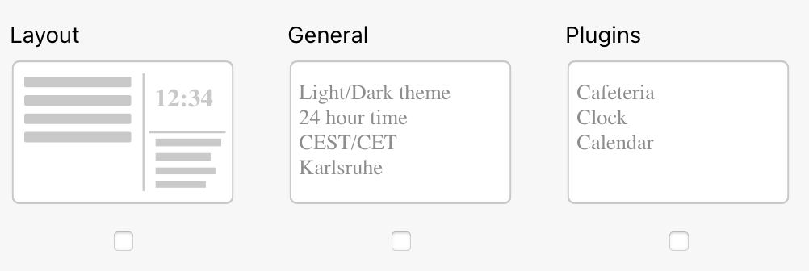
Bug Report
Dashboard
Invalid defaults file
TimeInput bug
Incorrect headers
Table component
ErrorlogPage can not be visited

Slide 15
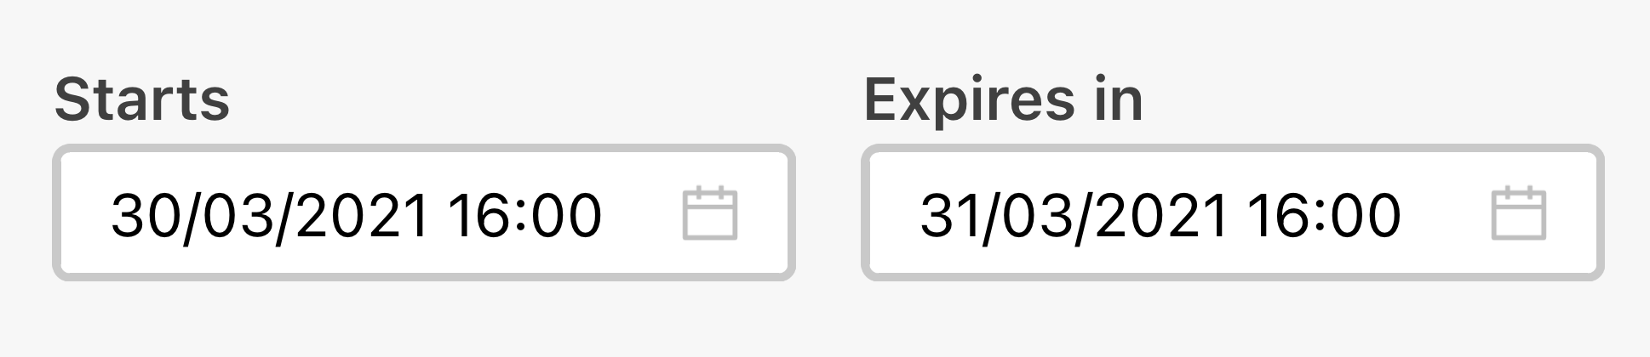
Bug Report
Dashboard
Invalid defaults file
TimeInput bug
Incorrect headers
Table component
ErrorlogPage can not be visited

Slide 16
Bug Report
Dashboard
Invalid defaults file
TimeInput bug
Incorrect headers
Table component
ErrorlogPage can not be visited

Slide 17
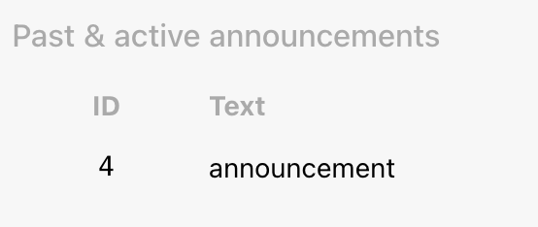
Bug Report
Dashboard
Invalid defaults file
TimeInput bug
Incorrect headers
Table component
ErrorlogPage can not be visited

Slide 18
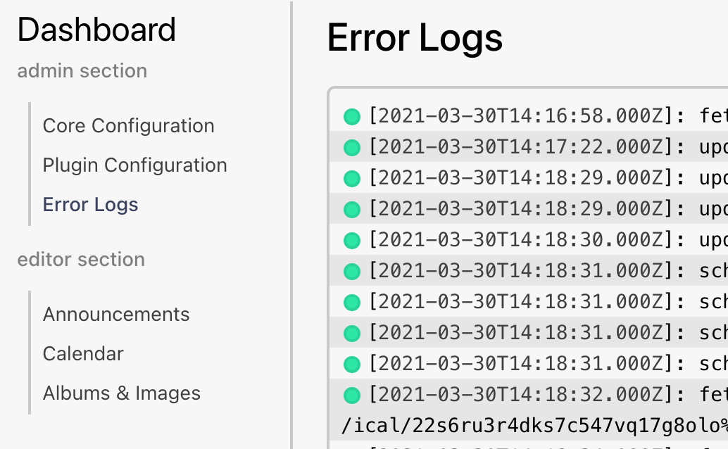
Bug Report
Dashboard
Invalid defaults file
TimeInput bug
Incorrect headers
Table component
ErrorlogPage could not be visited

Slide 19
Bug Report
Frontend
Flickering on update data
Announcements not being displayed instantly
CSS inheritance problem
Layout component errors not being displayed
No checks for layout containing plugins not mentioned in plugins.yml
CarouselSlot bug
ImageDisplay z-index

Slide 20

Bug Report
Frontend
Flickering on update data
Announcements not being displayed instantly
CSS inheritance problem
Layout component errors not being displayed
No checks for layout containing plugins not mentioned in plugins.yml
CarouselSlot bug
ImageDisplay z-index

Slide 21
Bug Report
Frontend
Flickering on update data
Announcements not being displayed instantly
CSS inheritance problem
Layout component errors not being displayed
No checks for layout containing plugins not mentioned in plugins.yml
CarouselSlot bug
ImageDisplay z-index

Slide 22
Bug Report
Frontend
Flickering on update data
Announcements not being displayed instantly
CSS inheritance problem
Layout component errors not being displayed
No checks for layout containing plugins not mentioned in plugins.yml
CarouselSlot bug
ImageDisplay z-index

Slide 23
Bug Report
Frontend
Flickering on update data
Announcements not being displayed instantly
CSS inheritance problem
Layout component errors not being displayed
No checks for layout containing plugins not mentioned in plugins.yml
CarouselSlot bug
ImageDisplay z-index

Slide 24
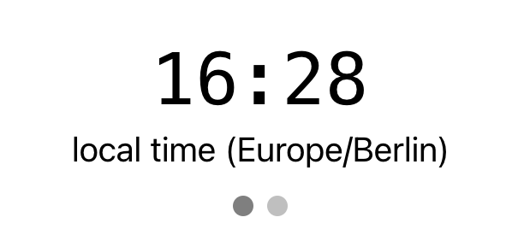
Bug Report
Frontend
Flickering on update data
Announcements not being displayed instantly
CSS inheritance problem
Layout component errors not being displayed
No checks for layout containing plugins not mentioned in plugins.yml
CarouselSlot bug
ImageDisplay z-index

Slide 25

Bug Report
Frontend
Flickering on update data
Announcements not being displayed instantly
CSS inheritance problem
Layout component errors not being displayed
No checks for layout containing plugins not mentioned in plugins.yml
CarouselSlot bug
ImageDisplay z-index

Slide 26
Bug Report
Backend
Unable to update refresh time
Unspecific error codes
Invalid issuer encoded in JWT
LocalRepository.findByID can crash
YAML parsing library inconsistencies
Calendar events race condition

Slide 27
Bug Report
Backend
Unable to update refresh time
Unspecific error codes
Invalid issuer encoded in JWT
LocalRepository.findByID can crash
YAML parsing library inconsistencies
Calendar events race condition

Slide 28
Bug Report
Backend
Unable to update refresh time
Unspecific error codes
Invalid issuer encoded in JWT
LocalRepository.findByID can crash
YAML parsing library inconsistencies
Calendar events race condition

Slide 29
Bug Report
Backend
Unable to update refresh time
Unspecific error codes
Invalid issuer encoded in JWT
LocalRepository.findByID can crash
YAML parsing library inconsistencies
Calendar events race condition

Slide 30
Bug Report
Backend
Unable to update refresh time
Unspecific error codes
Invalid issuer encoded in JWT
LocalRepository.findByID can crash
YAML parsing library inconsistencies
Calendar events race condition

Slide 31
Bug Report
Backend
Unable to update refresh time
Unspecific error codes
Invalid issuer encoded in JWT
LocalRepository.findByID can crash
YAML parsing library inconsistencies
Calendar events race condition

Slide 32
Log List
New functions or interfaces were added or changed
to resolve bugs
to make testing easier
to make debugging easier
The ImageDisplayPage was added to the Dashboard

Slide 33
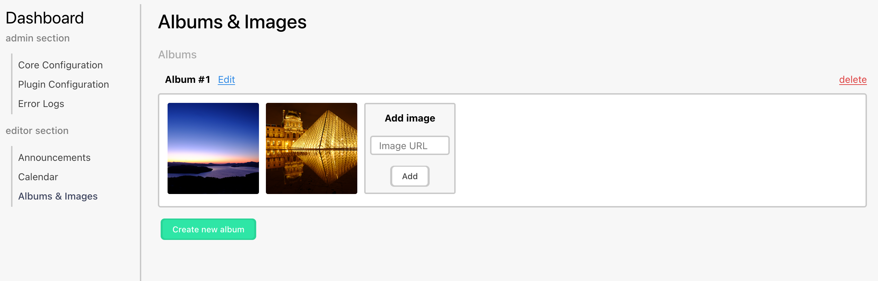
Image Display Page

Slide 34
Thank you any questions left?

