Slide 1
Heterogenous effects of ECB monetary policy
Advanced Empirical Macroeconomic Analysis
Oscar Ernst Alfthan Madsen
Kasper Weilby Wieghorst Knudsen

Slide 2
Introduction
Research question:
To what extent ECBs shock propagate heterogeneously between Euroarea countries.
Motivation:
Single Monetary Policy: Uniform Monetary Policy Stand from ECB.
Uneven propagation: Country-specific characteristics vary impact.
Recent increase in inflation: 2022 inflation crisis.
Divergence: Growing disparities in macro-outcomes
Literature has found diverging results
Results:
Real GDP: Only a few countries differ from Germany.
HICP: All countries but France differ from Germany

Slide 3
Outline
Identify monetary policy shocks
First Stage Regression
Local Projection Instrumental Variables
Panel Local Projections Instrumental Variables
Robustness of results

Slide 4
Identifying exogenous Monetary Policy shocks
Monetary Policy is inherently endogenous:
It responds to ongoing business cycles.
Extinction of Pure Monetary Policy:
Traditional method: Look purely at ECB rate changes.
Post 2014: Primarily different methods used
Multidimensionality of ECB Monetary Policy:
1) Pure monetary policy: The change in the short-term interest rate
2) Forward Guidance: Path for future interest rates
3) Quantitative Easing: Asset purchasing programs (from 2014)

Slide 5
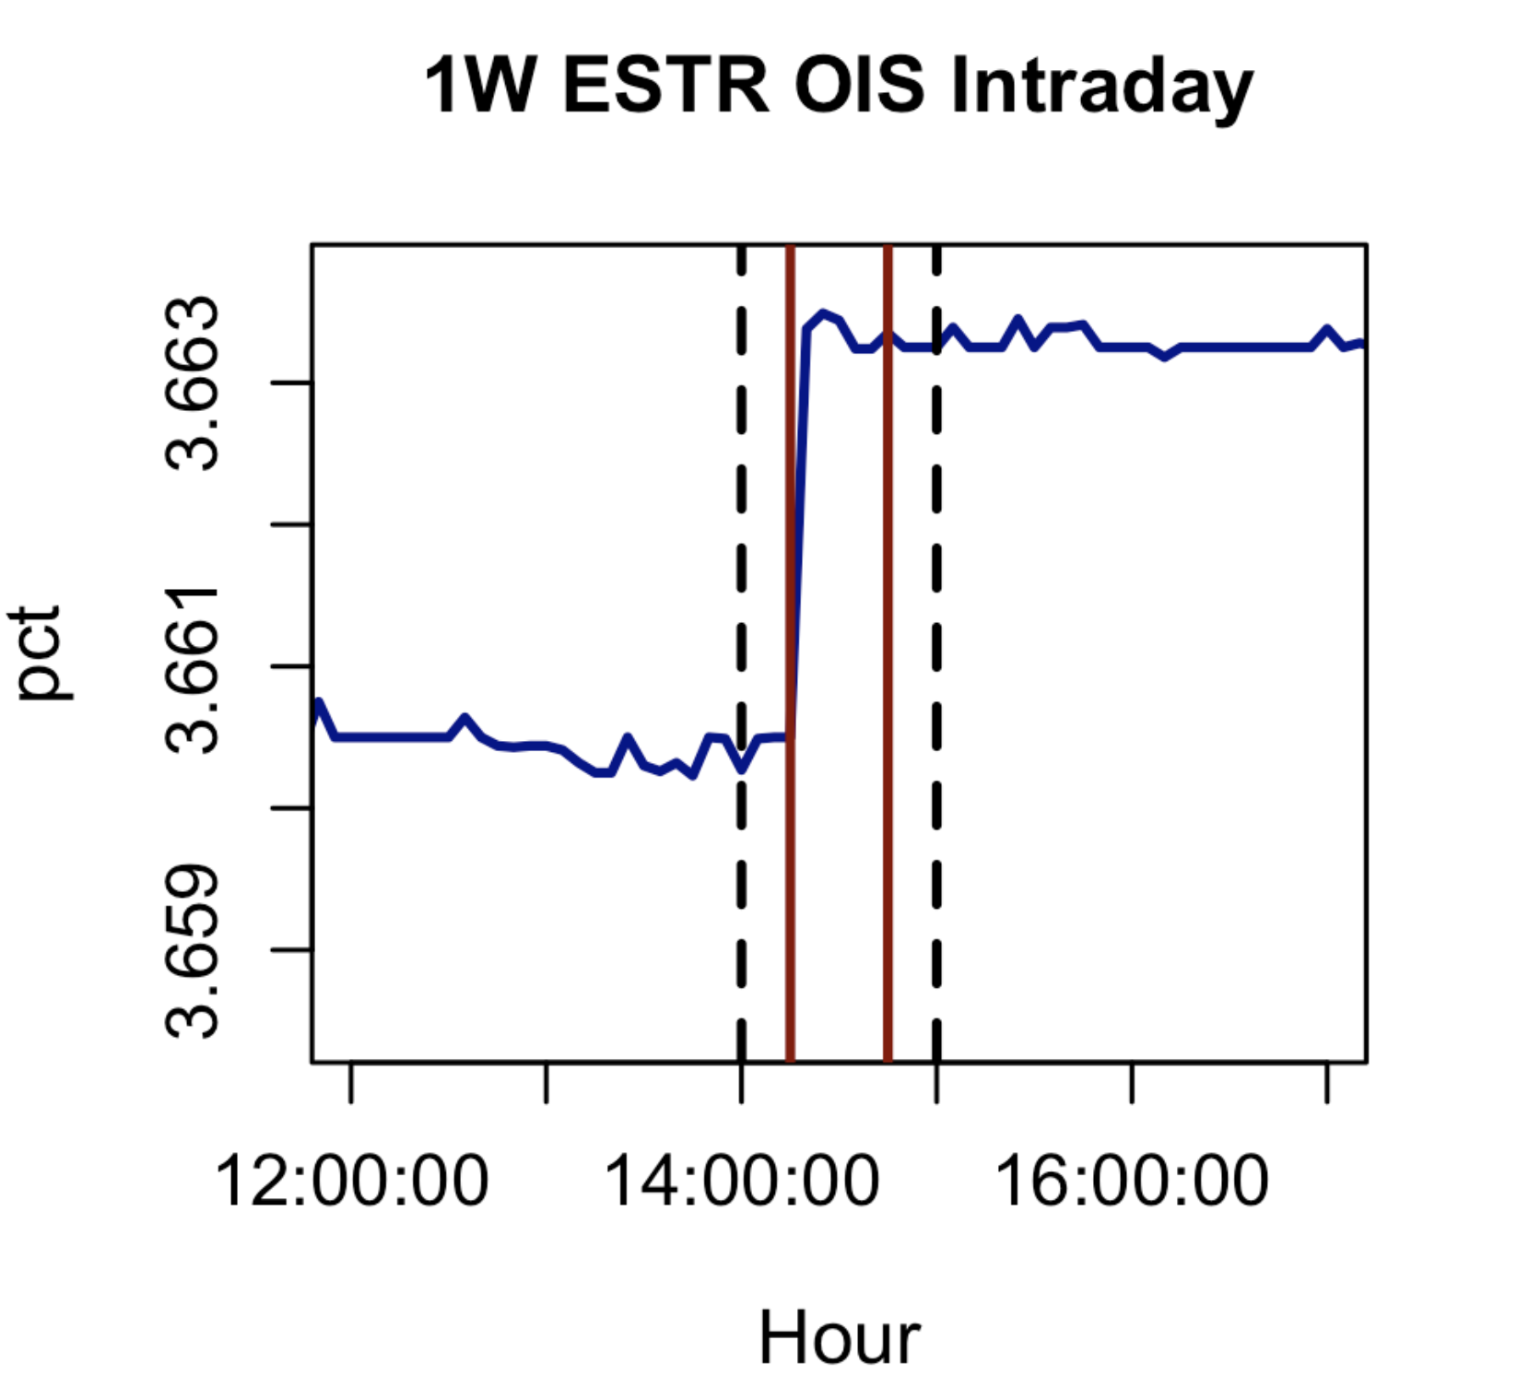
MP shock Identification I
Multi dimensionality of ECB monetary policy.
Goal: Identify three exogenous ECB monetary policy shocks
Use change in OIS-rates of different maturities.
Problem: 7 series of unexpected OIS rate changes
Solution: PCA → Reduce the dimensionality while maintaining variation.
Results: 3 orthogonal series of purely statistical measures – explains 96.3% of variation.
Lacks economic meaning

Slide 6
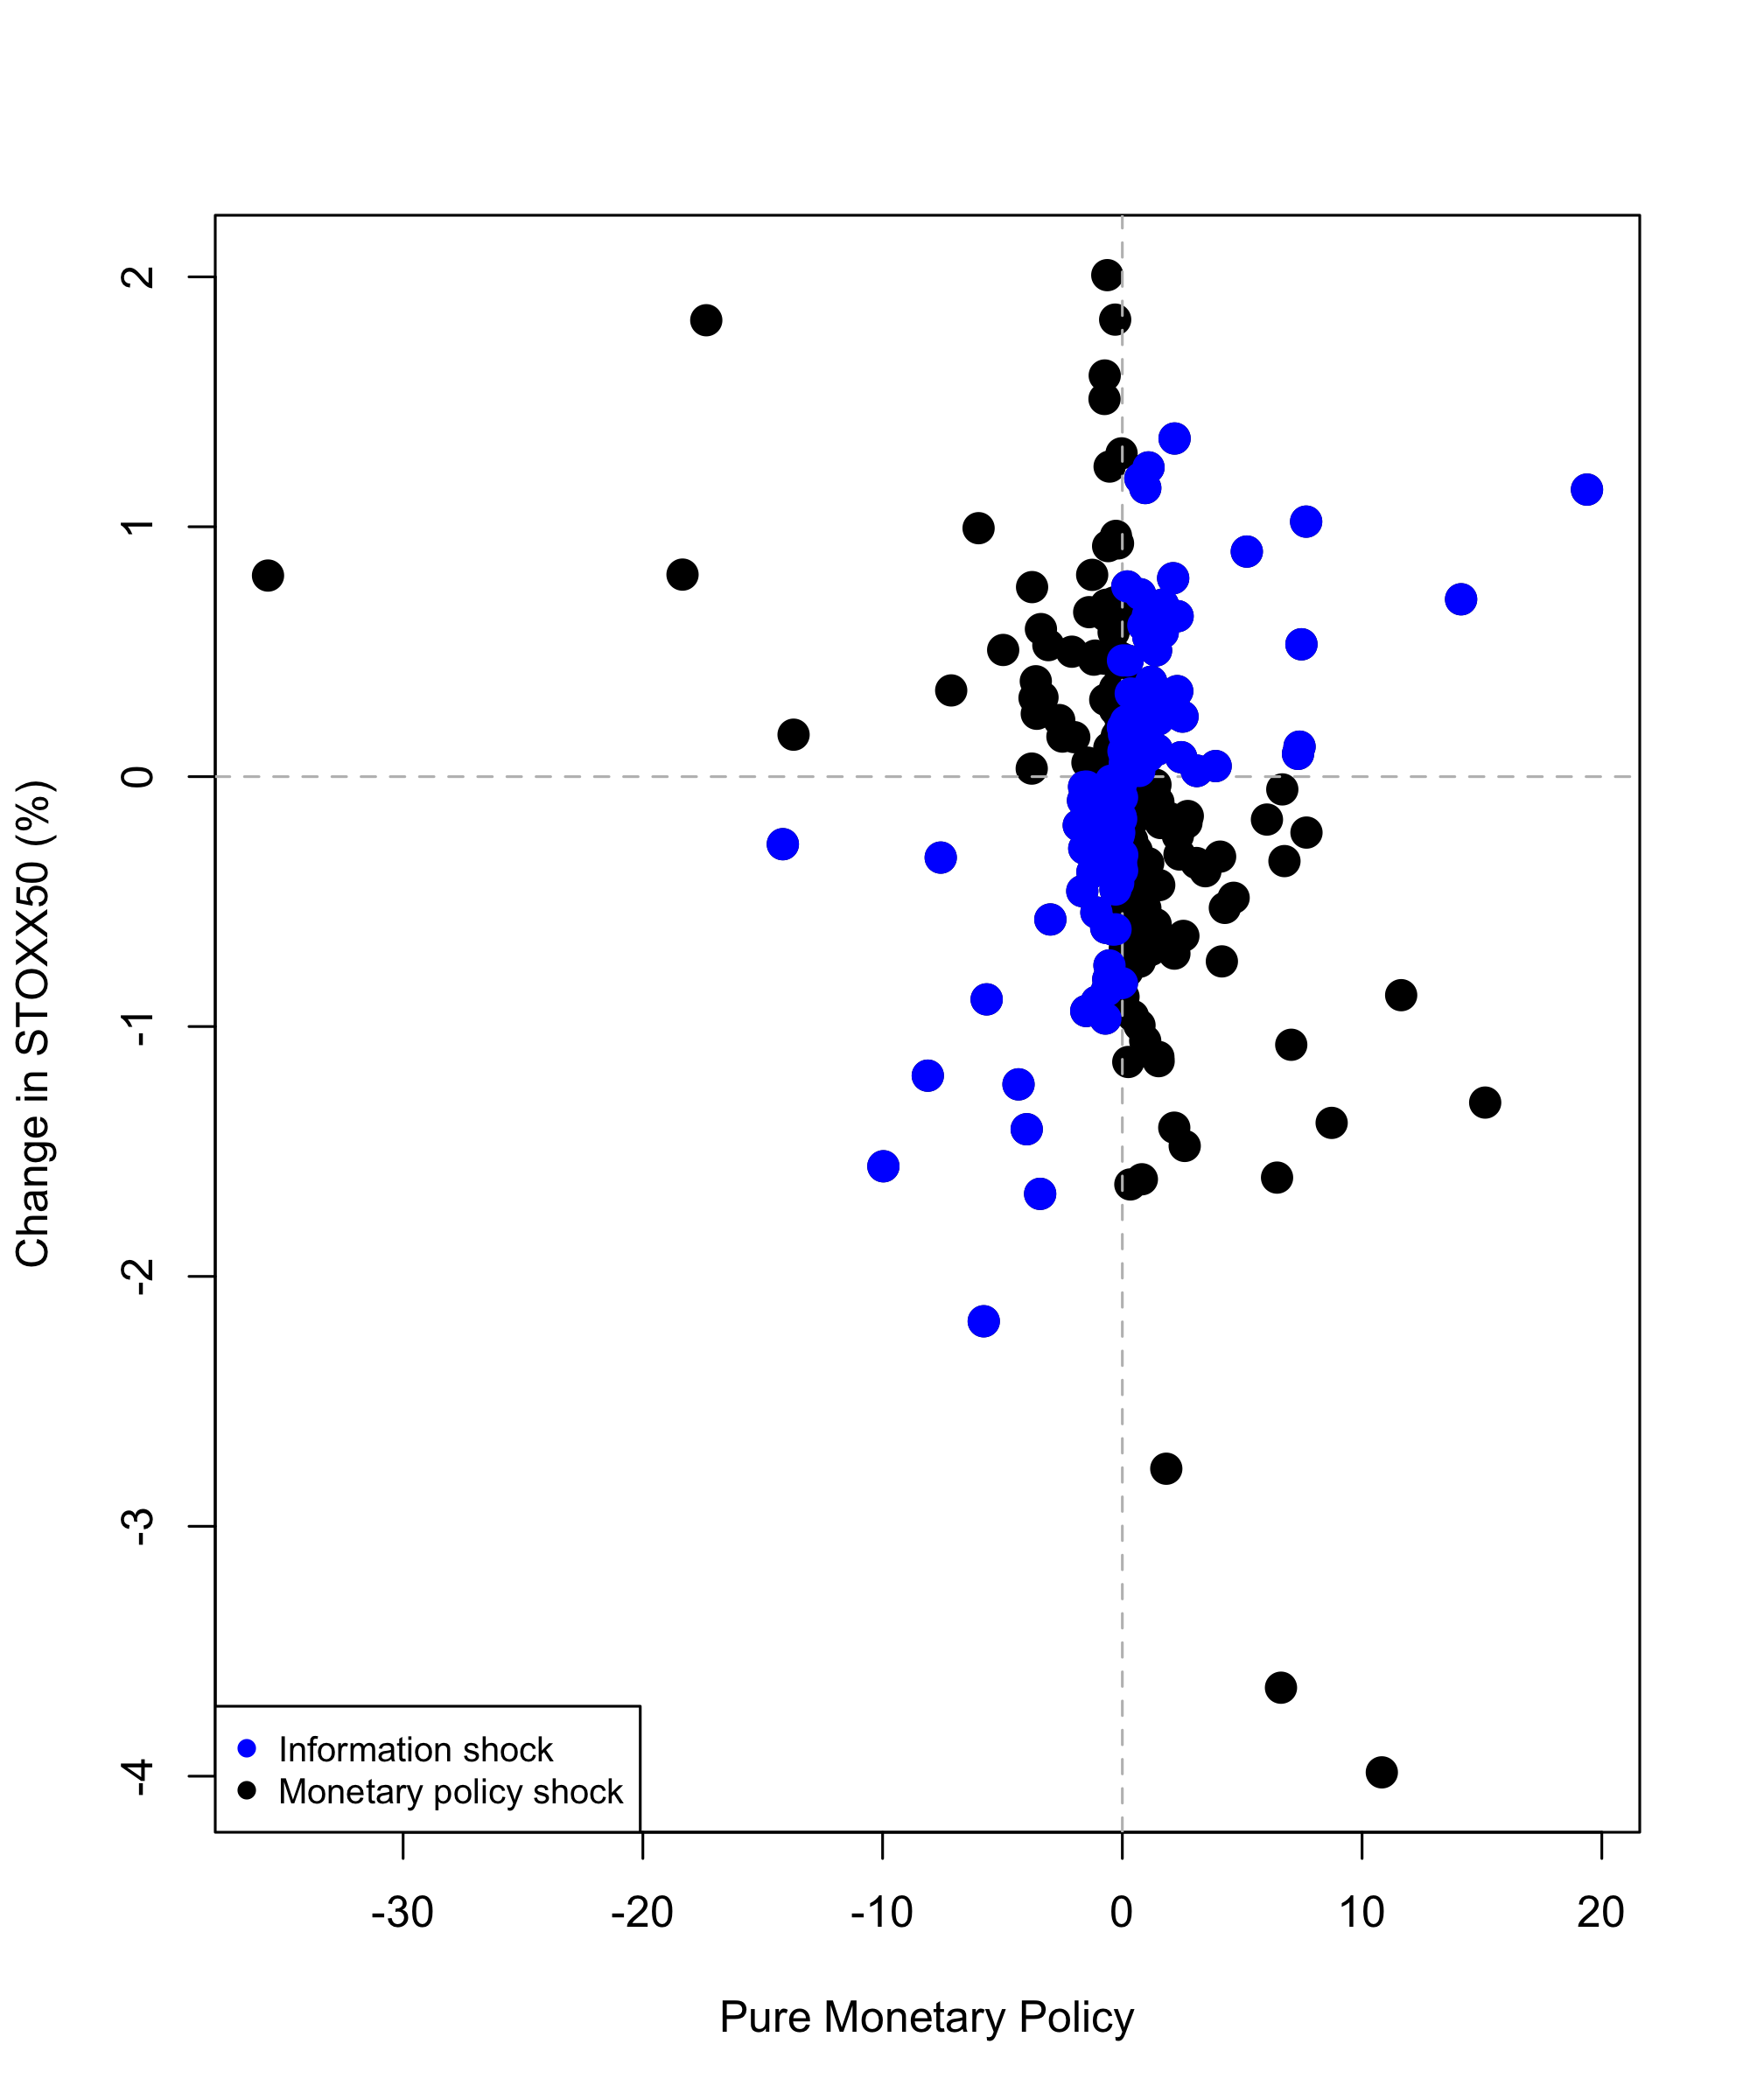
MP Shock Identification – II
Impose economic structure by specifying a factor model that provides an economic interpretation.
HF changes in rates around MP announcements:
1) Pure Monetary: Negative co-movements
2) Information Shocks: Positive co-movements
Remove information shocks (46.8%).

Slide 7
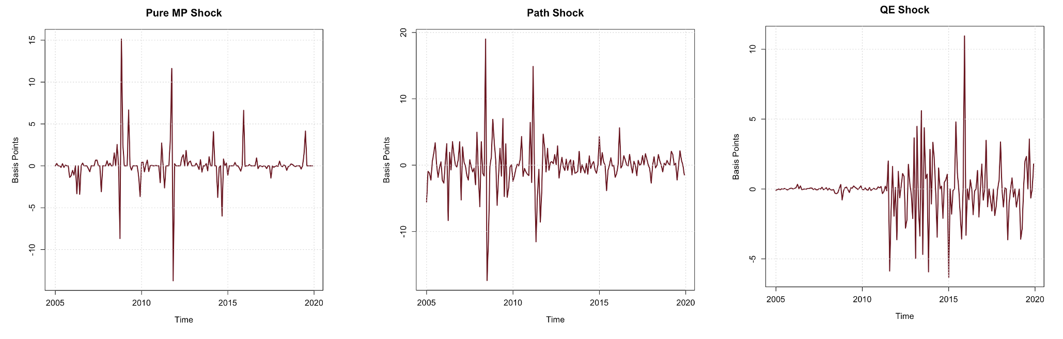
MP Shock Identification – Exogenous shocks
Shocks are now:
NOT significantly different from 0
Have no serial correlation
Pure MP shock die off, after 2015
Forward guidance (Path), is smaller after 2012
Forward guidance begins in 2013

Slide 8
Data used
Core countries: Germany, France, Austria, the Netherlands, Denmark
Peripheral countries: Portugal, Spain, Italy and Greece
Baseline country = Germany
Quarterly data from Q1 2004 to Q4 2019.
Real GDP per capita
HICP
Consumption
2-year Bundesbank yield
Log-difference: Data is approximately percentage change

Slide 9
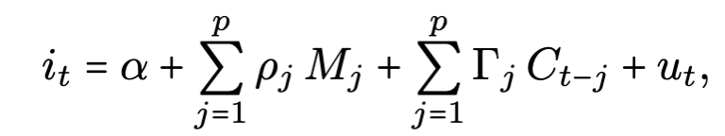
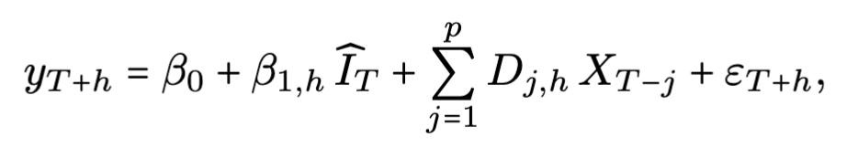
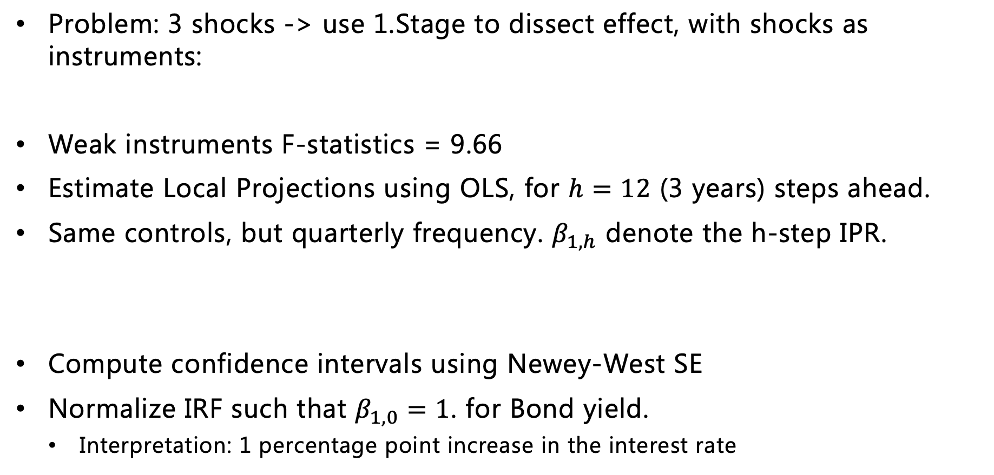
Local Projection Instrumental Variables
Problem: 3 shocks -> use 1.Stage to dissect effect, with shocks as instruments:
Weak instruments F-statistics = 9.66
Estimate Local Projections using OLS, for $h=12$ (3 years) steps ahead.
Same controls, but quarterly frequency. $β_{1,h}$ denote the h-step IPR.
Compute confidence intervals using Newey-West SE
Normalize IRF such that $β_{1,0}=1$. for Bond yield.
Interpretation: 1 percentage point increase in the interest rate

Slide 10
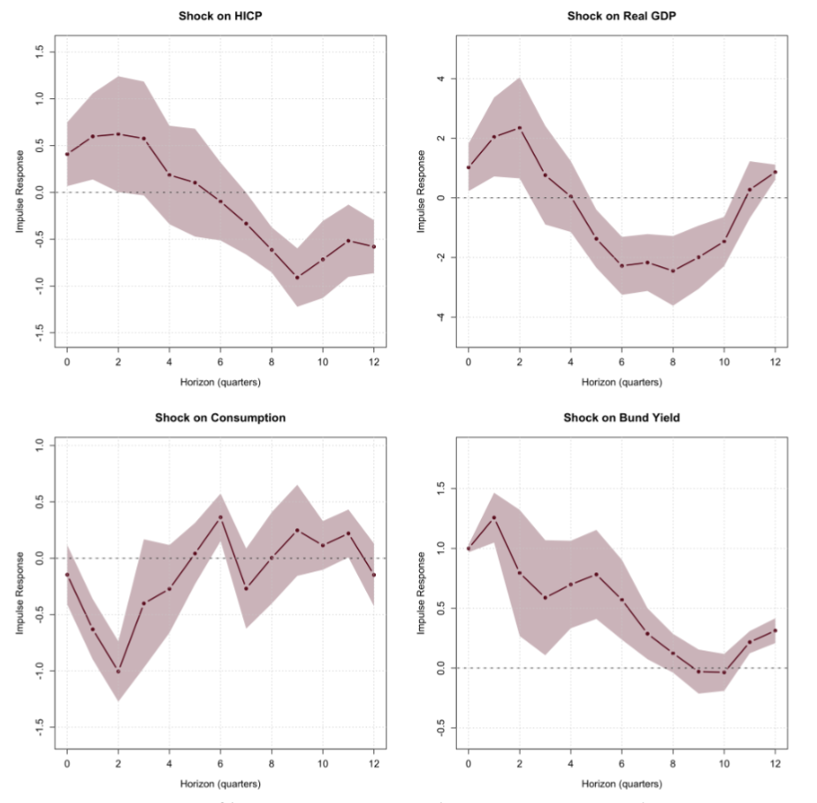
Local Projections – IRF for Germany
HICP: Increase on impact (Price-Puzzle). Decrease in prices after 2 years.
GDP: Initial increase but decrease after 1-2 years.
Consumption: Fall on impact, and quickly returns
Bond yield: Falls monotonically towards baseline

Slide 11
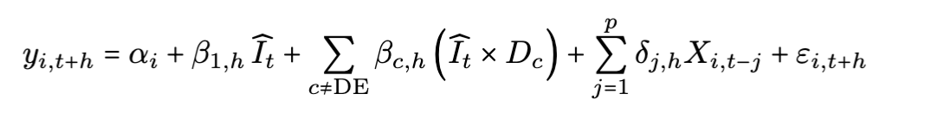
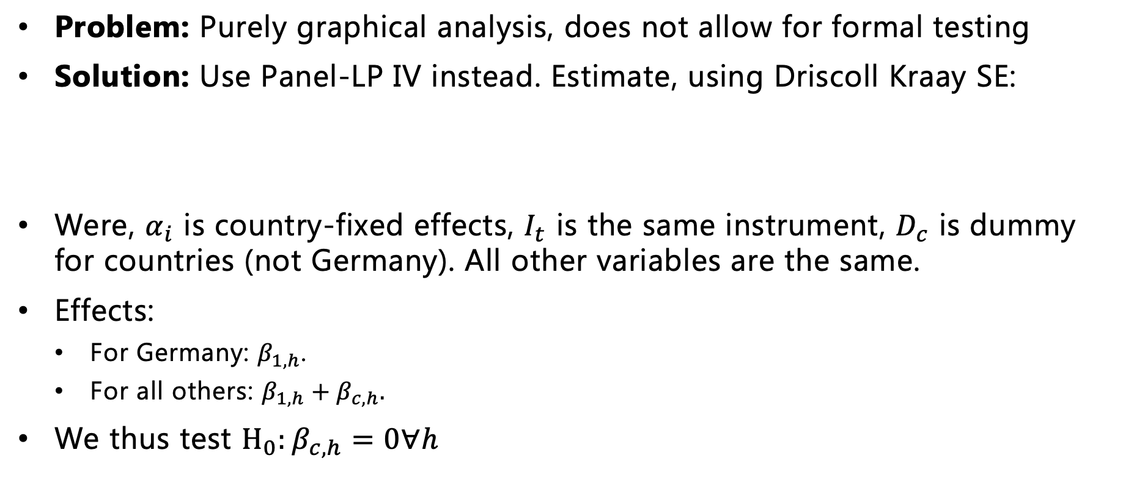
Panel LP-IV
Problem: Purely graphical analysis, does not allow for formal testing
Solution: Use Panel-LP IV instead. Estimate, using Driscoll Kraay SE:
Were, $α_{i}$ is country-fixed effects, $I_{t}$ is the same instrument, $D_{c}$ is dummy for countries (not Germany). All other variables are the same.
Effects:
For Germany: $β_{1,h}$.
For all others: $β_{1,h}+β_{c,h}.$
We thus test $H_{0}:β_{c,h}=0∀h$

Slide 12
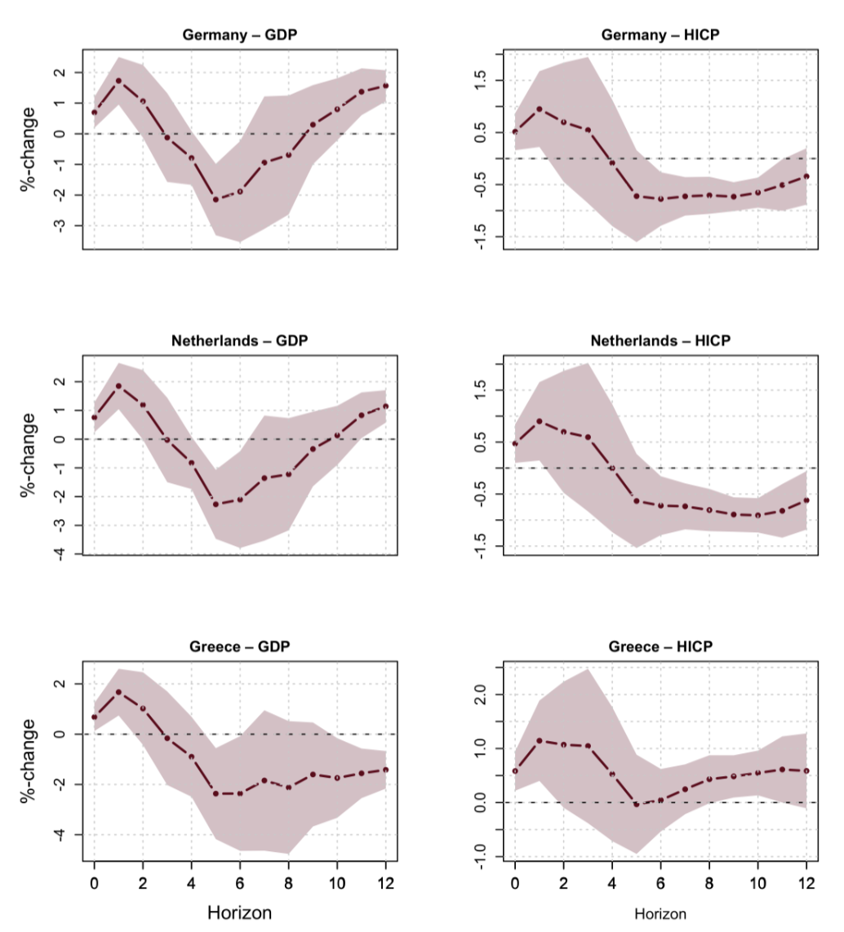
Impulse Responses
GDP: More uniform responses. Greece deviate at longer horizons.
HICP: Larger divergence, also at earlier horizons.

Slide 13
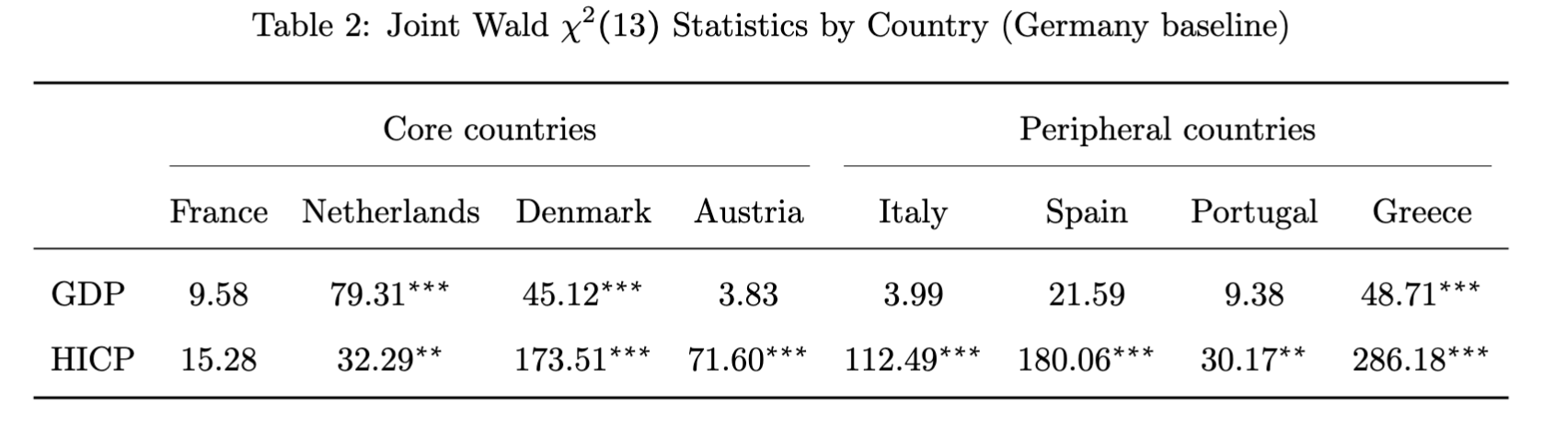
Heterogenous effects
Heterogenous effects in GDP only for the Netherlands, Denmark and Greece.
Heterogenous effects for all (but France) in HICP

Slide 14
Level of heterogenous effects
Baseline:
GDP decrease by 1.45 percentage point after 2 years
HICP decrease by 0.91 percentage points after 3 years
Core countries: All (but Denmark) have
Smaller drops in GDP:
Larger drops in HICP
Peripheral countries: All countries have:
Larger drops in GDP
Smaller drops in HICP (But Portugal).

Slide 15
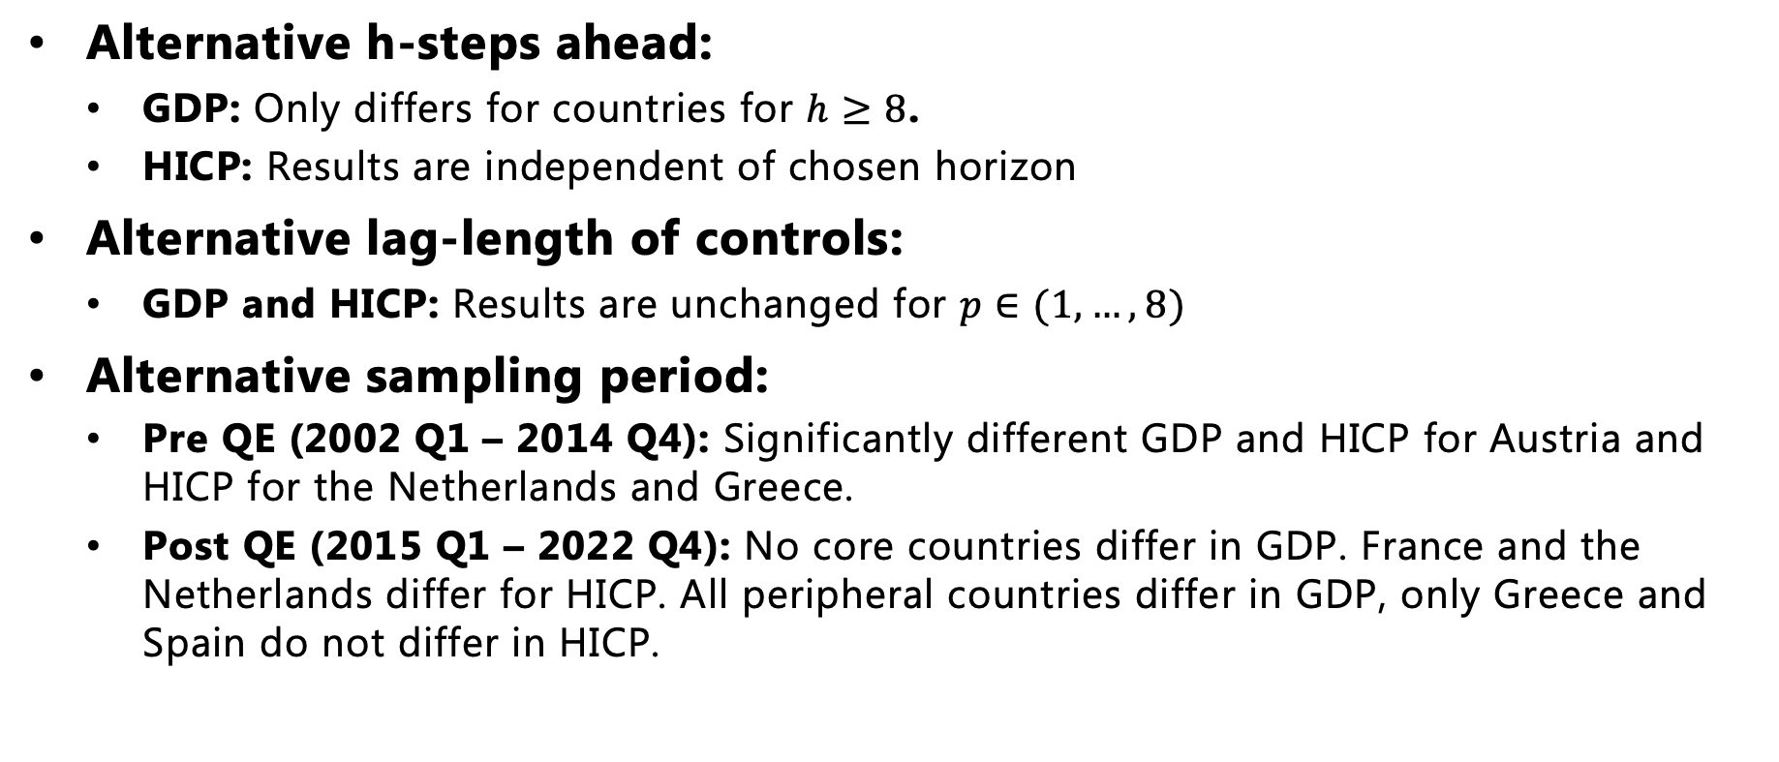
Robustness of results
Alternative h-steps ahead:
GDP: Only differs for countries for $h≥8$.
HICP: Results are independent of chosen horizon
Alternative lag-length of controls:
GDP and HICP: Results are unchanged for $p∈(1,…,8)$
Alternative sampling period:
Pre QE (2002 Q1 – 2014 Q4): Significantly different GDP and HICP for Austria and HICP for the Netherlands and Greece.
Post QE (2015 Q1 – 2022 Q4): No core countries differ in GDP. France and the Netherlands differ for HICP. All peripheral countries differ in GDP, only Greece and Spain do not differ in HICP.

Slide 16
Overall conclusions
Real GDP: Only a few countries respond significantly different from Germany.
Denmark and Greece: Both experience larger drops in real GDP after two-years (-1.45 & -0.84 percentage point). Materializes late and remains modest in size.
HICP: Much larger divergences from Germanys responds
All countries (but France), differ from Germany.
Core countries experience smaller price decline. Peripheral countries experience a larger price increase.
Robustness: Real GDP conclusion changes to some degree when changing lags of controls and h-steps ahead. HICP conclusions are robust
Sampling period: Heterogeneity peaks in post-QE periods. Indicating greater structural differences

