Slide 1
Decision steps: | 1: Does the method yield estimates of ND and RFD compatible with Chesson’s inequality? | no |  | yes | yes | yes | yes
 | 2: Do you know the factors that govern population dynamics? | no |  | no | no | yes | yes
 | 2: How will empirical data be obtained? | experimental or observational |  | experimental or observational | experimental | experimental | experimental
 | 3: Can you have monocultures? | no |  | yes | yes | yes | yes
 | 4: Can you assume ≥ 1 species is at steady-state? | no |  | no | yes | no | no
 | 5: Need a method for more than 2 focal species at a time? | yes |  | no | yes | yes | no
 | 6: The resource is: | not explicit |  | not explicit or biotic (dynamic) | not explicit | biotic (dynamic) | abiotic
Method |  | Negative frequency dependence |  | Lotka-Volterra | Sensitivity | MacArthur’s CRM | Tilman’s R* CRM
 | Foundational paper for model | Rees and Westoby 1997 |  | Volterra 1928 | MacArthur 1970 | MacArthur 1970 | Tilman 1977
 | Theoretical paper linking model to MCT | Adler et al 2007 |  | Chesson 2000 | Carrol et al 2011 | Chesson 1990 | Letten 2017
 | Empirical paper using model for MCT | Levine and HilleRisLambers 2009 |  | Godoy and Levine 2014 | Narwani et al 2013 | none | Letten 2017
Experimental Requirements | Requires invasion from rare? | no |  | no | yes | no | no
 | How many mixtures of species A and B? | ≥2 |  | ≥1 | 2 | no | no
 | Are time-series required? | short |  | long | short | none | none
 | How many experiments required for pairwise predictions for n species | m*n*(n-1), where m≥2 |  | n+[n(n-1)/2] | n(n-1) | 2n | 2n
Outputs | Can the method predict coexistence for new combinations of species? | no |  | no | no | yes | yes
 | Can the method predict coexistence under different environment? | no |  | no | no | yes | some

Slide 2
 |  | Are the methods algebraically equivalent? |  |  |  |  |  | Do the methods give the same prediction about coexistence?
 |  | NFD | L-V model | Sensitivity | MCR | TCR |  | NFD | L-V model | Sensitivity | MCR | TCR
NFD: frequency dependency slope |  |  | N | N | N | N |  |  | N | N | N | N
L-V: Lotka-Volterra model fitting (α) |  |  |  | Y | Y | Y |  |  |  | Y | Y* | Y*
Sensitivity: (S_{i}) |  |  |  |  | Y | Y |  |  |  |  | Y* | Y*
MCR: MacArthur’s consumer-resource model |  |  |  |  |  | - |  |  |  |  |  | -
TCR: Tilman’s consumer-resource model

Slide 3
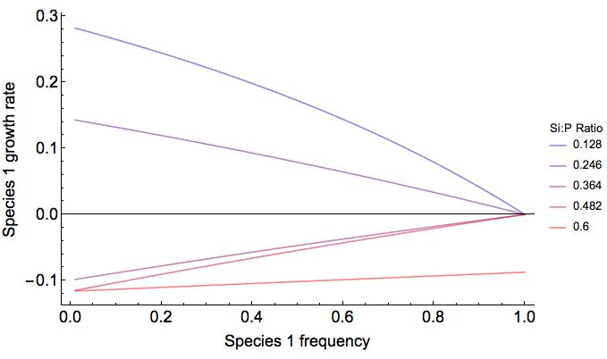
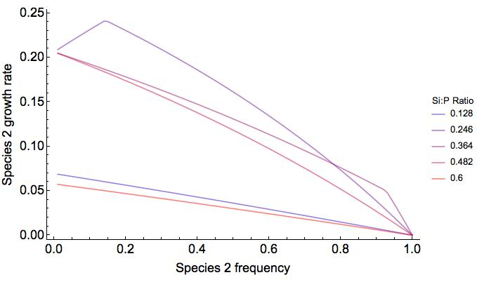
Supplement Figure XXX. Results of numerical simulations showing that a consumer-resource model can produce a non-linear relationship between a species’ frequency and growth rate. When the negative frequency dependence method is applied to these numerical experiments, the slope of the relationship is dependent upon the relative densities of the two species and cannot be used to compute ND and RFD as show by Adler et al (2007).

Slide 4
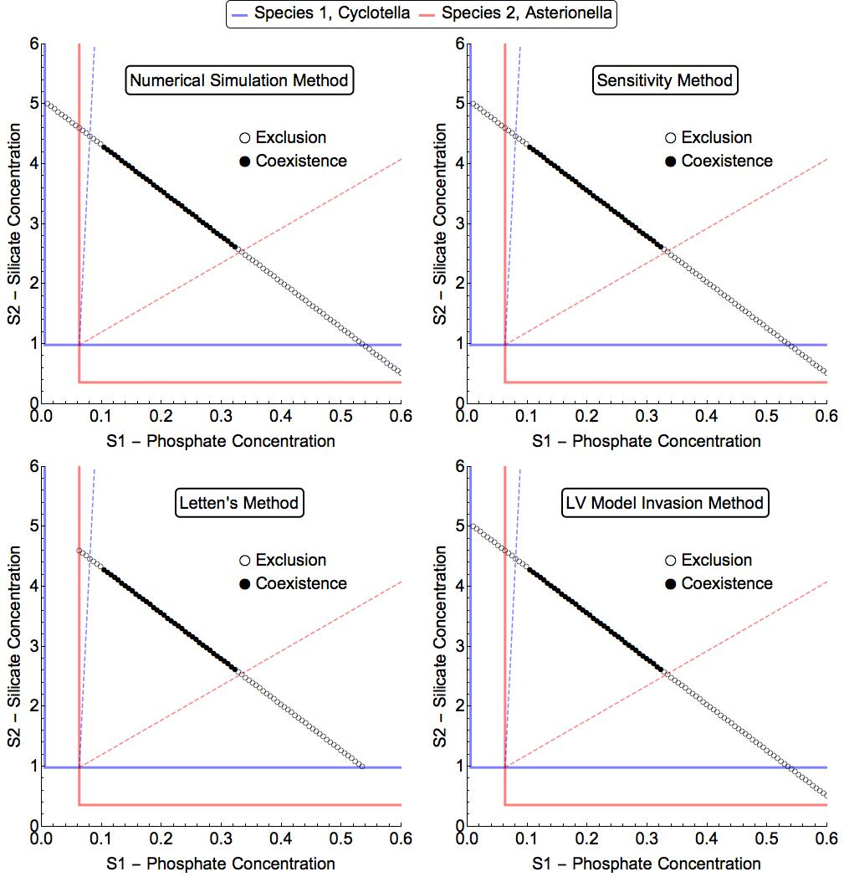
Supplement Figure XXX. Results of numerical simulations showing that three methods yield the same prediction for species coexistence (sensitivity, Tilman’s CRM, and the L-V method).
CASEY NEEDS TO WRITE DETAILS OF HOW THESE WERE GENERATED. THIS FIGURE IS REFERENCED BY TABLE 2.

