Slide 1
Hypothesis
Strong selection process
Heterotrophic Nano-flagellate
(HNF) diversity
Weak selection process
Bacteria diversity

Slide 2
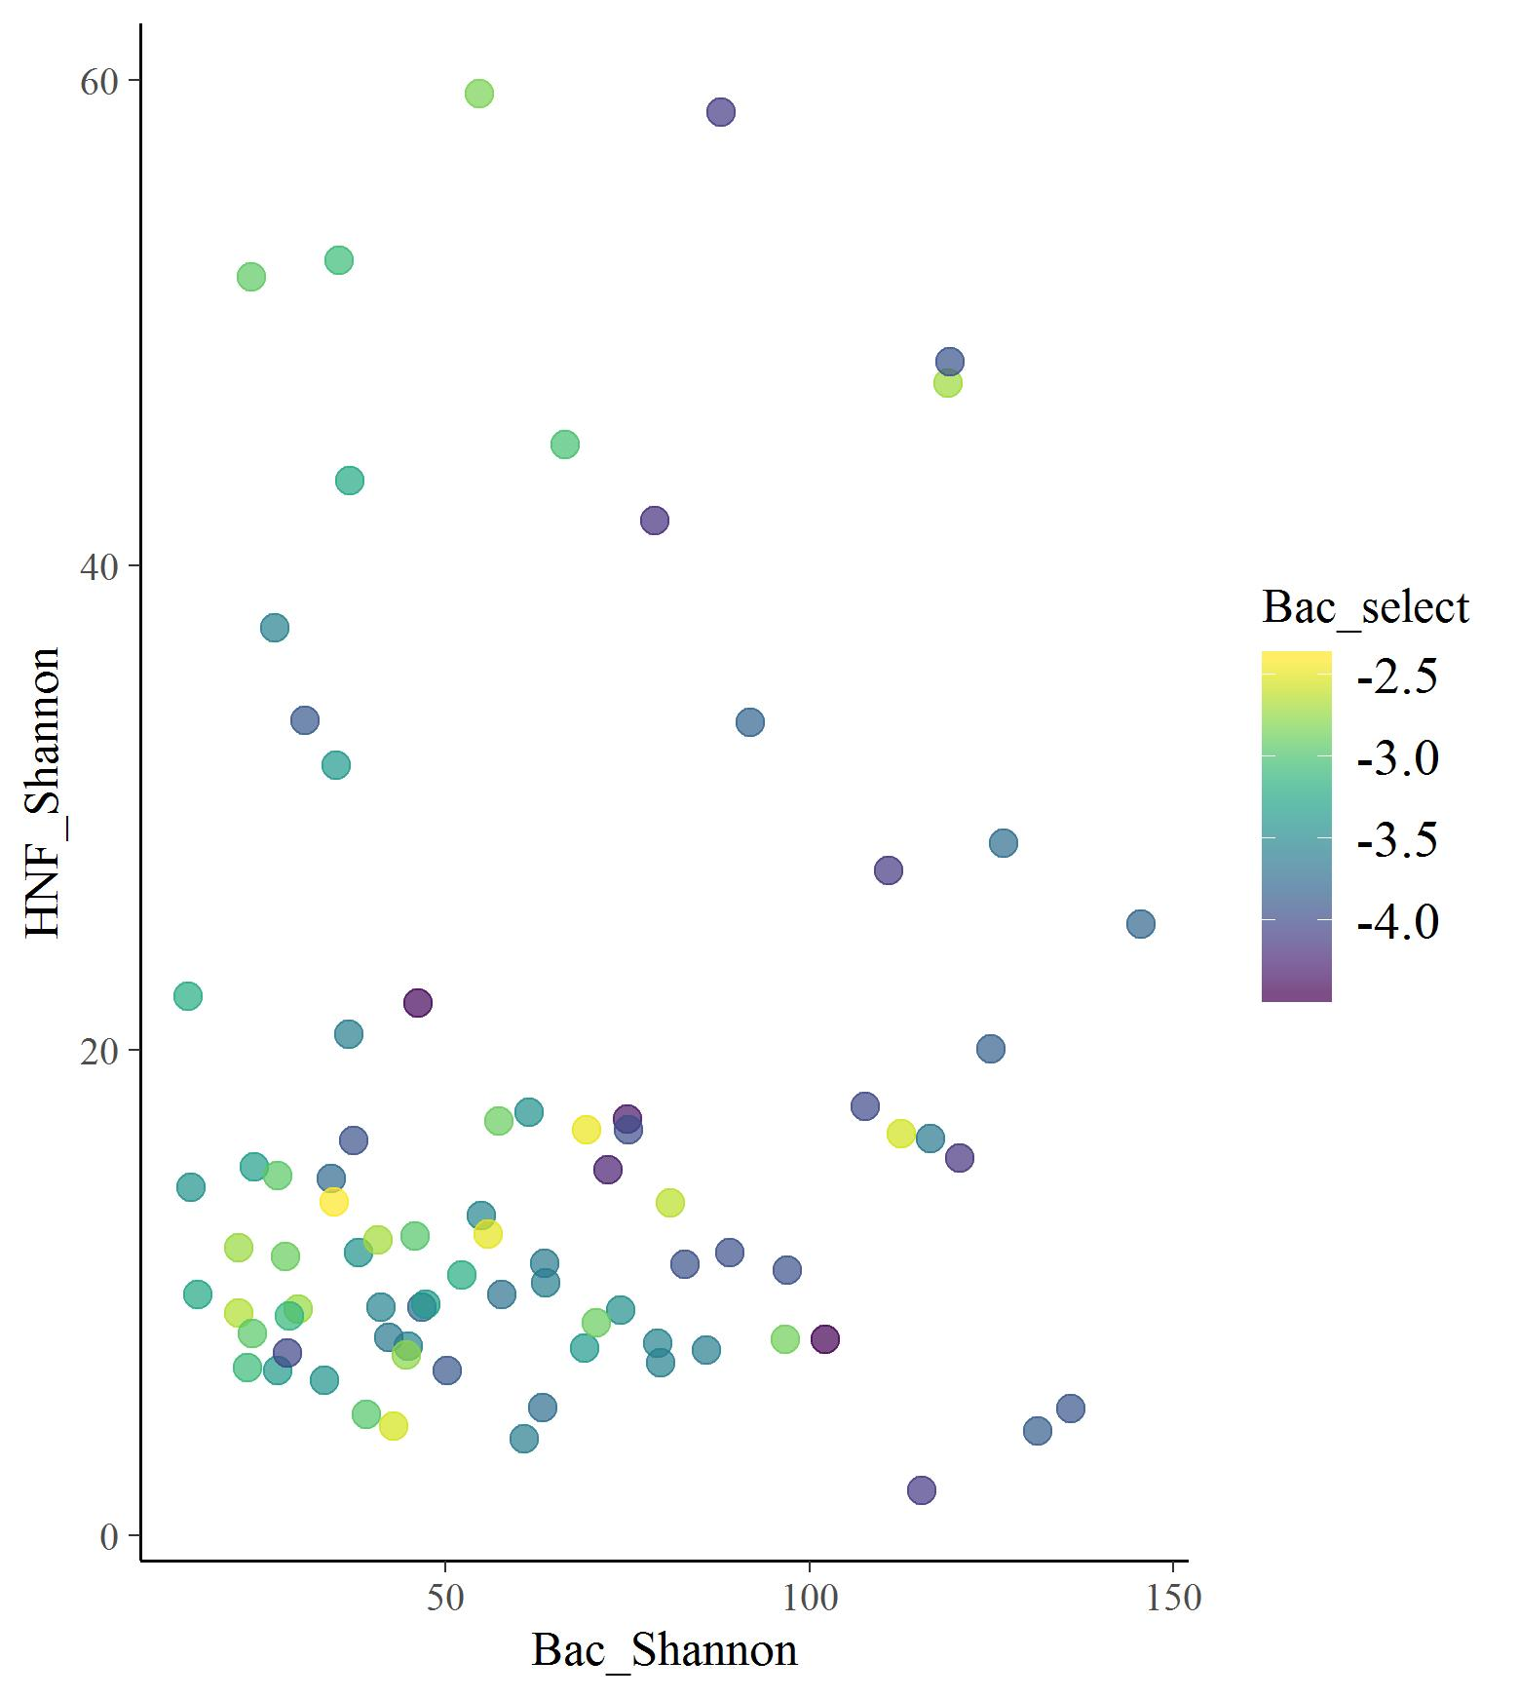
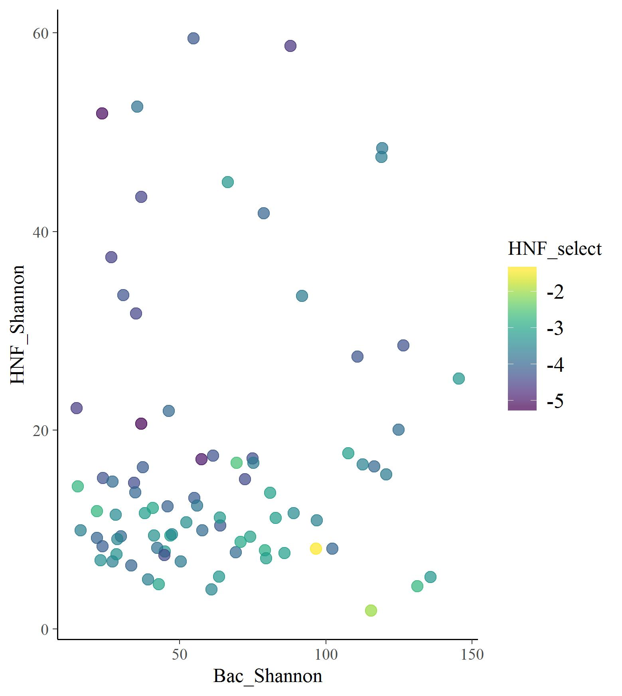
alpha level biplots

Slide 3
Cruise
HNF diversity
3.75 (0.03, 7.48)
Bacteria diversity
0.76
(0.21, 1.31)
HNF
Selection processes
Bacteria
Selection processes

Slide 4
Cruise
HNF biomass
Bacteria biomass
HNF diversity
3.75 (0.03, 7.48)
Bacteria diversity
0.76
(0.21, 1.31)
HNF
Selection processes
Bacteria
Selection processes

Slide 5
Cruise
Spatial heterogeneity
Productivity (Nutrient)
HNF biomass
Bacteria biomass
HNF diversity
+
Bacteria diversity
+
HNF
Selection processes
Bacteria
Selection processes

Slide 6
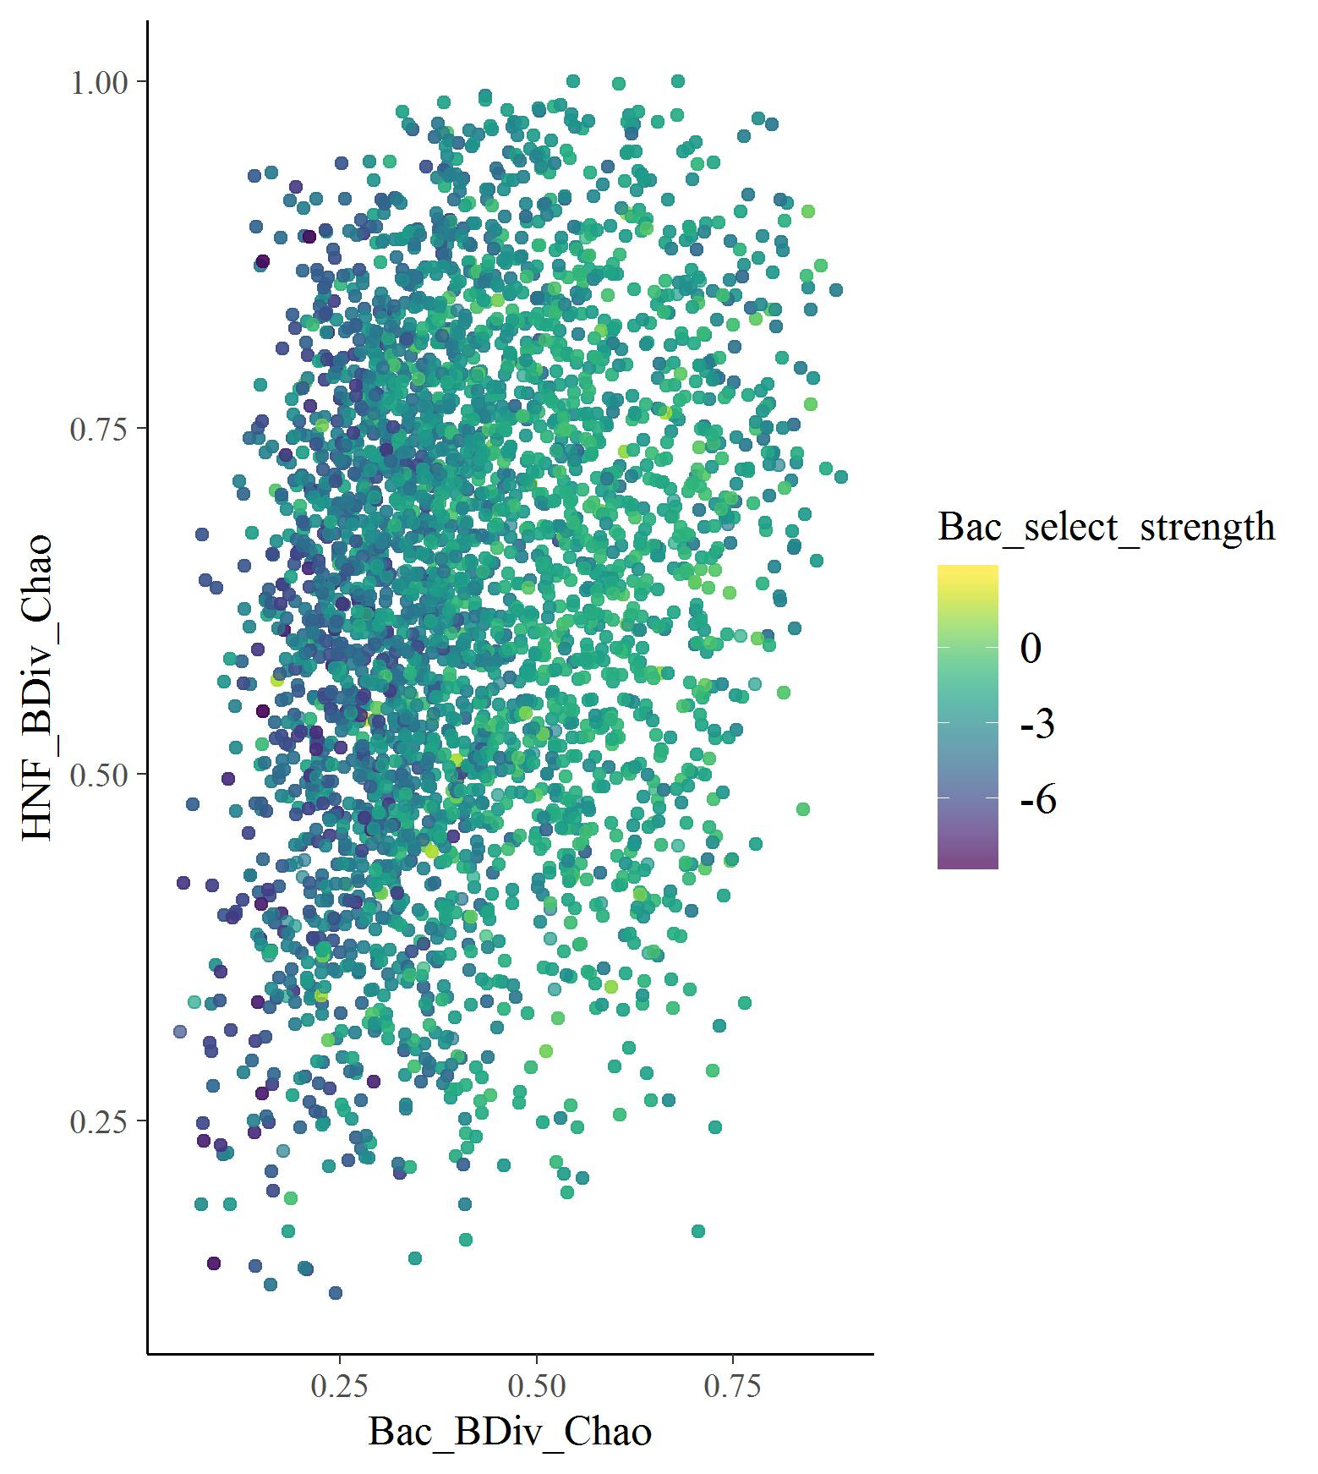
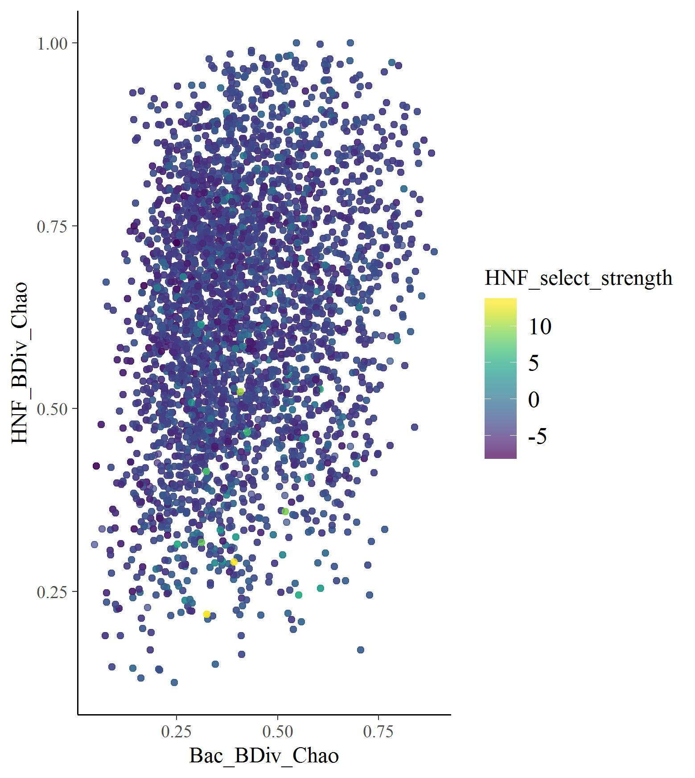
alpha level biplots

Slide 7
Season
HNF diversity
0.49 (0.47, 0.52)
Bacteria diversity
0.017
(0.01, 0.02)
0.08
(0.07, 0.084)
HNF
Selection processes
Bacteria
Selection processes

Slide 8
Season
HNF biomass
Bacteria biomass
-0.76
(-0.89, -0.62)
0.11
(0.03, 0.19)
0.16
(0.01, 0.31)
0.1
(0.01, 0.19)
HNF diversity
0.49 (0.47, 0.52)
Bacteria diversity
0.017
(0.01, 0.02)
0.08
(0.07, 0.084)
HNF
Selection processes
Bacteria
Selection processes

Slide 9
Season
Spatial heterogeneity
Productivity (Nutrient)
HNF biomass
Bacteria biomass
HNF diversity
Bacteria diversity
HNF
Selection processes
Bacteria
Selection processes

