Slide 1
Ecosystem functioning
Prey diversity
Predator diversity

Slide 2
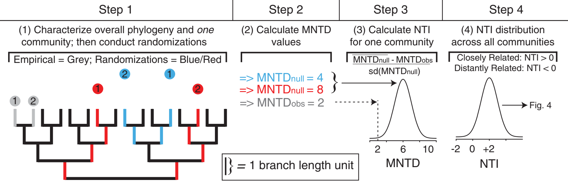

Slide 3
β-NTI
MNTD_{obs}
Null mean
MNTD

Slide 4
Bacteria diversity
Hetero-trophic nano-flagellate (HNF) diversity
Deterministic
assembly processes of
HNF community
Deterministic
assembly processes of
bacteria community
Deterministic
assembly processes
of HNF (Bacteria) community
HNF (Bacteria) diversity
Bacteria (HNF) diversity
Deterministic assembly processes
of HNF (Bacteria) community

Slide 5
Bacteria
β-diversity
Hetero-trophic nano-flagellate (HNF)
β-diversity
Deterministic
assembly processes of
HNF community
Deterministic
assembly processes of
bacteria community
Deterministic
assembly processes
of HNF (Bacteria) community
HNF (Bacteria) diversity
Bacteria (HNF) diversity
Deterministic assembly processes
of HNF (Bacteria) community

Slide 6
Bacteria species richness
0.106 (p = 0.17)
HNF species richness
0.223 (p = 0.07)
Deterministic assembly processes of
HNF community
Deterministic assembly processes of
Bacteria community

Slide 7
Bacteria biomass
HNF biomass
Bacteria species richness
0.09 (p = 0.22)
HNF species richness
0.213 (p = 0.08)
Deterministic assembly processes of
HNF community
Deterministic assembly processes of
Bacteria community

Slide 8
Bacteria biomass
HNF biomass
Bacteria species richness
0.172 (p = 0.06)
HNF species richness
0.212 (p = 0.08)
Deterministic assembly processes of
HNF community
Deterministic assembly processes of
Bacteria community
Temperature
Chla
TN
TP
Salinity
PAR

Slide 9
Bacteria species richness
0.148 (p = 0.09)
HNF Shannon diversity
Deterministic assembly processes of
HNF community
Deterministic assembly processes of
Bacteria community

Slide 10
Bacteria biomass
HNF biomass
Bacteria species richness
0.148 (p = 0.09)
HNF Shannon diversity
Deterministic assembly processes of
HNF community
Deterministic assembly processes of
Bacteria community

Slide 11
Bacteria biomass
HNF biomass
Bacteria species richness
0.22
HNF Shannon diversity
Deterministic assembly processes of
HNF community
Deterministic assembly processes of
Bacteria community
Temperature
Chla
TN
TP
Salinity
PAR

Slide 12
Bacteria species richness
0.126 (p = 0.13)
HNF Simpson diversity
Deterministic assembly processes of
HNF community
Deterministic assembly processes of
Bacteria community

Slide 13
HNF biomass
HNF biomass
Bacteria species richness
0.134 (p = 0.13)
HNF Simpson diversity
Deterministic assembly processes of
HNF community
Deterministic assembly processes of
Bacteria community

Slide 14
Bacteria biomass
HNF biomass
Bacteria species richness
0.22
HNF Simpson diversity
Deterministic assembly processes of
HNF community
Deterministic assembly processes of
Bacteria community
Temperature
Chla
TN
TP
Salinity
PAR

Slide 15
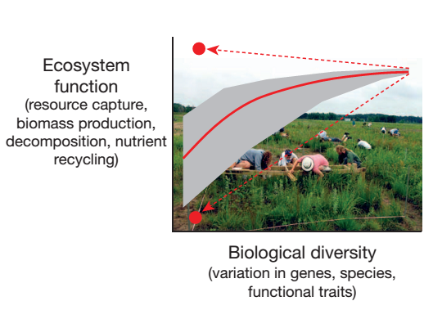
Notes:
For example, there are 500+ studies that have manipulated some aspects of biodiversity of plants either at the level of genes, species, or functional traits,
And the overwhelming majority showed that the processes performed in those ecosystems that regulated the capture of resources like nutrient or light., the production of biomass by the plants, decomposition and recycling of nutrients that keep the system to function efficiently
Those functions are almost positively related to biodiversity.
These study also infer that the main mechanism underlying this positive relationship is resource partitioning.
As this theoretical study demonstrates, if we illustrate the ecosystem with different resource axes like temperature and soil ph, and use white discs to represent the resources used or occupied by species. When there more species in the systems, together they can capture the resource more efficiently.
The implication of this positive relationship is that if we lose species of plants, the ecosystem is going to be less efficient and less productive.
(The implication of this is that if we were to lose species of plants in the Anthropocene, we are going to see the reduction of efficiency and productivity of the whole entire ecosystem. )
However, this positive relationship and the inferred mechanisms are concluded from studies dominated by plant communities.

Slide 16
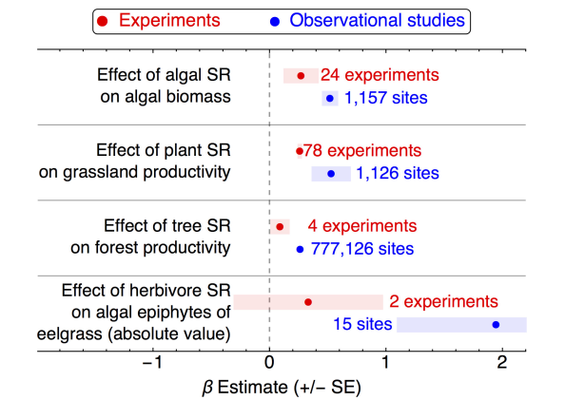
Effect of algal species richness on algal biomass
Effect of grass species richness on grassland productivity
Effect of tree species richness on forest productivity
Diversity effect
Notes:
And that is the conclusion we seem to reach consistently whether we are doing experiments or whether we are looking at unmanipulated observational studies.
For example , this meta-analysis published last year quantifies the effects of algal species richness on algal biomass,
The effects of grass and tree species richness on their productivity
in experimental system, which is labeled in red and in more natural systems, which is labeled in blue
They found that either in the experimental studies or in natural observational studies, the relationship between primary producer diversity and EF are positive.
The implication here is that we are always expecting to lose ecosystem functions when losing plant species
And we have consistent evidences from the manipulative experiments or the observational studies.

Slide 17
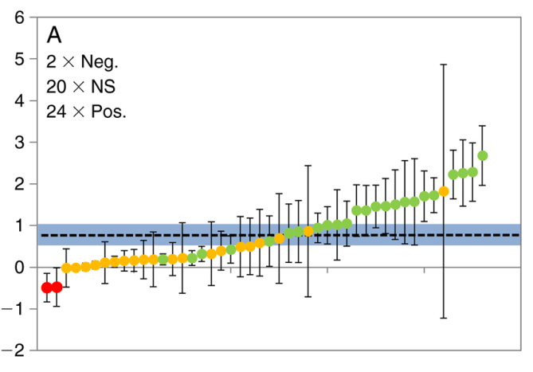
Effects of
predator diversity
Studies
Notes:
However, when it comes to consumer or animal communities, the relationship between resource prey consumption and consumer diversity becomes less consistent.
Here, this metaanalysis plot the effects of consumer diversity on ecosystem functions [the consumption of resource prey], and rank them from the smallest to the largest.
An the green dots here represent significantly positive effects of consumer diversity
The yellow dots mean the non-significant effects
And red dots represent negative relationship between consumer diversity and consumption of resource prey.
This meta-analysis show that, there are far more variable relationships between consumer diversity and the consumption of resource prey than there are in plants.

Slide 18
