Slide 1
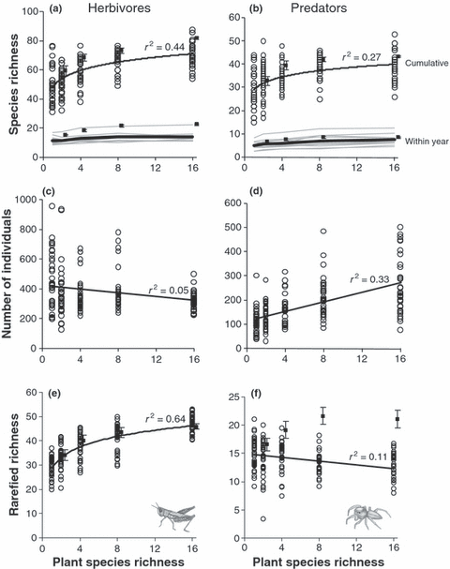
Plant species loss decreases arthropod diversity and shifts trophic structure
Ecology Letters, Volume: 12, Issue: 10, Pages: 1029-1039, First published: 10 September 2009, DOI: (10.1111/j.1461-0248.2009.01356.x)
Notes:
Effects of plant species richness on (a) herbivore and (b) predator species richness, (c) herbivore and (d) predator cumulative abundance, and cumulative rarefied (e) herbivore and (f) predator richness. In (a) and (b), upper data points and the upper dark line are for cumulative richness (when pooled across years). Lower grey lines are for each of the 11 years of data, and the dark line running through them is the means across all years. In (a), (b), (e), and (f), solid squares show the predicted richness (± 95% confidence interval) based on additive contributions of each monoculture for the cumulative data set (the lower squares in (a) and (b) are for yearly data). Rarefaction accounts for effects of arthropod abundance on diversity. For predator abundance (d), one outlying point is not shown for which 1303 spiderlings were sampled on one day in a two species plot. r2 values in all figures are for simple least squares regression.
IF THIS IMAGE HAS BEEN PROVIDED BY OR IS OWNED BY A THIRD PARTY, AS INDICATED IN THE CAPTION LINE, THEN FURTHER PERMISSION MAY BE NEEDED BEFORE ANY FURTHER USE. PLEASE CONTACT WILEY'S PERMISSIONS DEPARTMENT ON PERMISSIONS@WILEY.COM OR USE THE RIGHTSLINK SERVICE BY CLICKING ON THE 'REQUEST PERMISSIONS' LINK ACCOMPANYING THIS ARTICLE. WILEY OR AUTHOR OWNED IMAGES MAY BE USED FOR NON-COMMERCIAL PURPOSES, SUBJECT TO PROPER CITATION OF THE ARTICLE, AUTHOR, AND PUBLISHER.

