Slide 1

Mechanisms underlying the predator-prey diversity relationship in marine bacterioplankton – implications from the community assembly processes
Feng-Hsun Oscar Chang
@ IONTU 422 lab meeting

Slide 2
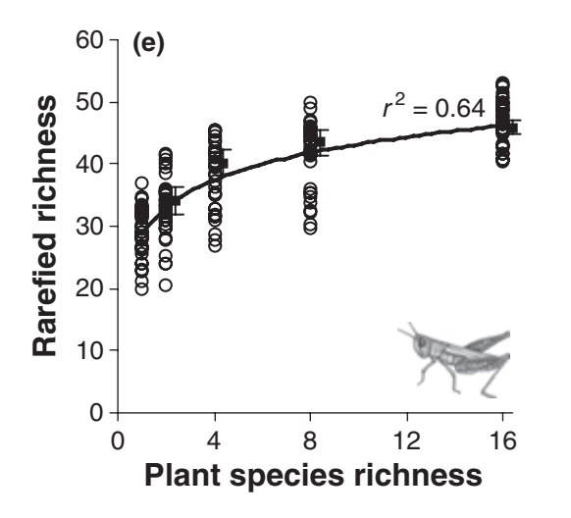
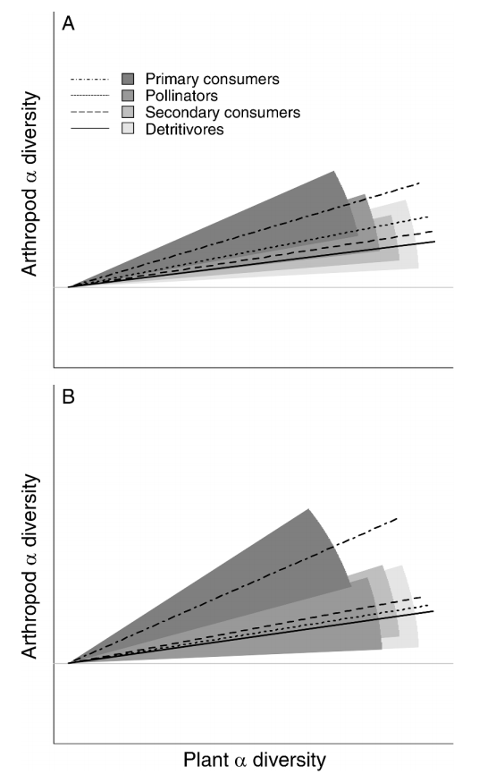
Haddad et al. 2009 @ Eco. Lett.
Castagneyrol et al. 2012 @ Ecology

Slide 3
Why the diversity of predator and prey are positively associated?
+
Predator
diversity
Prey
diversity

Slide 4
+
Predator
diversity
Prey
diversity
Predator
diversity
Prey
diversity
+/-
+/-
Confounding
factors

Slide 5
+
Predator
diversity
Prey
diversity
+
Predator
diversity
Prey
diversity
+/-
+/-
Confounding
factors

Slide 6
+
Predator
diversity
Prey
diversity
+
Predator
diversity
Prey
diversity
+
+/-
+/-
Confounding
factors

Slide 7
Predator
diversity
Prey
diversity
Deterministic assembly processes
of predator community
Deterministic assembly processes
of prey community

Slide 8
+
Predator
diversity
Prey
diversity
decompose
Predator
diversity
Prey
diversity
Deterministic assembly processes
of predator community
Deterministic assembly processes
of prey community

Slide 9
Divergent
assembly processes
Homogeneous
assembly processes

Slide 10
Species pool
Divergent
assembly processes
Homogeneous
assembly processes
Local community
Local community
High α diversity
Low α diversity

Slide 11
Species pool
Divergent
assembly processes
Homogeneous
assembly processes
Local communities
Local community
High β diversity
Low β diversity

Slide 12
Hypothesis: Predator (prey) diversity increases the divergent assembly processes of prey (predator) community, which in turn increase prey (predator) diversity.
Predator
diversity
Prey
diversity
+
+
+
+
Divergent assembly processes of predator community
Divergent assembly processes of prey community

Slide 13
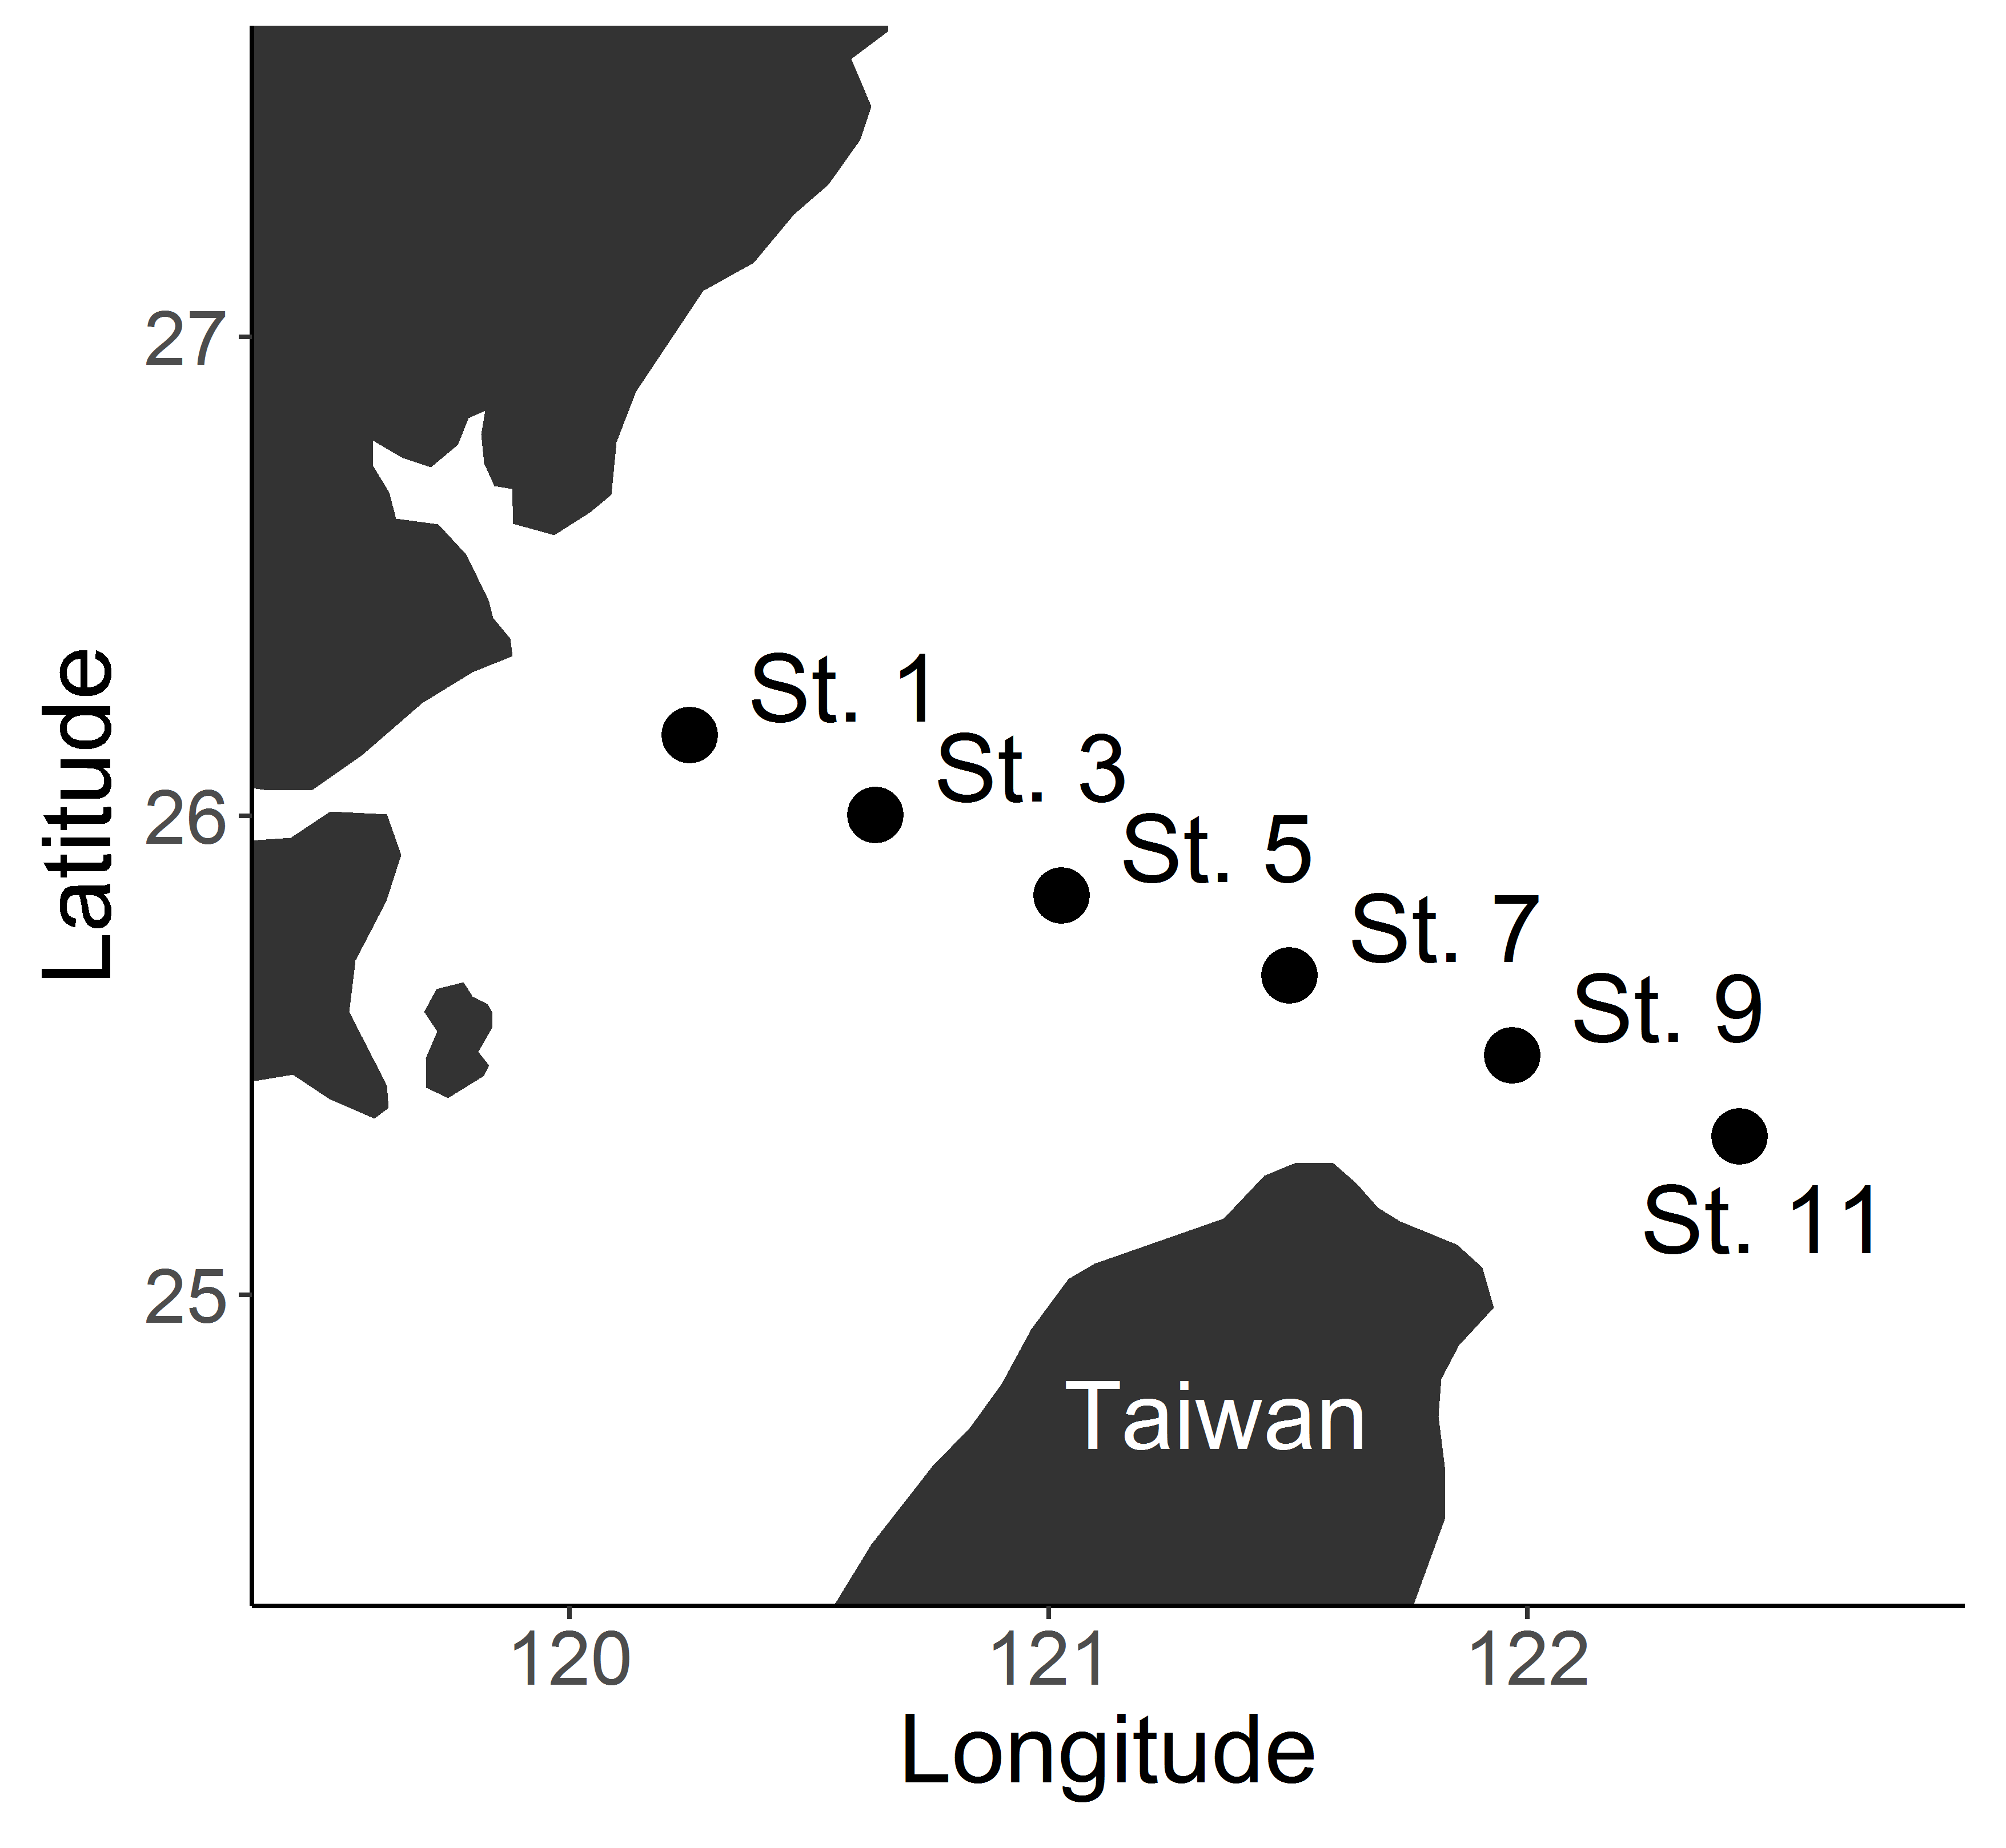
14 Cruises
6 Stations
Predator: Heterotrophic nanoflagellates (HNF)
Prey: Bacteria

