Slide 1

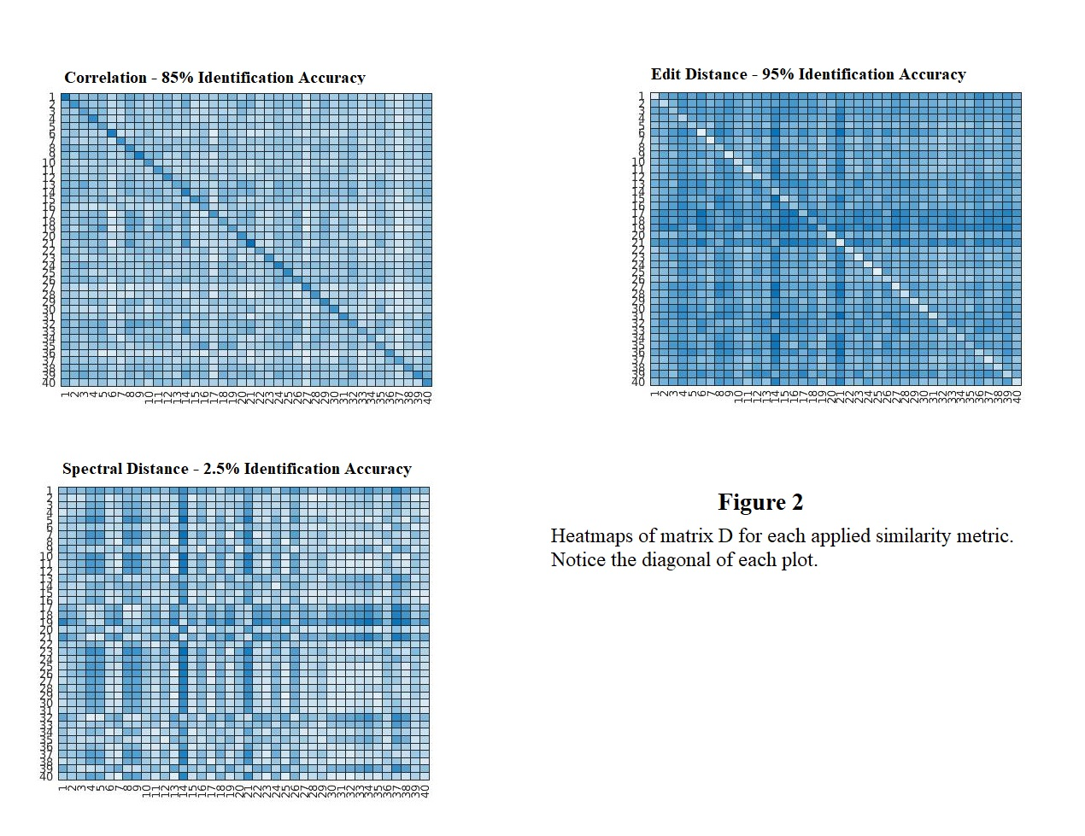
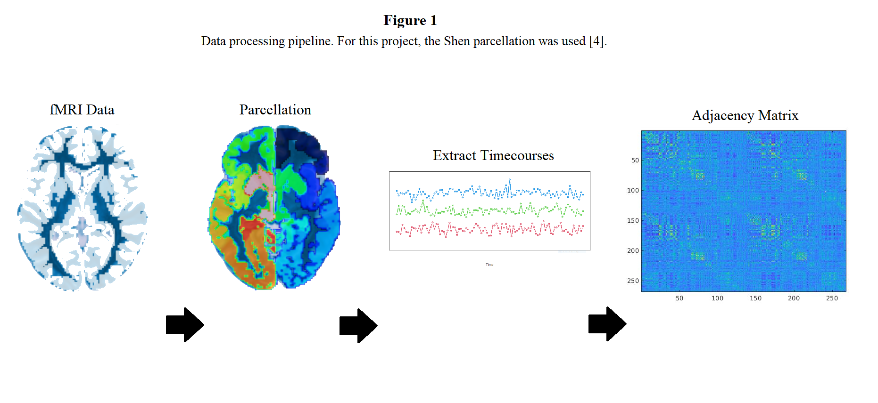
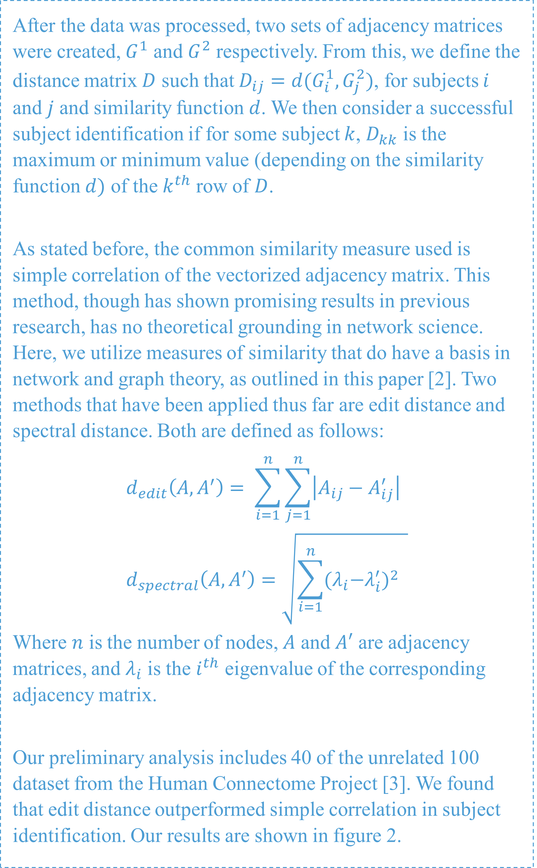
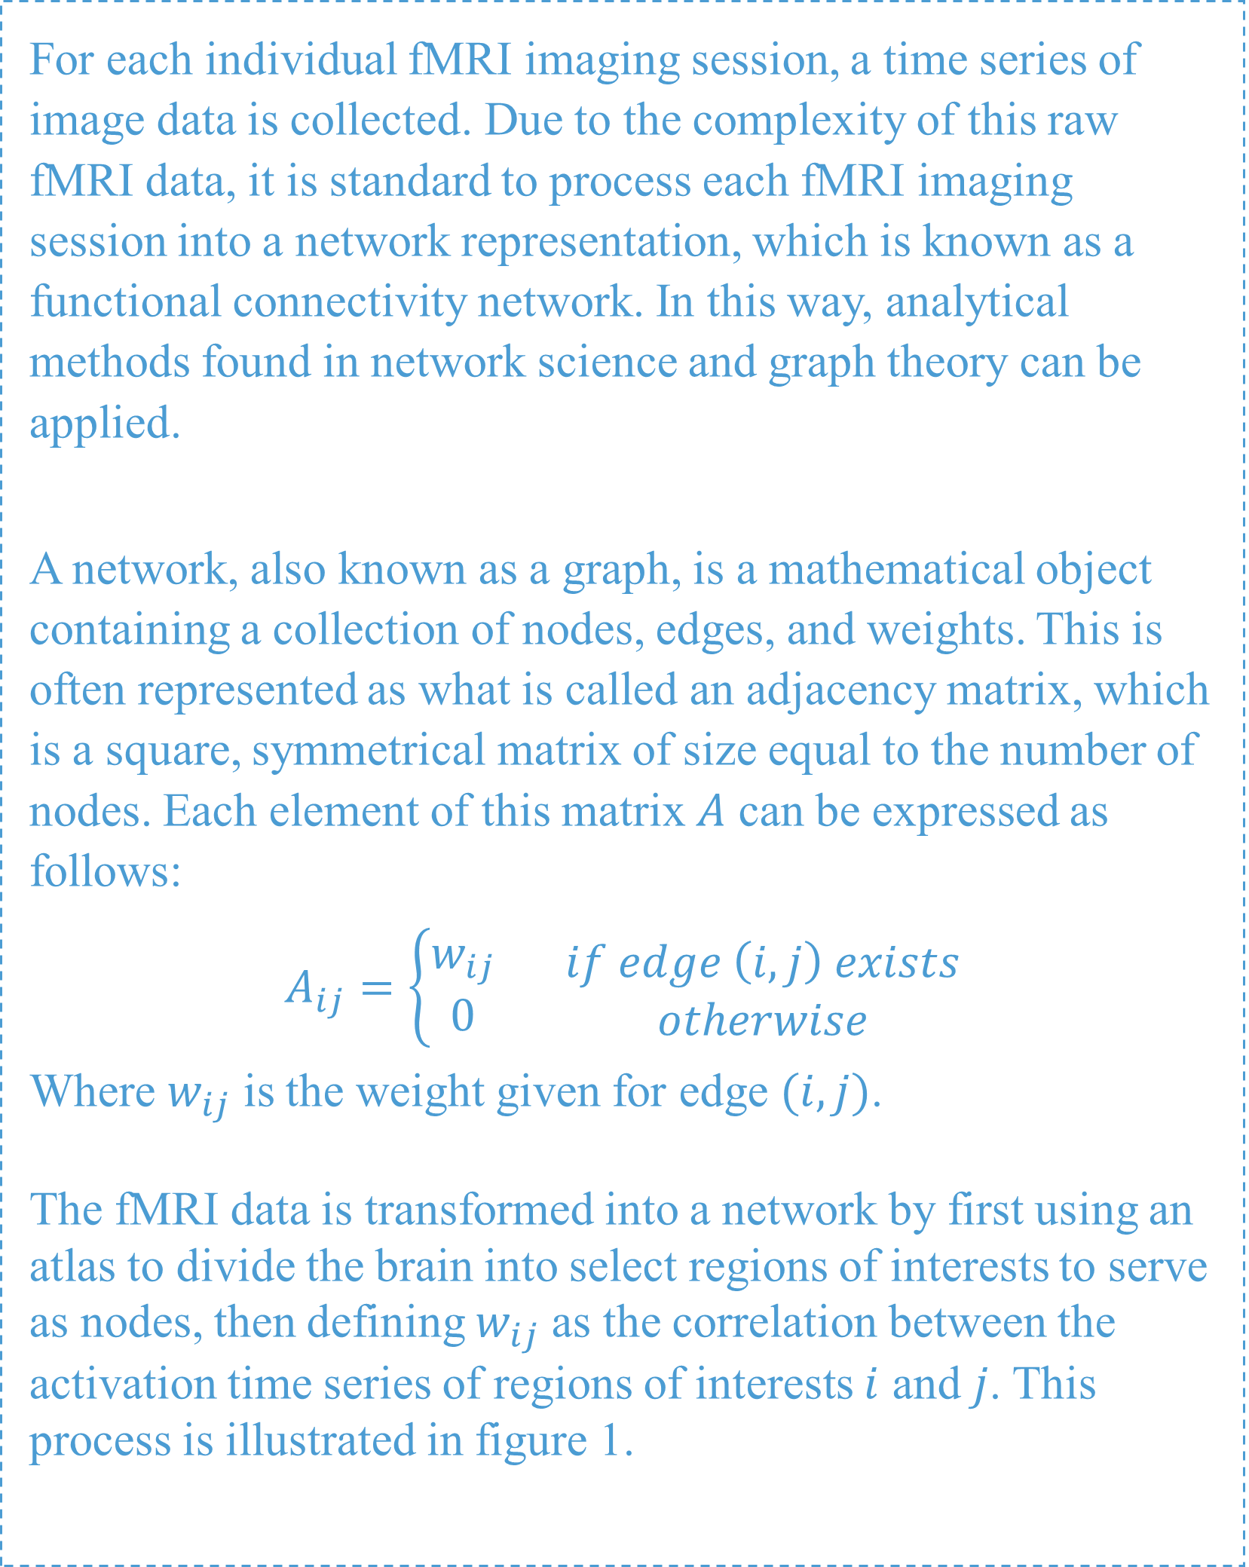
Identifying Individuals from Brain Connectivity Networks Using Graph Measures of Similarity
Oscar Fawcett, Dr. Nicolas Fraiman, Dr. Eran Dayan
Department of Statistics and Operations Research, Department of Radiology, UNC-Chapel Hill
ABSTRACT
INTRODUCTION
ANALYSIS & RESULTS
Functional magnetic resonance imaging (fMRI) of the brain can be used for accurately identifying, or “fingerprinting”, individuals. Identifying subjects based on their fMRI data has been useful in understanding the stability of neural substrates over time and across individuals, and their relationship to predicting behavioral and cognitive outcomes. This process of identification is done by transforming the brain imaging data into what is known as functional connectivity networks, calculating how “similar” each network is from one imaging session to all networks from another imaging session, and predicting a subject’s identity based on a similarity measure. However, the common similarity measure used is based on simple correlation analysis between each vectorized network, which lacks mathematical foundation. We investigate here the integration of other network similarity measures by methods found in traditional graph theory such as edit distance and spectral distance.
In 2015, Finn et al. showed that functional magnetic resonance imaging (fMRI) of the brain is capable of accurately identifying individuals [1]. This was done by comparing how similar each functional connectivity network from one imaging session was to another. However, the similarity measure used by Finn et al. and others is based on simple correlation analysis between each vectorized functional connectivity network, which lacks mathematical foundation.
Here, we investigate the integration of other network similarity measures found in traditional graph theory to the subject identification problem.
After the data was processed, two sets of adjacency matrices were created, $G^{1}$ and $G^{2}$ respectively. From this, we define the distance matrix $D$ such that $D_{ij}=d(G_{i}^{1},G_{j}^{2})$, for subjects $i$ and $j$ and similarity function $d$. We then consider a successful subject identification if for some subject $k$, $D_{kk}$ is the maximum or minimum value (depending on the similarity function $d)$ of the $k^{th}$ row of $D$.
As stated before, the common similarity measure used is simple correlation of the vectorized adjacency matrix. This method, though has shown promising results in previous research, has no theoretical grounding in network science. Here, we utilize measures of similarity that do have a basis in network and graph theory, as outlined in this paper [2]. Two methods that have been applied thus far are edit distance and spectral distance. Both are defined as follows:
$$d_{edit}\left(A,A^{′}\right)= \sum_{i=1}^{n}{\sum_{j=1}^{n}{\left|A_{ij}−A_{ij}^{′}\right|}} \\ d_{spectral}\left(A,A^{′}\right)=\sqrt{\sum_{i=1}^{n}{{{(λ}_{i}−λ_{i}^{′})}^{2} } }$$
Where $n$ is the number of nodes, $A$ and $A′$ are adjacency matrices, and $λ_{i}$ is the $i^{th}$ eigenvalue of the corresponding adjacency matrix.
Our preliminary analysis includes 40 of the unrelated 100 dataset from the Human Connectome Project [3]. We found that edit distance outperformed simple correlation in subject identification. Our results are shown in figure 2.
DATA PROCESSING
DISCUSSION
For each individual fMRI imaging session, a time series of image data is collected. Due to the complexity of this raw fMRI data, it is standard to process each fMRI imaging session into a network representation, which is known as a functional connectivity network. In this way, analytical methods found in network science and graph theory can be applied.
A network, also known as a graph, is a mathematical object containing a collection of nodes, edges, and weights. This is often represented as what is called an adjacency matrix, which is a square, symmetrical matrix of size equal to the number of nodes. Each element of this matrix $A$ can be expressed as follows:
$$A_{ij}=\left\{\begin{aligned}w_{ij} \\ 0\end{aligned}\right. \begin{matrix}if edge \left(i,j\right) exists \\ otherwise\end{matrix}$$
Where $w_{ij}$ is the weight given for edge $(i,j)$.
The fMRI data is transformed into a network by first using an atlas to divide the brain into select regions of interests to serve as nodes, then defining $w_{ij}$ as the correlation between the activation time series of regions of interests $i$ and $j$. This process is illustrated in figure 1.
From the results found in the previous section, there are a few things of note. First, in our current dataset edit distance is outperforming simple correlation, thus there is potential for this measure of similarity to be a better choice for the task of subject identification. In addition to this, it is also of note that spectral distance is performing very poorly compared to the other methods. A possible explanation for this is that while edit distance measures local structural differences between two networks, spectral distance measures more global structural differences between two networks [2]. So, it could be the case that functional connectivity networks have very similar global structures to them, resulting in more local measures of similarity performing better in distinguishing them apart.
Moving forward, processing more fMRI data for our analysis will be prioritized, with the target goal being to have the full unrelated 100 dataset from the Human Connectome Project [3] processed. Simultaneously, more measures of similarity will be tested, including NETSIMILE, resistance distance, and DELTACON. There will also be opportunity to study the robustness of the predictions each similarity measure makes, as well as which nodes are most useful in subject identification.
REFERENCES
[1] Finn, E., Shen, X., Scheinost, D. et al. Functional connectome fingerprinting: identifying individuals using patterns of brain connectivity. Nat Neurosci 18, 1664–1671 (2015). https://doi.org/10.1038/nn.4135
[2] Willis, Peter and Meyer, Froncois G.. Metrics for Graph Comparison: A Practitioner’s Guide. PLoS ONE 15(2): e0228728, 2022. https://doi.org/10.1371/journal.pone.0228728
[3] Van Essen, D.C. et al. The WU-Minn Human Connectome Project: an overview. Neuroimage 80, 62–79 (2013).
[4] Shen X, Tokoglu F, Papademetris X, Constable RT. Groupwise whole-brain parcellation from resting-state fMRI data for network node identification. Neuroimage. 2013 Nov 15;82:403-15. doi: 10.1016/j.neuroimage.2013.05.081. Epub 2013 Jun 4. PMID: 23747961; PMCID: PMC3759540.

