Slide 1
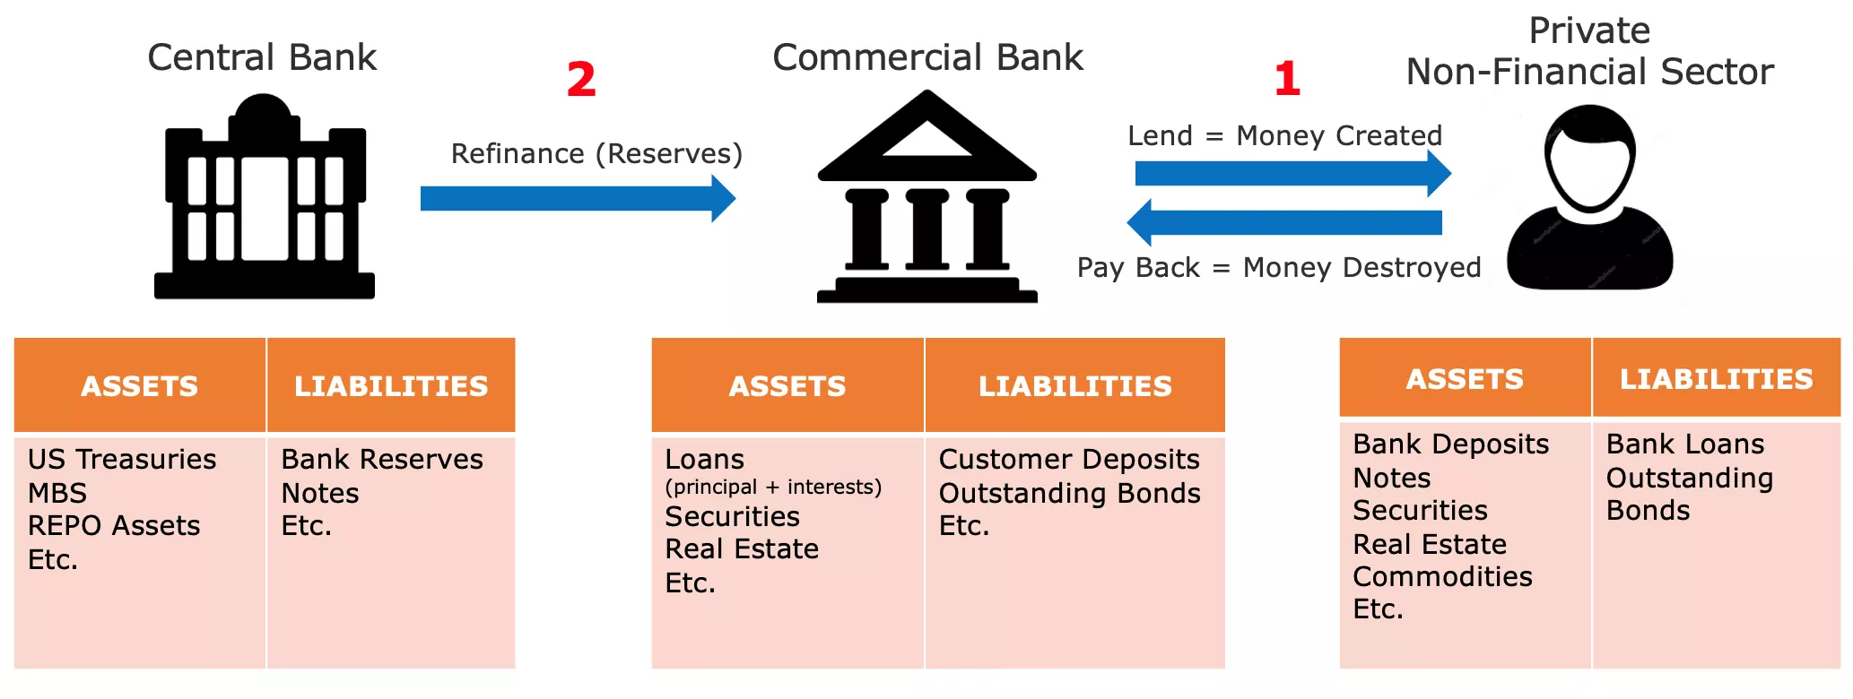
Central Bank
Commercial Bank
Private
Non-Financial Sector
Refinance (Reserves)
Lend = Money Created
Pay Back = Money Destroyed
ASSETS
LIABILITIES
ASSETS
LIABILITIES
ASSETS
LIABILITIES
US Tresuries
MBS
REPO Assets
Etc.
Bank Reserves
Notes
Etc.
Loans
(principal + interests)
Securities
Real estate
Etc.
Customer Deposits
Outstanding Bonds
Etc.
Bank Deposits
Notes
Securities
Real Estate
Commodities
Etc.
Bank Loans
Outstanding Bonds

Slide 2
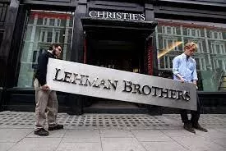

Slide 3
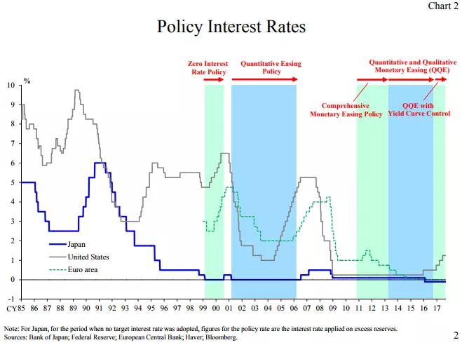
Policy Interest Rate
Zero Interest Rate Policy
Quantitative Easing
Policy
Quantitative and Qualitative Monteary Easing (QQE)
Comprehensive
Monteary Easing Policy
QQE with
Yield Curve Control
Japan
United States
Euro Area
Note: For Japan, for the period when no target interest rate was adopted, figures for the policy rate are the interest rate applied on excess reserves.
Sources: Bank of Japan; Federal Reserve; European Central Bank; Haver; Bloomberg

Slide 4
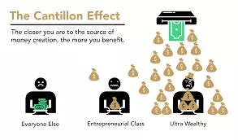
The Cantillon effect
The closer you are to the source of money creation, the more you benefit.
Everyone Else
Enterpreneurial Class
Ultra Wealthy

Slide 5
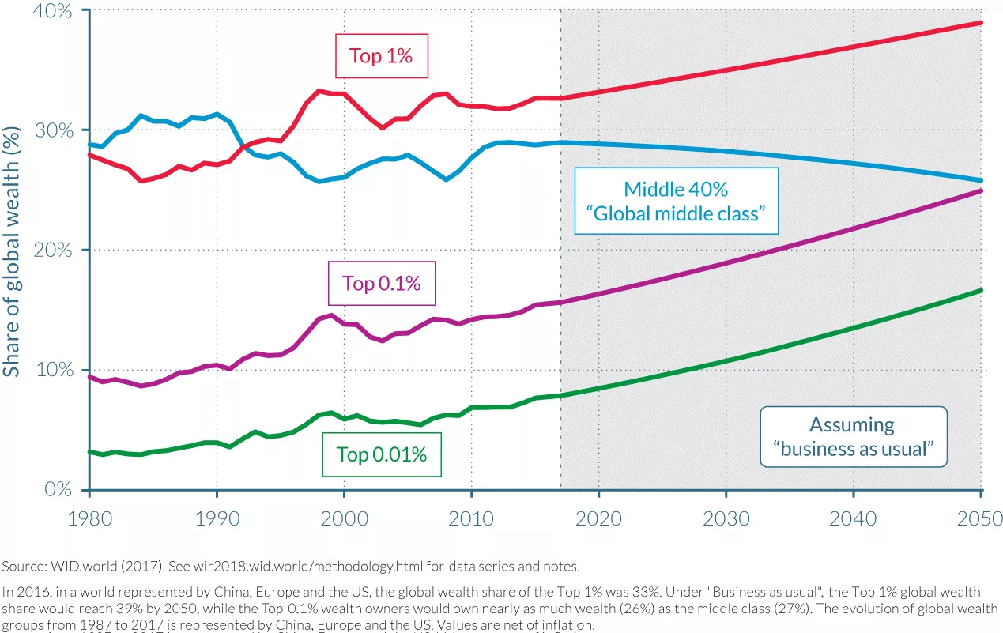
Top 1%
Middle 40%
“Global middle class”
Share of global wealth (%)
Top 0.1%
Assuming
“business as usual”
Top 0.01%
Source: WID.world (2017). See wir2018.wid.world/methodology.html for data series and notes.
In 2016, in a world represented by China, Europe and the US, the global welath share of the Top 1% was 33%. Under “Business as usual”, the Top 1% global wealth share would reach 39% by 2050, while the Top 0.1% welath owners would own nearly as much wealth (26%) as the middle class (27%). The evolution of global wealth groups from 1987 to 2017 is represented by China, Europe and the US. Values are net of inflation.

Slide 6
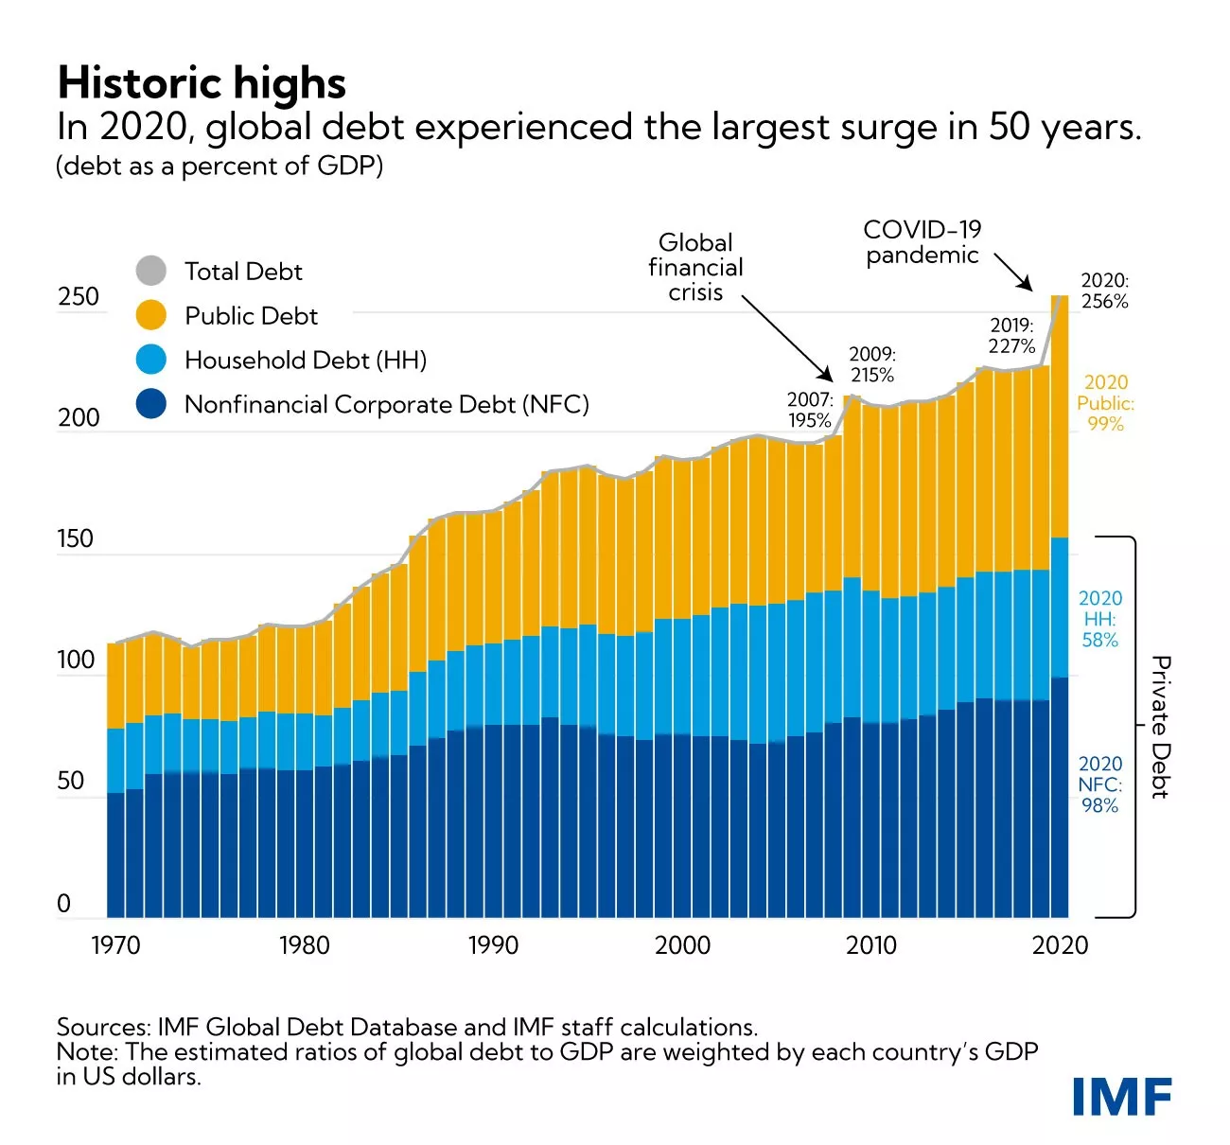
Historic highs
In 2020, global debt experienced the largest surge in 50 years.
(debt as percentage of GDP)
Global financial crisi
COVID-19 pandemic
Total Debt
Public Debt
Household Debt (HH)
Nonfinancial Corporate Debt (NFC)
Private Debt
Sources: IMF Global Debt Database and IMF staff calculations.
Note: The estimated ratios of global debt to GDP are weighted by each country’s GDP in US dollars

Slide 7
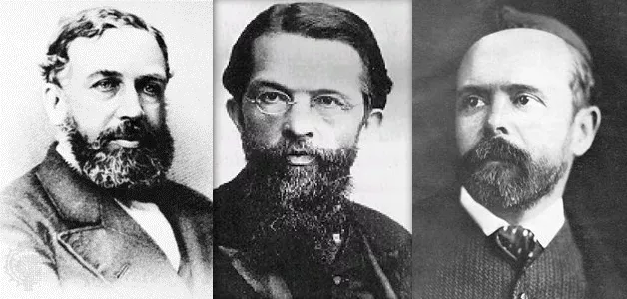

Slide 8
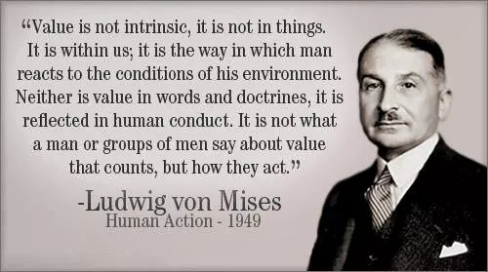
“Value is not intrinsic, it is not in things.
It is within us; it is the way in which man reacts to the conditions of his enviroment. Neither is value in words and doctrines, it is reflected in human conduct. It is not what a man or groups of men say about value that counts, but how they act.”
-Ludwig von Mises
Human Action - 1949

Slide 9
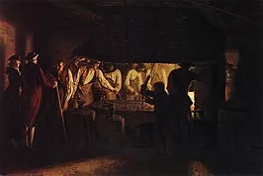

Slide 10
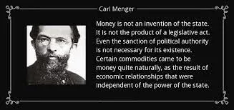
Money is not an invention of the state. It is not the product of a legislative act.Even the santion of political authority is not necessary for its existence.
Certain commodities came to be money quite naturally, as the result of economic relationships that were independent of the power of the state.

Slide 11
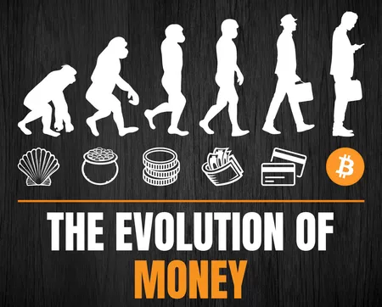
THE EVOLUTION OF
MONEY

Slide 12
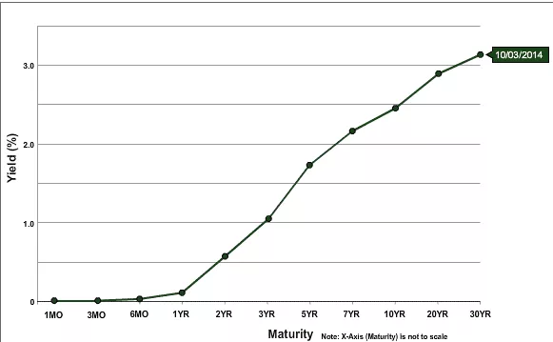
Yield (%)
Maturity
Note: X-Axis (Maturity) is not to scale

Slide 13
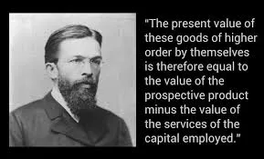
“The present value of these goods of higher order by themselves is therefore equal to the value of the prospective product minus the value of the services of the capital employed.”

Slide 14
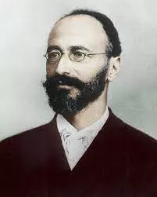

Slide 15
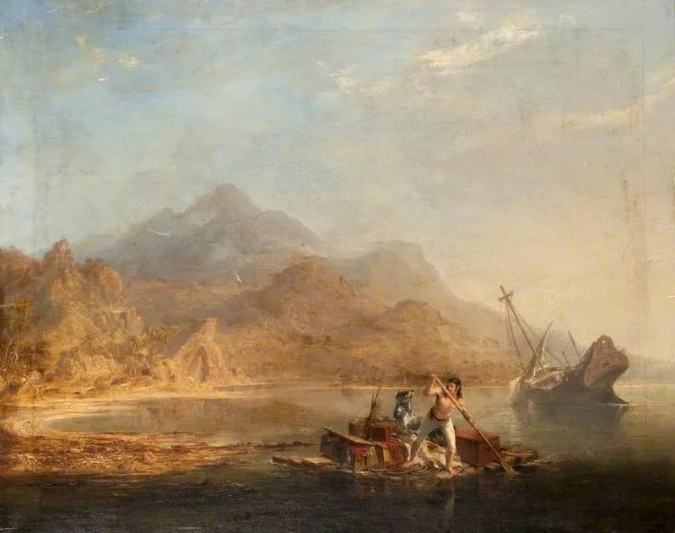

Slide 16
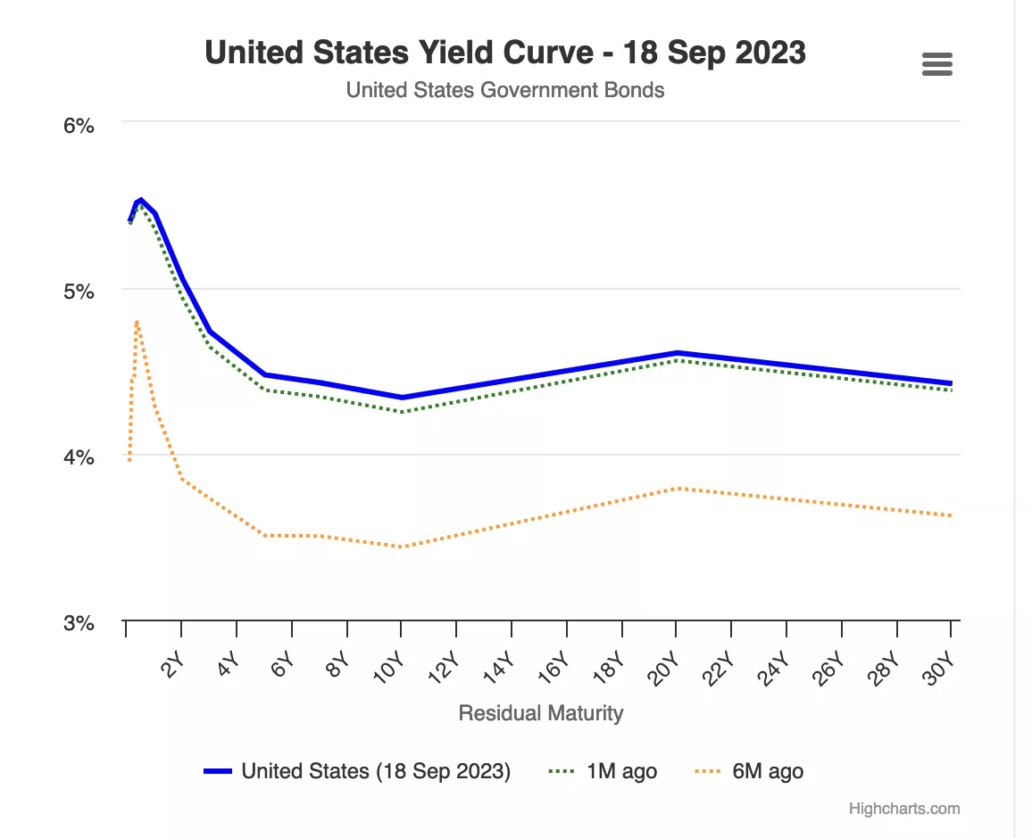
United States Yield Curve – 18 Sep 2023
United States Government Bonds
Residual Maturity
United States (18 Sep 2023)
1M ago
6M ago

Slide 17
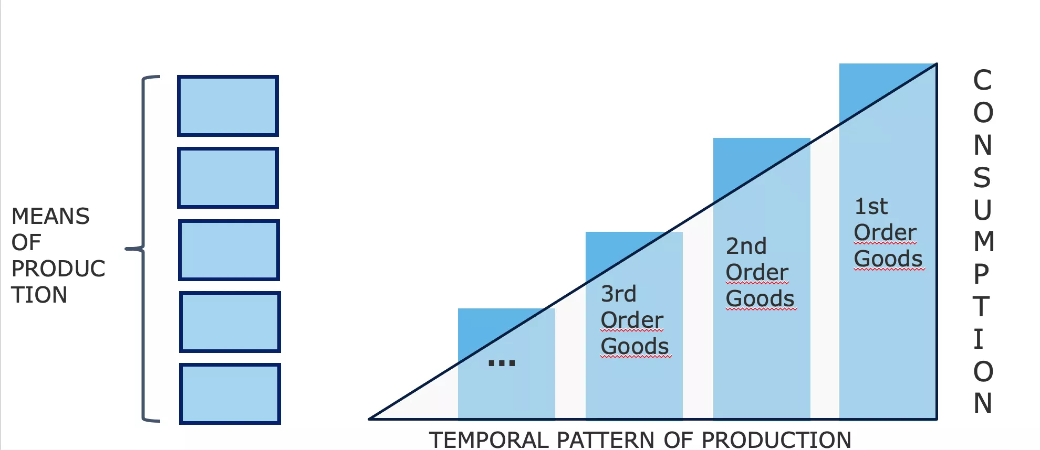
CONSUMPTION
MEANS OF PRODUCTION
1st Order Goods
2nd Order Goods
3rd Order Goods
TEMPORAL PATTERN OF PRODUCTION

Slide 18
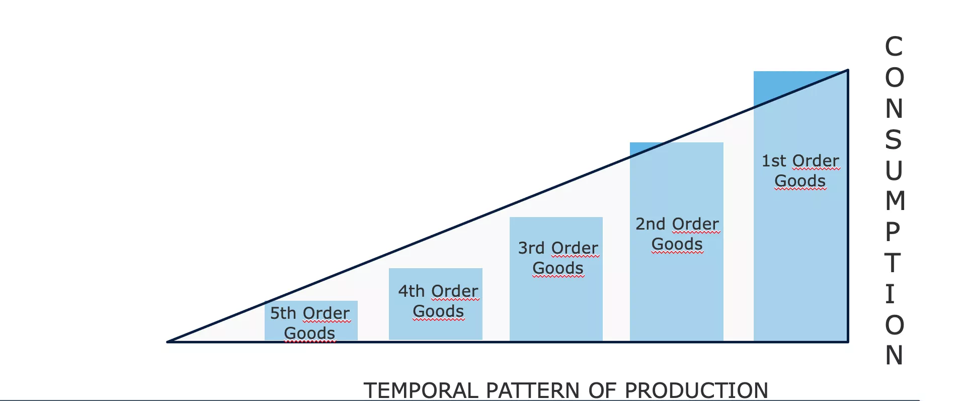
CONSUMPTION
1st Order Goods
2nd Order Goods
3rd Order Goods
4th Order Goods
5th Order Goods
TEMPORAL PATTERN OF PRODUCTION

Slide 19
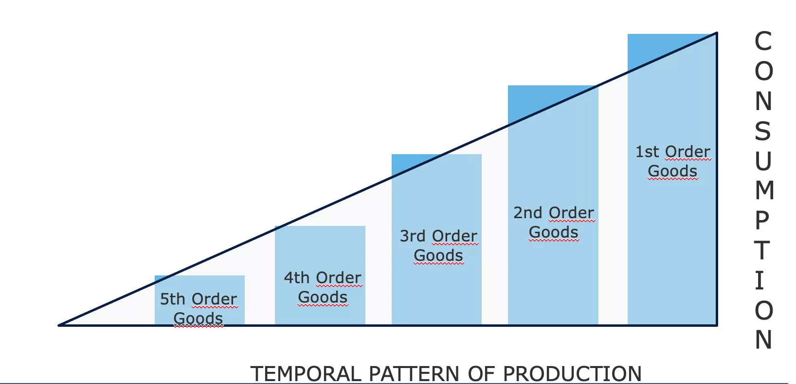
CONSUMPTION
1st Order Goods
2nd Order Goods
3rd Order Goods
4th Order Goods
5th Order Goods
TEMPORAL PATTERN OF PRODUCTION

Slide 20
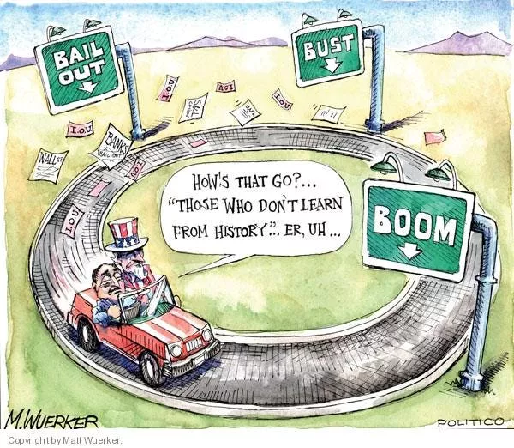
How’w that go?…
“Those who don’t learn from history”…
Er, UH...

Slide 21
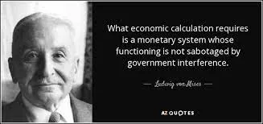
What economic calculation requires is a monetary system whose functioning in not sabotaged by government interference.
– Ludwig von Mises –

Slide 22
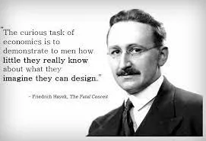
“The curious task of economics is to demonstrate to men how little they really know about what they imagine they can design.”
– Friedrich Hayek, The Fatal Conceit

Slide 23
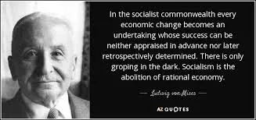
In the socialist commonwealth every economic change becomes an undertaking whose success can be neither appraised in advance nor later retrospectively determined. There is only groping in the dark. Socialist is the abolition of rational economy.
– Ludwig von Mises –

