Slide 1
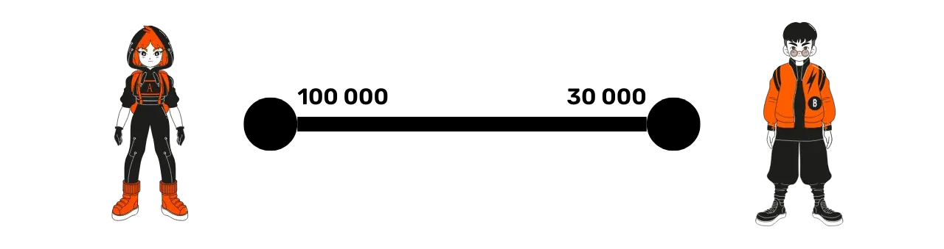

Slide 2


Slide 3
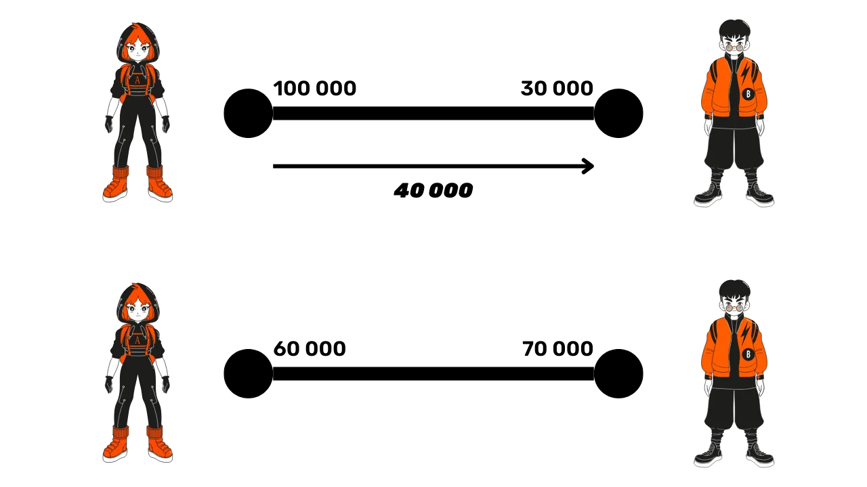

Slide 4
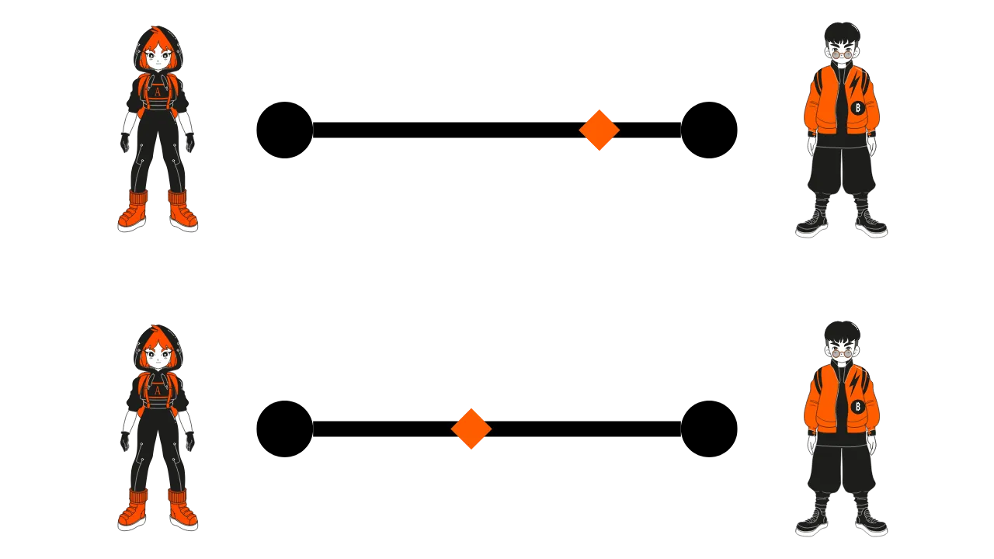

Slide 5
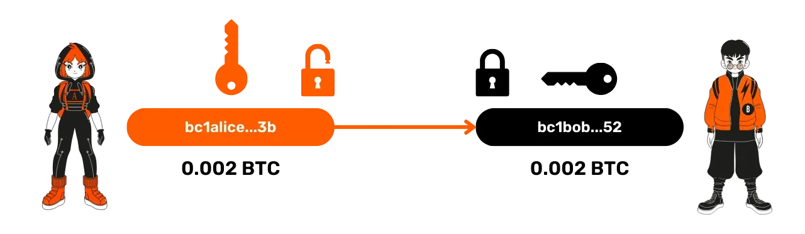

Slide 6
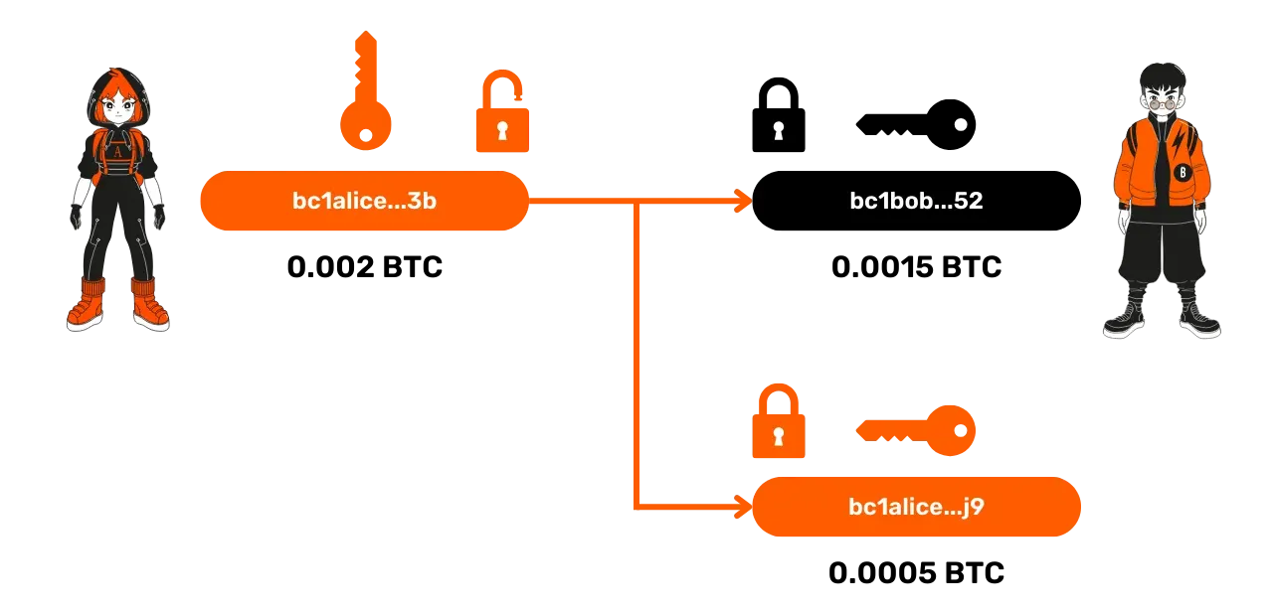

Slide 7
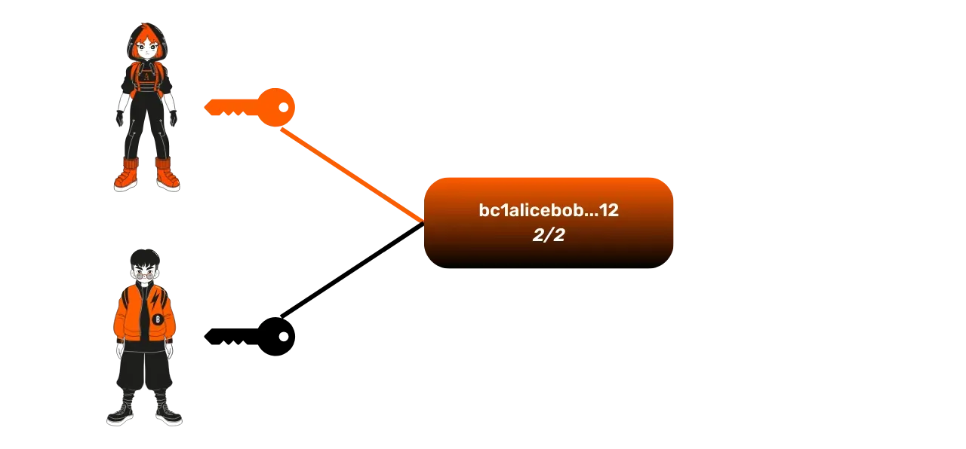

Slide 8
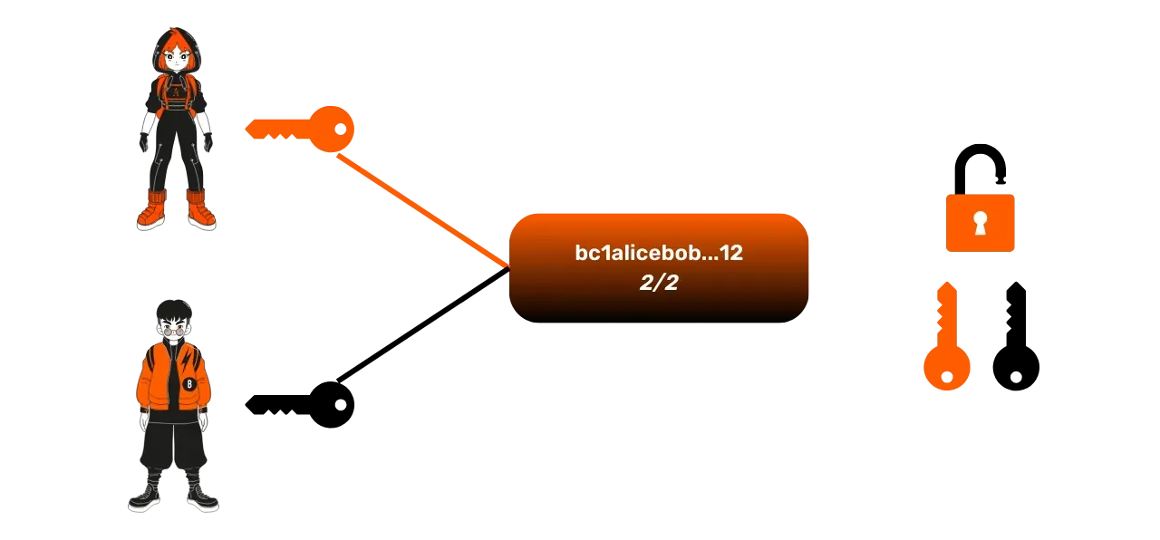

Slide 9


Slide 10
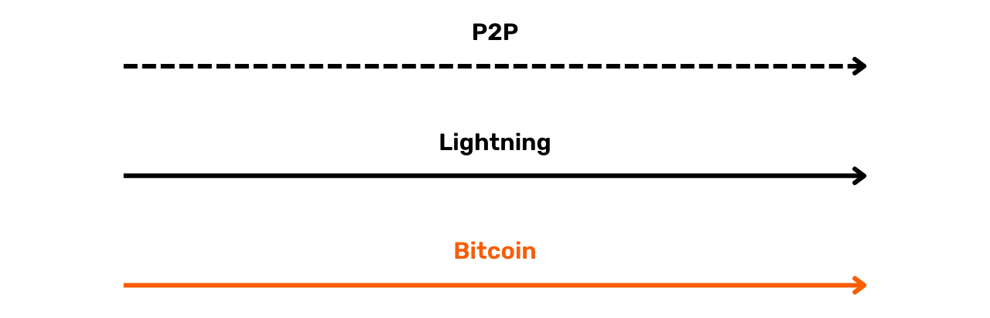

Slide 11
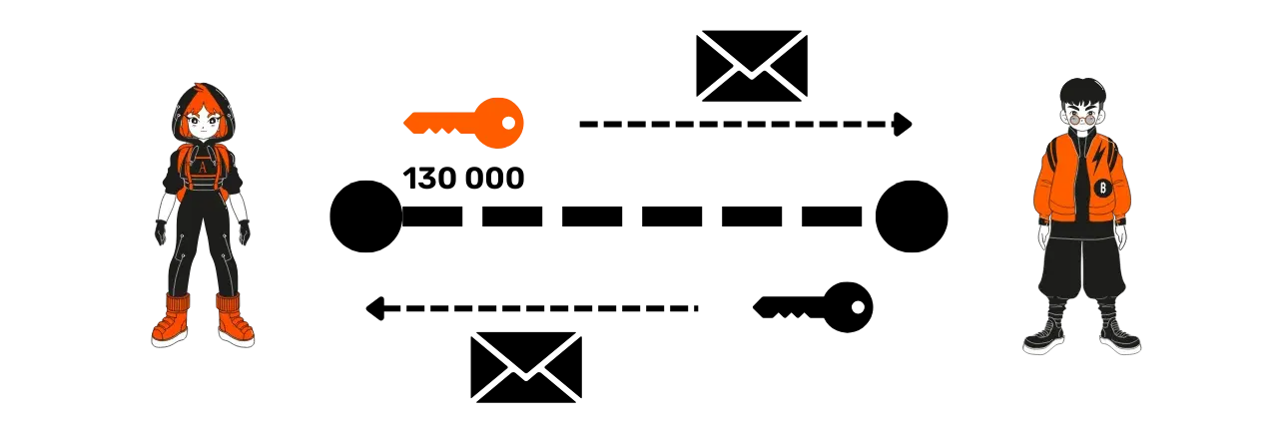

Slide 12


Slide 13
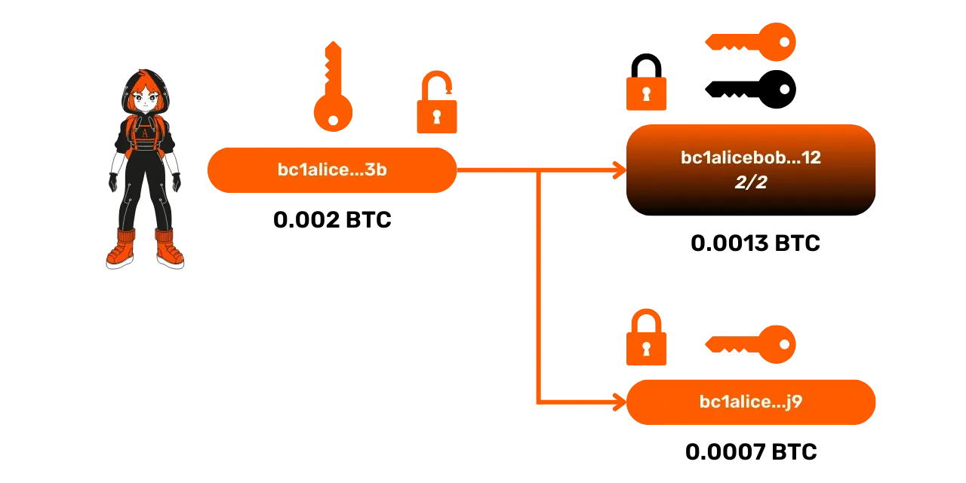

Slide 14
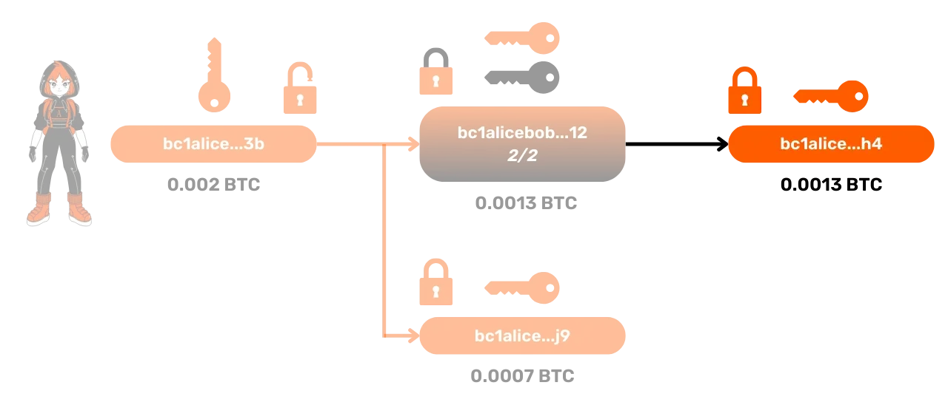

Slide 15
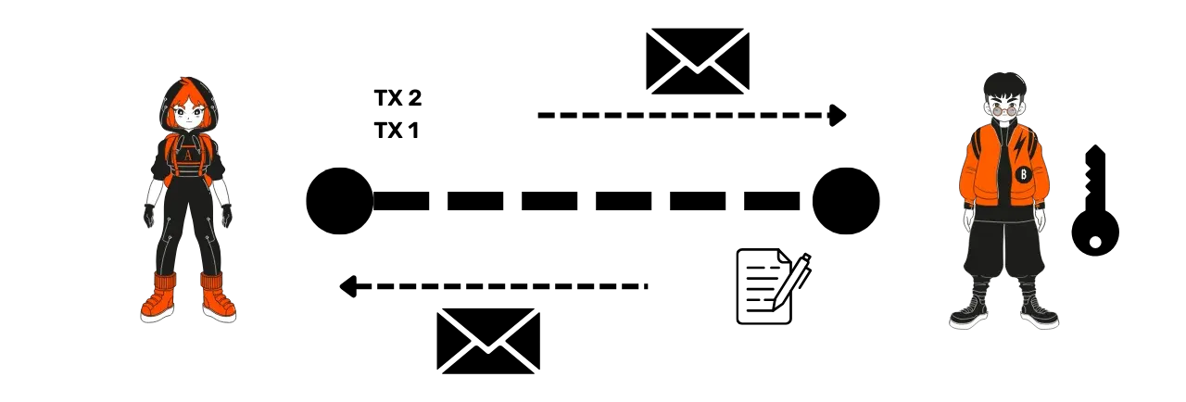

Slide 16
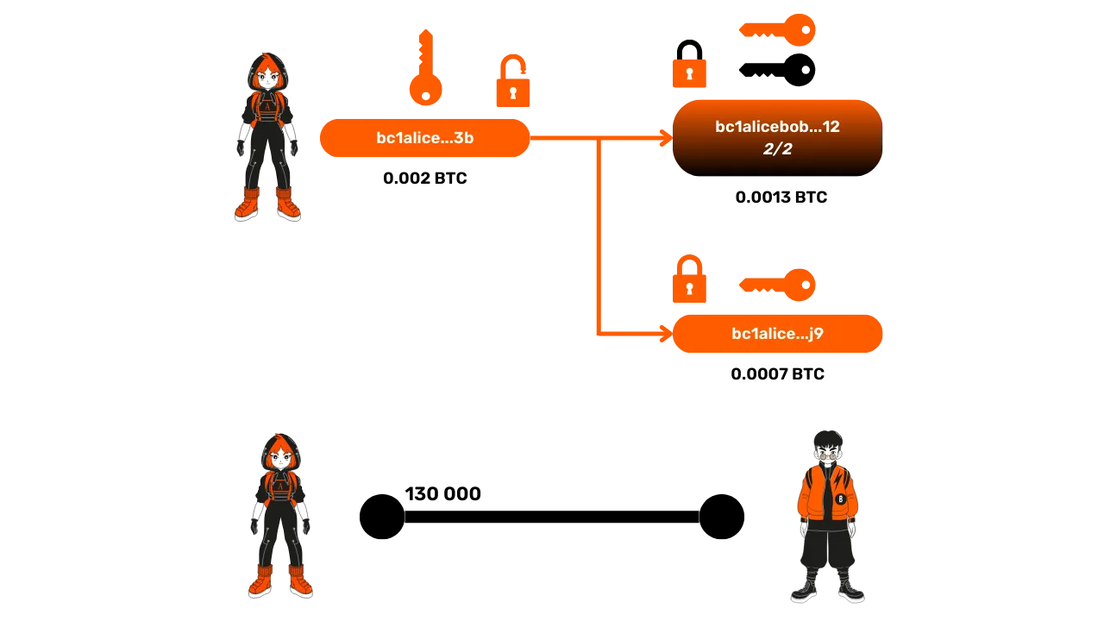

Slide 17
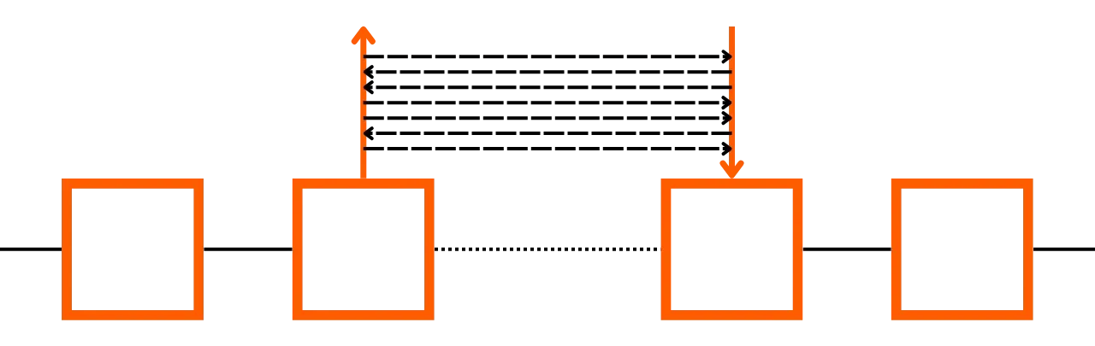

Slide 18
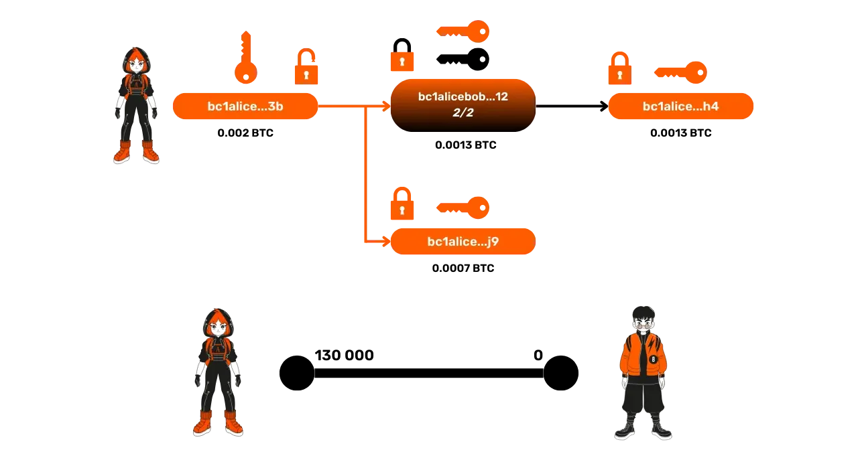

Slide 19
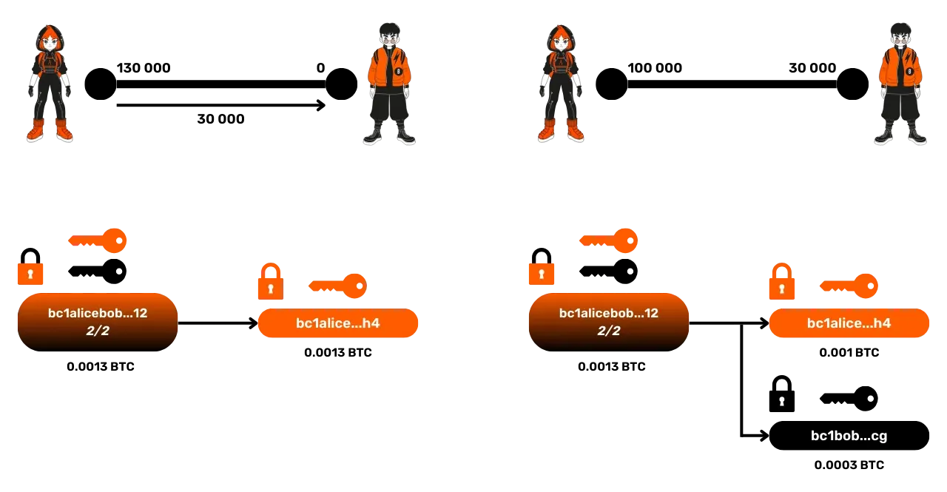

Slide 20
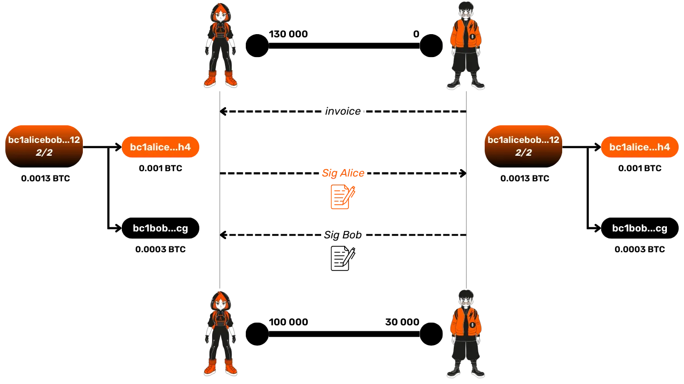
invoice
Alice’s sig.
Bob’s sig.

Slide 21
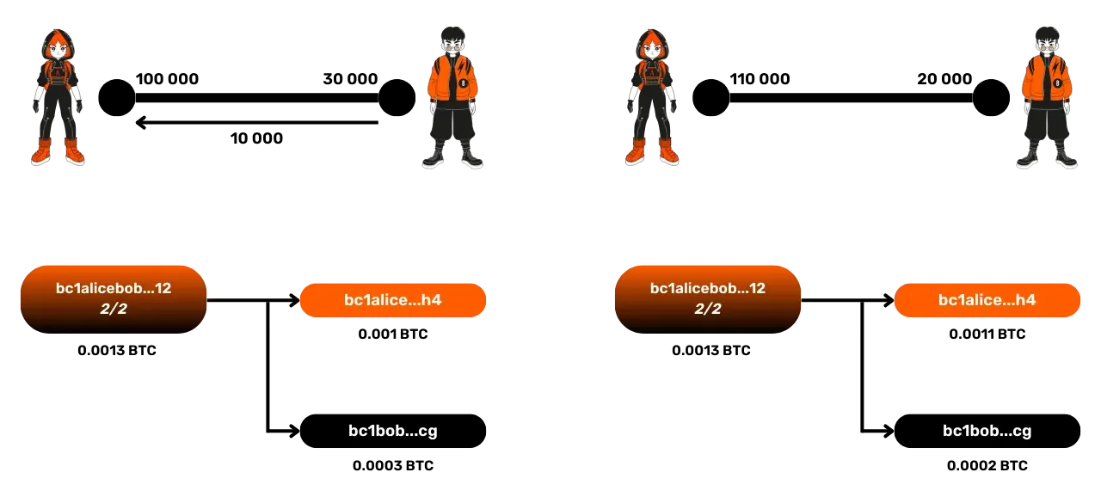

Slide 22


Slide 23
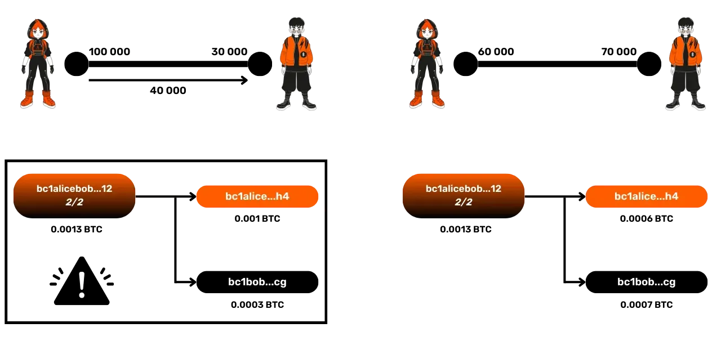

Slide 24
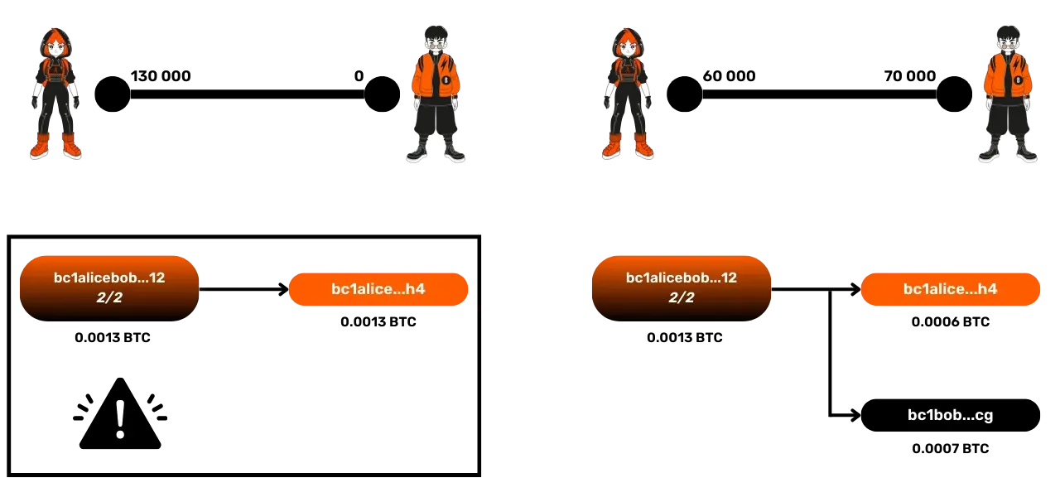

Slide 25
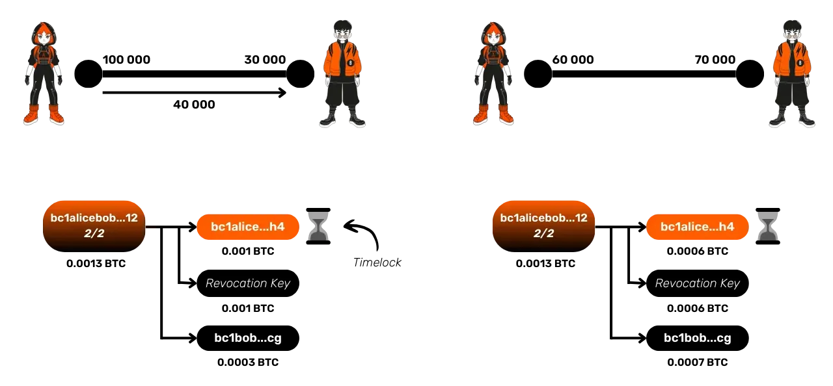
Revocation Key
Revocation Key

Slide 26
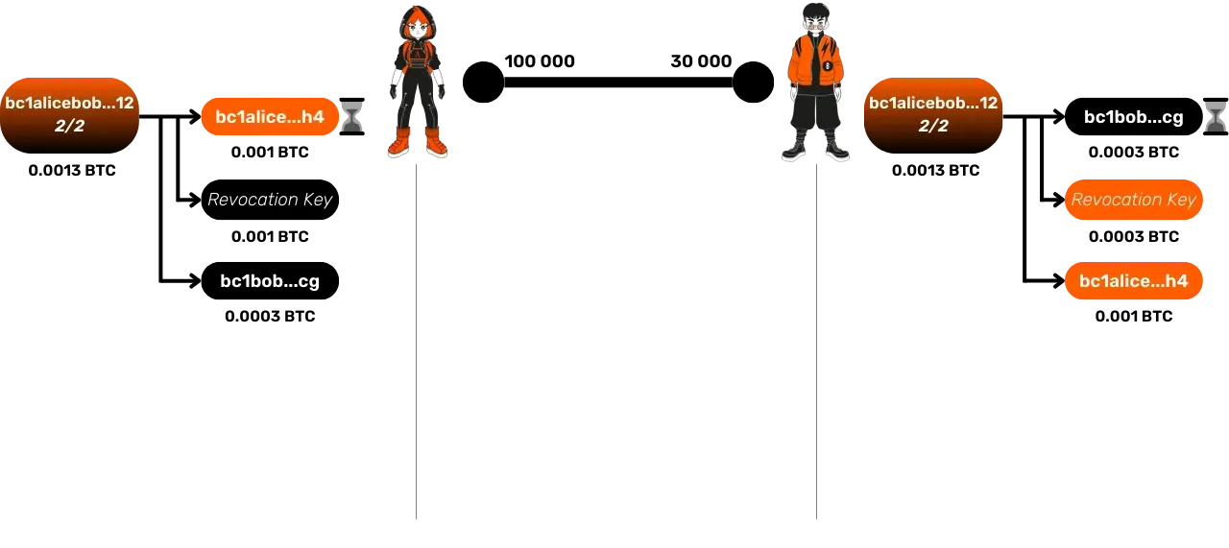
Revocation Key
Revocation Key

Slide 27
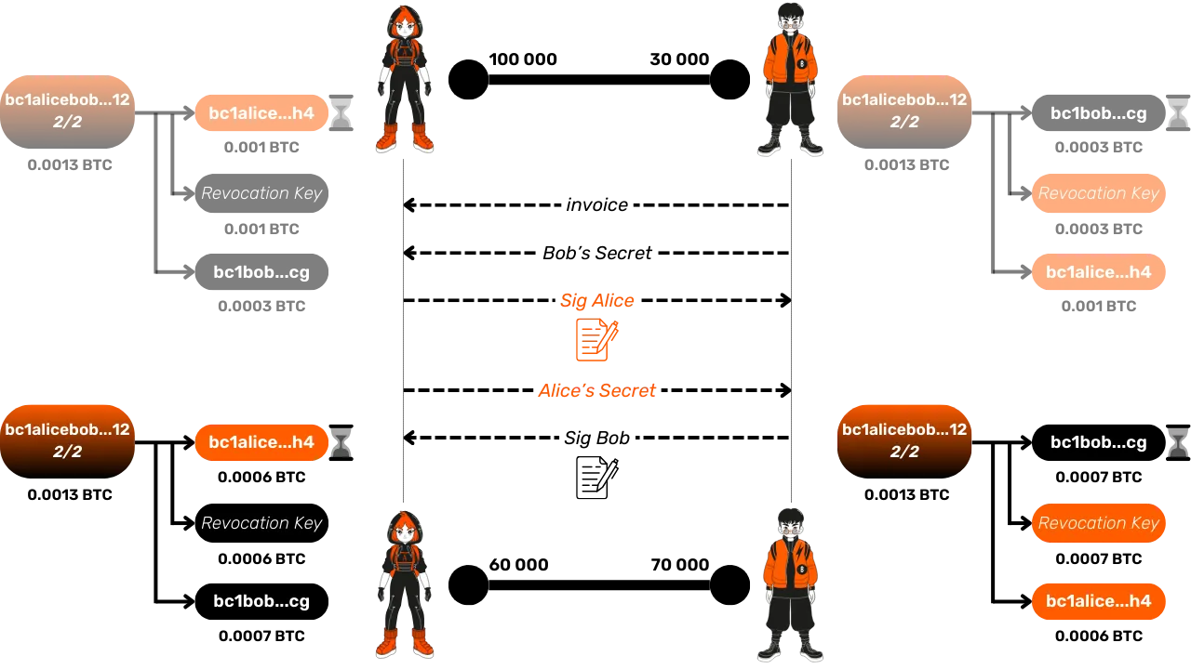
Revocation Key
invoice
Revocation Key
Bob’s Secret
Alice’s sig.
Alice’s Secret
Bob’s sig.
Revocation Key
Revocation Key

Slide 28
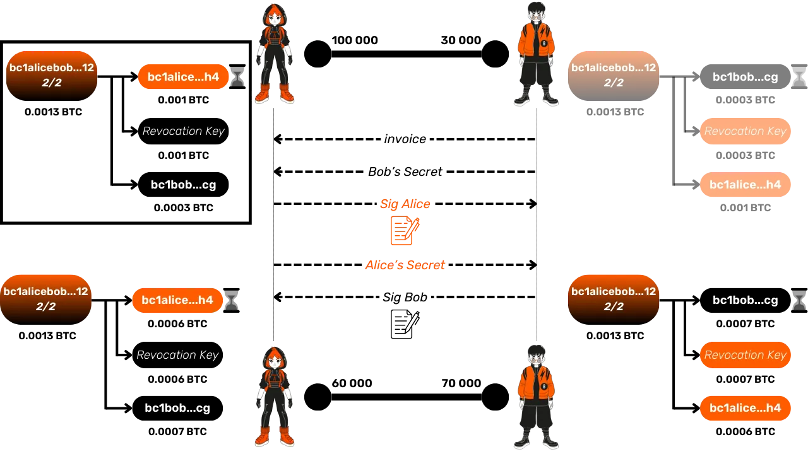
Revocation Key
invoice
Revocation Key
Bob’s Secret
Alice’s sig.
Alice’s Secret
Bob’s sig.
Revocation Key
Revocation Key

Slide 29
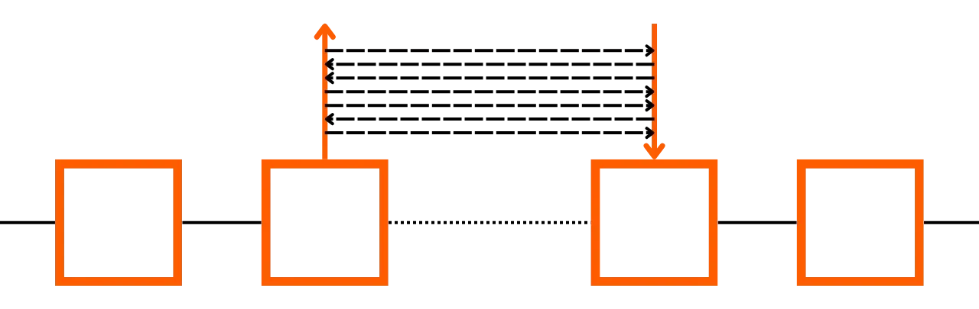

Slide 30
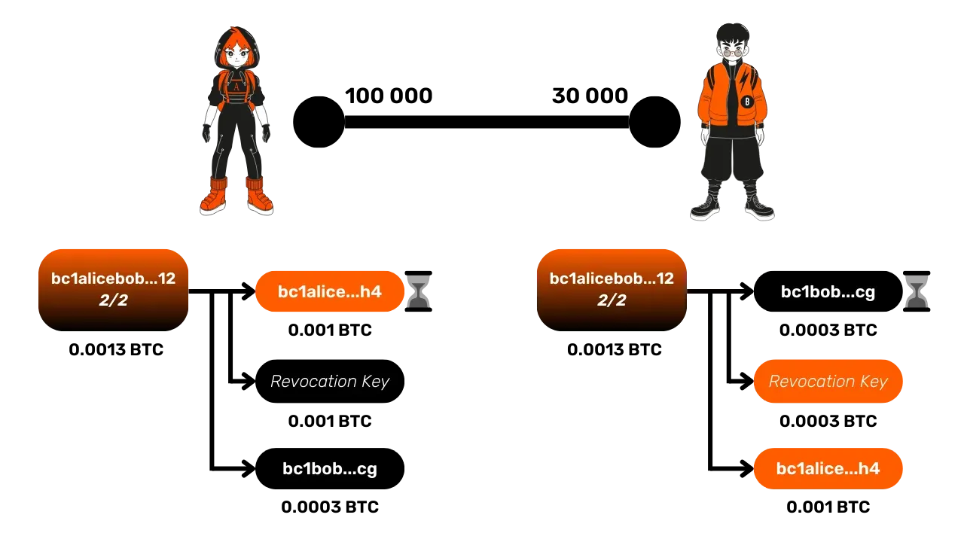
Revocation Key
Revocation Key

Slide 31
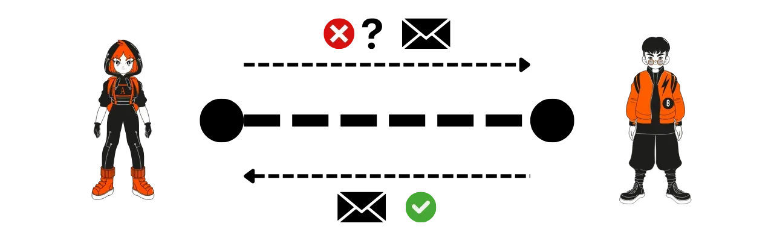

Slide 32
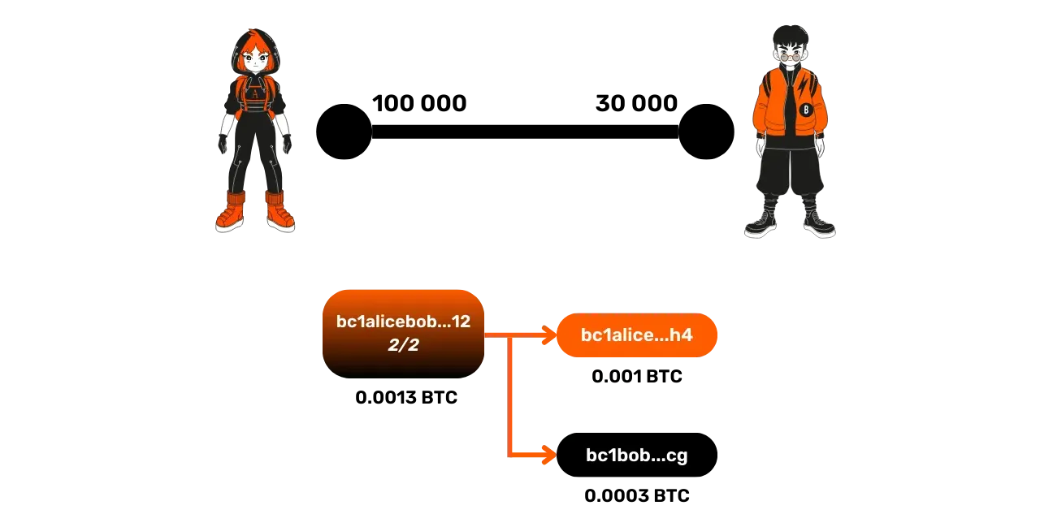

Slide 33
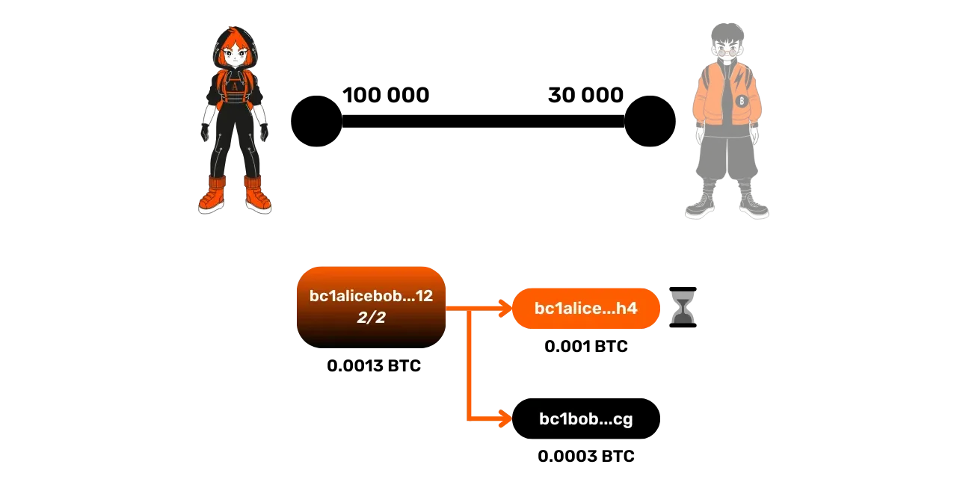

Slide 34
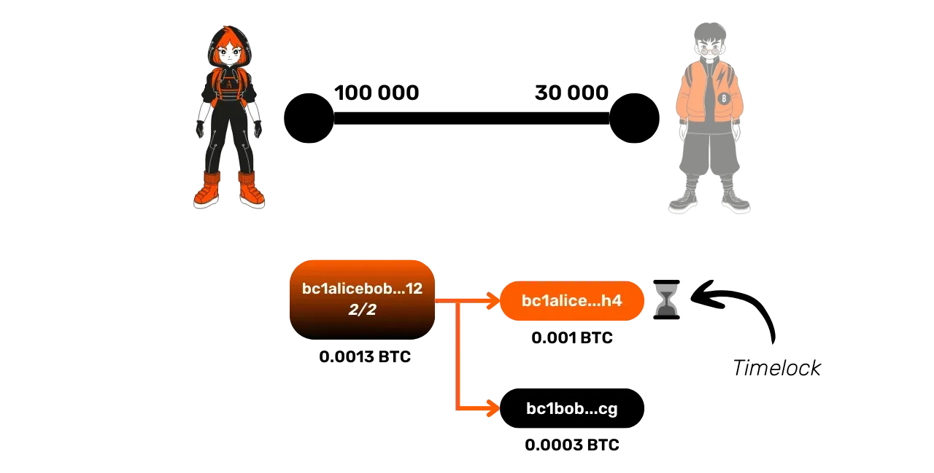

Slide 35
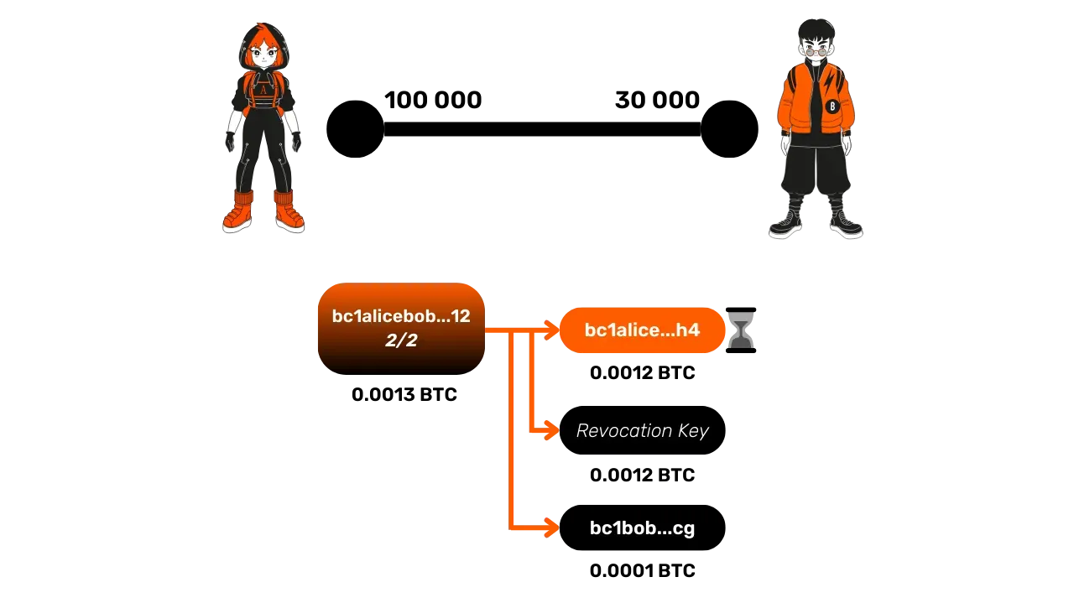
Revocation Key

Slide 36
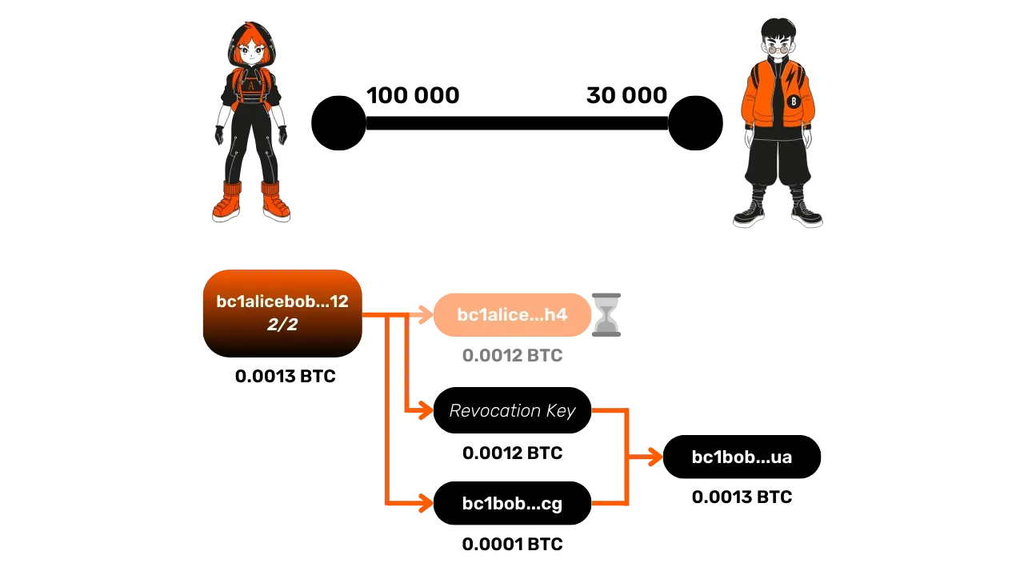
Revocation Key

Slide 37
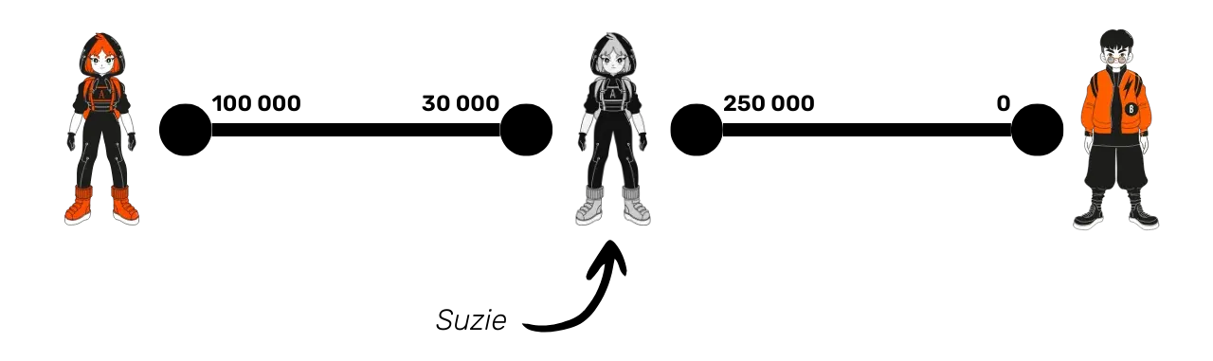

Slide 38
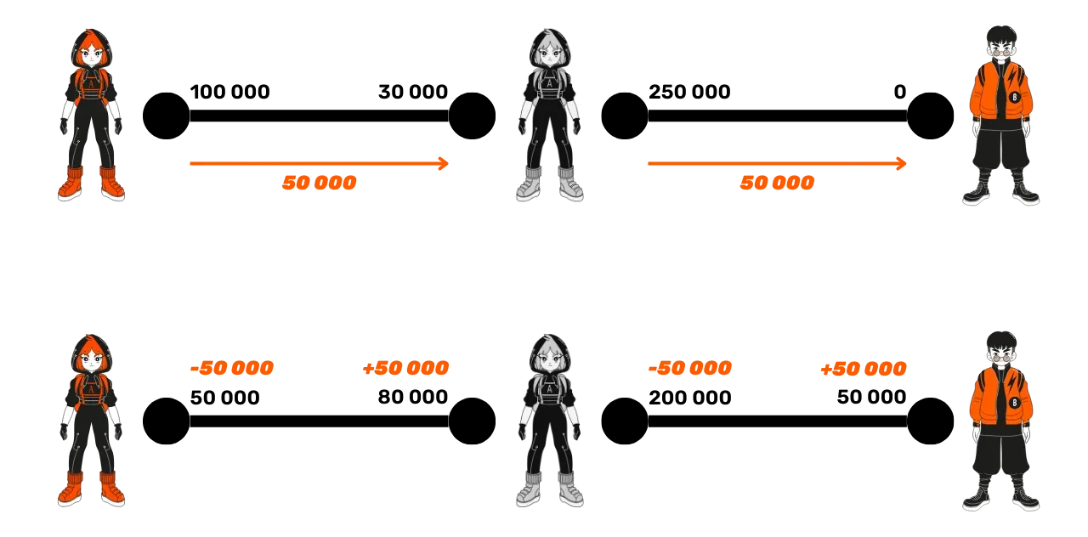

Slide 39
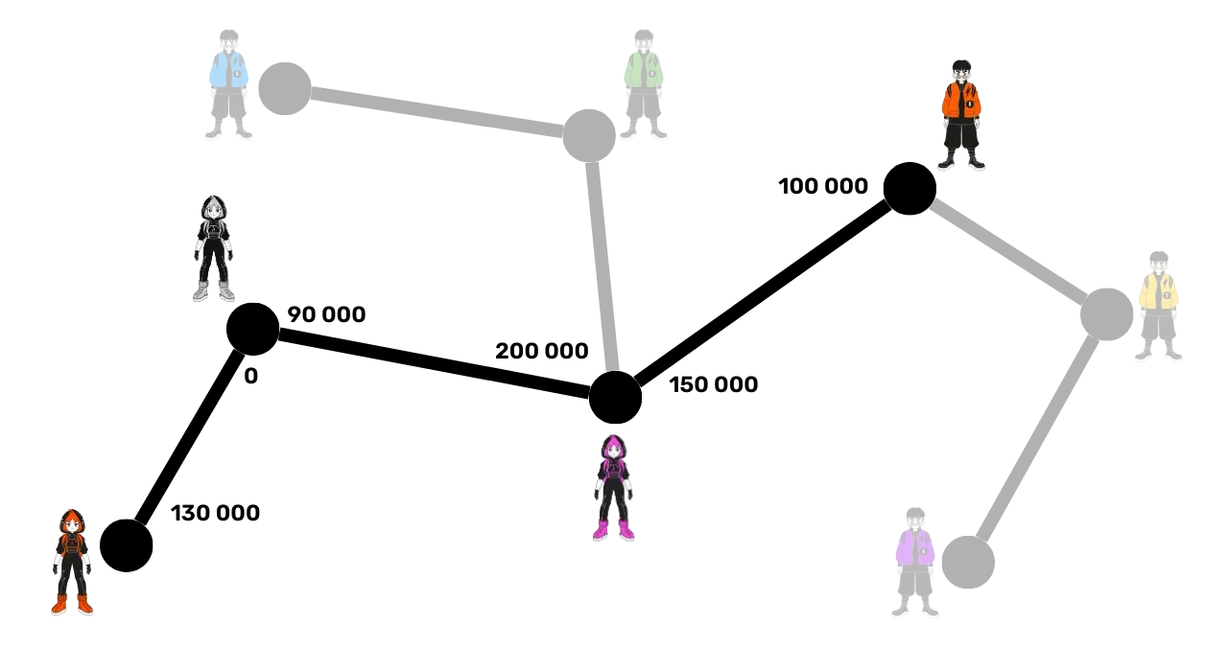

Slide 40
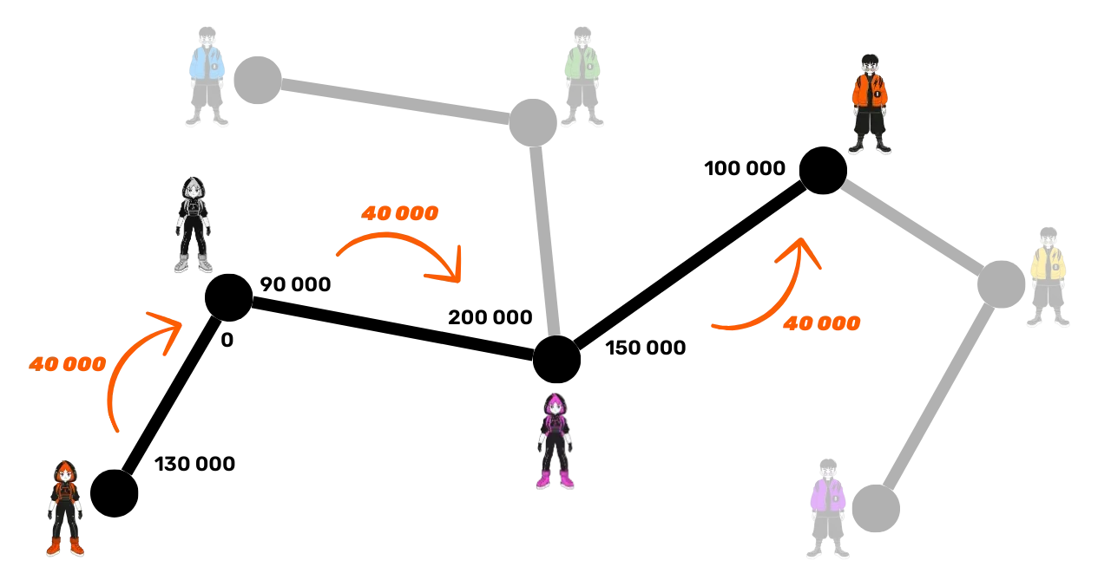

Slide 41
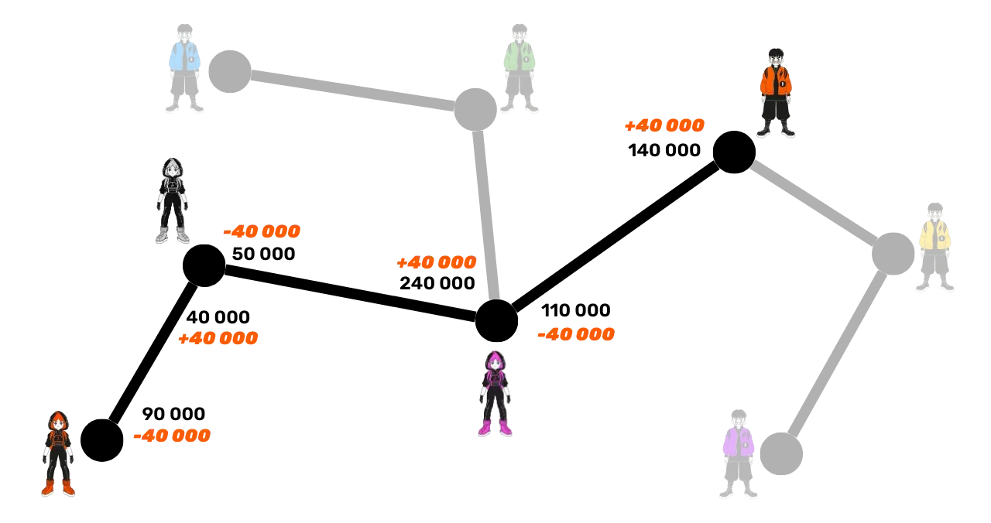

Slide 42
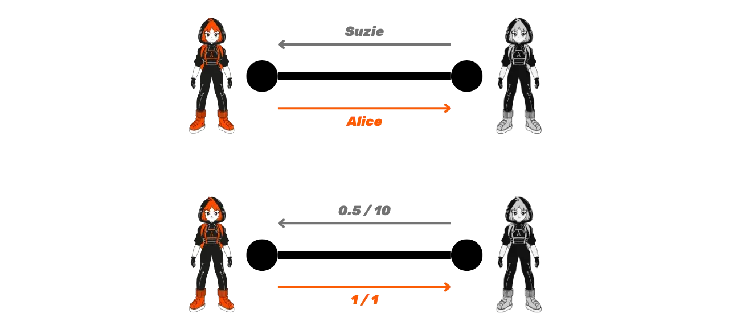

Slide 43


Slide 44
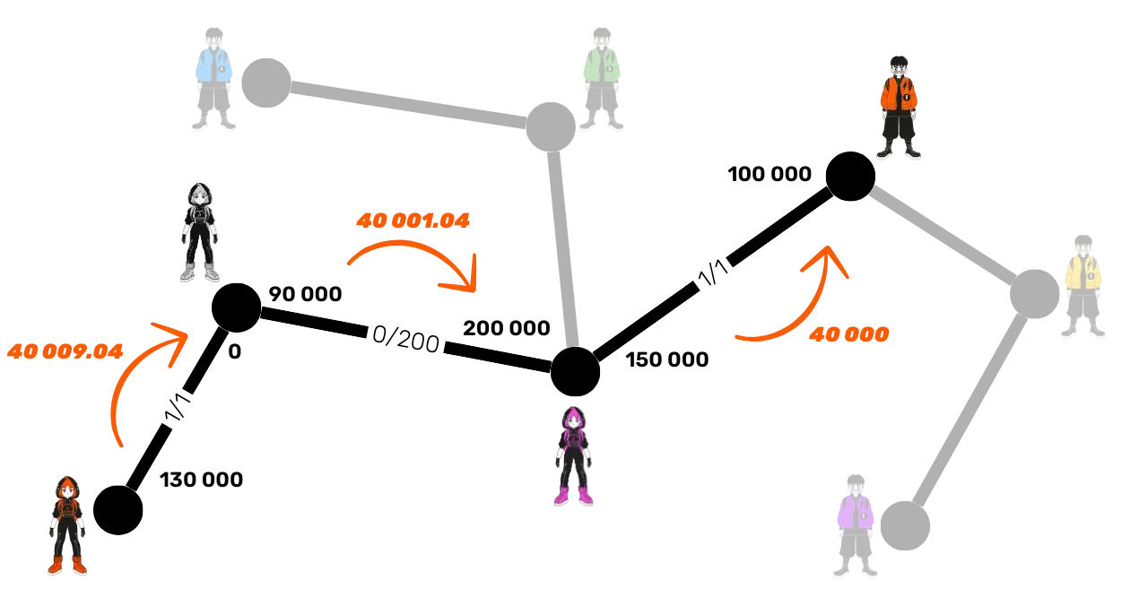

Slide 45
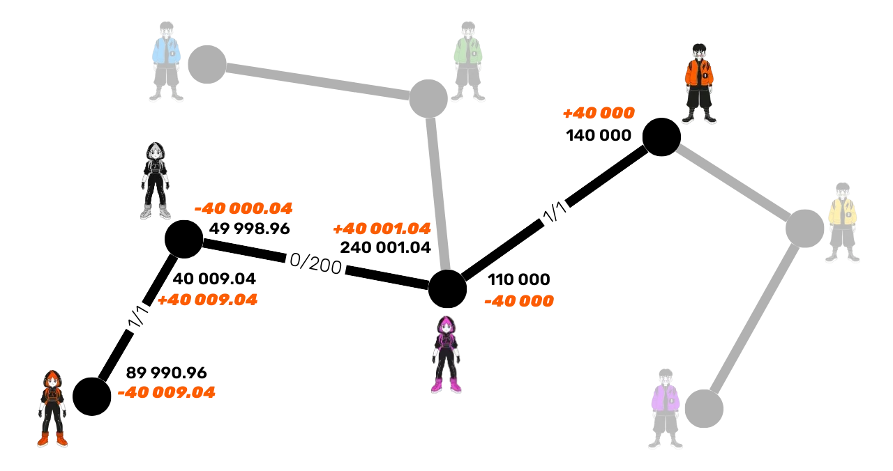

Slide 46
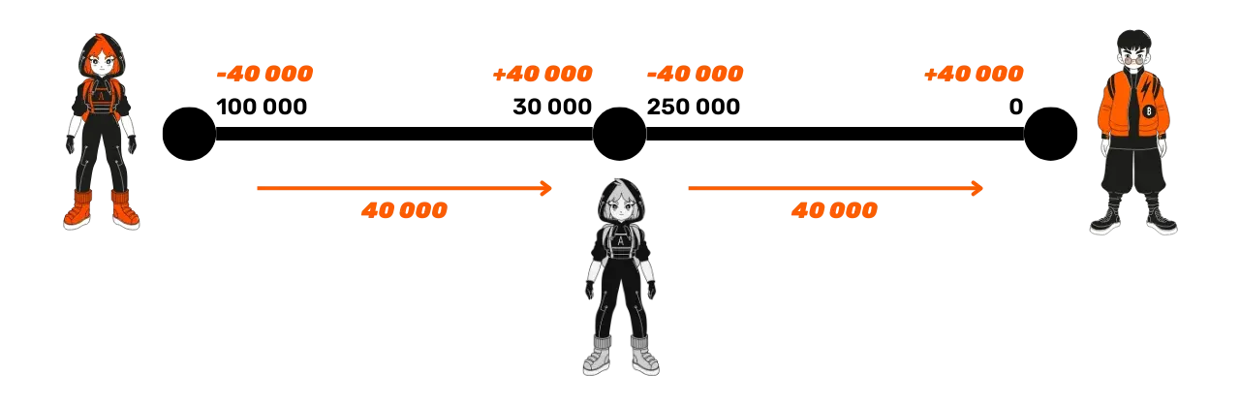

Slide 47
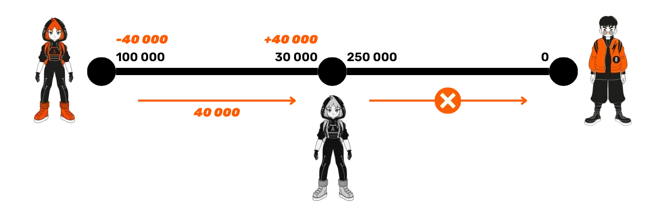

Slide 48
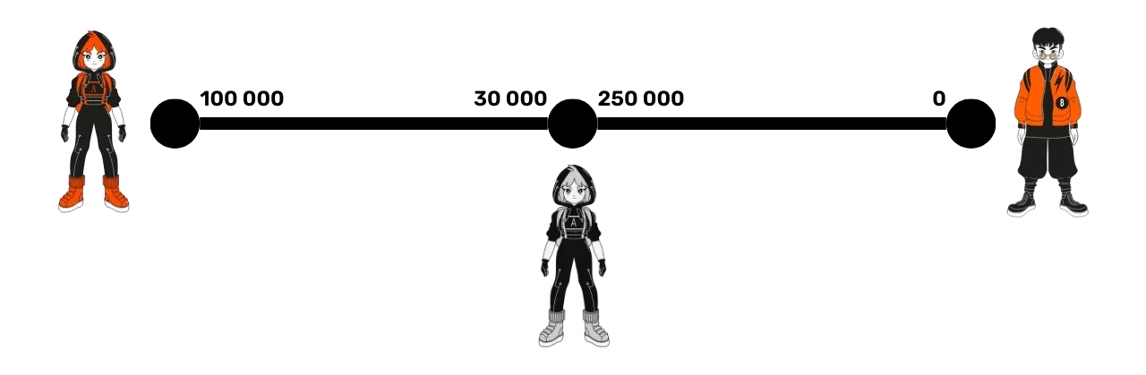

Slide 49


Slide 50


Slide 51
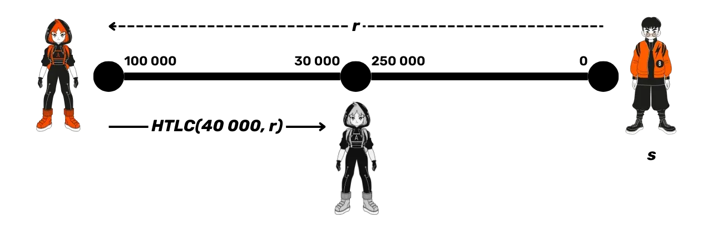

Slide 52
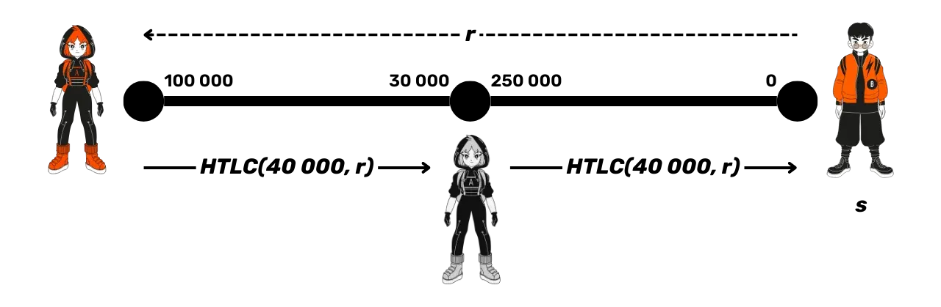

Slide 53
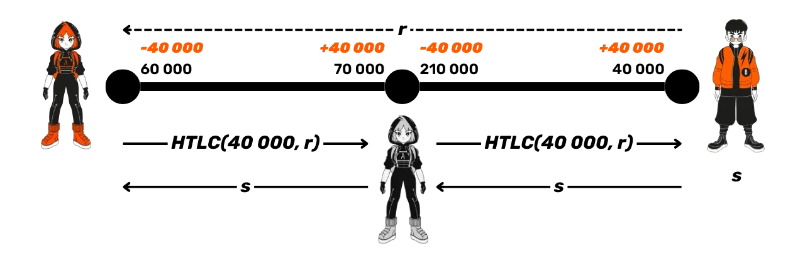

Slide 54
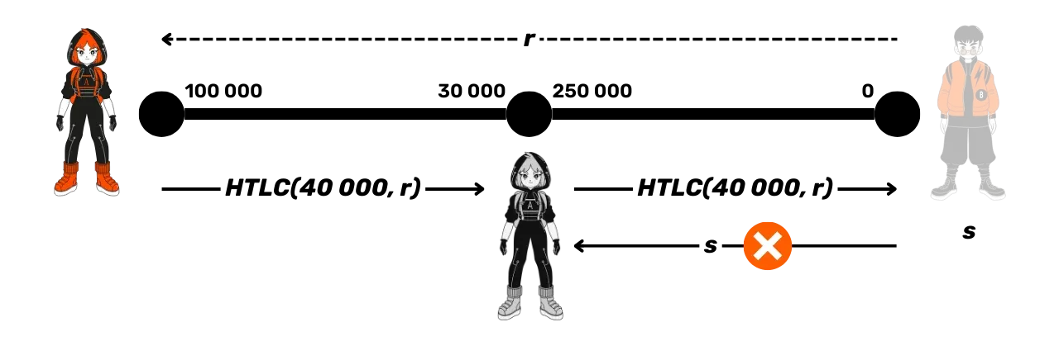

Slide 55
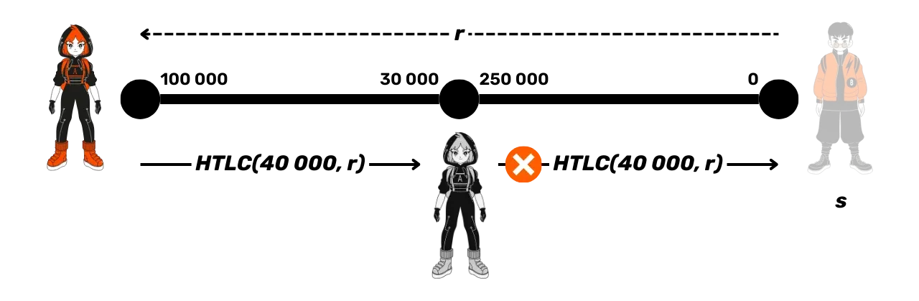

Slide 56
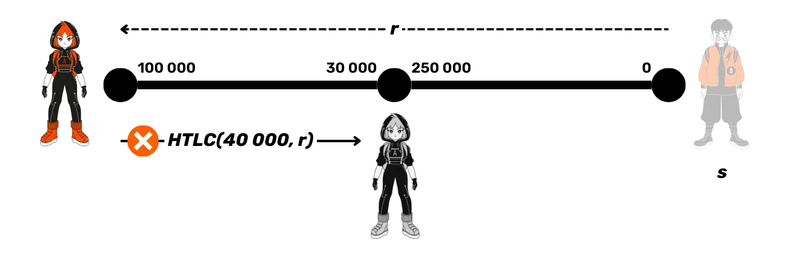

Slide 57
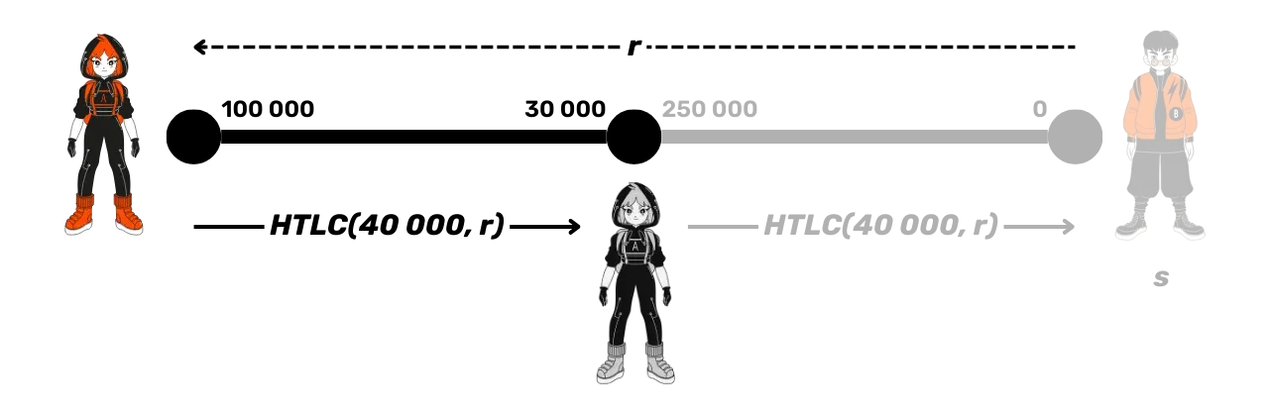

Slide 58

Revocation Key
Revocation Key

Slide 59

Revocation Key
Revocation Key

Slide 60

Revocation Key
Revocation Key

Slide 61


Slide 62


Slide 63


Slide 64


Slide 65


Slide 66


Slide 67


Slide 68

Invoice

Slide 69

Amount
Normal:
Asks for invoice
Gives the invoice
Amount
Shows QR Code
Scans QR code

Slide 70

Invoice (amount, hash, id)
Normal:
Payment (amount, hash, id)
Payment (amount, preimage, id)

Slide 71


Slide 72


Slide 73


Slide 74


Slide 75


Slide 77
Revocation Key
invoice
Revocation Key
Bob’s Secret
Alice’s sig.
Alice’s Secret
Bob’s sig
Revocation Key
Revocation Key

Slide 78

Revocation Key

Slide 79


Slide 80


Slide 81


Slide 83


Slide 84


