Slide 1
Bioinformatics at the DKFZ
Introduction to Neural Networks
22 April 2026
Dr. Óscar González-Velasco
B330 - Division of Applied Bioinformatics
(oscar.gonzalezvelasco@dkfz-heidelberg.de)
Notes:
1

Slide 2
Introduction to neural networks
Agenda
Go to the repository:
https://github.com/OscarGVelasco/DKFZ_bio_2026
Colorectal Adenocarcinoma dataset:
- RNA-Seq + clinical data
- Task: tumor stage classification
Python libraries: Sklearn, pandas, numpy & pytorch
Notes:
Warren McCulloch y el matemático Walter Pitts

Slide 3
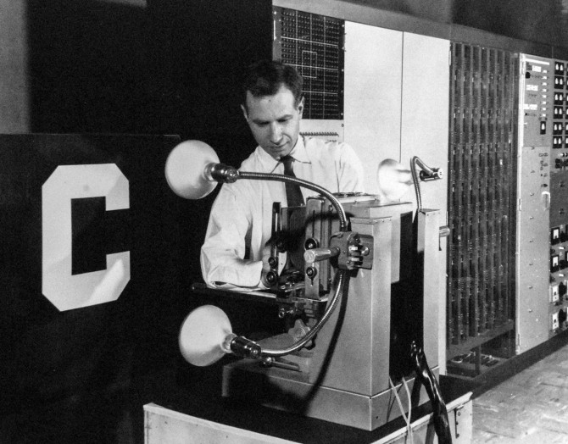
Introduction to neural networks
Agenda
A little bit of history…
In July 1958, the U.S. Office of Naval Research unveiled a remarkable invention.
An IBM 704 – a 5-ton computer the size of a room – was fed a series of punch cards. After 50 trials, the computer taught itself to distinguish cards marked on the left from cards marked on the right.
Frank Rosenblatt at the Cornell Aeronautical Laboratory invented the perceptron
Notes:
Warren McCulloch y el matemático Walter Pitts

Slide 4
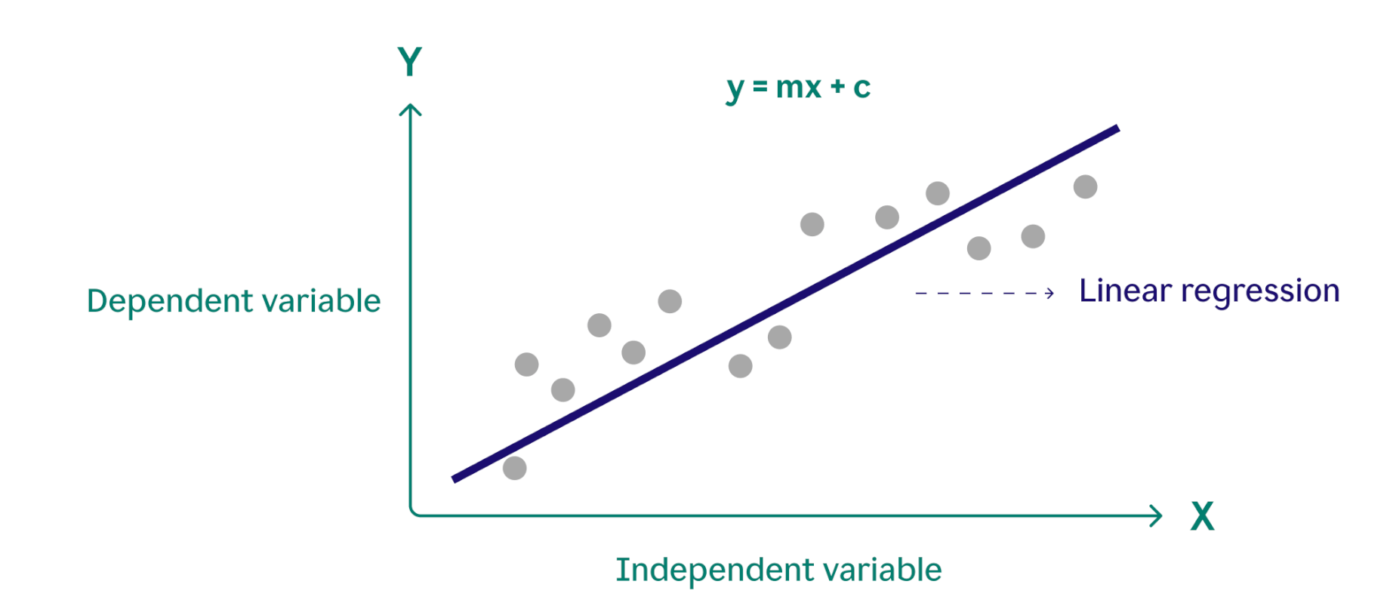
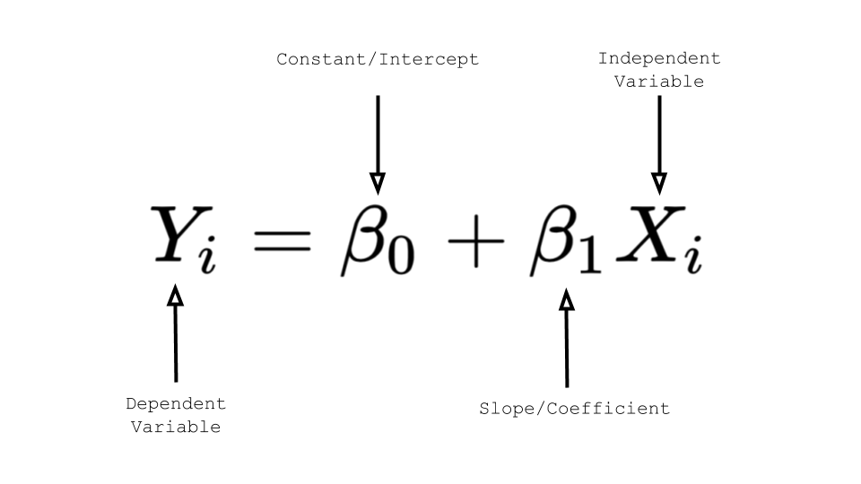
Introduction to neural networks
Agenda
How can we model the data?

Slide 5
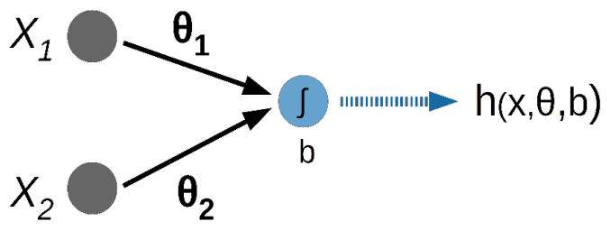
Introduction to neural networks
Agenda
The minimal neural network
weights
inputs
bias

Slide 6


Introduction to neural networks
Agenda
The minimal neural network
weights
inputs
bias
Sounds familiar?
As vector form (standard notation)

Slide 7
Introduction to neural networks
Agenda
rnaseq_nn_exercise.py
- Blocks 1 to 4: Preparing the data
Notes:
Warren McCulloch y el matemático Walter Pitts

Slide 8
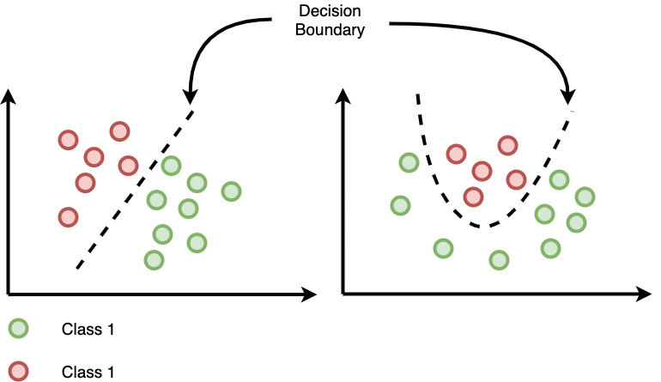
Introduction to neural networks
So… we have a linear neural network, is it enough?
Agenda

Slide 9
Introduction to neural networks
So… we have a linear neural network, is it enough?
Agenda
2

Slide 10

Introduction to neural networks
Agenda
Introducing non-linearity
f ( )
Introduce a new function

Slide 11
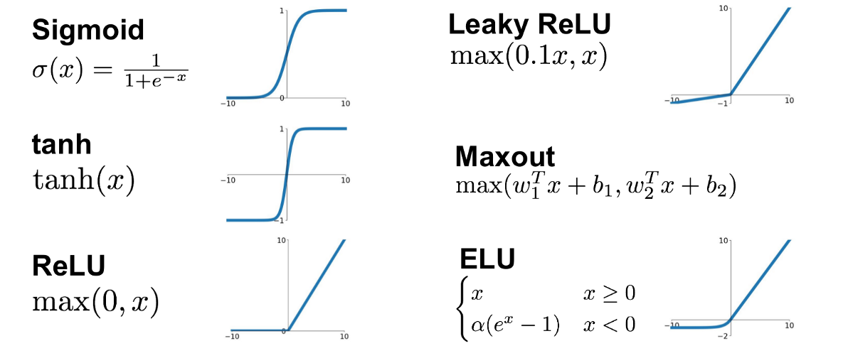
Introduction to neural networks
Introducing non-linearity
Activation functions
Agenda
Choose your non-linear f:
Introduce a new function

Slide 12
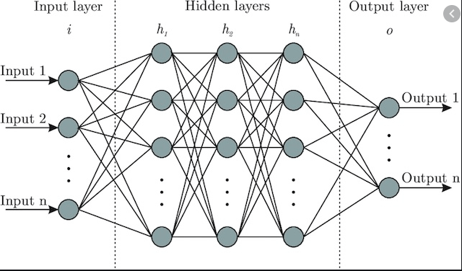
Introduction to neural networks
Agenda
Multiple layers – Deep learning
We need to escalate!

Slide 13
Introduction to neural networks
Agenda
Multiple layers – Deep learning
We need to escalate!
Observation:
Outputs of a layer are the basis for the next layer input

Slide 14
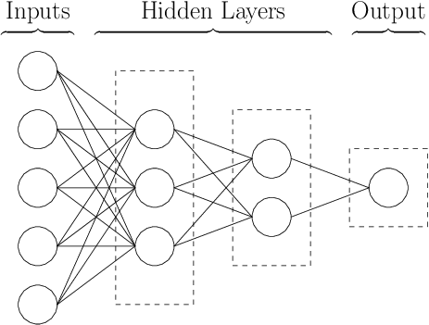
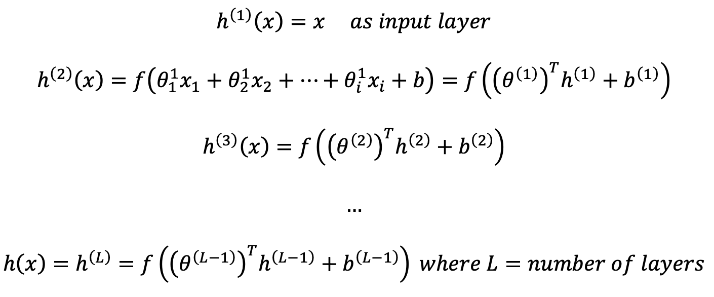
Introduction to neural networks
Agenda
Multiple layers – Deep learning

Slide 15
Introduction to neural networks
Agenda
Multiple layers – Deep learning

Slide 16
Introduction to neural networks
Agenda
Multiple layers – Deep learning

Slide 17
Introduction to neural networks
Agenda
Multiple layers – Deep learning

Slide 18
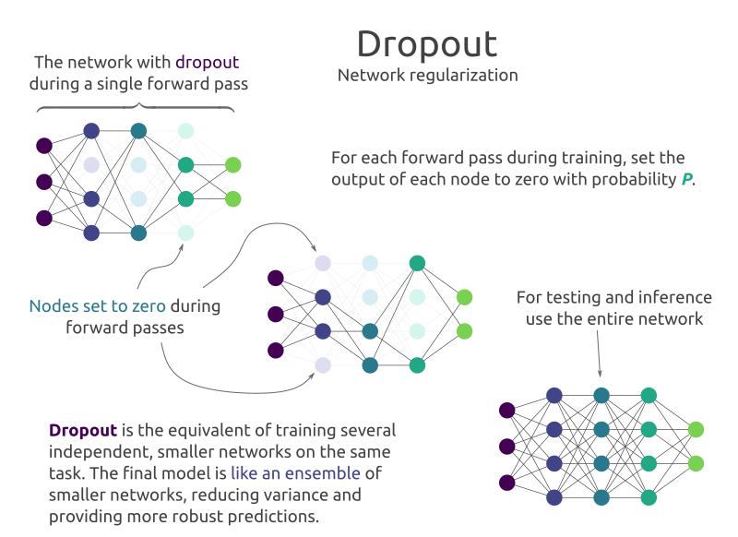
Dropout Regularization
Ridge regression
Dropout is an iterative procedure wherein at each iteration each node in the network is dropped independently and identically according to a Bernoulli random variable with parameter θ.
*Basic regularization method used in neural networks

Slide 19
Introduction to neural networks
Agenda
rnaseq_nn_exercise.py
- Blocks 5 to 6: Define the model architecture using pytorch

Slide 20
Introduction to neural networks
Agenda
Multiple layers – Deep learning
How to compute errors
and learn from it?

Slide 21
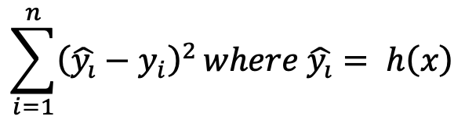
Introduction to neural networks
Agenda
Multiple layers – Deep learning
Sums of squared errors

Slide 22
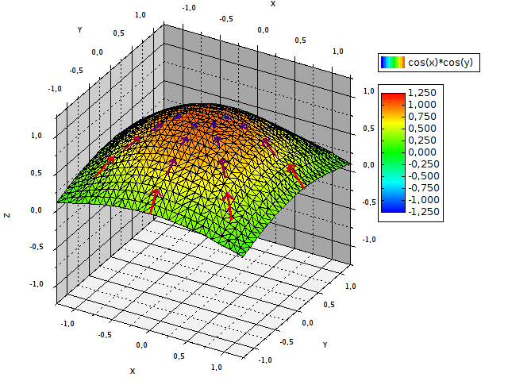
Introduction to neural networks
Agenda
Gradient concept
In vector calculus, the gradient of a scalar-valued differentiable function f of several variables is the vector field ∇f whose value at a point p gives the direction and the rate of fastest increase.
Notes:
Nabla

Slide 23
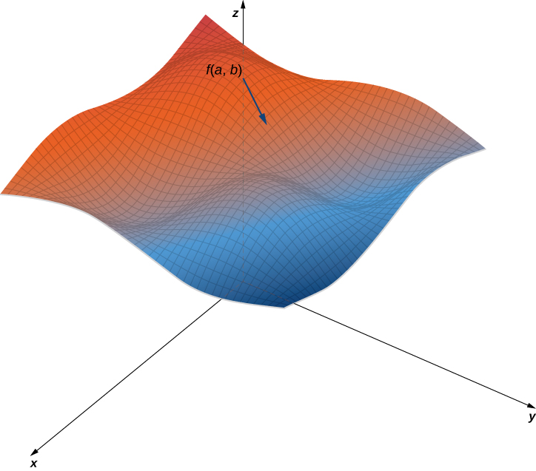
Introduction to neural networks
Agenda
Gradient concept
In vector calculus, the gradient of a scalar-valued differentiable function f of several variables is the vector field ∇f whose value at a point p gives the direction and the rate of fastest increase.

Slide 24
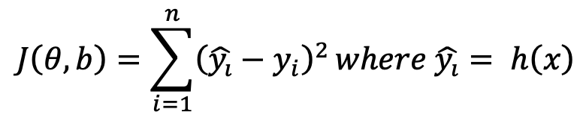
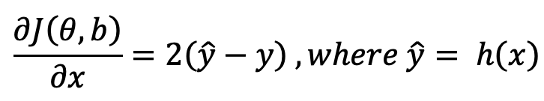
Introduction to neural networks
Agenda
Stochastic Gradient Descent
(SGD)
Objective Function:
Partial Derivative of the obj. funct.
Exploiting the gradient to minimize the error loss

Slide 25
Introduction to neural networks
Agenda
Stochastic Gradient Descent
(SGD)
Partial Derivative of the obj. funct.
Compute error
Compute partial derivative

Slide 26

Introduction to neural networks
Agenda
Stochastic Gradient Descent
(SGD)
Partial Derivative of the obj. funct.
Backpropagation algorithm (chain rule)
Back-propagate error
Compute partial derivatives across layers

Slide 27

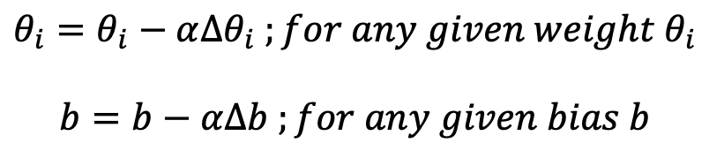
Introduction to neural networks
Agenda
Stochastic Gradient Descent
(SGD)
Partial Derivative of the obj. funct.
Backpropagation algorithm (chain rule)
Update weights & parameters accordingly
Update weights & parameters
-for each layer-
Learning Rate

Slide 28
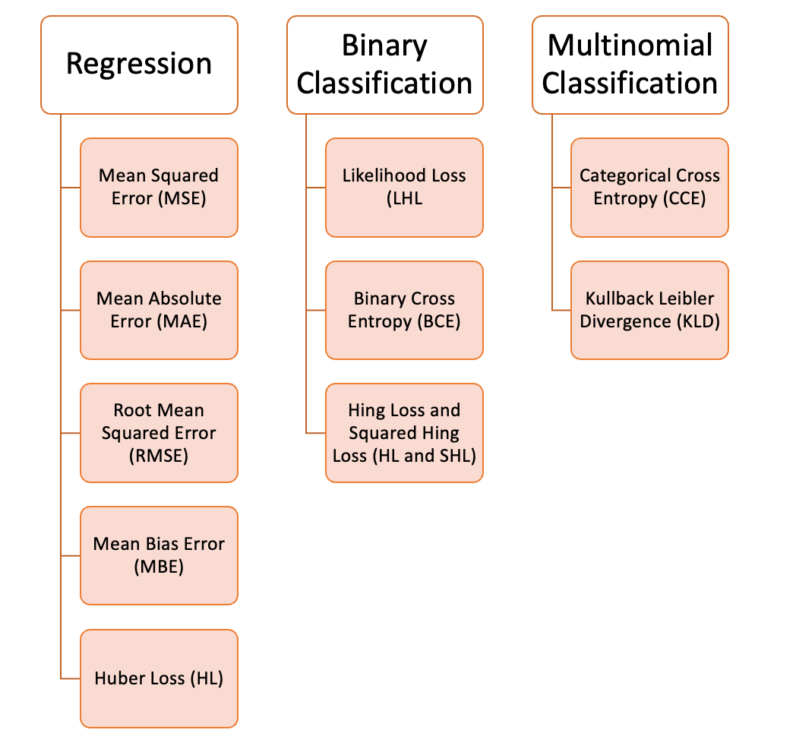
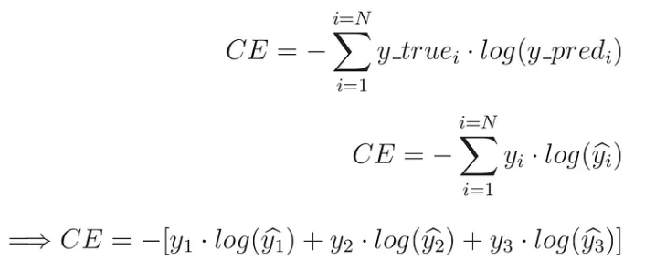
Introduction to neural networks
Agenda
Collection of loss functions
Categorical Cross Entropy
Distribution of predicted probabilities
… with activation function
SoftMax

Slide 29
Introduction to neural networks
Agenda
rnaseq_nn_exercise.py
- Blocks 7 to 8: Define training parameter and exec training

Slide 30
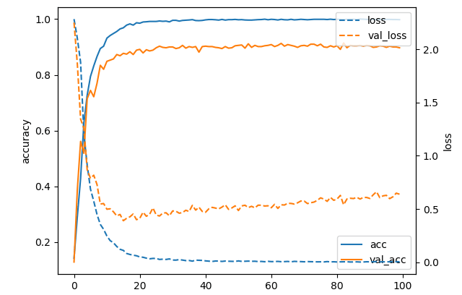
Introduction to neural networks
Agenda
When does the training ends?

Slide 31
Introduction to neural networks
Agenda
When does this nightmare ends?
Early Stopping

Slide 32
Introduction to neural networks
Agenda
rnaseq_nn_exercise.py
- Block 9: Model evaluation
If time allows:
- Test different model hyperparameter (++layers, n. of neurons…)
Data preprocessing (top variable genes + 0 exprs)
Training overfitting (early stop vs long training)

Slide 33
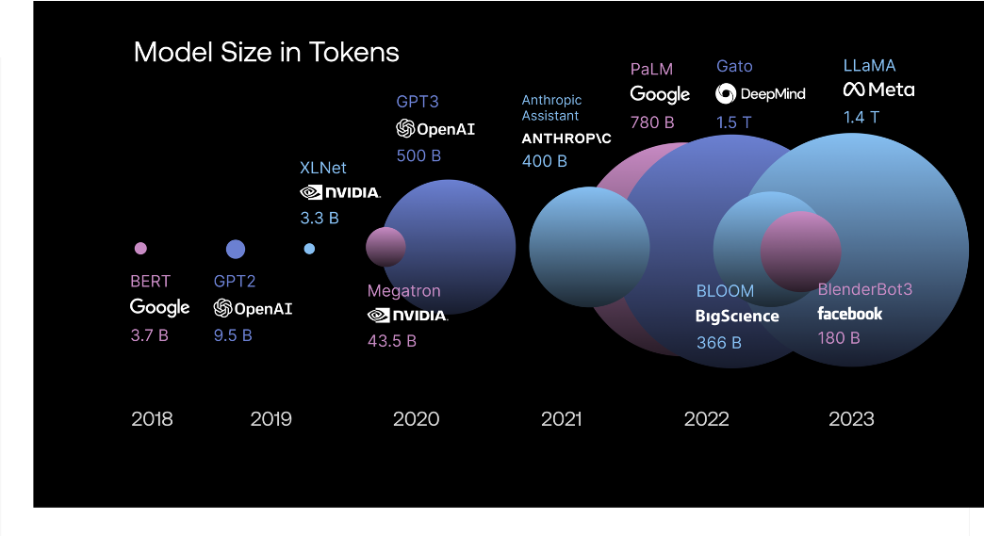
A Complexity problem:
Agenda
State of the art of popular AI models:
complexity of AI models

Slide 34
Bioinformatics at the DKFZ
Introduction to Neural Networks
22 April 2026
Dr. Óscar González-Velasco
B330 - Division of Applied Bioinformatics
(oscar.gonzalezvelasco@dkfz-heidelberg.de)
Notes:
34

