Slide 1
Technical Challenge Solution
Oscar Garcia

Slide 2
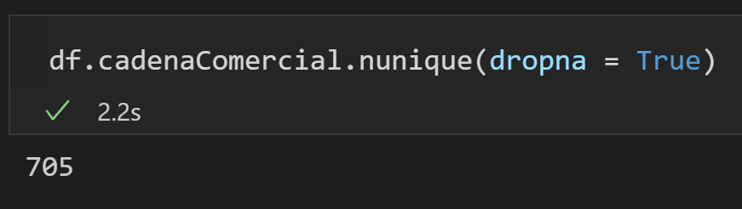
1. How Many commercial chains are monitored?

Slide 3
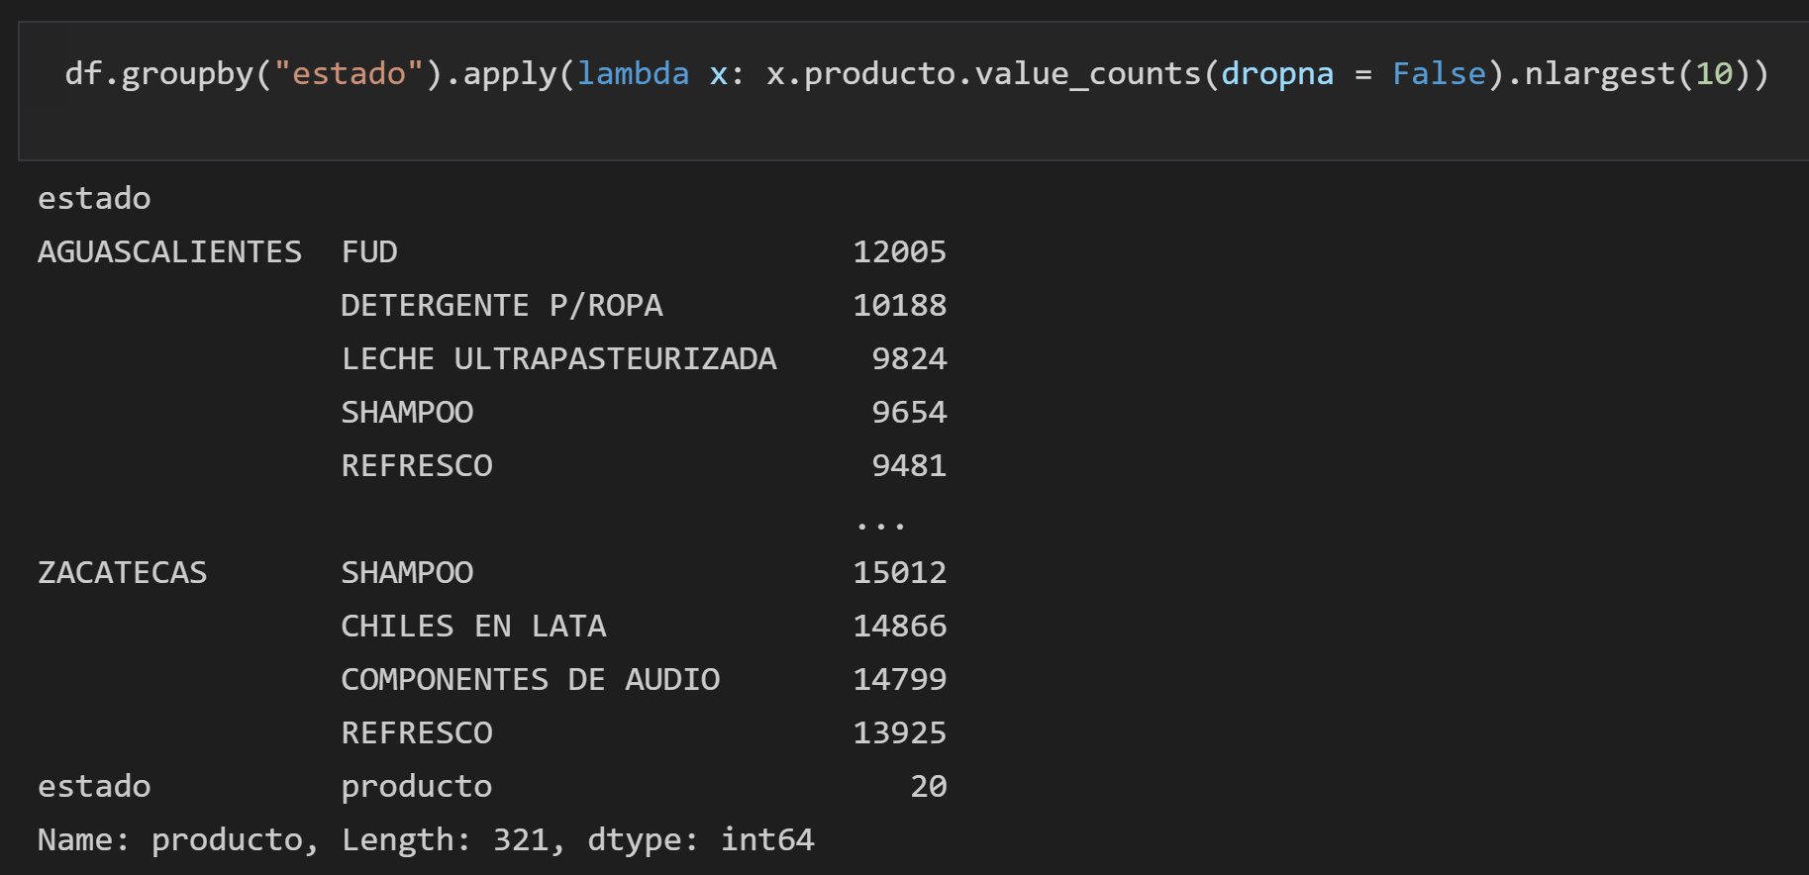
2. What are the top 10 monitored products by State?

Slide 4
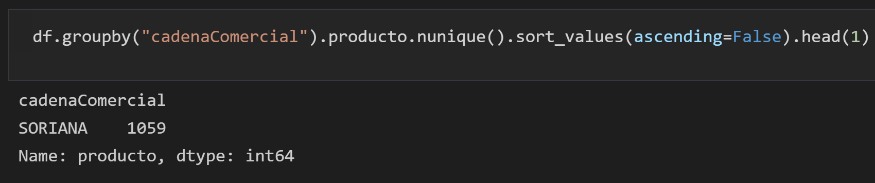
3. Which is the commercial chain with the highest number of monitored products?

Slide 5
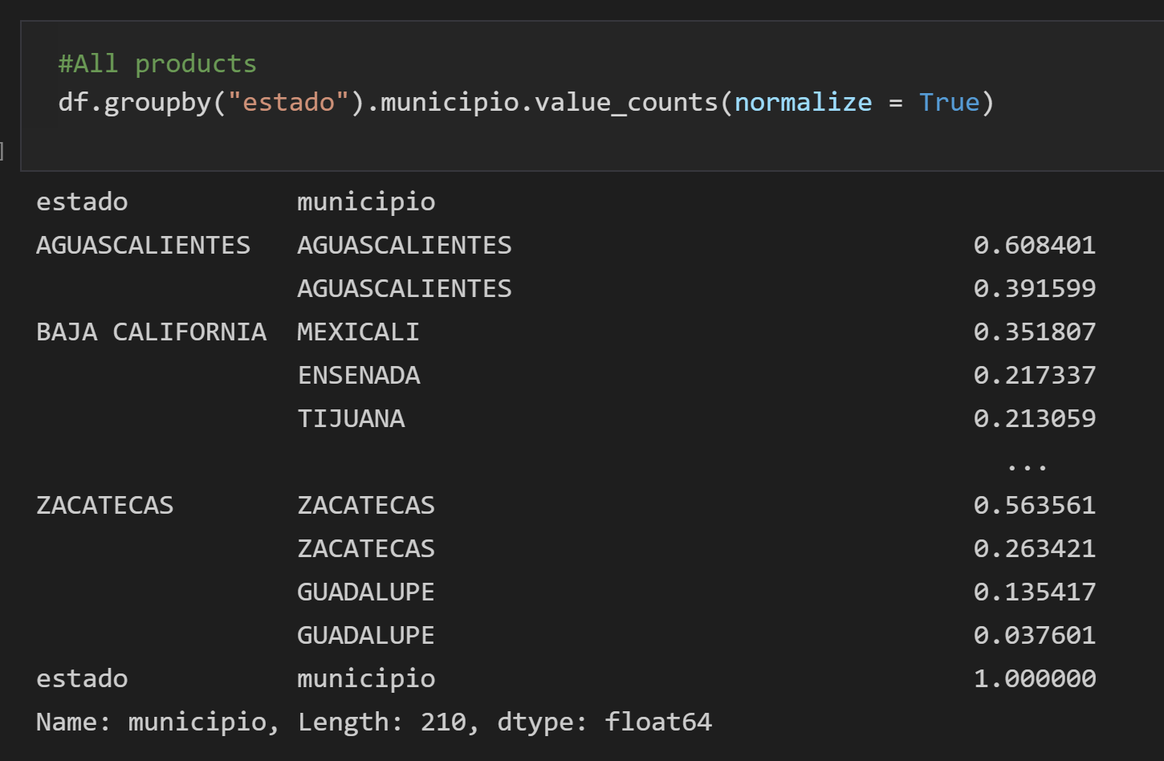
4. Use the data to find an interesting fact

Slide 6
5. What are the lessons learned from this exercise?
Must ensure the data quality of the database before performing analysis

Slide 7


6. Can you identify other ways to approach this problem?

