Slide 1
Technical Challenge Solution
Oscar Garcia

Slide 2


Data Engine - Spark

Slide 3
Data Cleaning - States
There are some errors when reading the dataframe.
These are fixed by specifying escape characters or filter the errors out

Slide 4
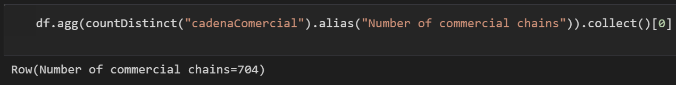
1. How many commercial chains are monitored?

Slide 5
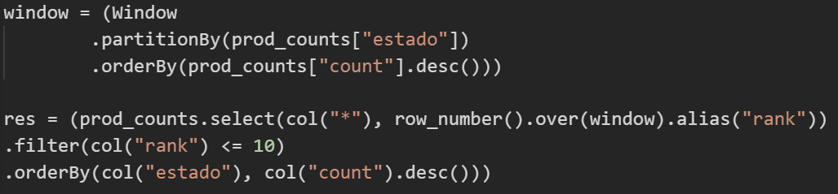
2. What are the top 10 monitored products by State?

Slide 6
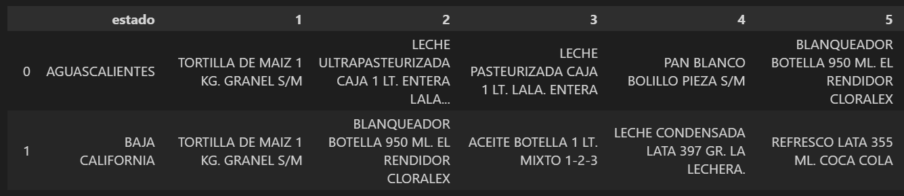
2. What are the top 10 monitored products by State?

Slide 7
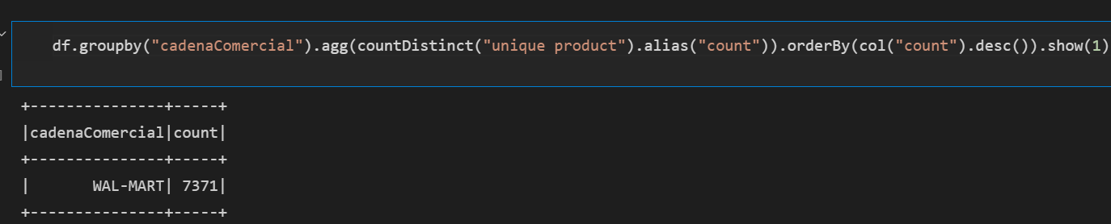
3. Which is the commercial chain with the highest number of monitored products?

Slide 8
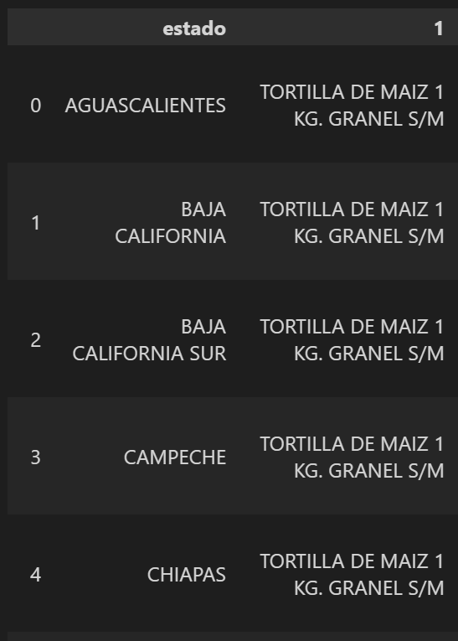
4. Use the data to find an interesting fact

Slide 9
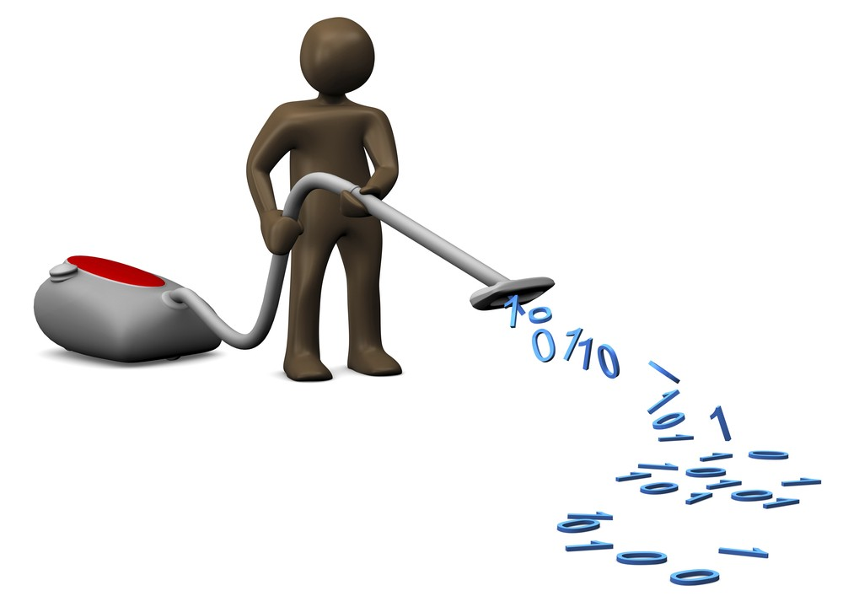
5. What are the lessons learned from this exercise?

Slide 10
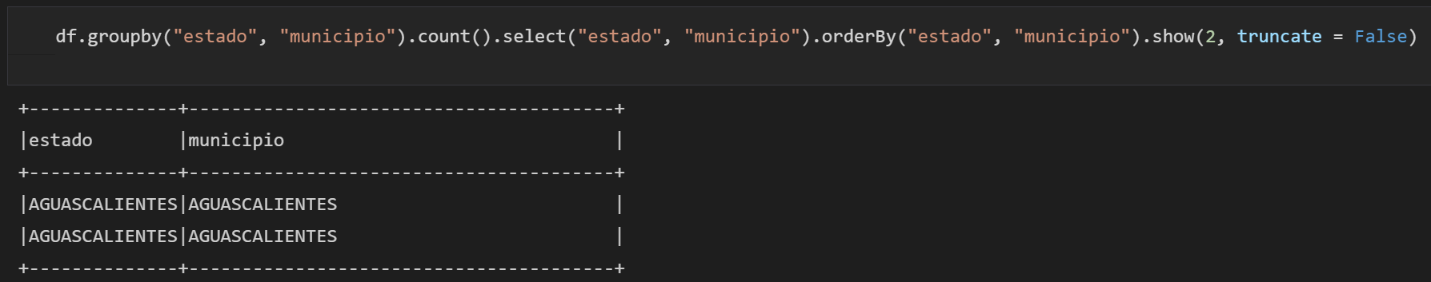
6. Can you identify other ways to approach this problem?

