Slide 1
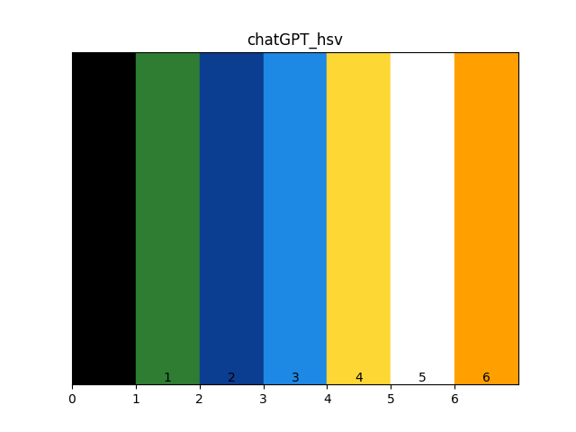
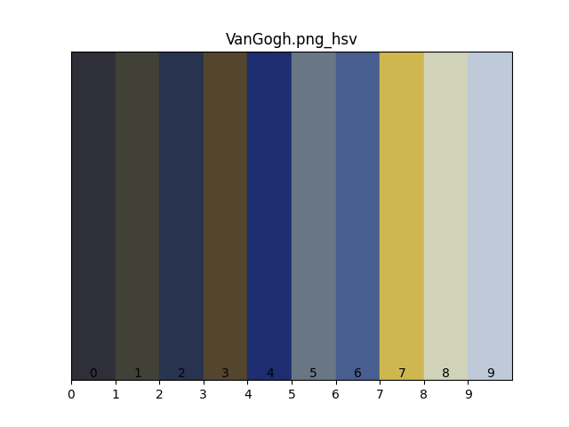
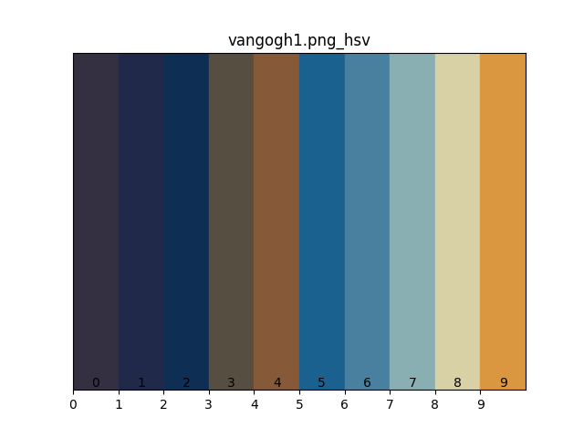
chatGPT:['#000000', '#2e7d32', '#0b3d91', '#1e88e5', '#fdd835', '#ffffff', '#ff9f00']
test.png:['#a349a4', '#d3a9d4', '#00a2e8', '#ed1c24', '#60c5f1', '#f46a70', '#9fdcf6', '#f8aaad', '#f7fcfe', '#ffffff']
VanGogh.jpg:['#000000', '#031624', '#18333e', '#34514d', '#1d3d78', '#3f608d', '#6b8f85', '#6d94b1', '#bacb6d', '#b0d2af']
VanGogh.png:['#2e2f38', '#424138', '#28334f', '#54452f', '#1d2d70', '#697785', '#485e90', '#cfb74f', '#d1d3b9', '#bfcad8']
vangogh1.png:['#343041', '#21294a', '#0f2e54', '#564e40', '#865939', '#1b6190', '#49809f', '#89afb2', '#d9d1a6', '#db973f']
vangogh2.png:['#29222b', '#202b3f', '#415355', '#5c5a4b', '#634d39', '#315f76', '#784f29', '#71908a', '#b37537', '#b8a481']

Slide 2
标题标题
文本内容，重点关键词测试

